Slide 1
IntelliJ IDEA
Static Code Analysis
Hamlet D'Arcy
Canoo Engineering AG
@HamletDRC
http://hamletdarcy.blogspot.com

Slide 2
Static Code Analysis
Code Inspections
JSR 305 and 308 Annotations
Duplicate Detection
Stack Trace Analysis
Dataflow Analysis
Dependency Structure Matrix

Slide 3





About Me
Notes:
About Me
http://www.manning.com/koenig2/
http://hamletdarcy.blogspot.com
Twitter: @HamletDRC
Groovy, CodeNarc, JConch Committer
GPars, Griffon, Gradle, etc. Contributor
GroovyMag, NFJS magazine author
JetBrains Academy Member

Slide 4
Static Code Analysis
Code Inspections
JSR 305 and 308 Annotations
Duplicate Detection
Stack Trace Analysis
Dataflow Analysis
Dependency Structure Matrix

Slide 5
class _01Example {
private static long count = 0L;
public synchronized void increment() {
count++;
}
}
Notes:
Static access on instance lock

Slide 6
class _02Example {
private boolean active = false;
public boolean isActive() {
return active;
}
public synchronized void activate() {
active = true;
}
}
Notes:
Field accessed in sync and non-sync context

Slide 7
class _03Example {
private final ReentrantLock lock = new ReentrantLock();
private boolean active = false;
public boolean isActive() throws Exception {
lock.lock();
boolean result = active;
lock.unlock();
return result;
}
public void activate() {
lock.lock();
active = true;
lock.unlock();
}
}
Notes:
lock acquired & not properly unlocked

Slide 8
class _04Example {
private static final boolean DEFAULT = true;
void myMethod(Boolean value) {
if (value == null)
System.out.println("value: null");
value = DEFAULT;
System.out.println("received: " + value);
}
}
Notes:
Suspicious Indentation of Control Statement

Slide 9
class _05Example {
Frame makeFrame(int height, int width) {
Frame frame = new Frame();
frame.setSize(height, width);
return frame;
}
Rectangle makeRectangle() {
int x = 0;
int y = 0;
return new Rectangle(y, x, 20, 20);
}
}
Notes:
Suspicious Variable/Parameter Name

Slide 10
Bad practice
Correctness
Internationalization
Malicious code vulnerability
Multi-threaded correctness
Performance
Code style violations
Dodgy
* Bill Pugh, FindBugs

Slide 11
… and more
Suppress False Positives
Define profiles and scopes
Run on demand
Run from command line
Team City integration
FindBugs, PMD & CheckStyle plugins
Language and framework support...
Notes:
- Command line & CI integration
- command line: need a valid .idea / .ipr file
- http://www.jetbrains.com/idea/webhelp/running-inspections-offline.html
- inspect.bat or inspect.sh in idea/bin
- CI Integration: TeamCity has inspections built in

Slide 12
Supported Frameworks
Android
Ant
Application Server Inspections
CDI(Contexts and Dependency Injection)
CSS
Faces Model
FreeMarker
Google App Engine,
Google Web Toolkit
Groovy
Guice
Hibernate
HTML
J2ME
Java EE
JavaScript
JSF
JSP
Junit
LESS
Maven
OSGi
RELAX NG
SCSS
Spring Model
Spring Web Services
SQL
TestNG
Velocity
Java WebServices
Webflow Model
WSDL
XML
Xpath
XSLT
... and many more
Notes:
- Mention WebStorm for other inspections

Slide 13
Write Your Own
IntelliJ IDEA Static Analysis:
Custom Rules with Structural Search & Replace
On http://JetBrains.tv

Slide 14
10 Best Unknown Inspections
Illegal package dependencies
'this' reference escapes constructor
Field accessed in both synched & unsynched contexts
non private field accessed in synched context
Synchronization on 'this' and 'synchronized' method
return of collection or array field
call to 'Thread.run()'
expression.equals("literal") rather than "literal".equals(expression)
equals method does not check class of parameter
method may be static
http://hamletdarcy.blogspot.com/2008/04/10-best-idea-inspections-youre-not.html

Slide 15
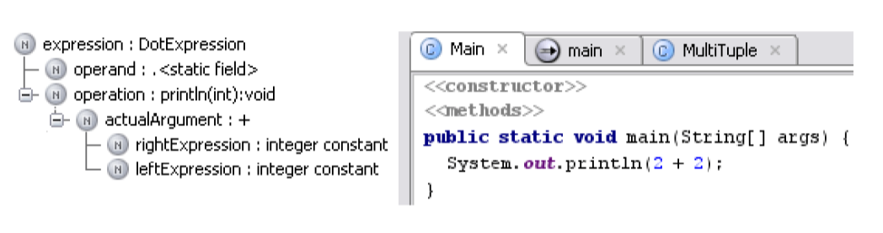
How it Works
Searches AST for Bug Patterns

Slide 16
How it Works
@Override
public void visitMethod(@NotNull final PsiMethod method) {
super.visitMethod(method);
if (method.hasModifierProperty(PsiModifier.ABSTRACT)) {
return;
}
if (!RecursionUtils.methodMayRecurse(method)) {
return;
}
if (!RecursionUtils.methodDefinitelyRecurses(method)) {
return;
}
super.registerMethodError(method);
}

Slide 17
Static Code Analysis
Code Inspections
JSR 305 and 308 Annotations
Duplicate Detection
Stack Trace Analysis
Dataflow Analysis
Dependency Structure Matrix

Slide 18
@Immutable and @GuardedBy
@Immutable
public class GuardedByExample {
private final Object lock = new Object();
@GuardedBy("lock")
private final List<Object> myList = new ArrayList<Object>();
public Object getElement(int index) {
synchronized (lock) {
return myList.get(index);
}
}
public void addElement(Object e) {
synchronized (lock) {
myList.add(e);
}
}
}
Notes:
- @GuardedBy and @Immutable - GuardedByExample.java
- Add jcp classes to classpath
- non final GuardedBy field, not guarded correctly
- non final field in @Immutable class

Slide 19
@Nullable and @NotNull
public class NullableExample {
@Nullable Integer getId() {
return 1;
}
@NotNull String getName() {
return "name";
}
@Override public String toString() {
if (getName() == null) {
return getId().toString() + "<unknown>";
} else {
return getId().toString() + getName();
}
}
}
Notes:
- http://www.jetbrains.com/idea/documentation/howto.html
- Add annotations to classpath
- Can be associated with other annotations (like Hibernate's)
- Infer Nullity - http://www.jetbrains.com/idea/webhelp/inferring-nullity.html
- http://blogs.jetbrains.com/idea/2011/03/more-flexible-and-configurable-nullublenotnull-annotations/

Slide 20
@Pattern
class PatternExample {
@Pattern("[a-zA-Z]+")
String getName() {
return "my name";
}
}
Notes:
- Enforces String against a regex

Slide 21
@Language
public class LanguageExample {
@Language("Groovy")
String getScript() {
return "5.times { i -> println \"Hello $i\" } ";
}
String getMarkup() {
@Language("XML")
String markup = "<root><body>Some Text</body></root>";
return markup;
}
}
Notes:
- @Language - LanguageExample.java
- Syntax checks language snippets
- http://www.jetbrains.com/idea/webhelp/using-language-injections.html

Slide 22
@Nls, @NonNls, @PropertyKey
Resource bundle & i18n integration
Extracting hard-coded String literals: http://goo.gl/VZDln
Documentation: http://goo.gl/NWzsv

Slide 23
Static Code Analysis
Code Inspections
JSR 305 and 308 Annotations
Duplicate Detection
Stack Trace Analysis
Dataflow Analysis
Dependency Structure Matrix

Slide 24
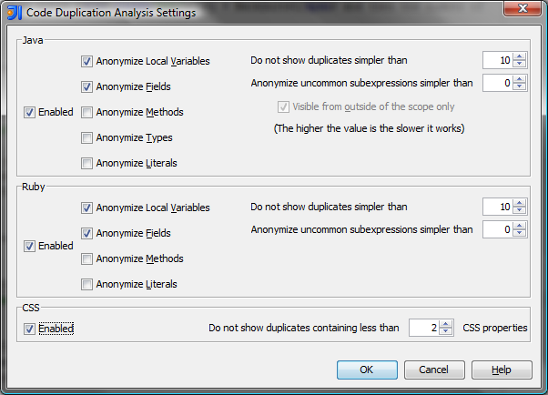

Slide 25
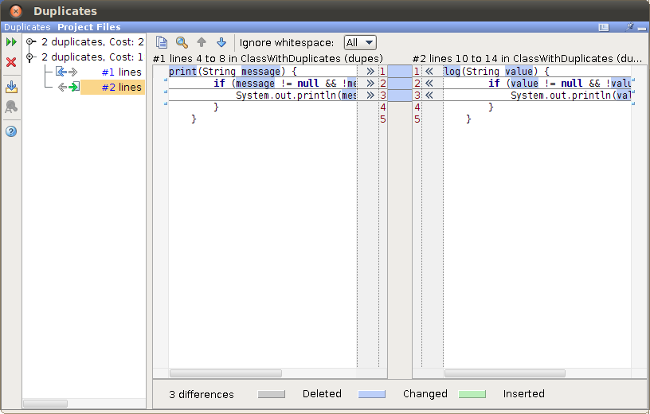

Slide 26
Duplicate Detection
Anonymizes Local Variables, Fields, Methods, Types, and Literals
Provides weighted/scored analysis
Supports several languages
More info: http://goo.gl/qmhhd

Slide 27
Static Code Analysis
Code Inspections
JSR 305 and 308 Annotations
Duplicate Detection
Stack Trace Analysis
Dataflow Analysis
Dependency Structure Matrix

Slide 28
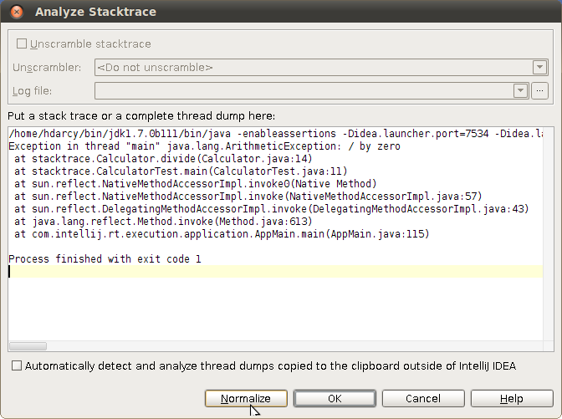

Slide 29
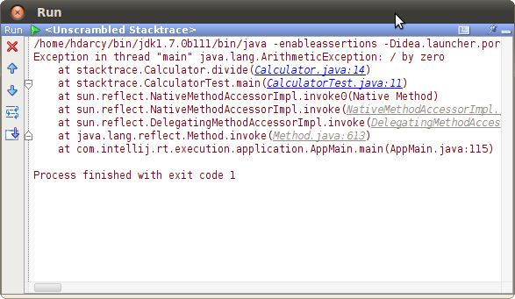

Slide 30
Analyze Stacktrace
Copy and paste log files into IDEA
ZKM Unscramble support (& others)
More Info: http://goo.gl/A8i87

Slide 31
Static Code Analysis
Code Inspections
JSR 305 and 308 Annotations
Duplicate Detection
Stack Trace Analysis
Dataflow Analysis
Dependency Structure Matrix

Slide 32
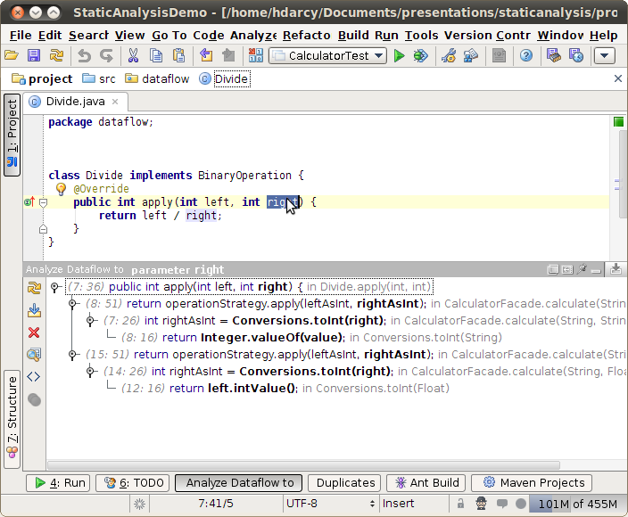

Slide 33
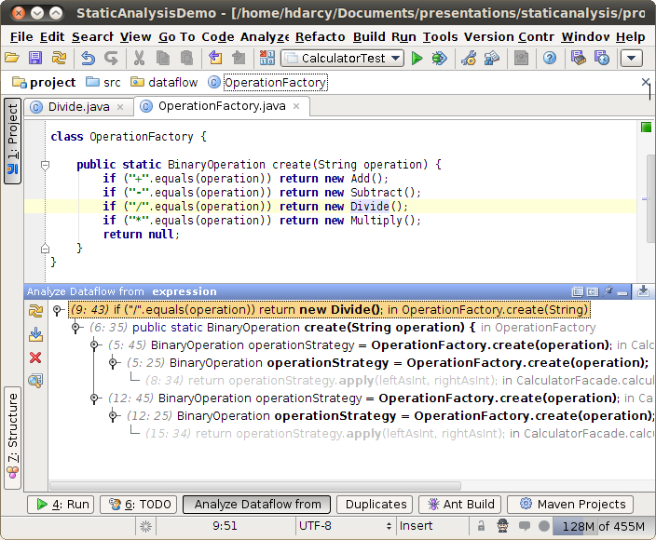

Slide 34
Dataflow Analysis
Code archeology
to here – how a reference gets set
from here – where a reference goes to
More info: http://goo.gl/Cp92Q
Notes:
- http://www.jetbrains.com/idea/webhelp/dataflow-analysis.html
- code archeology - better understand the inherited project code, interpret complicated parts of the code, find bottlenecks in the source, and more.
- Dataflow to here - Shows how a reference gets set. ie Divide by zero example
- Dataflow from here - Shows where a reference goes to. ie new Divide() example

Slide 35
Static Code Analysis
Code Inspections
JSR 305 and 308 Annotations
Duplicate Detection
Stack Trace Analysis
Dataflow Analysis
Dependency Structure Matrix

Slide 36
Dependency Structure Matrix
Analyzes structure of complex projects
Shows module, package, class dependencies
Shows cyclic & backwards dependencies
Helps eliminate illegal dependencies

Slide 37
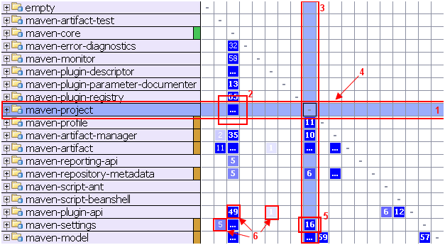

Slide 38
1. The selection highlights classes which
dependencies are being viewed

Slide 39
2. The ellipsis in cell indicates there are more than 99 dependencies between maven-core and maven-project

Slide 40
3. The column shows the dependencies of the selected row

Slide 41
4. The row shows the dependencies on the selected row

Slide 42
5. Cell indicates that maven-project has 16 dependencies on maven-settings

Slide 43
6. More dependencies - brighter color

Slide 44
Dependency Structure Matrix
Demos on JetBrains site & booth
Feature Overview: http://goo.gl/0bcz3
JetBrains Blog Post: http://goo.gl/fdj26
Canoo Blog Post: http://goo.gl/M1hTY

Slide 45
Static Code Analysis
Code Inspections
JSR 305 and 308 Annotations
Duplicate Detection
Stack Trace Analysis
Dataflow Analysis
Dependency Structure Matrix

Slide 46
Learn More – Q & A
My JetBrains.tv Screencasts: http://tv.jetbrains.net/tags/hamlet
My IDEA blog: http://hamletdarcy.blogspot.com/search/label/IDEA
Work's IDEA blog: http://www.canoo.com/blog/tag/idea/
Main blog: http://hamletdarcy.blogspot.com
YouTube channel: http://www.youtube.com/user/HamletDRC
Twitter: http://twitter.com/hamletdrc
IDEA RefCard from DZone: http://goo.gl/Fg4Af
Share-a-Canooie – http://people.canoo.com/share/
Hackergarten – http://www.hackergarten.net/

