Slide 1
Groovy Compiler Metaprogramming and AST Transformations
Hamlet D'Arcy
Pearson
@HamletDRC
hamletdrc@gmail.com
http://hamletdarcy.blogspot.com
OpenOffice Slides: http://is.gd/4cckb
Notes:
Who am I?
* I write Java as a day job
* Pearson was first full-time Java gig 3 years ago. On first day architect told me to learn Groovy.
* Tried introducing more Groovy at work to mixed results
* Prefer to write Groovy than Java in almost all cases
Why am I doing this
* I like to write (-> my blog)
* I like to meet people (-> user groups & conferences)
* I like open source (Groovy contributor. Small contributor to JConch, Easyb, JetGroovy)
Traveling to Madison has exceeded my expectations!

Slide 2
What is Groovy?
Notes:
"Groovy is the REAL Java 2. Henceforth, we can think of the Java language (not the platform) as forever 1.x. Groovy is what the real second version of Java should have been." Neal Ford (This is pretty questionable)
dynamic language for the JVM
- builds on strengths of Java
- inspired by Python, Ruby, Smalltalk
- almost-zero learning curve
- supports DSL Languages and compact syntax
- easy shell and build scripts
- reducing scaffolding code
- simplifies testing by supporting unit testing and more indirection
- seamlessly integrates with all existing Java objects and libraries
- compiles straight to Java bytecode so you can use it anywhere you use Java
Notes for those new to Groovy:
Looser syntax - No Parenthesis or semicolons
Looser typing – type annotations not required
Named Arguments – not just positional arguments
Closures

Slide 3
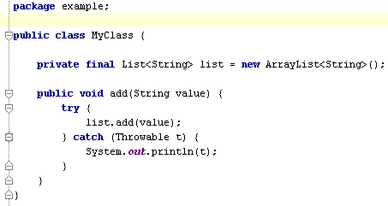
Notes:
Is this Java or Groovy?
This shows what in Groovy is the same as in Java:
* keywords
* exception handling
* entity definitions and instantiation
* Packaging & Imports
* Java 5 enums, generics
“All Java programmers are already Groovy programmers”

Slide 4
What is different?
Notes:
What's Different?
* True OO with no primitives * String templating
* Closures * Operator overloading
* Better syntax for new types * Extended libraries
Groovy Console Demo (need nightly build of 1.7 Groovy Console)
Groovy Strings
def name = "Hamlet"
println "Hello $name"
Closures
3.times { println it }
(10..15).each { println it }
def x = [ 1, 2, 3]
def f = { List list -> list.each { println it } }
f x
Putting it all together
def names = ["Hamlet", "Dave", "Bucky"]
println """
<root>
<people>
${writer -> names.each { writer.write " <person>$it</person>\n" }}
</people>
</root>
"""
Amazing glue language. Mention optional static typing. Types get in your way for Controllers and components with no dependencies

Slide 5
How does it work?
Notes:
groovy & groovyc - standard tools, work with Ant
Bidirectional compiler... and now Tri-directional compiler in 1.7!
It is Class files
Demo of scripts and javap output: (SimpleGroovyClass.groovy in scripts folder)
class Person {
def firstName
def lastName
def greet() {
println "Hello $firstName $lastName"
}
}
Compiled from "SimpleGroovyClass.groovy"
public class Person extends java.lang.Object implements groovy.lang.GroovyObject{
...
public Person();
public java.lang.Object greet();
protected groovy.lang.MetaClass $getStaticMetaClass();
public groovy.lang.MetaClass getMetaClass();
public void setMetaClass(groovy.lang.MetaClass);
public java.lang.Object getFirstName();
public void setFirstName(java.lang.Object);
public java.lang.Object getLastName();
public void setLastName(java.lang.Object);
...
}

Slide 6
What is Metaprogramming?
Notes:
- writing a program that manipulates programs, including itself.
- Groovy makes metaprogramming easy and provides a number of techniques for doing so.
- It's much more than open classes.
- about creation and mutation of methods based on information not available at code time
- Allows more flexibility in your application, albeit at a potential increase in complexity
Types of things you can do:
‐ Intercept method calls to override/enhance the services an object provides
‐ Inject new methods to add to the list of services an object provides
Groovy is one of the best languages for runtime metaprogramming today.
Compile time metaprogramming is an alternative to runtime metaprogramming.
CTM is much more:
* compile time static code analysis.
* embedded languages
* changing the semantics of the language.
It allows wild and different things to happen but is a bit of pandora's box.
We’ll talk about
‐ What you can do
‐ How to do it
‐ and Walk through some code examples
We won't talk about: GORM, invokeMethod, or invokeProperty (much).

Slide 7
class Event {
@Delegate Date when
String title
}
Notes:
DelegateExample.groovy

Slide 8
class Event {
@Delegate Date when
String title
}
% javap Event
public class Event extends
...
public long getTime();
public boolean after(java.util.Date);
public int getMonth();
...
Notes:
@Delegate is just a plain old annotation.
That means it is an interface with no implementation behind it.
Why does the bytecode have all the public methods of date?
Why doesn't Event extend Date or implement Date interface?

Slide 9
def s = new ArithmeticShell()
assert 2 == s.evaluate(' 1+1 ')
assert 1.0 == s.evaluate('cos(2*PI)')
shouldFail(SecurityException) {
s.evaluate('new File()')
}
Notes:
From “On Lisp”:
Lisp is an excellent language for writing compilers and interpreters, but it offers another way of defining a new language which is often more elegant and certainly much less work: to define the new language as a modification of Lisp. Then the parts of Lisp which can appear unchanged in the new language (e.g. arithmetic or I/O) can be used as is, and you only have to implement the parts which are different (e.g. control structure). A language implemented in this way is called an embedded language.

Slide 10
Spock Testing Framework
def "Does size method work?"() {
expect:
name.size() == size
where:
name << ['New', 'Orleans']
size << [3, 7]
}
Notes:
Are those goto labels? (yes)
What error occurs when run this? (illegal forward references, uninitialized variables, int compared to List)
What really happens when you run this?
* where block executes first (where variables are defined)
* expect block executes second (where variables are parsed/used)
We'll come back to this later!

Slide 11
Groovy is a compiled language
...oh yes it is
Compiled changes visible in .class file
...visible to all JVM users
Language syntax is a library feature
...not hardcoded into the language
Notes:
Groovy is compiled. It can be just-in-time compiled, but it is compiled and the bytecode is generated nonetheless.
Groovy language exposes several ways to hook into the compiler. You can see the code get transformed into an AST, and see that transformed into class output.
Anyone can do this. The semantics of the language is now a library feature you contribute to (although not the syntax).

Slide 12
AST for Groovy:
println 4
BlockStatement
ExpressionStatement
MethodCallExpression
VariableExpression
variable = this
originType = Object
ConstantExpression
Value = println:String
Name = null
ArgumentListExpression
ConstantExpression
Value = 4 : Integer
Name = $const$0
Notes:
Source is transformed into AST.
This is the AST for “println 4”
It is a tree structure and is typically walked with a Visitor. This pattern is implemented in Groovy.
* Show GroovyConsole AST Viewer
* Compare to Eclipse viewer
* Compare to M/Oslo

Slide 13
@WithLogging
def greet() {
println "Hello World"
}
Notes:
Local AST Transformations =
Simple, Annotation Driven Alternative

Slide 14
@WithLogging
def greet() {
println "Hello World"
}
groovysh> greet()
Starting greet
Hello World
Ending greet
groovysh>
(see code)
Notes:
Local AST Transformations =
Simple, Annotation Driven Alternative
Annotation is used to help you find the AST insertion point and then you rewrite the AST somehow.
2 drawbacks: Locating splice point is not supported by libraries or language. Rewriting/producing AST is not supported by libraries/language (but AST Builder is coming soon).
cd scripts\localxform
groovyc *groovy
groovy -cp . LoggingExample.groovy

Slide 15
@Delegate
@Immutable
@Lazy
@Newify
@Category
@Mixin
@PackageScope
@Grab
Notes:
Famous AST Transformations...
@Immutable – adds final + getters and no setters
@Lazy – adds lazy instantiation
@Newify – adds questionable ruby/python new syntax
@Category – easier category creation and usage
@Mixin – easier mixin creation and usage
@PackageScope – hack to add package scope to lang
@Grab – Great new dependency mgmt system

Slide 16
def s = new ArithmeticShell()
assert 2 == s.evaluate(' 1+1 ')
assert 1.0 == s.evaluate('cos(2*PI)')
shouldFail(SecurityException) {
s.evaluate('new File()')
}
Notes:
I wrote Arithmetic shell as an alternative to JEP, a arithmetic grammar and evaluator.
Provides advanced calculator like behavior to your application. Observes AST to restrict expressions to only those that are allowed in a calculator.
300 Line POGO alternative to custom grammar!
300 line alternative to expensive 3rd party library
Works off a visitor: each node type has a visit(ASTNode): void method.
Example: ./scripts/ArithmeticShell.groovy
Limitations: No real transforms b/c of visitor's void return type
Alternatives: 1) Finding all unbound variables in a script to generate cmd line help. 2) CodeNarc.

Slide 17
Spock Testing Framework
def "Does size method work?"() {
expect:
name.size() == size
where:
name << ['New', 'Orleans']
size << [3, 7]
}
Notes:
* Explain the path of execution
* Show AST
* Explain how it works
“Hijacking of goto” -> Drawback is you cannot change the grammar of the language. You're stuck with a Java-like grammar and most of the syntax. This can be very restricting.

Slide 18
Pitfalls!
Writing AST
Finding insertion points
Splicing AST into source
Splicing source into AST
Missing true transformations
Rigid Groovy/Java syntax
Variable capture

Slide 19
AstBuilder Coming in 1.7
new AstBuilder().buildFromSpec {
methodCall {
variable "this"
constant "println"
argumentList {
if (locale == "US") constant "Hello"
if (locale == "FR") constant "Bonjour"
else constant "Ni hao"
}
}
}
Notes:
AstBuilder is coming in Groovy 1.7 as part of GEP-2
Part of this is the AST DSL, which is a wrapper around all the constructors with some additional conveniences.
This example doesn't make this approach shine, but there is some merit in it.

Slide 20
AstBuilder Coming in 1.7
new AstBuilder().buildFromString (
""" println "Hello World" """
)
Notes:
AstFactory “from String” coming in Groovy 1.7 (GEP-2)
Simple usage. Able to convert Strings of source into AST (you could easily pass file contents to it).
This is nice and immediately useful for newcomers.
There are parameters which aren't shown.

Slide 21
AstBuilder Coming in 1.7
new AstBuilder().buildFromCode {
println "Hello World"
}
Notes:
AstFactory “from code” coming in Groovy 1.7 (GEP-2)
This is the holy grail of AST generation for 1.7
If this works, some feel the other two aren't needed!
It is quite hard to implement elegantly. Each ASTNode subtype needs special code and it feels like writing a quine each time. Ugh. This is the only approach not complete yet. Hopefully end of June timeframe.

Slide 22
Better Insertion Points in 2.0?
(defmacro nil! (var)
(list ’setq var nil))
(nil! x)
def x = …
nil! x
assert !x
Notes:
It is simple to rewrite a local variable at the calling location within a Lisp macro. nil! expands locally to set the value of x to null.
It is possible but not simple to do this Groovy. It is hard to find a method invocation called nil! b/c it could be aliased, imported, static imported. And that's just a method call.
Future Groovy needs to seamlessly give the user the hook to the local code/AST more like what Lisp does.

Slide 23
Better Splice Options in 2.0?
assert x is null // use code as assertion msg
[meta] def assert(cond as Expression):
return [|
if not $cond:
raise Exception(cond.ToCodeString())
|]
Notes:
Boo meta-methods show a technique also present in Lisp and Template Haskell: How to splice source code into a macro using the $ operator and how to splice AST back into source code using the [| |] operator (called quasi-quote or Oxford Brackets)
This is currently quite difficult in Groovy. Pulling the source AST into your transformer isn't easy from a visitor because you don't have access to accumulated tree. Pushing AST into source isn't easy because the visitor is all based on side effects and not a functional tree walker... (see next slide)

Slide 24
Missing True “Transformations”
void visitMethodCallExpression(MethodCallExpression e) {
// given a void return type... how will you transform
// MethodCallExpression into DeclarationExpression?
}
Notes:
It is much easier to route a method call to another different method call then rewrite the code completely. This leads to hacks.
What's needed is a functional style visitor in which all visit methods take an immutable ASTNode subtype and return an ASTNode value.
You know, you could probably write this as a library on top of Groovy 1.6

Slide 25
Rigid Groovy/Java Syntax
What transform converts this:
(let x (+ 5 1))
into this:
def x = 5 + 1
Notes:
I don't think this is possible. The Groovy syntax is fixed. You can “hijack” a goto label but you can't replace the syntax.
There is a difference between syntax and semantics. AST Transforms allow you to change semantics only.
Maybe now you can appreciate a simple, minimal syntax with all other constructs built as libraries on top of that?

Slide 26
Variable Capture
@WithParameterLogging
...
astBuilder.build(
“def result = new StringBuilder();”)
...
@WithParameterLogging
def myMethod(String key, String value) {
...
def result = [ ]
...
}
Notes:
Imagine a transform writing a variable declaration into the AST and then a method writing the same variable. This will produce a compile error.
Groovy has “unhygenic” macros (as well as Lisp, right?)
Groovy is missing a gensym operator, which results in naming conflicts. There is not a good solution to this problem and it will get worse over time.
There are 2 types of capture. I'm not clear on details:
Argument Capture and Free Symbol Capture. In one, the calling context has something overridden, in other the calling context shadows something.

Slide 27
Compile Time Metaprogramming
Good Things
When nothing else will do
To call functions without evaluating arguments
To modify variables in calling scope
Bad Things
Difficult to write?
Source code clarity
Runtime clarity
Version Compatibility
Notes:
“The first step in translating a function into a macro is to ask yourself if you really need to do it. Couldn’t you just as well declare the function inline.”
“When do macros bring advantages? … Usually the question is not one of advantage, but necessity.”
Both quotes Paul Graham – On Lisp
When is it necessity
1 - in a function call, all the arguments are evaluated before the function is even invoked. You can work around this in a macro.
2 - A macro can generate an expansion containing a variable whose binding comes from the context of the macro call:
(defmacro foo (x)
‘(+ ,x y))

Slide 28
Compile time or run-time?
Notes:
Compile Time
* Visible in bytecode
* Supports semantic language changes
* Low level source access
Runtime
1) Simpler 2) Better documented 3) Easier to debug 4) Supports principle of least surprise better
There is a new idea on the mailing list every week. Why should they be added to the language? Why was @Singleton for that matter?
Groovy blurs boundaries between compile & runtime because Groovy is most often compiled seconds before execution.

Slide 29
Smalltalk-80
(1980)
Dynamic Language
Metaobject Protocol
(2007)
Simula 67
(1967)
Groovy
(2003)
1960
1970
1980
1990
2000
2010
Notes:
Simula introduced inheritence
Smalltalk introduced doesNotUnderstand:
Groovy introduced invokeMethod
Atilla Szegedi introduced JVM Dynamic Language Metaobject protocol

Slide 30
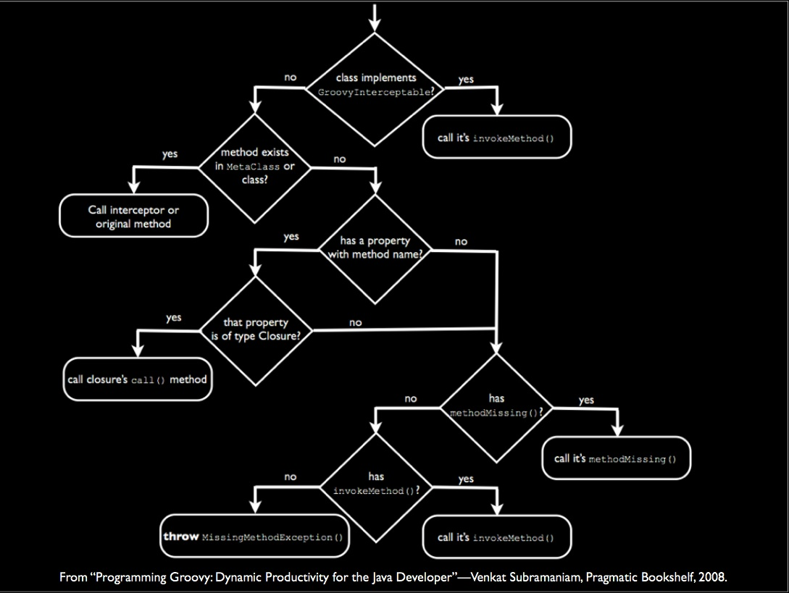
Notes:
An adapter based approach to language interoperability would have to replicate this in order to call into Groovy.

Slide 31
JVM Dynamic Language
Metaobject Protocol
((Scriptable)obj).get("foo");
vs.
metaobjectProtocol.get(obj, "foo");
Notes:
Dynamic MOP provides “navigator” based service layer to locate and invoke methods.

Slide 32
Composability
Groovy MOP
Can handle?
JRuby MOP
Can handle?
Invoke
Method
Java MOP
Can handle?
MethodMissing
Exception
Notes:
Key is Composability

Slide 33
Smalltalk-80
(1980)
Dynamic Language
Metaobject Protocol
(2007)
Simula 67
(1967)
Groovy
(2003)
1960
1970
1980
1990
2000
2010
Notes:
The history of programming languages doesn't seem to be about making the right fundamental decisions and having further work build on it. It seems to be about finding ways to safely put more and more flexibility in the hands of the programmers. I relish the idea of one day being able to safely modify method invocation in a language, and the Dynamic MOP seems like a good step forward.

Slide 34
There's a lot we didn't talk about
Notes:
Actually, not too much missed for compile time.
Get Involved with the prototype. Fix some of the broken unit tests.
Next enhancement should be easier insertion points.
Consider looking at:
Spock Framework, CodeNarc, groovy-core annotations
My blog. GEP-2. Mailing list. What else?

Slide 35
Thank You!
Hamlet D'Arcy
Pearson
@HamletDRC
hamletdrc@gmail.com
http://hamletdarcy.blogspot.com
OpenOffice Slides: http://is.gd/4cckb

