Slide 1
Introducing Groovy
Hamlet D'Arcy
Canoo Engineering, AG
@HamletDRC

Slide 2
What is Groovy?
Groovy is an agile and dynamic language for the Java Virtual Machine
Builds upon the strengths of Java but has additional power features inspired by languages like Python, Ruby & Smalltalk
Makes modern programming features available to Java developers with almost-zero learning curve
Supports Domain Specific Languages and other compact syntax so your code becomes easy to read and maintain

Slide 3
What is Groovy?
Increases developer productivity by reducing scaffolding code when developing web, GUI, database or console applications
Simplifies testing by supporting unit testing and mocking out-of-the-box
Seamlessly integrates with all existing Java objects and libraries
Compiles straight to Java byte code so you can use it anywhere you can use Java

Slide 4
Hello World in Java
public class HelloWorld {
private String name;
public void setName(String name) { this.name = name; }
public String getName(){ return name; }
public String greet() { return “Hello “+ name; }
public static void main(String args[]) {
HelloWorld helloWorld = new HelloWorld();
helloWorld.setName(“Groovy”);
System.out.println( helloWorld.greet(); )
}
}

Slide 5
Hello World in Groovy
public class HelloWorld {
private String name;
public void setName(String name) { this.name = name; }
public String getName(){ return name; }
public String greet() { return “Hello “+ name; }
public static void main(String args[]) {
HelloWorld helloWorld = new HelloWorld();
helloWorld.setName(“Groovy”);
System.out.println( helloWorld.greet(); )
}
}

Slide 6
A Groovier version...
class HelloWorld {
String name
public void setName(String name) { this.name = name }
public String getName(){ return name }
public String greet() { return “Hello “+ name }
static void main(String args[]) {
HelloWorld helloWorld = new HelloWorld()
helloWorld.setName(“Groovy”)
System.out.println( helloWorld.greet() )
}
}

Slide 7
A Groovier version...
class HelloWorld {
String name
public String greet() { return “Hello “+ name }
static void main(args) {
HelloWorld helloWorld = new HelloWorld()
helloWorld.setName(“Groovy”)
println( helloWorld.greet() )
}
}

Slide 8
A Groovier version...
class HelloWorld {
String name
def String greet() { return “Hello “+ name }
static main(args) {
def helloWorld = new HelloWorld()
helloWorld.setName(“Groovy”)
println( helloWorld.greet() )
}
}

Slide 9
A Groovier version...
class HelloWorld {
String name
def String greet() { “Hello $name“ }
static main(args) {
def helloWorld = new HelloWorld()
helloWorld.setName(“Groovy”)
println( helloWorld.greet() )
}
}

Slide 10
A Groovier version...
class HelloWorld {
String name
def String greet() { “Hello $name“ }
static main(args) {
def helloWorld = new HelloWorld()
helloWorld.name = “Groovy”
println( helloWorld.greet() )
}
}

Slide 11
A Groovier version...
class HelloWorld {
String name
def String greet() { “Hello $name“ }
static main(args) {
def helloWorld = new HelloWorld()
helloWorld[“$name“] = “Groovy”
println( helloWorld.greet() )
}
}

Slide 12
A Groovier version...
class HelloWorld {
String name
def String greet() { “Hello $name“ }
static main(args) {
def helloWorld = new HelloWorld(name: “$name“)
println( helloWorld.greet() )
}
}

Slide 13
A Groovier version...
class HelloWorld {
String name
def String greet() { “Hello $name“ }
}
def helloWorld = new HelloWorld(name: “$name“)
println( helloWorld.greet() )

Slide 14
From Java...
public class HelloWorld {
private String name;
public void setName(String name) { this.name = name; }
public String getName(){ return name; }
public String greet() { return “Hello “+ name; }
public static void main(String args[]) {
HelloWorld helloWorld = new HelloWorld();
helloWorld.setName(“Groovy”);
System.out.println( helloWorld.greet(); )
}
}

Slide 15
… to Groovy
class HelloWorld {
String name
def String greet() { “Hello $name“ }
}
def helloWorld = new HelloWorld(name: “$name“)
println( helloWorld.greet() )

Slide 16
Important Points
Groovy compiles to Java .class files and JVM Bytecode
Groovy scripts are valid Java classes
Nearly all Java libraries and tools work with Groovy as well

Slide 17
Other Goodies
Closures / Function Objects
Metaprogramming and Builders
Type Coercion
Operator Overloading
Excellent tool and testing support
Default method parameter values
Named Parameters
More Operators ?: and ?. And <=> and * and *.

Slide 18
Groovy as a View-Layer Technology
Dynamic language with closures
Builder-Style user interface creation
See examples

Slide 19
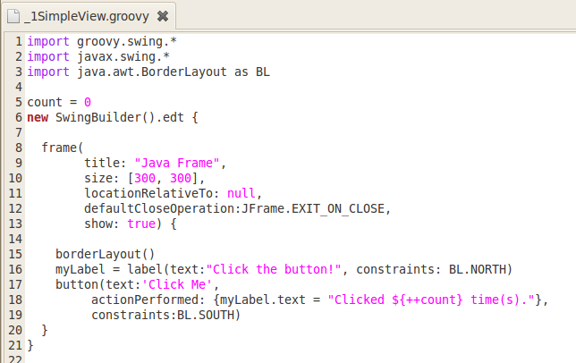

Slide 20
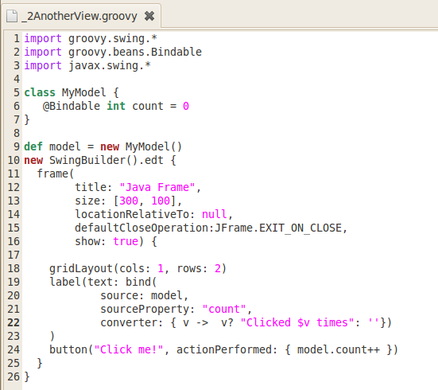

Slide 21
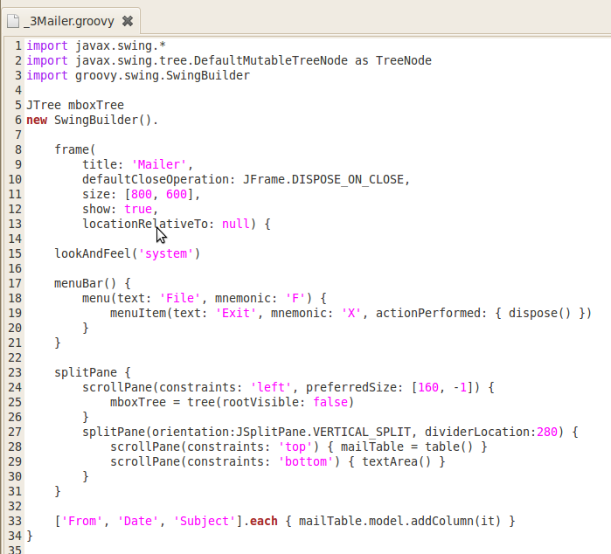

Slide 22
Summary
Dynamic language, more modern than Java
Leverages Java ecosystem and knowledge base
Good for UI definitions (and many other things as well)
Good for low-ceremony extensions

