Slide 1
Slimmed Down Software
A Lean Approach
Hamlet D'Arcy
Canoo Engineering, AG
@HamletDRC
Notes:
Here's my bio, in case you're wondering:
Hamlet D'Arcy has been writing software for over a decade, and has spent considerable time coding in C++, Java, and Groovy. He's passionate about learning new languages and different ways to think about problems. Hamlet is the founder of the Basel-based Hackergarten open source coding group, and regularly participates and speaks at local and international user groups and conferences. Hamlet is a committer on the Groovy and CodeNarc projects, and is a contributor on a few other open source projects (including Jconch, IntelliJ IDEA, and the IDEA Groovy Plugin). He blogs regularly at http://hamletdarcy.blogspot.com and can be found on Twitter as HamletDRC (http://twitter.com/hamletdrc).

Slide 2
We're here to talk about...
the process of writing software
the waste of writing software
improving how we write software
improving our team

Slide 3





Slide 4
Extreme Programming
Scrum
Waterfall
Lean
Agile
RUP
Kanban
Notes:
There is a large world of software process. All of the choices here are good choices depending on your context, even Waterfall. I believe knowing some details from all of these makes you a better decision maker regardless of your final choice.
The slide exists so that I can get a feel for the audience skill level and familiarity on the topic.

Slide 5
Extreme Programming
Scrum
Waterfall
Lean
Agile
RUP
Kanban
Notes:
The focus and narrative of the talk is based on Lean. However, Scrum, XP, and Kanban are discussed as well.

Slide 6

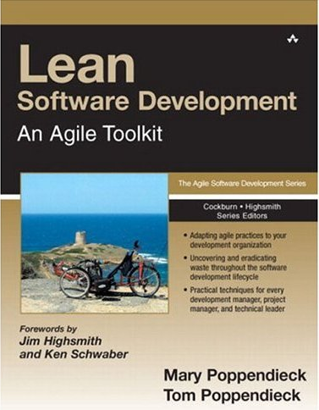
1988 – Japan 2003 – Minnesota
Notes:
Lean History
Lean grew out of the influential Toyota Production System, a set of philosophies and practices to weed out waste, inconsistency, and overburden from a manufacturing. In the 1990′s (in Minnesota) the Poppendieck's applied it to a software project. In 2003 they published “Lean Software Development”. The principles have been revised over time.
The Poppendieck's books are very good. Also, they are from Minnesota, where I used to live. Yeah Minnesota.

Slide 7
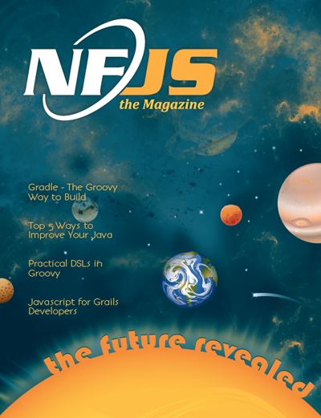
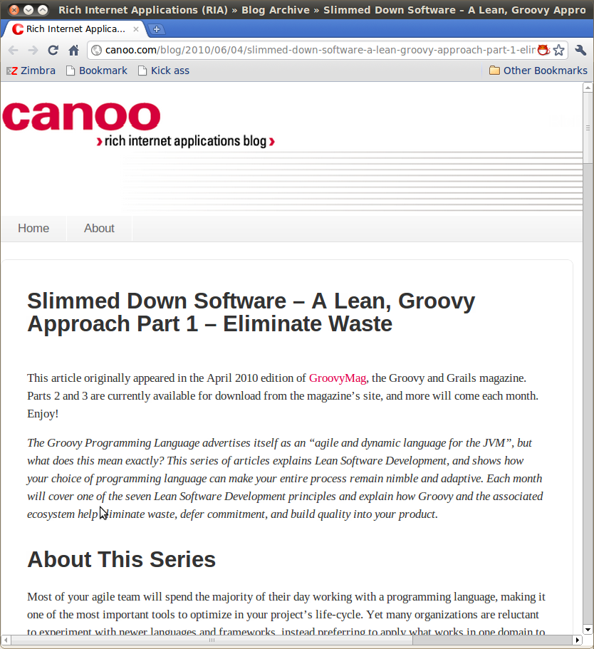
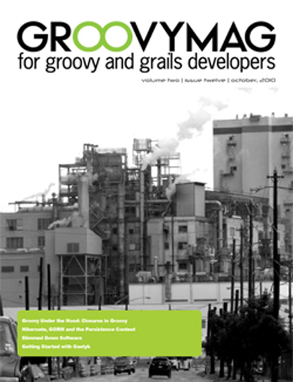
As seen in...
http://nofluffjuststuff.com/
http://canoo.com/blog
http://groovymag.com
Notes:
Some places to find more information:
Waste: http://www.canoo.com/blog/2011/03/08/waste/
Archives of agile related writings:
http://hamletdarcy.blogspot.com/search/label/craft
http://www.canoo.com/blog/tag/agile/
Lean Groovy Presentation (video): http://www.infoq.com/presentations/Lean-Groovy
Lean Groovy Blog Posts:
http://www.canoo.com/blog/2011/03/02/lean-groovy-7-optimize-the-whole/

Slide 8
7 Lean Principles
Eliminate Waste
Build Quality In
Create Knowledge
Defer Commitment
Deliver Fast
Respect People
Optimize the Whole
Notes:
1.Eliminate Waste – Reduce work in progress and half done work
2.Build Quality In – Instead of settling for finding defects, optimize your process to create fewer defects
3.Create Knowledge – Create fast feedback cycle and encode project information in executable form
4.Defer commitment – Delay decisions until the last responsible moment
5.Deliver Fast – Increase velocity by working in small batches and removing bottlenecks
6.Respect People – Create an environment that lets every single person contribute
7.Optimize the Whole – Measure up and avoid sub-optimization
I find it easy to embrace Lean across all levels of an organization, from CEO to Janitor. The principles are specific enough to align a team but broad enough to appeal across an organization. I once spent a three-hour car ride discussing eliminating waste with the senior manager and director of my development group, and then arrived at work to help an eager development team make practical changes to reach the goals we had discussed. Compare that to a methodology with principles of “Honesty” and “Communication”. I have yet to find a use for vague principles beyond their ability to make me feel a little better about a crummy process.

Slide 9
7 Lean Principles
XP Values & Principles
Eliminate Waste
Build Quality In
Create Knowledge
Defer Commitment
Deliver Fast
Respect People
Optimize the Whole
Communication
Simplicity
Feedback
Courage
Respect
Assume Simplicity
Embrace Change
Notes:
Compare the XP principles to the Lean Principles.
Lean is much more concrete and practical, and this is a strength.

Slide 10
7 Lean Principles
Eliminate Waste
Build Quality In
Create Knowledge
Defer Commitment
Deliver Fast
Respect People
Optimize the Whole

Slide 11

Eliminate Waste
Stop doing things that aren't worth the effort

Slide 12

Eliminate Waste
Do the same things with less effort
Notes:
This is deceptively simple. If these two rules are simple, then why is making a lasting change so hard? Why aren’t we hurtling forward at work to ever higher levels of productivity? The reality is that we are good and seeing waste but not good at seeing its causes, and we often eliminate a wasteful practice without finding a suitable replacement.

Slide 13

Who reads these?
Which parts?
Notes:
Some documents need to be written. But which sections of your document are essential to the success of the project, and which are just baggage? You should know the answer to this question (and they surely can't all be essential). Knowing the answer enables you to write a better document or take less time to get the same value out of a document.

Slide 14
“If you document everything,
you are giving everything an
equal weight”
Notes:
"If you document everything, you are giving everything an equal weight. Do that for a complex system, and you are buried in detail. In any system there are some aspects that are more important than the others, key aspects of the system that once understood, will help someone to learn more. The art in documentation is to find how to document these aspects as clearly as possible." Martin Fowler

Slide 15
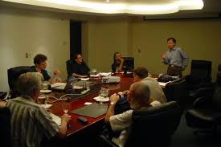
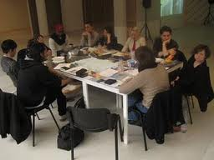
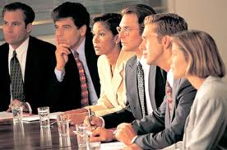
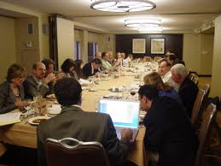


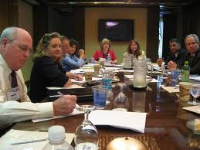
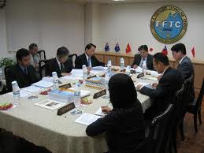

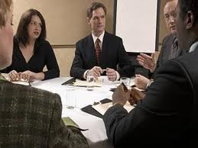


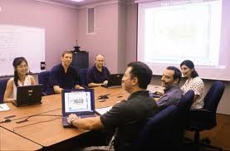
Deja Vu?
Notes:
Excessive meetings form another good example. Why do some workplaces have so many meetings? This is often a sign of a broken decision making process. Fixing a culture of meetings requires you to both find the cause and make a replacement. First identify the real problem, difficulties making decisions, and then experiment with new ways to solve the problem. Perhaps you need to discuss and embrace decision forms other than “unanimous”, or learn to hold shorter, more specific meetings, or just create a team decision board and handle issues in the team room instead of the conference room.

Slide 16
How to Make a Decision
Consensus
Majority
Plurality
Dictatorship
Gradients of Agreement
Notes:
Consensus – The most common in IT. Everyone agrees.
Majority – Decision is made when most people agree
Plurality – Decision is made by largest common group
Dictatorship – Decision is made by one person
Gradients of Agreement – From Agile Coaching
Identify the stakeholders for a decision. Not everyone gets to be involved with every decision. Tread lightly. Consensus gives everyone the illusion of equal power over an unproductive process.

Slide 17
How to Make a Decision
Endorse
Block
Agree with
reservations
Mixed feelings
Disagree but go
with majority
From “Agile Coaching”

Slide 18

Extreme Programming
sounds great!
Can we do it without
changing our process?

Slide 19
Write Only
Process Improvement
Notes:
Can't recognize waste use case: “Write Only Process Improvement”. As a group tries to adopt a better process, they are only allowed to add new practices without removing unneeded ones. This is the bane of agile pilot groups around the world. Your team is certainly free to try a Scrum style iteration with story cards, a burndown chart, and iterative planning. But you still need to adhere to the enterprise standards of full requirements documents, weekly status reports, and quarterly deployments. Feel free to add whatever you want to the process, just don’t dare remove anything. This arrangement requires duplicate work, quickly consumes the time of the Scrum Master, and leads to the conclusion that agile methods are slower than the alternative. Of course a new practice is slower if you’re not allowed to abandon the old way of doing things. The Agile Manifesto has a wonderful parody site called the “Manifesto for Half-Arsed Agile Software Development”. While the original manifesto claims to value “Working software over comprehensive documentation”, the parody adds the line “as long as that software is comprehensively documented.” This rings perfectly true for so many Agile pilot projects: please try your new process, but be sure to follow the old one as well. New practices are adopted despite “Write Only Process Improvement”, never because of it. http://www.halfarsedagilemanifesto.org/

Slide 20
Recognizing Waste
In-Process Inventory
Over-Production
Extra Processing
Transportation
Motion
Waiting
Defects
Notes:
To reduce cost and be more effective we must eliminate waste. By now you know we do this in two ways: find the real cause of software waste and find suitable replacements to eliminate the cause. To help us understand waste we can turn to the Lean community for inspiration. Lean is a broad and growing movement, and was first brought to the software world by Mary and Tom Poppendieck in the book Lean Software Development[1]. Lean provides, among other things, a set of categories for recognizing waste. Learning how these categories apply to software is a good first step for improvements.
These are the categories of waste within a manufacturing production system (not a software production system). The next slide shows how these categories from manufacturing map to software.

Slide 21
Recognizing Waste
In-Process Inventory
Over-Production
Extra Processing
Transportation
Motion
Waiting
Defects
Partially Done Work
Extra Features
Relearning
Handoffs
Task Switching
Delays
Defects
Notes:
The categories of software waste are different within different books. These are the categories provided by the Poppendieck's in (I think) Implementing Lean. I used to have the correct citation but I lost it now and I'm too lazy to stand up and search the bookshelf. Trust me on this one.
Let's talk about these 7 types of waste, starting with partially done work.

Slide 22

Partially Done Work
Notes:
So you own a bicycle factory and you make 1000 mountain bike frames with the plan to later make the handlebars and ship the whole units. When your customers decide they want road bikes instead you’re stuck with 1000 useless frames.
You didn't think it was waste when you were building the frames, but when demand changed you were left with a lot of useless metal. Anything ½ done is waste because there may not be a demand for the product by the time it is finally fully built.
It would have been better to produce one entire bike at a time. Then, you would never be left with excess inventory.

Slide 23

Partially Done Work
Notes:
Or maybe, instead of a bicycle tycoon, you are a humble developer needing to write a new fangled Service Oriented Architecture. Someone (usually a consultant) says “You need to design Contract First” so you spend two weeks creating ten different WSDL service descriptors by hand. Guess what happens when the architecture group decides to switch to REST and plain old XML services? Yup, you just worked for two weeks and have nothing to show for it. In-process inventory is a risk and a cost, whether it is half built bicycles or partially complete web services. Changing requirements and technologies will leave you with wasted effort sooner or later. When this happens to me I think, “I wish I’d spent two weeks at home instead, it would have had the same value to my company.” Partially done work manifests in many ways in software development.

Slide 24
Partially Done Work
Code without Tests
  TDD? ATDD?
Notes:
Work that has been started but not delivered eats up the time investment from developers but does not provide value to the client. Any work that has been started but not completed is a form of waste, and we must optimize our life-cycle to keep our user stories out of this state!
Done isn’t done until the unit and acceptance tests pass.

Slide 25
Partially Done Work
Code without Tests
  TDD? ATDD?
Code Not Checked In
  Continuous Integration? Code on a branch?
Notes:
Code not checked in is a form of waste. Code not on the main development is a form of waste. This is one reason I'm hesitant to embrace the branch-crazy world of distributed version control (I'm learning though).
A proper continuous integration and project automation system can help reduce partially done work. Developers can make small changes, check in, and have the system verify that no tests break.
CI is a bit topic, and project automation is an even bigger one. I've heard good reviews of Jez Humble's book on the topic but have not read it myself. Perhaps it's something to read of you want to know more.

Slide 26
Partially Done Work
Code without Tests
  TDD? ATDD?
Code Not Checked In
  Continuous Integration? Code on a branch?
Undeployed Code
  Automated acceptance tests? Automated deployments?
Notes:
It is logical that developing features in small increments means you deliver sooner, and there is value in that. Delivering a partial system on an earlier calendar date means the customer starts accruing a return on investment before project completion, and this can even result in the system paying for itself before the project is even finished. But will delivering smaller increments really increase or decrease your output in the long term? The answer from queuing theory research is that smaller batch size increases output.
Are you really delivering value at the end of each iteration?

Slide 27
Partially Done Work
Code without Tests
  TDD? ATDD?
Code Not Checked In
  Continuous Integration? Code on a branch?
Undeployed Code
  Automated acceptance tests? Automated deployments?
Concurrent, single-person projects
Notes:
Many 'teams' assign each developer on the team a different task. If there are 5 people then there are 5 small projects in parallel. The problem with this is that it extends the time that each project is partially done. If each mini-project is 60 hours in size (two weeks on the calendar), then the team velocity is 300 hours at the end of two weeks.
What happens during an emergency, when all work must be abandoned after 1 week for some other critical task? With single person projects nothing is delivered after one week. 150 hours were exerted writing software and resulted in zero value.
A better alternative is to have all 5 developers work on one task together until it is finished. That way partially done work is minimized. When the 2 week iteration is canceled after just one week, then the team has still delivered 150 hours of the project, or roughly half of the mini-projects.

Slide 28
Recognizing Waste
Partially Done Work
Extra Features
Relearning
Handoffs
Task Switching
Delays
Defects
Notes:
The next category of waste is extra features.

Slide 29
Extra Features
65% of software features are rarely to never used (Standish Group)
Notes:
This 'fact' was presented by Standish at an XP conference. It was the conference in Italy (I think XP 2002). Again, I have a citation, but it is buried somewhere on my machine. I can find it if you really need it.
The implication is that we could save 65% of our costs by simple not writing those features that no one uses. Easier said than done.

Slide 30
Extra Features
65% of software features are rarely to never used (Standish Group)
Avoid Big Design Up Front
  YAGNI, KISS
  Evolutionary Architecture? Emergent Design?
  Beware: Emergent Design is a mindful process
Notes:
Here are some ideas to avoid writing extra features.
YAGNI = You Ain't Gonna Need It
KISS = Keep it simple stupid
There have been several conference talks and blogs about Evolutionary Architecture and Emergent Design over the years. This seems to work best with a highly skilled team.

Slide 31
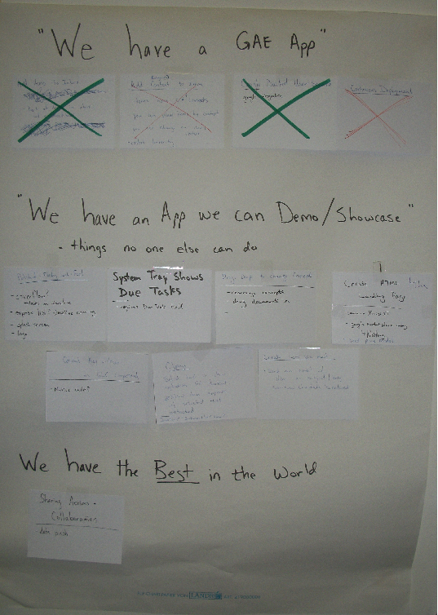

Notes:
Another technique to avoid feature bloat is “minimal marketable feature set”.
This picture is the minimal marketable feature set for the Canoo Finish product we worked on last Fall.
The idea is to define the absolute minimum features a product needs to be released and then do no more. This ensures that only the most important things get into your product.

Slide 32
Extra Features
65% of software features are rarely to never used (Standish Group)
Avoid Big Design Up Front
  YAGNI, KISS
  Evolutionary Architecture? Evolutionary Design?
  Define a Minimal Marketable Feature Set

Slide 33
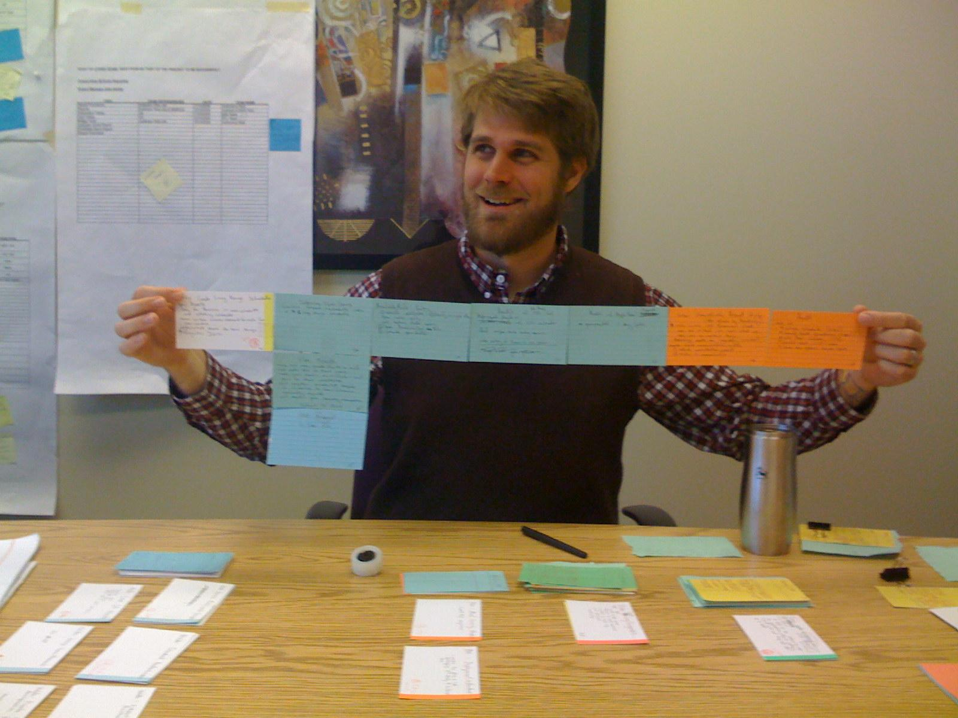
Notes:
Story cards are a lightweight alternative to requirements documents.
This is me with a “hamcordian”, a story card.

Slide 34
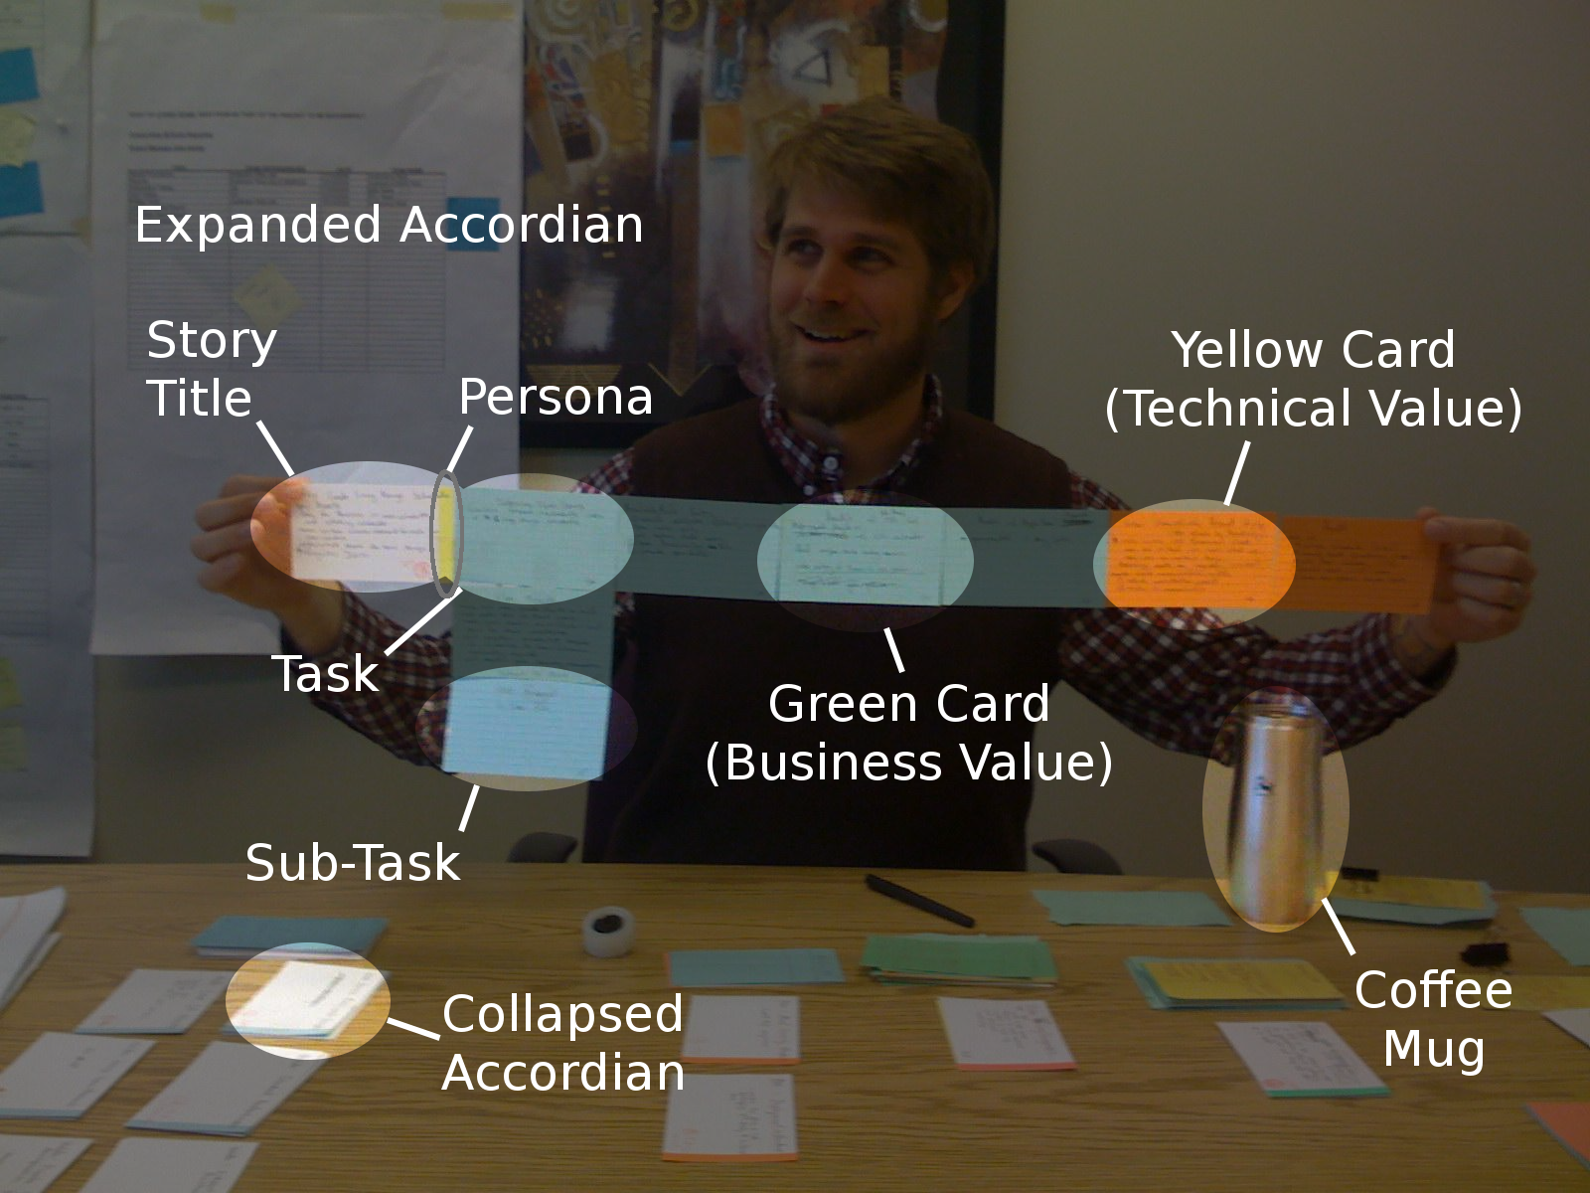
Notes:
There are many approaches to story cards.
Experiment and see what works best for you.

Slide 35
Extra Features
65% of software features are rarely to never used (Standish Group)
Avoid Big Design Up Front
  YAGNI, KISS
  Evolutionary Architecture? Evolutionary Design?
  Define a Minimal Marketable Feature Set
  Prefer Low-Ceremony Processes, like story cards

Slide 36
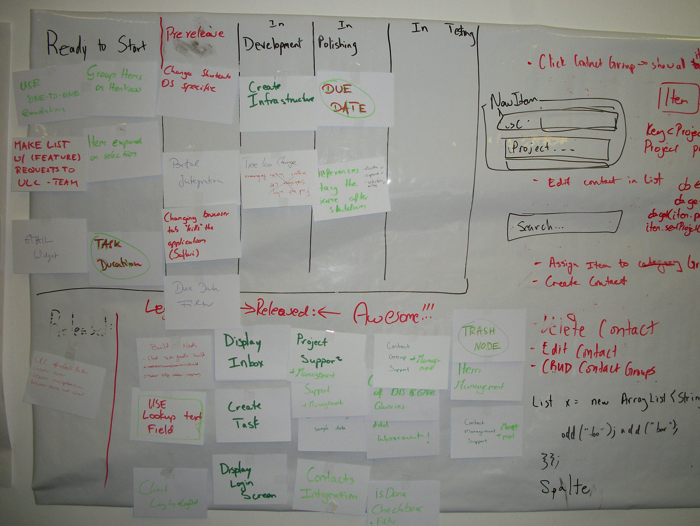
Flow of Value
Notes:
This is the Kanban board for our project. It helps us keep a minimal amount of work in progress and also focus on delivering full features one at a time to the users.
The problem with scrum iterations is that an iteration is not a unit of value, it is a unit of time. The customer is not asking to have time delivered, she is asking to have value delivered.
This is possibly good for maintenance team as well, where the team does not have tasks that fit well into a Scrum backlog. That's a guess though. I haven't tried it on a maintenance team myself.

Slide 37
Extra Features
65% of software features are rarely to never used (Standish Group)
Avoid Big Design Up Front
  YAGNI, KISS
  Evolutionary Architecture? Evolutionary Design?
  Define a Minimal Marketable Feature Set
  Prefer Low-Ceremony Processes, like story cards
  Deliver full features to users quickly

Slide 38
Recognizing Waste
Partially Done Work
Extra Features
Relearning
Handoffs
Task Switching
Delays
Defects
Notes:
Relearning is the next category.

Slide 39
Relearning
How do you not lose or forget information?
How do you chronicle successes and failures
Notes:
Rework in manufacturing is easy to identify. Sending a bike frame back through painting to turn it from blue to red is rework. You shouldn’t have painted it blue in the first place and now you’ve wasted time and paint. How does this map to software development? Discovering something we once knew but have now forgotten is one definition. In big companies it’s quite common to have two different groups independently verify a technical failure. You hear anecdotal evidence of it after work wherever developers gather to drink.
Dev #1 – Ugh, our new web framework sucks.
Dev #2 – Yes, we tried the same framework last year and it does suck.
How great would it be if this conversation could have happened six months ago before the second attempt at using the web framework. Sharing and broadcasting failures is just as important as broadcasting successes. Good decisions come from knowing what you should not do as much as what you should do.
For more, read this: http://www.canoo.com/blog/2011/03/08/waste/

Slide 40
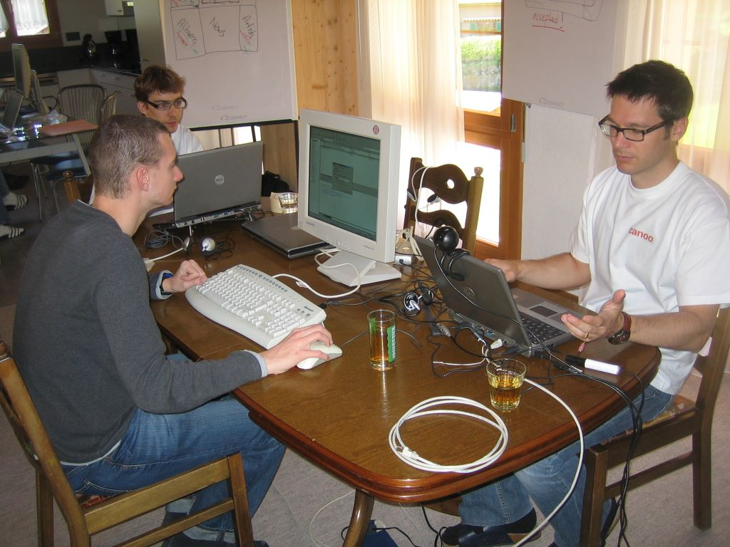
Notes:
A Team Room (sort of)
Team rooms create tacit knowledge. Creating knowledge is good.

Slide 41
Relearning
How do you not lose or forget information?
How do you chronicle successes and failures
Team rooms create tacit knowledge

Slide 42
Relearning
How do you not lose or forget information?
How do you chronicle successes and failures
Team rooms create tacit knowledge
Automated tests create explicit knowledge
  Every defect is fixed with a test
Notes:
The problem with tacit knowledge is that it is not executable or easily verified. But you know what is executable and easily verified? Automated tests.
You can avoid relearning by making sure that every defect fixed is accompanied by a passing unit test. This ensures that the defect will never again be introduced (in theory, at least).

Slide 43
Relearning
How do you not lose or forget information?
How do you chronicle successes and failures
Team rooms create tacit knowledge
Automated tests create explicit knowledge
  Every defect is fixed with a test
Can your documents have comments? Can they be marked out-of-date?
Notes:
I find Word to be a poor platform for software documentation. For some reason it is everywhere though.
How often have you read a document and thought, “This information is old and out-of-date.” Did you do anything about it? Probably not. What do you think the next person did with the document? Did they know it was out of date too, did they have to discover this information themselves?
You can't easily leave a comment on a Word document or mark a Word document out-of-date. A wiki allows you to do this though. I prefer wikis for project documentation because when you find false information you can at least leave a comment telling future readers when things aren't right.

Slide 44
Recognizing Waste
Partially Done Work
Extra Features
Relearning
Handoffs
Task Switching
Delays
Defects
Notes:
Next up: Handoffs.

Slide 45
Handoffs
Transferring information between people is lossy

Slide 46
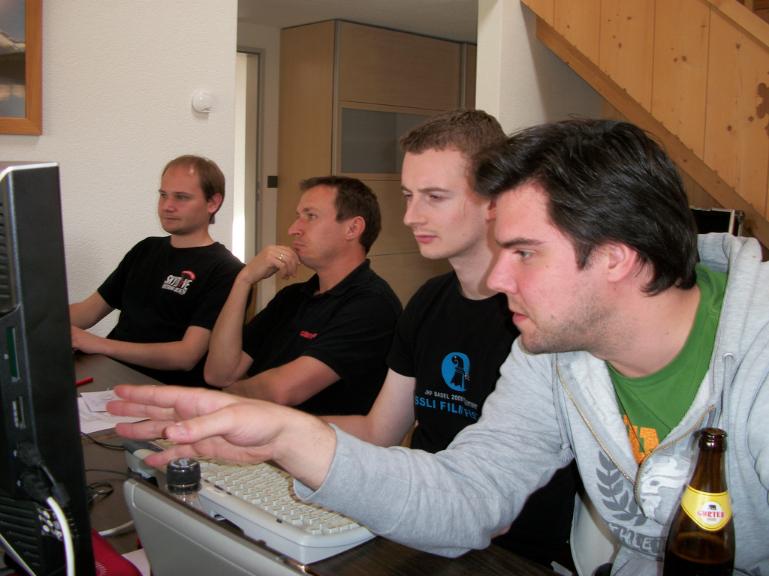
Notes:
Pair programming creates redundancy. With a pairing-team, I've seen new team members ramped up without a formal handoff. This is good; we need to avoid handoffs.
If you want to ensure just-in-time delivery of system knowledge to your new teammate then sit the entire team in the same room and let the newbie ask questions when they are needed.

Slide 47
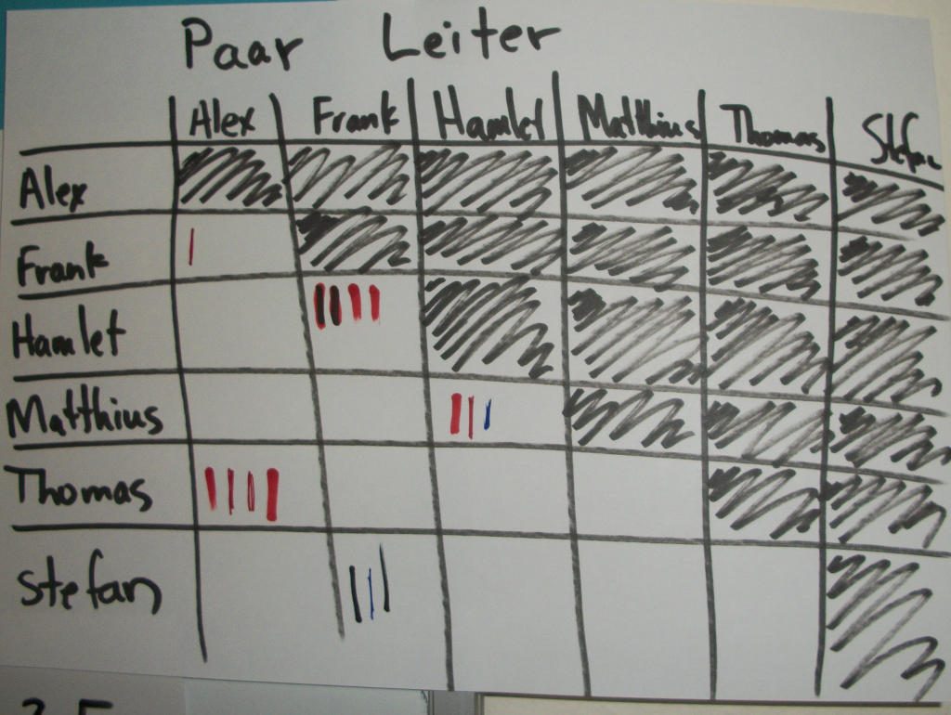
Notes:
A pair ladder helps you manage pairing, making sure cliques don't form and that people really are pairing together. If you're not getting traction or have low adoption with pairing, then perhaps try a pair-ladder to track who is pairing with whom.

Slide 48
Handoffs
Transferring information between people is lossy
Team Rooms & Pairing minimize handoffs
  'Pair Ladders' can be used to promote fair pairing

Slide 49
Handoffs
Transferring information between people is lossy
Team Rooms & Pairing minimize handoffs
  'Pair Ladders' can be used to promote fair pairing
Open Source & Non-Proprietary software reduces handoff cost
Notes:
Proprietary software increases handoffs. New people with the right skills cannot be hired when the only company using a technology is you.
Using open source and non-proprietary software reduces the need for handoffs. I wish more companies thought about this when they make the decision to build their own web framework.

Slide 50
Recognizing Waste
Partially Done Work
Extra Features
Relearning
Handoffs
Task Switching
Delays
Defects

Slide 51
Task Switching
3 one-week tasks always take longer than 3 weeks to deliver
Notes:
Even if the task switching time is 10 seconds, then 3 one-week tasks will take 3 weeks and 30 seconds.

Slide 52
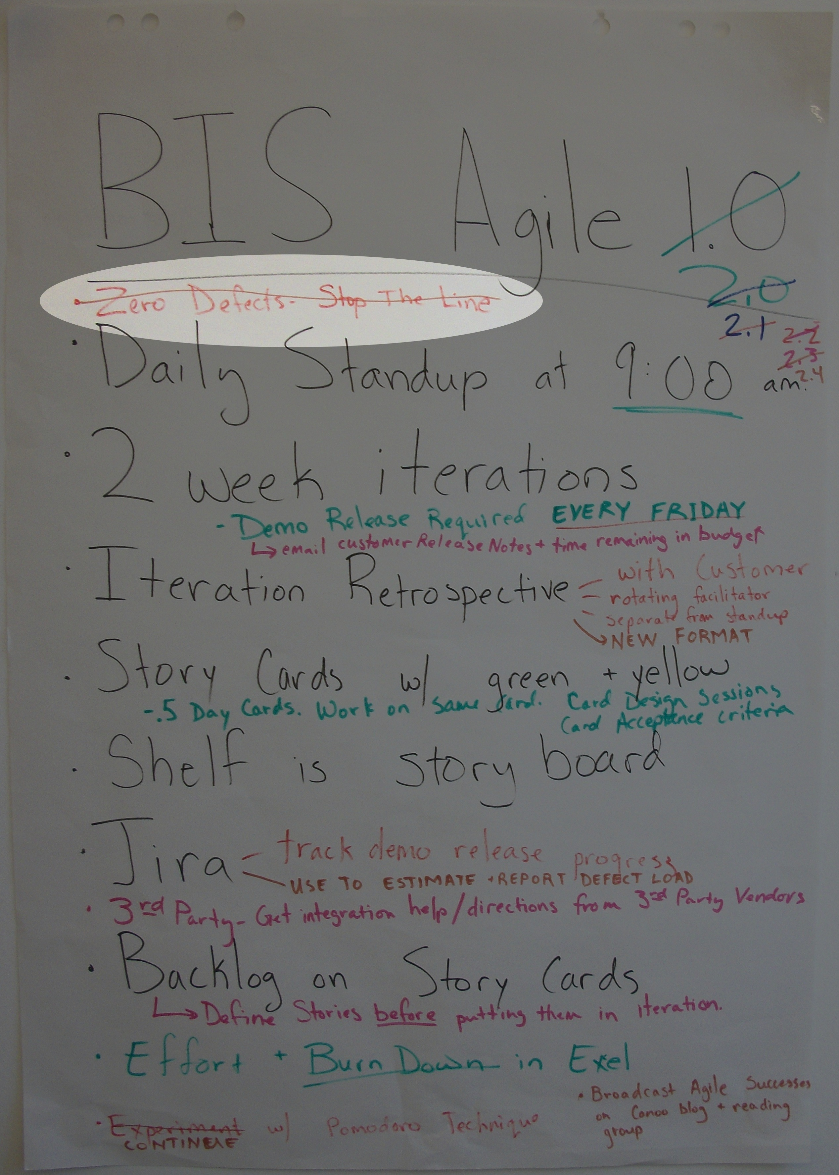
Zero Defects
Stop the Line
Notes:
One particularly rigorous Lean practice is a zero tolerance or stop the line approach for defects. The idea is that no defects should exist in the system, and when a defect is present then all attention and effort must be focused on resolving the issue before normal work resumes. In the face of error conditions and ambiguities, the assembly line stops until the issue is resolved. The effect is that your daily process becomes fine tuned around producing a high quality product early in production as opposed to optimizing a defect cycle days or weeks later. Stop the defects before they happen. My team recently applied this approach for a single two-week iteration with interesting results. Based on our retrospectives, we decided to not continue with a strict enforcement of this policy, but we all agreed we learned a lot and the lessons learned were carried forward to our current process. A worthwhile experiment; I suggest you try it.
We tried a zero-defect approach, where we would stop all feature work and fix defects immediately when they were found. But we found this to increase our task switching.
Defects and maintenance work is a big interruption.

Slide 53
Task Switching
3 one-week tasks always take longer than 3 weeks to deliver
Maintenance work often requires a task switch
  Maintenance Team?
  Defect Fridays?
Notes:
There is always maintenance work arriving at an uneven rate. You can’t eliminate that disruption but you can minimize it. One way is with a separate maintenance team, but I can’t imagine living through that drudgery for more than a few weeks before looking for a new job. Plus, living with your code in production brings valuable lessons. A temporary maintenance team where you serve for only a few weeks has worked for me in the past, mainly because there is a light at the end of the tunnel and you know when your tour of duty is up. A better solution is having maintenance days. For example, every Friday the team must work solely on defects and maintenance issues. Having everyone work maintenance is fair, and it also minimizes interruption. When a small team is needed to solve a problem then the right people are available and feature work isn’t being interrupted. Just be careful. Senior team members tend to have more vacation and sometimes take Fridays off near the end of the year. If this is the case, pick a different day. Also, some defects take longer than one day to fix. You may find defect Friday stretching into defect Monday as well, splintering the team.

Slide 54
Recognizing Waste
Partially Done Work
Extra Features
Relearning
Handoffs
Task Switching
Delays
Defects
Notes:
Wait for it...
Wait for it...
… delays.

Slide 55
Delays
Time waiting is time wasted

Slide 56
Delays
Time waiting is time wasted
Avoid large tasks
Beware documentation signoffs
  Prefer mini-docs
Create a Value Stream Map
Notes:
Waiting for approval on a document is a big source of wait times within big companies. If your large requirements document is not approved, then why have a large document in the first place? Why not break it up into smaller pieces, in which case portions of it can be approved and you can move on. If your design documents need approval, then why not break these up into manageable portions as well. In Waterfall shops, or other bureaucratic environments, the process police don’t normally care if you produce more, smaller documents. Just avoid having no documentation. Short iterations aren’t just for code. If you’re stuck with delays, break down the problem into smaller pieces and deliver less more often.

Slide 57
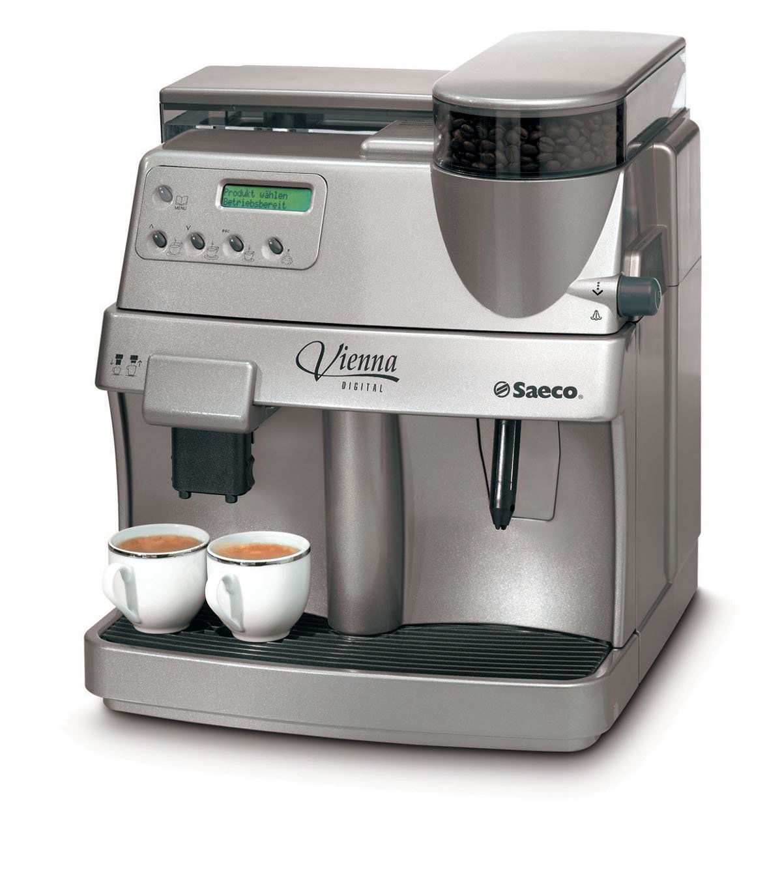



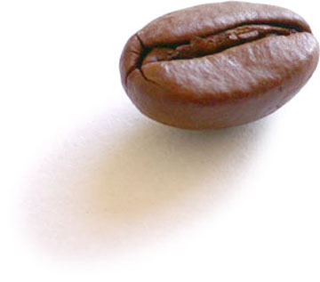
Value Stream Mapping
refill water
120 / 10
refill beans
120 / 10
Notes:
This is a value stream map of Canoo's coffee machine.
Walk to the machine (2 minutes)
Press the button and wait (30 seconds)
Every tenth time refill the water (2 minutes)
Every tenth time refill the beans (2 minutes)
On average, a cup of coffee takes 174 seconds.

Slide 58
Value Steam Mapping
174 Seconds Average
= CHF 43,000 a year
150 Seconds Average
= CHF 37,500 a year
Notes:
One particularly useful Lean practice for eliminating waste is Value Stream Mapping. Sit down at a whiteboard with your development team and write out your software process: the steps and time it takes to move an idea from inception to customer delivery. Where are the bottlenecks? What are the delays? Why does it take so long? Visualizing and quantifying your process helps everyone clearly see problem areas.
The bottlenecks in the coffee process are waiting for the coffee, refilling the water, and refilling the beans. Instead of waiting for the coffee a person could refill the beans just a little every time, or refill the water just a little every time. Viola, you're no longer waiting. This reduces the cost of coffee to 150 seconds on average.
We are a small company. But if we did this then we would save almost 6000 francs a year. Why wouldn't we do this?

Slide 59
Recognizing Waste
Partially Done Work
Extra Features
Relearning
Handoffs
Task Switching
Delays
Defects

Slide 60
Defects
Better use of meetings or documentation cannot produce higher quality
Quality comes from people caring
Notes:
These aren't quantified, but it's how I feel.

Slide 61
Defects
Better use of meetings or documentation cannot produce higher quality
Quality comes from people caring
QA and Developers should work in same testing tool
Focus on prevention not discovery
  Code Quality Tools
  Code Reviews
  Pair-Programming as Code Review
Notes:
If quality is the domain of a single person or department, then it’s likely quality does not describe your product. Moving QA forward in the process needs to mean partnering on acceptance tests that constitute the design of the product. Having a developer and tester pairing on the same workstation is a good sign, and automated acceptance test frameworks facilitate this. Fitnesse, easyb, whatever. Having a developer and tester work in different tools, where neither has access to the other, leads to strong test ownership and little collaboration. It is easy to give the advice that “whenever a defect is found, a test should be created so that it cannot happen again.” To do this, you need to pick a development tool where your testers can create a failing test for the developers, and then throw out that other one you were using before.

Slide 62
Usability Defects
User interfaces do have defects
Use Paper Prototyping and Guerrilla Usability
Integrate user testing into your software lifecycle
Notes:
Reworking UI is a form of defect.
I suggest you read this, which describes how to integrate usability into a agile lifecycle: http://www.canoo.com/blog/2010/03/19/10-lessons-learned-from-usability-testing/

Slide 63
Recognizing Waste
Partially Done Work
Extra Features
Relearning
Handoffs
Task Switching
Delays
Defects
Notes:
That's it for waste!
Let's move on...

Slide 64
There is a big difference between eliminating waste and not creating it in the first place.
- Alan Shalloway

Slide 65
7 Lean Principles
Eliminate Waste
Build Quality In
Create Knowledge
Defer Commitment
Deliver Fast
Respect People
Optimize the Whole
Notes:
If you want to build a high quality product, you could inspect your product after it is built to ensure that it conforms to standards. But it would be better to change how the product is made so as not to create defects in the first place. Picking the best of breed testing practices and using them before the system is completely built is of utmost importance to quality software. At one point in time JUnit and Java were the state of the art in software testing, and eventually Test Driven Development gained mind-share in the industry, pushing testing into the same phase as development. Today, some of the best tools and practices are coming from the Behavior Driven Development community.

Slide 66
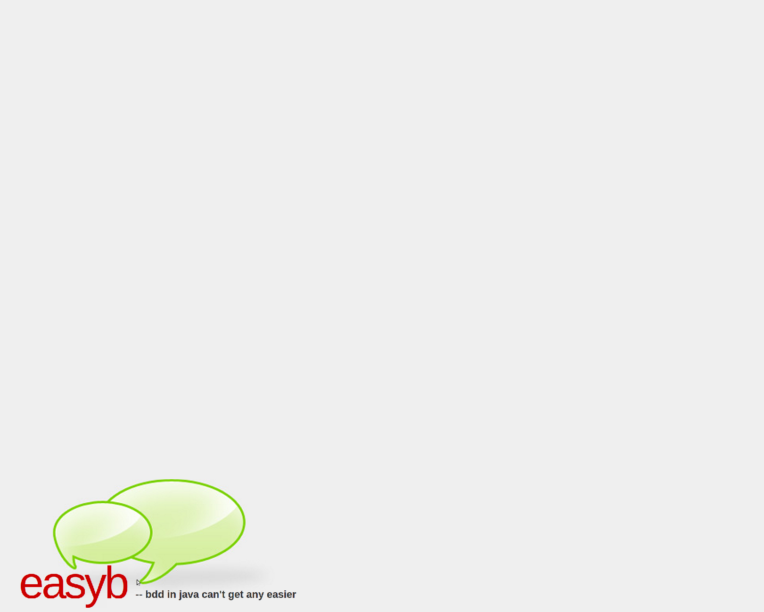
using 'xmlunit'
scenario 'web service should return XML based users', {
given 'a user web service', {
service = new UserWebService()
}
when 'a user is looked up in the web service', {
webServiceResult = service.get(123456)
}
then 'the user's record should be found', {
webServiceResult.shouldBeIdenticalTo """
<user id="123456">
<firstname>John</firstname>
<lastname>Doe</lastname>
</user>"""
}
}

Slide 67
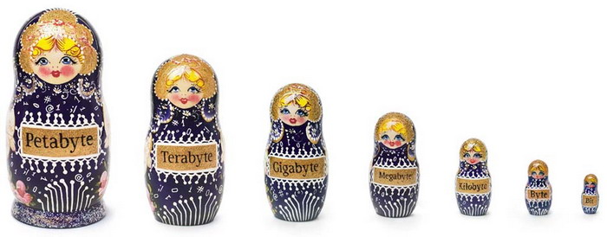
Minimal Syntax
Hierarchical Test Cases
Ubiquitous Language?
Notes:
BDD bills itself as “Unit Testing Done Right”. So what was wrong with unit testing? Unit testing is a good start, but often addresses how objects behave at the microscopic level rather than focusing on what matters to stakeholders. BDD changes this by focusing testing back on the project and the value of the system. Developers are encouraged to focus on why tests should be created rather than adhering slavishly to a one test per object approach. It might sound more like functional testing than unit testing.
The way to focus tests back on business value is by developing and using a ubiquitous language. When your customer says, “The user should be able to change their password,” then that should be your test name. Calling your test fixture UserManagerTest, your test method testChangePassword, and your assertion assertEquals creates an artificial language barrier between you as a developer and the business. It is better to call the test User Features, the test method user must change password, and the assertion “should be”. A common and ubiquitous language breaks down barriers between you and the business and keeps you focused on why you're writing the system in the first place.
Cons – assertEquals is a ubiquitous language.

Slide 68
7 Lean Principles
Eliminate Waste
Build Quality In
Create Knowledge
Defer Commitment
Deliver Fast
Respect People
Optimize the Whole

Slide 69
Software Engineer or Computer Programmer?
Notes:
“Software Engineer” evokes a sense of professionalism, adherence to standards, and attention to quality that sometimes seems lacking in our industry. But “Engineer” also carries negative connotations when applied to software.
Mike Mannion says, “Software development has less to do with conveyor-belt-fabrication (the image unfortunately most likely to be to be conjured up when we use the word engineering) than knowledge acquisition.”
Software development is a knowledge creating process. We discover what needs to be done in order to delight our customers. Your product will benefit by finding ways to speed up this knowledge acquisition.

Slide 70
Software Development as Knowledge Acquisition
short, frequent learning cycles
delayed commitment
Notes:
Specifically, Lean provides two practices for this: short, frequent learning cycles and delayed commitment.

Slide 71
Large requirements and
specification documents provide a
wonderful illusion of certainty
Notes:
So where does all this created knowledge reside? Large requirements and specification documents are enticing because they provide a wonderful illusion of certainty. They can be agreed upon in meetings, verified with checklists, cross referenced with traceability matrices, and then enforced by lawyers and courts when projects fail. Great software has as much to do with rock solid documentation as a great marriage has to do with a rock solid prenuptial agreement. No thanks, I say.

Slide 72
Can tests be Documentation?
Evangelists have oversold
Developers have under-delivered
Notes:
Unit Tests as documentation. Have the evangelists oversold this idea or have the developers writing tests underdelivered?
The software industry has clearly turned towards executable solutions for knowledge creation and retention. The code you write, and the tests that accompany it are the most basic persistent form of system knowledge, and it is important that this knowledge be verified in an automated way.
The problem with traditional unit tests is that the test framework imposes so many particularities that the important knowledge of how your system must behave gets lost in a noise of subclassing, type definitions, mock objects, and annotations. Wiki and spreadsheet based solutions like Fitnesse are a nice idea in theory, but I have not yet found customers willing to edit test data directly. Instead it is left to the developer to do it.

Slide 73
class SpockUserTest extends Specification {
def "does user service contain known set of users?"() {
setup:
def service = new UserService()
expect:
def user = service.get(username)
user.firstName == firstname
user.lastName == lastname
user.id == userID
where:
username | firstname | lastname | userID
'user1' | 'John' | 'Doe' | 123456
'user2' | 'Jane' | 'Doe' | 654321
'user3' | 'John' | 'Smith' | 789987
}
}
Notes:
the arrange-act-assert pattern originated with William Wake as a way to add clarifying structure to unit tests. Codify and standardize the way tests are written: First arrange all necessary preconditions and inputs, then act on the object or method under test, and finally assert that the expected results have occurred.
Encoding your tests with comments is an interesting idea, but in the end comments are not executed, grow stale, and become misleading.
Spock data tends to be read in vertical columns, since each column is input to the expect block. The clean layout helps communicate and create knowledge about your system. The important part of the system is how it behaves, how the UserService retrieves users. This information is front and center communicating to any future programmers on the project. The data that ensures this behavior comes later, and is usually less important than the assertions. The Arrange, Act, Assert pattern is required in imperative, sequential programming. Luckily, a strong language and an innovative framework let you focus more on knowledge creation than satisfying the semantics of your chosen compiler.
Data driven tests are just one of the options in Spock specifications. As you explore Spock you'll find many of the BDD concepts available to use, as well as a unique solution to working effectively with mocking frameworks. Spock is built on JUnit, so it works without effort for popular build tools and IDEs, and the online documentation is superb (how often can you say that about an open source framework?). If you want to take tests as a form of knowledge creation, then Spock is definitely worth investigating.
Point: Tests as knowledge. Less ceremony lets you reveal more about the system. Only shows the important parts

Slide 74
7 Lean Principles
Eliminate Waste
Build Quality In
Create Knowledge
Defer Commitment
Deliver Fast
Respect People
Optimize the Whole
Notes:
The best time to make a decision is at the “Last Responsible Moment”: the point in time where not making a decision eliminates an important alternative. By delaying decisions we are ensured that when new information does becomes available then we can factor it into our project. Just be sure not to wait too long because at some point a lack of decision will force your hand.
You'll also hear people talk about the “cost of delay”

Slide 75
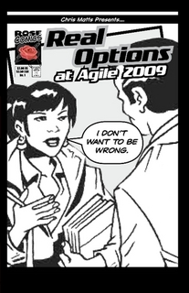
3 Types of Decisions
Right, Wrong, or None
Notes:
One of the most interesting agile family members to arrive recently is the Real Options community, which grew out of an understanding of financial risk management models. Given the recent world banking crisis, following the advice of financial risk modelers may seem as foolish as looking to BP for a good decision making framework. It is better to think of Real Options as a methodology based on both mathematical models and the basic principle of many agile processes: the freedom to choose.

Slide 76
a premature decision today
an informed decision tomorrow
no decision and missed opportunity
Notes:
Regardless of your role, there are three types of decisions: a right decision, a wrong decision, and no decision. Real Options is about harnessing the power of “no decision”, which can be the best decision to make because it allows us to defer commitment until we have more information available. A better informed decision is a better decision and more likely to be right. There is a big value difference between making a premature decision today, making an informed decision tomorrow, and not making a decision at all and having an opportunity pass you by.

Slide 77





Slide 78
$
$$
$$$
$$$$$
Notes:
Options have value

Slide 79
$
11 pm
$$
12 pm
$$$
All night
$$$$$
All night
Notes:
Options Expire
Real options are about the flow of information arrival; remember how developing software was a knowledge creation process? Creating knowledge in the system, and deferring decisions until this knowledge is available, leads to better decisions... making the “right decision” more frequently. We need information to arrive before making commitments, and we push out decision making until the last responsible moment. As the authors state, “The last responsible moment is after which execution of an option is too late. The option no longer exists or you’re not able to execute it any more.”[1].
Never commit early unless you know why

Slide 80

… weekly lesson in
delayed commitment

Slide 81
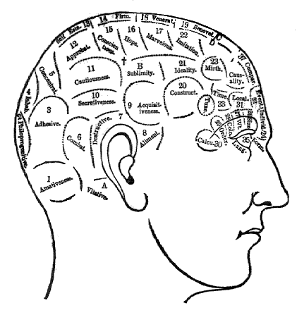
Humans hate uncertainty
Notes:
So give them specifics.
This might sound like common sense. But it is very difficult to follow because of the psychology surrounding decision making. People hate uncertainty, so they naturally drive to make decisions early. This is even more evident in big meetings, where leaders need to be seen leading and progress needs to be made. Not only are big meetings costly, but they can lead to premature decisions, thus further driving the cost of business up. Counter-act this aversion to uncertainty by timeboxing decisions: pick an exact date or conditions to be met before making a decision. Replace the phrase, “We should not make a decision on this” with either “We should not make a decision until after the next iteration on Tuesday” or “We should not make a decision until after the prototype of Plan B is finished.” Giving people certainly over the time frame of a decision balances the natural angst of deferring the decisions. And as you can guess, keeping an up-to-date issue log visible in the team area is a best practice.

Slide 82
“Very dynamic languages like Lisp, TCL
and Smalltalk are often used for prototyping...
[One] reason given for these languages being
good for prototyping is that they don’t require you
to pin down decisions early on. JAVA has exactly
the opposite property: it forces you to make
choices explicitly.”
James Gosling 1996
Notes:
Perfectly well said, except that Groovy is missing from the list of good dynamic languages and JAVA is now written Java, as enforced by the divine writ of the Sun/Oracle legal department. As Java programmers, we are used to making commitments: up front and not deferred. We are asked by the compiler to make them early and make them often.

Slide 83

Delayed Commitment Applied
Identify options
Identify when option expires
Identify steps to seek new options until the expiry date
Wait... wait... wait... until conditions are correct for deciding
Decide quickly and act with confidence
Notes:
Put options thinking to work in your next meeting. Recognize when a premature decision is being made and then make like Doctor House and follow these 5 steps to delay the commitment
This may require keeping an active, visible issue list and being accountable for options. But you can prevent premature decisions by strategically delaying and then tracking when decisions actually do need to be made.

Slide 84
7 Lean Principles
Eliminate Waste
Build Quality In
Create Knowledge
Defer Commitment
Deliver Fast
Respect People
Optimize the Whole
Notes:
The easiest way to deliver quickly is to deliver less. There is a kind of mathematical simplicity to that statement. Short iterations are a reflection of this principle: pick one thing to do, finish it, release it, then move to the next thing. The assertion agile makes is that you'll go faster over time by continuing to work in small batches. The rhythm of the iteration is the same each time: take a small piece of work, finish it, integrate and release, then start over.

Slide 85

Spoiled Sashimi and
Deployment Charades
Notes:
Fake sashimi and continuous integration
Developing features in small increments means you deliver sooner, and there is value in that. Delivering a partial system on an earlier calendar date means the customer starts accruing a return on investment before project completion, and this can even result in the system paying for itself before the project is even finished
BUT... are you really delivering value at the end of each iteration?
Do you have a minimal marketable feature set? Or is each iteration just an undeployed milestone in a larger release plan?
Also, will delivering smaller increments really increase your output in the long term? The answer from queuing theory research is “yes”.

Slide 86

Queuing Theory
Delivery slows as...
variability increases
batch size increases
utilization increases
Notes:
Queuing theory is the study of waiting in lines, or queues, and concerns itself with making your wait as short as possible. It can be applied to software development if we look at our overall development process as a system that takes ideas and visions as input and produces working, tested, and documented software as output. In software production, delivering fast means getting ideas and visions to flow faster through the system, producing working software sooner. Studying how queues work, whether it is supermarket queues, bank teller lines, or your team's product backlog, has produced several findings that should influence how you schedule and manage work:
As variability increases, delivery becomes slower – The more people that show up at a bank, then the longer they will each on average have to wait. The more features crammed into your product or iteration backlog , then the longer each takes to deliver.
As batch size increases, delivery becomes slower – Guess what happens when there is one user story in your backlog that is twice as large as all the others? The same thing that happens when someone shows up in a supermarket express lane pushing a cart overstuffed with goods: processing time increases and delivery becomes slower.
As utilization increases, delivery becomes slower – If your web servers are operating at 100% capacity then your operations team (possibly you!) should be getting paged so that the problem can be fixed. In a traffic jam, everyone has to wait longer, and the same applies to the development process. You shouldn't schedule your servers or your team to be utilized 100%. It leaves no time for task switching, maintenance, improvements, or innovation.

Slide 87
Little's Law
Inventory = Arrival Rate × Flow Time
50 People at taxi stand (Inventory)
1 Minutes Per Person (Flow Time)
Wait is 50 minutes (Arrival Rate)

Slide 88
You will move user stories to done faster by
reducing the amount of stories in-process
(an over simplification)
Notes:
Little's Law implies that you can deliver faster by reducing work in process, or the amount of items in the system. As your inventory diminishes, items flow through the process faster. When lines are shorter at the supermarket then more customers can make it through the checkout counters. And you will move user stories to done faster by reducing the amount of stories in-process.

Slide 89
Work in small batches
Create slack time
Reduce variability
Notes:
Be careful, as this is a simplification. Reducing work-in-progress without making any other changes will also reduce throughput. Small batches, slack, and reduced variability should still be your goals. As H.H. Munro said, “A little inaccuracy sometimes saves a ton of explanation.”

Slide 90
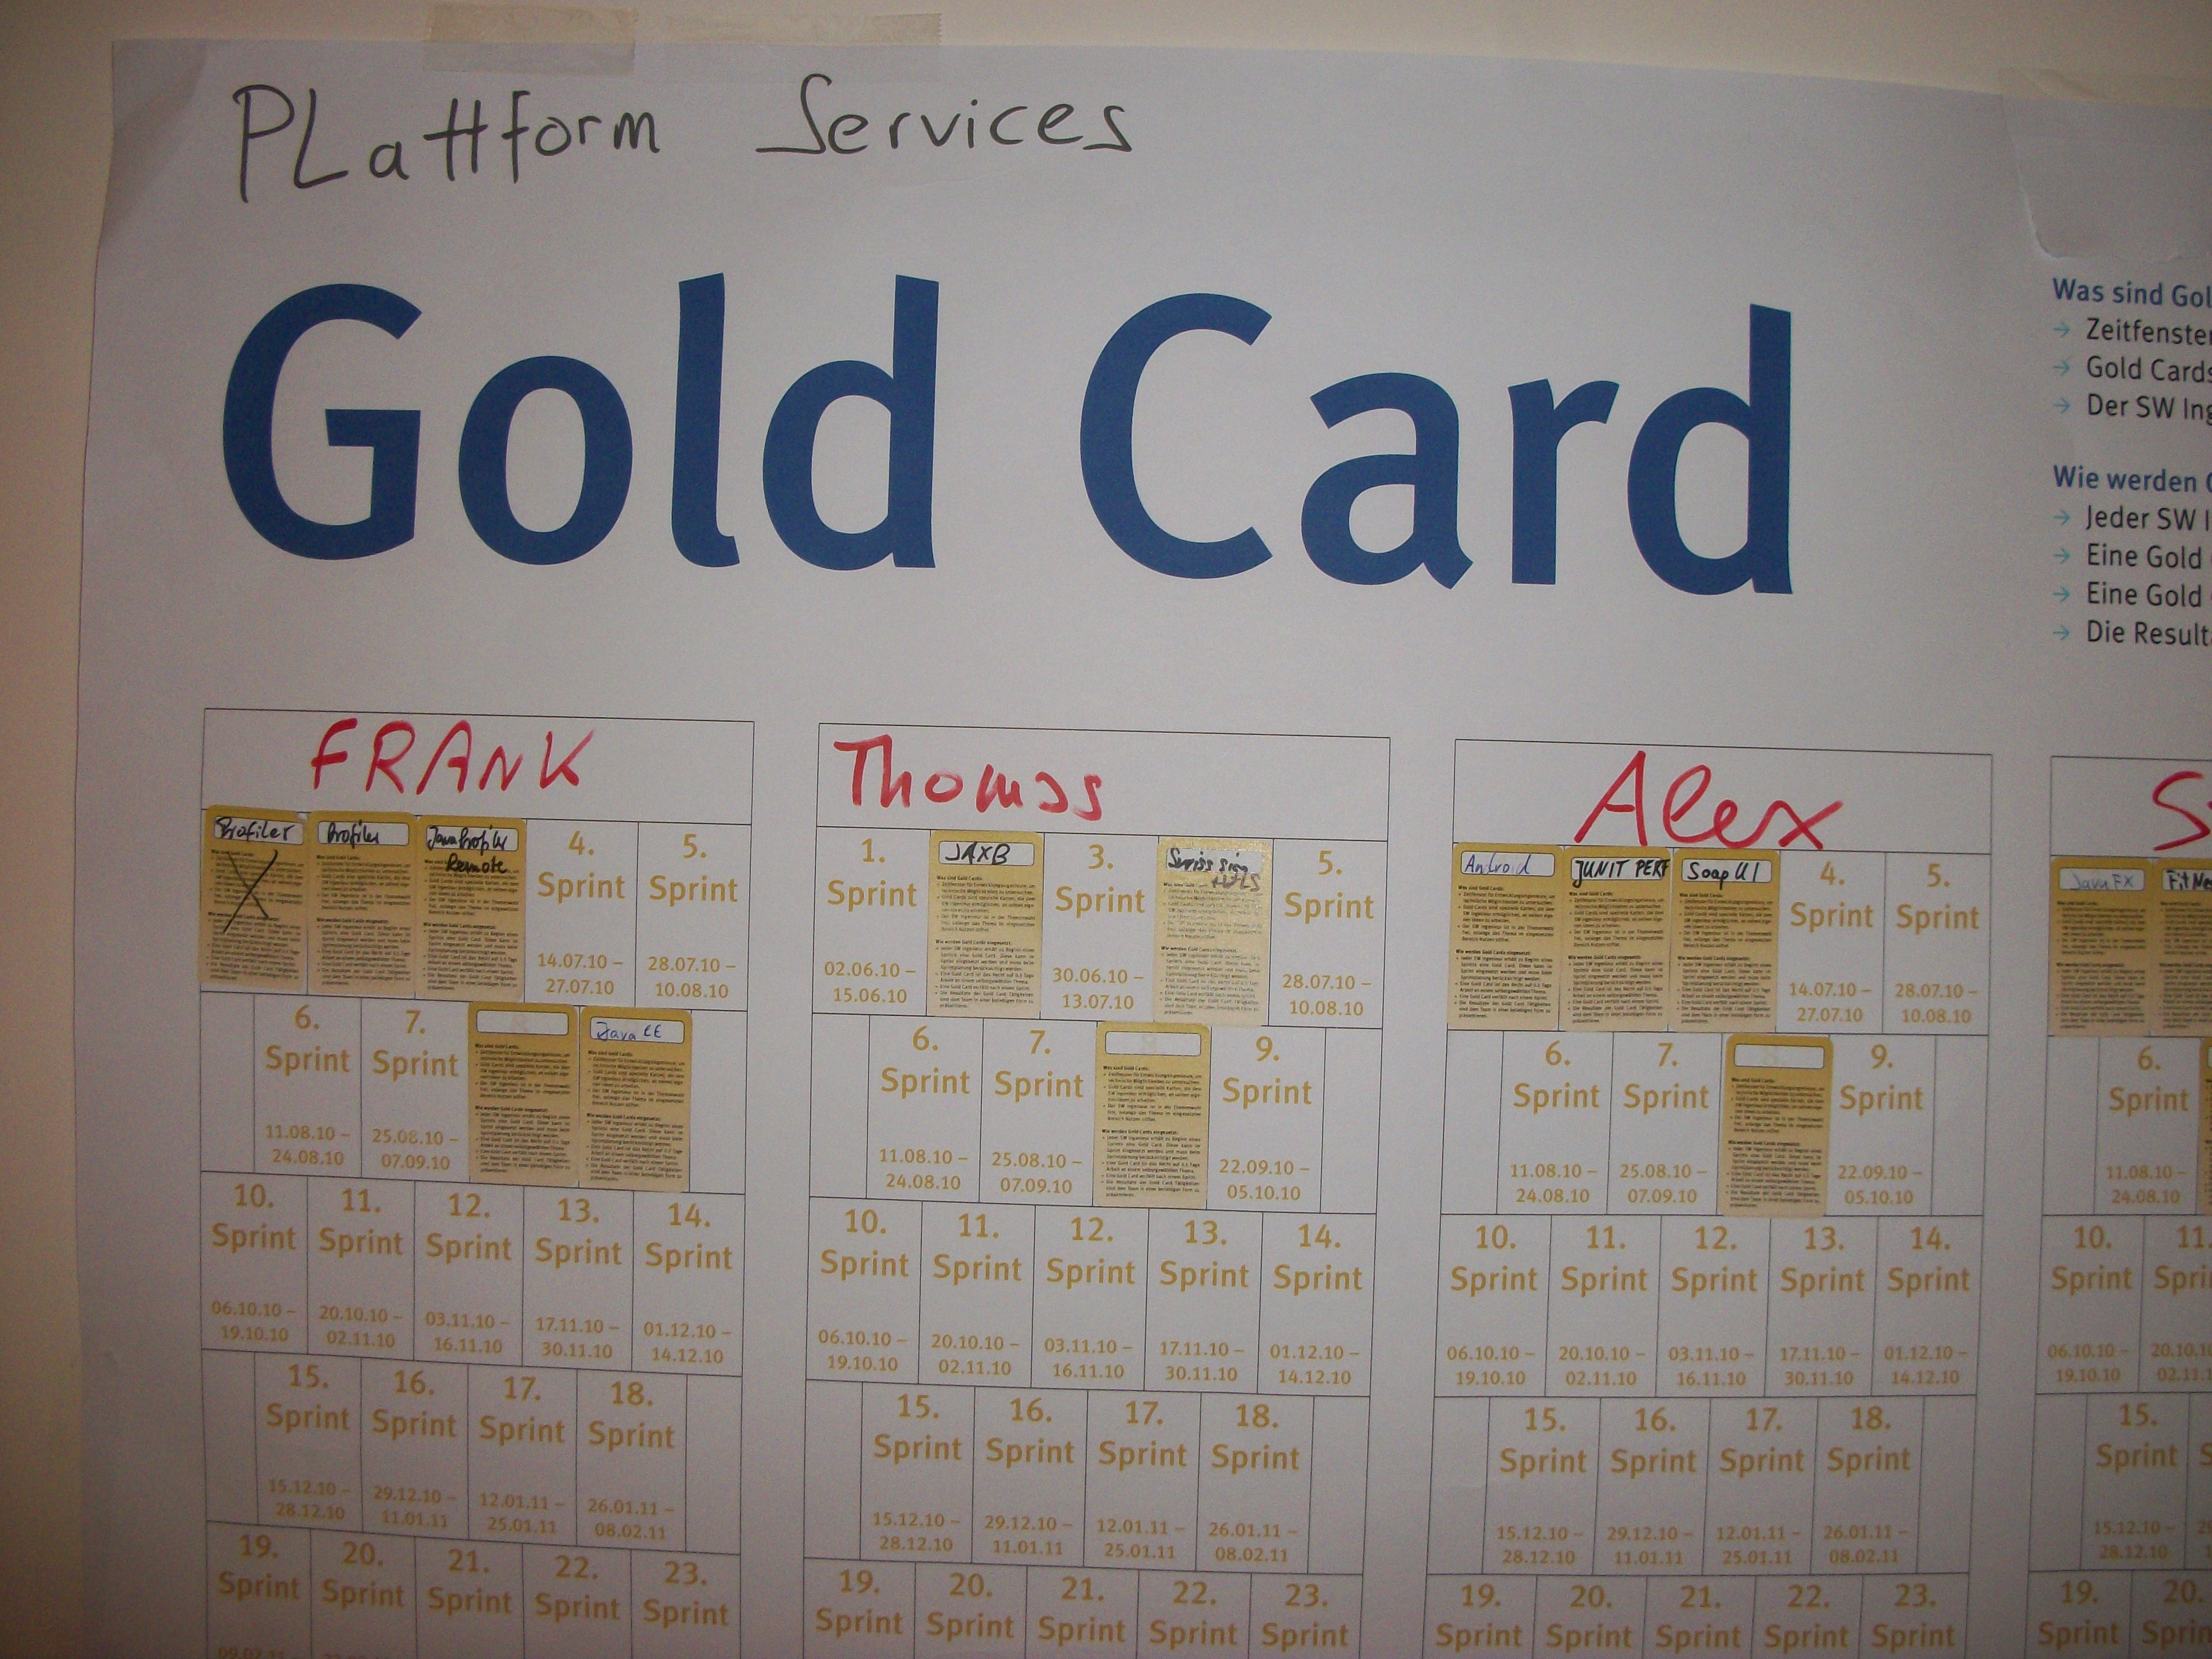
Notes:
Slack Time.
Built into process.

Slide 92
Recipe for Going Faster
Problem
Review
Options
Experiment
From “Agile Coaching”
(a very good book)
Notes:
"Framing a change as an experiment helps focus that team on the benefit because you'll need to discuss how to evaluate whether the experiment is a success." Experiments quickly become the status quo, even before the end of iteration. "You'll also notice that each change they adopt reduces their resistance to the next change."
There is always more work to do to improve your system, even for teams with a small batch size, steady arrival rates, steady processing rates, and built in slack time. The best way to increase throughput in a system is to find the biggest bottleneck and fix it. Work often piles up when developers hand off features to QA. If so, then it's time to take more ownership of quality and start writing your own automated acceptance tests. Easyb is an excellent choice for writing Groovy based acceptance tests. If work is piling up in operations, waiting to be deployed to the test environment or production environment, then it's time to help with project and deployment automation. Currently, Gradle is the best choice for project automation tools, and its features outweigh the more limited scripting abilities of the competitors like Maven, GMaven, or Gant, and the front end to Gradle is conveniently Groovy based.

Slide 93
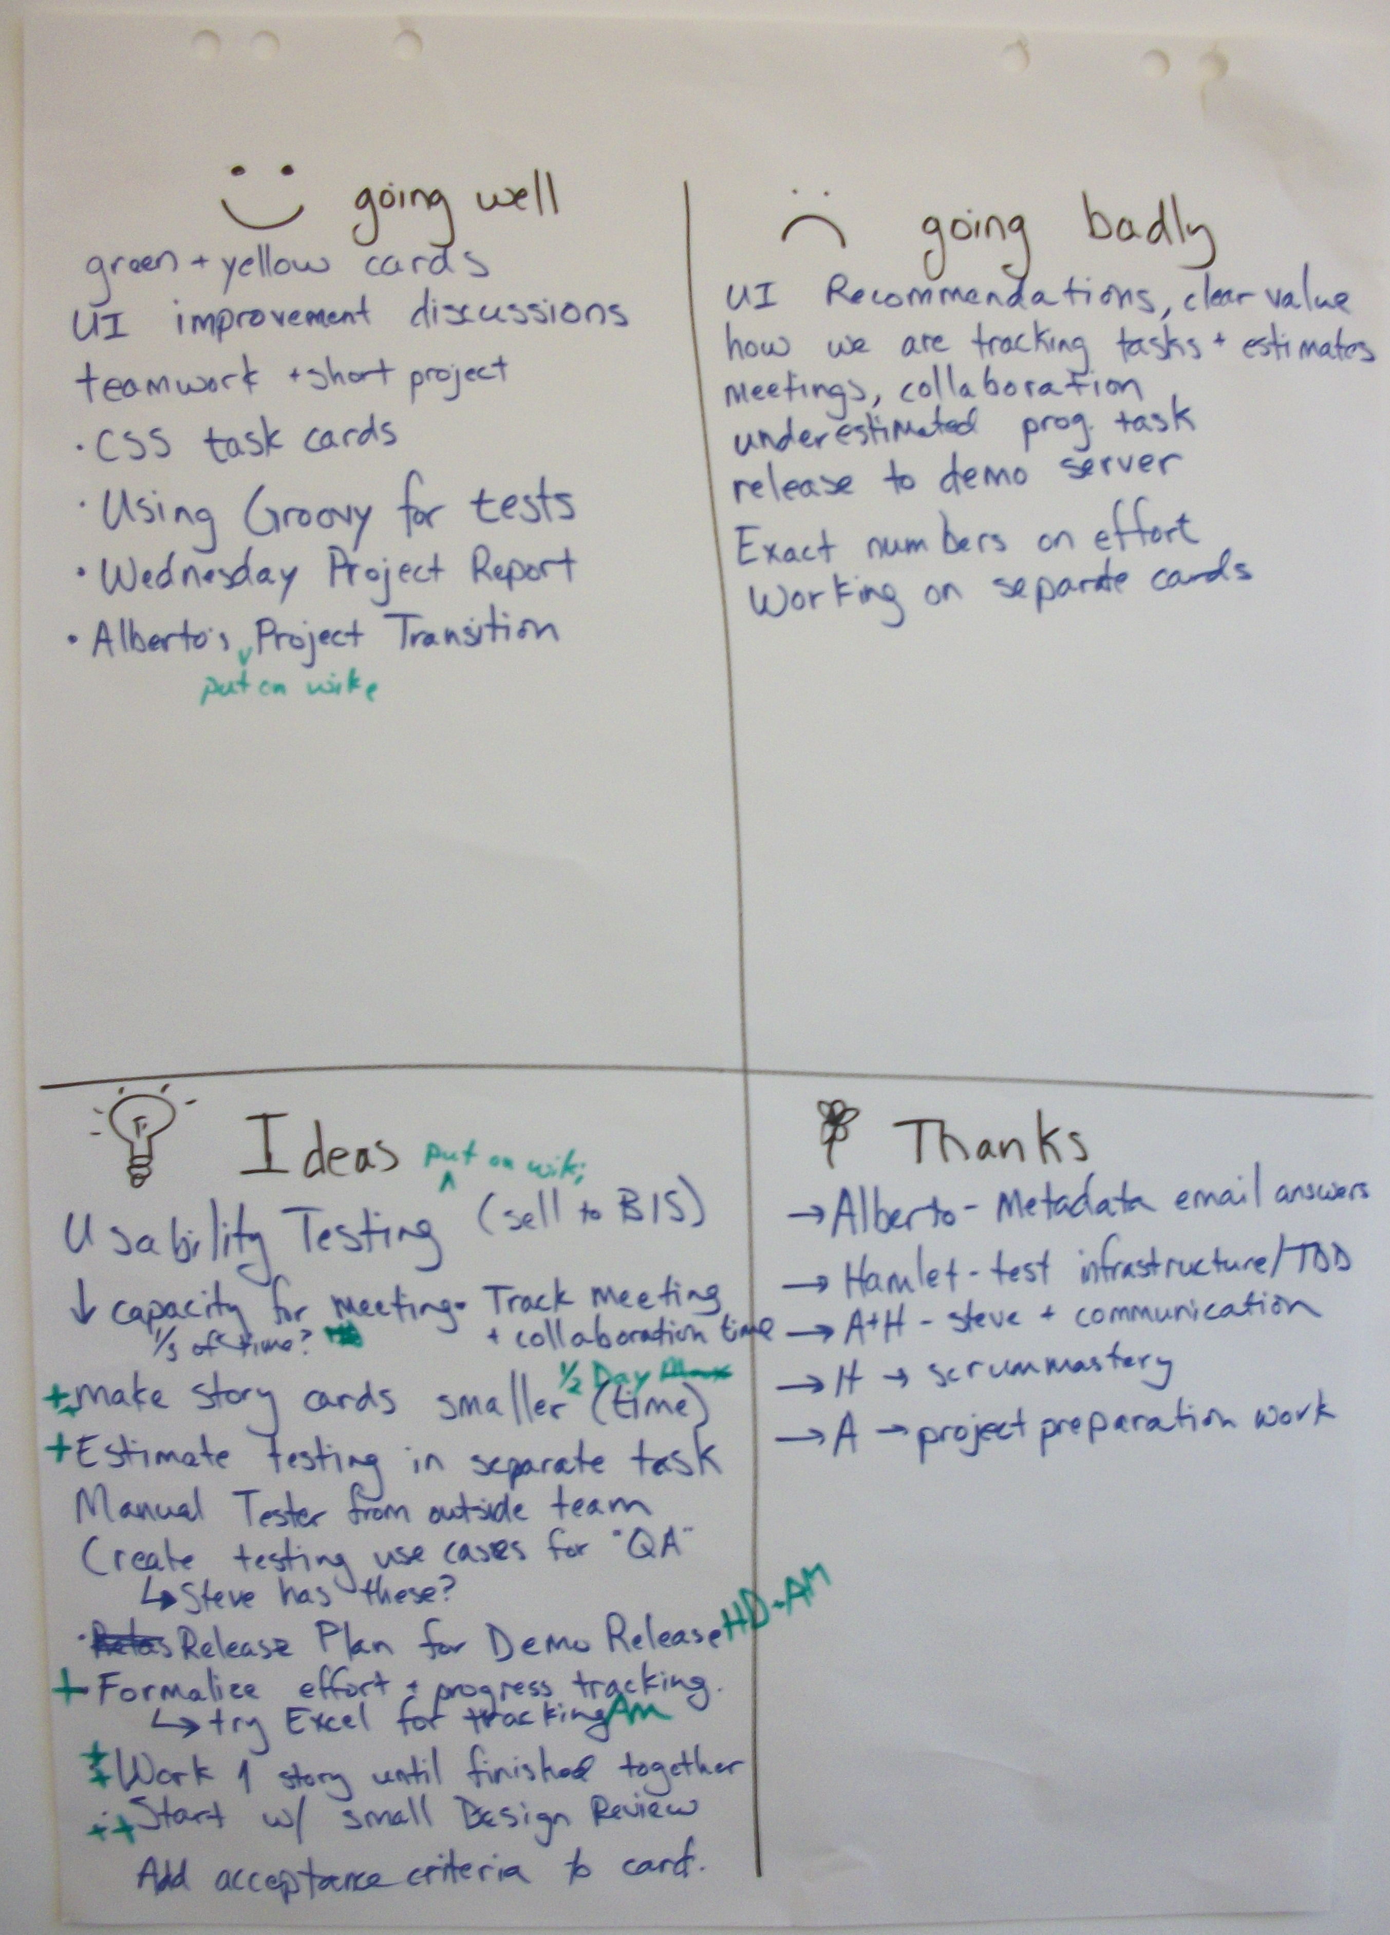

Slide 94
Recipes for Disaster
Experiment
Review
Options
Problem
Review
Options
Notes:
The worst way to increase throughput in a system is to increase productivity in a non-bottleneck area. If your deployment process has no bottlenecks, then migrating from Maven to Gradle will not help you deliver faster. Improving test coverage in a system with no defects and rework isn't going to help deliver fast. There is only locations in your process that should be improved are the bottlenecks, and even then it makes sense only to work on the worst bottleneck, fix it, and then move on to the next. Addressing capacity bottlenecks can reduce cycle time even in organizations that are already efficient.
Suggestion: create a value stream map of a recent feature. See where the bottle necks really occurred. Often they are out of the developers' control.

Slide 95
delivery four week later
refactoring for 40 hours
paying a $100,00 license fee
skipping user interface design
ignoring risk of team member leaving
Profit and Loss Sheet
Notes:
Delays are a different type of waste more akin to lost opportunity cost. You may follow the advice here, and bring a lean software project to market in 6 months. Or maybe you don't and it takes you 7 months. A naïve way to calculate the extra cost is one month of paying the development team. But what about the cost of not having your product on the market? You must count the cost of lost market share, a later return on investment, and less revenue. Delays have costs (paying the team for a longer time) but they also have expenses (less revenue and market share). With so many variables, decisions are tough.
To simplify decisions, put on your accountant hat and create a profit and lost worksheet estimating costs, expenses, and income. And be sure to make them all in the same unit: dollars, euros, whatever. Next time you are debating whether it is better to deliver in two weeks with an extra feature are now without the feature, simply consult the P&L sheet and see which is more profitable. With an economic model, the team becomes empowered to look after the business' best interests themselves. And data and knowledge based decisions provide an easy-out when arguing with passionate product owners and developers. The Poppendieck text [1] provides some excellent templates to follow.

Slide 96
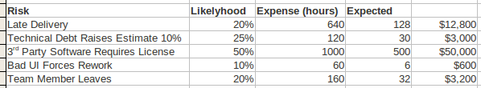
Notes:
Here is a spreadsheet of the same risks with different data, such as the likelihood of occurrence, the expense the risk would cost, and what it costs at $100 an hour.

Slide 97
Profit and Loss Sheet
delivery four week later $64K
refactoring for 40 hours $12K
paying a $100,00 license fee $100K
skipping user interface design $6K
ignoring risk of team member leaving $16K

Slide 98
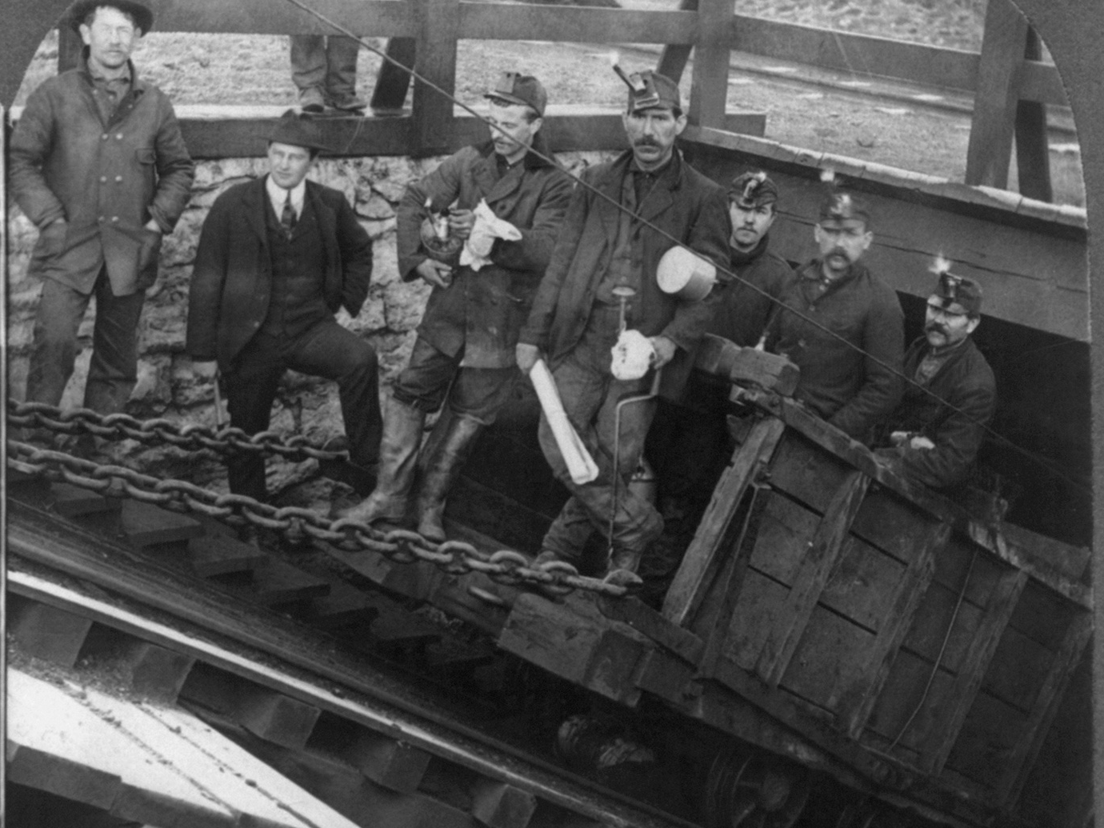
5 to 7 Million US$
(not my estimate)
Notes:
A study done considered how much money people earned over the course of their life in order to take a life-threatening job. The study was done on miners. The study found that the miners valued their lives around 5 to 7 million dollars.
The health care industry in the US values your life at around $50,000 a year. Standford economists claim that the proper number should be $129,000 a year.
At any rate, you can get creative and find a way to monetize about anything. The rationale “if it just saves one life” needs to go.

Slide 99
7 Lean Principles
Eliminate Waste
Build Quality In
Create Knowledge
Defer Commitment
Deliver Fast
Respect People
Optimize the Whole
Notes:
Respecting people means creating an environment where the human element drives innovation and value. Creative problem solving and spontaneity are our most valuable assets, and great companies arrange their development process to let every single employee be able to exercise these traits.

Slide 100
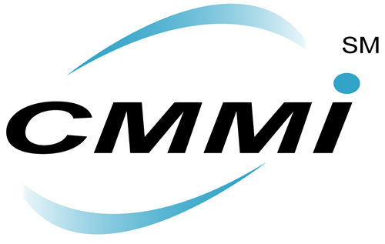
Success (really)
Notes:
My experience with a big Capability Maturity Model (CMM) rollout was exactly the antithesis of this: we brought in several outside consultants who proceeded to observe the way we worked, then created a disciplined process we were required to follow. In their hearts, the consultants believed they were respecting people because the process they documented and codified was the one that we ourselves, the workers, had created ad hoc over the last several years. But our ability to improvise and make changes to the process greatly diminished. Trying something new meant filling out paper work and appearing before a process change group, so most people stopped bothering. The consultants never understood why we refused to display any sort of ownership over the new process. Well, it's hard to think you own something when you aren't allowed to change it. A development process must be malleable and open to experimentation, not locked down. There is nothing wrong with bringing in some outside help, but be careful who you choose. Consultants leave you with a some new documents or artifacts; coaches leave you with new skills.

Slide 101

Closed Door
Architecture
Notes:
I've seen many development led initiatives fail to respect people as well. At a previous company we had a distinct pattern for making big technical decisions: call all the best people into a room to discuss the possibilities then assign a small group to deliver the changes. This ensured that the best developers solved the major issues, but everyone not in the council had neither input nor visibility into changes that affected their work. It was incredibly demoralizing to be a junior developer and know a big, new web framework was being developed behind closed doors, with no obvious way to influence its outcome. If you're having a meeting with all the best people in your department, then there is only one thing you should be doing: firing everyone else. Seriously, what's the value proposition of tolerating mediocrity? Why employ someone only to ignore their most valuable asset, their creative problem solving process?

Slide 102
“Changing culture is hard, but for many organizations,
it’s the critical first step towards better software”
Nathaniel Schutta

Slide 103
“Changing organizational culture is an intriguing for study, but rarely something that you want to tackle just to get slightly better software development.”
Pete McBreen

Slide 104

Dude's Law
Value = Why / How
(V = W / H)
Notes:
Dude's Law comes from David Hussman.
if (H)ow increase and (W)hy is constant, then (V)alue is reduced. Or, in a similar way to Ohm’s Law, If your W is constant (you know what you expect) and you reduce H (less process) then the V increases. As you drive the mechanics (H)ow towards zero, which you could call leaning out your processes, (V)alue increases even if Why is constant)

Slide 105
Agile Adoption State 0
behave territorially
are inflexible
grow uncomfortable with uncertainty
treat developers as a commodity
believe development is a linear process
(you're not ready)
Notes:
You’re not ready for agile if you:
* behave territorially. You mark your territory like an aggressive dog, refusing to share power or information, and let everyone know if you weren’t included in the decision. When something new comes up, avoid it or kill it.
* are inflexible. You’ve got a policy for everything. If it’s not in the book, it doesn’t exist. This is the way we’ve always done it.
* grow uncomfortable with uncertainty. In an agile project, you will not know the project end date or even what features will be delivered in the next iteration. You cannot stand this, and will insist on fixed dates and costs right up front.
* treat developers as a commodity; a uniform, fungible resource. They are all alike. You can’t trust them to think for themselves, you’ve got to make the important decisions for them.
* believe development is a linear process. You ignore unpleasant feedback. Rather than acting on it, you always stick to the plan, just like a politician in an ill-advised military quagmire.

Slide 106
7 Lean Principles
Eliminate Waste
Build Quality In
Create Knowledge
Defer Commitment
Deliver Fast
Respect People
Optimize the Whole
Notes:
Optimizing the Whole in Lean refers to making sure you always measure up. Improving your business is too often an exercise in sub-optimization: you may spend all your effort on improving the unit testing experience without realizing that it's your interactions with operations that are derailing the project, or you may perfect your team's delivery process while the rest of the company continues behaving wastefully. In either case, it pays to step back and examine the situation as a whole. If you're optimizing your unit testing with Groovy, then step back and ask how you can improve the entire project and not just testing. If you're working with your team on a better software life-cycle, then step back and ask how you could improve the life-cycle of all the teams.

Slide 107
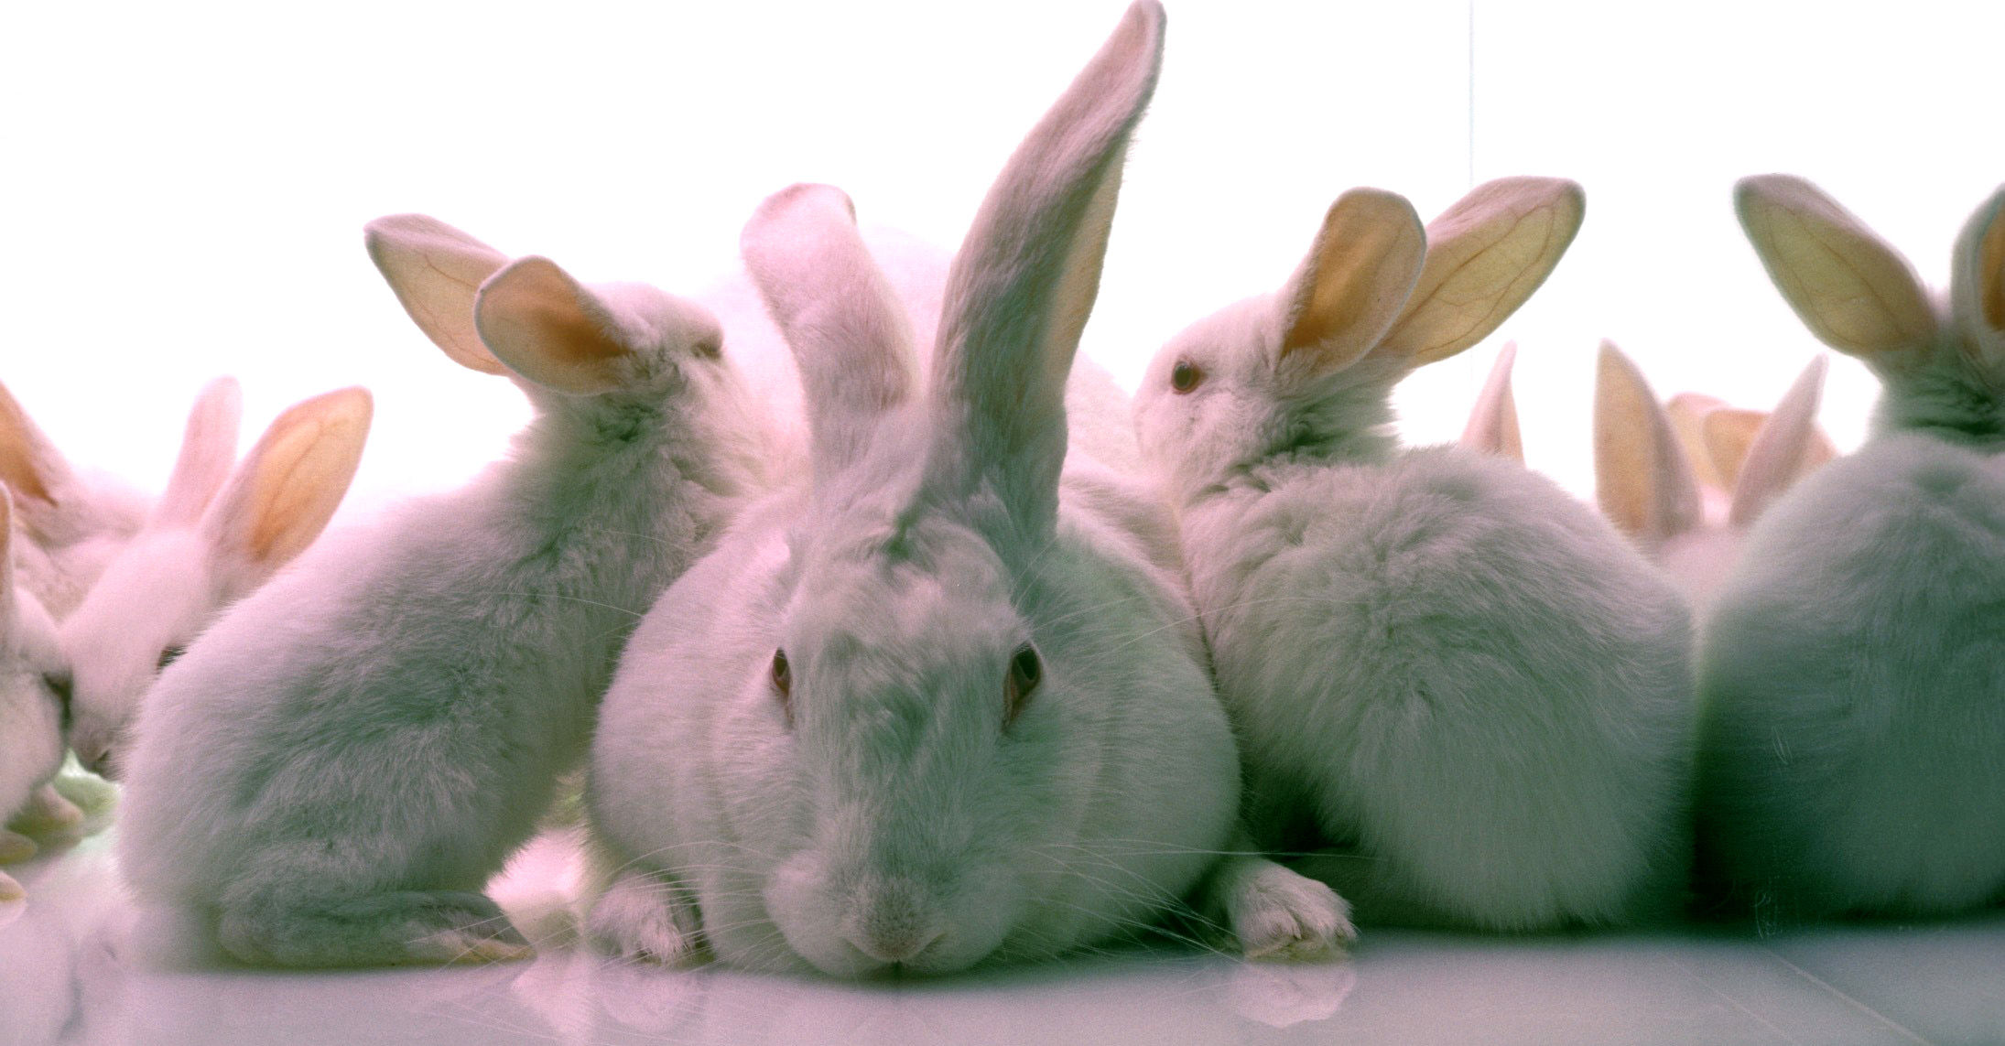
Documents Breed in Captivity
Which is the canonical source?
Requirements, User Stories,
Test Plans, Tests?
Notes:
Docs are a horrible violator of DRY.
Writing code is a lot more than just making the unit tests pass. More importantly you must know which tests to write and what the customer needs. And this means having developers work closely with customers or business analysts. Oftentimes the customer or analysts document the behavior of the system in one format (user stories), developers re-document it in another (functional tests), and QA re-encodes it in another (test plans). Once the code is complete, can the requirements be generated from the tests? Can the story cards or test plan be used as input to the tests? Probably not, since most testing tools and writing tools are so different. Tools like fitnesse and easyb can help in this area.

Slide 108
Other thoughts...
Measure Up?
Value Stream Map?
Forget about new developer tools?

Slide 109
7 Lean Principles
Eliminate Waste
Build Quality In
Create Knowledge
Defer Commitment
Deliver Fast
Respect People
Optimize the Whole
Notes:
In the end, each software project is different and it is up to you to decide whether benefits shown here are worth advocating for within your team. As lean says, “There is no one right way.”
In the words of the Pragmatic Programmer Tip Number 5: “Be a catalyst for change”.

Slide 110
“Be a catalyst for change”
Pragmatic Programmer Tip 5

Slide 111

Thanks!
http://canoo.com/blog
http://hamletdarcy.blogspot.com
@HamletDRC
http://tv.jetbrains.net/tags/hamlet
http://www.youtube.com/hamletdrc
Groovy, Grails, RIA, and Agile Consulting
info@canoo.com or hamlet.darcy@canoo.com

