Slide 1

Code Generation on the JVM
Hamlet D'Arcy | Canoo Engineering AG

Slide 2





Professional Software Developer
Open Source Committer
  JConch (Java Concurrency)
  CrushGraphics (Logo for .NET)
And Contributor
  Griffon Plugins
  CodeNarc
  Gradle
  Gpars
  ...

Slide 3


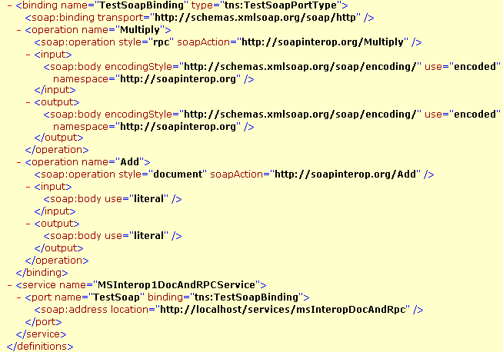
I hate code generation too!
Bean
Generation
Stub
Generation
WSDL
Generation

Slide 4




… but it isn't all bad.

Slide 5
Project Lombok

Slide 6
public class Person {
private String firstName;
private String lastName;
void setFirstName(String fName) {
this.firstName = fName;
}
public String getFirstName() {
return firstName;
}
public void setLastName(String lName) {
this.lastName = lName;
}
public String getLastName() {
return firstName;
}
}
import lombok.Getter;
import lombok.Setter;
public class Person {
@Getter @Setter private String firstName;
@Setter @Setter private String lastname;
}

Slide 7
public class SynchronizedExample {
private final Object $lock = new Object[0];
public void doSomething() {
synchronized($lock) {
return ...;
}
}
}
import lombok.Synchronized;
public class SynchronizedExample {
@Synchronized
public void doSomething() {
return ...;
}
}

Slide 8
Generates Java Boilerplate
Compile Time Only
  For Eclipse and javac
Removable with delombok
Read the fine print
  You should know what is generated

Slide 9
Spring Roo

Slide 10
Moves Java Boilerplate to .aj files
  Uses AspectJ's inter-type declaration (ITD) features
  “Roo doesn't believe in magic!”
Compile Time Only
  Not a runtime
  Not an Annotation Processing library
  No dynamic proxy objets
Removable with rollout mechanism
There is a lot of code on disk
  Is this Roo's fault?

Slide 11


Slide 12
class Event {
String title
}

Slide 13
class Event {
String title
}
class Event {
String title
public void getTitle() {
title
}
public String setTitle(String t) {
this.title = t
}
}

Slide 14
class Event {
@Delegate Date when
}

Slide 15
class Event implements Comparable, Clonable {
Date when
boolean after(Date when) {
this.when.after(when)
}
boolean before(Date when) {
this.when.before(when)
}
Object clone() {
this.when.clone()
}
int compareTo(Date anotherDate) {
this.when.compareTo(otherDate)
}
int getDate() {
this.when.date
}
int getDay() {
this.when.day
}
int getHours() {
this.when.hours
}
int getMinutes() {
this.when.minutes
}
int getMonth() {
this.when.month
}
int getSeconds() {
this.when.seconds
}
long getTime() {
this.when.time
}
int getTimezoneOffset() {
this.when.timezoneOffset
}
int getYear() {
this.when.year
}
void setDate(int date) {
this.when.date = date
}
void setHours(int hours) {
this.when.hours = hours
}
void setMinutes(int minutes) {
this.when.minutes = minutes
}
void setMonth(int month) {
this.when.month = month
}
void setSeconds(int seconds) {
this.when.seconds = seconds
}
void setTime(long time) {
this.when.time = time
}
void setYear(int year) {
this.when.year = year
}
String toGMTString() {
this.when.toGMTString()
}
String toLocaleString() {
this.when.toLocaleString()
}
}
class Event {
@Delegate Date when
}

Slide 16
class Event {
@Lazy ArrayList speakers
}

Slide 17
class Event {
@Lazy ArrayList speakers
}
class Event {
ArrayList speakers
def getSpeakers() {
if (speakers != null) {
return speakers
} else {
synchronized(this) {
if (speakers == null) {
speakers = []
}
return speakers
}
}
}
}
Also handles:
  Initial values
  Volatile fields

Slide 18
@Immutable
class Event {
String title
}

Slide 19
Class is final
Properties must be @Immutable or effectively immutable
Properties are private
Mutatators throw ReadOnlyPropertyException
Map constructor created
Tuple constructor created
Equals(), hashCode() and toString() created
Dates, Clonables, and arrays are defensively copied on way in and out (but not deeply cloned)
Collections and Maps are wrapped in Immutable variants
Non-immutable fields force an error
Special handling for Date, Color, etc
Many generated methods configurable
@Immutable
class Event {
String title
}

Slide 20
@Newify
@Category
@Package Scope
@Grab
… and many more as libraries
GContracts - @Insures, @Requires, @Invariant
Spock - @RunIf({jdkVersion >= 1.6 })

Slide 21
… have you seen Groovy's AST Browser?
AST for “println 4”
BlockStatement
ExpressionStatement
MethodCallExpression
VariableExpression
variable = this
originType = Object
ConstantExpression
Value = println:String
Name = null
ArgumentListExpression
ConstantExpression
Value = 4 : Integer
Name = $const$0

Slide 22
GroovyCodeVisitor
public interface GroovyCodeVisitor {
void visitBlockStatement(BlockStatement statement);
void visitForLoop(ForStatement forLoop);
void visitWhileLoop(WhileStatement loop);
void visitDoWhileLoop(DoWhileStatement loop);
...
}

Slide 23
GroovyCodeVisitor
… source in groovy/src/examples/groovyShell
public interface GroovyCodeVisitor {
void visitBlockStatement(BlockStatement statement);
void visitForLoop(ForStatement forLoop);
void visitWhileLoop(WhileStatement loop);
void visitDoWhileLoop(DoWhileStatement loop);
...
}
def s = new ArithmeticShell()
assert 2 == s.evaluate(' 1+1 ')
assert 1.0 == s.evaluate('cos(2*PI)')

Slide 24
CodeNarc – static analysis for Groovy
class SystemRunFinalizersOnExitAstVisitor extends AbstractAstVisitor {
def void visitMethodCallExpression(MethodCallExpression call) {
if (call.objectExpression in VariableExpression) {
def target = call.objectExpression.variable
if (target == "System" && call.method in ConstantExpression) {
if (call.method.value == "runFinalizersOnExit") {
addViolation(call)
}
}
}
super.visitMethodCallExpression(call);
}
}

Slide 25
… from “Hijacking Goto Labels”
Spock – Testing Framework for Groovy
def "Does simple math work?"() {
expect:
def s = new ArithmeticShell()
s.evaluate(input) == output
where:
input | output
'1 + 1' | 2
'cos(2*PI)' | 1.0
}

Slide 26
Groovy is a compiled language
...oh yes it is
Compiled changes visible in .class file
...visible to all JVM users
Language semantics are a library feature
...not hardcoded into the language

Slide 27
How it Works
Local AST Transformations
Global AST Transformations
AST Builder
AST Templates
ANTLR Plugins

Slide 28
Local AST Transformations
class Event {
@Delegate Date when
}
@GroovyASTTransformationClass("org.pkg.DelegateTransform")
public @interface Delegate {
...
}
@GroovyASTTransformation(phase = CompilePhase.CANONICALIZATION)
public class DelegateTransform implements ASTTransformation {
public void visit(ASTNode[] nodes, SourceUnit source) {
...
}
}

Slide 29
Global AST Transformations
spock-core-0.3.jar!
/META-INF/services/org.codehaus.groovy.transform.ASTTransformation
org.spockframework.compiler.SpockTransform
@GroovyASTTransformation(phase = CompilePhase.SEMANTIC_ANALYSIS)
public class SpockTransform implements ASTTransformation {
public void visit(ASTNode[] nodes, SourceUnit sourceUnit) {
...
}
}

Slide 30
AST Builder
def ast = new ExpressionStatement(
new MethodCallExpression(
new VariableExpression("this"),
new ConstantExpression("println"),
new ArgumentListExpression(
new ConstantExpression("Hello World")
)
)
)
def ast = new AstBuilder().buildFromCode {
println "Hello World"
}

Slide 31
AST Templates
… from “GEP 4 - AstBuilder AST Templates”
def wrapWithLogging(MethodNode original) {
new AstBuilder().buildFromCode {
println "starting $original.name"
$original.code
println "ending $original.name"
}
}

Slide 32
… from “Groovy ANTLR Plugins for Better DSLs”
given "some data" {
...
}
when "a method is called" {
...
}
then "some condition should exist" {
...
}

Slide 33


Thanks!
What to do next:
  Groovy Wiki
  Groovy Mailing List is amazingly helpful
  Use your creativity and patience
  Come to Hackergarten at Canoo
  http://hamletdarcy.blogspot.com & @HamletDRC
I am speaking at:
  GR8 Conference
  CZ Jug
  Your JUG? Please?

