Slide 1

Groovy
Code Generation
Hamlet D'Arcy – Canoo Engineering AG
@HamletDRC
http://hamletdarcy.blogspot.com

Slide 2
Agenda
AST Whirlwind Tour
AST Transformations (Groovy & Java)
Static Analysis (CodeNarc & IntelliJ IDEA)
GContracts & Spock
AST Transformations (Mirah)

Slide 3




About Me

Slide 4
I shot an elephant in my pajamas.

Slide 5
Subject:
I
Verb:
shot
Direct Object:
an elephant
Indirect Object:
in my pajamas

Slide 6
I shot an elephant in my pajamas.
How he got in my pajamas,
I'll never know.

Slide 7
Subject:
I
Verb:
shot
Participle Phrase
an elephant
in my pajamas

Slide 8
We invited the strippers, JFK and Stalin

Slide 9

We invited the strippers, JFK and Stalin

Slide 10
Subject:
We
Verb:
invited
Participle:
strippers
JFK
Stalin

Slide 11

We invited the strippers, JFK and Stalin

Slide 12
Subject:
We
Verb:
invited
Participle Phrase:
the strippers
JFK
Stalin

Slide 13


Slide 14


Slide 15


Slide 16
public class Person {
private String name;
public void setName(String name) {
this.name = name;}
public String getNameName() {
return name;
}
public static void main(String[] args) {
Person p = new Person();
p.setName(“Hamlet”);
System.out.println(p);
}
}

Slide 17
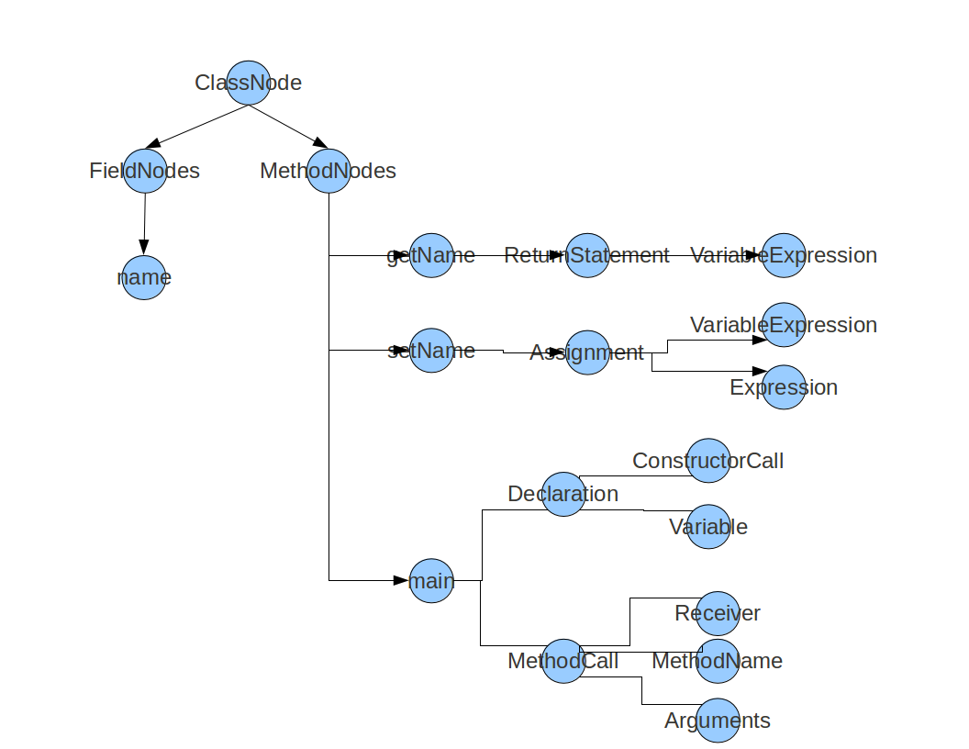

Slide 18


Slide 19
public class Person {
private String firstName;
private String lastName;
public void setFirstName(String fName) { this.firstName = fName; }
public String getFirstName() { return firstName; }
public void setLastName(String lName) { this.lastName = lName; }
public String getLastName() { return lastName; }
public String toString() {
return String.format(“Person{%s,%s}”, firstName, lastName);
}
public boolean equals(Object o) {
return ReflectiveEqualsBuilder.build(this, o);
}
public int hashCode() {
return ReflectiveHashCodeBuilder.build(this);
}
}

Slide 20
import lombok.Data;
@Data
public class Person {
private String firstName;
private String lastName;
}

Slide 21
@Getter / @Setter
@ToString
@EqualsAndHashCode
@NoArgsConstructor
@RequiredArgsConstructor
@AllArgsConstructor
@Data
@Cleanup
@Synchronized
@SneakyThrows
@Log
@Delegate
val

Slide 22
Generates Java Boilerplate
Compile Time Only
– For Eclipse and javac
– IDEA & NetBeans too
Removable with delombok
– Javadoc
– GWT
Read the fine print
– Know what is generated
– Slows compilation times?

Slide 23
How it Works
AST Transformations:
Annotation Processor
Javac Handler
Eclipse Handler

Slide 24
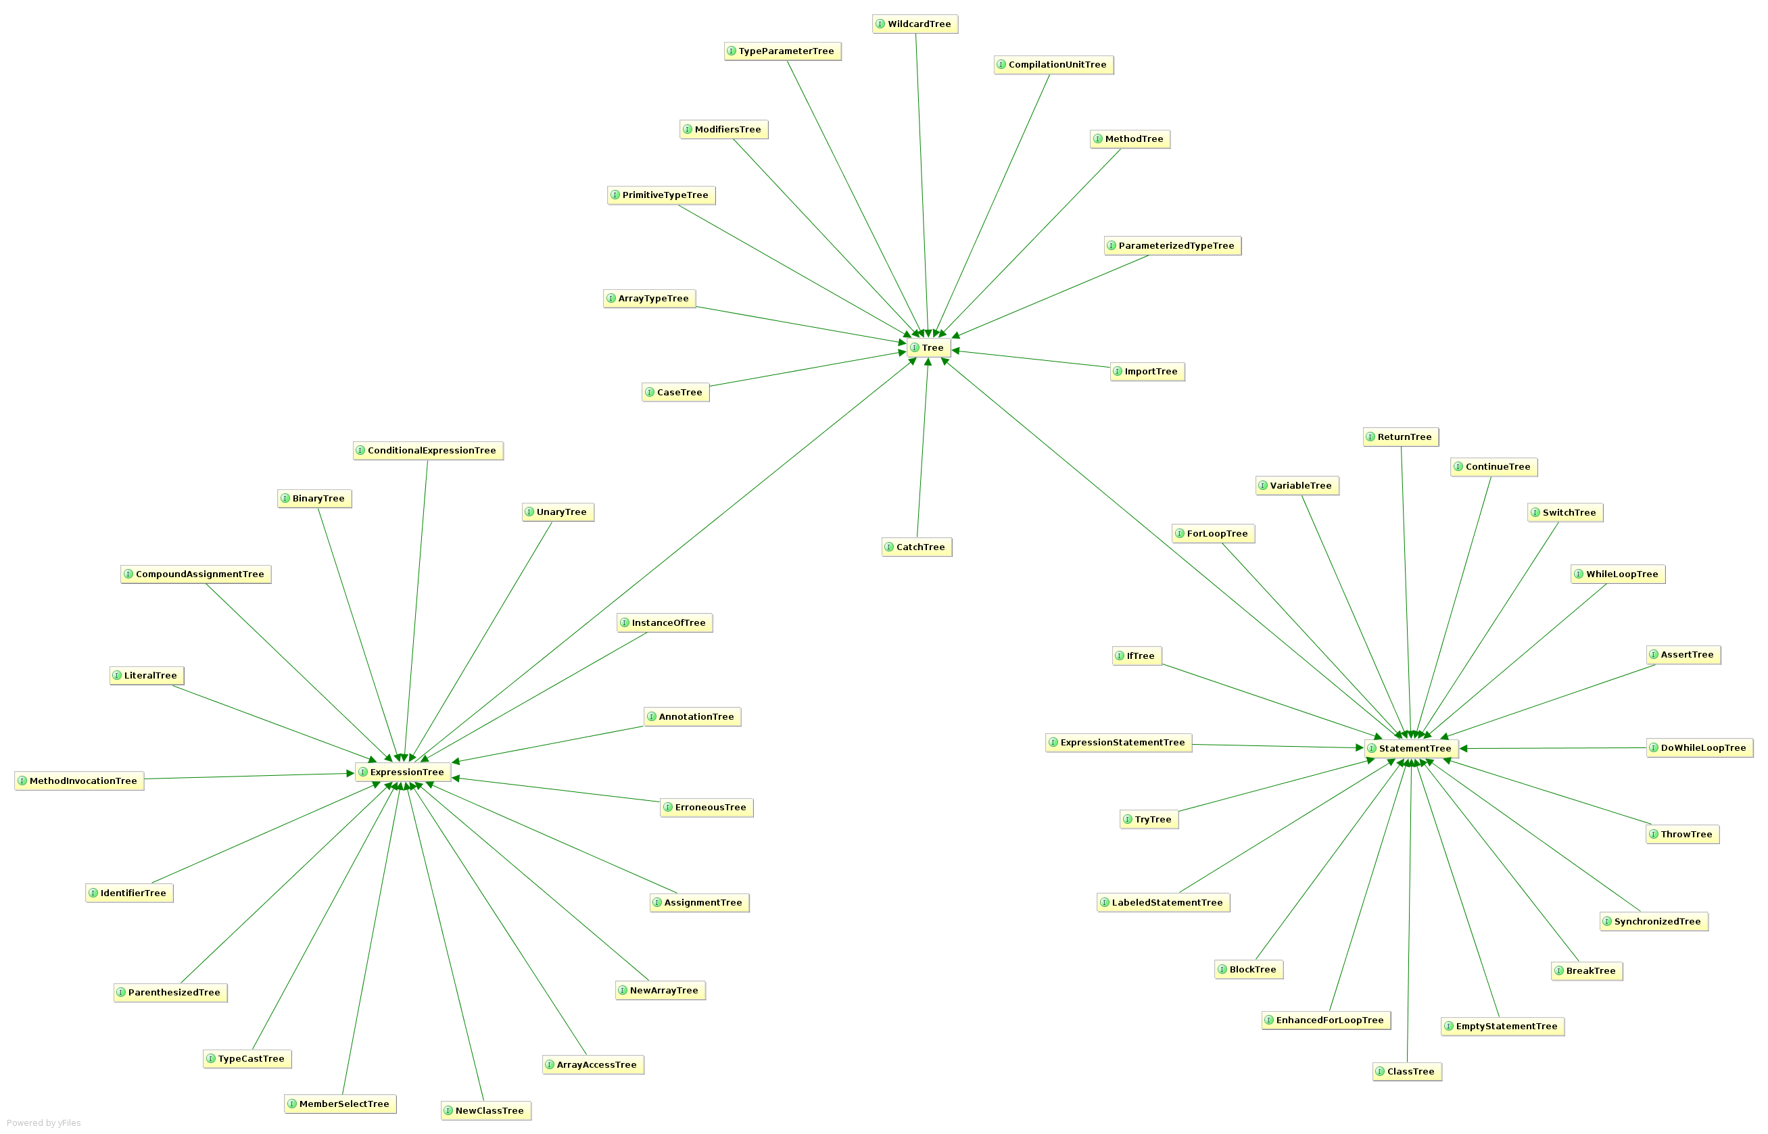

Slide 25
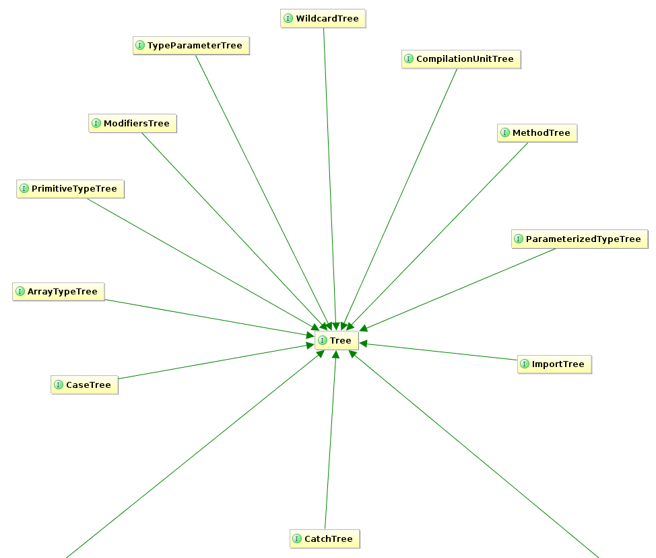

Slide 26
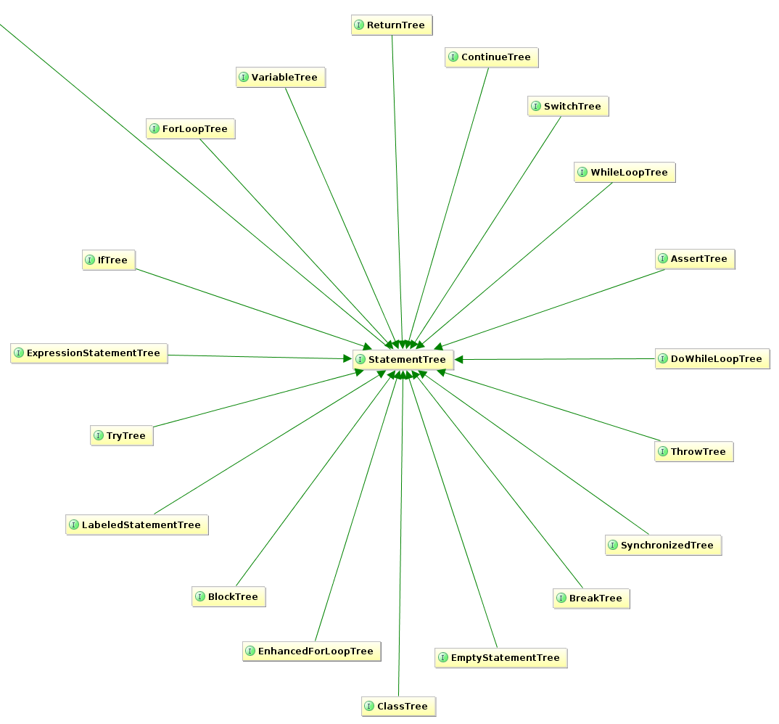

Slide 27
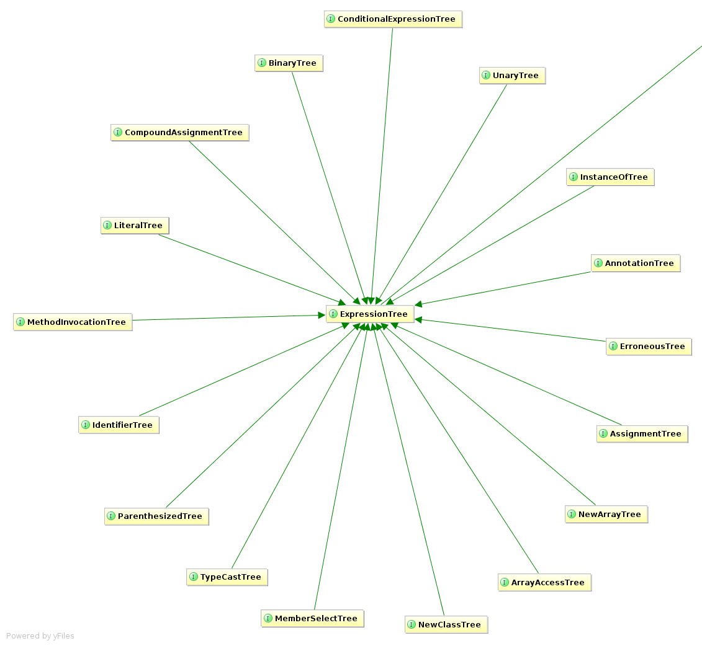

Slide 28
// javac
private void generatePropertyChangeSupportField(JavacNode node) {
if (fieldAlreadyExists(PROPERTY_SUPPORT_FIELD_NAME, node)) return;
JCExpression exp = chainDots(node.getTreeMaker(), node, "this");
JCVariableDecl fieldDecl = newField()
.ofType(PropertyChangeSupport.class)
.withName(PROPERTY_SUPPORT_FIELD_NAME)
.withModifiers(PRIVATE | FINAL)
.withArgs(exp)
.buildWith(node);
injectField(node, fieldDecl);
}
// ECJ
private void generatePropertyChangeSupportField(EclipseNode node) {
if (fieldAlreadyExists(PROPERTY_SUPPORT_FIELD_NAME, node)) return;
Expression exp = referenceForThis(node.get());
FieldDeclaration fieldDecl = newField()
.ofType(PropertyChangeSupport.class)
.withName(PROPERTY_SUPPORT_FIELD_NAME)
.withModifiers(PRIVATE | FINAL)
.withArgs(exp)
.buildWith(node);
injectField(node, fieldDecl);
}
Alex Ruiz – Custom AST
Transformations with Project Lombok
http://www.ibm.com/developerworks/java/library/j-lombok/

Slide 30
class Event {
String title
}
class Event {
String title
public void getTitle() {
title
}
public String setTitle(String t) {
this.title = t
}
}

Slide 31
class Event implements Comparable, Clonable {
Date when
boolean after(Date when) {
this.when.after(when)
}
boolean before(Date when) {
this.when.before(when)
}
Object clone() {
this.when.clone()
}
Int compareTo(Date anotherDate) {
this.when.compareTo(otherDate)
}
Int getDate() {
this.when.date
}
Int getDay() {
this.when.day
}
Int getHours() {
this.when.hours
}
Int getMinutes() {
this.when.minutes
}
Int getMonth() {
this.when.month
}
Int getSeconds() {
this.when.seconds
}
long getTime() {
this.when.time
}
Int getTimezoneOffset() {
this.when.timezoneOffset
}
Int getYear() {
this.when.year
}
void setDate(int date) {
this.when.date = date
}
void setHours(int hours) {
this.when.hours = hours
}
void setMinutes(int minutes) {
this.when.minutes = minutes
}
void setMonth(int month) {
this.when.month = month
}
void setSeconds(int seconds) {
this.when.seconds = seconds
}
void setTime(long time) {
this.when.time = time
}
void setYear(int year) {
this.when.year = year
}
String toGMTString() {
this.when.toGMTString()
}
String toLocaleString() {
this.when.toLocaleString()
}
}
class Event {
@Delegate Date when
}

Slide 32
class Event {
@Lazy ArrayList speakers
}
class Event {
ArrayList speakers
def getSpeakers() {
if (speakers != null) {
return speakers
} else {
synchronized(this) {
if (speakers == null) {
speakers = []
}
return speakers
}
}
}
}

Slide 33
@Immutable
class Event {
String title
}
– Class is final
– Properties must be @Immutable or effectively immutable
– Properties are private
– Mutatators throw ReadOnlyPropertyException
– Map constructor created
– Tuple constructor created
– Equals(), hashCode() & toString() created
– Dates, Clonables, & arrays are defensively copied on way in & out (but not deeply cloned)
– Collections & Maps are wrapped in Immutable variants
– Non-immutable fields force an error
– Special handling for Date, Color, etc
– Many generated methods configurable

Slide 34
Code Generation Transformations
@ToString
@EqualsAndHashCode
@Canonical
@Lazy
@InheritConstructors
@TupleConstructor

Slide 35
Class Design Annotations
Logging Improvements
@Delegate
@Singleton
@groovy.transform.Immutable
@Log
@Log4j
@Slf4j
@Commons

Slide 36
Declarative Concurrency
Easier Cloning and Externalizing
Safer Scripting
@Synchronized
@WithReadLock
@WithWriteLock
@AutoClone
@AutoExternalize
@TimedInterrupt
@ThreadInterrupt
@ConditionalInterrupt

Slide 37
How it Works
Local AST Transformations

Slide 38
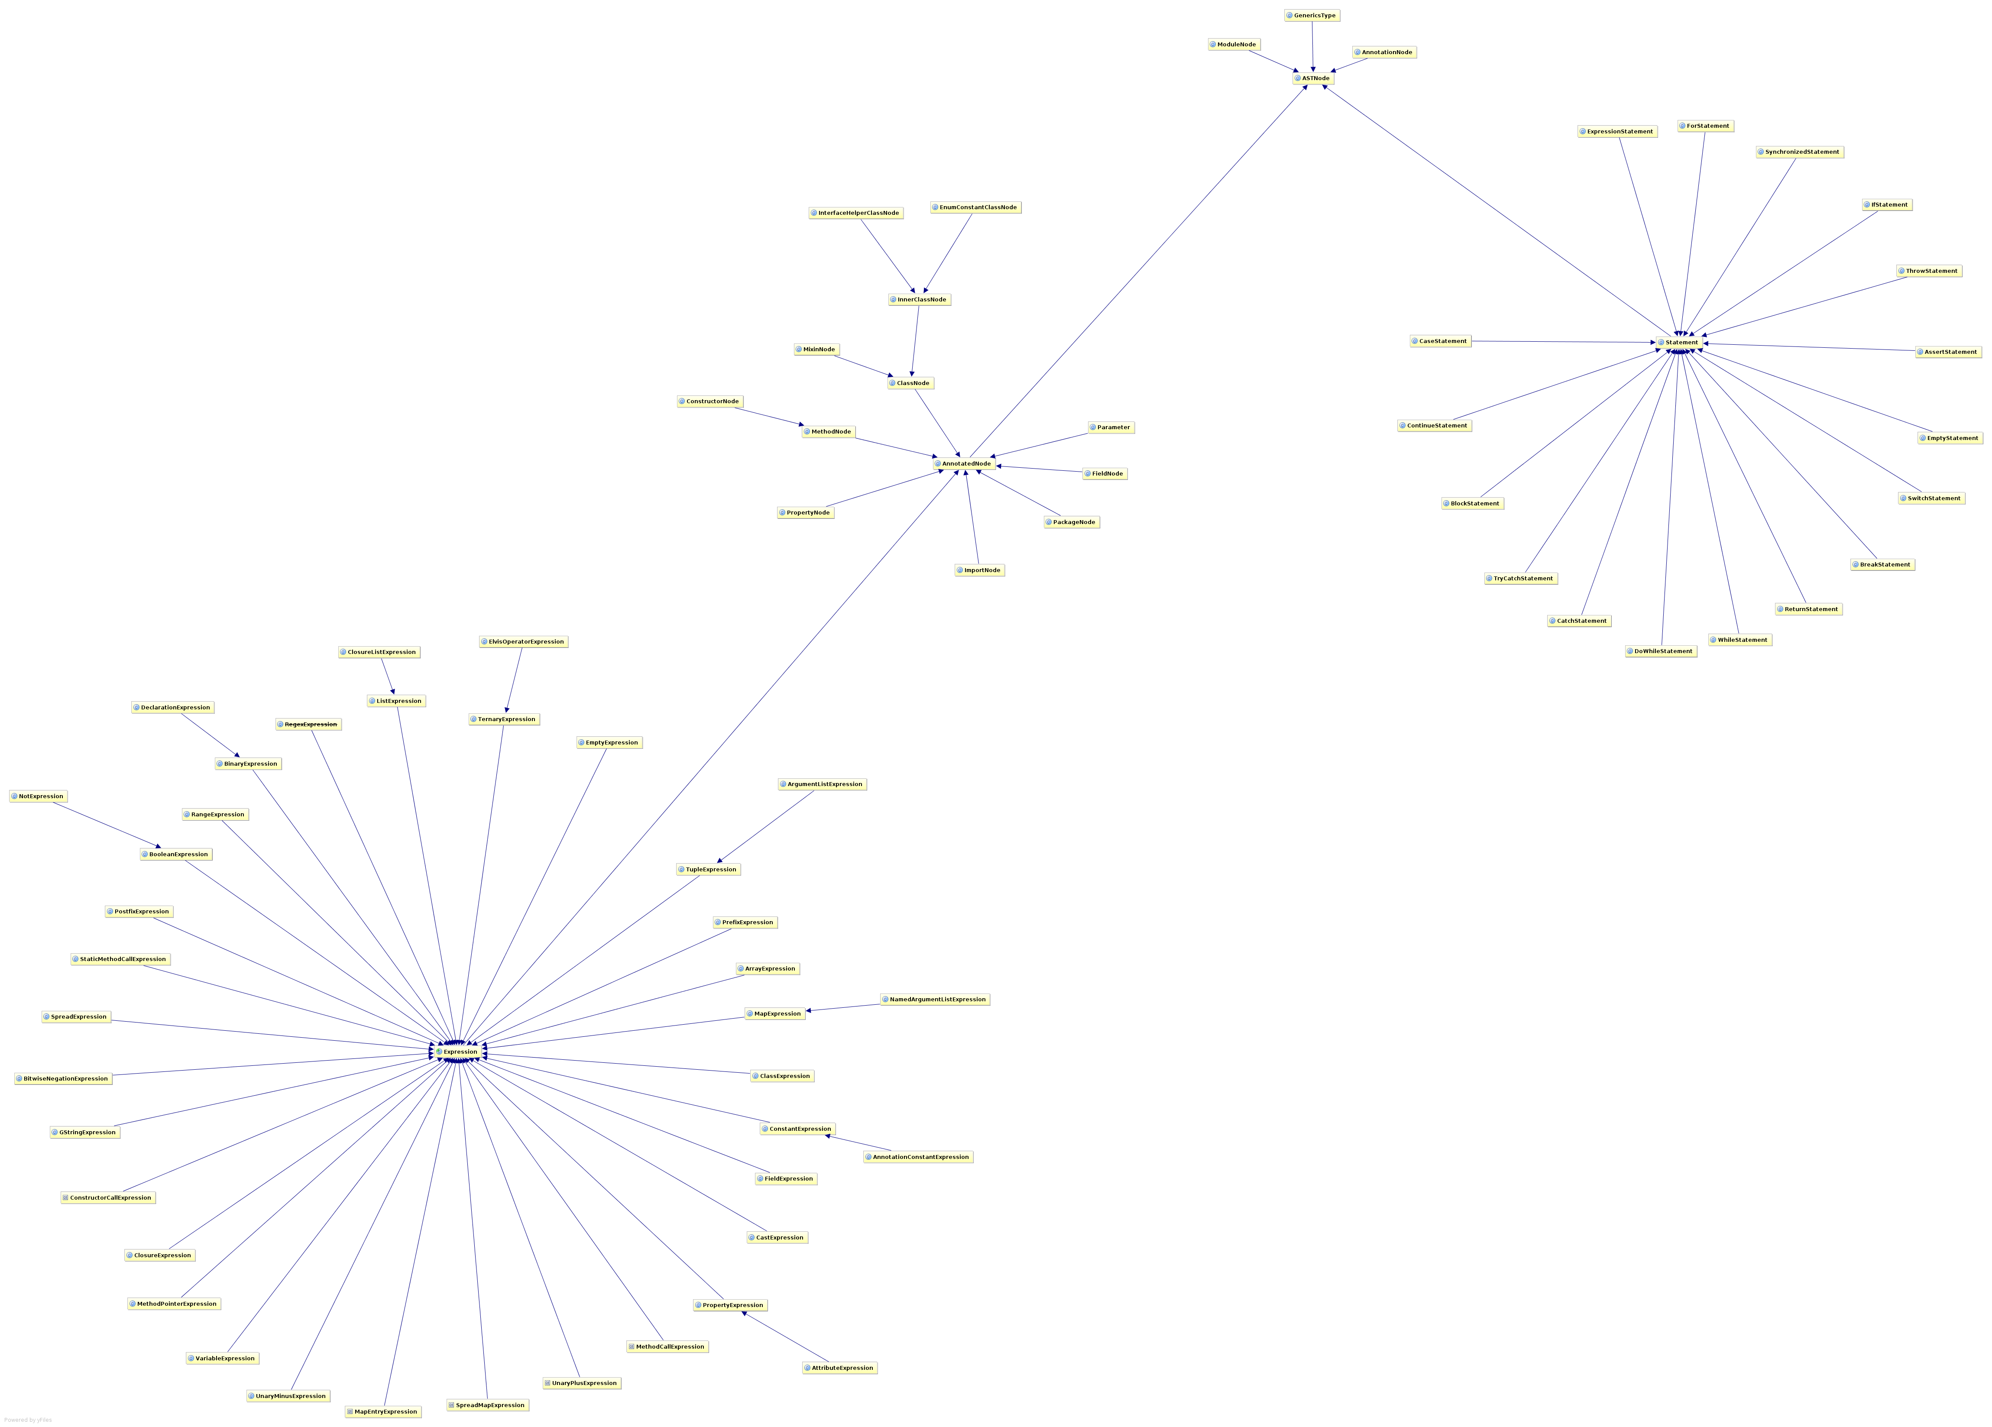

Slide 39
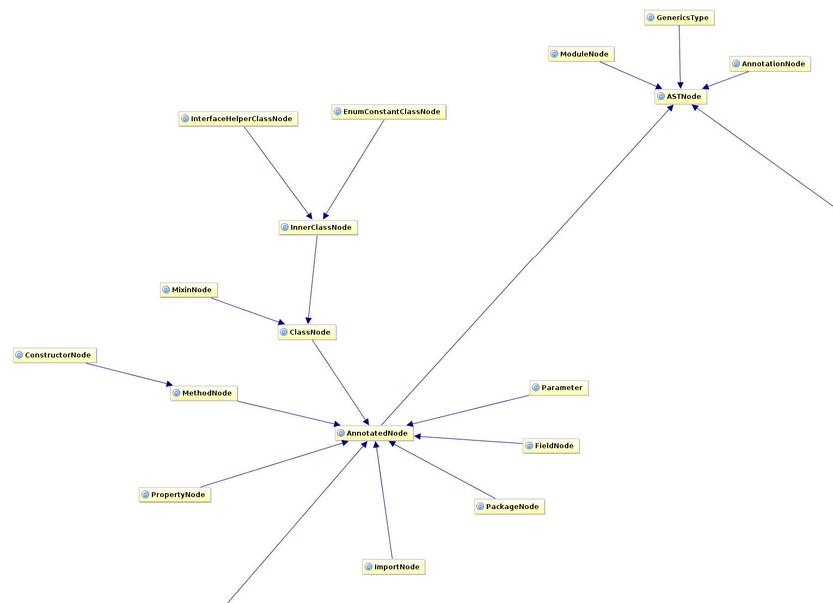

Slide 40
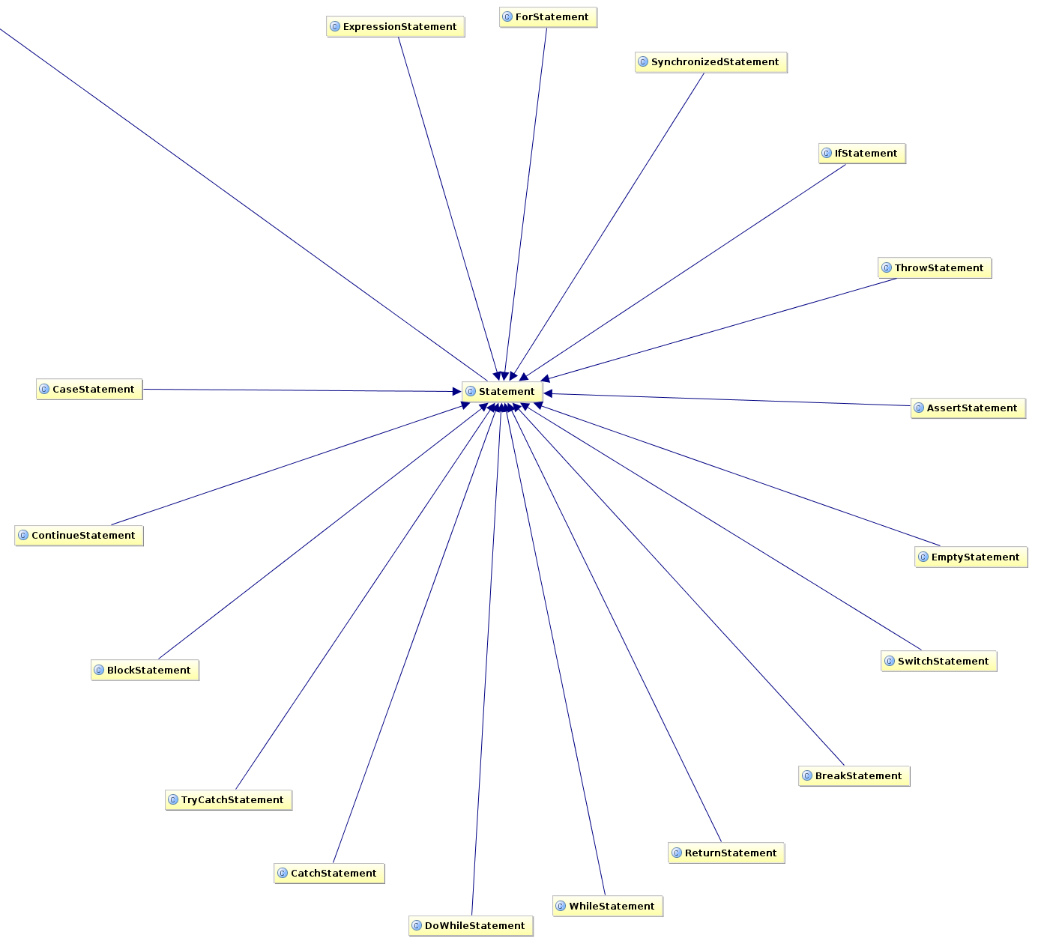

Slide 41
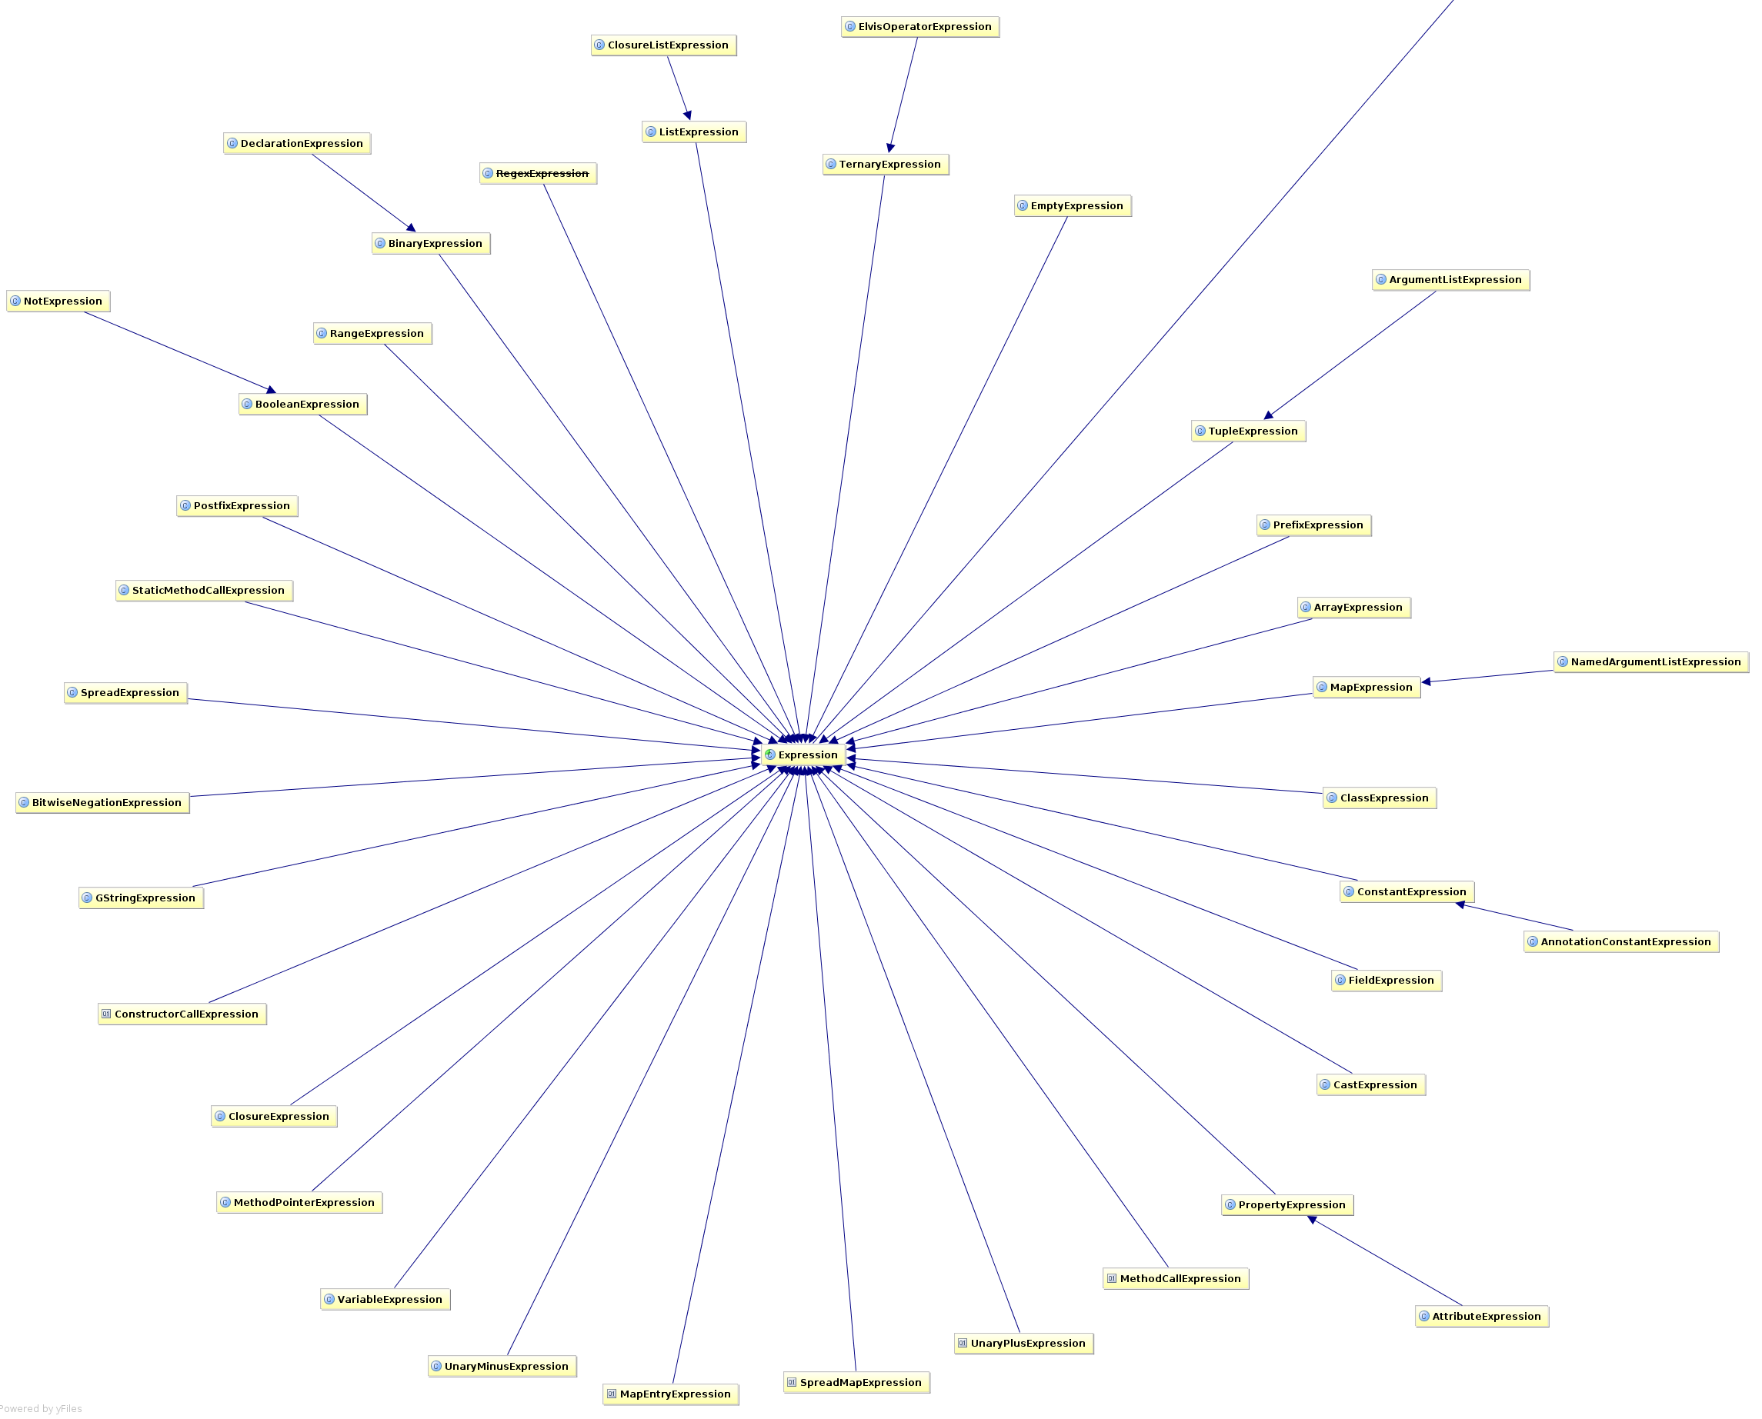

Slide 42
class Event {
@Delegate Date when
}
@GroovyASTTransformationClass("org.pkg.DelegateTransform")
public @interface Delegate {
...
}
@GroovyASTTransformation(phase = CANONICALIZATION)
public class DelegateTransform implements ASTTransformation {
public void visit(ASTNode[] nodes, SourceUnit source) {
...
}
}

Slide 43
Creating AST...

Slide 44
Creating AST... by hand
import org.codehaus.groovy.ast.*
import org.codehaus.groovy.ast.stmt.*
import org.codehaus.groovy.ast.expr.*
def ast = new ReturnStatement(
new ConstructorCallExpression(
ClassHelper.make(Date),
ArgumentListExpression.EMPTY_ARGUMENTS )
)
assert ast instanceof ReturnStatement

Slide 45
Creating AST... with a DSL
def ast = new AstBuilder().buildFromSpec {
returnStatement {
constructorCall(Date) {
argumentList {}
}
}
}
assert ast[0] instanceof ReturnStatement

Slide 46
Creating AST... with a String
def ast = new AstBuilder().buildFromString('new Date()')
assert assert ast[0] instanceof BlockStatement
assert ast[0].statements[0] instanceof ReturnStatement

Slide 47
Creating AST... from code
def ast = new AstBuilder().buildFromCode {
new Date()
}
assert ast[0].statements[0] instanceof ReturnStatement

Slide 48
Generating a main(...) Method
class MainExample {
@Main
public void greet() {
println "Hello from greet()!"
}
}
$ groovy MainExample.groovy
Hello from greet()!

Slide 49
MethodNode makeMainMethod(MethodNode source) {
def className = source.declaringClass.name
def methodName = source.name
def ast = new AstBuilder().buildFromString(
INSTRUCTION_SELECTION, false, """
package $source.declaringClass.packageName
class $source.declaringClass.nameWithoutPackage {
public static void main(String[] args) {
new $className().$methodName()
}
}
""")
ast[1].methods.find { it.name == 'main' }
}

Slide 50

Static Analysis with IDEA

Slide 51
How it Works
Compiles Java to AST
Analyzes AST Nodes
Rewrites with Strings

Slide 52
(x != null && x instanceof SomeClass)

Slide 53
(x != null && x instanceof SomeClass)
@Override
public void visitBinaryExpression(PsiBinaryExpression exp) {
if (exp.token == '==') {
if (exp.left instanceof BinaryExpression ... ) {
if (exp.right instanceof BinaryExpression ... ) {
registerError(exp, '...')
}
}
}
}

Slide 54
(x != null && x instanceof SomeClass)
@Override
public void visitBinaryExpression(PsiBinaryExpression expression) {
super.visitBinaryExpression(expression);
if (!expression.getOperationTokenType().equals(JavaTokenType.ANDAND)) {
return;
}
PsiExpression lOperand = expression.getLOperand();
PsiExpression rOperand = expression.getROperand();
if (!isBinaryExpressionAndInstanceOfCheck(lOperand, rOperand) &&
!isBinaryExpressionAndInstanceOfCheck(rOperand, lOperand)) {
return;
}
PsiBinaryExpression binaryExpression = getInnerBinaryExpression(expression);
if (!binaryExpression.getOperationTokenType().equals(JavaTokenType.NE)) {
return;
}
boolean leftIsNullCheck = isNullCheck(binaryExpression.getLOperand(), binaryExpression.getROperand());
boolean rightIsNullCheck = isNullCheck(binaryExpression.getROperand(), binaryExpression.getLOperand());
if (!leftIsNullCheck && !rightIsNullCheck) return;
PsiReferenceExpression theReference = getReferenceFromNotNullCheck(binaryExpression);
PsiExpression instanceOfOperand = getInstanceOfOperand(expression);
if (!(instanceOfOperand instanceof PsiReferenceExpression)) {
return;
}
String referenceNameA = (theReference).getReferenceName();
String referenceNameB = ((PsiReferenceExpression)instanceOfOperand).getReferenceName();
if (referenceNameA == null || referenceNameB == null) {
return;
}
if (!referenceNameA.equals(referenceNameB)) {
return;
}
registerError(expression);
}

Slide 55
Rewrite: (x instanceof SomeClass)
PsiElement andand = descriptor.getPsiElement();
if (andand instanceof PsiBinaryExpression) {
PsiExpression lhs = ((PsiBinaryExpression)andand).getLOperand();
PsiExpression rhs = ((PsiBinaryExpression)andand).getROperand();
if (lhs instanceof PsiInstanceOfExpression) {
replaceExpression((PsiBinaryExpression)andand, lhs.getText());
} else if (rhs instanceof PsiInstanceOfExpression) {
replaceExpression((PsiBinaryExpression)andand, rhs.getText());
}
}

Slide 56

Rewrite: (x instanceof SomeClass)
when (descriptor.psiElement) {
is PsiBinaryExpression @ (val lhs is PsiInstanceOfExpression, *) =>
replaceExpression(descriptor.psiElement, lhs.text)
is PsiBinaryExpression @ (*, val rhs is PsiInstanceOfExpression) =>
replaceExpression(descriptor.psiElement, rhs.text)
}
Kotlin's “Decomposer patterns”

Slide 57
How it Works
Compiles Java to AST
Analyzes AST Nodes
Rewrites with Strings

Slide 58
Static Analysis with CodeNarc

Slide 59
– Dead Code
– Defects like GString as Map Key, Duplicate Map Key
– Return path analysis (null returns)
– Type inference (and improving)
– Concurrency Problems (busy wait, etc)
– Poor Testing Practices
– Un-Groovy code
… and 255+ more rules

Slide 60
How it works
CodeNarc Rule:
Ban new java.util.Random() calls
@Override
void visitConstructorCallExpression(
ConstructorCallExpression call) {
if (AstUtil.classNodeImplementsType(call.type, Random)) {
addViolation(call, 'Using Random is insecure...')
}
super.visitConstructorCallExpression(call)
}

Slide 61
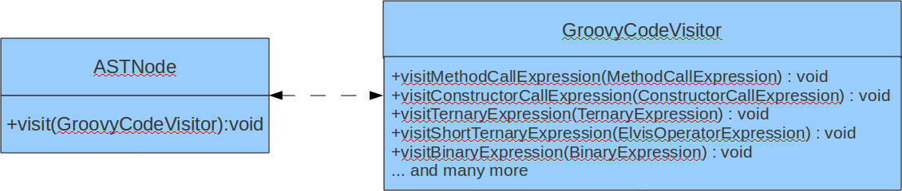
How it works

Slide 62
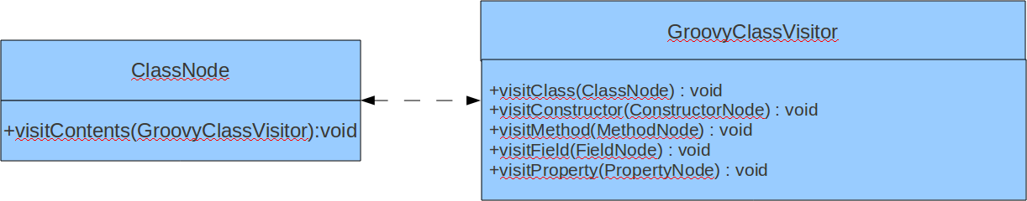
How it works

Slide 63
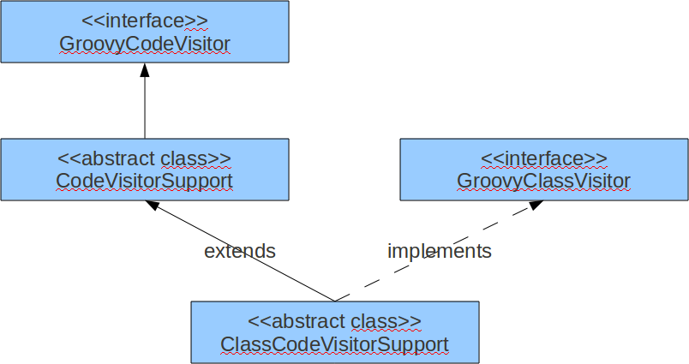
How it works

Slide 64
Tree Walking Strategies
Embedded Heterogeneous Tree Walker
External Tree Visitor
Tree Grammar
Tree Pattern Matcher

Slide 65
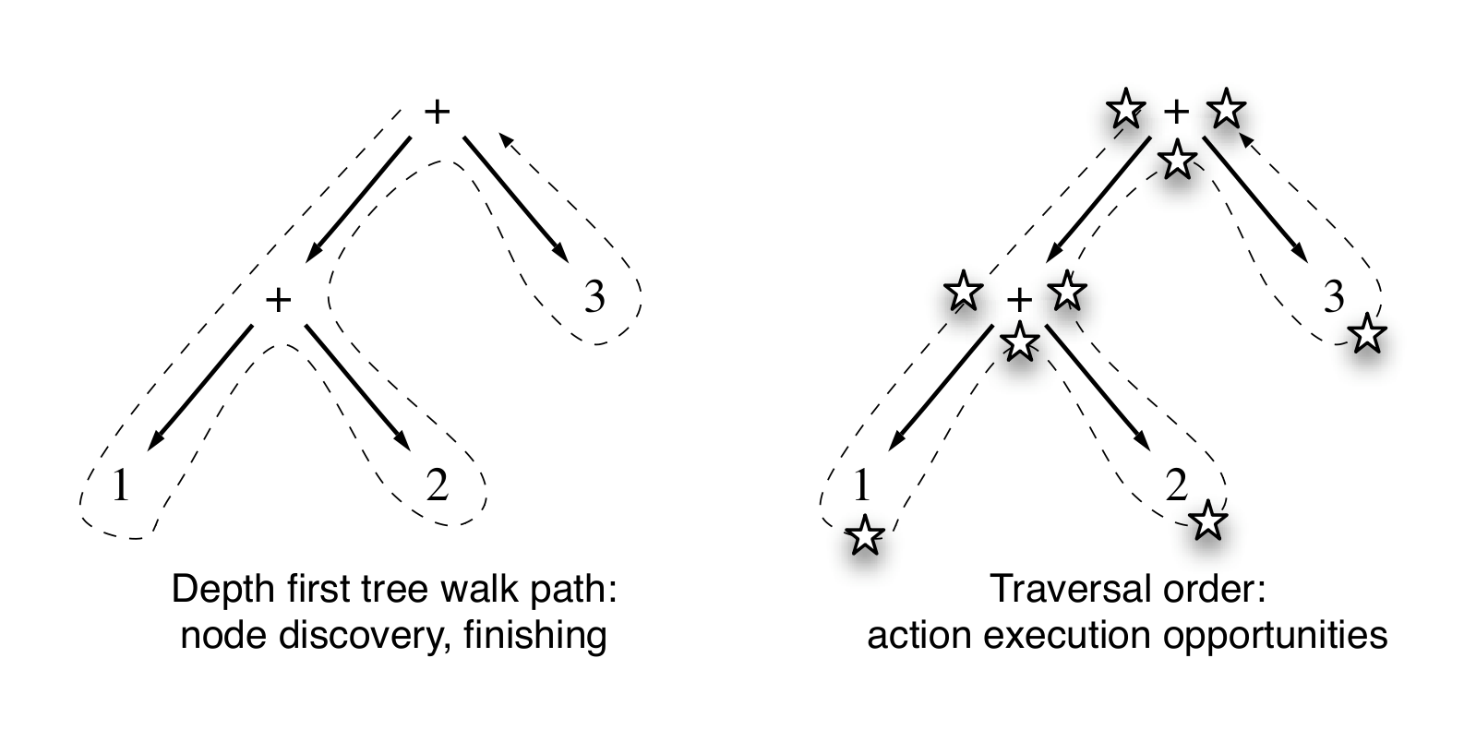
Traversal Order
From Terrence Parr's
“Language Implementation Patterns”

Slide 66
Tree Pattern Matcher – PMD
//FinallyStatement//ReturnStatement
//SynchronizedStatement/Block[1][count(*) = 0]
//AllocationExpression/ClassOrInterfaceType
[contains(@Image,'ThreadGroup')] |
//PrimarySuffix
[contains(@Image, 'getThreadGroup')]

Slide 67
How it Works
Compiles Groovy to AST
Analyzes AST Nodes
– Not well typed
– Not many tokens
– unreliable with other AST Transforms

Slide 68
Embedded Languages
def s = new ArithmeticShell()
assert 2 == s.evaluate(' 1+1 ')
assert 1.0 == s.evaluate('cos(2*PI)')
public interface GroovyCodeVisitor {
void visitBlockStatement(BlockStatement statement)
void visitForLoop(ForStatement forLoop)
void visitWhileLoop(WhileStatement loop)
void visitDoWhileLoop(DoWhileStatement loop)
...
}

Slide 69
Other Friends
Spock
GContracts

Slide 70

Java Perversions
def "Does simple math work?"() {
expect:
def s = new ArithmeticShell()
s.evaluate(input) == output
where:
input | output
'1 + 1' | 2
'cos(2*PI)' | 1.0
}

Slide 71
Global Transformations
Transform.jar
| - transforms
| - global
| - CompiledAtASTTransformation.class
| - CompiledAtASTTransformation$_visit_closure1.class
| - ...
| META-INF
| - services
| - org.codehaus.groovy.transform.ASTTransformation
| - org.codehaus.groovy.source.Extensions

Slide 72

Mirah

Slide 73
Ruby FizzBuzz
1.upto(100) do |n|
print "Fizz" if a = ((n % 3) == 0)
print "Buzz" if b = ((n % 5) == 0)
print n unless (a || b)
print "\n"
end

Slide 74
Mirah FizzBuzz
1.upto(100) do |n|
print "Fizz" if a = ((n % 3) == 0)
print "Buzz" if b = ((n % 5) == 0)
print n unless (a || b)
print "\n"
end

Slide 75
Mirah: Pure JVM Class Output
public class Fizz-buzz {
public static void main(String[] argv) {
...
do { n = __xform_tmp_4;
...
if (n % 15 == 0)
System.out.println("FizzBuzz");
else if (n % 5 == 0)
System.out.println("Buzz");
else if (n % 3 == 0)
System.out.println("Fizz");
else
System.out.println(n);
...
} while (__xform_tmp_4 <= __xform_tmp_5);
}
}

Slide 76
Mirah: .java File Output
if (((n % 15) == 0)) {
PrintStream temp$10 = System.out;
temp$10.println("FizzBuzz");
} else {
if (((n % 5) == 0)) {
PrintStream temp$11 = System.out;
temp$11.println("Buzz");
} else {
if (((n % 3) == 0)) {
PrintStream temp$12 = System.out;
temp$12.println("Fizz");
} else {
PrintStream temp$13 = System.out;
temp$13.println(n);
}
}
}

Slide 77
What it Means
– Fast
– Lightweight
– Uses JDK
– Runs on Android?
– Runs on GWT?

Slide 78
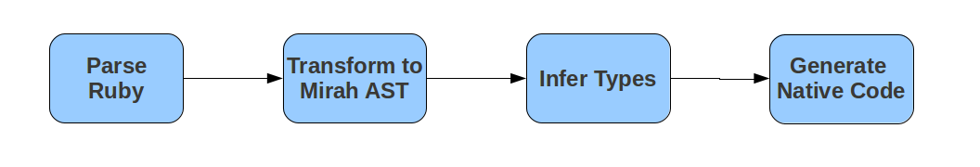
How it Works

Slide 79
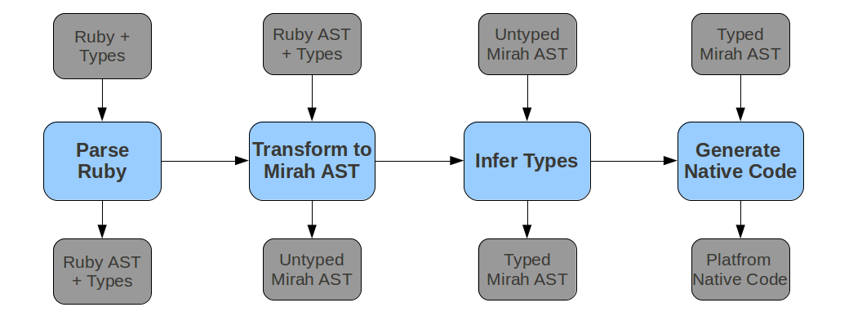
How it Works

Slide 80
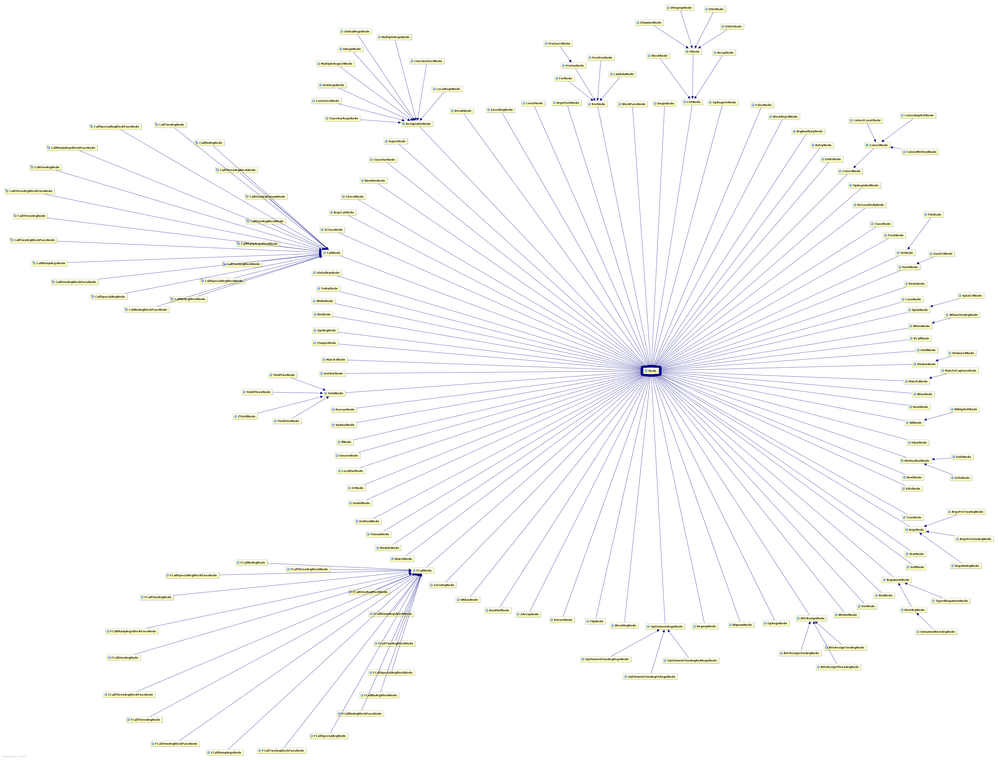

Slide 81
Mirah Macros
macro def eachChar(value, &block)
quote {
`value`.toCharArray.each do | my_char |
`block.body`
end
}
end
eachChar('Hola Greach Conference!') do | my_char |
puts my_char
end

Slide 82
Mirah Macros
class Person
make_attr :firstName, :string
end
p = Person.new
p.firstName = 'hamlet'
puts p.firstName

Slide 83
Mirah Macros
macro def make_attr(name, type)
attribute_name = name.string_value()
quote {
def `name`
@`name`
end
def `"#{attribute_name}_set"`(value:`type`)
@`name` = value
end
}
end

Slide 84
Summary
AST Transformations are Framework oriented
      Easily transform classes and fields
      Difficult to find call-sites
      Still Difficult to generate AST
Macros are more general
      Compiler handles invocation
      Easily quote ASTs into source
      Static types are a big win for transformations

Slide 85
Not Covered Here...
Homogeneous AST
      JRuby: Normalized Heterogeneous AST
      Groovy: Irregular Heterogeneous AST

Slide 86

Not Covered Here...
Homogeneous AST
      JRuby: Normalized Heterogeneous AST
      Groovy: Irregular Heterogeneous AST

Slide 87
Agenda
AST Whirlwind Tour
AST Transformations (Groovy & Java)
Static Analysis (CodeNarc & IntelliJ IDEA)
GContracts & Spock
AST Transformations (Mirah)

Slide 88
Thanks!
What to do next:
– Groovy Wiki and Mailing List is amazingly helpful
– Use your creativity and patience
– http://hamletdarcy.blogspot.com & @HamletDRC
Groovy, Grails, Griffon, and Agile Consulting
info@canoo.com or hamlet.darcy@canoo.com

