Slide 1
New Ideas for Old Code
Hamlet D'Arcy – Canoo Engineering AG
@HamletDRC http://hamletdarcy.blogspot.com

Slide 2
Agenda
Refactoring Ideas
– Safely refactoring procedural code
– Managing dependencies
Social Ideas
– Morale, energy, and politics
– Ideas for starting

Slide 3
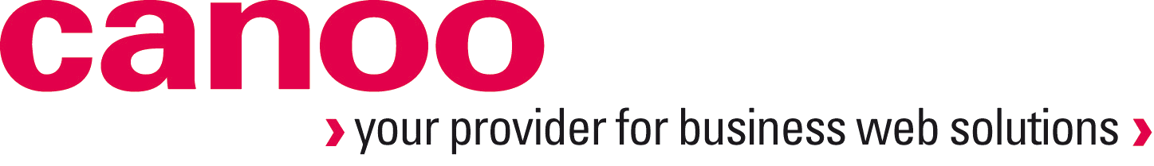




About Me
About Me
Notes:
I work for Canoo. I write and ship code every week.
I've been a committer to Groovy for almost two years, and have written a few smaller features.
I'm the most active developer for CodeNarc, a static analysis tool for Groovy.
I'm a co-author for Groovy in Action 2nd Edition, which is in MEAP now from the Manning website.
I'm a JetBrains academy member, which means we promote each other.
Lastly, I've spent years slogging on Legacy Code.

Slide 4
What is legacy code?
Notes:
Many, many definitions.
Ask: who has the longest class? Mine was 10,000 lines long. It's no longer that long though. You should know this statistic. Java NCSS can be used on a lazy Friday afternoon to find out.
Most developers can pinpoint their pain points without using imperical metrics. Metric and technical debt tools are nice for selling the idea of refactoring or convincing others of the need... but in practice everyone knows their most horrible classes.

Slide 5
Legacy Code is not...
Stable?
Testable?
Tested?
Easy to change?
Defect Free?
Notes:
"Legacy code is code we've gotten from someone else"
– Michael Feathers
LC is difficult to change.
LC is demoralizing and not fun to work with.
LC is the code you'd like to change but can't.
LC is a trap your resume may not survive.
LC lacks the proper design you would give it today
Properties of LC: Massive classes. Tangled dependencies. Low test coverage. Uses service location and direct constructor calls
“LC is code without tests” is a flippant answer.
Code w/out tests is bad code, but is it legacy?
If you were confident you could change the code w/out breaking it then you'd just do it. But you aren't. For that you need tests.
In practical terms, this means LC is code without good tests.
Good definition b/c it points to a solution.

Slide 6
Solving Legacy Code
Know where you want to go
Learn how to get there
Apply 51% Rule
Notes:
Solving it does not mean eliminating all accidental complexity
Know where you want to go and then step in that direction. You can't solve all problems. Make and adhere to priorities.
Learn how to get there – This presentation. Good books: “Working Effectively with Legacy Code”. Refactoring. Refactoring to Patterns.
51% Rule - If you know of an change you can make to improve the code base, and you're making that change 49% of the time, then your problem is getting worse. If your QA dept wants to do automated testing, they might hire an automation expert to reduce the time it take to do regression. If there is one person writing automated tests cases, and 4 writing manual test cases, what is happening to the time it takes to do regression? It is increasing with each release of the software and your problem is getting worse. To improve a problem, you must staff so that you're doing the right thing 51% of the time. Unit Test coverage isn't exactly addressed by this issue because quality is not directly correlated to test coverage. Be careful making this argument. Teams tend towards the extremes. a 49% practice wil tend towards 0 over time and a 51% will tend towards 100%. You don't need to get management to buy off on 100% improvement, just get them to sign off on 51% and let momentum do the rest.

Slide 7
Agenda
Refactoring Ideas
– Safely refactoring procedural code
– Managing dependencies
Social Ideas

Slide 8
Refactoring vs. Rengineering

Slide 9
Cover and Modify vs. Edit and Pray

Slide 10
“Whenever I do refactoring, the first step is
always the same. I need to build a solid set of tests for that section of code.”
Martin Fowler – “Refactoring”
Notes:
Why is refactoring a word you can barely mention to QA and Operations without horrified reactions? Because nobody starts with tests.
If you don't have test coverage during refactoring then you're not actually refactoring. You're just changing shit. It is OK to change things without coverage, but calling it refactoring is harmful, because if you introduce a bug then “refactoring” is blamed even though what you were doing was not refactoring.
Refactoring by Martin Fowler - I still believe this is the book to read when starting out on the path to being an engineer. Refactoring laid out a vision of good, clean code that went beyond simply working correctly. The beauty of Refactoring was that it laid out specific instructions on how to make crummy code better. And those instructions were almost mechanical in their execution... first do this, then do this, then finish.
I have a story to tell at this point that is too long for the slide. You shoulda been here!

Slide 11
Don't change code without tests
Can't write tests without changing code
Notes:
Legacy Code Dilemma - When we change code, we should have tests in place. To put tests in place, we often have to change code.
Working Effectively with Legacy Code covers this concept well

Slide 12
“I insist that you pair when you use the dependency-breaking techniques I've
described in this book.”
Michael Feathers – WELC
Notes:
The next few slides detail how you can refactor when you do not have test coverage.

Slide 13
Lean on the Tools
Notes:
Broken Windows - "If I can remove tiny pieces of duplication, I do those first because often it makes the big picture clearer." Michael Feathers
It is best to get the code into a state where there are no compile warnings.
FindBugs, PMD, CodeNarc, IDEA Inspections & Quickfixes. Sonar reports, code coverage, etc.
final local variables and final fields - this coding convention can be very revealing. Move towards these patterns for better composed methods. No more populate() methods.

Slide 14
Lean on the Compiler
Notes:
"If a tool can extract methods for you safely, you don't need tests to verify your extractions." But you shouldn't reorder statements, especially instance methods. Try making a series of changes with tools only and you'll be safe. There are a ton of changes you can make like this, including Extract Class the most important one.
"Judgement is a key programming skill, and we can get into trouble when we try to act like super-smart programmers." Feathers
Seek out refactorings that are checked by your compiler

Slide 15
Return Back, Not Out
Notes:
Once again, from Michael Feathers:
http://michaelfeathers.typepad.com/michael_feathers_blog/2010/11/return-back-not-out.html

Slide 16
void populateAddress(int addressID, Person p) {
Address a = lookupAddress(addressID);
p.setAddress(a);
}

Slide 17
void populateAddress(int addressID, Person p) {
Address a = lookupAddress(addressID);
p.setAddress(a);
}
Address getAddress(int addressID) {
return lookupAddress(addressID);
}

Slide 18
void addEvenNumbers(int bottom, int top, List target) {
for (int x = bottom; x <= top; x++) {
if (x % 2 == 0) {
target.add(x);
}
}
}

Slide 19
void addEvenNumbers(int bottom, int top, List target) {
for (int x = bottom; x <= top; x++) {
if (x % 2 == 0) {
target.add(x);
}
}
}
List<Integer> getEvenNumbers(int bottom, int top) {
ArrayList<Integer> result = new ArrayList<>();
for (int x = bottom; x <= top; x++) {
if (x % 2 == 0) {
result.add(x);
}
}
return result;
}

Slide 20
class Widget {
JPanel userPanel;
Widget() {
createUserPanel();
}
void createUserPanel() {
userPanel = new JPanel();
userPanel.add(new JLabel("First Name:"));
userPanel.add(new JTextField());
userPanel.add(new JLabel("Last Name:"));
userPanel.add(new JTextField());
}
}

Slide 21
class Widget {
final JPanel userPanel;
public Widget2() {
this.userPanel = createUserPanel();
}
JPanel createUserPanel() {
JPanel panel = new JPanel();
panel.add(new JLabel("First Name:"));
panel.add(new JTextField());
panel.add(new JLabel("Last Name:"));
panel.add(new JTextField());
return panel;
}
}

Slide 22
Return Back, Not Out
Design functions with single return values
Decompose problem into several functions
Relationships between outputs reveals new classes
Multiple Return Values?
Notes:
Whenever you are tempted to use ‘ref’ or ‘out’ in C# consider whether you can do the work by designing functions with single return values.
Sometimes we find that we can decompose the problem into several functions rather than one.
When you don’t have exceptions, error codes are often munged into the return value. Passing values back via parameters can be cleaner at times in C, but if you are working in a more modern language there really are better alternatives.
At other times we find some relationship between outputs that leads us to create a new class or struct that we can use as a single return type.
A function is supposed to do some thing for you, not some things. If a function is giving you two things, it's beyond its quota
Tuple when you want to return two values from a function? Either built in or a Pair object

Slide 23
... arrays
Object[] getEvenNumbers(int bottom, int top) {
List<Integer> elements = new ArrayList<>();
for (int x = bottom; x <= top; x++) {
if (x % 2 == 0) {
elements.add(x);
}
}
return new Object[] {elements, elements.size()};
}
Object[] x = getEvenNumbers(5, 20);
List<Integer> elements = (List<Integer>) x[0];
int count = (Integer) x[1];
Notes:
Whenever you are tempted to use ‘ref’ or ‘out’ in C# consider whether you can do the work by designing functions with single return values.
Sometimes we find that we can decompose the problem into several functions rather than one.
When you don’t have exceptions, error codes are often munged into the return value. Passing values back via parameters can be cleaner at times in C, but if you are working in a more modern language there really are better alternatives.
At other times we find some relationship between outputs that leads us to create a new class or struct that we can use as a single return type.
A function is supposed to do some thing for you, not some things. If a function is giving you two things, it's beyond its quota
Tuple when you want to return two values from a function? Either built in or a Pair object

Slide 24
... result type
ResultObj getEvenNumbers(int bottom, int top) {
List<Integer> elements = new ArrayList<>();
for (int x = bottom; x <= top; x++) {
if (x % 2 == 0) {
elements.add(x);
}
}
return new ResultObj(elements, elements.size());
}
ResultObj y = getEvenNumbers2(5, 20);
List<Integer> elements = y.elements;
int count = y.count;
Notes:
Whenever you are tempted to use ‘ref’ or ‘out’ in C# consider whether you can do the work by designing functions with single return values.
Sometimes we find that we can decompose the problem into several functions rather than one.
When you don’t have exceptions, error codes are often munged into the return value. Passing values back via parameters can be cleaner at times in C, but if you are working in a more modern language there really are better alternatives.
At other times we find some relationship between outputs that leads us to create a new class or struct that we can use as a single return type.
A function is supposed to do some thing for you, not some things. If a function is giving you two things, it's beyond its quota
Tuple when you want to return two values from a function? Either built in or a Pair object

Slide 25
... result type
class ResultObj {
private List<Integer> elements;
private int count;
public ResultObj(List<Integer> elements, int count) {
this.elements = elements;
this.count = count;
}
}
Notes:
Whenever you are tempted to use ‘ref’ or ‘out’ in C# consider whether you can do the work by designing functions with single return values.
Sometimes we find that we can decompose the problem into several functions rather than one.
When you don’t have exceptions, error codes are often munged into the return value. Passing values back via parameters can be cleaner at times in C, but if you are working in a more modern language there really are better alternatives.
At other times we find some relationship between outputs that leads us to create a new class or struct that we can use as a single return type.
A function is supposed to do some thing for you, not some things. If a function is giving you two things, it's beyond its quota
Tuple when you want to return two values from a function? Either built in or a Pair object

Slide 26
... tuples
def getEvenNumbers(int bottom, int top) {
def elements = (bottom..top).findAll {
it % 2 == 0
}
[elements, elements.size()]
}
def (elements, count) = getEvenNumbers(5, 15)
Notes:
Whenever you are tempted to use ‘ref’ or ‘out’ in C# consider whether you can do the work by designing functions with single return values.
Sometimes we find that we can decompose the problem into several functions rather than one.
When you don’t have exceptions, error codes are often munged into the return value. Passing values back via parameters can be cleaner at times in C, but if you are working in a more modern language there really are better alternatives.
At other times we find some relationship between outputs that leads us to create a new class or struct that we can use as a single return type.
A function is supposed to do some thing for you, not some things. If a function is giving you two things, it's beyond its quota
Tuple when you want to return two values from a function? Either built in or a Pair object

Slide 27
... pairs
Pair<List<Integer>, Integer> getEvenNumbers(
int bottom, int top) {
List<Integer> elements = new ArrayList<>();
for (int x = bottom; x <= top; x++) {
if (x % 2 == 0) {
elements.add(x);
}
}
return Pair.from(elements, elements.size());
}
Pair<List<Integer>, Integer> x = getEvenNumbers3(5, 20);
List<Integer> elements = x.getLeft();
Integer count = x.getRight();
Notes:
Whenever you are tempted to use ‘ref’ or ‘out’ in C# consider whether you can do the work by designing functions with single return values.
Sometimes we find that we can decompose the problem into several functions rather than one.
When you don’t have exceptions, error codes are often munged into the return value. Passing values back via parameters can be cleaner at times in C, but if you are working in a more modern language there really are better alternatives.
At other times we find some relationship between outputs that leads us to create a new class or struct that we can use as a single return type.
A function is supposed to do some thing for you, not some things. If a function is giving you two things, it's beyond its quota
Tuple when you want to return two values from a function? Either built in or a Pair object

Slide 28
... pairs
class Pair<T, U> {
final T left;
final U right;
Pair(T left, U right) {
this.left = left;
this.right = right;
}
T getLeft() { return left; }
U getRight() { return right; }
static <T, U> Pair<T, U> from(T left, U right) {
return new Pair<>(left, right);
}
}
Notes:
Whenever you are tempted to use ‘ref’ or ‘out’ in C# consider whether you can do the work by designing functions with single return values.
Sometimes we find that we can decompose the problem into several functions rather than one.
When you don’t have exceptions, error codes are often munged into the return value. Passing values back via parameters can be cleaner at times in C, but if you are working in a more modern language there really are better alternatives.
At other times we find some relationship between outputs that leads us to create a new class or struct that we can use as a single return type.
A function is supposed to do some thing for you, not some things. If a function is giving you two things, it's beyond its quota
Tuple when you want to return two values from a function? Either built in or a Pair object

Slide 29
“Java isn't Lisp.”
– Mark Reinhold
discussing java.util.Pair

Slide 30
You don't need BPM

Slide 31
You don't need BPM
(big procedural methods)

Slide 32
public void save() {
runValidationQuery();
performPartialSave();
runValidationQuery2();
finishSave();
}
Notes:
“There is something mesmerizing about large chunks of procedural code: They seem to beg for more"
-- Michael Feathers
"one pervasive problem in legacy code bases is that there often aren't any layers of abstraction; the most important code in the system often sites intermingled with low-level API calls... Code is harder to understand when it is littered with wide interfaces containing dozens of unused methods. When you create narrow abstractions targeted toward what you need, your code communciates better and you are left with a better seam."
-- Michael Feathers
Command/Query seperation A method should be a command or a query, but not both. A command is a method that can modify the state of the object but that doesn't return a value. A query is a method that returns a value but that does not modify the object.
-- Michael Feathers

Slide 33
Extract Method Object
MyObjectSaver saver = new MyObjectSaver();
public void save() {
saver.save();
}
Notes:
Break Out Method Object - Ward Cunningham - Move big method to it's own class.
Allows you to test the container of the save() method by mocking out the MyObjectSaver. In general, pass more on the constructor and less on the save() method (maybe one object at most, the entity being saved). This will aide later in creating narrow interfaces. This is about bringing the class with save() method under test.
The conversion process can be completely automated by IDEA, and mostly by Eclipse. A good example of Leaning on the Tools and Leaning on the compiler.

Slide 34
Extract Class
public void save() {
new QueryValidator1().apply();
new PartialSaver().apply();
new QueryValidator2().appy();
new FinishSaver().apply();
}
Notes:
This helps you bring each step under test, but it does not help you test the enclosing class.
Is this a great domain model, no. Is it better than alternative? Quite likely. Are these meaningful abstractions? Not really. How do we fix that? This does increase conceptual complexity. Programmers have developed a sense of how things work correctly that you are breaking.
The conversion process can be completely automated by IDEA, and mostly by Eclipse. A good example of Leaning on the Tools and Leaning on the compiler.

Slide 35
Move to Meaningful Abstraction
final List<Step> steps = Arrays.asList(
new QueryValidator1(),
new PartialSaver(),
new QueryValidator2(),
new FinishSaver()
);
public void save() {
for (Step step : steps) {
step.apply();
}
}
Notes:
Grouping things together because they happen at the same time is a weak relationship. It's not a very general way to think about a system. The next step after Extract Class from the last slide could be this example, which is possibly more meaningful.
Each step (Saver) can implement a narrow interface.This can be meaningful. Then the save methods can be a general composite. As more save methods follow this general composite you have another meaningful abstraction. Now you've seperated how an object is saved from what it does.

Slide 36
“...some of the attributes that support good testability also make for poor readability.”
– Walter Harley
Notes:
"...some of the attributes that support good testability also make for poor readability. For example, loosely coupled objects make it easy to supply mocks for testing; but they also make it hard to see what's going on in the production code."

Slide 37
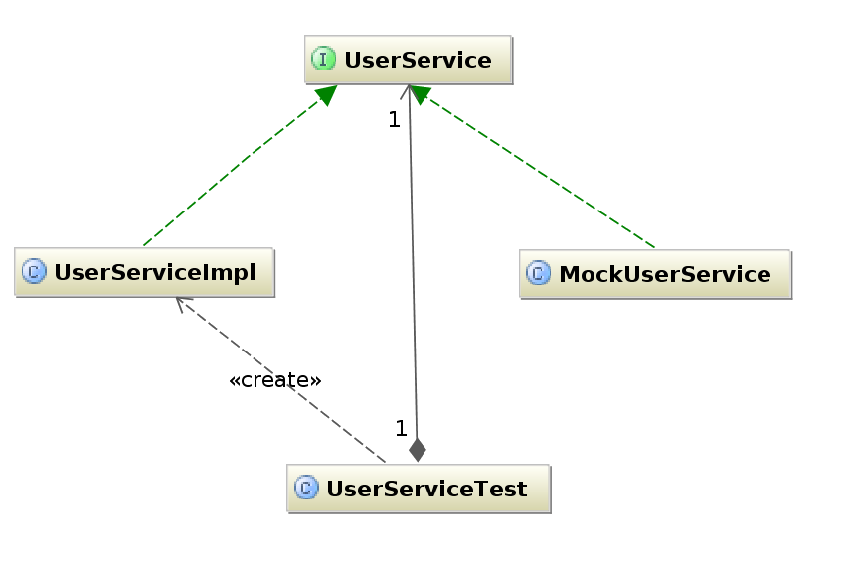
Beware Meaningless Abstractions
Notes:
What can you do about convulated designs that originate to aid in testing? The answer is all about abstractions.
Are you creating meaningful or meaningless abstractions
A useful abstraction is not always a meaningul abstraction. The “Interface-Impl” pattern is useful but meaningless.
Some tools let you subclass/proxy classes (Mockito, EasyMock, etc) – But this is no long-term solution to the interface/impl problem. What does it really add? A few less classes? Over time this is not the right choice.
Readability suffers in Java because of our culture of naming things, and we write our abstractions based on name instead of type.
Readability suffers in Java because we have become supremely efficient and versed at producing meaningless abstractions.
Long term readability depends on finding type based abstractions, rather than name based ones, and then being diligent and intentional about coding to those abstractions.
Use appropriate data types, even at the micro level. Strings and ints are not Files and Enums!

Slide 38
Agenda
Refactoring Ideas
– Safely refactoring procedural code
– Managing dependencies
Social Ideas

Slide 39
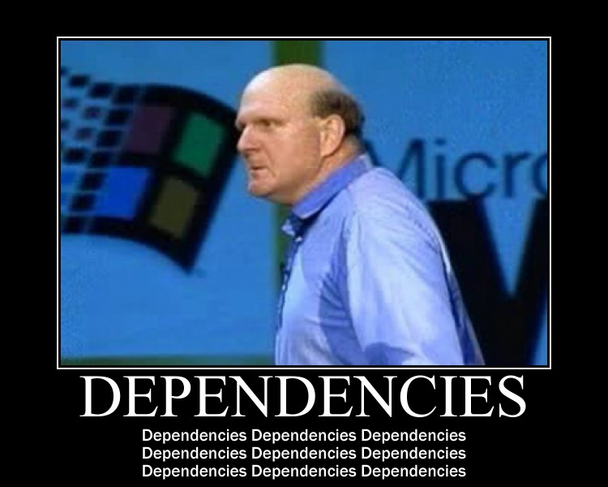
Notes:
This is the point in the presentation where I jump around like a crazed monkey and screen “dependencies” over and over and over...

Slide 40
private void createWheel(){ ... }
public void drive() { ... }
private void makePedal() { ... }
public static Car build(DataSource ds) { ... }
private void buildBody() { ... }
Notes:
Consider this example, which is fairly typical Java code.
What methods depend on one another? How cohesive is this class? It is difficult to tell.

Slide 41
private static Wheel createWheel() { ... }
private static Pedal createPedal() { ... }
private static Body createBody() { ... }
private static Car build(Wheel w, Pedal p, Body b) {...}
public static Car build(DataSource ds) { ... }
public void drive() { ... }
Notes:
In this example, all private methods are static. It is easy to see what each method depends on, and it is easier to see that we should extract a CarBuilder object.

Slide 42
Use static (private) methods...
Declare dependencies in their type signatures
Can be moved to a new class in one keystroke
Static method declare; insteance methods hide
Notes:
static methods declare their direct dependencies in their type signature. This is good.
static methods can be moved to a new class with one keystroke. This is good.
static methods declare, instance method hide.
Finding hidden classes in your objects: If you prefer private static methods, then you can simply look at the names and type signatures on the class. The potential class extractions become much easier. It helpe to have a naming convention and type ordering convention.
Making an instance method static is now an automated refactoring in IntelliJ IDEA. Even in Eclipse, it is a refactoring where you can lean on the compiler.
Also prefer methods that are true functions – they take input parameters and return output as return values (instead of reading instance fields and writing to instance fields). Functional functions make caching/optimization/benchmarks trivial.

Slide 43
More dependencies...
Use Inversion of Control...
Pass only what an object needs
Don't be too specific
Notes:
Inversion of Control is your friend
Break dependencies by passing only what an object needs, not a wrapper with a getter. In the extreme, this works against using the appropriate type. For instance, if a method is interested in the size of a file, then have the method take a File object, not an int representing the file size. Or not. Use as appropriate.
Strive for system that requires Stubs to be passed, not mocks. Indirect input OK, indirect output (side effect) needs to be limited to certain areas.

Slide 44
boolean validateAddress(int personID) { ... }
boolean validateAddress(Person p) { ... }
boolean validateAddress(String postCode) { ... }
boolean validate(Address a) { ... }
Notes:
The first method obviously is mixing command and query code.
The second method parameter is too broad (unless there is something unique about the address of a person as opposed to the address of a company).
The third method is too specific. A String is not an address.
The fourth one is just right. In fact, it can just be called “validate”, the other details are part of the type signature.
Use the most appropriate type, it helps you build type based abstractions instead of named based ones. These type-based abstractions are more meaningful than name based abstractions.

Slide 45
Use Dependency Injection
Introduce constructor parameters
Snip dependency tree with an ApplicationContext Move globals to Spring with factory-method beans
Notes:
Your object graph is usually a tree. Chose point to start DI and just run with it. Somehow reward people to do this. Pick a branch and say "Everything below branch x is DI, everything above it is Service Location".
1.Extract Field on heavyweight local variables in class, instantiating them in the constructor.
2.Extract parameter in constructor
3.When constructor parameters become unwieldy, introduce DI container
4.Move globals to Spring with factory-method beans
Step 2 : Over time constructor parameter lists will become huge as large classes have their dependencies exposed list this. This is symptom of problem, not problem itself. As part of the feature work, working from the bottom, strive to place an application context as high up the dependency tree as you can, and snip those dependencies.

Slide 46
Use Dependency Injection
Replace reflection with Spring
Apply to interfaces with many subclasses
Beware writing an ApplicationContext for unit tests
Notes:
Stake out areas that have natural entry points. Is there an interface with 40 subclasses, all which are instantiated using reflection? Look for reflection and insert Spring here. I don't mind seeing class instantiation through reflection because it usually means that I can easily convert it to use Spring.
Spring configuration for unit test a la UnitTestInitializer - Not a good idea in the long term.

Slide 47

“I write unit tests for one reason: so my coworkers don't **** up my code.”
– David Angry
Notes:
Testing supposedly makes things easier to change
JUnit tests often make things harder to change
Is your goal to make future changes easier, verify your own changes, or stop backwards regression?
Stopping backwards regression is an underused feature of unit tests. If you know that something is true now, and needs to be true foever in the future, regardless of any refactorings, then be sure to write a unit test for it. Think enviornmental concerns more than objects and code... (see next slide)

Slide 48
Use Junit, ASM, and BCEL to avoid introducing...
NoSuchMethodExceptions
ClassNotFoundExceptions
Dynamic class loading problems
Reflection problems
Notes:
What keeps breaking? Is it the same weird edge case? Can you write a really unique unit test for it? Can you test the package and class name of every class loaded through reflection? Can you use ASM/BCEL to make sure dependencies don't change? Did this with InvocationAnalyzer.
Using reflection? Write a unit test to make sure you don't get tripped up.

Slide 49
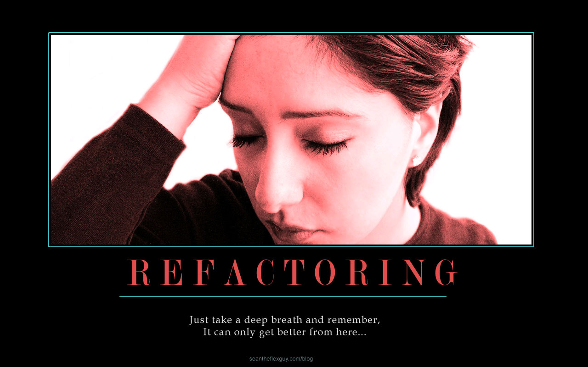

Slide 50
Next Steps... Scratch Refactoring
Set a timer
Tag your code
Refactor without tests
Step back and analyze
Is it better? If not, revert
Notes:
The best technique for learning about code is refactoring... Scratch refactoring is a good way to convince yourself that you understand the most important things about the code, and that, in itself, can make the work go easier.
git or IDEA Local History greatly helps with experimentation and rollback.
Experiment: When your result is not an improvement, then just delete the changes.
Be ruthless: Don't hold on to something because it took you a long time to write.

Slide 51
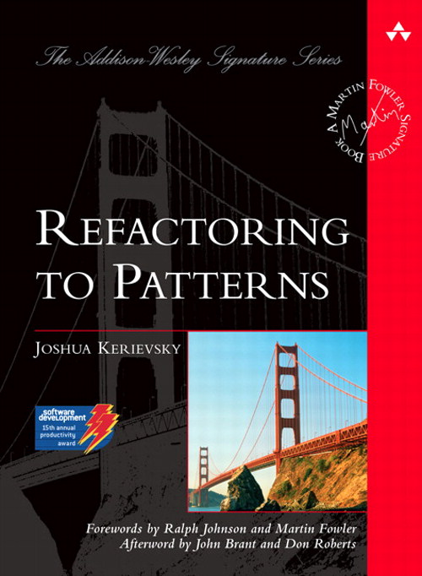
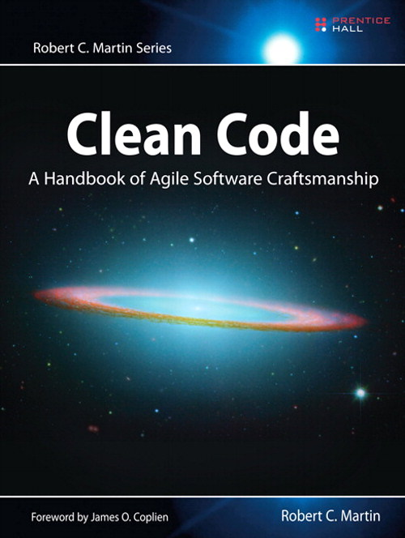
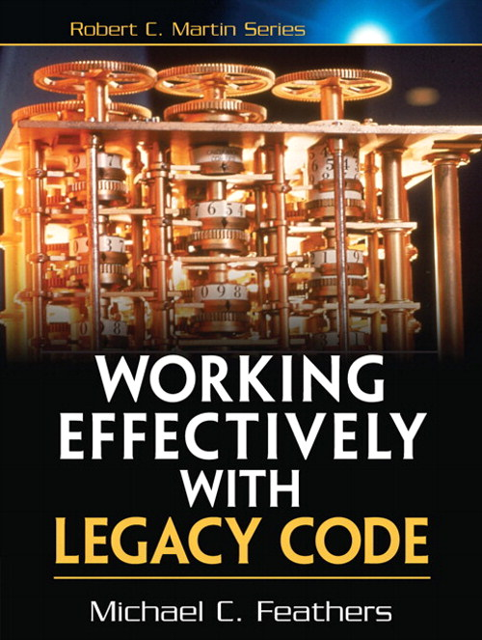
Next Steps... Refactoring Book Club
Notes:
A work-based book club is a good place to start for learning more about refactoring. Of these books, I recommend Refactoring to Patterns for the book club the most. The chapters are a good length, and participants can divide up the sections of the book to review.
Clean Code is a good book but a little but harder to fit into a book club. It produces good discussion, but the tips are short sometimes. Moderate the book club to make sure you move through the content quickly or the book club will take too long.
WELC – A great book with great content, but is longer and dryer than the other books. This book might be better read alone, or simply discussed free-form.

Slide 52
Agenda
Refactoring Ideas
Social Ideas
-- you problems
-- we problems
Notes:
I separate the social & cultural problems of legacy code into two categories: you and we problems.
You problems affect you and require a personal solution
We problems affect the team and require team solutions
This seems like good advice: “Should you find yourself in a chronically leaking boat, energy devoted to changing vessels is likely to be more productive than energy devoted to patching leaks.” -- Warren Buffet
But you can't just quit every job that presents problems.

Slide 53
"I'm Burned out and Depressed"

Slide 54
God grant me serenity to accept the code I cannot change, courage to change the code I can, and wisdom to know the difference.
– Erik Naggum
Notes:
Applying yourself to every problem will frustrate and burn you out.
Find you what code needs to change and what code to leave well enough alone.
This presentation will hopefully answer some of these questions for you.

Slide 55
“My co-workers are idiots”

Slide 56
Term | IQ Range
Moron | 51-70
Imbecile | 26-50
Idiot | 0-25
The problem is not intelligence
The problem is broken reward structures
Notes:
This is the medical classification* of idiot, imbecile, and moron. I assure you, none of your co-workers are any of these.
The real problem is almost always broken reward structures and a misunderstanding of what motivates your co-workers. Assume positive intent. Examine how people get rewarded to understand their actions. Then work to change incentive and reward plans to promote positive activity.
* These were Psychological categories that have been retired. At one point these were actual medical terms.

Slide 57
“I hate my job”

Slide 58
Do something uselessly cool outside work
Experiment in the test tree (Groovy?)
Find a way to make it fun
Notes:
You need to find a way to fight resignation and lethargy.
Morale ebbs and flows. Some months are better than others. Do something radically different outside work. TDD outside work to get in flow. Find way to bring it back. Some good outlets: graduate school, user groups, hackergartens
Design By Resume - Using Groovy in order to design by resume. Is that always a bad thing? "Reversing rot is not easy, and it's not quick.... take work, time, endurance, and care". How do you hire great people into a legacy code shop? How do you keep good people? Groovy in a job description is exciting.
Also, if you really don't like it then quit. It's OK to move on and find a new job that is more rewarding.

Slide 59

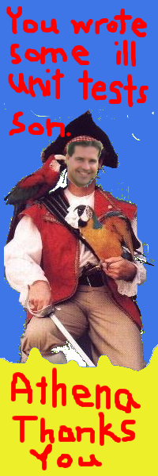
Notes:
Can you promote testability? We had a 100% Club and “Shanghai'd to Excellence” promotion.
“Shanghai'd to Excellence” gave a reward to the person that checked in the 1000th unit test. As a reward I made a custom bookmark. It was silly but fun and everybody remembers it.
A build trophy is shameful and negative, so pick something positive. Make it public. This isn't about creating change as it is about creating a shared project mythology. Changing legacy code is a long slog. Manufactured events provide events of shared experience. Much like a family vacation... it can suck for 7 days straight, but one drunken bonfire makes the trip memorable for the next 40 years.

Slide 60
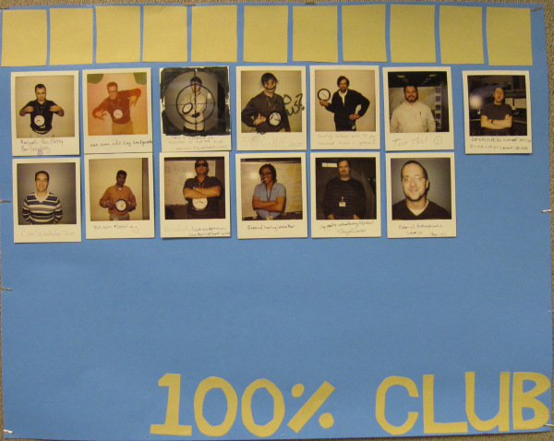
Notes:
The 100% Club was a way to promote people experimenting with 100% test coverage. When you checked in 100% coverage on a class then you got your picture on the board. After 8 members we had a pizza party.
100% is too high a target for everything, but it proves to people that it can be done, and it helps people learn that writing tests isn't always that hard.

Slide 61
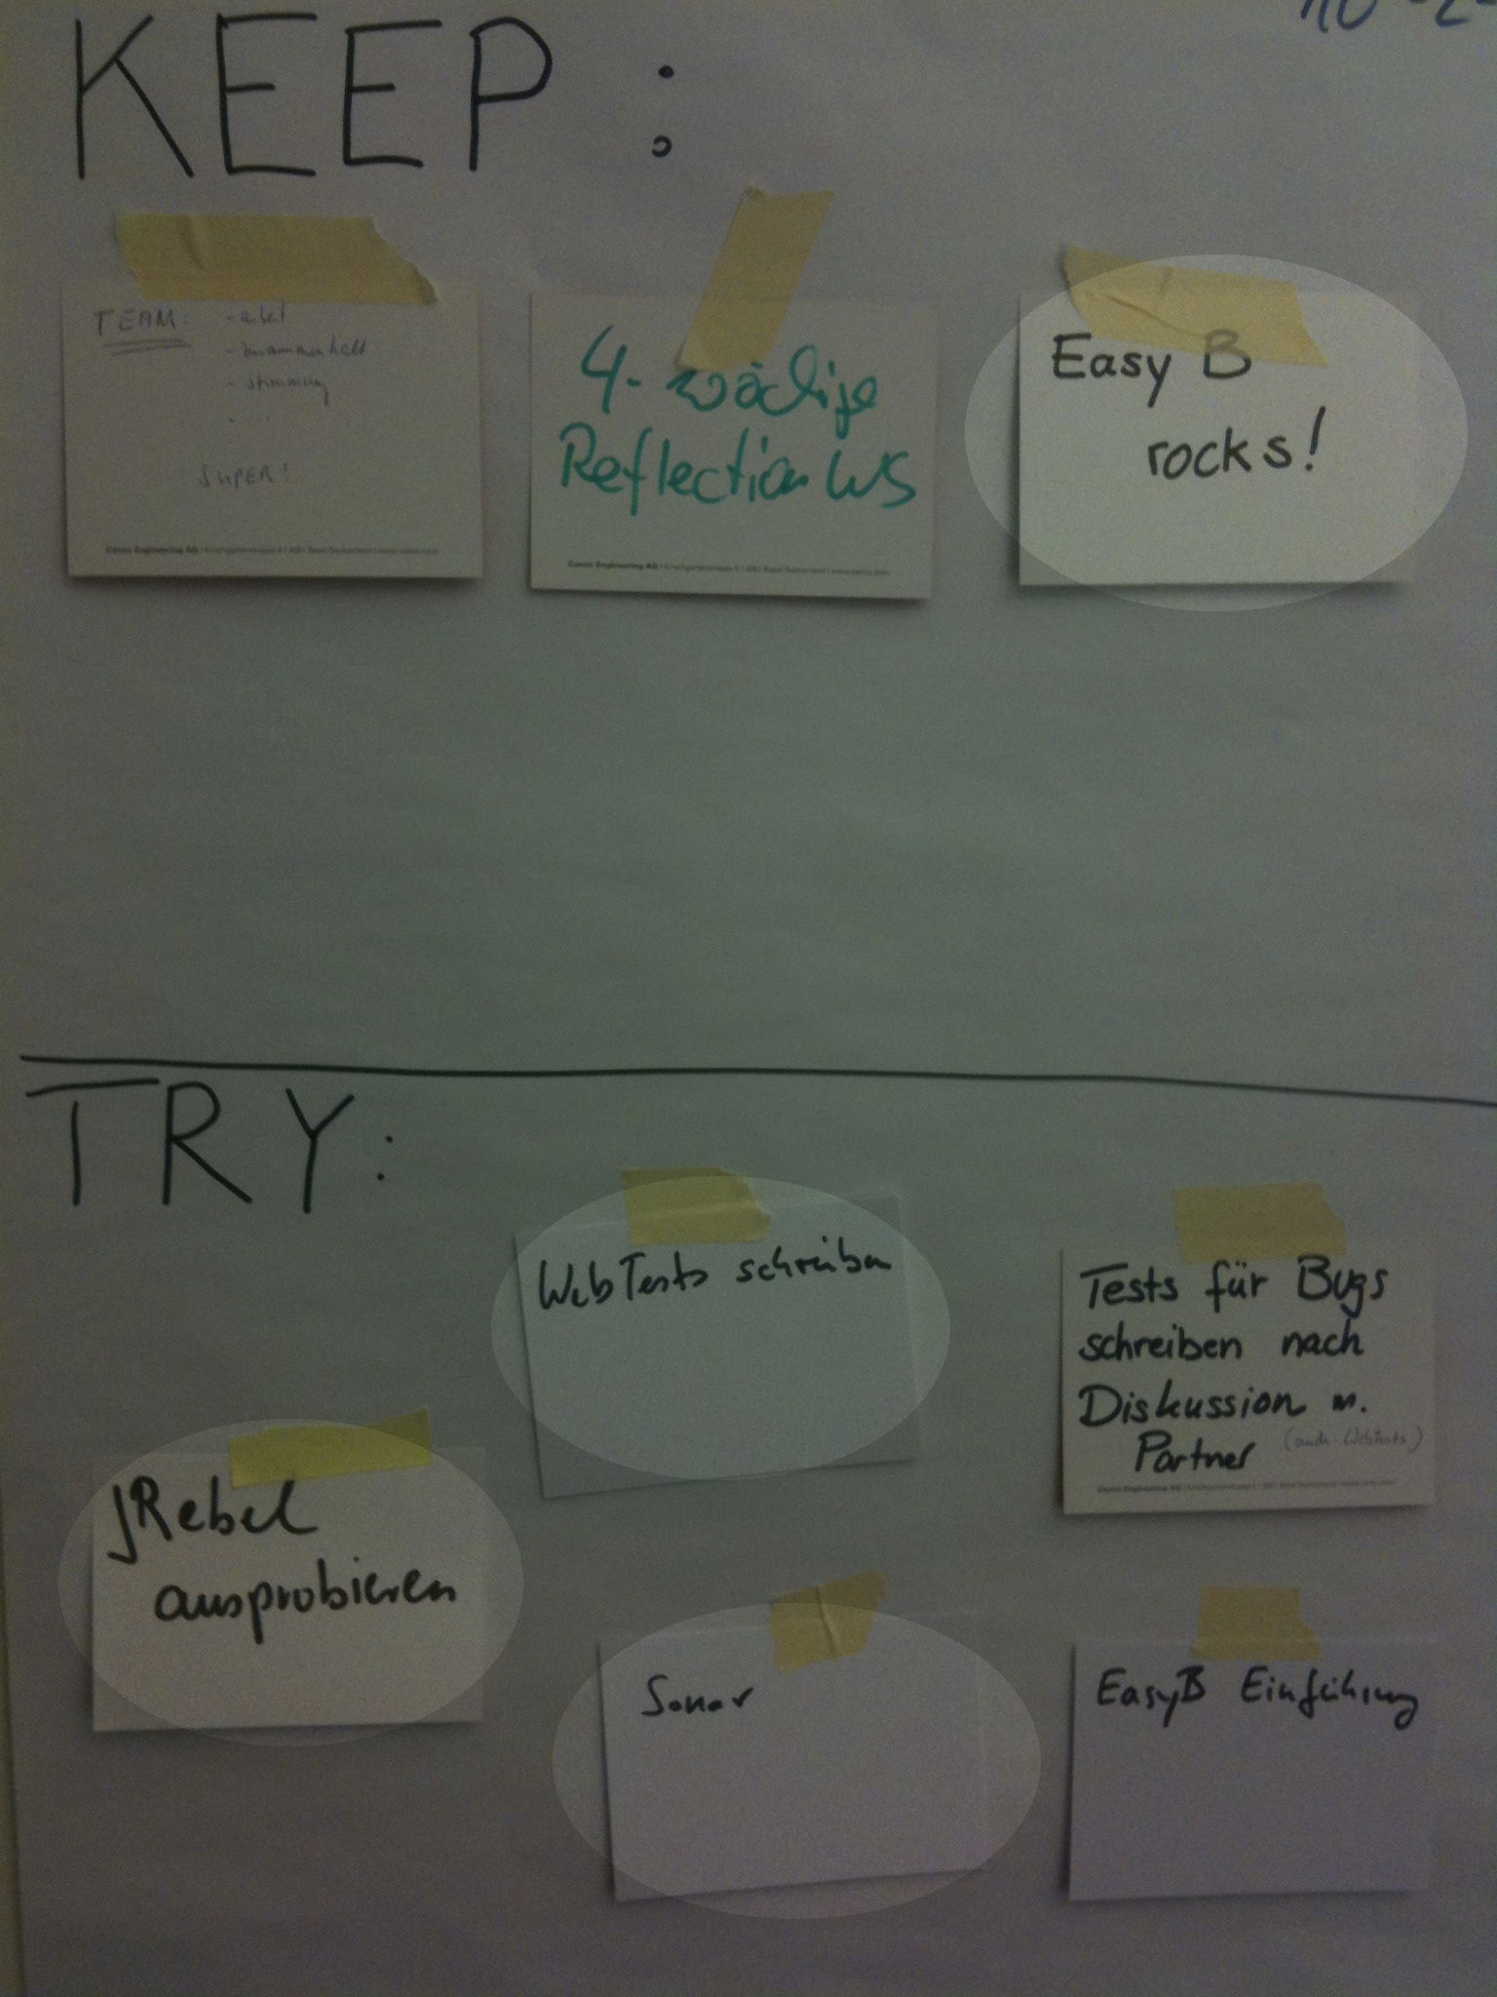
Notes:
This is a picture from a Canoo retrospective from our “Legacy Code Refactoring Team”. You can see some more ideas to add fun, energy, and better technology to your legacy code team:
* Hold retrospectives. This shows that you are committed to talking about and fixing the problems, even if you don't have enough resources to make substantial changes. Make the retros as small as possible (developers only) to start. Only when you get good at retrospectives should you try to incorporate the larger team/department.
* Try crazy ideas in test tree (not production code). Here we see easyb and WebTest being used
* Use and prototype new tools, such as Jrebel
* The build is an excellent place to experiment, here the team is hooking up Sonar to the build. Gradle is also a popular theme.
Just because you're stuck with legacy production code does not mean you have to have legacy code in the test and build. Time to upgrade off of Junit and Ant!

Slide 62
“I can't do it alone”

Slide 63
You can't do it alone
Requires large committment
(or no committment at all)
Beware cross-team dependencies
Notes:
Contractors are your friend. You can you tell contractors what the expectation is for code coverage and then hold them to it. They are much more likely to do it than a full-time employee. It looks good on resumes and they don't get in trouble when they bend rules.
If your code has cross team dependencies then you can't make a decision for that other team. Big monolithic projects are deadly because there is no way to make a local decision. All decisions affect all teams.
Getting classes into test harnesses requires a committment. Who is committed? You, managers, team mates? Everyone? Many in the process improvement community feel that effective change can only come from the top down.
Small refactorings while pair programming are a good way to spread the idea that this is possible. But beware pairing in a physical environment where pairing is uncomfortable or cramped.

Slide 64
“We don't know how to do this”

Slide 65
Try daily refactorings
Speaker lunch-and-learns
Share-a-canooie
Coding Dojos
Notes:
I learned about “Daily Refactorings” from Geepaw Hill. (http://anarchycreek.com/). Include 15 minutes of refactoring every day from every team member. Talk about it in the standup as part of your process. This makes refactoring part of your process and starts the discussion for future refactorings and eliminates fear. "Breaking down a big class into pieces can be pretty involved work unless you do it a couple of times a week. When you do, it becomes routine. You get better at figuring out what can break and what can't, and it is much easier to do." -- Michael Feathers
Most speakers will present at your company for free or a minimal charge. Watch the User Group schedule and conference schedule in your area and invite a speaker that travels to your town. Canoo is hosting 2 days of Git training with Matthew McCollough this way. He is coming to Jax.de and I kindly asked him to visit Canoo for training, which he agreed to.
Canoo offers “Share-a-Canooie”. We'll come to your project for free, for half a day, and pair program with you. We think we can deliver value in 1/2 a day and there is really no charge. If you want to prototype something or try a new technology, then talk to us and we'll help you out.

Slide 66
“We need a big rewrite”

Slide 67
Change is either incremental or excremental
Prefer staffing for 51% of incremental changes
Consider a refactoring team
Notes:
If you're considering a big rewrite then please, please, please read “The Big Rewrite” by Chad Fowler. We'll hopefully talk you out of it. http://chadfowler.com/2006/12/27/the-big-rewrite
Rewrites/ports are chronically underestimated, hard to manage, and incredibly stressful (in my experience).
Refactoring Teams
Canoo staffs a refactoring team for a major bank. There are advantages and disadvantages to a refactoring team, but don't rule out the idea of a refactoring team. An idea like this is hard to judge outside of the specific contraints in which it is implemented. That said, our team has been successful. It is a political environment and the feature team simply cannot take the time to refactor the old code before writing features, so the refactor team works ahead of the feature team to make sure the refactorings are finished before the feature is finished. Key to success is that the two team must work together and communicate, and the feature team must produce less technical debt than they have in the past.
Good idea? Bad idea? If you have an opinion then I'd love to hear it @hamletdrc or hamlet.darcy@canoo.com

Slide 68
Refactoring Team Case Study
Huge enterprise
Successful, 5 year old project
Phase 1: Architecture Re-engineering
Phase 2: Component Refactoring
20% of project budget
Agile prioritization
Highly skilled, external team on-site part-time
Notes:
If you're considering a big rewrite then please, please, please read “The Big Rewrite” by Chad Fowler. We'll hopefully talk you out of it. http://chadfowler.com/2006/12/27/the-big-rewrite
Rewrites/ports are chronically underestimated, hard to manage, and incredibly stressful (in my experience).
Refactoring Teams
Canoo staffs a refactoring team for a major bank. There are advantages and disadvantages to a refactoring team, but don't rule out the idea of a refactoring team. An idea like this is hard to judge outside of the specific contraints in which it is implemented. That said, our team has been successful. It is a political environment and the feature team simply cannot take the time to refactor the old code before writing features, so the refactor team works ahead of the feature team to make sure the refactorings are finished before the feature is finished. Key to success is that the two team must work together and communicate, and the feature team must produce less technical debt than they have in the past.
Good idea? Bad idea? If you have an opinion then I'd love to hear it @hamletdrc or hamlet.darcy@canoo.com

Slide 69
“We can't get traction”

Slide 70
TDD for defects?
Code coverage minimums?
New team?
Notes:
Writing defect fixes using TDD is not a bad way to start. The scope of change is usually small. But be warned, tests for legacy code and defects are the hardest tests to write. If your team has never written tests before then they may decide that testing is not worth the effort.
Defining Coverage Minimums - Is spending effort on getting a tool in place really worth your time? Wouldn't you be better off adding coverage blilndly because you know you need it everywhere? Where does management stand on this? If people aren't writing unit tests then why aren't they on an improvement plan? Does management really want to add more coverage? What problem are minimums fixing? And will it really work? This seems unlikely to work to me. Code coverage minimums are a popular idea, but I have never seen it lead to long term change. If you want to try it then I suggest making it a 2-4 week experiment and then reflect on your progress.
If you team is staffed so that only 1 of 5 developers writes unit tests then the situation is hopeless (see the 51% rule). Find the other craftmen and work to get on a team together. Assemble a great team to “whip that legacy code” into shape.

Slide 71
“They won't let us”

Slide 72
“Don't change production code to enable testing”
“The changes you're making aren't designed well”
“You're creating too many types”
Notes:
These are all things that have been said to me.
On changes to enable testability: At what point is testability a first class design concern? Do your co-workers agree with you? Where did the idea of not changing production code to enable testing come from? Who? TDD is kind of an elaborate way around this. If you've dug a legacy hole, you'll need to violate this to dig yourself out.
On Design: Our goal isn't to create great design... goal is a design good enough to use as a wedge to break dependencies and allow us to test as we move forward
On “Too many types” - Myth: These techniques are not increasing the number of types in your system. They are increasing the number of names in your system. The types were all there to begin with they were just all mixed into a God object that hid that from you.
On Consistency – arbitrarily enforcing only some rules is most problematic, ie: a lack of data access layer but a plethora of final methods. Learn the tradeoff between the value of consistency and the value of experimentation. There is value in consistency as long as you're not doing things consistently badly! Experimentation needs to be done invisibly... not in shared objects, and you need to be responsible when things go awry.
You can grow high-quality areas, but don't be surprised if some of the steps you take to make changes involve making some code slightly uglier. This will be used against you by the people that want the status quo/legacy code to remain.

Slide 73
“We don't have time”
Notes:
Estimation Theater:
“What's the soonest date by which you can't prove you won't ship.” -- Attributed to Uncle Bob Martin

Slide 74
10 Second Code Review
Analyze import list
Before and after class length
Reward reducing line count
Keep notes and post results
Notes:
Code Reviews: Get People to start doing them. Some will, some won't. It won't bring the bottom people up, but it will bring the intermediate people up to a higher level. You can do a code review in 10 seconds if you really focus on two things:
Import List - What is being imported? What data types are your model, File? What data types are your view, JPanel and JTextField? Is the file mixing the two? The imports clearly show this on the screen without scrolling.
Class Size Delta - look at before and after class length. Did the person's change just raise the linecount from 5500 to 6000? Is this something you can enforce as a metric that can't climb?
How long should a class be? Who cares. You know your classes are too long, so just make them smaller.
http://hamletdarcy.blogspot.com/2009/07/10-second-code-review.html

Slide 75
"We don't know where to start"

Slide 76
Unstable Code
Sonar
Notes:
Where to start – start at the most unstable code... the class that has the highest revision # in version control
Sonar has metrics to report on many common problems and can help guide where you spend your time. But in practice, most experienced people know untiutively where the problem areas are.

Slide 77
Avoid Tumbleweeding
Avoid “Death by 1,000 Clever Ideas”
Notes:
Tumbleweeding – From “Ship It!” by Jared Richardson. A tumbleweed developer blows idly across the code base fixing small problems but never doing anything essential. Prevent this with accountability: pair programming & daily standup. Working remotely and working alone will get you in trouble.
Writing big band aids is fun, like a Generic Object Factory. It's not fun if 5 teams come up with a slightly different band aid. Death by a thousand clever ideas. (Clever is never a compliment. People like ideas that they should have thought of not ideas the never would have thought of. Repurposing existing objects is clever, simplifying the object model is intelligent.). Things like generic object factory aren't moving you towards solution, just towards short term testability.
Beware solutions that require heavy mocking to test

Slide 78
Agenda
Agenda
Refactoring Ideas
– Safely refactoring procedural code
– Managing dependencies
Social Ideas
– Moral, energy, and politics
– Ideas for starting

Slide 79
Unsolved Mysteries
Database compatibility
Team members you can't get rid of
Your problem at work
Notes:
Databases are very static and hard to change. Often we don't have the power to change them, even if we know a better design. I have not read it, but “Refactoring Databases” by Scott Ambler is a frequently recommended book.
Some team members should be but can't be fired. I am sorry the world works this way.
Your problem at work is unsolved. Why else would you read this far? Now go out there and get working, there is only one problem standing in your way...

Slide 80
“The last hazards are fear and resignation”
– Michael Feathers
Notes:
"The last hazards are fear and resignation: fear that we can't change a particular piece of code and make it easier to work with, and resignation because whole areas of the code just aren't getting any better."
Michael Feathers

Slide 81
Thanks
Twitter: @HamletDRC
Blog: http://hamletdarcy.blogspot.com
Work Blog: http://www.canoo.com/blog
JetBrains.tv Screencasts: http://tv.jetbrains.net/tags/hamlet
YouTube Screencasts: http://www.youtube.com/user/HamletDRC
Share-a-Canooie – http://people.canoo.com/share/

