Slide 1
Static Analysis &
AST Transformations
Hamlet D'Arcy – @HamletDRC
Canoo Engineering AG

Slide 2
What it is
How it works
What is possible
IDEA Inspections
PMD
CodeNarc
FindBugs
AndroidLint
Groovy 2.0
AST
Rewriting Code
Transformations
XPath Expressions
Lombok
Groovy

Slide 3





About Me
Notes:
About Me
http://www.manning.com/koenig2/
http://hamletdarcy.blogspot.com
Twitter: @HamletDRC
Groovy, CodeNarc, JConch Committer
GPars, Griffon, Gradle, etc. Contributor
GroovyMag, NFJS magazine author
JetBrains Academy Member

Slide 4
What it is
How it works
What is possible
IDEA Inspections
PMD
CodeNarc
FindBugs
AndroidLint
Groovy 2.0
AST
Rewriting Code
Transformations
XPath Expressions
Lombok
Groovy

Slide 5
try {
doSomething();
} catch (UnsupportedOperationException e) {
handleError(e);
} catch (IllegalStateException e) {
handleError(e);
} catch (IllegalArgumentException e) {
handleError(e);
}

Slide 6
try {
doSomething();
} catch (UnsupportedOperationException
| IllegalStateException
| IllegalArgumentException e) {
handleError(e);
}

Slide 7
int readFirst(String path) throws Exception {
FileReader reader = new FileReader(path);
try {
return reader.read();
} finally {
reader.close();
}
}

Slide 8
int readFirst(String path) throws Exception {
try (FileReader reader = new FileReader(path)) {
return reader.read();
} finally {
reader.close();
}
}

Slide 9
Frame makeFrame(int height, int width) {
Frame frame = new Frame();
frame.setSize(height, width);
return frame;
}
Rectangle makeRectangle() {
int x = 0;
int y = 0;
return new Rectangle(y, x, 20, 20);
}

Slide 10
Frame makeFrame(int height, int width) {
Frame frame = new Frame();
frame.setSize(width, height);
return frame;
}
Rectangle makeRectangle() {
int x = 0;
int y = 0;
return new Rectangle(x, y, 20, 20);
}

Slide 11
private static long count = 0L;
synchronized void increment() {
count++;
}

Slide 12
private static long count = 0L;
private static Object LOCK = new Object();
void increment() {
synchronized (LOCK) {
count++;
}
}

Slide 13
private boolean active = false;
boolean isActive() {
return active;
}
synchronized void activate() {
active = true;
}

Slide 14
private boolean active = false;
synchronized boolean isActive() {
return active;
}
synchronized void activate() {
active = true;
}

Slide 15
private boolean active = false;
private final ReentrantLock lock = new ReentrantLock();
boolean isActive() {
lock.lock();
boolean result = active;
lock.unlock();
return result;
}

Slide 16
private boolean active = false;
private final ReentrantLock lock = new ReentrantLock();
boolean isActive() {
lock.lock();
try {
return active;
} finally {
lock.unlock();
}
}

Slide 17
private static final boolean DEFAULT = true;
void myMethod(Boolean value) {
if (value == null)
System.out.println("value: null");
value = DEFAULT;
System.out.println("received: " + value);
}

Slide 18
private static final boolean DEFAULT = true;
void myMethod(Boolean value) {
if (value == null) {
System.out.println("value: null");
value = DEFAULT;
}
System.out.println("received: " + value);
}

Slide 19
Correctness
Multi-threaded correctness
Malicious code vulnerability
Bad practice
Internationalization
Performance
Code style violations
Dodgy
* Bill Pugh, FindBugs

Slide 20
IDEA Static Analysis
Access to more than bytecode
Access to parameter names
Access to whitespace
Access to parenthesis
… and much more

Slide 21
… and more
Suppress False Positives
Define profiles and scopes
Run on demand or one at a time
Run from command line
Team City integration
FindBugs, PMD & CheckStyle plugins
Language and framework support...
Notes:
- Command line & CI integration
- command line: need a valid .idea / .ipr file
- http://www.jetbrains.com/idea/webhelp/running-inspections-offline.html
- inspect.bat or inspect.sh in idea/bin
- CI Integration: TeamCity has inspections built in

Slide 22
Supported Frameworks
Android
Ant
Application Server Inspections
CDI(Contexts and Dependency Injection)
CSS
Faces Model
FreeMarker
Google App Engine,
Google Web Toolkit
Groovy
Guice
Hibernate
HTML
J2ME
Java EE
JavaScript
JSF
JSP
Junit
LESS
Maven
OSGi
RELAX NG
SCSS
Spring Model
Spring Web Services
SQL
TestNG
Velocity
Java WebServices
Webflow Model
WSDL
XML
Xpath
XSLT
... and many more
Notes:
- Mention WebStorm for other inspections

Slide 23
10 Best Unknown Inspections
Illegal package dependencies
'this' reference escapes constructor
Field accessed in both synched & unsynched contexts
non private field accessed in synched context
Synchronization on 'this' and 'synchronized' method
return of collection or array field
call to 'Thread.run()'
expression.equals("literal") rather than "literal".equals(expression)
equals method does not check class of parameter
method may be static
http://hamletdarcy.blogspot.com/2008/04/10-best-idea-inspections-youre-not.html

Slide 24
What it is
How it works
What is possible
IDEA Inspections
PMD
CodeNarc
FindBugs
AndroidLint
Groovy 2.0
AST
Rewriting Code
Transformations
XPath Expressions
Lombok
Groovy

Slide 25
What it is
How it works
What is possible
IDEA Inspections
PMD
CodeNarc
FindBugs
AndroidLint
Groovy 2.0
AST
Rewriting Code
Transformations
XPath Expressions
Lombok
Groovy

Slide 26
What it is
How it works
What is possible
IDEA Inspections
PMD
CodeNarc
FindBugs
AndroidLint
Groovy 2.0
AST
Rewriting Code
Transformations
XPath Expressions
Lombok
Groovy

Slide 27
AndroidLint
Inconsistent Arrays
Reference to an ID that is not in the current layout
HashMap can be replaced with SparseArray
Unused Resources
Duplicate icons
Design issues like ... and (c), etc
and many more resource issues

Slide 28
What it is
How it works
What is possible
IDEA Inspections
PMD
CodeNarc
FindBugs
AndroidLint
Groovy 2.0
AST
Rewriting Code
Transformations
XPath Expressions
Lombok
Groovy

Slide 29
What it is
How it works
What is possible
IDEA Inspections
PMD
CodeNarc
FindBugs
AndroidLint
Groovy 2.0
AST
Rewriting Code
Transformations
XPath Expressions
Lombok
Groovy

Slide 30
FindBugs vs PMD vs IDEA
IDEA has tons of inspections, quickfixes, and TeamCity integration
Dedicated IDEA shops don't need others
IDEA not always easy to run with build/CI
IDEA inspections aren't easy to use from Eclipse
FindBugs literally finds bugs. PMD is more best practices

Slide 31
QAPlug vs. Dedicated Plugins
QAPlug - Can run for Uncommitted Files
QAPlug - Nicer user interface
QAPlug gives you less control over rulesets and rules
Dedicated plugins are a little easier to share config files with

Slide 32
What it is
How it works
What is possible
IDEA Inspections
PMD
CodeNarc
FindBugs
AndroidLint
Groovy 2.0
AST
Rewriting Code
Transformations
XPath Expressions
Lombok
Groovy

Slide 33
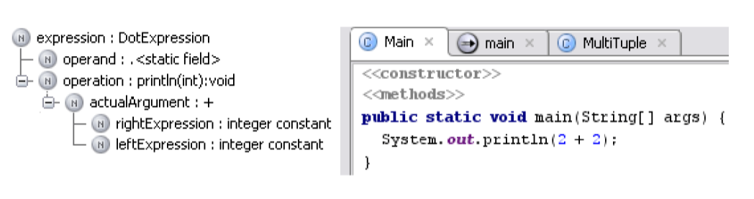
How it Works
Searches AST for Bug Patterns

Slide 34
I shot an elephant in my pajamas.

Slide 35
Subject:
I
Verb:
shot
Direct Object:
an elephant
Indirect Object:
in my pajamas

Slide 36
I shot an elephant in my pajamas.
How he got in my pajamas,
I'll never know.

Slide 37
Subject:
I
Verb:
shot
Participle Phrase
an elephant
in my pajamas

Slide 38
I want to thank my parents,
Jesus and Oprah Winfrey

Slide 39



I want to thank my parents,
Jesus and Oprah Winfrey

Slide 40
Subject:
I
Verb:
want
Infinitive:
to thank
Participle:
my parents
God
Oprah
Winfrey

Slide 41
I want to thank my parents,
Jesus and Oprah Winfrey

Slide 42
I want to thank my parents,
Jesus and Oprah Winfrey
God
b. ?
Oprah
b. 1954
You
b. 1954
You
b. 1954
You
b. 1954
You
b. 1976

Slide 43
Subject:
I
Verb:
want
Infinitive:
to thank
Participle Phrase:
my parents
God
Oprah
Winfrey

Slide 44


Slide 45


Slide 46
2 + 3 * 4

Slide 47
2 + 3 * 4
+
*
2
3
4

Slide 48
2 + 3 * 4
+
*
*
2
+
4
3
4
2
3

Slide 49
(+ 2 (* 3 4))
+
*
*
2
+
4
3
4
2
3

Slide 50


Slide 51
public class Person {
private String name;
public void setName(String name) {
this.name = name;
}
public String getNameName() {
return name;
}
public static void main(String[] args) {
Person p = new Person();
p.setName(“Hamlet”);
System.out.println(p);
}
}

Slide 52
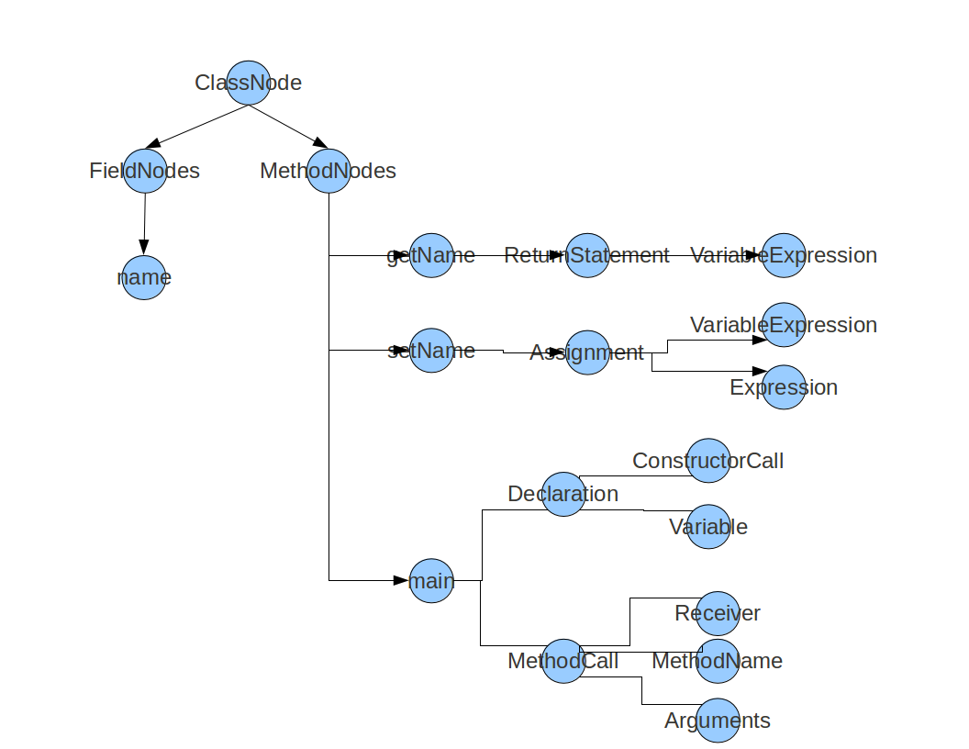

Slide 53
How it Works
Searches AST for Bug Patterns

Slide 54
How it Works
@Override
public void visitMethod(@NotNull final PsiMethod method) {
super.visitMethod(method);
if (method.hasModifierProperty(PsiModifier.ABSTRACT)) {
return;
}
if (!RecursionUtils.methodMayRecurse(method)) {
return;
}
if (!RecursionUtils.methodDefinitelyRecurses(method)) {
return;
}
super.registerMethodError(method);
}

Slide 55
How it Works
@Override
public void visitIfStatement(GrIfStatement stmt) {
super.visitIfStatement(stmt);
int branches = calculateNumBranches(stmt);
if (branches <= getLimit()) {
return;
}
registerStatementError(stmt, stmt);
}

Slide 56
Tree Pattern Matcher (PMD)
//FinallyStatement//ReturnStatement
//SynchronizedStatement/Block[1][count(*) = 0]
//SwitchStatement[not(SwitchLabel[@Default='true'])]

Slide 57
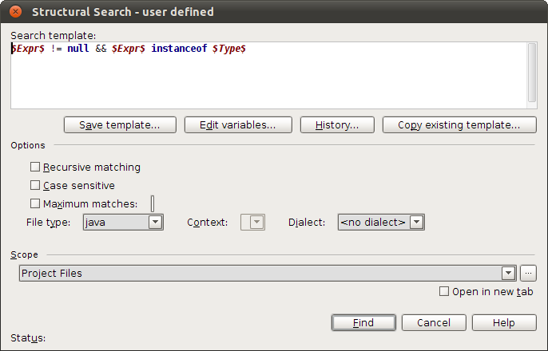
Structural Search and Replace

Slide 58
Write Your Own
IntelliJ IDEA Static Analysis:
Custom Rules with Structural Search & Replace
On http://JetBrains.tv

Slide 59
What it is
How it works
What is possible
IDEA Inspections
PMD
CodeNarc
FindBugs
AndroidLint
Groovy 2.0
AST
Rewriting Code
Transformations
XPath Expressions
Lombok
Groovy

Slide 60
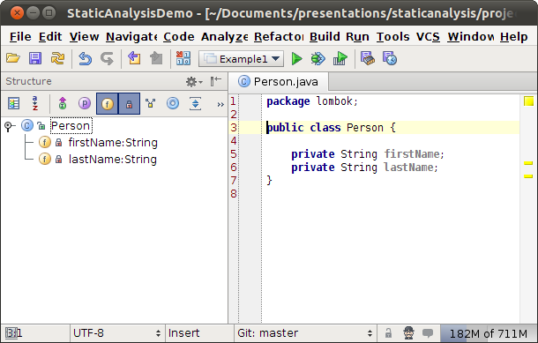

Slide 61
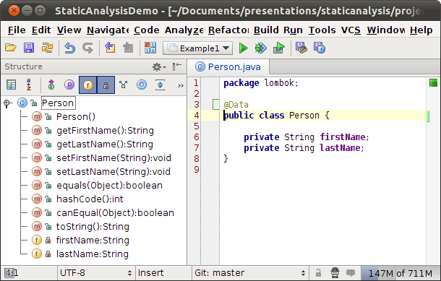

Slide 62
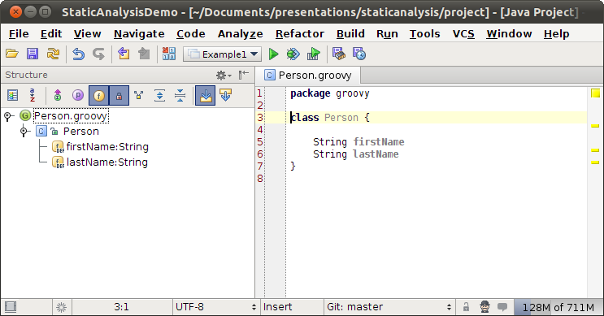

Slide 63
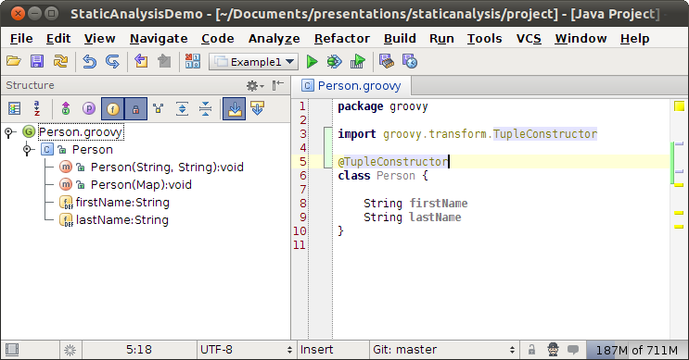

Slide 64
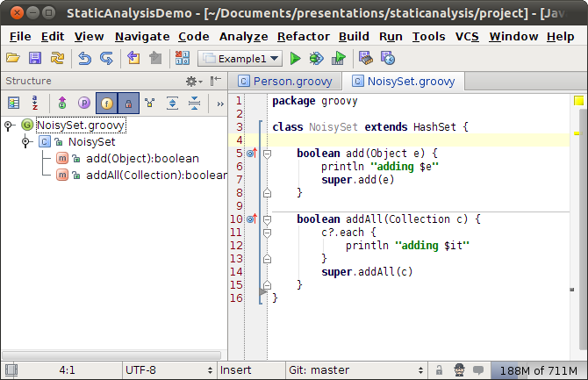

Slide 65
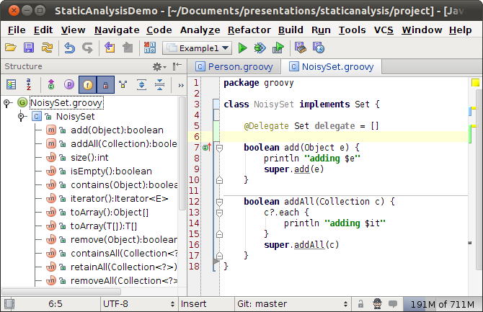

Slide 66
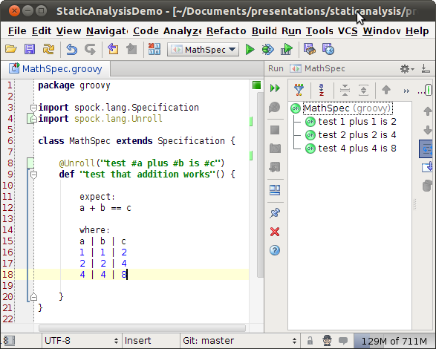

Slide 67
Software Lifecycle
… run in real-time
IDEA Inspections
PMD
CodeNarc
FindBugs
AndroidLint
Groovy 2.0

Slide 68
Software Lifecycle
… run with build
IDEA Inspections
PMD
CodeNarc
FindBugs
AndroidLint
Groovy 2.0

Slide 69
Not Covered
@Immutable, @GuardedBy
@Pattern & @Language
@Nls, @NonNls, @PropertyKey
Duplicate Detection & Dataflow Analysis
Dependency Analysis & Dependency Structure Matrix
That was last year:
http://www.slideshare.net/HamletDRC/static-analysis-in-idea

Slide 70
What it is
How it works
What is possible
IDEA Inspections
PMD
CodeNarc
FindBugs
AndroidLint
Groovy 2.0
AST
Rewriting Code
Transformations
XPath Expressions
Lombok
Groovy

Slide 71
Learn More – Q & A
My JetBrains.tv Screencasts: http://tv.jetbrains.net/tags/hamlet
My IDEA blog: http://hamletdarcy.blogspot.com/search/label/IDEA
Work's IDEA blog: http://www.canoo.com/blog/tag/idea/
Main blog: http://hamletdarcy.blogspot.com
YouTube channel: http://www.youtube.com/user/HamletDRC
Twitter: http://twitter.com/hamletdrc
IDEA RefCard from DZone: http://goo.gl/Fg4Af
IDEA Keyboard Stickers: See me
Share-a-Canooie – http://people.canoo.com/share/
Hackergarten – http://www.hackergarten.net/

