Slide 1
AST and Why You Should Care
Hamlet D’Arcy
Senior Software Development Engineer

Slide 2
I shot an elephant in my pajamas

Slide 3
Subject:
I
Verb:
shot
Direct Object:
an elephant
Indirect Object:
in my pajamas

Slide 4
I shot an elephant in my pajamas
How he got in my pajamas, I’ll never know

Slide 5
Subject:
I
Verb:
shot
Participle Phrase
an elephant
in my pajamas

Slide 6
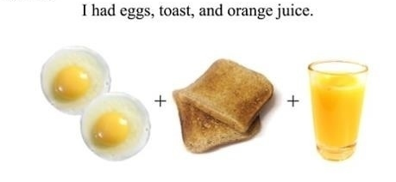

Slide 7
Subject:
I
Verb:
had
Participle:
eggs
toast
orange juice

Slide 8
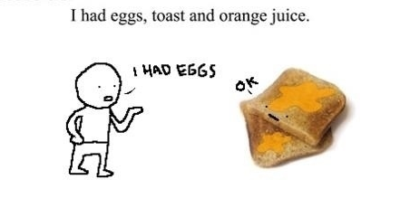

Slide 9
Subject:
I
Verb:
had
Participle Phrase:
eggs
toast
orange juice

Slide 10
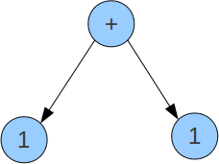

Slide 11
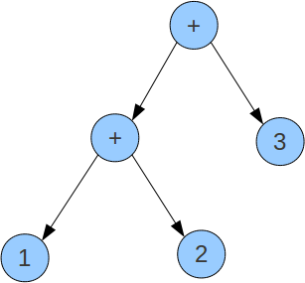

Slide 12
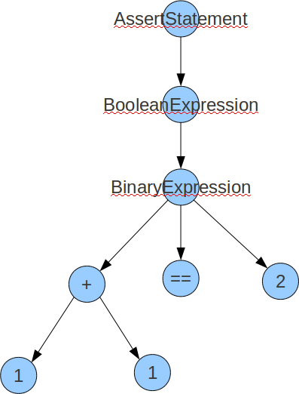

Slide 13
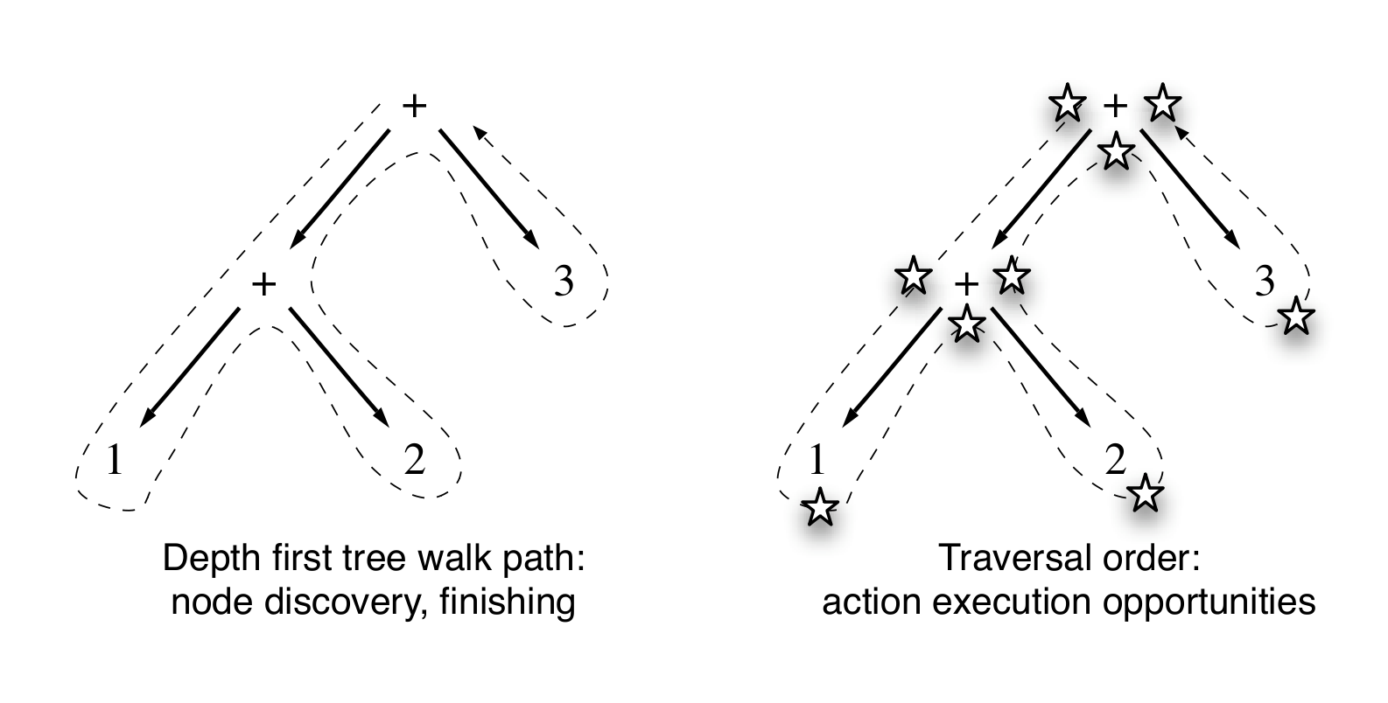
From Terrence Parr's “Language Implementation Patterns”
13
13

Slide 14
What’s in the AST?
dense
convenient
meaningful
Notes:
dense (no unnecessary nodes)
convenient (easy to walk)
meaningful (emphasize operators, operands, and the relationship between them)

Slide 15
What’s in the AST?
Homogenous?
Normalized Heterogeneous?
Irregular Heterogeneous?
https://github.com/HamletDRC/presentations/blob/master/asttransformations/ast_homo_vs_hetero.txt
Notes:
dense (no unnecessary nodes)
convenient (easy to walk)
meaningful (emphasize operators, operands, and the relationship between them)

Slide 16
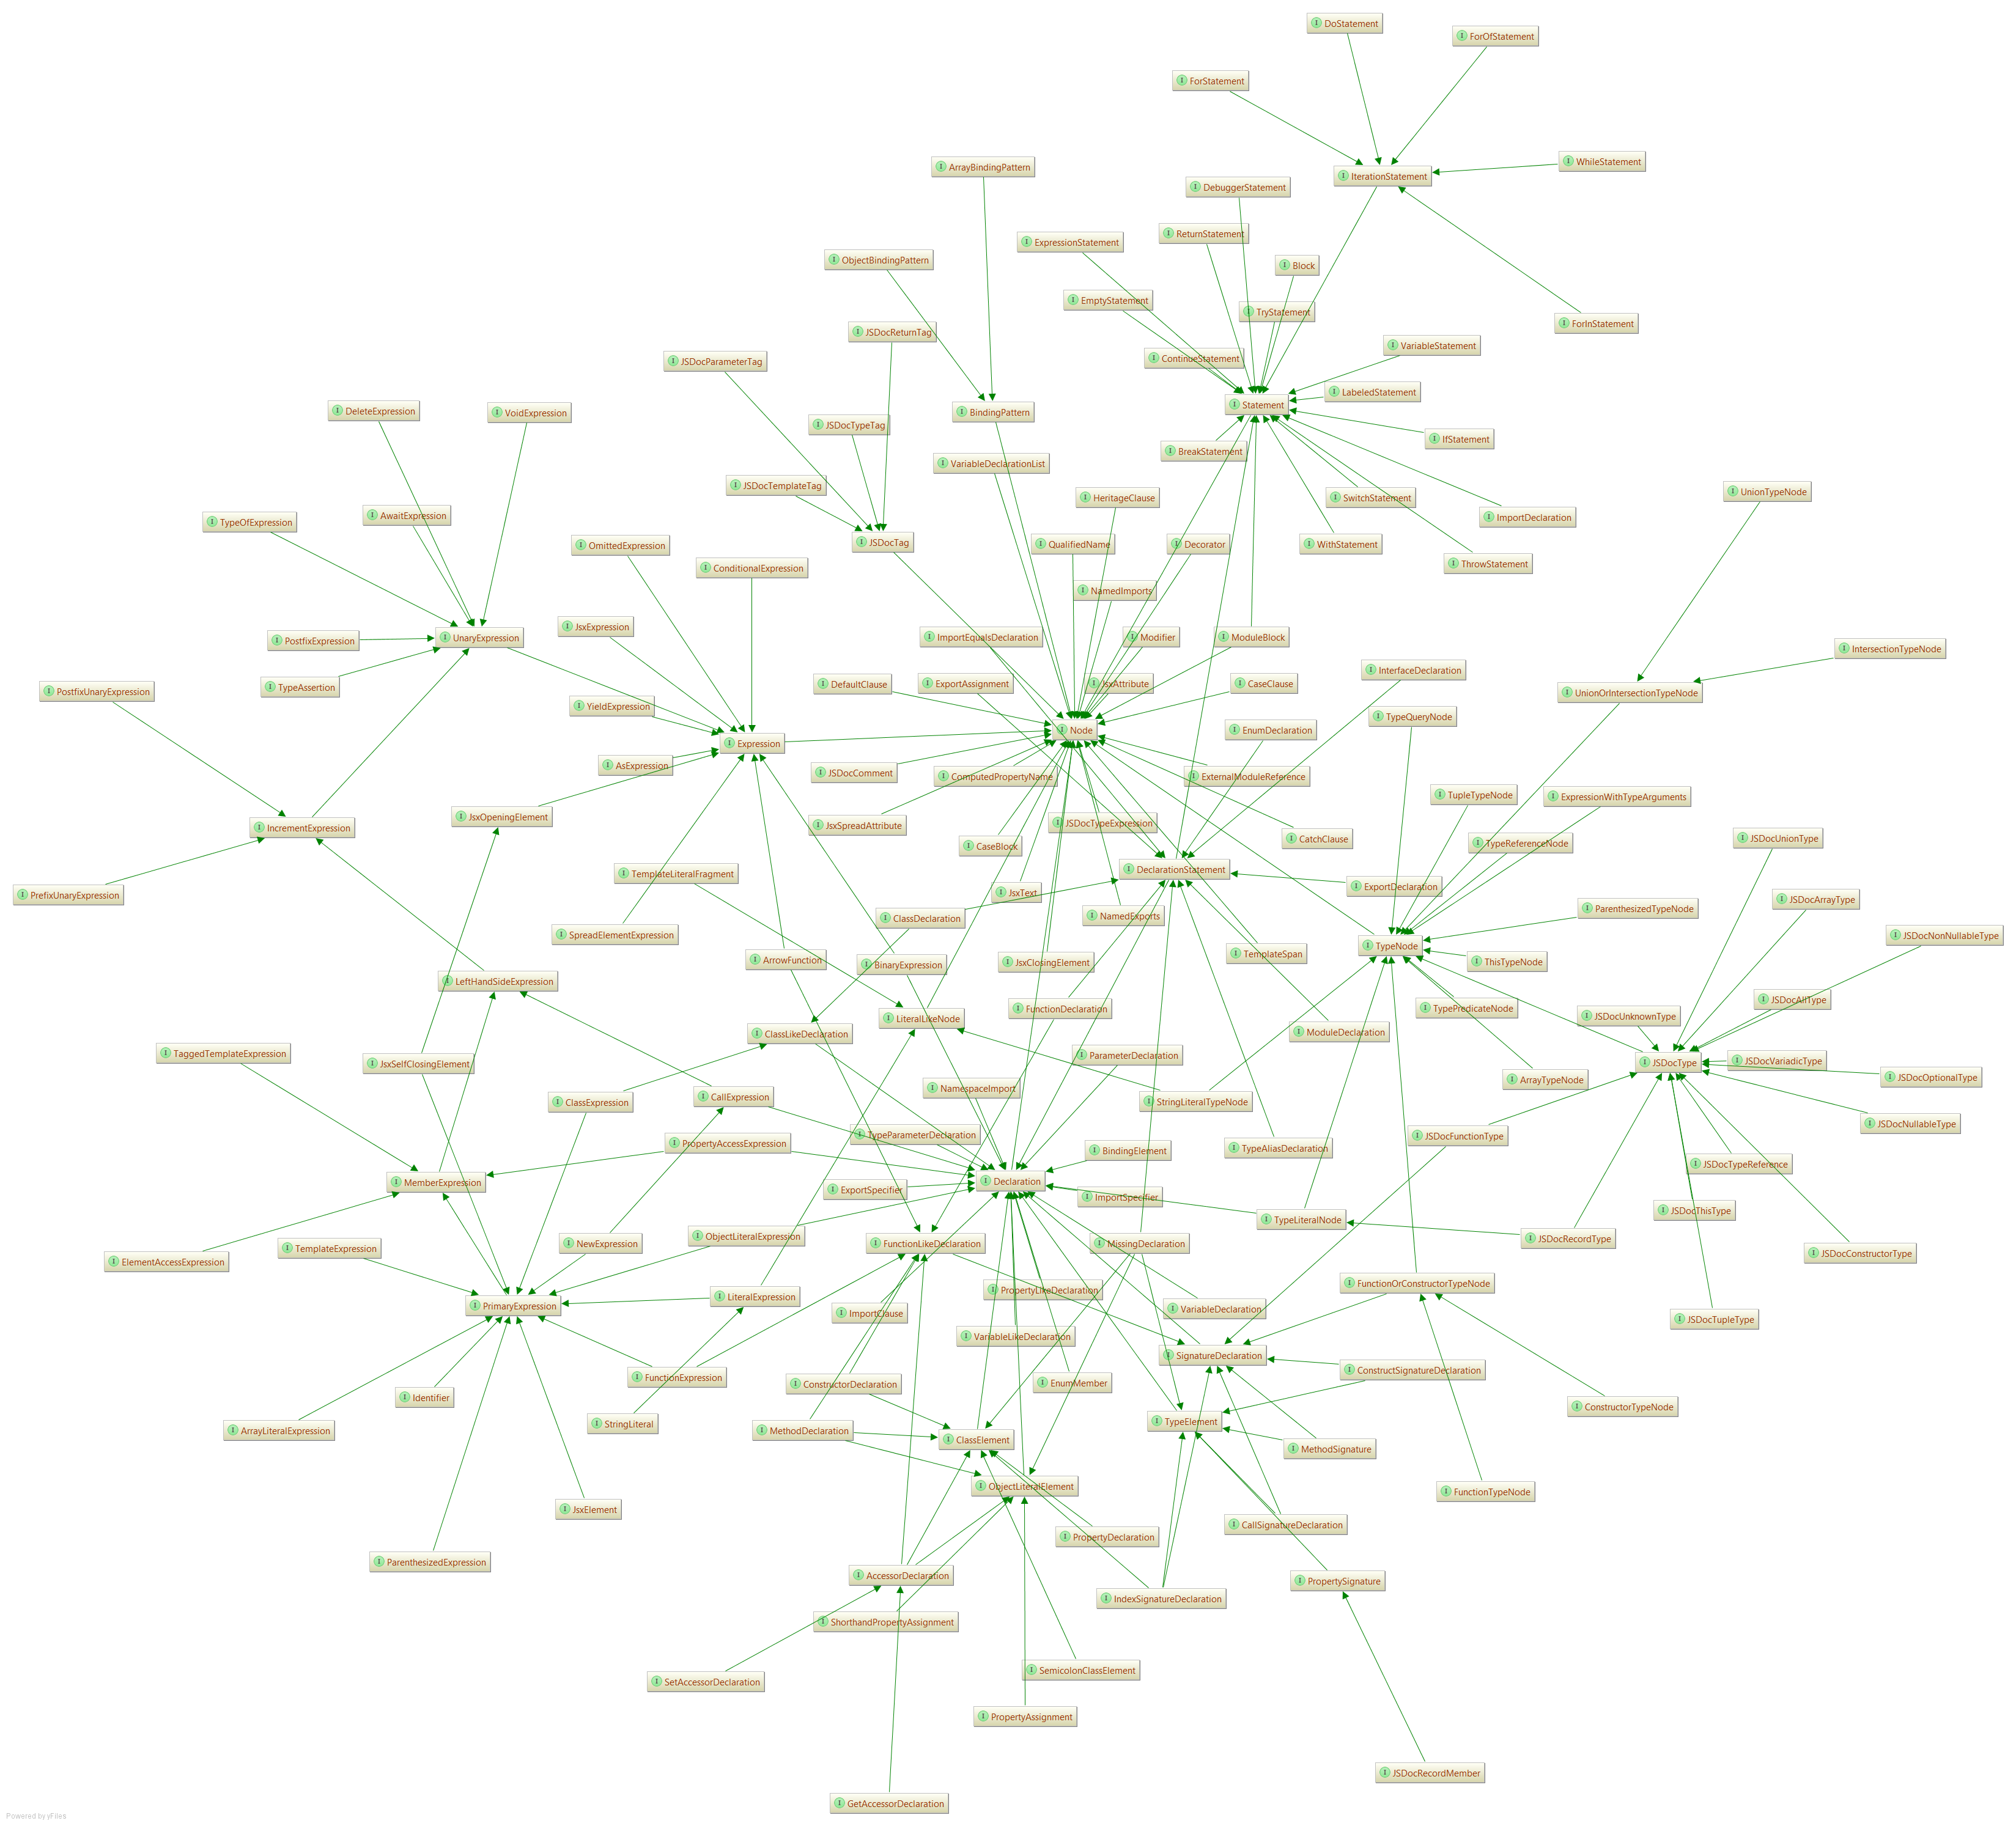

Slide 17
What’s in the AST?
Embedded Heterogeneous Tree Walker
External Tree Visitor
Tree Grammar
Tree Pattern Matcher
https://github.com/HamletDRC/presentations/blob/master/asttransformations/ast_walking.txt
Notes:
dense (no unnecessary nodes)
convenient (easy to walk)
meaningful (emphasize operators, operands, and the relationship between them)

Slide 18
visitAnyKeyword(node: ts.Node)
visitArrayLiteralExpression(node: ts.ArrayLiteralExpression)
visitArrowFunction(node: ts.FunctionLikeDeclaration)
visitBinaryExpression(node: ts.BinaryExpression)
visitBindingElement(node: ts.BindingElement)
visitBindingPattern(node: ts.BindingPattern)
visitBlock(node: ts.Block)
visitBreakStatement(node: ts.BreakOrContinueStatement)
visitCallExpression(node: ts.CallExpression)
visitCallSignature(node: ts.SignatureDeclaration)
visitCaseClause(node: ts.CaseClause)
visitClassDeclaration(node: ts.ClassDeclaration)
visitClassExpression(node: ts.ClassExpression)
visitCatchClause(node: ts.CatchClause)
visitConditionalExpression(node: ts.ConditionalExpression)
visitConstructorDeclaration(node: ts.ConstructorDeclaration)
visitConstructorType(node: ts.FunctionOrConstructorTypeNode)
visitContinueStatement(node: ts.BreakOrContinueStatement)
visitDebuggerStatement(node: ts.Statement)
visitDefaultClause(node: ts.DefaultClause)
visitDoStatement(node: ts.DoStatement)
visitElementAccessExpression(node: ts.ElementAccessExpression)
visitEnumDeclaration(node: ts.EnumDeclaration)
visitExportAssignment(node: ts.ExportAssignment)
visitExpressionStatement(node: ts.ExpressionStatement)
visitForStatement(node: ts.ForStatement)
visitForInStatement(node: ts.ForInStatement)
visitForOfStatement(node: ts.ForOfStatement)
visitFunctionDeclaration(node: ts.FunctionDeclaration)
visitFunctionExpression(node: ts.FunctionExpression)
visitFunctionType(node: ts.FunctionOrConstructorTypeNode)
visitGetAccessor(node: ts.AccessorDeclaration)
visitIdentifier(node: ts.Identifier)
visitIfStatement(node: ts.IfStatement)
visitImportDeclaration(node: ts.ImportDeclaration)
visitImportEqualsDeclaration(node: ts.ImportEqualsDeclaration)
visitIndexSignatureDeclaration(node: ts.IndexSignatureDeclaration)
visitInterfaceDeclaration(node: ts.InterfaceDeclaration)
visitJsxAttribute(node: ts.JsxAttribute)
visitJsxElement(node: ts.JsxElement)
visitJsxExpression(node: ts.JsxExpression)
visitJsxSelfClosingElement(node: ts.JsxSelfClosingElement)
visitLabeledStatement(node: ts.LabeledStatement)
visitMethodDeclaration(node: ts.MethodDeclaration)
visitMethodSignature(node: ts.SignatureDeclaration)
visitModuleDeclaration(node: ts.ModuleDeclaration)
visitNamedImports(node: ts.NamedImports)
visitNamespaceImport(node: ts.NamespaceImport)
visitNewExpression(node: ts.NewExpression)
visitObjectLiteralExpression(node: ts.ObjectLiteralExpression)
visitParameterDeclaration(node: ts.ParameterDeclaration)
visitPostfixUnaryExpression(node: ts.PostfixUnaryExpression)
visitPrefixUnaryExpression(node: ts.PrefixUnaryExpression)
visitPropertyAccessExpression(node: ts.PropertyAccessExpression)
visitPropertyAssignment(node: ts.PropertyAssignment)
visitPropertyDeclaration(node: ts.PropertyDeclaration)
visitPropertySignature(node: ts.Node)
visitRegularExpressionLiteral(node: ts.Node)
visitReturnStatement(node: ts.ReturnStatement)
visitSetAccessor(node: ts.AccessorDeclaration)
visitSourceFile(node: ts.SourceFile)
visitStringLiteral(node: ts.StringLiteral)
visitSwitchStatement(node: ts.SwitchStatement)
visitTemplateExpression(node: ts.TemplateExpression)
visitThrowStatement(node: ts.ThrowStatement)
visitTryStatement(node: ts.TryStatement)
visitTypeAssertionExpression(node: ts.TypeAssertion)
visitTypeLiteral(node: ts.TypeLiteralNode)
visitTypeReference(node: ts.TypeReferenceNode)
visitVariableDeclaration(node: ts.VariableDeclaration)
visitVariableStatement(node: ts.VariableStatement)
visitWhileStatement(node: ts.WhileStatement)
visitWithStatement(node: ts.WithStatement)
visitNode(node: ts.Node)
walkChildren(node: ts.Node)

Slide 19
tslint-microsoft-contrib Demo

Slide 20
Resources
typescriptServices.d.ts
syntaxWalker.d.ts
Using the Compiler API
https://github.com/Microsoft/TypeScript/wiki/Using-the-Compiler-API
Investigating Typescript Compiler APIs
http://blog.scottlogic.com/2015/01/20/typescript-compiler-api.html
“typescript-compiler-docs” project
https://github.com/basarat/typescript-compiler-docs

