Slide 1
Secure TypeScript
Hamlet D’Arcy
Senior Software Development Engineer

Slide 2
export module actions { class AsyncAction { private delegate; constructor(delegate) { this.delegate = delegate; } public invoke(): number { return setTimeout(this.delegate, 0); } } }

Slide 3
export module actions { class AsyncAction { private delegate; constructor(delegate) { this.delegate = delegate; } public invoke(): number { return setTimeout(this.delegate, 0); } } }
>> src/preso.ts[4, 1]: missing 'use strict'

Slide 4
export module actions { class AsyncAction { private delegate; constructor(delegate) { this.delegate = delegate; } public invoke(): number { return setTimeout(this.delegate, 0); } } }
>> src/preso.ts[4, 1]: missing 'use strict'
Microsoft SDL Violation CWE 398 - Indicator of Poor Code Quality CWE 710 - Coding Standards Violation

Slide 5
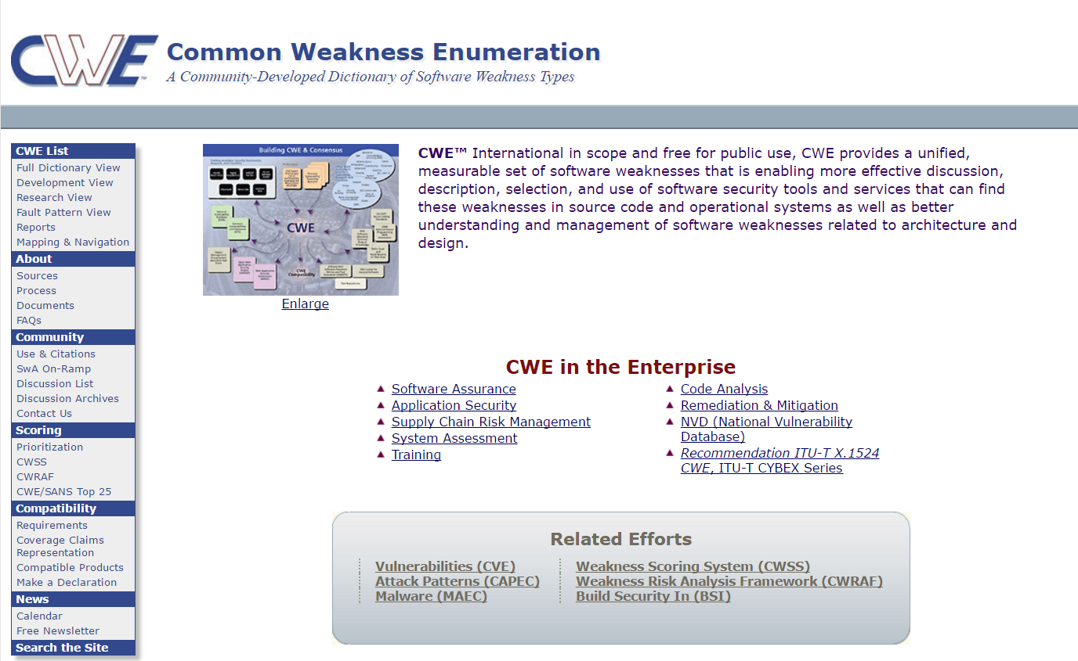
https://cwe.mitre.org/index.html

Slide 6

https://www.microsoft.com/en-us/sdl/

Slide 7
"use strict"; export module actions { class AsyncAction { private delegate; constructor(delegate) { this.delegate = delegate; } public invoke(): number { return setTimeout(this.delegate, 0); } } }

Slide 8
"use strict"; export module actions { class AsyncAction { private delegate; constructor(delegate) { this.delegate = delegate; } public invoke(): number { return setTimeout(this.delegate, 0); } } }
>> src/preso.ts[14, 20]: Forbidden setTimeout string parameter: this.delegate

Slide 9
"use strict"; export module actions { class AsyncAction { private delegate; constructor(delegate) { this.delegate = delegate; } public invoke(): number { return setTimeout(this.delegate, 0); } } }
>> src/preso.ts[14, 20]: Forbidden setTimeout string parameter: this.delegate Microsoft SDL Violation CWE 95 - Improper Neutralization of Directives in Dynamically Evaluated Code ('Eval Injection') CWE 676 - Use of Potentially Dangerous Function CWE 242 - Use of Inherently Dangerous Function CWE 116 - Improper Encoding or Escaping of Output"

Slide 10
"use strict"; export module actions { class AsyncAction { private delegate; constructor(delegate) { this.delegate = delegate; } public invoke(): number { return setTimeout(this.delegate, 0); } } }
>> src/preso.ts[14, 20]: Forbidden setTimeout string parameter: x >> src/preso.ts[8, 29]: expected parameter: 'delegate' to have a typedef

Slide 11
"use strict"; export module actions { class AsyncAction { private delegate: () => void; constructor(delegate: () => void) { this.delegate = delegate; } public invoke(): number { return setTimeout(this.delegate, 0); } } }

Slide 12
let count = 0; function wrapFunction(delegate) { count++; return new Function(delegate); } wrapFunction(() => {})(); wrapFunction(() => {})(); console.log(count);

Slide 13
let count = 0; function wrapFunction(delegate) { count++; return new Function(delegate); } wrapFunction(() => {})(); wrapFunction(() => {})(); console.log(count);
>> src/preso.ts[5, 12]: forbidden: Function constructor with string arguments
Microsoft SDL Violation CWE 95 - Improper Neutralization of Directives in Dynamically Evaluated Code ('Eval Injection') CWE 676 - Use of Potentially Dangerous Function CWE 242 - Use of Inherently Dangerous Function CWE 116 - Improper Encoding or Escaping of Output

Slide 14
import React = require('react'); function renderTwitterStream() { return <iframe src={'/static/twitter.html'} /> }

Slide 15
import React = require('react'); function renderTwitterStream() { return <iframe src={'/static/twitter.html'} /> }
>> src/preso.tsx[4, 12]: An iframe element requires a sandbox attribute CWE 915 - Improperly Controlled Modification of Dynamically-Determined Object Attributes

Slide 16
import React = require('react'); function renderTwitterStream() { return <iframe sandbox='allow-forms allow-scripts' src={'/static/twitter.html'} /> }
import React = require('react'); function renderTwitterStream() { return <iframe src={'/static/twitter.html'} /> }

Slide 17
import React = require('react'); function renderTwitterStream() { return <iframe sandbox='allow-scripts allow-same-origin' src={'/static/twitter.html'} /> }
import React = require('react'); function renderTwitterStream() { return <iframe src={'/static/twitter.html'} /> }

Slide 18
import React = require('react'); function renderTwitterStream() { return <iframe sandbox='allow-scripts allow-same-origin' src={'/static/twitter.html'} /> }
import React = require('react'); function renderTwitterStream() { return <iframe src={'/static/twitter.html'} /> }
>> src/preso.tsx[4, 28]: An iframe element defines a sandbox with both allow-scripts and allow-same-origin

Slide 19
Other Security Rules…
no-eval
no-document-domain
no-document-write
no-inner-html
no-http-string
react-no-dangerous-html

Slide 20
/** * Common Bugs and Correctness. The following rules should be turned on because they * find common bug patterns in the code or enforce type safety. */
"jquery-deferred-must-complete" "mocha-no-side-effect-code" "no-backbone-get-set-outside-model" "no-bitwise" "no-conditional-assignment" "no-constant-condition" "no-stateless-class" "no-unnecessary-bind"
"no-unnecessary-override" "no-unsafe-finally" "promise-must-complete" "react-this-binding-issue" "react-unused-props-and-state" "triple-equals" "valid-typeof"

Slide 21
/** * Code Clarity. The following rules should be turned on because they * make the code generally more clear to the reader. */
…
"chai-prefer-contains-to-index-of“ "chai-vague-errors”
"max-func-body-length“
"no-function-expression“ "no-unnecessary-field-initialization“
"no-unsupported-browser-code“
"prefer-const“ …

Slide 22
Rulesets
tslint-microsoft-contrib - https://github.com/Microsoft/tslint-microsoft-contrib
tslint - https://github.com/palantir/tslint
tslint-react - https://github.com/palantir/tslint-react
tslint-eslint-rules - https://github.com/buzinas/tslint-eslint-rules
codelyzer (Angular Rules)- https://github.com/mgechev/codelyzer
vrsource-tslint-rules - https://github.com/vrsource/vrsource-tslint-rules

Slide 23
Resources
recommended_ruleset.js and recommended tslint.json
grunt validate-config – forces all rules to be defined
tslint-warnings.csv – All CWE mappings for all rules
Visual Studio Code – TSLint Plugin
Microsoft Careers – 46 Open Position in Switzerland

Slide 24
[].constructor.constructor

Slide 25
[].constructor.constructor('alert(1)')()

