Slide 1
AST Transformations
Hamlet D'Arcy
@HamletDRC
http://hamletdarcy.blogspot.com

Slide 2
Agenda
Lombok and Groovy AST Transformations
      – Abstract Syntax Trees
CodeNarc and IntelliJ IDEA
      – Static Analysis and Code Rewriting
GContracts, Spock, Groovy++
      – Frame-Oriented Code Generation
Mirah
      – Macros and Static Typing

Slide 3




About Me

Slide 4

Project Lombok

Slide 5
public class Person {
private String firstName;
private String lastName;
void setFirstName(String fName) {
this.firstName = fName;
}
public String getFirstName() {
return firstName;
}
public void setLastName(String lName) {
this.lastName = lName;
}
public String getLastName() {
return firstName;
}
}
import lombok.Getter;
import lombok.Setter;
public class Person {
@Getter
@Setter
private String firstName;
@Getter
@Setter
private String lastname;
}

Slide 6
@Getter / @Setter
@ToString
@EqualsAndHashCode
@NoArgsConstructor
@RequiredArgsConstructor
@AllArgsConstructor
@Data
@Cleanup
@Synchronized
@SneakyThrows
@Log
@Delegate
val

Slide 7
Generates Java Boilerplate
Compile Time Only
– For Eclipse and javac
– IDEA & NetBeans too
Removable with delombok
– Javadoc
– GWT
Read the fine print
– Know what is generated

Slide 8

How it Works

Slide 9

How it Works

Slide 10

How it Works

Slide 11
How it Works
Annotation Processor
Eclipse Handler
Javac Handler

Slide 12
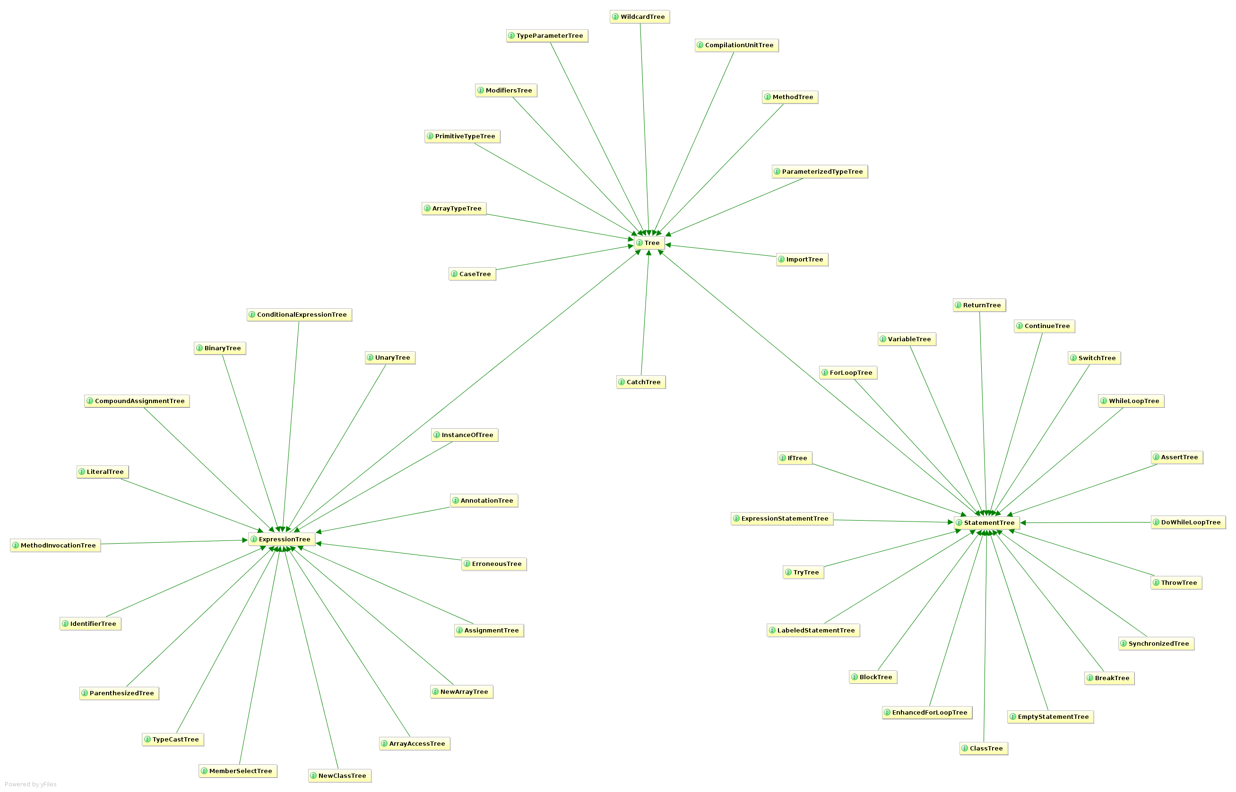

Slide 13
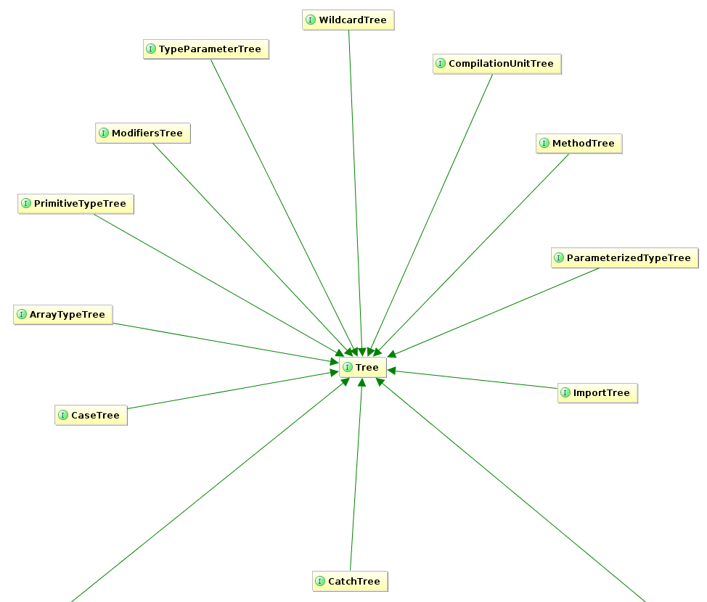

Slide 14
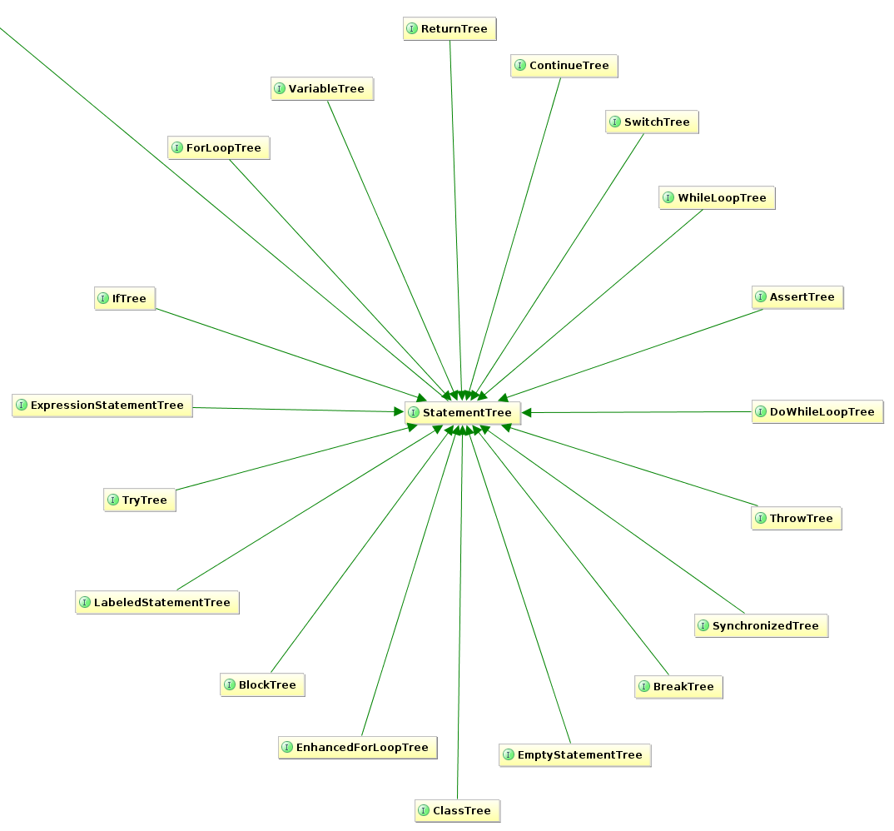

Slide 15
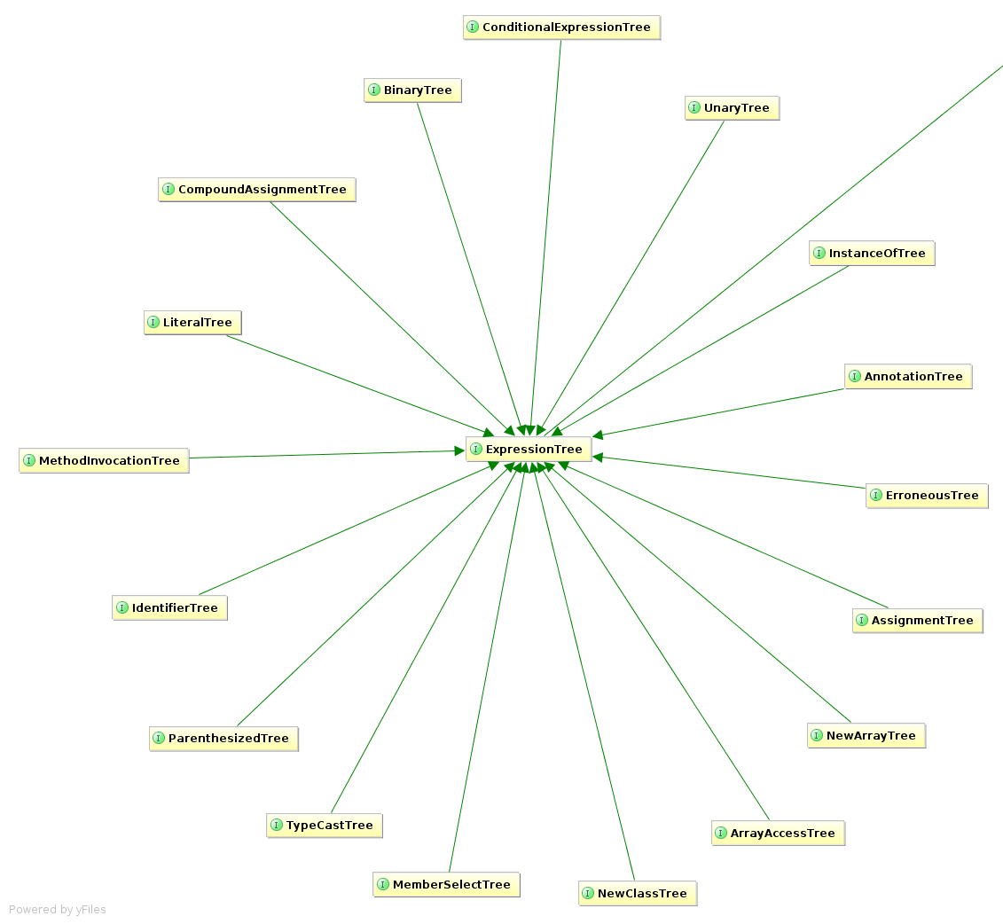

Slide 16
// javac
private void generatePropertyChangeSupportField(JavacNode node) {
if (fieldAlreadyExists(PROPERTY_SUPPORT_FIELD_NAME, node)) return;
JCExpression exp = chainDots(node.getTreeMaker(), node, "this");
JCVariableDecl fieldDecl = newField()
.ofType(PropertyChangeSupport.class)
.withName(PROPERTY_SUPPORT_FIELD_NAME)
.withModifiers(PRIVATE | FINAL)
.withArgs(exp)
.buildWith(node);
injectField(node, fieldDecl);
}
// ECJ
private void generatePropertyChangeSupportField(EclipseNode node) {
if (fieldAlreadyExists(PROPERTY_SUPPORT_FIELD_NAME, node)) return;
Expression exp = referenceForThis(node.get());
FieldDeclaration fieldDecl = newField()
.ofType(PropertyChangeSupport.class)
.withName(PROPERTY_SUPPORT_FIELD_NAME)
.withModifiers(PRIVATE | FINAL)
.withArgs(exp)
.buildWith(node);
injectField(node, fieldDecl);
}
Alex Ruiz – Custom AST
Transformations with Project Lombok
http://www.ibm.com/developerworks/java/library/j-lombok/

Slide 17
Groovy

Slide 18
class Event {
String title
}
class Event {
String title
public void getTitle() {
title
}
public String setTitle(String t) {
this.title = t
}
}

Slide 19
class Event implements Comparable, Clonable {
Date when
boolean after(Date when) {
this.when.after(when)
}
boolean before(Date when) {
this.when.before(when)
}
Object clone() {
this.when.clone()
}
Int compareTo(Date anotherDate) {
this.when.compareTo(otherDate)
}
Int getDate() {
this.when.date
}
Int getDay() {
this.when.day
}
Int getHours() {
this.when.hours
}
Int getMinutes() {
this.when.minutes
}
Int getMonth() {
this.when.month
}
Int getSeconds() {
this.when.seconds
}
long getTime() {
this.when.time
}
Int getTimezoneOffset() {
this.when.timezoneOffset
}
Int getYear() {
this.when.year
}
void setDate(int date) {
this.when.date = date
}
void setHours(int hours) {
this.when.hours = hours
}
void setMinutes(int minutes) {
this.when.minutes = minutes
}
void setMonth(int month) {
this.when.month = month
}
void setSeconds(int seconds) {
this.when.seconds = seconds
}
void setTime(long time) {
this.when.time = time
}
void setYear(int year) {
this.when.year = year
}
String toGMTString() {
this.when.toGMTString()
}
String toLocaleString() {
this.when.toLocaleString()
}
}
class Event {
@Delegate Date when
}

Slide 20
class Event {
@Lazy ArrayList speakers
}
class Event {
ArrayList speakers
def getSpeakers() {
if (speakers != null) {
return speakers
} else {
synchronized(this) {
if (speakers == null) {
speakers = []
}
return speakers
}
}
}
}

Slide 21
@Immutable
class Event {
String title
}
– Class is final
– Properties must be @Immutable or effectively immutable
– Properties are private
– Mutatators throw ReadOnlyPropertyException
– Map constructor created
– Tuple constructor created
– Equals(), hashCode() & toString() created
– Dates, Clonables, & arrays are defensively copied on way in & out (but not deeply cloned)
– Collections & Maps are wrapped in Immutable variants
– Non-immutable fields force an error
– Special handling for Date, Color, etc
– Many generated methods configurable

Slide 22
Code Generation Transformations
@ToString
@EqualsAndHashCode
@Canonical
@Lazy
@InheritConstructors
@TupleConstructor

Slide 23
Class Design Annotations
Logging Improvements
@Delegate
@Singleton
@groovy.transform.Immutable
@Log
@Log4j
@Slf4j
@Commons

Slide 24
Declarative Concurrency
Easier Cloning and Externalizing
Safer Scripting
@Synchronized
@WithReadLock
@WithWriteLock
@AutoClone
@AutoExternalize
@TimedInterrupt
@ThreadInterrupt
@ConditionalInterrupt

Slide 25
How it Works
Local AST Transformations

Slide 26
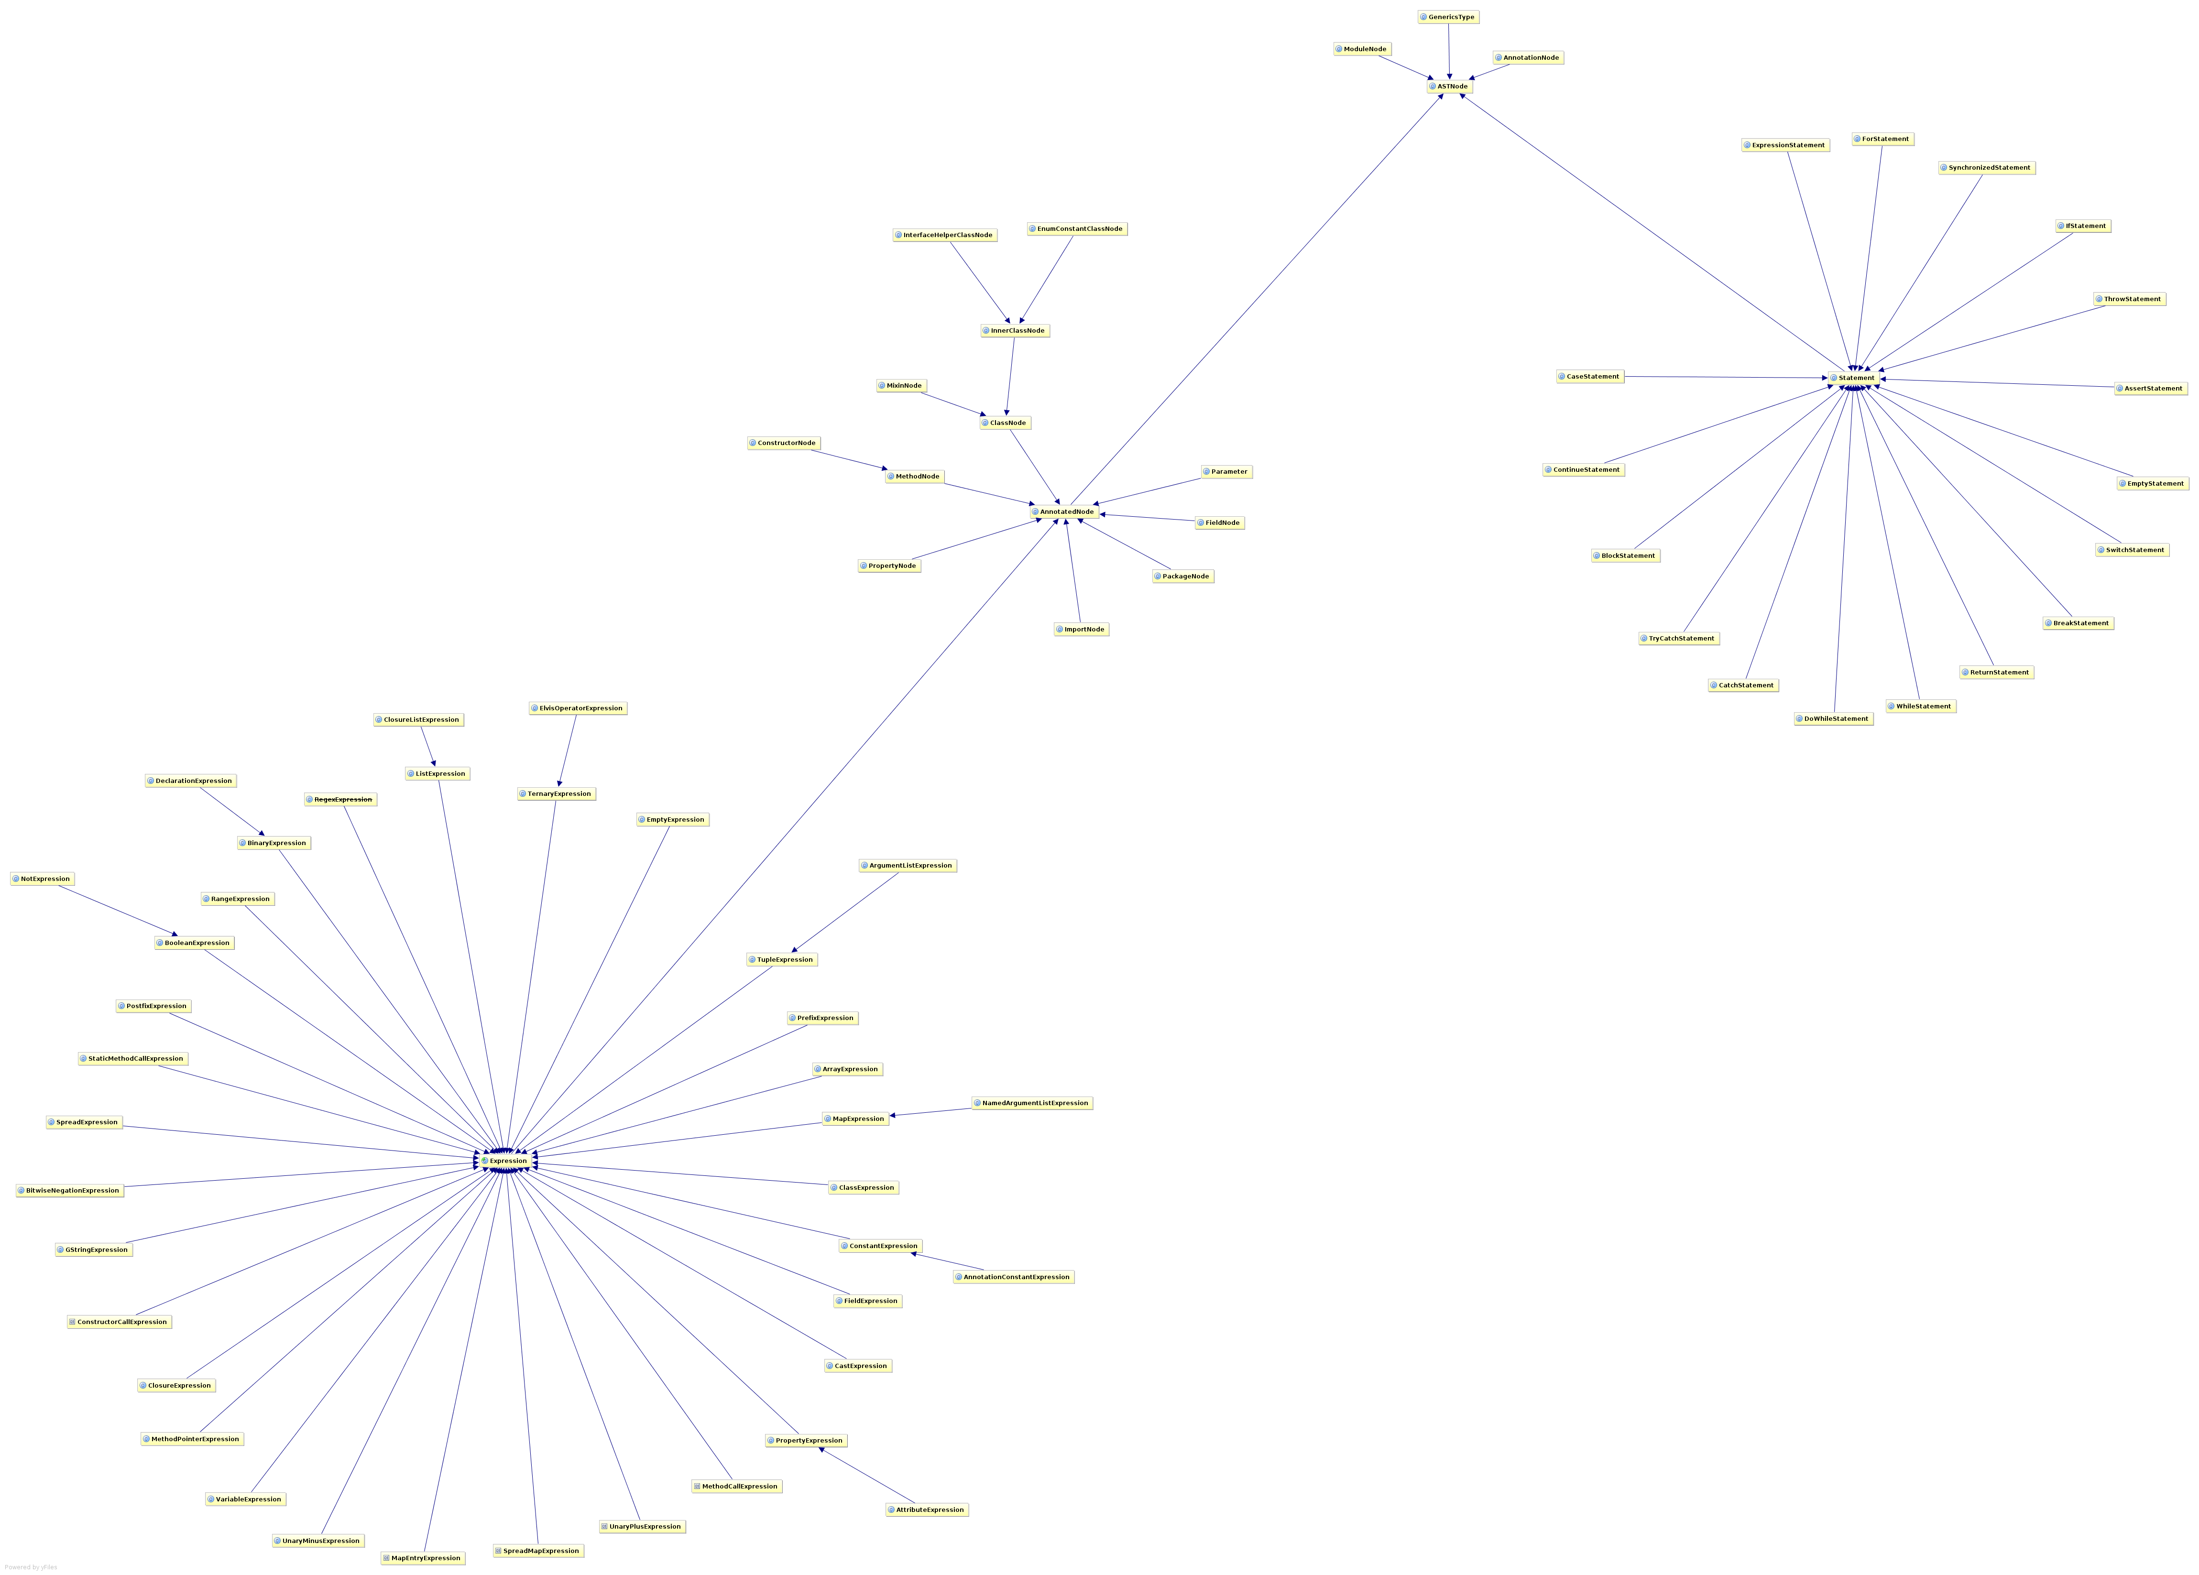

Slide 27
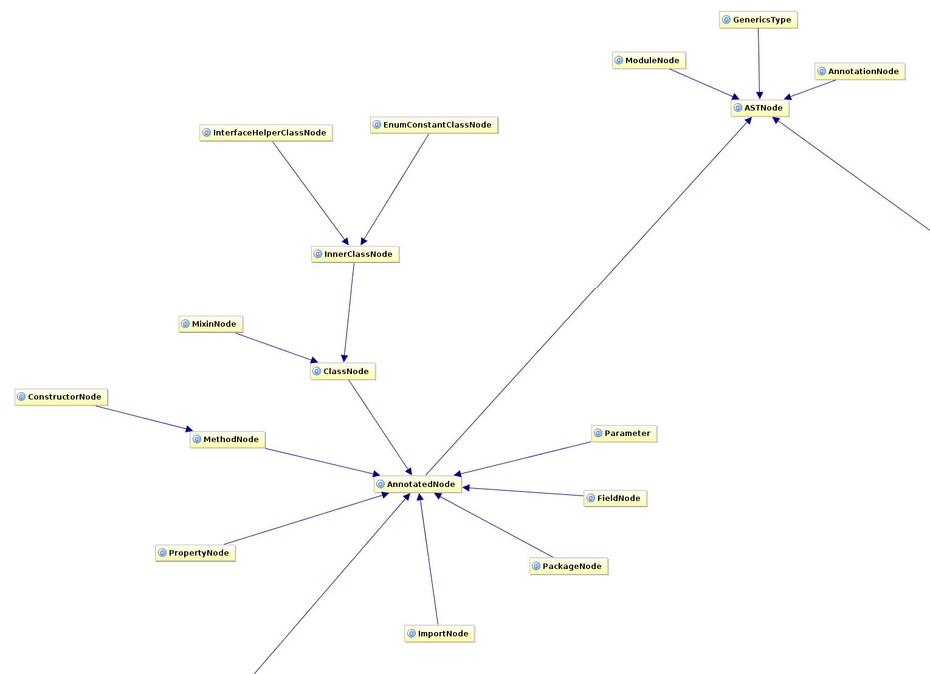

Slide 28
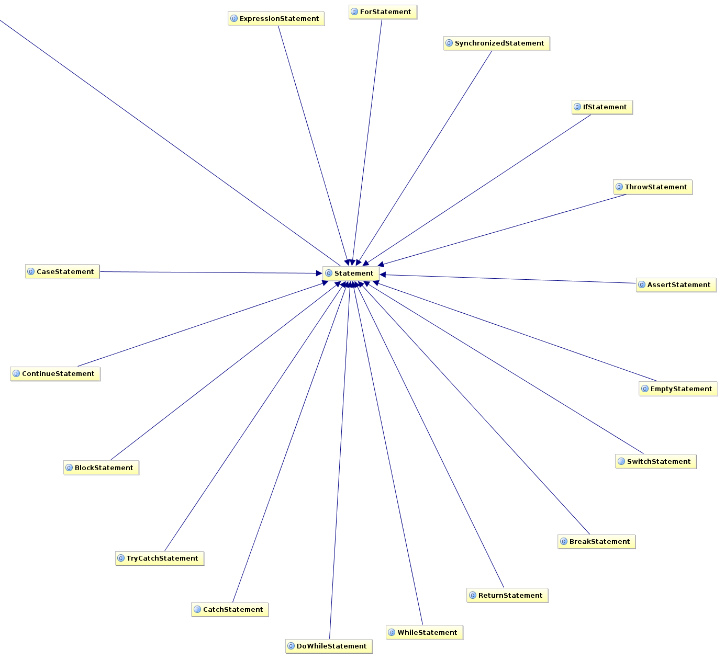

Slide 29
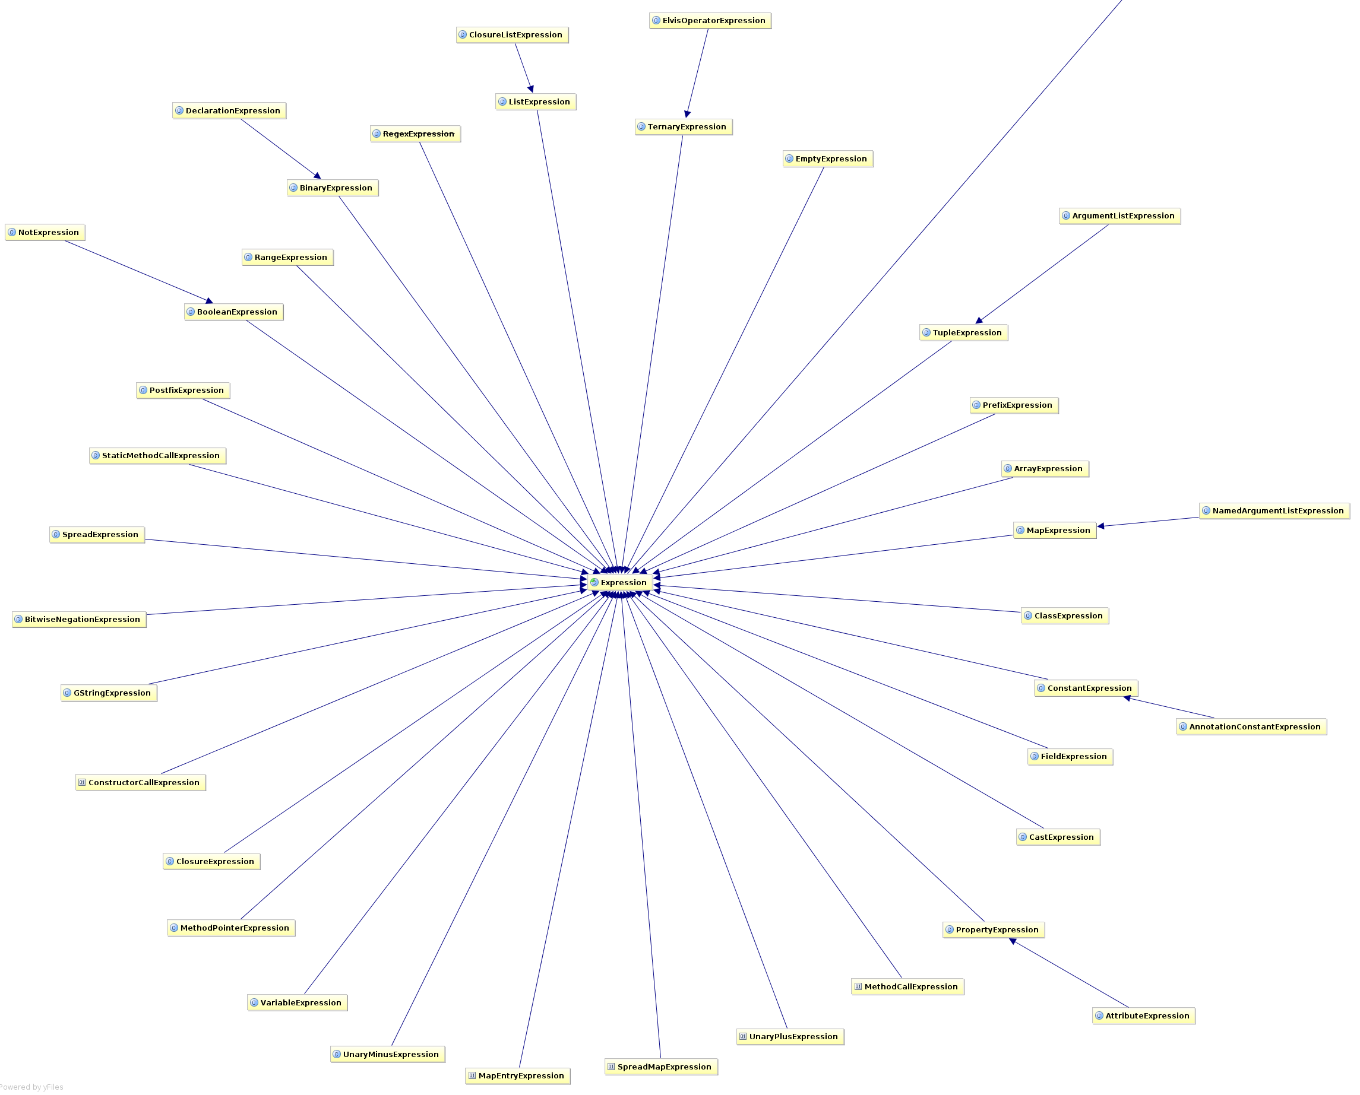

Slide 30
class Event {
@Delegate Date when
}
@GroovyASTTransformationClass("org.pkg.DelegateTransform")
public @interface Delegate {
...
}
@GroovyASTTransformation(phase = CANONICALIZATION)
public class DelegateTransform implements ASTTransformation {
public void visit(ASTNode[] nodes, SourceUnit source) {
...
}
}

Slide 31
Creating AST...

Slide 32
Creating AST... by hand
import org.codehaus.groovy.ast.*
import org.codehaus.groovy.ast.stmt.*
import org.codehaus.groovy.ast.expr.*
def ast = new ReturnStatement(
new ConstantExpression(
new ConstructorCallExpression(
ClassHelper.make(Date),
ArgumentListExpression.EMPTY_ARGUMENTS )
)
)
assert ast instanceof ReturnStatement

Slide 33
Creating AST... with a DSL
def ast = new AstBuilder().buildFromSpec {
returnStatement {
constructorCall(Date) {
argumentList {}
}
}
}
assert ast[0] instanceof ReturnStatement

Slide 34
Creating AST... with a String
def ast = new AstBuilder().buildFromString('new Date()')
assert assert ast[0] instanceof BlockStatement
assert ast[0].statements[0] instanceof ReturnStatement

Slide 35
Creating AST... from code
def ast = new AstBuilder().buildFromCode {
new Date()
}
assert ast[0].statements[0] instanceof ReturnStatement

Slide 36
Demo
– Adding a main() method

Slide 37

Static Analysis with IDEA

Slide 38
How it Works
Compiles Java to AST
Analyzes AST Nodes
Rewrites with Strings

Slide 39
(x != null && x instanceof SomeClass)
@Override
public void visitBinaryExpression(PsiBinaryExpression exp) {
if (exp.token == '==') {
if (exp.left instanceof BinaryExpression ... ) {
if (exp.right instanceof BinaryExpression ... ) {
registerError(exp, '...')
}
}
}
}

Slide 40
(x != null && x instanceof SomeClass)
@Override
public void visitBinaryExpression(PsiBinaryExpression expression) {
super.visitBinaryExpression(expression);
if (!expression.getOperationTokenType().equals(JavaTokenType.ANDAND)) {
return;
}
PsiExpression lOperand = expression.getLOperand();
PsiExpression rOperand = expression.getROperand();
if (!isBinaryExpressionAndInstanceOfCheck(lOperand, rOperand) &&
!isBinaryExpressionAndInstanceOfCheck(rOperand, lOperand)) {
return;
}
PsiBinaryExpression binaryExpression = getInnerBinaryExpression(expression);
if (!binaryExpression.getOperationTokenType().equals(JavaTokenType.NE)) {
return;
}
boolean leftIsNullCheck = isNullCheck(binaryExpression.getLOperand(), binaryExpression.getROperand());
boolean rightIsNullCheck = isNullCheck(binaryExpression.getROperand(), binaryExpression.getLOperand());
if (!leftIsNullCheck && !rightIsNullCheck) return;
PsiReferenceExpression theReference = getReferenceFromNotNullCheck(binaryExpression);
PsiExpression instanceOfOperand = getInstanceOfOperand(expression);
if (!(instanceOfOperand instanceof PsiReferenceExpression)) {
return;
}
String referenceNameA = (theReference).getReferenceName();
String referenceNameB = ((PsiReferenceExpression)instanceOfOperand).getReferenceName();
if (referenceNameA == null || referenceNameB == null) {
return;
}
if (!referenceNameA.equals(referenceNameB)) {
return;
}
registerError(expression);
}

Slide 41
Rewrite: (x instanceof SomeClass)
PsiElement andand = descriptor.getPsiElement();
if (andand instanceof PsiBinaryExpression) {
PsiExpression lhs = ((PsiBinaryExpression)andand).getLOperand();
PsiExpression rhs = ((PsiBinaryExpression)andand).getROperand();
if (lhs instanceof PsiInstanceOfExpression) {
replaceExpression((PsiBinaryExpression)andand, lhs.getText());
} else if (rhs instanceof PsiInstanceOfExpression) {
replaceExpression((PsiBinaryExpression)andand, rhs.getText());
}
}

Slide 42
Rewrite: (x instanceof SomeClass)
def andand = descriptor.psiElement
if (andand instanceof PsiBinaryExpression) {
def lhs = andand.lOperand
def rhs = andand.rOperand
if (lhs instanceof PsiInstanceOfExpression) {
replaceExpression(andand, lhs.text)
} else if (rhs instanceof PsiInstanceOfExpression) {
replaceExpression(andand, rhs.text)
}
}

Slide 43
How it Works
Compiles Java to AST
Analyzes AST Nodes
Rewrites with Strings

Slide 44
Static Analysis with CodeNarc

Slide 45
– Dead Code
– Defects like Gstring as Map Key, Duplicate Map Key
– Return path analysis (null returns)
– Type inference (and improving)
– Concurrency Problems (busy wait, etc)
– Poor Testing Practices
– Un-Groovy code
… and 240+ more rules

Slide 46
How it works
CodeNarc Rule:
Ban new java.util.Random() calls
@Override
void visitConstructorCallExpression(
ConstructorCallExpression call) {
if (AstUtil.classNodeImplementsType(call.type, Random)) {
addViolation(call, 'Using Random is insecure...')
}
super.visitConstructorCallExpression(call)
}

Slide 47
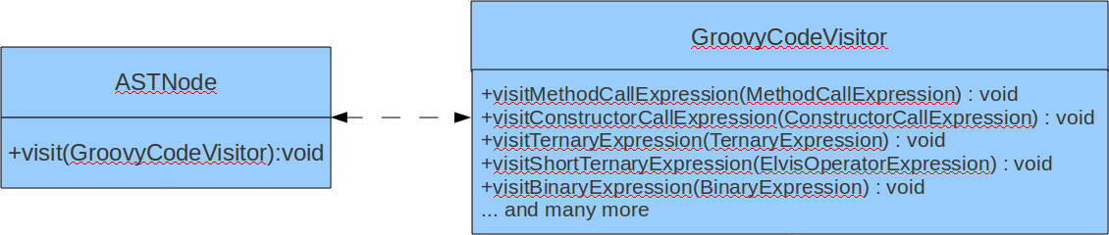
How it works

Slide 48
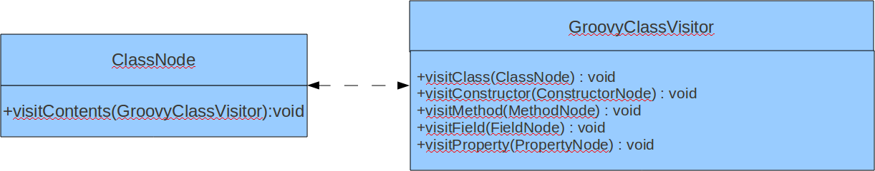
How it works

Slide 49
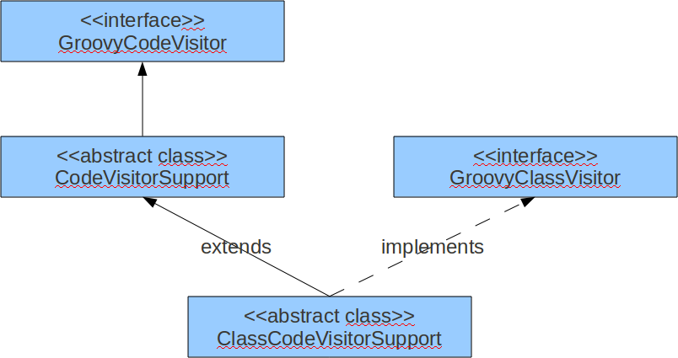
How it works

Slide 50
Tree Walking Strategies
Embedded Heterogeneous Tree Walker
External Tree Visitor
Tree Grammar
Tree Pattern Matcher

Slide 51
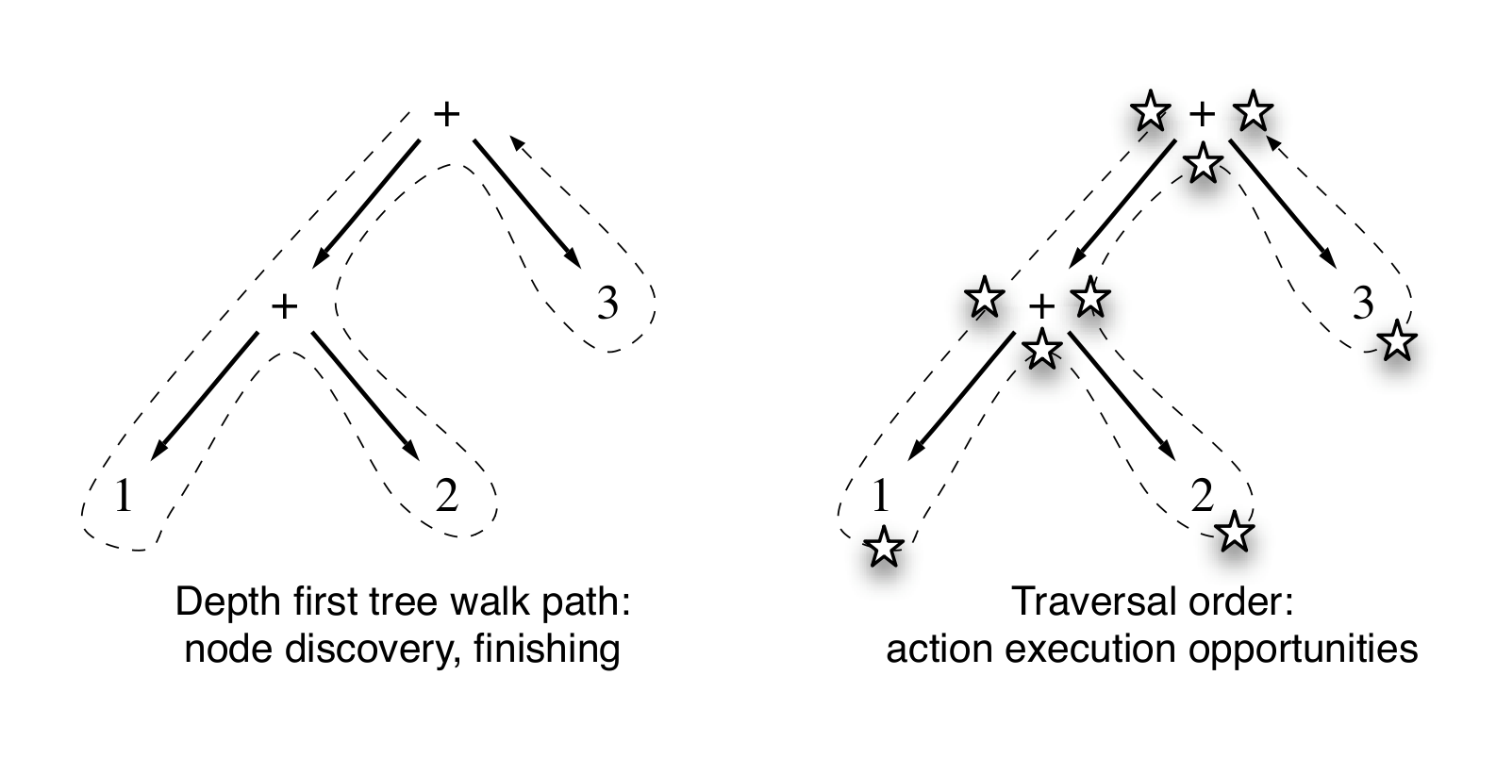
Traversal Order
From Terrence Parr, “Language Implementation Patterns”

Slide 52
Embedded Languages
def s = new ArithmeticShell()
assert 2 == s.evaluate(' 1+1 ')
assert 1.0 == s.evaluate('cos(2*PI)')
public interface GroovyCodeVisitor {
void visitBlockStatement(BlockStatement statement);
void visitForLoop(ForStatement forLoop);
void visitWhileLoop(WhileStatement loop);
void visitDoWhileLoop(DoWhileStatement loop);
...
}

Slide 53
How it Works
Compiles Groovy to AST
Analyzes AST Nodes
– Not well typed
– Not many tokens
– unreliable with other AST Transforms

Slide 54
Other Friends
GContracts
Spock
Groovy++

Slide 55

Java Perversions
def "Does simple math work?"() {
expect:
def s = new ArithmeticShell()
s.evaluate(input) == output
where:
input | output
'1 + 1' | 2
'cos(2*PI)' | 1.0
}

Slide 56
Global Transformations
Transform.jar
| - transforms
| - global
| - CompiledAtASTTransformation.class
| - CompiledAtASTTransformation$_visit_closure1.class
| - ...
| META-INF
| - services
| - org.codehaus.groovy.transform.ASTTransformation
| - org.codehaus.groovy.source.Extensions

Slide 57

Mirah

Slide 58
Ruby FizzBuzz
1.upto(100) do |n|
print "Fizz" if a = ((n % 3) == 0)
print "Buzz" if b = ((n % 5) == 0)
print n unless (a || b)
print "\n"
end

Slide 59
Mirah FizzBuzz
1.upto(100) do |n|
print "Fizz" if a = ((n % 3) == 0)
print "Buzz" if b = ((n % 5) == 0)
print n unless (a || b)
print "\n"
end

Slide 60
Mirah: Pure JVM Class Output
public class Fizz-buzz {
public static void main(String[] argv) {
...
do { n = __xform_tmp_4;
...
if (n % 15 == 0)
System.out.println("FizzBuzz");
else if (n % 5 == 0)
System.out.println("Buzz");
else if (n % 3 == 0)
System.out.println("Fizz");
else
System.out.println(n);
...
} while (__xform_tmp_4 <= __xform_tmp_5);
}
}

Slide 61
Mirah: .java File Output
if (((n % 15) == 0)) {
PrintStream temp$10 = System.out;
temp$10.println("FizzBuzz");
} else {
if (((n % 5) == 0)) {
PrintStream temp$11 = System.out;
temp$11.println("Buzz");
} else {
if (((n % 3) == 0)) {
PrintStream temp$12 = System.out;
temp$12.println("Fizz");
} else {
PrintStream temp$13 = System.out;
temp$13.println(n);
}
}
}

Slide 62
What it Means
– Fast
– Lightweight
– Uses JDK
– Runs on Android?
– Runs on GWT?

Slide 63
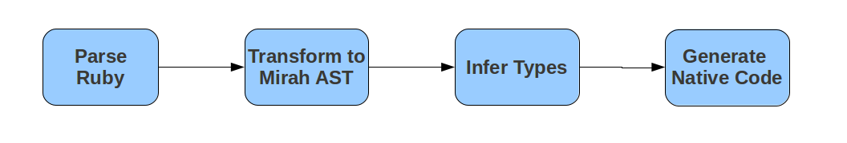
How it Works

Slide 64
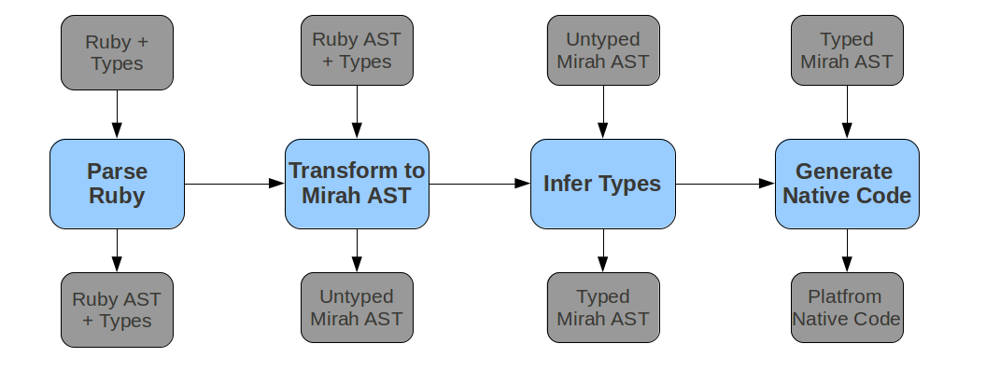
How it Works

Slide 65
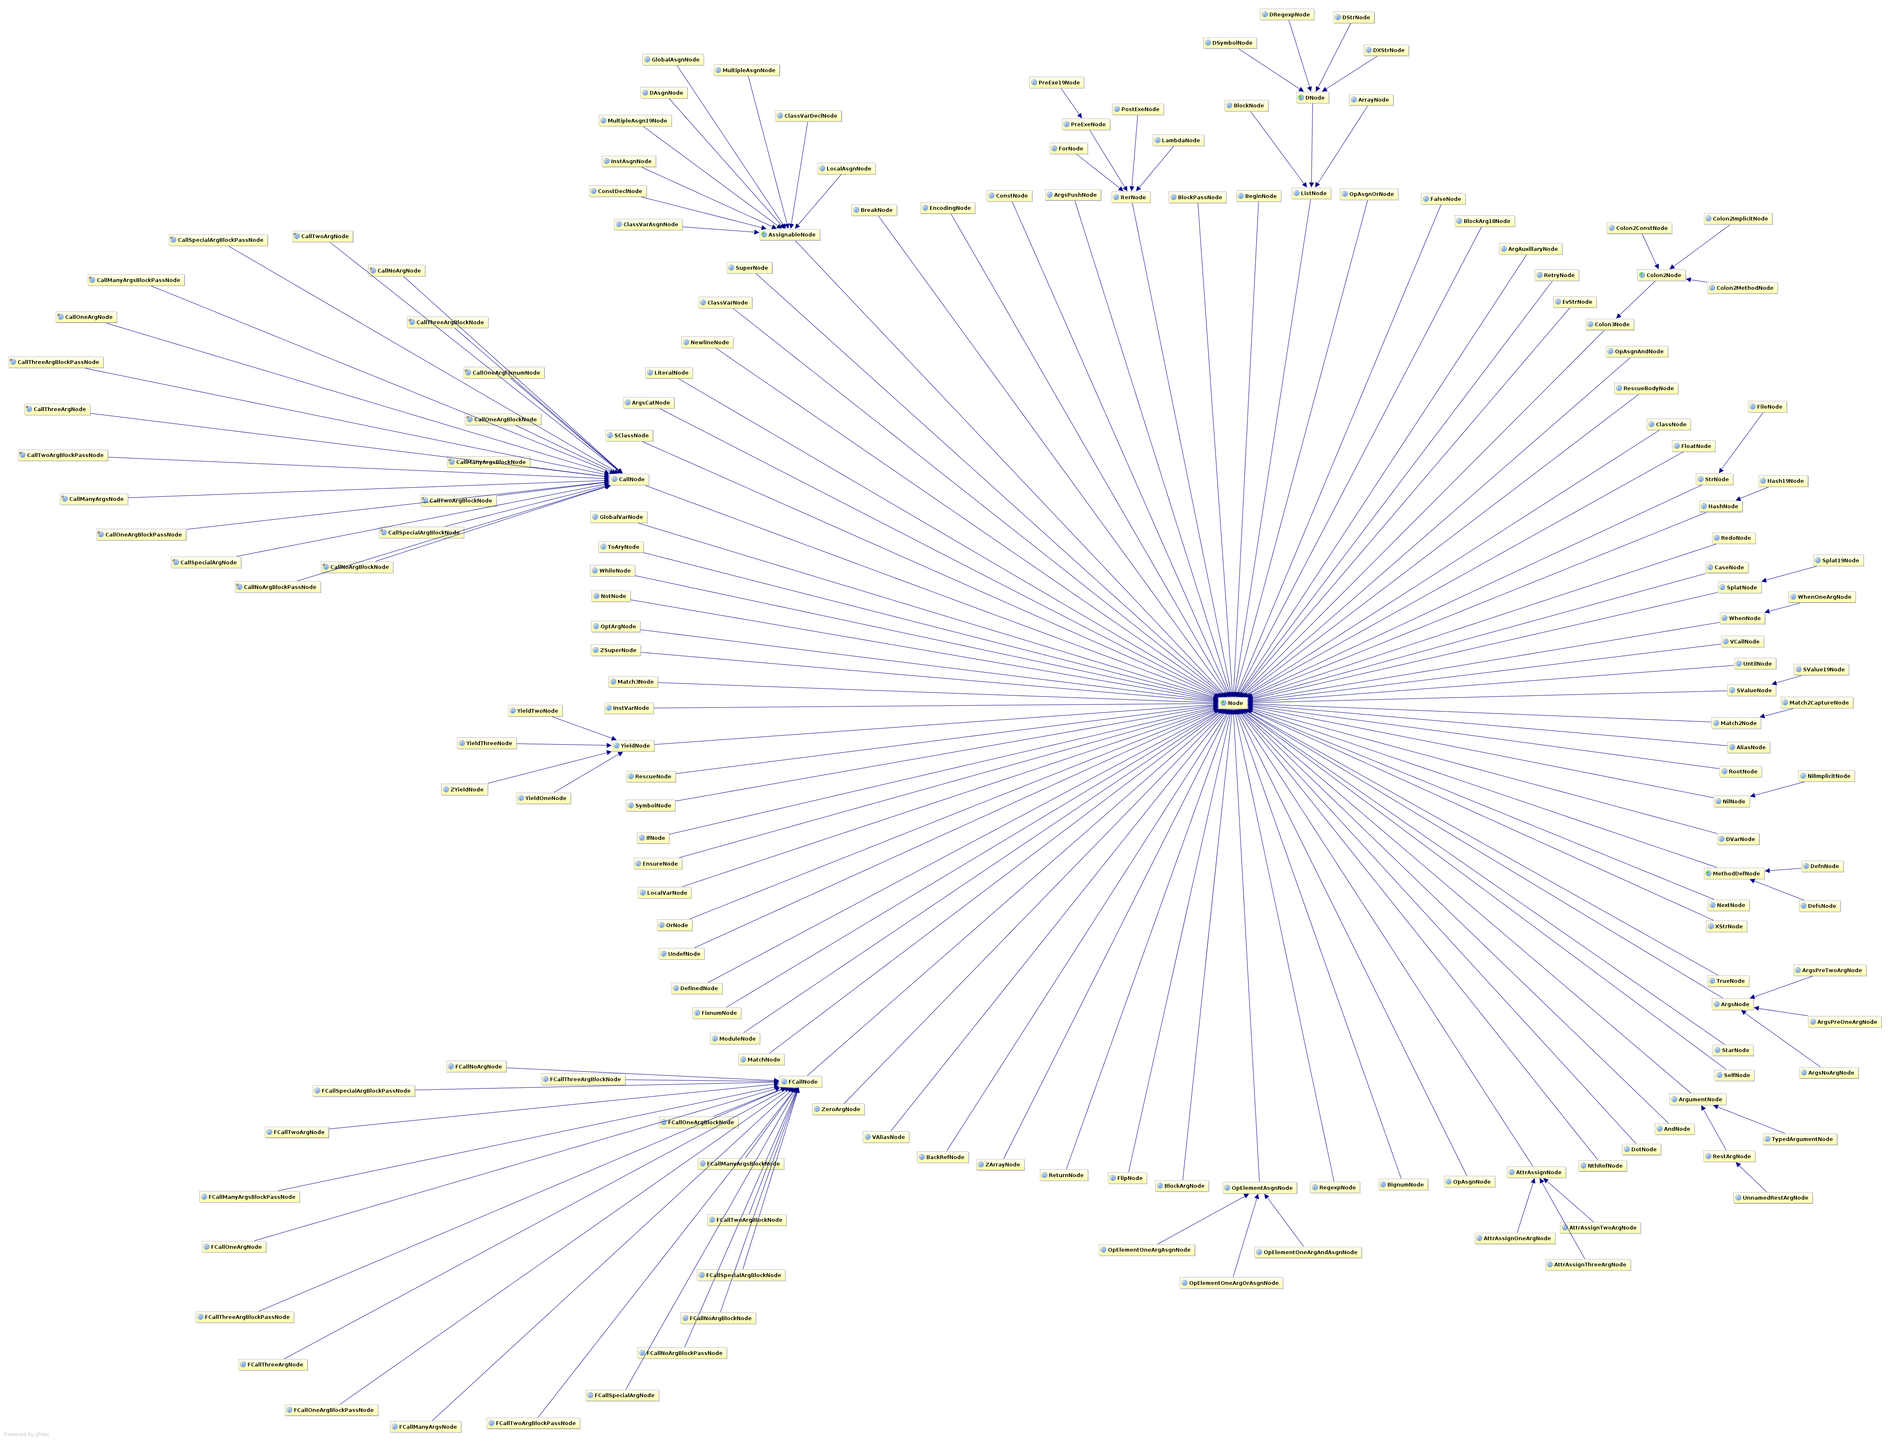

Slide 66
Mirah Macros
macro def eachChar(value, &block)
quote {
`value`.toCharArray.each do | my_char |
`block.body`
end
}
end
eachChar('laat de leeeuw niet ...') do | my_char |
puts my_char
end

Slide 67
Summary
AST Transformations are Framework oriented
      Easily transform classes and fields
      Difficult to find call-sites
      Still Difficult to generate AST
Macros are more general
      Compiler handles invocation
      Easily quote ASTs into source
      Static types are a big win for transformations

Slide 68
Not Covered Here...
Homogeneous AST
      JRuby: Normalized Heterogeneous AST
      Groovy: Irregular Heterogeneous AST

Slide 69

Not Covered Here...
Homogeneous AST
      JRuby: Normalized Heterogeneous AST
      Groovy: Irregular Heterogeneous AST

Slide 70
Agenda
Lombok and Groovy AST Transformations
      – Abstract Syntax Trees
CodeNarc and IntelliJ IDEA
      – Static Analysis and Code Rewriting
GContracts, Spock, Groovy++
      – Frame-Oriented Code Generation
Mirah
      – Macros and Static Typing

Slide 71
Thanks!
What to do next:
– Groovy Wiki and Mailing List is amazingly helpful
– Use your creativity and patience
– http://hamletdarcy.blogspot.com & @HamletDRC
Groovy, Grails, Griffon, and Agile Consulting
info@canoo.com or hamlet.darcy@canoo.com

