Slide 1




Thinking in Functions
Hamlet D'Arcy
Pearson
@HamletDRC
hamletdrc@gmail.com
http://hamletdarcy.blogspot.com
OpenOffice Slides: http://is.gd/39E1s

Slide 2
What 3 books should be required reading for every college grad?
Notes:
A good question. Gets in your head and can't leave.
This was an exercise at a teacher's retreat.

Slide 3



Joshua Kerievsky's List
Notes:
Joshua Kerievsky “I.D.E.A.L. CS Graduates” - Agile 2006, Minneapolis. Educator's track.
1. How to read a book – “Find an uncomfortable chair”
Me: “Always highlight”, “write up review”, “collect quotes”
2.Simple & Direct: a rhetoric for writers – “most writing is rewriting” and this applies to software too
Me: Is Martin's “Clean Code” the same book in a different context?
3.The Collected Dialogs – understanding rhetoric and argument is a necessary skill.
Me: Understanding Ethos, Logos, and Pathos is important to how I observe the world, but not always in how I behave in the world. What's missing?

Slide 4
What 3 books should be required reading for every college grad?
Notes:
1. What are your three books? (note, this is college grad not CS grad). Write down 1 on a notecard and bring it to drinks after the meeting.
How did you make this list? Did you ask yourself...
What 3 books changed my life?
What did I not know then that I do know now?
What are three books I like now?
In college, we aren't always challenged to think. Or we are challenged but within comfortable constraints.

Slide 5
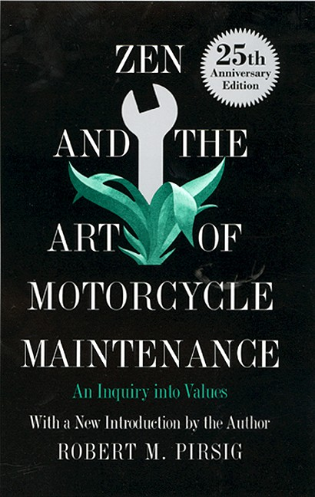

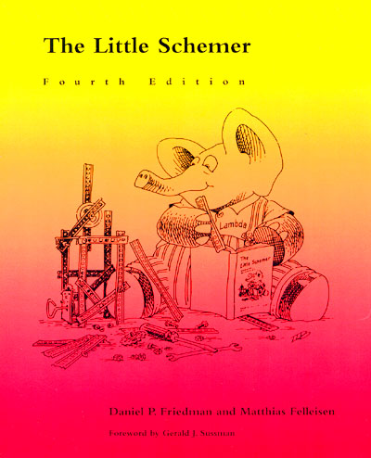
Notes:
1.Zen and the Art of Motorcycle Maintenance - "The world is much more than it seems. Every decision you make and action you take contains a rich subtext describing what you believe and what you value. Thinking about your life can reveal how you should live your life."
Asking “What should I do next?” is less important than asking “What values inform my behavior?”

Slide 6
Notes:
2.Clash of Civilizations - "The world is a rich and complex place with irreconcilable differences that can lead to serious and brutal conflicts. The diversity and tolerance espoused on college campuses hides some of the truths about civilizational conflicts. Understanding the world we live in is an important aspect of being a global citizen"
Conflicts define history. We will not all get along because we do not all share the same values and principles. This is a challenging book for challenging times. (Conflicts define your career, btw)
How much intolerance can a tolerant society tolerate? Murder in Amsterdam by Ian Baruma is a good book to explore this with.

Slide 7
Notes:
1.The Little Schemer - "There is great beauty, creativity, and joy in science and mathematics, and it is far from simple memorization. There is little you're truly incapable of learning, as evidenced by this simple lesson in lambda calculus, combinatorials, and the halting problem"
The last book is there because of my history: a sociology undergrad degree who saw no value or creativity in technology or science as a profession.
Value Judgement: It is more important to think about how to solve problems than to actually go out and solve problems. There is always value in “going meta”
Sow how did a liberal arts major come to this?

Slide 8
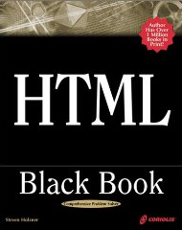
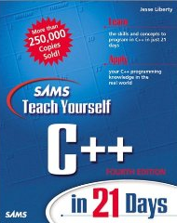
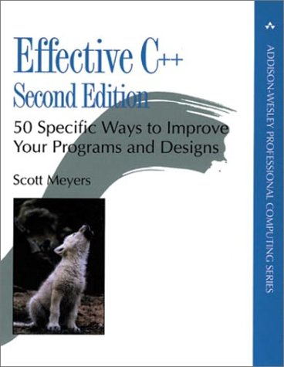
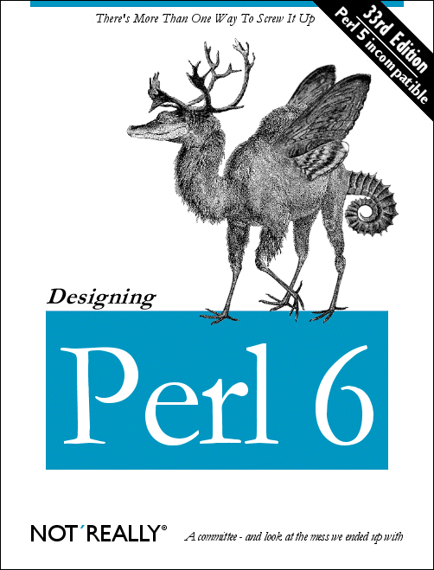
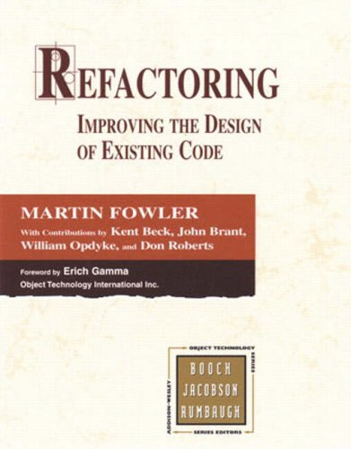
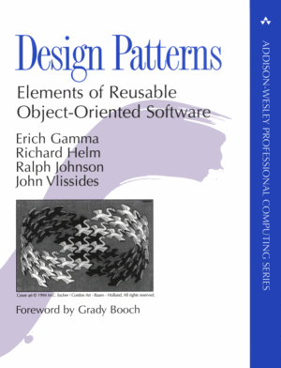
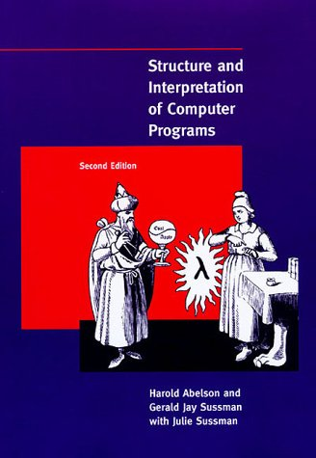
… a little self indulgence
1997 2009
Notes:
I did not “come out the chute” thinking FP was the only way to solve problems. Far from it, I exited college skeptical of technology as a beneficial force much less thinking of a career in programming.
This is the short chronicle of one person's thoughts over 12 years of time.
[is it not odd that a talk on FP quickly goes meta and becomes an autobiogaphy of thinking about thinking]

Slide 9
Notes:
1997
Making websites part authoring and part publishing
HTML Block Book taught me writing code was a creative endeavor. The form was the content. Coding was self-expression and creative.
(Note, if I'd known about CMSs and separating content from structure then I would have /hated/ learning HTML. I like it because it was mixed).

Slide 10
Notes:
1998
Making things is fun. Games are fun. I'll try my hand at something more serious. Plus I need the money.
The compiler was the ultimate objective critic.
C++ taught me to appreciate objectivity. There are only two questions I need to answer: “Does it compile?” and “Does it work (i.e. not crash)?”
Freedom from opinions was liberating. There is a right and wrong answer to problems.

Slide 11
Notes:
1998
It takes a lot of work to be really good at something (which I never achieved in C++)
There is a craft to software development, not a science. Memorizing a lot of rules and heuristics is the right way forward to being better at what you're doing. Understanding the details downward (towards the hardware) is the key to becoming a better craftsman.
Software development is a craft not a science
I defined myself as a computer programmer
It was a bit like trying to memorize the DM guide in D&D

Slide 12
Notes:
2000
Depression is a result of intelligence. You are smart enough to know something is wrong with the world, but not aware enough to live a better solution.
Something was wrong with C++ programming. I could smell the smells.
Some tools are better than others for solving certain problems.
Being a better craftsman meant finding better tools and staying on top of the latest trends.

Slide 13
Notes:
2001 - Refactoring changed my life.
Being a better programmer meant discovering and using idioms common to several languages and several platforms. It was not about digging down into the details of hardware and OS issues.
Previously, programming was an objective (but creative) endeavor.
Refactoring revealed that there are several principles and heuristics to apply to a component. Balancing which approach to use was a subjective matter.
Being a good programmer was a matter of opinions and taste

Slide 14
Notes:
2003 – Software design is an on-going subjective debate where participants balance competing ideas with what will work best at the time.
Abstraction is the common theme across system. Solving a problem means making it look like some other, previously solved problem (sounds like mathematical proofs, huh?
System design will be informed by the person most capable of arguing a point (i.e. glib). Which was exactly the problem with Sociology. The difference was in the tangible work product and act of building.

Slide 15
Notes:
2008 – SCIP Book club. (book is free online)
There is ton of stuff you don't know and have never heard of. Recursion, infinite streams, constraint based systems. There are entire worlds outside of OO that can inform your (subjective) system designs.
System design is driven by opinions. In matters of opinions it pays to be widely and well read.
Academic book where solving academic (math) problems is a matter of opinion and taste!
FP is somber, dense, and difficult, but very well written and rewarding if you stick with it

Slide 16
Notes:
2008 – The Little Schemer. FP is fun, easy, and frivolous
The most advanced topics in the world can be explained one simple, tangible step at a time. Uses Socratic method as gentle introduction to topics like Y-Combinator and halting problem.
“What You Need to Know to Read This Book: The reader must be comfortable reading English, recognizing numbers, and counting.”
FP solutions are...
* elegant because they are simple
* simple because they are declarative
* simple because they are consistent
* simple because they are understandable from top to bottom (turtles all the way down)

Slide 17
a little Little Schemer...
Is it true that this is an atom?
5
Is it true that this is an atom?
'pickles'
Is it true that this is a list?
[pickles]
Is it true that this is a list?
[5, pickles]
Notes:
Yes
Yes
Yes
Yes

Slide 18
Is it true that this is a list?
[[5, 'pickles'], 'and', 'cheese']
Is it true that this is a list?
[]
Is it true that this is a list?
[ [ ], [ ], [ ] ]
Notes:
Yes
Yes
Yes
Perfect, now you understand lists and atoms.

Slide 19
What is x.head() where x is
[1, 2, 3]
What is x.head() where x is
[[1, 2, 3], 4, 5, 6]
What is x.head() where x is
[ ]
Notes:
1
[1, 2, 3]
No answer

Slide 20
What is x.tail() where x is
['a', 'b', 'c']
What is x.tail() where x is
[['a', 'b', 'c'], 'd', 'e', 'f']
What is x.tail() where x is
[ ]
Notes:
[b, c]
[d, e, f]
No answer

Slide 21
What is x.tail().head() where x is
['a', 'b', 'c']
What is x.head().tail() where x is
['a', 'b', 'c']
What is the definition of .head() and .tail()?
Notes:
B
No answer
Great, you understand head and tail (aka car and cdr). But that's only important if you want to sound academic.

Slide 22
Let's write a function!
def size(lat) {
...
}
assert 0 == size([])
assert 1 == size(['apples'])
assert 2 == size(['apples', 'pears'])
Notes:
What is the first thing you need to do?
Hint: look at the first assertion

Slide 23
Let's write a function!
def size(lat) {
if (!lat) 0
...
}
assert 0 == size([])
assert 1 == size(['apples'])
assert 2 == size(['apples', 'pears'])
Notes:
Yes!
What is next?
Look at the assertions... the answer must be at least 1, right?

Slide 24
Let's write a function!
def size(lat) {
if (!lat) 0
else 1 + ...
}
assert 0 == size([])
assert 1 == size(['apples'])
assert 2 == size(['apples', 'pears'])
Notes:
Here is a hint...

Slide 25
We wrote a function!
def size(lat) {
if (!lat) 0
else 1 + size(...)
}
assert 0 == size([])
assert 1 == size(['apples'])
assert 2 == size(['apples', 'pears'])
Notes:
Here is another hint...
Can we use head() or tail() ?

Slide 26
We wrote a function!
def size(lat) {
if (!lat) 0
else 1 + size(lat.tail())
}
assert 0 == size([])
assert 1 == size(['apples'])
assert 2 == size(['apples', 'pears'])
Notes:
Does this work?

Slide 27
… try another
def isMember(a, lat) {
...
}
assert false == isMember(2, [])
assert true == isMember(2, [1, 2, 3])
assert false == isMember(66, [1, 2, 3])
Notes:
What is the first thing we should do?
What is the first assertion?

Slide 28
… try another
def isMember(a, lat) {
if (!lat) false
...
}
assert false == isMember(2, [])
assert true == isMember(2, [1, 2, 3])
assert false == isMember(66, [1, 2, 3])
Notes:
Correct, empty list is false.
What is the next assertion?

Slide 29
… try another
def isMember(a, lat) {
if (!lat) false
else if (lat.head() == a) true
...
}
assert false == isMember(2, [])
assert true == isMember(2, [1, 2, 3])
assert false == isMember(66, [1, 2, 3])
Notes:
Now what, should we call ourself?

Slide 30
… try another
def isMember(a, lat) {
if (!lat) false
else if (lat.head() == a) true
else isMember(...)
}
assert false == isMember(2, [])
assert true == isMember(2, [1, 2, 3])
assert false == isMember(66, [1, 2, 3])
Notes:
What is the parameter?

Slide 31
… try another
def isMember(a, lat) {
if (!lat) false
else if (lat.head() == a) true
else isMember(a, lat.tail())
}
assert false == isMember(2, [])
assert true == isMember(2, [1, 2, 3])
assert false == isMember(66, [1, 2, 3])
Notes:
Does this work?

Slide 32
The 1st Commandment
Always ask null? or zero?
as the first question
in expressing any function
Notes:
Let's see some more examples of this...

Slide 33
some more functions...
def plus(n, m) {
if (m == 0) n
else plus(add1(n), m-1)
}
assert 2 == plus(2, 0)
assert 4 == plus(2, 2)

Slide 34
def minus(n, m) {
if (m == 0) n
else minus(sub1(n), m-1)
}
assert 2 == minus(2, 0)
assert 5 == minus(10, 5)

Slide 35
def multiply(n, m) {
if (m == 0) 0
else
plus(n, multiply(n, (sub1(m))))
}
assert 0 == multiply(3, 0)
assert 6 == multiply(2, 3)
Notes:
I think you got it.
Was that hard?

Slide 36
What is cons(a, list) where
a = 'peanut'
list = ['butter', 'and', 'jelly']
What is cons(a, list) where x is
a = ['peanut', 'fluff']
list = ['and', 'jelly']
What is cons(a, list) where x is
a = [1, 2, 3]
list = 4
Notes:
[peanut, butter, and, jelly]
[ [peanut, fluff] ] , and, jelly ]
No answer, 2nd parameter must be list
Are you ready to use cons?

Slide 37
def evens(lat) {
...
}
assert [] == evens([])
assert [2, 4] == evens([2, 3, 4, 5])
Notes:
What is first assert?
What is 1st commandment?

Slide 38
def evens(lat) {
if (!lat) []
...
}
assert [] == evens([])
assert [2, 4] == evens([2, 3, 4, 5])
Notes:
What is the next question we need to ask?

Slide 39
def evens(lat) {
if (!lat) []
else if (!(lat.head() % 2)) ...
else ...
}
assert [] == evens([])
assert [2, 4] == evens([2, 3, 4, 5])
Notes:
“Is the first element odd? “

Slide 40
def evens(lat) {
if (!lat) []
else if (lat.head() % 2)
evens(lat.tail())
else ...
}
assert [] == evens([])
assert [2, 4] == evens([2, 3, 4, 5])
Notes:
Now should we use our new built in?

Slide 41
def evens(lat) {
if (!lat) []
else if (lat.head() % 2)
evens(lat.tail())
else
cons(...)
}
assert [] == evens([])
assert [2, 4] == evens([2, 3, 4, 5])
Notes:
What is the first parameter to cons?

Slide 42
def evens(lat) {
if (!lat) []
else if (lat.head() % 2)
evens(lat.tail())
else
cons(lat.head(), ...)
}
assert [] == evens([])
assert [2, 4] == evens([2, 3, 4, 5])
Notes:
What is the 2nd?

Slide 43
def evens(lat) {
if (!lat) []
else if (lat.head() % 2)
evens(lat.tail())
else
cons(lat.head(), evens(lat.tail()))
}
assert [] == evens([])
assert [2, 4] == evens([2, 3, 4, 5])
Notes:
Does this work?

Slide 44
Are you getting a feel
for building functions?

Slide 45
def remove(a, lat) {
...
}
assert [] == remove('apples', [])
assert ['oranges'] ==
remove('apples', ['apples', 'oranges'])
assert ['butter'] ==
remove('peanut', ['peanut', 'butter'])
Notes:
What is 1st assertion? What is 1st commandment?

Slide 46
def remove(a, lat) {
if (!lat) []
...
}
assert [] == remove('apples', [])
assert ['oranges'] ==
remove('apples', ['apples', 'oranges'])
assert ['butter'] ==
remove('peanut', ['peanut', 'butter'])
Notes:
What question should we ask next?

Slide 47
def remove(a, lat) {
if (!lat) []
else if ...
else ...
}
assert [] == remove('apples', [])
assert ['oranges'] ==
remove('apples', ['apples', 'oranges'])
assert ['butter'] ==
remove('peanut', ['peanut', 'butter'])
Notes:
So ask it!

Slide 48
def remove(a, lat) {
if (!lat) []
else if (lat.head() == a) ...
else ...
}
assert [] == remove('apples', [])
assert ['oranges'] ==
remove('apples', ['apples', 'oranges'])
assert ['butter'] ==
remove('peanut', ['peanut', 'butter'])
Notes:
What is the answer?

Slide 49
def remove(a, lat) {
if (!lat) []
else if (lat.head() == a) lat.tail()
else ...
}
assert [] == remove('apples', [])
assert ['oranges'] ==
remove('apples', ['apples', 'oranges'])
assert ['butter'] ==
remove('peanut', ['peanut', 'butter'])

Slide 50
def remove(a, lat) {
if (!lat) []
else if (lat.head() == a) lat.tail()
else cons(...)
}
assert [] == remove('apples', [])
assert ['oranges'] ==
remove('apples', ['apples', 'oranges'])
assert ['butter'] ==
remove('peanut', ['peanut', 'butter'])

Slide 51
def remove(a, lat) {
if (!lat) []
else if (lat.head() == a) lat.tail()
else cons(lat.head(), ...)
}
assert [] == remove('apples', [])
assert ['oranges'] ==
remove('apples', ['apples', 'oranges'])
assert ['butter'] ==
remove('peanut', ['peanut', 'butter'])

Slide 52
def remove(a, lat) {
if (!lat) []
else if (lat.head() == a) lat.tail()
else cons(lat.head(), remove(a, lat.tail()))
}
assert [] == remove('apples', [])
assert ['oranges'] ==
remove('apples', ['apples', 'oranges'])
assert ['butter'] ==
remove('peanut', ['peanut', 'butter'])

Slide 53
The 2nd Commandment
Use cons to build lists

Slide 54
remember evens?
def evens(lat) {
if (!lat) []
else if (lat.head() % 2) evens(lat.tail())
else cons(lat.head(), evens(lat.tail()))
}

Slide 55
remember remove?
def remove(a, lat) {
if (!lat) []
else if (lat.head() == a) lat.tail()
else cons(lat.head(), remove(a, lat.tail()))
}
Notes:
Do you notice similarities?

Slide 56
The 3rd Commandment
When building a list,
describe the first typical element,
then cons it onto the natural recursion

Slide 57
remember size?
What if we write it differently?
def size(lat) {
if (!lat) 0
else 1 + size(lat.tail())
}

Slide 58
The 4th Commandment
Always change at least one argument while recurring. It must be changed to be closer to termination. The changing argument must be tested in the termination condition
Notes:
Yes, it is best to avoid infinite recursion.

Slide 59
remember size?
def size(lat) {
if (!lat) 0
else 1 + size(lat.tail())
}

Slide 60
remember evens?
def evens(lat) {
if (!lat) []
else if (lat.head() % 2)
evens(lat.tail())
else
cons(lat.head(), evens(lat.tail()))
}

Slide 61
The 5th Commandment
When building a value with +,
always use 0 for the value of the terminating line
When building a value with *,
always use 1 for the value of the terminating line
When building a value with cons,
always consider [ ] for the value of the terminating line

Slide 62
Are you getting a feel
for building functions?

Slide 63
remember isMember?
def isMember(a, lat) {
if (!lat) false
else
if (lat.head() == a) true
else isMember(a, lat.tail())
}
How often does the value a change?
Notes:
If it never changes then why do we keep passing it?

Slide 64
better?
def isMember(a, list) {
def inner = { lat ->
if (!lat) false
else
if (lat.head() == a) true
else inner(lat.tail())
}
inner(list)
}
Notes:
This seems a little cleaner
Please note, this is invalid groovy. You cannot reference a named closure from within that closure.

Slide 65
The 6th Commandment
Simplify only after the
function is correct

Slide 66
Have you ever heard of the
Extract Method Refactoring?
Notes:
When you see the same code duplicated, extract it into a single method to eliminate the duplication.

Slide 67
The 8th Commandment
Use help functions to abstract
from representations

Slide 68
remember evens?
def evens(lat) {
if (!lat) []
else
if (lat.head()%2) evens(lat.tail())
else cons(lat.head(), evens(lat.tail()))
}

Slide 69
imagine odds
def evens(lat) {
if (!lat) []
else
if (lat.head()%2) evens(lat.tail())
else cons(lat.head(), evens(lat.tail()))
}
def odds(lat) {
if (!lat) []
else
if (lat.head()%2 == 0) odds(lat.tail())
else cons(lat.head(), odds(lat.tail()))
}
Notes:
Do you see the duplication?
But it is hard to extract a method here to eliminate duplication...

Slide 70
Does this work too?
def isOdd(x) { x % 2 == 1 }
def evens(lat) {
if (!lat) []
else
if (isOdd(lat.head())) evens(lat.tail())
else cons(lat.head(), evens(lat.tail()))
}
Notes:
This is one way to do it but doesn't go far enough

Slide 71
What about this version?
def collect(lat, f) {
if (!lat) []
else
if (f(lat.head())) collect(lat.tail(), f)
else cons(lat.head(), collect(lat.tail(), f))
}
def evens(lat) {
collect(lat, { x -> x % 2 == 1 })
}
def odds(lat) {
collect(lat, { x -> x % 2 == 0 })
}
Notes:
We extracted 2 methods and then passed them into the function.
Is this commandment 8 or a new commandment?
This doesn't actually run :(

Slide 72
The 9th Commandment
Abstract common patterns
with a new function
Notes:
A new one.
Did we forget commandment 6?

Slide 73
… post 6th Commandment
def collect(list, f) {
def inner = { lat ->
if (!lat) []
else if (f(lat.head())) inner(lat.tail())
else cons(lat.head(), inner(lat.tail()))
}
inner(list)
}
def evens(lat) {
collect(lat, { x -> x % 2 == 1 })
}
def odds(lat) {
collect(lat, { x -> x % 2 == 0 })
}

Slide 74
remember remove?
def remove(a, lat) {
if (!lat) []
else if (lat.head() == a) lat.tail()
else cons(lat.head(), remove(a, lat.tail()))
}
Can we make it remove an element
and tell you the size of the element?

Slide 75
def removeAndCount(a, lat) {
...
}
assert [] == removeAndCount('cake', [])
assert [['pie', 3]] ==
removeAndCount('cake', ['pie', 'cake'])

Slide 76
def removeAndCount(a, lat) {
if (!lat) []
...
}
assert [] == removeAndCount('cake', [])
assert [['pie', 3]] ==
removeAndCount('cake', ['pie', 'cake'])

Slide 77
def removeAndCount(a, lat) {
if (!lat) []
else if (lat.head() == a) ...
else ...
}
assert [] == removeAndCount('cake', [])
assert [['pie', 3]] ==
removeAndCount('cake', ['pie', 'cake'])

Slide 78
def removeAndCount(a, lat) {
if (!lat) []
else if (lat.head() == a) lat.tail()
else ...
}
assert [] == removeAndCount('cake', [])
assert [['pie', 3]] ==
removeAndCount('cake', ['pie', 'cake'])

Slide 79
def removeAndCount(a, lat) {
if (!lat) []
else if (lat.head() == a) lat.tail()
else cons(
... ,
...)
}
assert [] == removeAndCount('cake', [])
assert [['pie', 3]] ==
removeAndCount('cake', ['pie', 'cake'])

Slide 80
def removeAndCount(a, lat) {
if (!lat) []
else if (lat.head() == a) lat.tail()
else cons(
cons(lat.head(), [size(lat.head())]),
...)
}
assert [] == removeAndCount('cake', [])
assert [['pie', 3]] ==
removeAndCount('cake', ['pie', 'cake'])

Slide 81
def removeAndCount(a, lat) {
if (!lat) []
else if (lat.head() == a) lat.tail()
else cons(
cons(lat.head(), [size(lat.head())]),
removeAndCount(a, lat.tail()))
}
assert [] == removeAndCount('cake', [])
assert [['pie', 3]] ==
removeAndCount('cake', ['pie', 'cake'])

Slide 82
The 10th Commandment
Build functions to collect more
than one value at a time

Slide 83
Did we forget the 6th
Commandment again?

Slide 84
… that's better.
def removeAndCount(a, list) {
def inner = { lat ->
if (!lat) []
else if (lat.head() == a) lat.tail()
else cons(
cons(lat.head(), [size(lat.head())]),
inner(lat.tail()))
}
inner(list)
}

Slide 85
That is all.
There isn't any more.

Slide 86
Where are my design patterns?
Strategy Pattern
Template Method
Factory Pattern
Observer Pattern
Composite Pattern
Notes:
Key unit of abstraction is a function, not an object
This doesn't mean throwing away your OO skills and knowledge, just applying it a little differently.
Many of these patterns are naturally expressed using functions. They don't need a name.
Our evens/odds implementation is a strategy pattern, isn't it?

Slide 87
Template Method
abstract class Template {
def template(input) {
def x = step1(input)
def y = step2(x)
step3(y)
}
def step1(input) { ... }
protected abstract step2(input)
def step3(input) { ... }
}
class TemplateImpl extends Template {
def step2(input) { ... }
}
Notes:
All the keywords are bolded. They bind you into an abstraction.

Slide 88
Template Method?
def step1(input) { ... }
def step3(input) { ... }
def template(input, step2) {
def x = step1(input)
def y = step2(x)
step3(y)
}
def templateImpl = { input ->
template(input, { ... })
}
Notes:
Note, templateImpl is a function that wraps another function, hiding one of the parameters.
This is called “Partial Function Application” or “Currying”. Do you feel academic now?

Slide 89
Where are all the keywords?
Notes:
In Java, your mechanism of abstraction are “extends”, “implements”, and “abstract”.
In FP, your mechanism of abstraction is the function.
FP is simpler and more consistent than mainstream OO

Slide 90
Factory Pattern
interface Calculation {
def apply(n, m);
}
class CalculationFactory {
def plus() { [apply: {n, m -> n + m } ] }
def minus() { [apply: {n, m -> n - m } ] }
def times() { [apply: {n, m -> n * m } ] }
def divide() { [apply: {n, m -> n / m } ] }
}
assert 5 ==
new CalculationFactory().plus().apply(2, 3)
Notes:
Not bad in Groovy.

Slide 91
Factory Pattern?
let calculate f n m = f n m
let plus = calculate (+)
let minus = calculate (-)
let times = calculate (*)
let divide = calculate (/)
assert (5 = plus 2 3)
Notes:
This is deliberately obtuse so you can see the “factoryness” of it.
calcFactory usage is binding 1 of 3 arguments to the calculate function. This is called “Partial Function Application”. Do you feel academic now?
Why is the syntax different here? Because it's much easier to express this one in F#/OCaml syntax than Groovy. Symbols are a function, but somehow Groovy won't let you treat them like one. Hmmm. Inconsistent.

Slide 92
Observer Pattern
class MyObserver implements Observer {
void update(Observable subject, state) {
...
}
}
vs.
def myObserver = { subject, state -> ... }
Notes:
Simplicity is not about typing less characters. How many concepts do you count in the two examples?
FP example: a function. parameters.
OO example: a class, “implements”, an interface, method implementing (void, not def), a named type (Observable, so implementing works). What's not shown that you'll need to know: a constructor, method invocation on an object

Slide 93
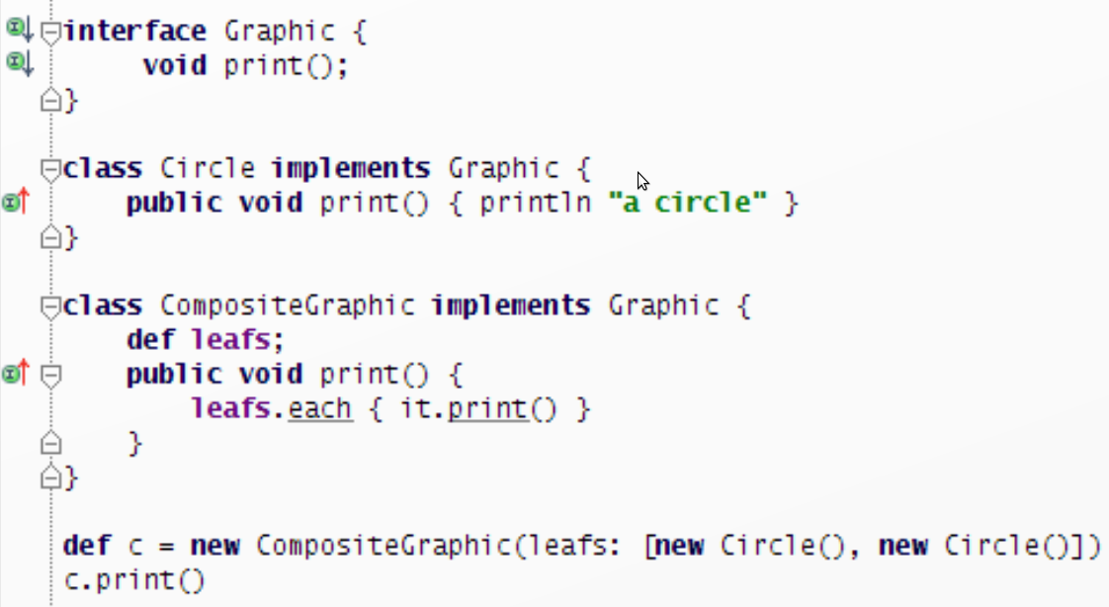
Composite Pattern
Notes:
The composite idea is simple to understand.
The composite implementation is an orgy of complexity. You need 4 gutter marks and 4 colors to understand it. This is a lot of complexity.

Slide 94
Composite Pattern?
def circle = { println "a circle" }
def makeComposite = { leaf1, leaf2 ->
{ -> leaf1(); leaf2() }
}
makeComposite(circle, circle)()
Notes:
I thought there were no semi-colons in Groovy?
makeComposite is a function that returns a function. This is called a “Higher Order Function” Feel academic?
MakeComposite is also called a “Combinator”.

Slide 95
def makeComposite = { leaf1, leaf2 ->
{ -> leaf1(); leaf2() }
}
A combinator is a higher-order function
that uses only function application
and earlier defined combinators
to define a result from its arguments.

Slide 96
are there new patterns?
κατα μορφή ανα μορφή
ὑλο μορφή meta-μορφή
Does this help?

Slide 97
Catamorphisim
κατα = downward, catastrophe
μορφή = form, shape
'a list -> 'b
def sum(list) {
if (!list) 0
else list.head() + sum(list.tail())
}
Notes:
a recursive function that starts with a broad shape (a big old list) and funnels it into a single output (like an integer). The size() or length() method on a list can be a catamorphism. These functions are sometimes called “fold”. They take a type signature of List <Type A> into <Type B>.

Slide 98
Anamorphism
ανα = upward
μορφή = form, shape
'a -> 'b list
def first(max) {
if (max == 1) [1]
else cons(max, first(max-1))
}
Notes:
Take a single input and expand it upwards into a wide list. This one is frequently called “unfold”,

Slide 99
Hylomorphism
ὑλο = wood
μορφή = form, shape
composition of an anamorphism and a catamorphism
('a -> 'b list) + ('b list -> 'c)
('a -> 'c)
def sumFirst(max, list) {
sum(first(max))
}

Slide 100
Metamorphism
composition of a catamorphism and an anamorphism
('a list -> 'b) + ('b -> 'c list)
('a list -> 'c list)
assert ['a', 'b', 'c', 'd'] ==
wordListToChars(["ab", "cd"])
def wordListToChars(list) {
chars(concat(list))
}

Slide 101
what's the point?
The primary unit of abstraction is the function
Ideas behind OO patterns hold true in FP
Your OO skills are still valuable in FP
Notes:
FP skills are also useful in OO programming. Especially concurrency, but also correctness.

Slide 102
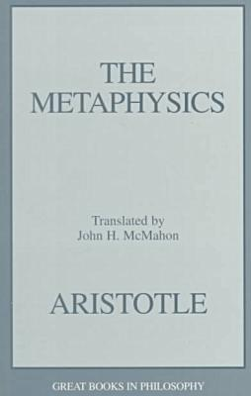
a final diversion...
Notes:
Do you know why it is called metaphysics?
The term Metaphysics was created by a first century translator of Aristotle. It's the title he gave to the untitled chapter that came after the chapter on physics.

Slide 103
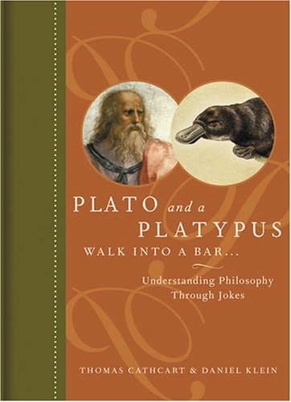
Notes:
This is a much better treatment of the same material.

Slide 104
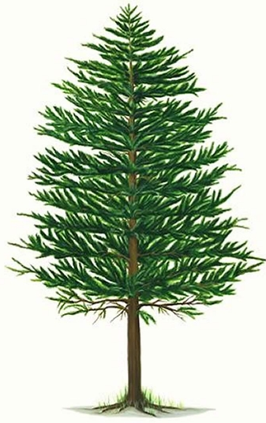
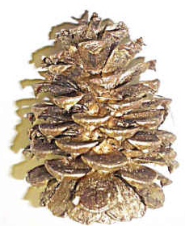


telos
Notes:
everything has a telos, an inner goal it is meant to attain. A pine cone has an inner goal of a pine tree. A coffee bean has a telos of a double latte. It is what the coffee bean was meant to be.
On a larger scale, most software has a telos too.
It's not hard to argue that software components have a telos; it is considerably harder to do so about humans in general!

Slide 105

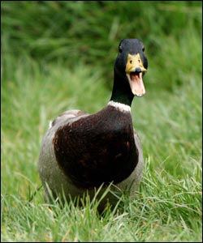
Notes:
"What makes this so?" What makes an elephant an elephant? What makes a duck a duck? Just as importantly, what makes an elephant not a duck?
Aristotle makes a distinction between essential properties and accidental properties of an object. The essential properties are those traits that makes a thing that thing. A black elephant is still an elephant. A gray duck is still a duck. But if your elephant has feathers and a beak, then perhaps it's not really an elephant. Accidental properties, on the other hand, describe how a thing is rather than what it is. The color brown is accidental to a duck, but feathers and a beak are pretty essential.

Slide 106
Accidental Complexity
println "Hello World"
vs.
class HelloWorld {
public static void main(String args[]) {
System.out.println("Hello World");
}
}
Notes:
Which has more accidental complexity?

Slide 107
Essential Complexity
(print (- 40 (* 2 (+ 5 10))))
vs.
println 40 - (5 + 10 * 2)
Notes:
Lisp might have accidental complexity in the parenthesis. But Lisp prints 10 and Groovy prints 15
Hiding the parens leads to miscalculations, as in this example. The parens are not accidental complexity but essential complexity.
The Lisp version is superficially more complex. It shows all the essential properties of arithmetic while the Groovy/Java version abbreviates them away to nothingness. The Groovy/Java version is therefore more complex because it is missing essential features like operator precedence. Sometimes simplicity is more verbose than complexity, as this example shows, and sometimes complexity is more verbose, as the Hello World example shows.

Slide 108
The software you write has a telos
Simplicity is showing only traits essential to telos
Complexity is showing only traits accidental to telos
Hiding essential traits and showing accidental traits both lead to complexity.

Slide 109
“Learning Functional Programming in a non-functional language is like learning OO in Cobol”
-Brian Hurt

Slide 110
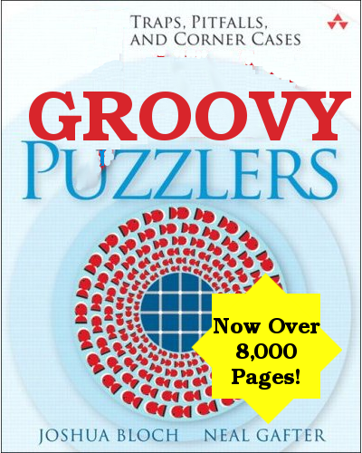
Notes:
Groovy was not created in order to make a more consistent Java or a Java with fewer language concepts.
Groovy is a very cool language, but it has a lot of edge cases and complexity.

Slide 111
Are these interchangeable?
def plus(n, m) { ... }
def plus = { n, m -> ... }
Notes:
What is a function in Groovy?
Not really. It is sometimes hard to predict when they can reference each other.

Slide 112
isMember isBroken
def isMember(a, list) {
def inner = { lat ->
if (!lat) false
else if (lat.head() == a) true
else inner(lat.tail())
}
inner(list)
}
groovy.lang.MissingMethodException: No signature of method: inner()

Slide 113
plus isBroken
def plus(n, m) {
if (m == 0) n
else plus(add1(n), m-1)
}
plus(1, 100000)
Caught: java.lang.StackOverflowError

Slide 114
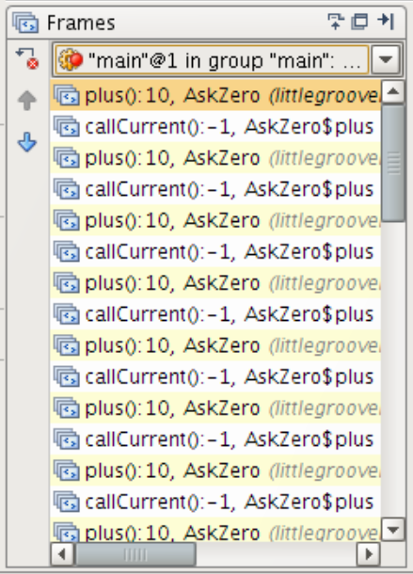
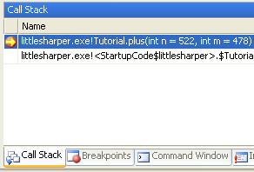
Groovy Callstack
F# Callstack
Notes:
It is rather pointless to program in an FP style in a language without tail calls.
Luckily, this should be coming to the JVM sometime in the future. There is a small expert group forming but no JSR for this.

Slide 115
def plus(n, m) {
if (m == 0) n
else plus(add1(n), m-1)
}
Callstack
n : Object, m : Object
Callstack
n : Object, m : Object
Callstack
n : Object, m : Object

Slide 116

So how does Clojure work?
Callstack
n : Object, m : Object
Callstack
n : Object, m : Object
Callstack
n : Object, m : Object
Notes:
instead of calling functions from within another function, you return a bounce "call" to the trampoline which makes the call for you, doing the same with the return value of that call until it gets a land (a non-bounce return). This avoids the use of the stack for function calls, but allows you to use function closure as a means of saving state.
“the problem comes down to coding tail recursion in C without growing the stack. Many implementations achieve this by using a device known as a trampoline, a piece of code that repeatedly calls functions. All functions are entered via the trampoline. When a function has to call another, instead of calling it directly it returns the address of the function to be called, the arguments to be used, and so on, to the trampoline. This ensures that the C stack does not grow and iteration can continue indefinitely.”

Slide 117
if/else is kinda weak
def remove(a, lat) {
if (!lat) []
else if (lat.head() == a) lat.tail()
else (cons(lat.head(), remove(a, lat.tail())))
}
Can you make .head() or .tail() of this?
Notes:
If elses are not that great an decomposing structures.
If all your abstractions are built up by asking questions about things then it will help to have a better way to ask questions.

Slide 118
Structural Pattern Matching
let rec remove a lat =
match lat with
| [] -> []
| head :: tail when head = a -> List.tl lat
| head :: tail -> head :: remove a tail
Notes:
No repetitive head() and tail() calls
No weird “cons” calls
No parenthesis
No commas
No semi colons
No braces

Slide 119
Will Groovy get FP?
Structural Pattern Matching
… considered for 1.7
… debated for 2.0
Tail Call Optimization
… not currently on roadmap
Recursive Closures/Inner Methods
… not currently on roadmap

Slide 120
Thinking in Groovy
Everything is not a function
Language is not a paragon of consistency
Elegance is terseness

Slide 121
Thinking in Functions
Everything is a function
Beauty in consistency
Elegance is simplicity
Notes:
No repetitive head() and tail() calls
No weird “cons” calls
No parenthesis
No commas
No semi colons
No braces

Slide 122
Uncle Bob's Bowling...
(defn new-game [] [])
(defn frame-type [[first second]]
(cond
(= 10 first) :strike
(= 10 (+ first second)) :spare
:else :no-mark))
(defmulti frame-size frame-type)
(defmethod frame-size :strike [_] 1)
(defmethod frame-size :spare [_] 2)
(defmethod frame-size :no-mark [_] 2)
(defmulti frame-score frame-type)
(defmethod frame-score :strike [[_ first second]] (+ 10 (+ first second)))
(defmethod frame-score :spare [[_ _ next]] (+ 10 next))
(defmethod frame-score :no-mark [[first second]] (+ first second))
(defn score [game]
(loop [frame 1 rolls game score 0]
(if (> frame 10)
score
(recur (inc frame) (subvec rolls (frame-size rolls)) (+ score (frame-score rolls))))))

Slide 123
Uncle Haskell's Bowling...
score [x, y] = x + y -- Normal Frame
score [10, x, y] = 10 + x + y -- Strike
score [x, y, z] = 10 + z -- Spare
score (10:(x:(y:rest))) = 10 + x + y + score (x:(y:rest)) -- Strike
score (x:(y:(z:rest))) | (x + y) == 10 = 10 + z + score (z:rest)--Spare
score (x:(y:rest)) | otherwise = x + y + score rest -- Normal Frame
Functional
Simple
Consistent

Slide 124
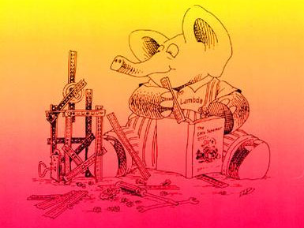
Notes:
The power of functional programming isn't in functions, or recursion, or the trivial examples you use here- it's in monads and arrows and continuation passing style and scrap your boilerplace and lazy data structures and all the other tricks and patterns that build on top of these simple capabilities. Just like the real power of OO programming isn't in defining objects and inheritance, but on what you do with them.

