Slide 1

Metaprogramming in Groovy
Scott Vlaminck
refactr
Hamlet D'Arcy
Pearson

Slide 2
What is Groovy?
Notes:
"Groovy is the REAL Java 2. Henceforth, we can think of the Java language (not the platform) as forever 1.x. Groovy is what the real second version of Java should have been." Neal Ford
dynamic language for the JVM
builds on strengths of Java but features inspired by Python, Ruby, Smalltalk
available to Java developers with almost-zero learning curve
supports DSL Languages and compact syntax
makes writing shell and build scripts easy with its powerful processing primitives, OO abilities and an Ant DSL
reducing scaffolding code when developing all sorts of applications
simplifies testing by supporting unit testing and mocking out-of-the-box
seamlessly integrates with all existing Java objects and libraries
compiles straight to Java bytecode so you can use it anywhere you use Java
No Parenthesis
Named Arguments
Closures
- similar in some ways to delegates in .NET
Scott & Hamlet – Each explain how you use it

Slide 3
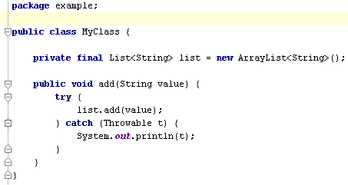
Notes:
Is this Java or Groovy?
This shows what in Groovy is the same as in Java:
* keywords
* exception handling
* entity definitions and instantiation
* Packaging & Imports
* Java 5 enums, generics

Slide 4
What is different?
Notes:
What's Different?
* True OO with no primitives
* String templating
* Closures
* Operator overloading
* Better syntax for new types
* Extended libraries
Groovy Console Demo (need nightly build of 1.7 Groovy Console)
Groovy Strings
def name = "Hamlet"
println "Hello $name"
Closures
3.times { println it }
(10..15).each { println it }
def x = [ 1, 2, 3]
def f = { List list -> list.each { println it } }
f x
Putting it all together
def names = ["Hamlet", "Scott", "Jason"]
println """
<root>
<people>
${writer -> names.each { writer.write " <person>$it</person>\n" }}
</people>
</root>
"""
Amazing glue language. Mention optional static typing. Types get in your way for Controllers and components with no dependencies

Slide 5
How does it work?
Notes:
groovy & groovyc - standard tools, work with Ant
Bidirectional compiler... and now Tri-directional compiler in 1.7
It is Class files
Demo of scripts and javap output

Slide 6
What is Metaprogramming?
Notes:
Metaprogramming is writing a program that manipulates programs, including itself.
Groovy makes metaprogramming easy and provides a number of techniques for doing so.
Metaprogramming is more about the creation and mutation of methods at runtime based on runtime information
Metaprogramming Allows more flexibility in your application, albeit at a potential
increase in complexity
Types of things you can do:
‐ Intercept method calls
‐ Inject new methods
We’ll talk about
‐ What you can do
‐ How to do it
‐ and Walk through some code examples
Groovy is one of the best languages for metaprogramming today.

Slide 7
O-R Mapping in Grails
Notes:
Grails adds O-R Mapping to Plain old Groovy objects
Grails was inspired by many aspects of Rails, especially Convention over Configuration
Examples:
Person.findAllByName(‘Scott’)
Person.findAllByNameLike(‘Jo%’) //… Joe, John, …
Person.findAllByDateOfBirthGreaterThan(aDate)
Person.findAllByNameAndDateOfBirthGreaterThan('Scott', aDate)
I didn't do anything to get these methods.
Metaprogramming allows Grails to respond to method calls like these on my domain class
None of these methods exist at server startup. Grails injects them the first time they are used in the application.

Slide 8
findAllBy* countBy*
LessThan
LessThanEquals
GreaterThan
GreaterThanEquals
Between
Like
Ilike (ignorecase like)
IsNotNull
IsNull
Not
Equal
NotEqual
And
Or
Notes:
This is the standard way of interacting with the database in Grails.
You can use SQL, HQL, etc, but most often don't.

Slide 9
methodMissing(String name, Object[] args)
Notes:
If a method doesn't exist, Groovy will allow your class to try do something with it in methodMissing
In Groovy, every class has a Metaclass. The metaclass has extra information about each class
When a method is invoked, Groovy first checks to see if the Metaclass can respond to the call. If not, Groovy checks to see if the class can respond to the call.
So for O-R Mapping in Grails, the method call is handled by methodMissing, using Regex to decide if and how to respond. It then creates a new method and adds it to the Metaclass to handle future calls to the same method
Example: Person

Slide 10
Aspect Oriented Programming
Notes:
Why AOP?
‐ Crosscutting concerns (things that don’t actually impact what your application is supposed to do)
Examples:
‐ Logging
‐ Security
For our example, we'll implement a very simple 'around advice' to do method logging
‐ A metaobject protocol is one way to implement aspect‐oriented programming languages
- wikipedia

Slide 11
invokeMethod(String name, Object[] args)
Notes:
invokeMethod handles all method invocations in specific instances

Slide 12
methodMissing(String name, Object[] args) invokeMethod(String name, Object[] args)
Notes:
methodMissing vs. invokeMethod
When to use which: it comes down to what you want to do and which feels right
invokeMethod – handle all method invocations
methodMissing – handle only those methods that don't exist

Slide 13
Builders
Notes:
Groovy Builders provide a concise syntax for building arbitrary nested tree structures
As a simple example, take XML creation
XML has a nested tree structure
Lots of ways to implement builders in Groovy
More information:
- http://groovy.codehaus.org/Builders
- http://refactr.com/blog/2007/10/groovy‐builders/

Slide 14
<stocks>
<stock symbol='JAVA' />
<stock symbol='MSFT' />
<stock symbol='IBM' />
</stocks>
Notes:
XML has a nested tree structure, but creating XML in code can often be painful
It might be nice if our code could reflect the output structure
This is such a problem that many languages are handling XML as a special case, building it right into the language itself.
With Groovy Builders it can – without building special language constructs for XML.
But the generic Groovy builder concept, is useful for many other situations as well.
Using Groovy's MarkupBuilder, the code does actually reflect the structure of the output we're looking for.
Within the builder syntax, you can also execute arbitrary logic
- if/else
- looping

Slide 15
Domain-Specific Languages
Notes:
‐ "targeted at a particular type of problem”
‐ context‐driven, fluent, small, expressive, simple
- easy to use and understand, not necessarily simple to design
Examples
‐ 3.days.ago
‐ Builders are basically an instance of a DSL

Slide 16
class Person {
String firstName static mapping = { table 'people' id column:'person_id'
}
}

Slide 17
Spock Testing Framework
def "HashMap accepts null key"() {
setup: def map = new HashMap()
when: map.put(null, "elem")
then: notThrown(NullPointerException)
}
Notes:
How do these goto labels work?

Slide 18
@Singleton
public class MyService { }
Notes:
@Singleton is just a plain old annotation.
That means it is an interface with no implementation behind it.
How did the bytecode get an instance field and a private constructor?

Slide 19
@Singleton
public class MyService { }
% javap MyService -private
Compiled from "MyService.groovy"
public class MyService extends ...
public static final MyService instance;
private MyService();
...
Notes:
@Singleton is just a plain old annotation.
That means it is an interface with no implementation behind it.
How did the bytecode get an instance field and a private constructor?

Slide 20
Groovy is a compiled language
...oh yes it is
Compiled changes visible in .class file
...visible to all JVM users
Language syntax is a library feature
...not hardcoded into the language
Notes:
Groovy is compiled. It can be just-in-time compiled, but it is compiled and the bytecode is generated nonetheless.
Groovy language exposes several ways to hook into the compiler. You can see the code get transformed into an AST, and see that transformed into class output.
Anyone can do this. The syntax of the language is now a library feature you contribute to.

Slide 21
AST for Groovy:
println 4
BlockStatement
ExpressionStatement
MethodCallExpression
VariableExpression
variable = this
originType = Object
ConstantExpression
Value = println:String
Name = null
ArgumentListExpression
ConstantExpression
Value = 4 : Integer
Name = $const$0
Notes:
Source is transformed into AST.
This is the AST for “println 4”
It is a tree structure and is typically walked with a Visitor. This pattern is implemented in Groovy.

Slide 22
def eval = { new ArithmeticShell().evaluate(it) }
assert 6 == eval(" 4 + 2 ")
assert 10 == eval(" 100 / 10 ")
assert 1.0 == eval("cos(2*PI)")
Notes:
I wrote Arithmetic shell as an alternative to JEP, a arithmetic grammar and evaluator.
Provides advanced calculator like behavior to your application. Observes AST to restrict expressions to only those that are allowed in a calculator.
300 Line POGO alternative to custom grammar!
300 line alternative to expensive 3rd party library

Slide 23
@WithLogging
def greet() {
println "Hello World"
}
Notes:
Local AST Transformations =
Simple, Annotation Driven Alternative

Slide 24
@WithLogging
def greet() {
println "Hello World"
}
groovysh> greet()
Starting greet
Hello World
Ending greet
groovysh>
(see code handout)
Notes:
Local AST Transformations =
Simple, Annotation Driven Alternative

Slide 25
@Delegate
@Immutable
@Lazy
@Newify
@Category
@Mixin
@PackageScope
@Grab
Notes:
Famous AST Transformations...
Need to look up meanings more...

Slide 26
Compile time or run-time?
Notes:
Compile Time
Visible in bytecode
Supports syntax changes
Low level source access
Runtime
Simple
???

Slide 27
Smalltalk-80
(1980)
Dynamic Language
Metaobject Protocol
(2007)
Simula 67
(1967)
Groovy
(2003)
1960
1970
1980
1990
2000
2010
Notes:
Simula introduced inheritence
Smalltalk introduced doesNotUnderstand:
Groovy introduced invokeMethod
Atilla Szegedi introduced JVM Dynamic Language Metaobject protocol

Slide 28
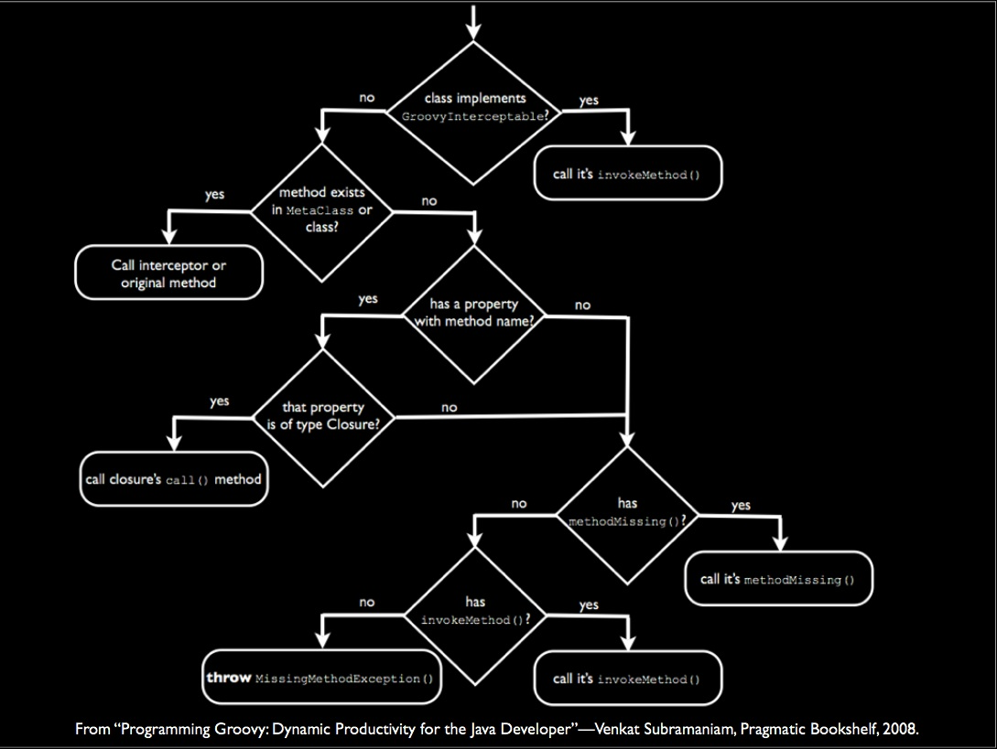
Notes:
An adapter based approach to language interoperability would have to replicate this in order to call into Groovy.

Slide 29
JVM Dynamic Language
Metaobject Protocol
((Scriptable)obj).get("foo");
vs.
metaobjectProtocol.get(obj, "foo");
Notes:
Dynamic MOP provides “navigator” based service layer to locate and invoke methods.

Slide 30
Composability
Groovy MOP
Can handle?
JRuby MOP
Can handle?
Invoke
Method
Java MOP
Can handle?
MethodMissing
Exception
Notes:
Key is Composability

Slide 31
Smalltalk-80
(1980)
Dynamic Language
Metaobject Protocol
(2007)
Simula 67
(1967)
Groovy
(2003)
1960
1970
1980
1990
2000
2010
Notes:
The history of programming languages doesn't seem to be about making the right fundamental decisions and having further work build on it. It seems to be about finding ways to safely put more and more flexibility in the hands of the programmers. I relish the idea of one day being able to safely modify method invocation in a language, and the Dynamic MOP seems like a good step forward.

Slide 32
Metaprogramming
Good Things
Bad Things
Notes:
“With power comes responsibility”
‐ paraphrasing Churchill
‐ Stan Lee, via Peter Parker’s uncle Ben
Concerns:
‐ Maintainability
‐ use of conven/ons can help to address this concern
Java classes in Groovy
‐ metaClass is read‐only
Although there is seamless Groovy‐Java interac/on,
you can only use these techniques on Groovy classes
(at least for now?)
Almost half of all programmers are below average. Do you want them doing this?
Director vs. Enabler

Slide 33
There's a lot we didn't talk about

Slide 34
“Thankyougoodnightiloveyouall”
- O. Osbourne after every song on the B-side of Tribute
Scott Vlaminck
Email: scott@refactr.com
Web: http://refactr.com/blog/
Hamlet D'Arcy
Twitter: HamletDRC
Email: HamletDRC@gmail.com
Web: http://hamletdarcy.blogspot.com

