Slide 1


Code Generation on the JVM
Hamlet D'Arcy
@HamletDRC http://hamletdarcy.blogspot.com

Slide 2
I confess...
My first real programming book was...

Slide 3
I confess...
My first real programming book was...
“Teach Yourself C++ in 24 Hours”

Slide 4
Agenda
Lombok
Spring Roo
Groovy AST Transformations
  – GContracts
  – CodeNarc
  – Spock

Slide 5





About Me

Slide 6
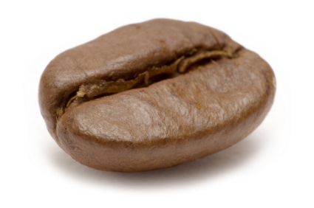

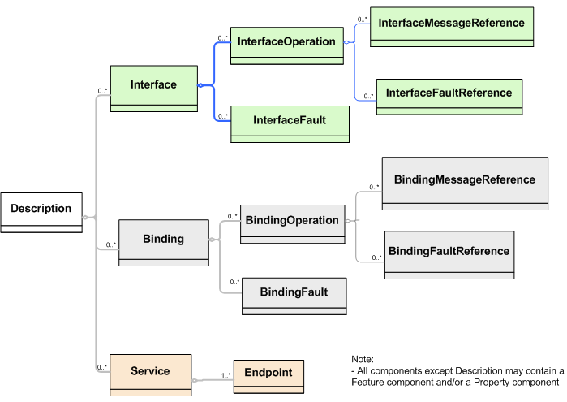
I hate code generation too!
Bean
Generation
Stub
Generation
WSDL
Generation

Slide 7




… but it isn't all bad.

Slide 8
Project Lombok

Slide 9
public class Person {
private String firstName;
private String lastName;
void setFirstName(String fName) {
this.firstName = fName;
}
public String getFirstName() {
return firstName;
}
public void setLastName(String lName) {
this.lastName = lName;
}
public String getLastName() {
return firstName;
}
}
import lombok.Getter;
import lombok.Setter;
public class Person {
@Getter @Setter private String firstName;
@Setter @Setter private String lastname;
}

Slide 10
public class SynchronizedExample {
private final Object $lock = new Object[0];
public void doSomething() {
synchronized($lock) {
return ...;
}
}
}
import lombok.Synchronized;
public class SynchronizedExample {
@Synchronized
public void doSomething() {
return ...;
}
}

Slide 11
@Getter / @Setter
@ToString
@EqualsAndHashCode
@NoArgsConstructor
@RequiredArgsConstructor
@AllArgsConstructor
@Data
@Cleanup
@Synchronized
@SneakyThrows
@Log
val

Slide 12
Generates Java Boilerplate
Compile Time Only
  – For Eclipse and javac
Removable with delombok
Read the fine print
  – You should know what is generated

Slide 13

How it Works

Slide 14

How it Works

Slide 15

How it Works

Slide 16
How it works
Annotation
Eclipse Handler
Javac Handler

Slide 17
// javac
private void generatePropertyChangeSupportField(JavacNode node) {
if (fieldAlreadyExists(PROPERTY_SUPPORT_FIELD_NAME, node)) return;
JCExpression exp = chainDots(node.getTreeMaker(), node, "this");
JCVariableDecl fieldDecl = newField()
.ofType(PropertyChangeSupport.class)
.withName(PROPERTY_SUPPORT_FIELD_NAME)
.withModifiers(PRIVATE | FINAL)
.withArgs(exp)
.buildWith(node);
injectField(typeNode, fieldDecl);
}
// ECJ
private void generatePropertyChangeSupportField(EclipseNode node) {
if (fieldAlreadyExists(PROPERTY_SUPPORT_FIELD_NAME, node)) return;
Expression exp = referenceForThis(node.get());
FieldDeclaration fieldDecl = newField()
.ofType(PropertyChangeSupport.class)
.withName(PROPERTY_SUPPORT_FIELD_NAME)
.withModifiers(PRIVATE | FINAL)
.withArgs(exp)
.buildWith(node);
injectField(typeNode, fieldDecl);
}
Alex Ruiz – Custom AST Transformations with Project Lombok
http://www.ibm.com/developerworks/java/library/j-lombok/

Slide 19
How it Works
`-- contacts
|-- Person.java
|-- Person_Roo_Configurable.aj
|-- Person_Roo_Entity.aj
|-- Person_Roo_JavaBean.aj
|-- Person_Roo_ToString.aj
`-- web
|-- PersonController.java
`-- PersonController_Roo_Controller.aj

Slide 20
How it Works
public class Person implements ConfigurableObject {
...
public String toString() {
return Person_Roo_ToString....Person$toString(this);
}
...
}
public class Person_Roo_ToString {
static String Person_Roo_ToString....Person$toString(
Person ajc$this_) {
StringBuilder sb = new StringBuilder();
...
return sb.toString();
}

Slide 21
Moves Java Boilerplate to .aj files
  – Uses AspectJ's inter-type declaration (ITD) features
  – “Roo doesn't believe in magic!”
Compile Time Only
  – Not a runtime
  – Not an Annotation Processing library
  – No dynamic proxy objects
Removable with rollout mechanism
There is a lot of code on disk
  – Is this Roo's fault?

Slide 23
class Event {
String title
}

Slide 24
class Event {
String title
}
class Event {
String title
public void getTitle() {
title
}
public String setTitle(String t) {
this.title = t
}
}

Slide 25
class Event {
@Delegate Date when
}

Slide 26
class Event implements Comparable, Clonable {
Date when
boolean after(Date when) {
this.when.after(when)
}
boolean before(Date when) {
this.when.before(when)
}
Object clone() {
this.when.clone()
}
int compareTo(Date anotherDate) {
this.when.compareTo(otherDate)
}
int getDate() {
this.when.date
}
int getDay() {
this.when.day
}
int getHours() {
this.when.hours
}
int getMinutes() {
this.when.minutes
}
int getMonth() {
this.when.month
}
int getSeconds() {
this.when.seconds
}
long getTime() {
this.when.time
}
int getTimezoneOffset() {
this.when.timezoneOffset
}
int getYear() {
this.when.year
}
void setDate(int date) {
this.when.date = date
}
void setHours(int hours) {
this.when.hours = hours
}
void setMinutes(int minutes) {
this.when.minutes = minutes
}
void setMonth(int month) {
this.when.month = month
}
void setSeconds(int seconds) {
this.when.seconds = seconds
}
void setTime(long time) {
this.when.time = time
}
void setYear(int year) {
this.when.year = year
}
String toGMTString() {
this.when.toGMTString()
}
String toLocaleString() {
this.when.toLocaleString()
}
}
class Event {
@Delegate Date when
}

Slide 27
class Event {
@Lazy ArrayList speakers
}

Slide 28
class Event {
@Lazy ArrayList speakers
}
class Event {
ArrayList speakers
def getSpeakers() {
if (speakers != null) {
return speakers
} else {
synchronized(this) {
if (speakers == null) {
speakers = []
}
return speakers
}
}
}
}
Also handles:
  Initial values
  Volatile fields

Slide 29
@Immutable
class Event {
String title
}

Slide 30
Class is final
Properties must be @Immutable or effectively immutable
Properties are private
Mutatators throw ReadOnlyPropertyException
Map constructor created
Tuple constructor created
Equals(), hashCode() and toString() created
Dates, Clonables, and arrays are defensively copied on way in and out (but not deeply cloned)
Collections and Maps are wrapped in Immutable variants
Non-immutable fields force an error
Special handling for Date, Color, etc
Many generated methods configurable
@Immutable
class Event {
String title
}

Slide 31
Code Generation Transformations
@ToString
@EqualsAndHashCode
@Canonical
@Lazy
@InheritConstructors
@TupleConstructor

Slide 32
Class Design Annotations
@Delegate
@Singleton
@groovy.transform.Immutable

Slide 33
Logging Improvements
@Log
@Log4j
@Slf4j
@Commons

Slide 34
Declarative Concurrency
@Synchronized
@WithReadLock
@WithWriteLock

Slide 35
Easier Cloning and Externalizing
@AutoClone
@AutoExternalize

Slide 36
Safer Scripting
@TimedInterrupt
@ThreadInterrupt
@ConditionalInterrupt

Slide 37
@Package Scope
@Grab
@Category
@Mixin
@Bindable
@IndexedProperties
@ListenerList
@Vetoable
@Newify
… and many more as libraries

Slide 38
GroovyCodeVisitor
public interface GroovyCodeVisitor {
void visitBlockStatement(BlockStatement statement);
void visitForLoop(ForStatement forLoop);
void visitWhileLoop(WhileStatement loop);
void visitDoWhileLoop(DoWhileStatement loop);
...
}

Slide 39
GroovyCodeVisitor
… source in groovy/src/examples/groovyShell
public interface GroovyCodeVisitor {
void visitBlockStatement(BlockStatement statement);
void visitForLoop(ForStatement forLoop);
void visitWhileLoop(WhileStatement loop);
void visitDoWhileLoop(DoWhileStatement loop);
...
}
def s = new ArithmeticShell()
assert 2 == s.evaluate(' 1+1 ')
assert 1.0 == s.evaluate('cos(2*PI)')

Slide 40
static analysis for Groovy
class SystemRunFinalizersOnExitAstVisitor extends AbstractAstVisitor {
def void visitMethodCallExpression(MethodCallExpression call) {
if (call.objectExpression in VariableExpression) {
def target = call.objectExpression.variable
if (target == "System" && call.method in ConstantExpression) {
if (call.method.value == "runFinalizersOnExit") {
addViolation(call)
}
}
}
super.visitMethodCallExpression(call);
}
}

Slide 41
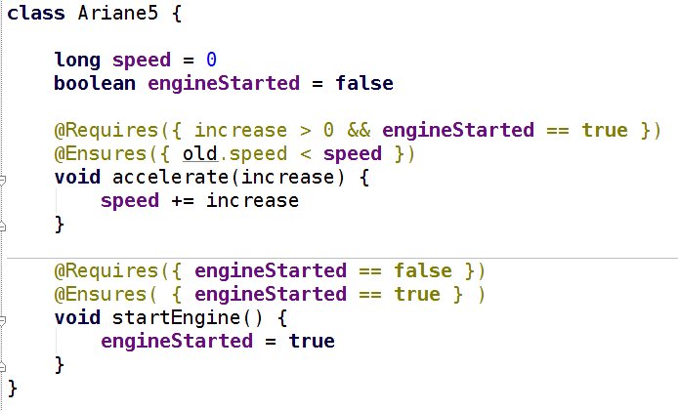
Gcontracts
Contract Driven Development

Slide 42
Spock
Groovy Testing Framework
… from “Hijacking Goto Labels”
def "Does simple math work?"() {
expect:
def s = new ArithmeticShell()
s.evaluate(input) == output
where:
input | output
'1 + 1' | 2
'cos(2*PI)' | 1.0
}

Slide 43
Groovy is a compiled language
...oh yes it is
Compiled changes visible in .class file
...visible to all JVM users
Language semantics are a library feature
...not hardcoded into the language

Slide 44
How it Works
Local AST Transformations
Global AST Transformations
AST Builder
ANTLR Plugins?

Slide 45
Local AST Transformations
class Event {
@Delegate Date when
}
@GroovyASTTransformationClass("org.pkg.DelegateTransform")
public @interface Delegate {
...
}
@GroovyASTTransformation(phase = CompilePhase.CANONICALIZATION)
public class DelegateTransform implements ASTTransformation {
public void visit(ASTNode[] nodes, SourceUnit source) {
...
}
}

Slide 46
Global AST Transformations
Transform.jar
| - transforms
| - global
| - CompiledAtASTTransformation.class
| - CompiledAtASTTransformation$_visit_closure1.class
| - ...
| META-INF
| - services
| - org.codehaus.groovy.transform.ASTTransformation
| - org.codehaus.groovy.source.Extensions
@GroovyASTTransformation(phase = CompilePhase.SEMANTIC_ANALYSIS)
public class SpockTransform implements ASTTransformation {
public void visit(ASTNode[] nodes, SourceUnit sourceUnit) {
...
}
}

Slide 47
AST Builder
def ast = new ExpressionStatement(
new MethodCallExpression(
new VariableExpression("this"),
new ConstantExpression("println"),
new ArgumentListExpression(
new ConstantExpression("Hello World")
)
)
)
def ast = new AstBuilder().buildFromCode {
println "Hello World"
}

Slide 48
AST Templates
… from “GEP 4 - AstBuilder AST Templates”
def wrapWithLogging(MethodNode original) {
new AstBuilder().buildFromCode {
println "starting $original.name"
$original.code
println "ending $original.name"
}
}

Slide 49
… from “Groovy ANTLR Plugins for Better DSLs”
given "some data" {
...
}
when "a method is called" {
...
}
then "some condition should exist" {
...
}

Slide 50
Thanks!
What to do next:
  – Groovy Wiki
  – Groovy Mailing List is amazingly helpful
  – Use your creativity and patience
  – 54 Pages of AST in GINA2 MEAP:

Slide 51
Agenda
Lombok
Spring Roo
Groovy AST Transformations
  – GContracts
  – CodeNarc
  – Spock

Slide 52
Thanks!
Twitter: @HamletDRC
Blog: http://hamletdarcy.blogspot.com
Work Blog: http://www.canoo.com/blog
JetBrains.tv Screencasts: http://tv.jetbrains.net/tags/hamlet
YouTube Screencasts: http://www.youtube.com/user/HamletDRC
Share-a-Canooie – http://people.canoo.com/share/
Hackergarten – http://www.hackergarten.net/

