Slide 1


Introduction to Julia Programming Language
Alper Kinaci, PhD
Sr. Computational Specialist
akinaci@northwestern.edu
Pascal Paschos, PhD
Sr. HPC Specialist
pascal.paschos@northwestern.edu
Research Computing
Services

Slide 2
Outline
Introduction to Julia (short presentation)
Live coding (using Jupyter notebook)
Parallelization demonstration

Slide 3
Julia Language
“Walk like Python, run like C”
Designed for ease-of-use (Python, MATLAB, R) and speed (C, C++) for high performance computational science
Borrowing from Python, C, C++, MATLAB, Lisp, Perl, Lua, Ruby
Open source, object-oriented, good for general-purpose programming
Designed for parallelism and distributed computing
Call for C & Fortran functions directly (no wrappers or special API)
20+ years younger than Python, still maturing in terms of available packages and extensibility

Slide 4
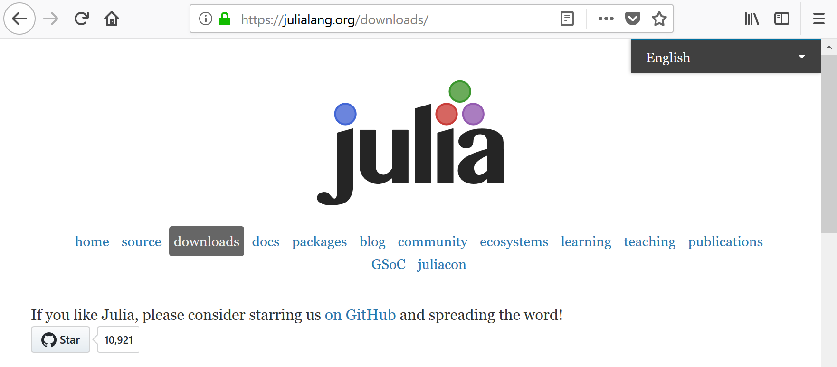
How to Get Julia
https://julialang.org/downloads/

Slide 5
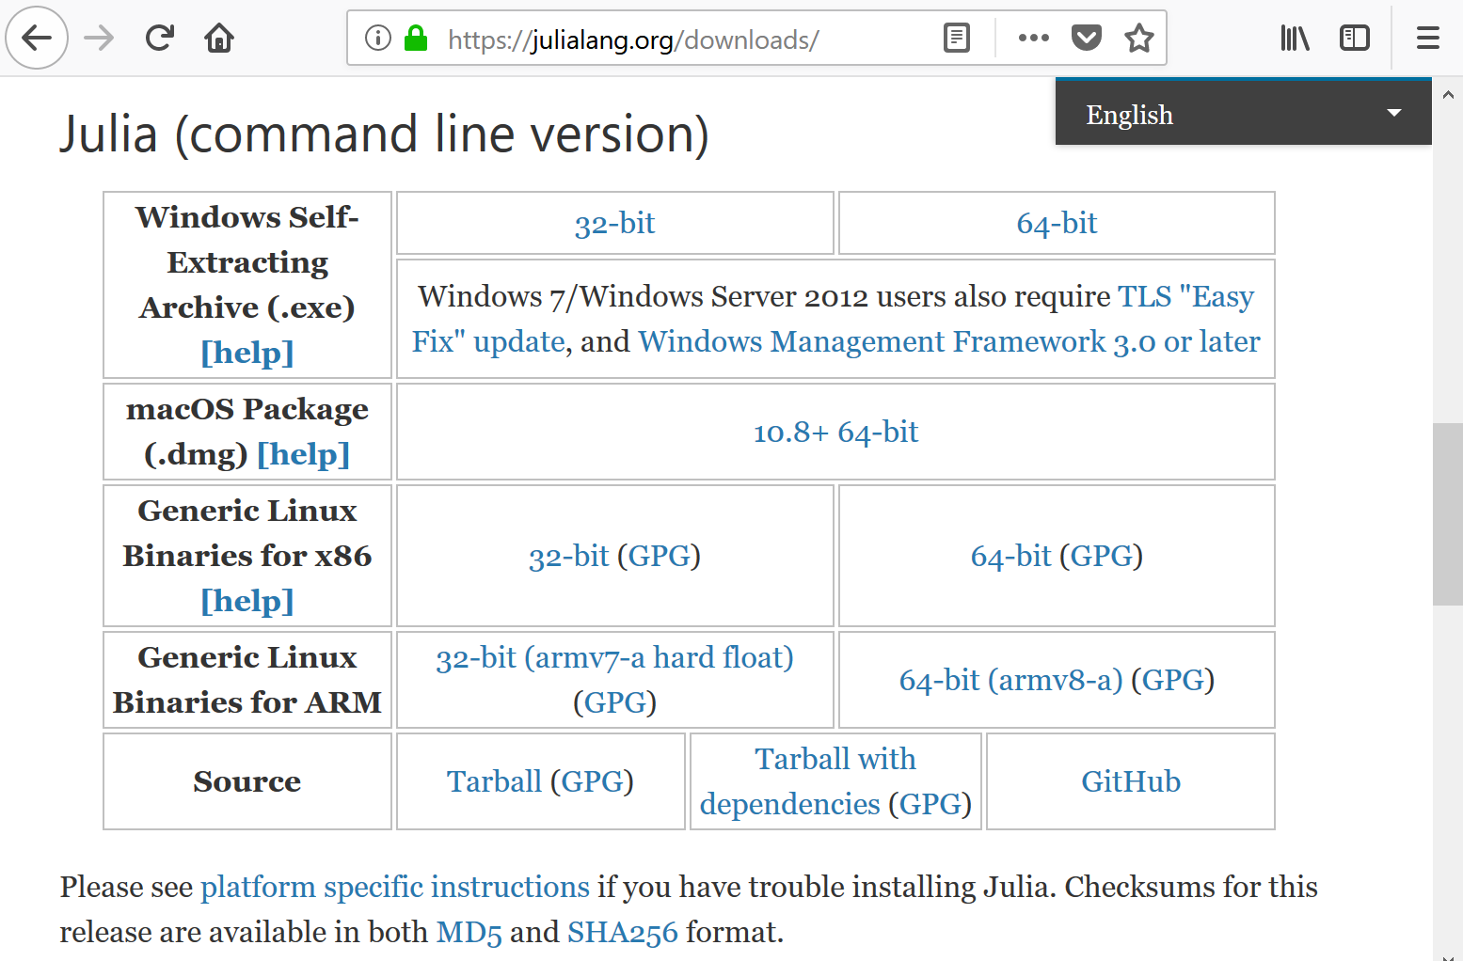
How to Get Julia

Slide 6
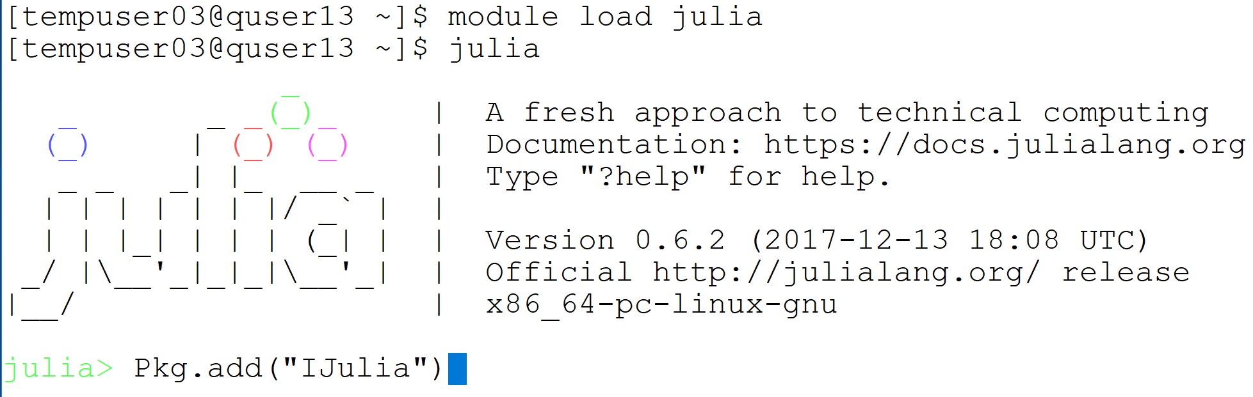

How to Get IJulia
https://github.com/JuliaLang/IJulia.jl

Slide 7
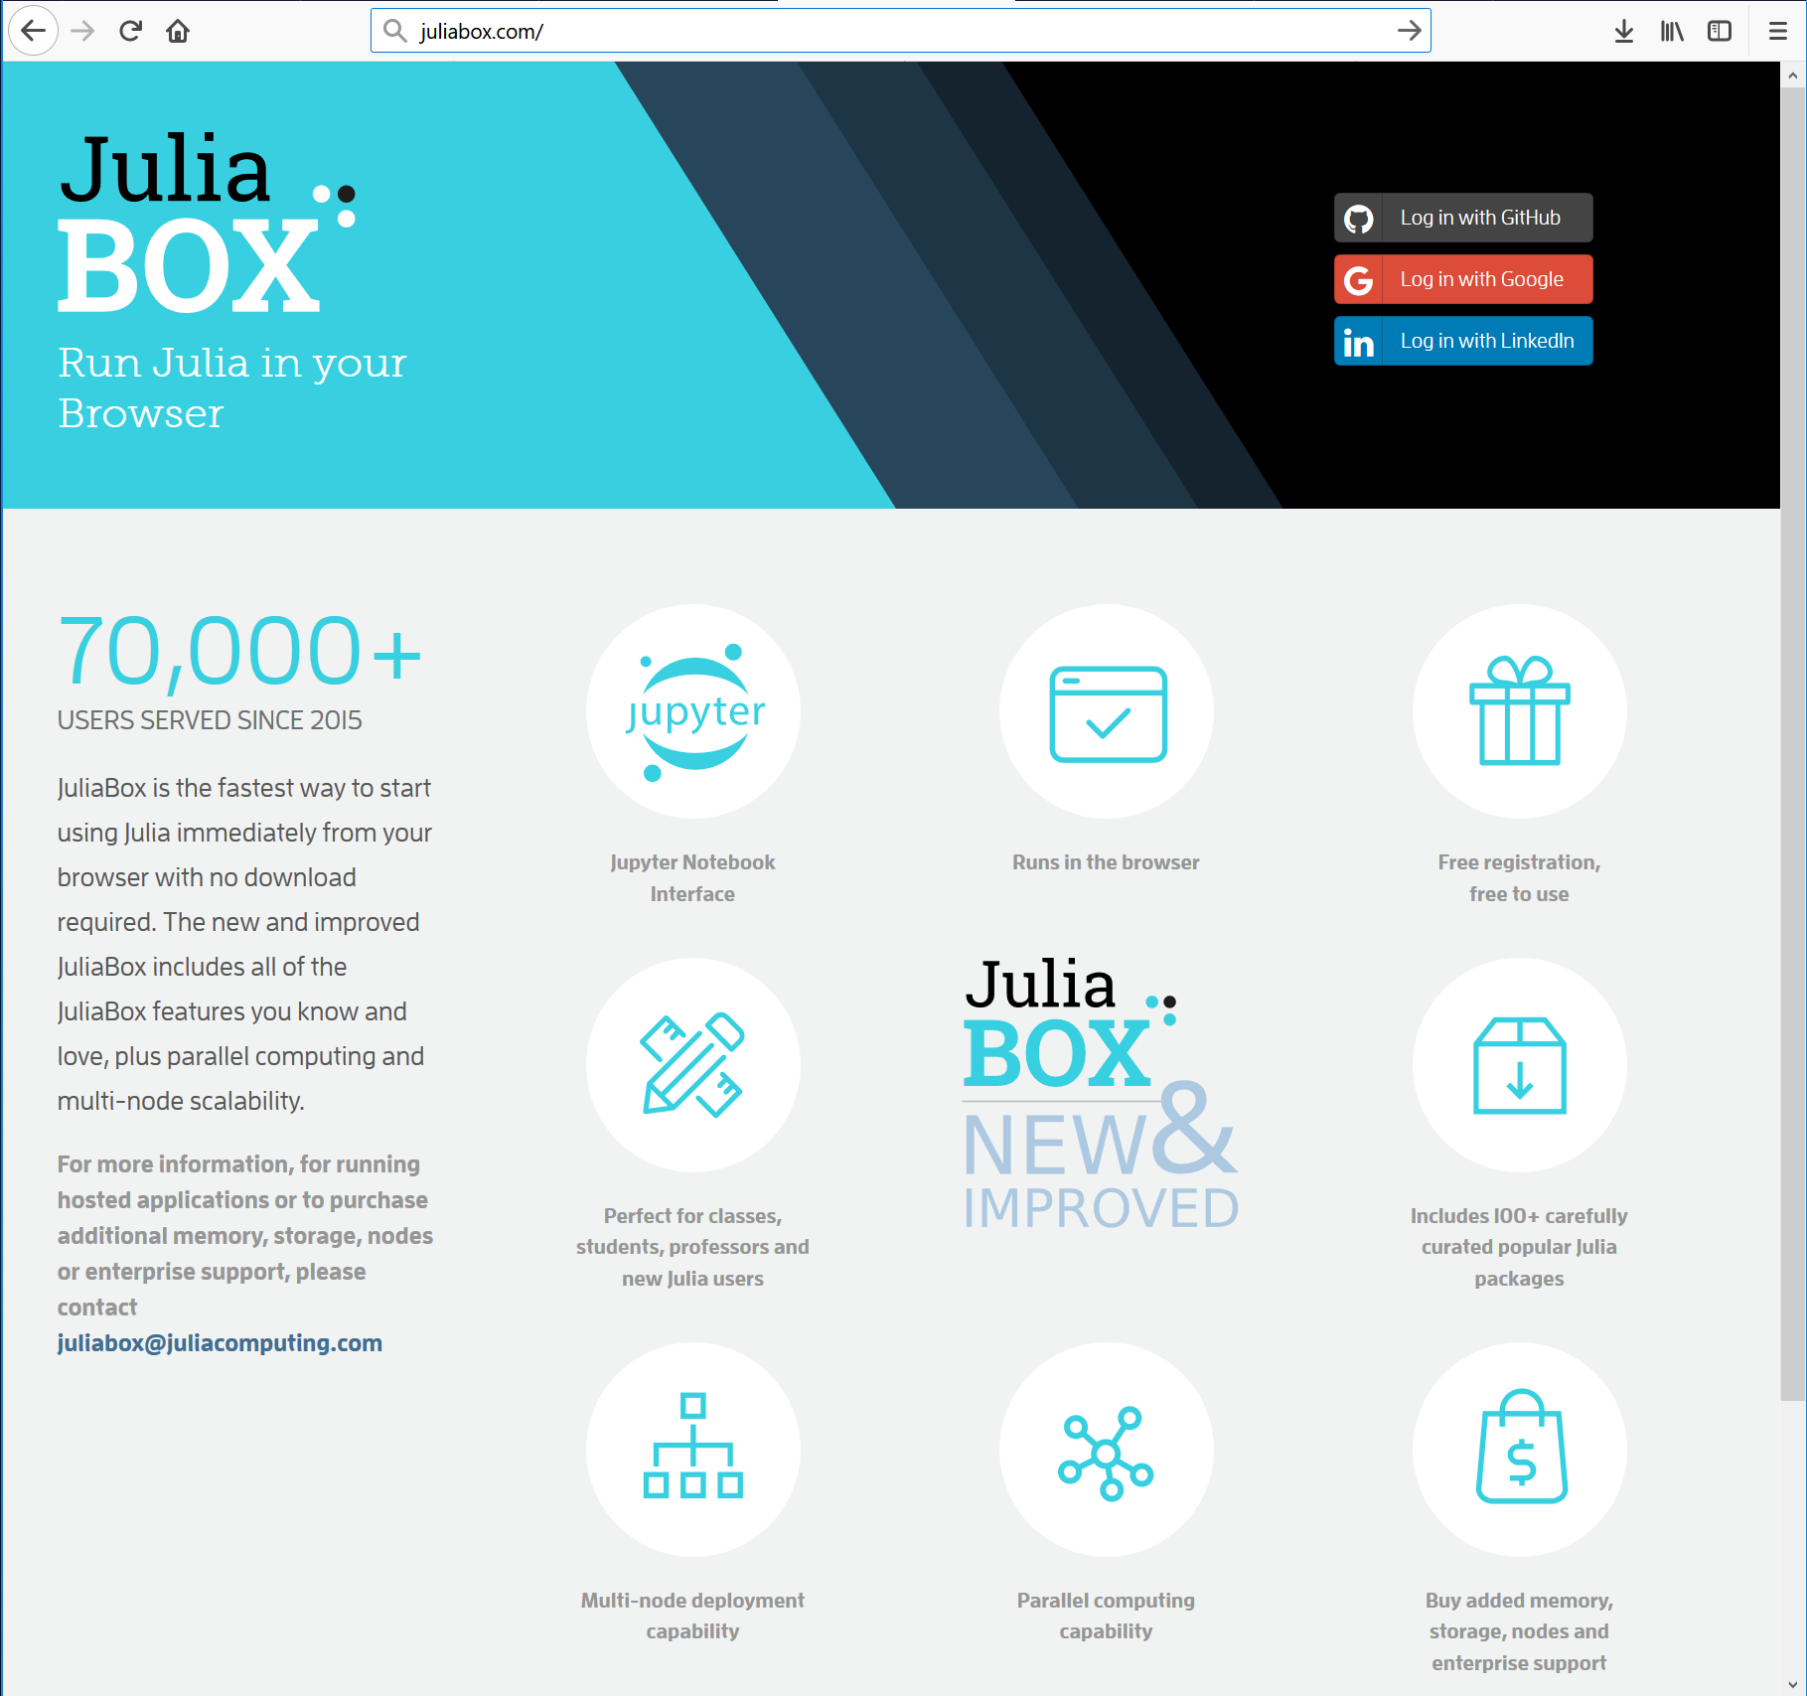
Instant Julia
https://juliabox.com

Slide 8
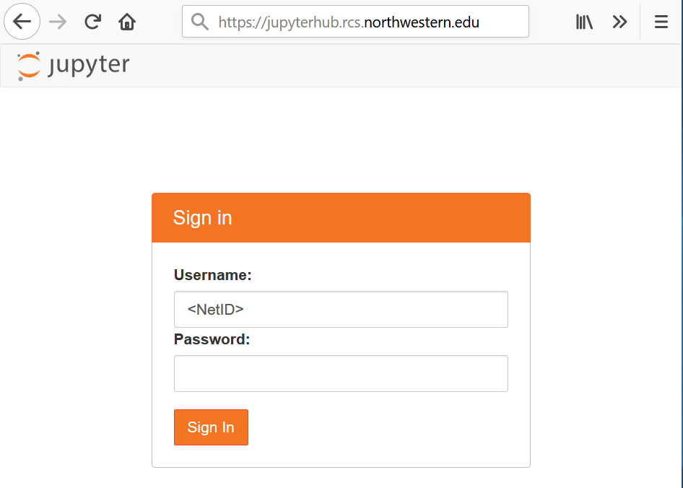
Connect to Jupyter Hub
The live coding part will use Jupyter notebook
The Jupyter Hub will be available during the session
https://jupyterhub.rcs.northwestern.edu

Slide 9
References
Julia documentation [https://docs.julialang.org/en/stable/index.html]
http://samuelcolvin.github.io/JuliaByExample/
http://math.mit.edu/~stevenj/Julia-cheatsheet.pdf
http://courses.csail.mit.edu/18.337/2017/
Beginning Julia Programming, Sandeep Nagar, 2017[https://link.springer.com/book/10.1007%2F978-1-4842-3171-5]

