Slide 1
A Parallel Algorithm for Updating Single-Source Shortest Paths in Large-Scale Dynamic Networks
Hammad Amer 22i-0877
Shayaan Khalid 22i-0863

Slide 2
Introduction
• Many real‑world networks (social, communication, transportation) evolve over time.
• Fast SSSP updates are critical for routing, centrality, and dynamic analysis.
• Why dynamic updates matter: Huge graphs (millions of nodes), frequent changes → can’t afford full recompute each time

Slide 3

Problem Statement
Given:
• Current graph G=(V,E) and existing SSSP tree T
• A batch of edge insertions and deletions ΔE
Goal:
• Update T to reflect new shortest distances without recomputing from scratch
Challenges:
1. Quickly identify the small “affected” subgraph for ΔE
2. Propagate distance changes in parallel without data races
3. Ensure convergence in a bounded number of iterations

Slide 4
Framework
Step 1-Detect & Pre‑update Locally
Step 2 – Iterative Propagation
Identify affected subgraphs from changed edges
• In parallel, for each deleted edge (u,v) in T mark v’s subtree as “disconnected”
• For each inserted edge (u,v), if dist(u)+w(u,v)<dist(v), update dist(v) and parent(v)
Iteratively update only those parts of the tree until not a single affected left
• While any vertex’s dist can still decrease:
– In parallel, relax all edges adjacent to vertices flagged “affected”
– Update dist and parent pointers, flag newly affected vertices

Slide 5
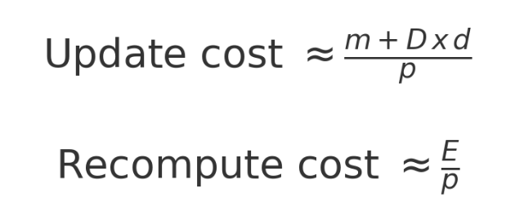
Complexity
GPU Results Update vs. recompute (Gunrock): Up to 8.5× faster on 50 M changes, 5.6× on 100 M.
CPU Results Update vs. recompute (Galois): Up to 5× speedup .

Slide 6
Parallelization Technique (1)
Inter‑node — MPI
Each rank holds its subgraph’s tree and flags
After Step 1 locally, exchange “boundary‐affected” vertices with neighbors via nonblocking MPI_Isend/Irecv
After boundary relaxations, a global MPI_Allreduce or a lightweight “any‐changed” token to know when to stop

Slide 7
Parallelization Technique (2)
INTRA-NODE — OPENMP/OPENCL
We annotate key loops with #pragma omp parallel for to distribute ΔE across CPU threads, letting each thread scan and pre‑update its local edges.
we iteratively enqueue a relaxation kernel—each work‑item processes one affected vertex’s adjacency list. this lets you amortize kernel‑launch overheads and fully leverage the GPU’s high memory bandwidth and SIMD execution.

Slide 8
Parallelization Technique (3)
GRAPH PARTITIONING — METIS
METIS is a graph partitioning tool that divides a large graph into smaller subgraphs (partitions) while minimizing the number of edges that cross between them. This reduces communication overhead in distributed settings (like MPI).
This helps in parallel SSSP updates with minimal inter-node data exchange.

Slide 9
MPI + OpenMP + METIS Strategy
1. Graph Partitioning (METIS):
– Pre‑partition G into P parts, minimize inter‑partition edges
2. Inter‑Node (MPI):
– Each MPI rank holds one partition
– Broadcast ΔE across ranks; only cut‑edges trigger communication
– Exchange frontier updates only along partition boundaries
3. Intra‑Node (OpenMP or GPU):
– Phase 1: parallel scan of local ΔE
– Phase 2: iterative relaxations with dynamic scheduling to balance subtrees
4. Synchronization:
– MPI_Barrier after Phase 1
– Nonblocking MPI_Isend/Irecv between each Phase 2 iteration

Slide 10
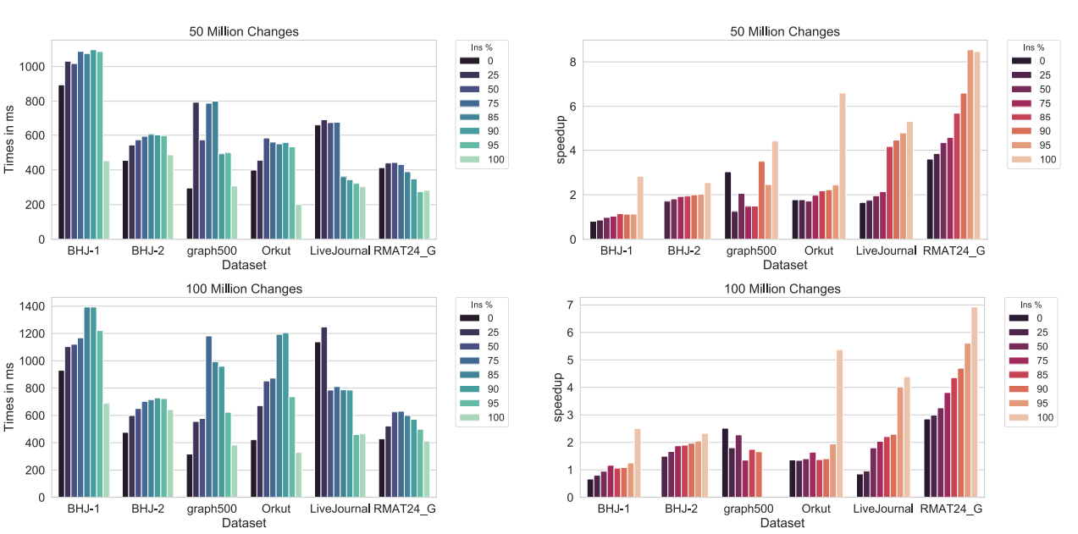
Comparison
If your change batch is mostly insertions (≥ 25–50%), the incremental update on the GPU can be several× faster than re‑running SSSP from scratch.
If your batch is dominated by deletions (≥ 75%), you may be better off throwing the whole thing away and recomputing the SSSP.

Slide 11
THANK YOU!
Any Questions

