Slide 1
Document Classification using KNN
Group 9
Syed Abdul Rehman (2021-CS-62)
Hammad Ejaz (2021-CS-102)

Slide 2

Agenda
Objectives
Methodology
Scraping and Preprocessing Stats
Graph Construction
MCS for Document Categorization
Classification with KNN
Evaluation
Project Management
Challenges Faced
2

Slide 3
Objectives
Collect large dataset from predefined categories.
Represent documents as directed graphs.
Identify common subgraphs in training set.
Implement KNN algorithm using graph similarity.
Classify test documents based on common subgraphs.
3

Slide 4
Methodology

Slide 5
Scraping and Preprocessing Stats
Category | No. of Documents/Articles | Avg Words (Per Doc) | Avg Words (After Preprocessing)
Travel | 15 | 900 | 750
Sport | 15 | 800 | 700
Food | 16 | 950 | 800

Slide 6
Graph Construction (libraries Used)
Networkx was used because of it’s:
Ease of use.
Compatibility with other libraries for further processing and visualization.
6

Slide 7
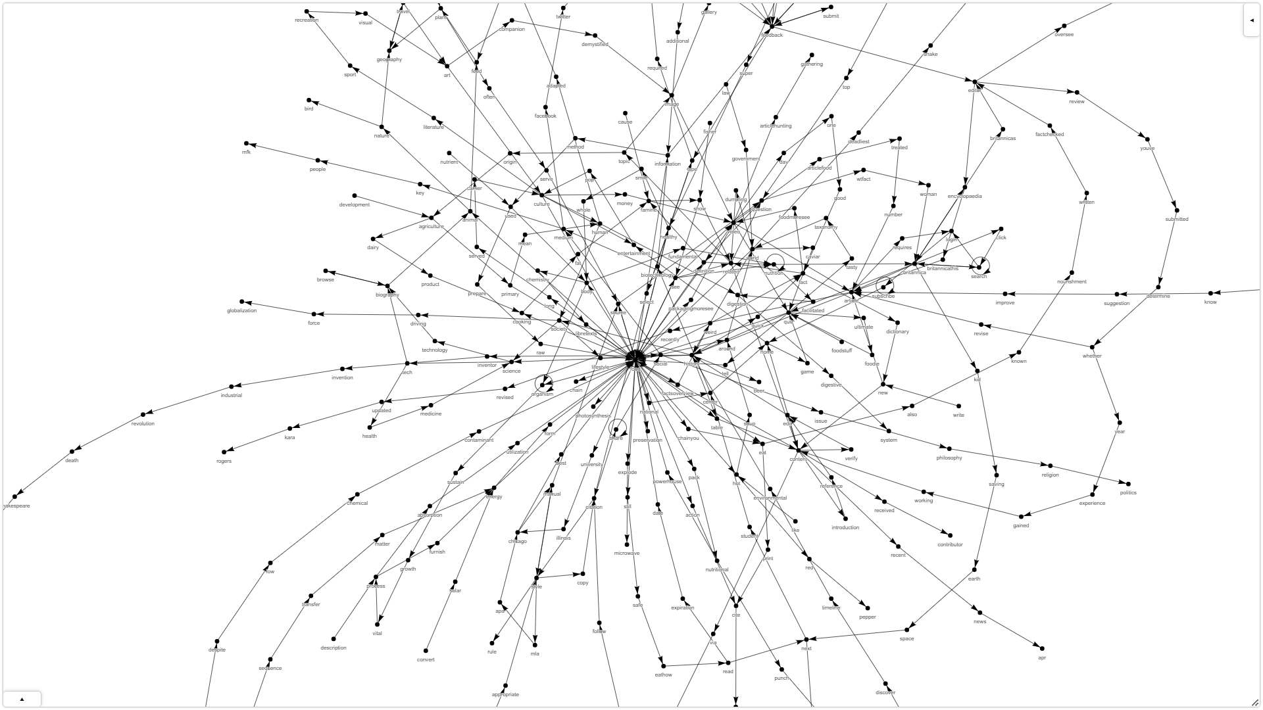
Graph Construction (Working)
Each unique word became a node.
Edges linked consecutive words.
The weight of each edge reflected the frequency of consecutive word occurrences.
7

Slide 8
MCS for Document Categorization
MCS (Maximal Common Subgraph) effectively categorizes documents.
It represents the largest common subgraph between two graphs.
8

Slide 9

Classification with KNN
Classify by looking for which graph is closest to the input graph.
Tie Breaker: selects the class with the highest count among tied neighbors.
The distance measure used:
9

Slide 10
Evaluation (metrics)
Precision: Measures true positive predictions relative to all positive predictions.
Recall: Measures true positive predictions relative to all actual positives.
F1-Score: Harmonic mean of precision and recall, providing a balanced measure.
Confusion Matrix: A table summarizing classification model performance.
10

Slide 11
Evaluation
Train Test Split: 80 20 %
Module Sklearn.metrics was used utilized to compute mentioned evaluation metrics to assess the model's performance on the test set.
11

Slide 12
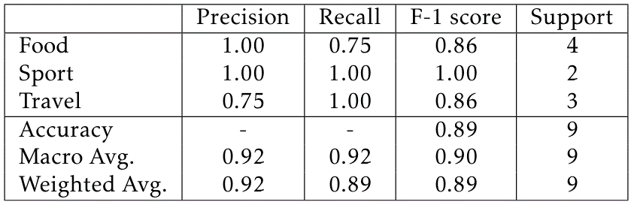
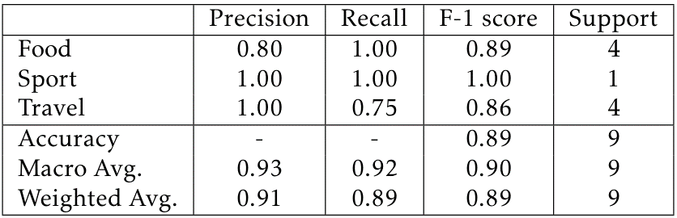
With Graph:
With Vectors:
12

Slide 13
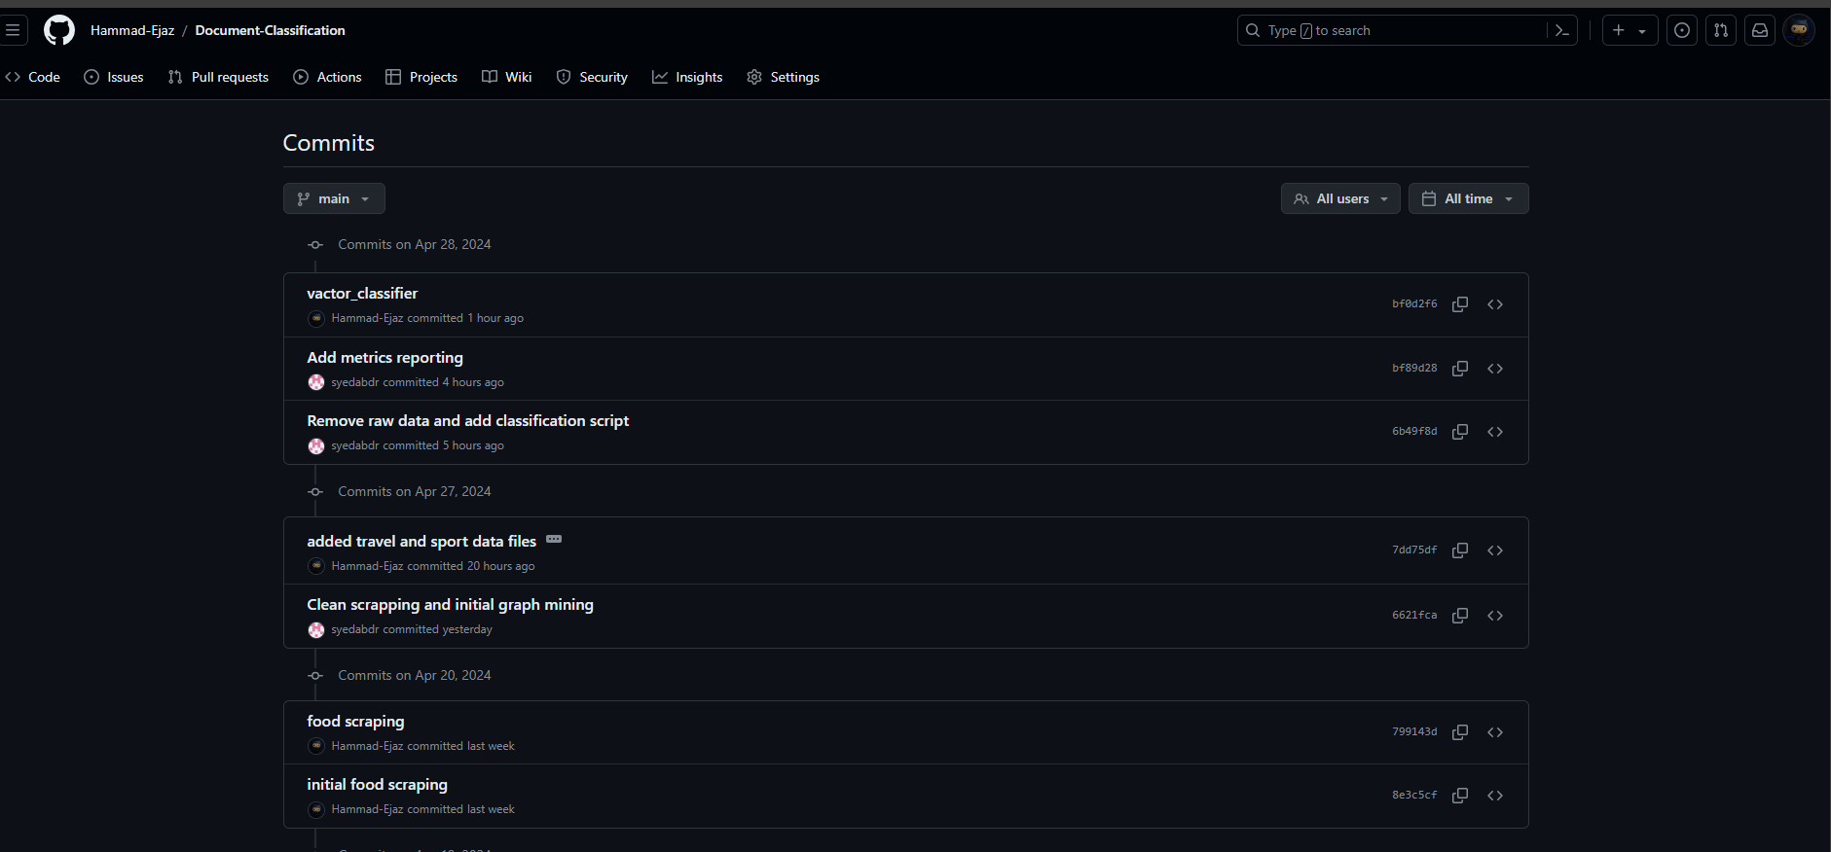
Project Management
Entire Project was managed
on Github.
13

Slide 14
Major Challenges Faced
Websites inaccessible via requests library, requiring alternative libraries.
Implementing MCS as NP problem, needing polynomial time and results.
Hyperparameter selection for optimized results: K and distance measure.
14

Slide 15
Thank you.

