Slide 1

Machine learning digit/letters classification thought Neural Network
By:
Hammad Arif, Zain Ali

Slide 2

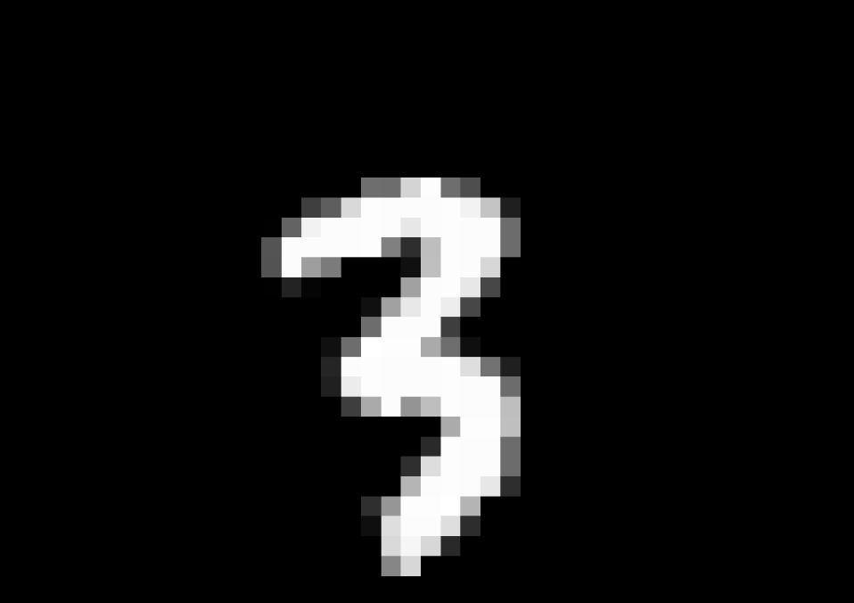
What’s the difference

Slide 3
What’s the differece

Slide 4
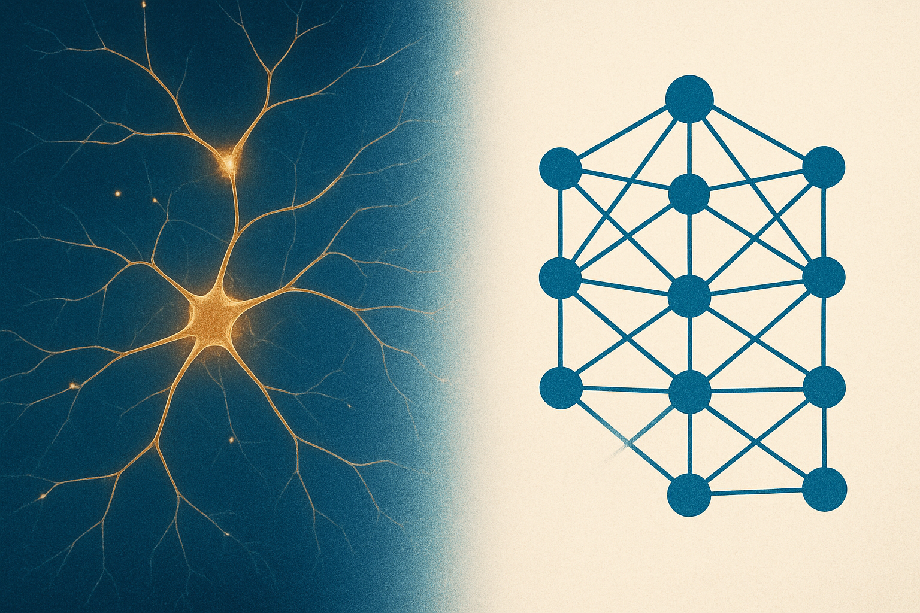
That’s where neural networks comes in
We try to replicate biological brain structure by which machine learns pattren recognision.

Slide 5
Presentation Walkthrough
Mnist/Emnist dataset
Neural Network
Trained Model(json)
Pytorch neural network
Test network (whole data)
Test random example
Neural Network Animated
Drawing App

Slide 6
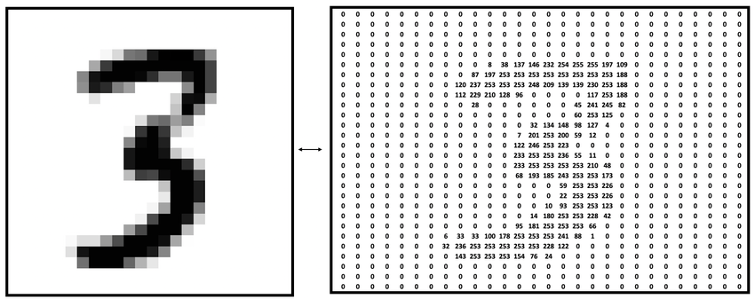
1: MNIST/EMNIST dataset
Its a flattened 28x28 pixels list of pictures that are grey scaled and been hand drawed
Each row has 785 values in which first value is the label and other 784 are the pixel value

Slide 7
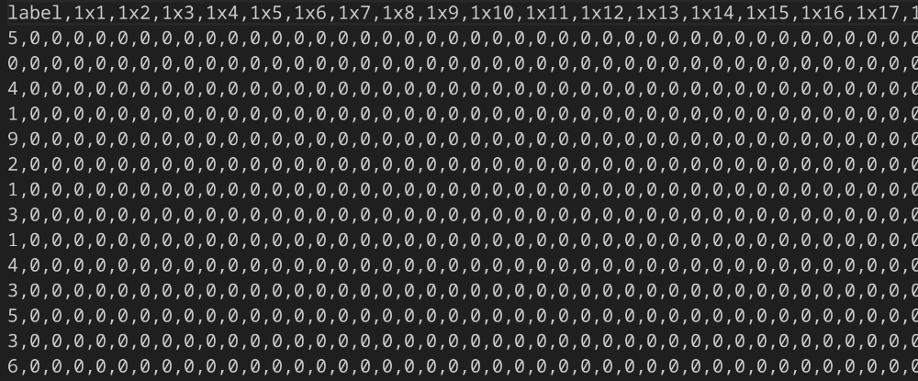
Mnist csv file

Slide 8
Since its grey scaled pixels value range from (0-255) 0 being all black and 255 being fully white
Image is centered at 20x20
Incase of Emnist date the pictures are rotated 90 degrees and fliped vertically

Slide 9
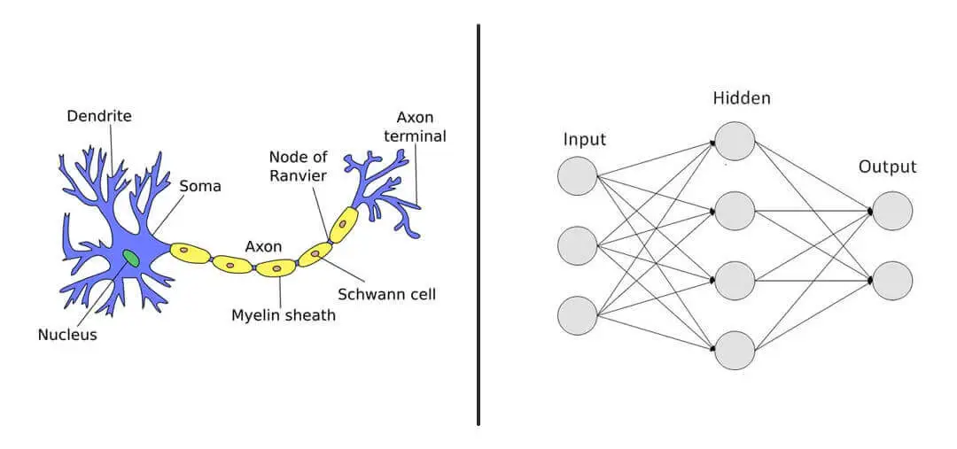
2: Neural Network

Slide 10
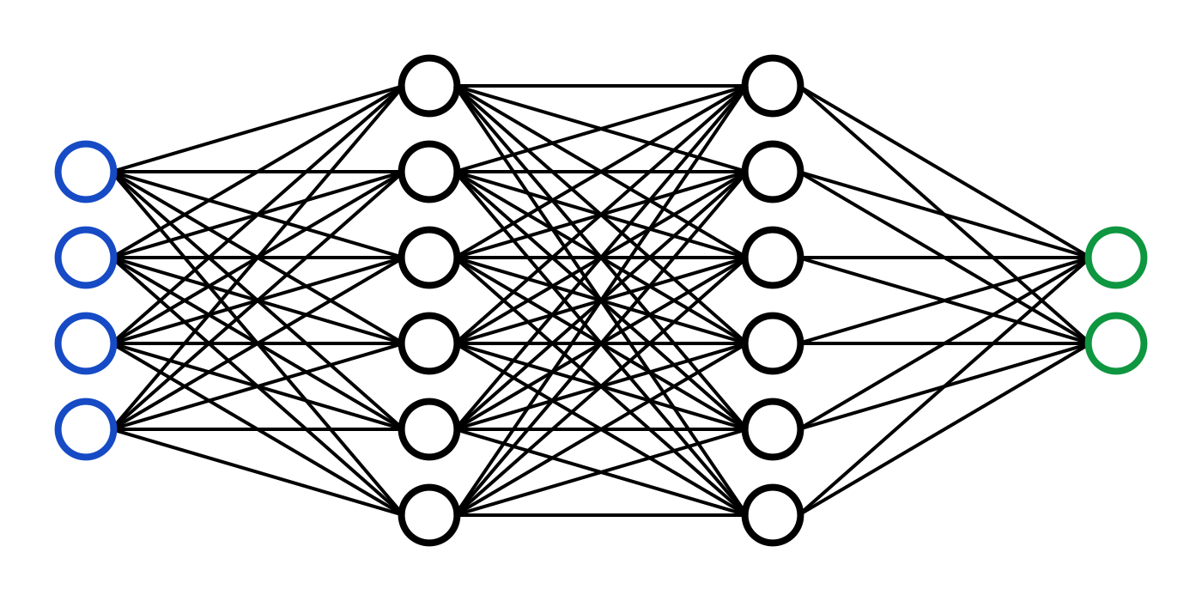
Neural Network Architecture
One input layer= number of pixels (784)
One output layer= number of classes (10|62)
And some hidden layers
Each layer have neuron that is connected to each neuron in previous layer except input layer

Slide 11
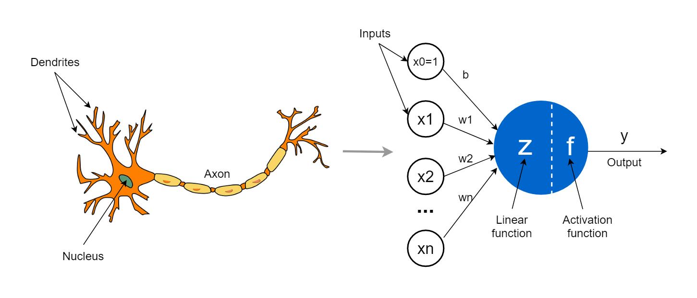
Neuron

Slide 12
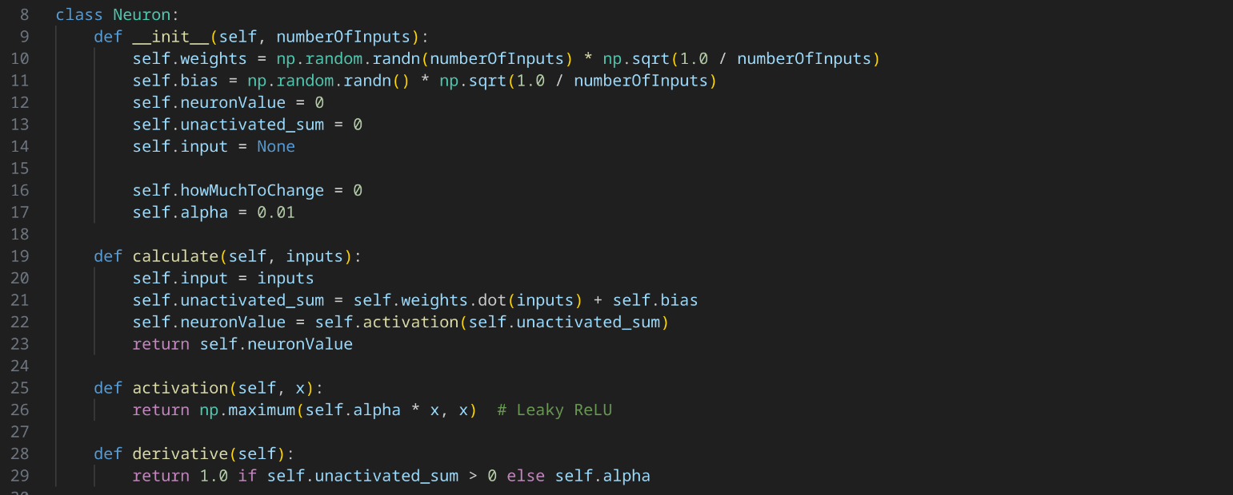
Neuron Implimentation

Slide 13
Farword propogation Farmula

Slide 14
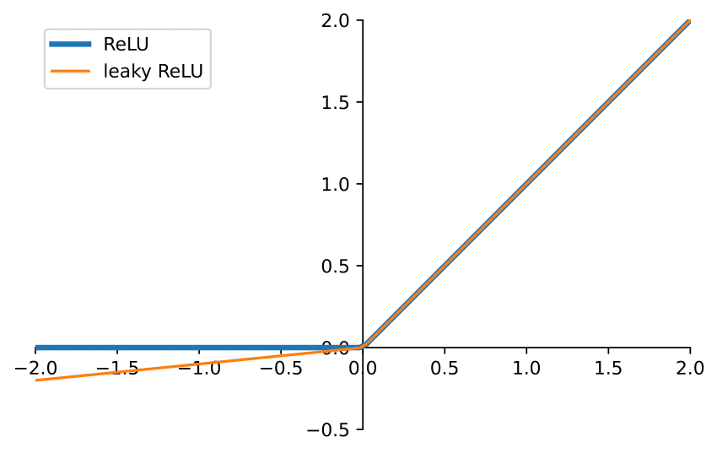
Activation function

Slide 15

Leaky ReLu Derivative

Slide 16
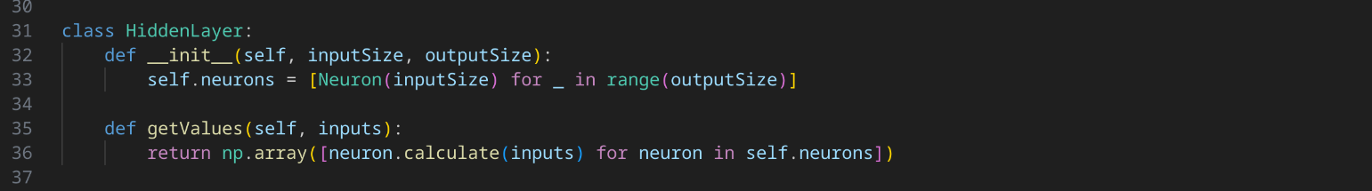
Hidden Layer Implimentation

Slide 17
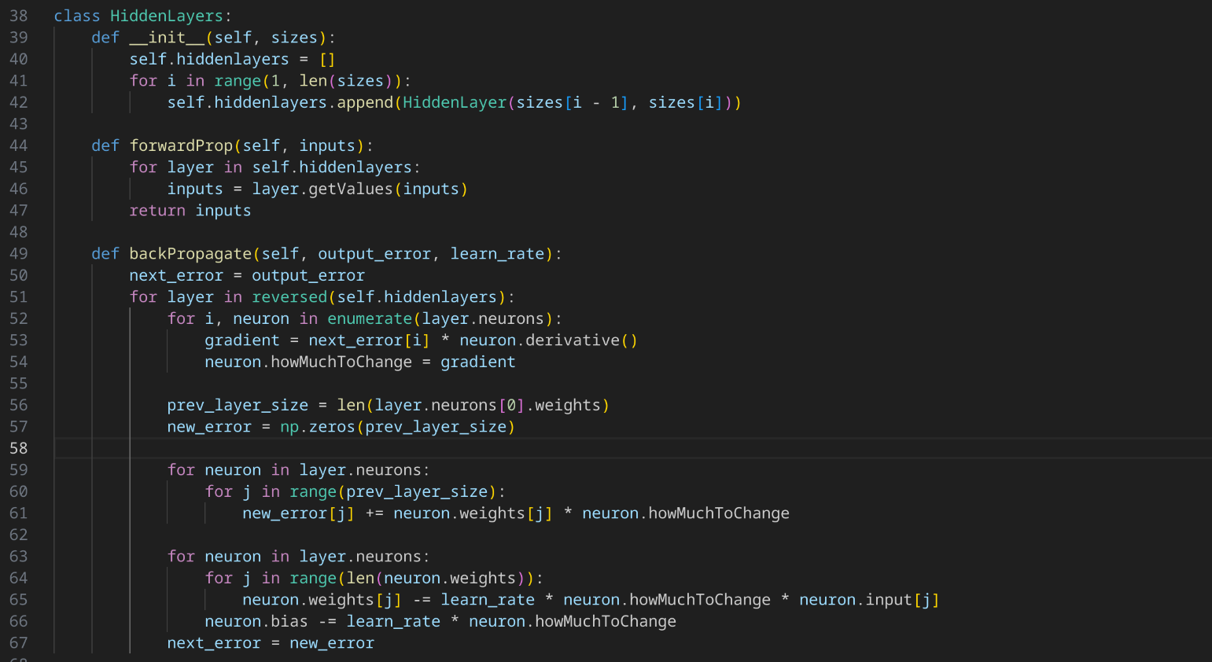
Hidden Layers implimentation

Slide 18
Farwork propogation
z=w.x+b
x=activation(z)
For each neuron
w=weights
x=input
b=bias

Slide 19
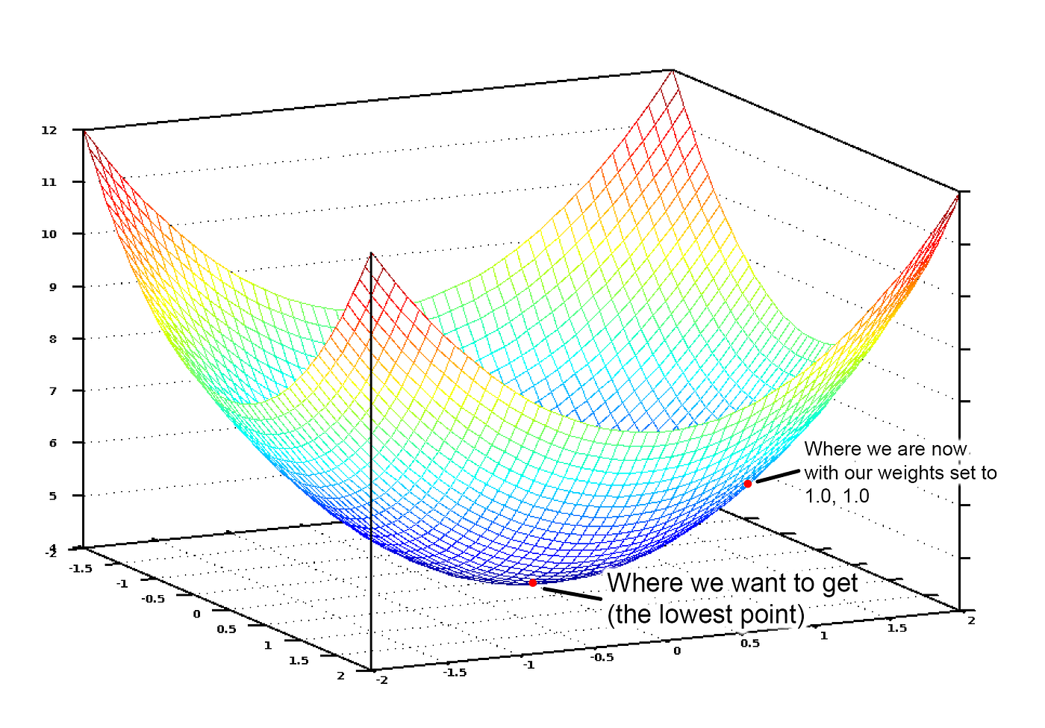
Farword Propogation
f(w1,w2)=c
For some weights it will produce some cost
Cost is how far the prediction is from the actual value
So it can be written as f(w)=c

Slide 20
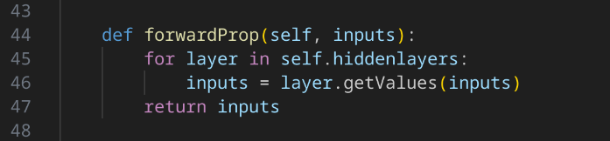
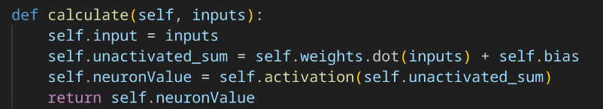
Forward Propogration Impimentation

Slide 21
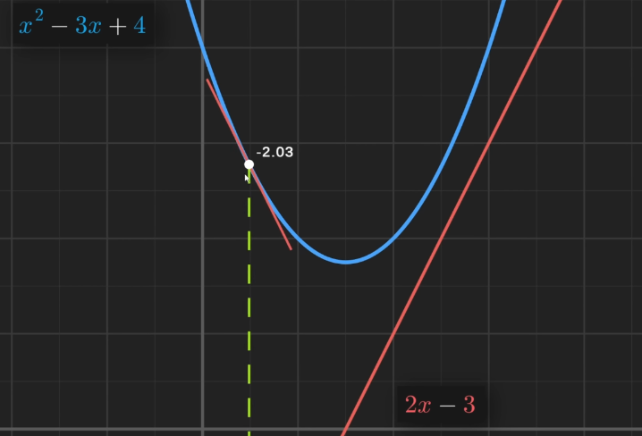
Back propogation
So taking drivative of f(w)=c as f’(w) will give us the gradiant
By subtracting the drivative by weights network will produce minimum cost
Hense closer to the actual value

Slide 22
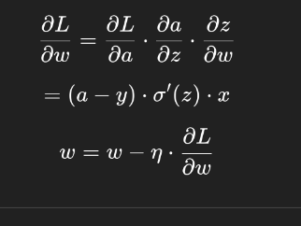
How derivative is calculated
Through chain rule
L = loss=cost
a= activated value=input
z=unactivated sum
w=weights
η=learning rate
σ′(z)=derivative of activation w.r.t z(in neuron structure

Slide 23
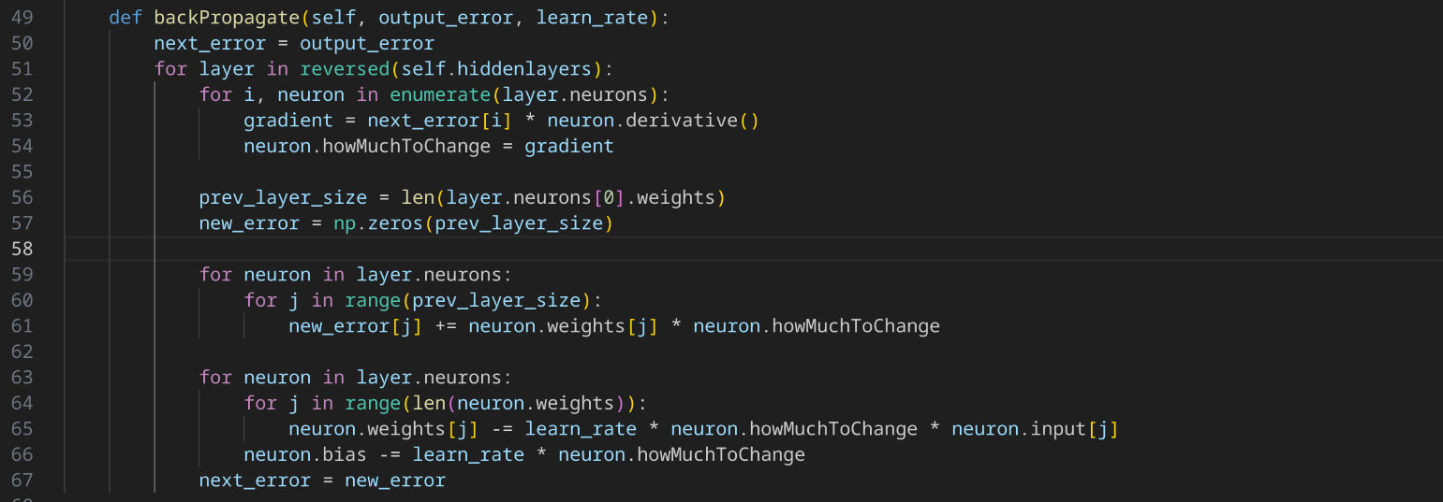
Back Propogation Implimentation

Slide 24
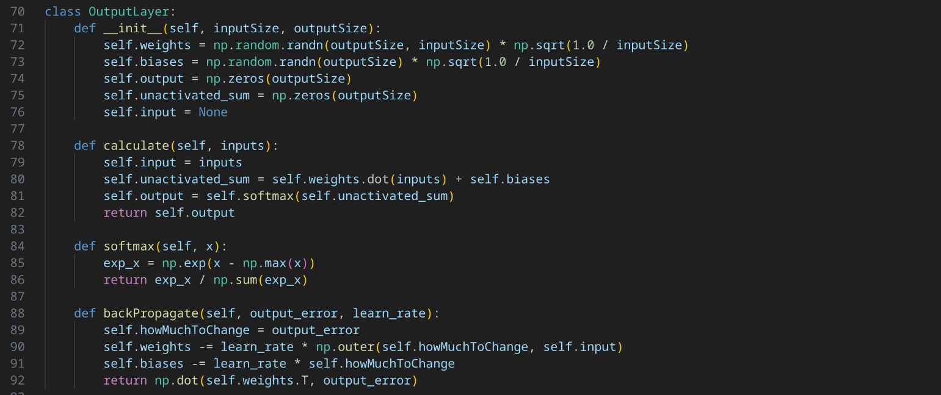
Output Layer Implimentation

Slide 25
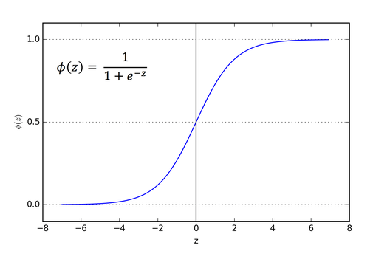
Sigmoid Activation

Slide 26
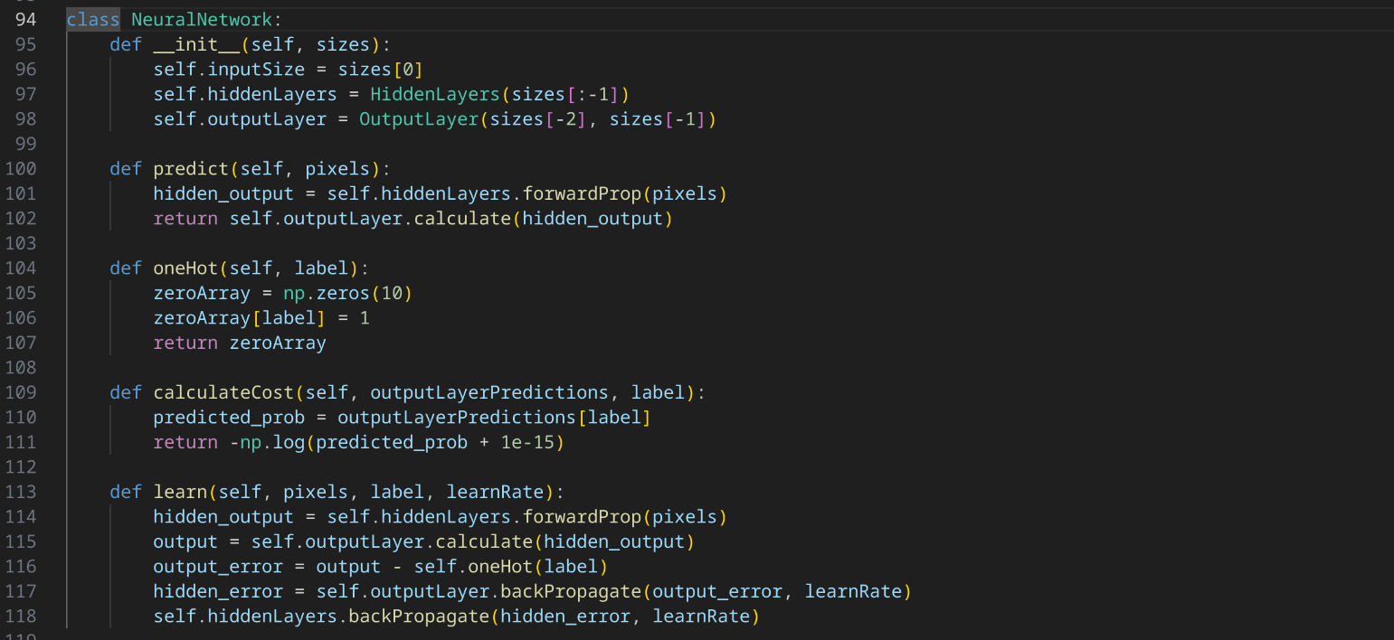
Full network implimentation

Slide 27
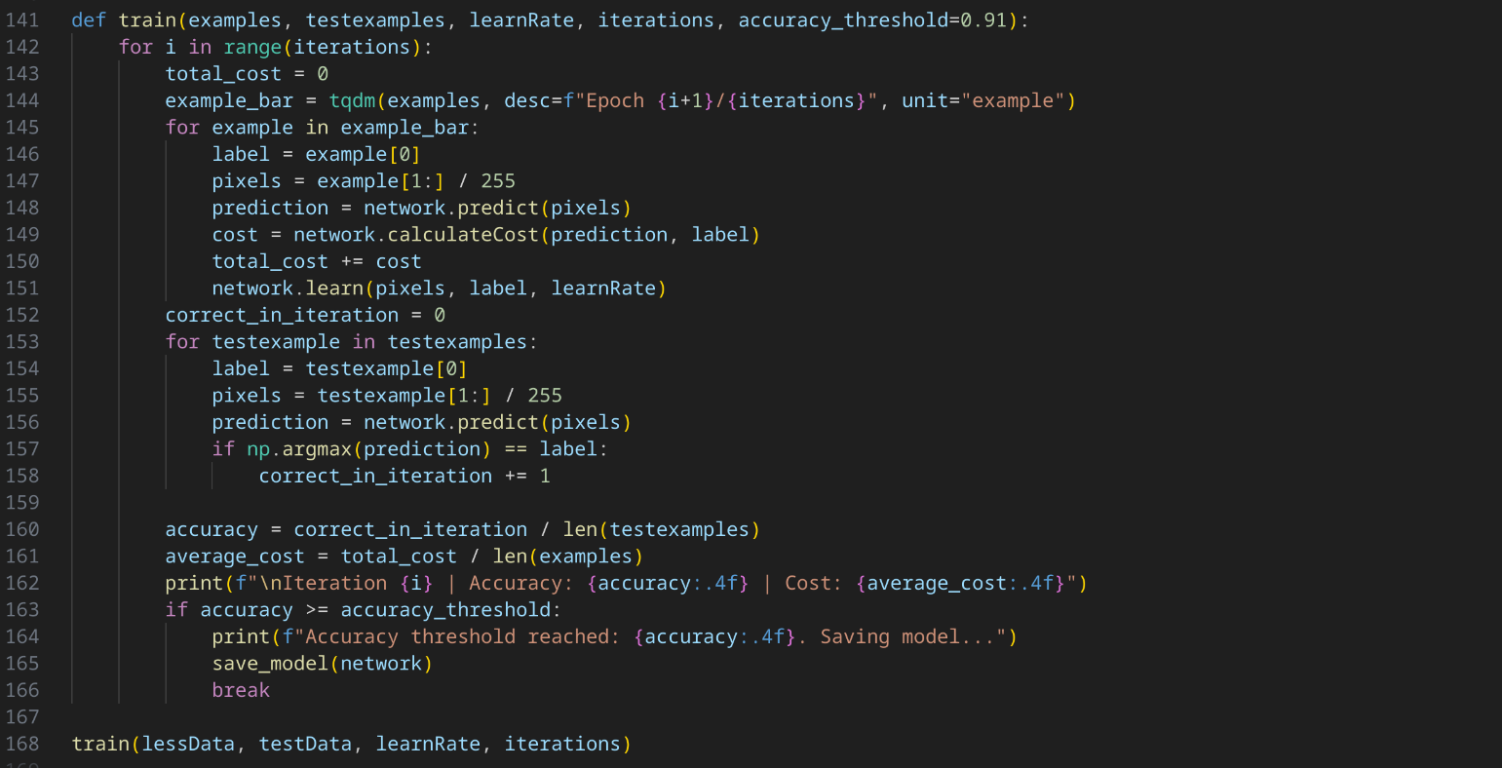
Training function

Slide 28
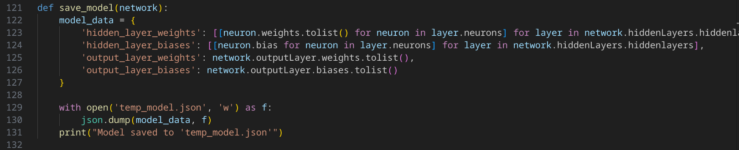
Saving model

Slide 29
3: Trained Model(json)

