Slide 1
Introduction
Team member
Supervisor
Muhammad Shameel
Muhammad Shabbir Hassan
Anees Ahmed
Hammad Ali

Slide 2
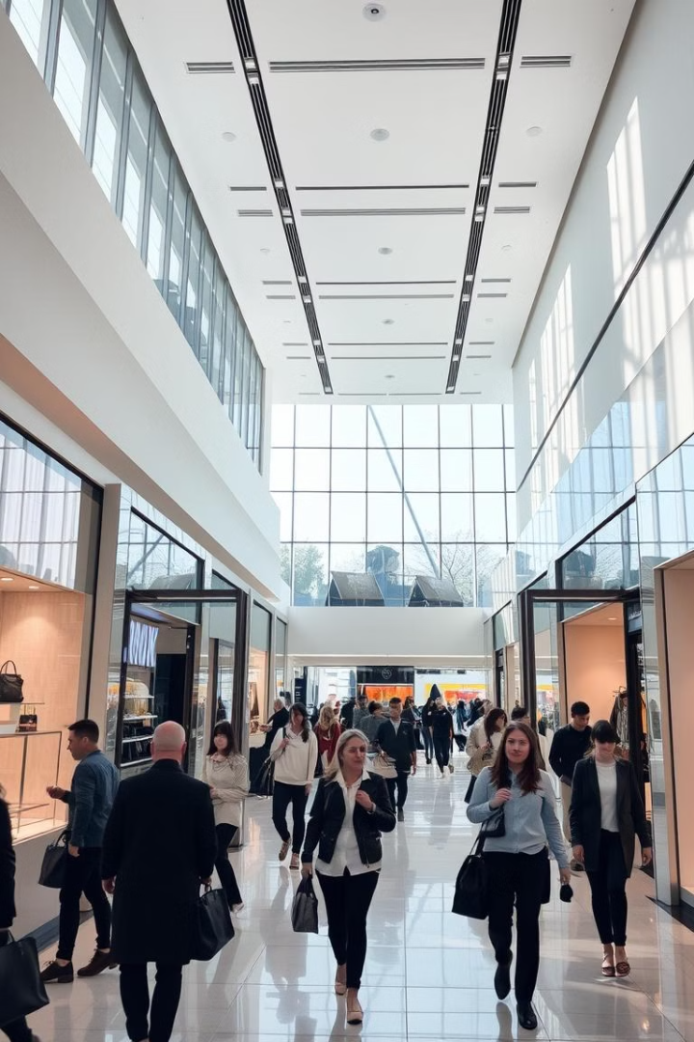
Shopping Mall Management System
This presentation outlines the development of a comprehensive Shopping Mall Management System, a software engineering project built using a structured Software Development Life Cycle (SDLC) methodology. This system addresses real-world challenges faced by shopping mall management, aiming to optimize operational efficiency and enhance customer experience.

Slide 3
Requirement Analysis
1
Data Collection
2
Key Insights
3
Project Objective
To gain valuable insights, our team conducted in-depth interviews with managers of a retail store, gaining firsthand knowledge of their daily operations. We meticulously observed and documented their existing processes, noting both their strengths and areas where improvements could be made.
Our analysis revealed several key pain points within the existing system. Manual product management was a significant source of inefficiencies, leading to errors in sales records. Long queues at checkout counters resulted in customer dissatisfaction, affecting their overall shopping experience.
The objective of this project is to design and develop an automated system that addresses these challenges. By streamlining product management, improving accuracy in sales records, and reducing checkout times, we aim to significantly enhance operational efficiency and elevate the customer experience within the shopping mall.

Slide 4
Requirement Specification
Functional Requirements
Non-functional Requirements
The system must provide comprehensive functionalities for both administrative staff and shoppers. Admin functionalities include adding, modifying, and deleting product details, managing sales records, and overseeing user accounts. User functionalities encompass browsing available products, adding items to a shopping cart, and securely completing checkout procedures.
The system must adhere to crucial non-functional requirements to ensure its reliability and user-friendliness. Robust security measures are essential, including data validation for admin access and user authentication. The system must exhibit high performance, enabling fast product searches and reliable data handling to ensure smooth operations.

Slide 5
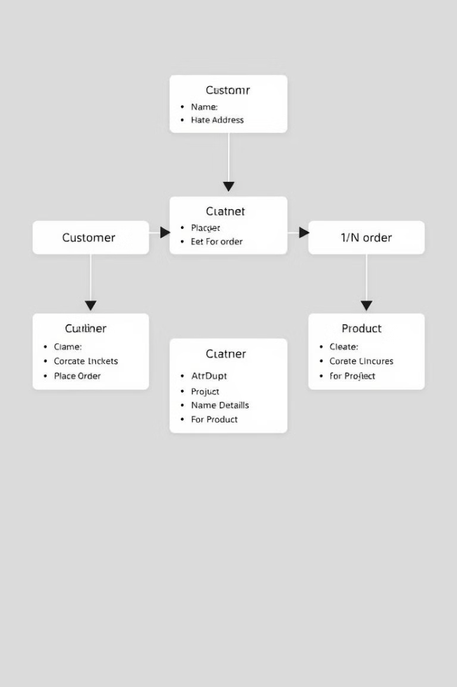
Design Phase: Class Diagram
Class
Description
Admin
Manages products, users, and system settings.
Product
Stores product details such as name, price, description, and availability.
User
Represents a shopper, with functionalities for browsing, adding to cart, and checkout.
Cart
Manages items added by users, allowing for quantity adjustments and removal.
FileHandling
Ensures data persistence by managing file operations for saving and retrieving data.

Slide 6
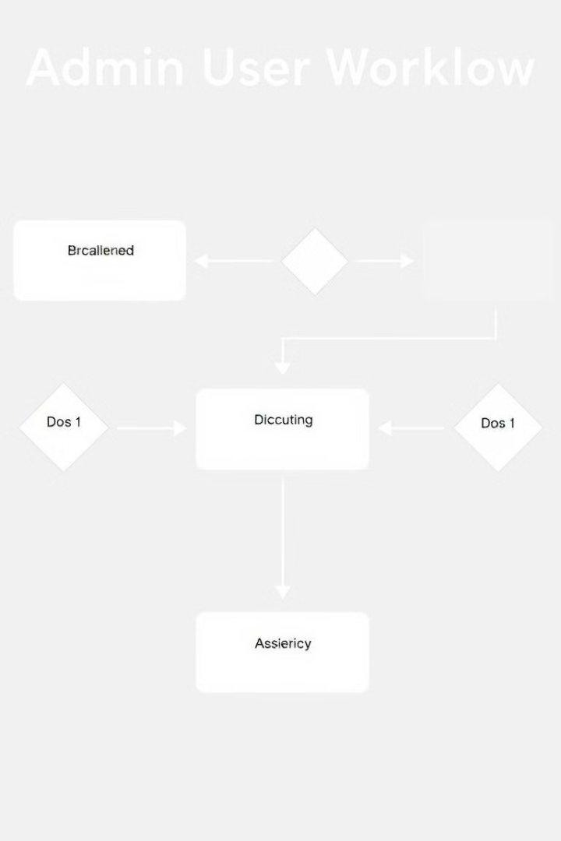



Design Phase: Admin Workflow
Admin Login
The admin user securely logs into the system using a unique username and password, providing access to restricted functionalities.
Product Management
The admin can add new products by entering their details, modify existing product information, and delete products from the system as needed.
Admin Logout
Upon completing their tasks, the admin logs out of the system, ensuring secure access control and data protection.

Slide 7




Design Phase: User Workflow
Product Browsing
Add to Cart
Checkout
Users can browse through a categorized list of products, viewing details such as name, price, and description. They can filter products based on specific criteria to refine their search.
Users can add desired products to their shopping cart, specifying quantities and confirming selections. The cart provides a dynamic view of the items selected for purchase.
Once users have completed their selection, they can proceed to checkout. They enter their payment details and complete the transaction securely, receiving a confirmation of their purchase.

Slide 8
Implementation Phase
The implementation phase involved the development of core features using the C++ programming language, ensuring efficient and robust system functionality. This phase encompassed:
1
Admin and User Modules
2
File-based Storage
3
Real-time Operations
We implemented dedicated modules for both admin and user functionalities, ensuring a seamless and intuitive user experience. Admins manage products, users, and system settings, while users browse, add to cart, and checkout.
We employed a secure file-based storage system for data persistence. This ensures that all product details, user information, and sales records are securely saved and retrieved, maintaining data integrity and reliability.
The system supports real-time product search functionality, allowing users to quickly find desired products. The checkout process is also designed to be efficient, ensuring prompt transaction processing and confirmation.

Slide 9
Testing Phase
Thorough testing was conducted throughout the development process to ensure the system's quality and functionality. We implemented various testing methods to guarantee its reliability:
Unit Testing
Integration Testing
System Testing
Individual features were tested in isolation, validating their functionality and ensuring they met specific requirements. For example, we tested the admin login process, product addition, and cart functionality.
We tested the interaction between different modules and components, ensuring they worked seamlessly together. This included testing the flow between admin and user workflows to ensure data consistency and smooth transitions.
The system was tested as a whole under real-world scenarios, simulating typical user interactions and operational workflows. This helped us identify and address potential bottlenecks and issues that could arise during actual use.

Slide 10

Maintenance
Regular maintenance is crucial for ensuring the continued smooth operation of the Shopping Mall Management System. This includes:
1
Periodic Updates
2
Future Scope
The system will receive periodic updates to address any identified bugs and enhance its functionality. These updates will be rolled out regularly to ensure the system remains reliable and secure.
The system has a future scope for incorporating additional features, such as advanced analytics and reporting capabilities. These enhancements will provide valuable insights into mall operations and customer behavior, further optimizing management decisions.

Slide 11
SDLC Summary
The Shopping Mall Management System was developed using a rigorous SDLC methodology, ensuring a systematic and structured approach to software development. This iterative process involved:
1
Process Overview
2
Key Outcomes
Starting with requirement analysis, we gathered information, defined goals, and documented specifications. The design phase involved creating a comprehensive class diagram and workflows for admin and user interactions. The implementation phase focused on coding the system using C++ and incorporating essential features. Thorough testing ensured functionality and reliability, and the system is now ready for deployment and ongoing maintenance.
This project has resulted in the creation of a robust and user-friendly Shopping Mall Management System. It simplifies store operations, streamlines product management, improves accuracy in sales records, and enhances the customer experience by reducing checkout times. We believe this system will significantly benefit the shopping mall by increasing efficiency, improving customer satisfaction, and driving business growth.

Slide 12

Thank You
This concludes our presentation on the Shopping Mall Management System. We appreciate your time and consideration.

