Slide 2
Looking inside a Computer
Most people believe that computers must be extremely complicated devices, because they perform such amazing tasks
Computer is a collection of parts, which are categorized according to the kinds of work they do
Glimpse inside a standard desktop computer
How these components work together and allow you to interact with the system

Slide 3
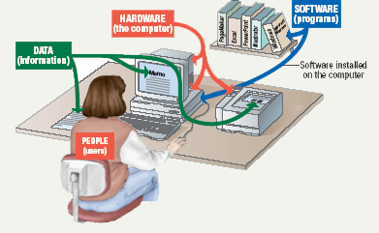
Parts of the Computer System
Computer systems have four parts
  Hardware
  Software
  Data
  User

Slide 4
Parts of Computer System – Hardware
Mechanical devices in the computer
Anything that can be touched
  e.g. printer, keyboard, mouse, CPU, monitor, connections etc.
consists of interconnected electronic devices that you can use to control the computer’s operation, input, and output.
generic term device refers to any piece of hardware

Slide 5
Parts of Computer System – Software
Set of instructions that makes the computer perform tasks
Provides an interface for user to access the hardware
Also called a program
Thousands of programs exist
  Some for computer’s own use (system programs)
  Some for the service of the user (application programs)
Reason majority of the people would want to purchase a computer
  It is providing utility to every one in any field and domain

Slide 6
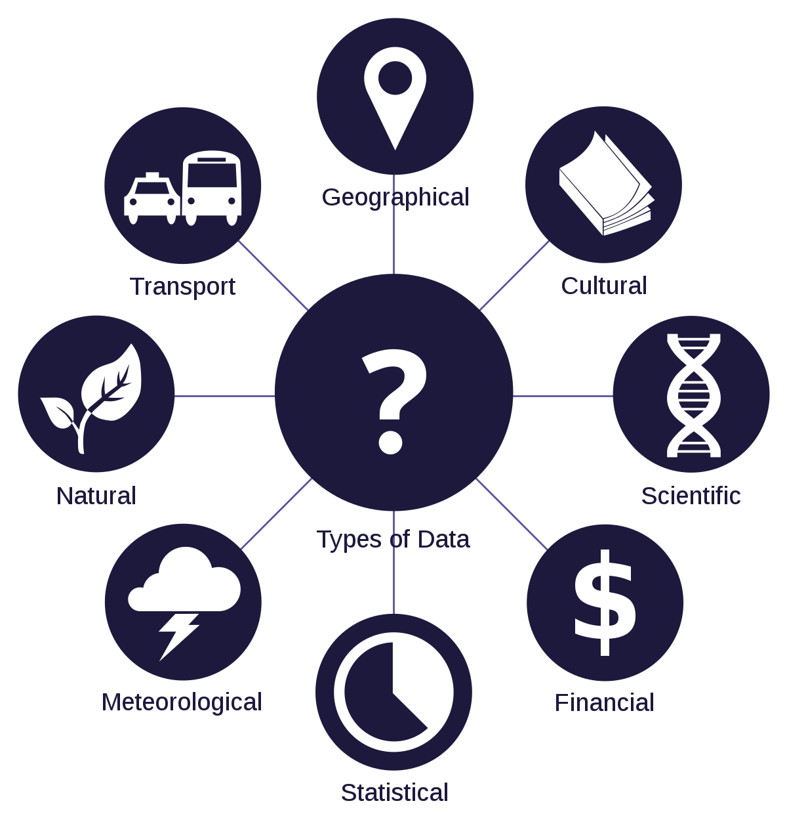
Parts of Computer System – Data
Pieces of information / individual facts
By themselves do not make much sense
Facts and statistics for analysis
Computers analyze the data

Slide 7
Parts of Computer System – Users
People operating the computer
Most important part
Tell the computer what to do
  Userless computers?
  people still design, build, program, and repair computer systems.

Slide 8
Information Processing Cycle
Converts data into information
Data
  The raw facts and figures that are processed into information
Information
  Data that has been summarized or otherwise manipulated for use in decision making
Processing /
Computation
Input
Output

Slide 9
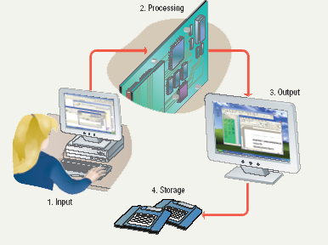
Steps to Process Data
Input
Processing
Output
Storage

Slide 10
Steps to Process Data
Input
  Computer accepts data from some source
Processing
  Computers processing components perform actions on the data based on instructions from user or program
Output
  Computer conveys result to user.
  Text, numbers, graphic, image, video, sound
  Optional
Storage
  Permanently store result on some medium
  Optional

Slide 11
Essential Computer Hardware
Computers use the same basic hardware
Hardware categorized into four types
  Processor
  Memory
  Input and Output
  Storage

Slide 12
Processing Devices
Processing
  The procedure that transforms raw data into useful information
To perform this transformation, the computer uses different processing devices
  CPU
  GPU
  DSP

Slide 13
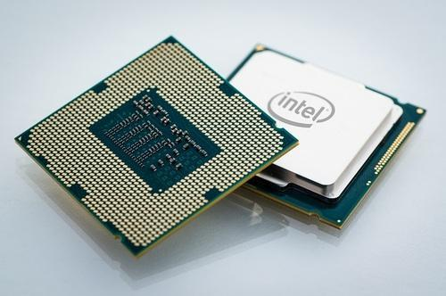
Processor
Brain of the Computer
Processor chip
  A tiny piece of silicon that contains millions of miniature electronic circuits.

Slide 14
Processor
Carries out instructions from the program
Manipulate the data
Most computers have several processors
Central Processing Unit (CPU)
Secondary processors
Processors made of silicon and copper

Slide 15
Memory
memory is one or more sets of chips that store data and/or program instructions, either temporarily or permanently.
Memory is a critical processing component in any computer
Two most important types
  Random access memory (RAM) and
  Read-Only memory (ROM).
work in very different ways and perform distinct functions

Slide 16
Random Access Memory
Also known as RAM or primary or main memory
Represent primary storage or temporary storage.
Hold data before processing and information after processing.
Volatile & Fast

Slide 17
Read Only Memory
Also called ROM
Nonvolatile
  Permanent storage of programs
Holds the computer boot-up directions

Slide 18
Cache Memory
Faster components and nearer to the CPU
The first memory location where the micro-processor searches for the required data to process.
Hierarchical distribution of cache into L1, L2 and L3.

Slide 19
Integration of all – Motherboard
Main printed circuit board in the computer
Everything connects to the motherboard
Expansion slots - “plugs” on the motherboard for expanding the PC’s capabilities via additional circuit boards (additional memory chips of secondary processing units)

Slide 20
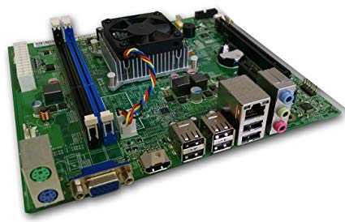
Integration of all – Motherboard

Slide 21
Storage Devices
Hold data and programs permanently
Electronic file cabinet
Difference between storage and memory
  More capacity in storage
  Contents are retained in storage even the power is off
  Storage is much cheaper
  Access speed is slow

Slide 22
Storage Devices
Magnetic storage
Optical storage
Flash memory

Slide 23
Magnetic Storage Devices
Storage of data over magnetized medium
Store data based on magnetized sections of magnetic surface called as platter. Representation of data based on magnetized or de-magnetized areas of medium.
Common examples of magnetic storage are HDD, Floppy Discs etc.

Slide 24
Optical Storage Devices
Use of laser technology to store and retrieve data.
Store data in form of tiny pits on the surface of the material using etching laser and is retrieved by reading those pits arranged in concentric tracks on disc surface.
Common examples of optical storage devices are CDs, DVDs, Blu-rays.

Slide 25
Flash memory based storage
Non-volatile memory chips used to store data.
Able to be electrically programmed
Non-moveable parts based devices
Examples of Flash memory based storage devices are Pen-drives, SSDs, MP3 players etc.

Slide 26
Input Devices
Input hardware - devices that allow people to put data into the computer in a form that the computer can use
Allows the user to interact
Input devices accept data
Keyboard
Mouse

Slide 27
Input Devices
Track ball or touch pad
Joystick
Scanners
Digital Camera
Microphone
Webcam
Digitizer

Slide 28
Output Devices
Output devices return processed data to the user or to another computer system.
Most common
  Monitor
  Printer
  Speaker
Some devices are both input and output
  Touch screens

Slide 29
Softwares
Tells the computer what to do
Reason people purchase computers
Two types
  System software
  Application software

Slide 30
System Software
Most important software - OS
Controls the computer’s hardware
Operating system
  tells the computer how to use its own components.
    Windows, Mac OS, Linux
Network operating system (OS)
  allows computers to communicate and share data across a network
    Windows Server Utility

Slide 31
Application Software
Accomplishes a specific task, designed for end user
Most common type of software
  Word processors
  Spreadsheet
  Database Management
  Presentation
  Graphics
  Multimedia authoring
  Entertainment and Education
  Games
  Web Design tools and web browsers

