Slide 1
Introduction to Computing
LEC-4

Slide 2
A Quick Recap
Parts of a Computer System
Information Processing Cycle
Discussing the essential hardware components

Slide 3
Computers Processing Data
Two components are involved in data processing, CPU and memory
Both installed in motherboard circuit

Slide 4
Central Processing Unit – CPU
Brain of a Computer
Where the data is manipulated & processed
Large scale computing devices are equipped with multiple processors
Each CPU has mainly two basic parts

Slide 5
Parts of a CPU
Two basic parts
1. Control Unit
2. Arithmetic & Logic Unit
Control Unit
ALU

Slide 6
Control Unit
Component of CPU directing the processor to respond to an instruction
Directs the operation of the CPU
Like traffic signals directs the flow of data through I/O, and other parts of CPU during each instruction

Slide 7
Arithmetic & Logic Unit – ALU
All of the computer data is stored in numbers.
Most of the processing deals in performing mathematical
operations.
Looking down onto the mathematical operations, computers perform two types of operations arithmetic & logical.

Slide 8
Arithmetic & Logic Unit – ALU
Performs arithmetic operations on numbers.
Operations include addition, subtraction, multiplication, & division.
Logical operations are comparison based operations including less than, greater than, equal to etc.

Slide 9
Operating in ALU
Control unit encounters the instructions and most of them involve movement of data.
Any instruction involving the arithmetic operations, control unit passes the instruction to ALU.
ALU performs the aforementioned operations on the data.

Slide 10
Where is data held when to be processed?
ALU includes group of registers used to hold data for processing.
Registers are high-speed memory locations built in CPU.
Given that control unit load two numbers to add up, they ll be loaded into registers in CPU & they’ll be added by the ALU and result will be saved in another register before leaving CPU.

Slide 11
Machine Cycles
Each time a CPU executes an instruction, it follows multiple steps.
Steps collectively form a machine cycle.
Machine cycle itself can be broken down into two sub-cycles.
  Instruction Cycle
  Execution Cycle

Slide 12
Instruction Cycle
During instruction cycle CPU performs two steps.
  Fetching
  Decoding
In this cycle, Control Unit at first fetches the instruction from the memory
It then decodes the instruction to commands corresponding to its instruction set.

Slide 13
Execution Cycle
After the instruction is fetched and decoded into its corresponding commands lists in the instruction set, it is ready to be executed.
The Execution cycle, likewise the instruction cycle consists of two steps.
  Execution
  Storage

Slide 14
Execution Cycle – Contd.
Corresponding commands in decode step are performed. In execution step the control unit may transfer the control to the ALU incase of arithmetic or logical operations to be performed.
The CPU may be needing to store the result in memory, although it is not necessary

Slide 15
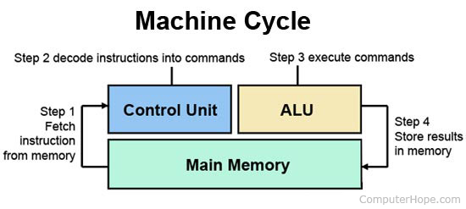

Slide 16
Central Processing Unit
Memory
..
.
.
.
.
.
.
.
..
.
.
.
.
8
9
10
Control Unit
2
3
11
12
13
14
Program Counter
Accumulator
Current Instruction Register
Memory Address Register
98
99
Memory Data Register
Load 10
100
101
Arithmetic Logic Unit
Add 11
Store 12
102
103

Slide 17
Central Processing Unit
Memory
..
.
.
.
.
.
.
.
..
.
.
.
.
8
9
10
Control Unit
2
3
11
12
13
14
100
Program Counter
Accumulator
Current Instruction Register
Memory Address Register
98
99
Memory Data Register
Load 10
100
101
Arithmetic Logic Unit
Add 11
Store 12
102
103

Slide 18
Central Processing Unit
Memory
..
.
.
.
.
.
.
.
..
.
.
.
.
8
9
10
Control Unit
2
3
11
12
13
14
100
Program Counter
Accumulator
Current Instruction Register
100
Memory Address Register
98
99
Memory Data Register
Load 10
100
101
Arithmetic Logic Unit
Add 11
Store 12
102
103

Slide 19
Central Processing Unit
Memory
..
.
.
.
.
.
.
.
..
.
.
.
.
8
9
10
Control Unit
2
3
11
12
13
14
101
Program Counter
Accumulator
Current Instruction Register
100
Memory Address Register
98
99
Load 10
Memory Data Register
Load 10
100
101
Arithmetic Logic Unit
Add 11
Store 12
102
103

Slide 20
Central Processing Unit
Memory
..
.
.
.
.
.
.
.
..
.
.
.
.
8
9
10
Control Unit
2
3
11
12
13
14
101
Program Counter
Accumulator
Load 10
Current Instruction Register
100
Memory Address Register
98
99
Load 10
Memory Data Register
Load 10
100
101
Arithmetic Logic Unit
Add 11
Store 12
102
103

Slide 21
Central Processing Unit
Memory
..
.
.
.
.
.
.
.
..
.
.
.
.
8
9
10
Control Unit
2
3
Load 10
11
12
13
14
101
Program Counter
Accumulator
Load 10
Current Instruction Register
100
Memory Address Register
98
99
2
Memory Data Register
Load 10
100
101
Arithmetic Logic Unit
Add 11
Store 12
102
103

Slide 22
Central Processing Unit
Memory
..
.
.
.
.
.
.
.
..
.
.
.
.
8
9
10
Control Unit
2
3
Load 10
11
12
13
14
101
Program Counter
Accumulator
Load 10
Current Instruction Register
2
100
Memory Address Register
98
99
2
Memory Data Register
Load 10
100
101
Arithmetic Logic Unit
Add 11
Store 12
102
103

Slide 23
Central Processing Unit
Memory
..
.
.
.
.
.
.
.
..
.
.
.
.
8
9
10
Control Unit
2
3
Load 10
11
12
13
14
101
Program Counter
Accumulator
Load 10
Current Instruction Register
2
101
Memory Address Register
98
99
2
Memory Data Register
Load 10
100
101
Arithmetic Logic Unit
Add 11
Store 12
102
103

Slide 24
Central Processing Unit
Memory
..
.
.
.
.
.
.
.
..
.
.
.
.
8
9
10
Control Unit
2
3
Load 10
11
12
13
14
101
Program Counter
Accumulator
Load 10
Current Instruction Register
2
100
Memory Address Register
98
99
Add 11
Memory Data Register
Load 10
100
101
Arithmetic Logic Unit
Add 11
Store 12
102
103

Slide 25
Central Processing Unit
Memory
..
.
.
.
.
.
.
.
..
.
.
.
.
8
9
10
Control Unit
2
3
Add 11
11
12
13
14
102
Program Counter
Accumulator
Add 11
Current Instruction Register
2
101
Memory Address Register
98
99
Add 11
Memory Data Register
Load 10
100
101
Arithmetic Logic Unit
Add 11
2
Store 12
102
103

Slide 26
Central Processing Unit
Memory
..
.
.
.
.
.
.
.
..
.
.
.
.
8
9
10
Control Unit
2
3
Add 11
11
12
13
14
102
Program Counter
Accumulator
Add 11
Current Instruction Register
2
101
Memory Address Register
98
99
3
Memory Data Register
Load 10
100
101
Arithmetic Logic Unit
Add 11
2
Store 12
102
103

Slide 27
Central Processing Unit
Memory
..
.
.
.
.
.
.
.
..
.
.
.
.
8
9
10
Control Unit
2
3
Add 11
11
12
13
14
102
Program Counter
Accumulator
Add 11
Current Instruction Register
3
101
Memory Address Register
98
99
3
Memory Data Register
Load 10
100
101
Arithmetic Logic Unit
Add 11
2
Store 12
102
103

Slide 28
Machine cycle – Complexity
The process seems complex, but computers accomplish the execution of millions of instruction in seconds.
It is also a performance measuring unit as Millions of Instructions Per Second - MIPS
Faster devices are also even measured in Billions of Instructions Per Second – BIPS

Slide 29
Pipelining
Pipelining or Pipeline processing refers to overlapping operations by moving data or instructions into a conceptual pipe with all stages of the pipe performing simultaneously.
Control unit starts a new machine cycle before the previous one ends up.
Based on concept to utilize resources at all the time and keep them busy.

Slide 30



Pipelining

Slide 31
Connecting Components
Buses are the electronic pathways between components
Two main types of Buses
  Internal (System)
  External (Expansion)
Internal bus allows components to connect on to motherboard whereas, the external bus enables the connectivity of peripheral devices.

Slide 32
Buses
Two Architecture
  Parallel bus
  Serial bus

Slide 33

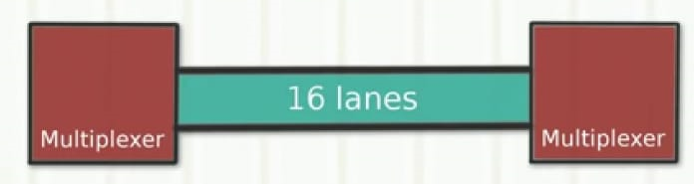
Parallel Bus

Slide 34
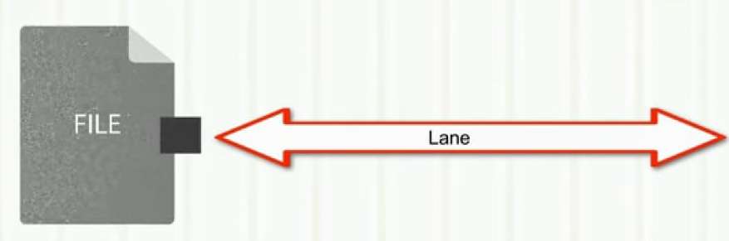
Serial Bus

Slide 35
System Bus – Data Bus & Address Bus
Parallel lines connecting CPU, memory & other hardware components mainly facilitating the exchange of data & memory addresses
System Bus has further three parts
  Data bus
  Address bus
  Control

Slide 36
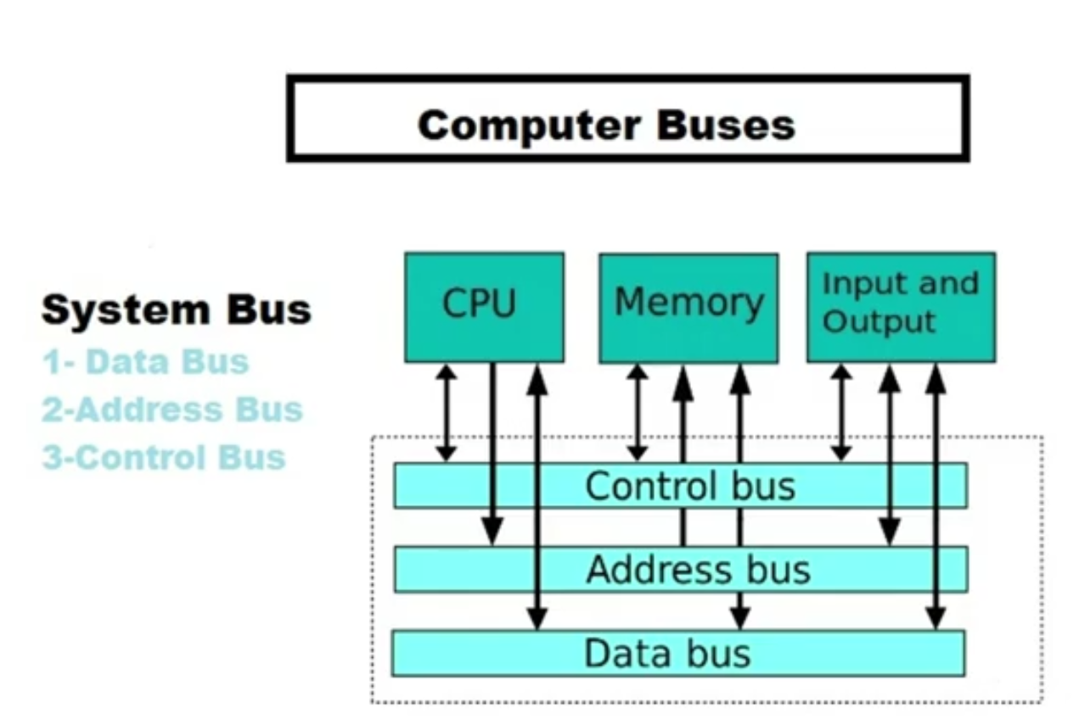
System Bus

Slide 37
Data Bus
Exchanging data between CPU, memory & hardware components on motherboard.
Like the highway lanes, the number of lines in data bus affects the speed of data exchange.
Each wire sends a total of 1 bit of data.
Speed measured in MHz.

Slide 38
Address Bus
Parallel lines like data bus connecting two or more hardware component specifying the physical address.
Processor accesses any memory location by specifying the address on the address bus.
The width of address bus determines the amount of memory that can be addressed.

Slide 39
Control Bus
Bus used to send control signals to other devices by CPU.
Used to communicate with devices within the computer.
An example of control bus is to send memory read/write signal to read or write to the memory.

Slide 40
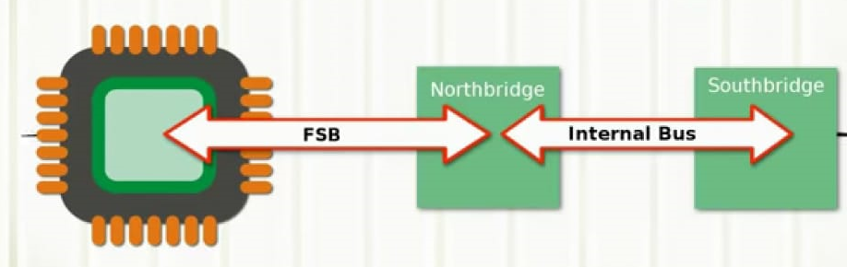
System Bus

Slide 41
