Slide 1
Introduction to Computing
LEC-5

Slide 2
A Quick Recap
Parts of CPU
Machine Cycle & Pipelined architecture
Buses and its types

Slide 3
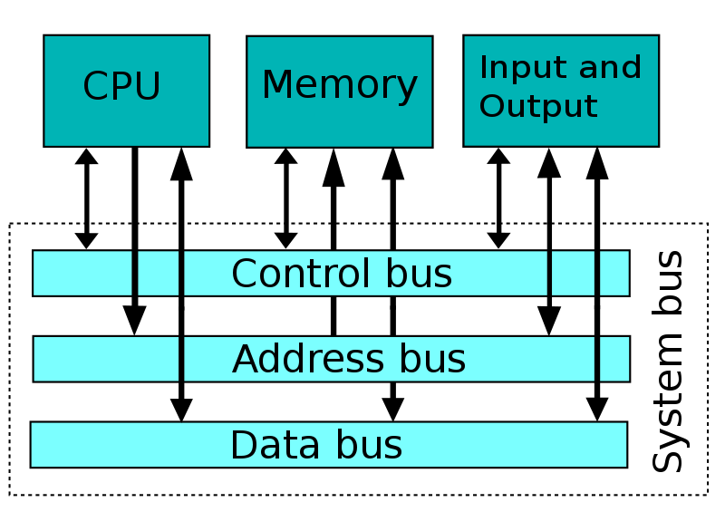
A Quick Overview

Slide 4
Registers
High speed memory locations equipped within the CPU.
Not part of any memory or storage device.
Temporarily store data or instruction.
Different type of registers based on the type of information they store.

Slide 5
Types of CPU Registers
Memory Address Register – Holds the memory address of location from which data is fetched. The register allows the access of data from the memory.
Memory Data Register – Holds the data to be stored into the memory or the data fetched from the memory
Program Counter – Keeps the address of the next instruction to be fetched and executed
General Purpose Registers – Temporarily hold data during execution

Slide 6
Types of CPU Registers
Instruction Register – Holds the instruction fetched from the memory waiting to be decoded.
Index Register– Holds the offset value for adding in the base register to calculate the effective address in array/vector operations.
Accumulator Register– Holds the results of arithmetic and logical operations.
Program Counter – Keeps the address of the next instruction to be fetched and executed

Slide 7
CPU registers in a scenario
Address of the instruction to be fetched is pointed by the PC, the address is loaded to the address bus and the instruction is fetched from the memory through data bus. The fetched instruction is loaded into instruction register.
After decoding the instruction, it seems that it may require the data to be fetched from the memory, the address of the memory is loaded in MAR.
The data is fetched from the memory and is given to the MDR.
The data fetched from the memory is added into the immediate value given in the instruction and is stored into the accumulator register.

Slide 8
CPU registers in a scenario
An instruction to be fetched is pointed by the PC, the instruction is loaded into the instruction register.
After decoding the instruction it seems that it may require the data to be fetched from the memory, the address of the memory is placed on to the MAR.
The data is fetched from the memory and is given to the MDR.
The data fetched from the memory is moved to the accumulator where as the other value is moved to a general purpose register. The sum of the two is stored into the accumulator register.

Slide 9
Size of Register
Number of bits the processor can handle.
Word size, width of the register is the amount of data a processor can handle at a time.
Width of registers can be 16, 32 or 64.
Size of the register refers to the terminology being used as 32-bit processor or 64-bit processor etc.

Slide 10
Cache
Small amount of very fast memory which stores copies of the data from the most frequently used main memory locations.
Sits between primary memory and CPU.
Can be located on a CPU chip or in a form of separate module.
Aim to reduce the access time of main memory.

Slide 11
Cache Function
Data stored within a cache might be those computed or utilized earlier.
Cache Hit is the presence of requested data in the cache.
Cache Miss is the unavailability of data and has to be fetched again from the original source.
Serving greater number of cache request, faster the performance.

Slide 12
Multi-level Cache
One large cache can hold greater amount of data resulting in a high hit ratio, however larger cache leads to greater access time.
To address the problem, fast and small sized cache is backed up with larger sized cache to hold large sized data.
Multi-level caches generally operate by checking the smallest level 1 (L1) cache first;
if it hits, the processor proceeds at high speed.
If the smaller cache misses, the next larger cache (L2) is checked, and then L3
so on, before external memory is checked.

Slide 13
Level-1, L1 Cache
Built directly onto the CPU chip.
Usually equipped with small sized memory space.
Fastest among all the cache levels.
Common sizes of L1 cache range from 32KB, 64KB, 128KB or so,

Slide 14
Level-2, L2 Cache
Slightly slower than L1 cache.
Size varies from 264KB to 16MB.
Processors comprise of ATC – Advanced Transfer Cache, built directly onto the CPU chip.
Able to process data much faster than the ones who have simple L2 cache.

Slide 15
Level-3, L3 Cache
L3 cache is a cache on the motherboard.
L1 and L2 in most of the computers, lie on the microprocessor
Cache ranges from the 4MB to 50MB.
The slowest of all.

Slide 16
Read Only Memory – ROM & its types
Memory chips storing permanent data.
Used to hold instruction to bootup OS.
Programmable Read Only Memory – PROM One time programmable memory chip, programmed at time of fabrication or manufacturing phase of devices.

Slide 17
Read Only Memory – ROM & its types
Erasable Programmable ROM – EPROM Able to write & erase the data using UV rays.
Electronically Erasable Programmable ROM – EEPROM Able to erase data electronically & then write data.
Needs special equipment to program & erase the memory chips.

Slide 18
EPROM
The memory chip consists of transistors that need to be charged up to a threshold.
The data is dissipated using the UV light rays exposed through the glass opening on the chip.
The glass opening is closed after programming it to save the data from ambient light.

Slide 19
EEPROM
The user based modifiable memory chip is erased by application of high voltage signals higher than the operating mode of +5V.
The device is re-programmed by putting into a burner and the data is electrically transferred to the chip in the form of signals.
Flash memory is a special example of EEPROM, an example of storage devices.

Slide 20
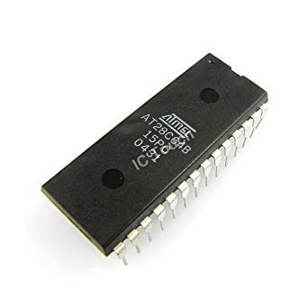
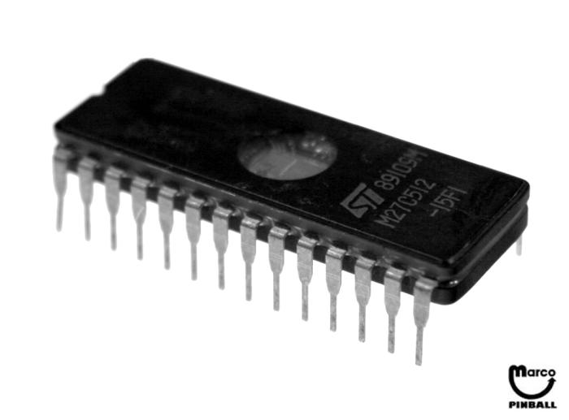
EPROM & EEPROM

Slide 21
Flash Memory
Data stored in the form of physical switches turned on and off for 0 and 1 respectively to hold the data.
Non-volatile memory.
Able to be erased and re-programmed.
Pen drives, Memory cards, Flash Cards, MP4, digital cameras equipped with it.

Slide 22
Random Access Memory
Random access means individual words of memory are directly accessed through wired-in addressing logic.
Volatile
A RAM must be provided with a constant power supply. If the power is interrupted, then the data are lost.
Can only be used as temporary storage

Slide 23
Static RAM
Bits stored as on/off switches
No charges to leak so no refreshing is required
Use of latches & Flip Flops
Faster and more reliable
Cache uses the SRAM

Slide 24
Dynamic RAM
Bits stored in capacitors as charge Presence of charge is 1, absence is 0.
Capacitors have a natural tendency to discharge.
1s held by the capacitors need to be refreshed as the value will be lost.
Periodic refreshing – Reading data and writing it again restoring the charge.

Slide 25
Using the SRAM and DRAM
Both memories are volatile however SRAM is more reliable than DRAM.
DRAM is less expensive & slower than SRAM and is mainly used in main memory.
SRAM are expensive & fast memory units mainly used in cache.

Slide 26
Asynchronous DRAM
Memory is not synchronized with system clock.
Data accessibility is a function of time & it is variable.
With systems having faster speeds, asynchronous adds latency to the system with not being able to deliver the required data in expected time.

Slide 27
Synchronous DRAM
Memory is synchronized with the clock speed of system.
Developed for high speed applications.
CPU knows the number of clock ticks to wait till the data is retrieved.
Efficient utilization of clock cycles, CPU would not look for data before it has been fetched.

Slide 28
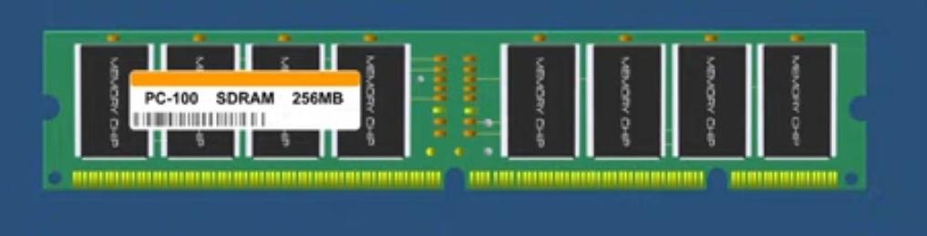
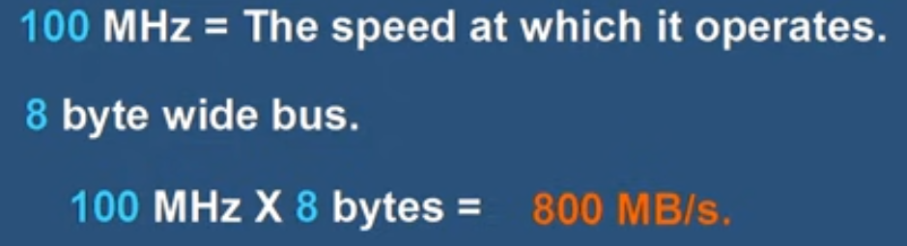
Synchronous DRAM

Slide 29
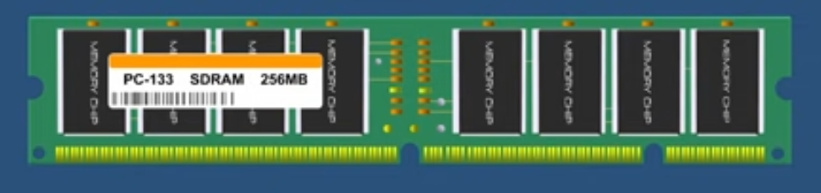
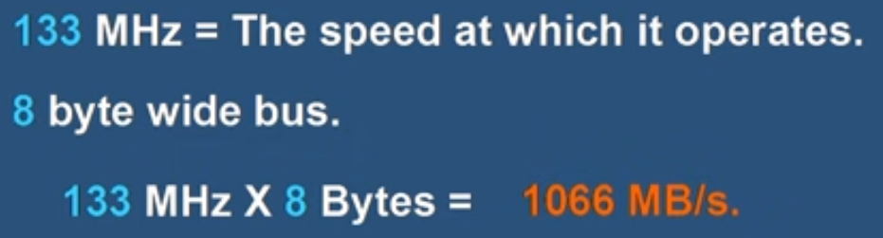
Synchronous DRAM

Slide 30
Synchronous DRAM

Slide 31
Synchronous DRAM
Many generations of SDRAM
DDR1, DDR2, DDR3 and DDR4.

Slide 32
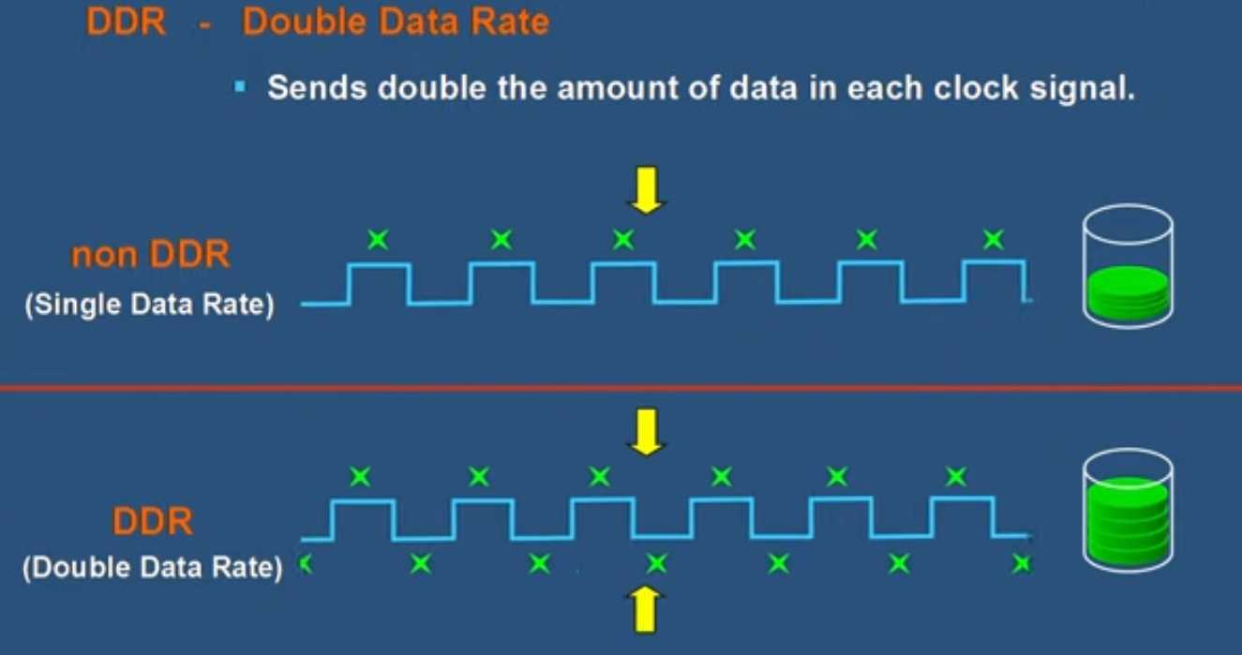
DDR

Slide 33
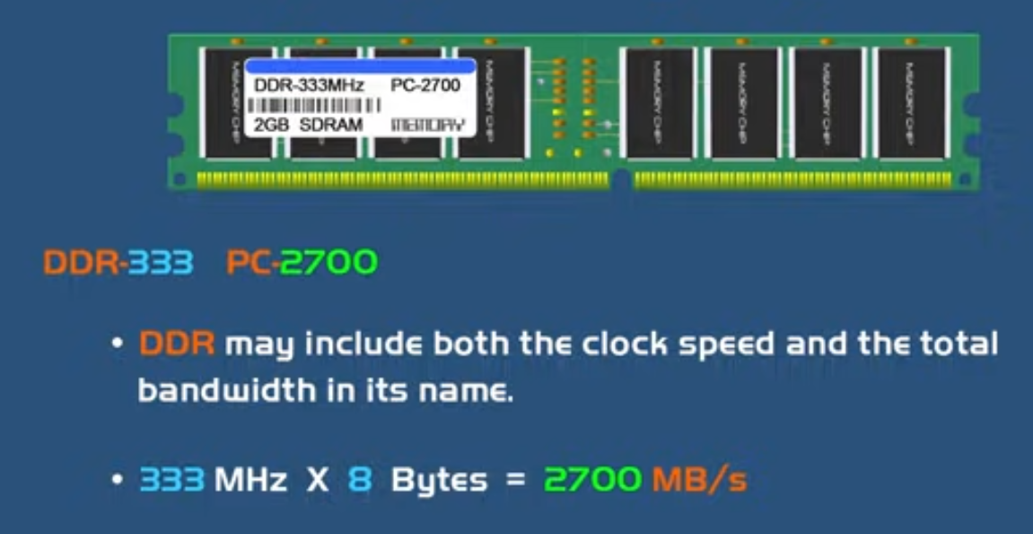
DDR

Slide 34
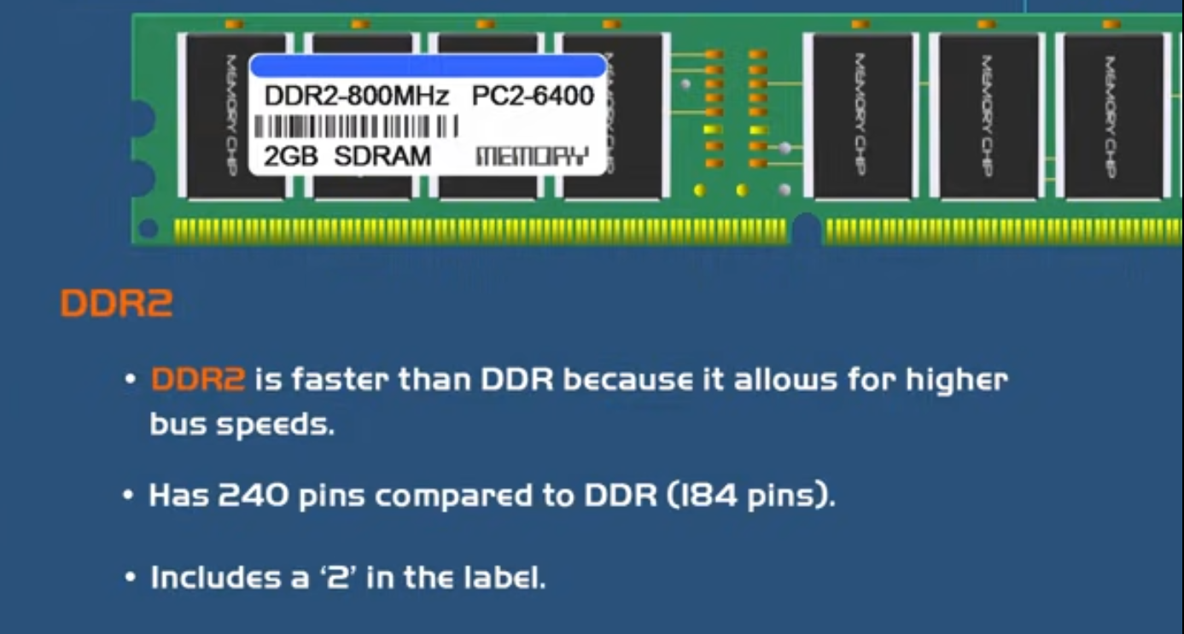
DDR

