Slide 1
Introduction to Computing
DATABASES

Slide 2
A Quick Recap
Process and its states
Transition of process through these states
Scheduling algorithms of Short Term Scheduler

Slide 3
File System
Computers use file systems to store data on medium such as hard-disks etc.
A file system contains the physical location of every piece of information on storage device.
Data is organized in form of directories, folders & sub-folders.

Slide 4
A Case Scenario
A company is having a large amount of data of their employees, customers, and sales.
They need to access the data concurrently by multiple employees.
Any change in the data must be reflected throughout the storage.
Restrictions have to be made to limit the access of the users.

Slide 5
Storing the data in OS file system.
The data will be stored in form of files that can have different formats.
Similar information will be saved in multiple files. e.g. customer information will be stored in customer files and it will also be stored in sales file.
Any change of data in one file would require changing in all other files.
e.g. Changing the city of a person requires the change in all other files the person info is present.

Slide 6
Storing the data in OS file system.
Same information may get saved with different metadata.
e.g. customer name in customer file is not exactly the same as in sales file. May occur due to typo error or wrong updates.
Restrictions can be applied on individual files however, those restrictions lead to addition of complexity in updating any changes in those restricted files.

Slide 7
Storing the data in OS file system - Drawbacks
Repeating information in multiple files adds data redundancy
Irregular updates and modifications leads to data inconsistency
Data inconsistency compromises data integrity
OS not flexible enough to provide constrained access over subset of data.

Slide 8
Database – The Centralized Approach
All the data is stored in a central location accessible by all.
Data is stored in a standardized and convenient format.
Data is managed by a controlling agent mainly a database management system.

Slide 9
What is a Database?
Structurally organized collection of data.
Structured to facilitate storage, deletion & modification of data rapidly.
Facilitates the applications to store data, forming repositories.

Slide 10
Structured Data?
Types of database varies according to the way they are stored and structurally organized.
One of the most common type of database is relational database.
Data is stored in the form of set of tables with relationships among them.

Slide 11
Relational Database
A table consists of collection of related data holding instances in form of rows also called as records. While the attributes of those instances are held up in form of columns called as fields.
The software that allows you to access the data and to manage the relational database is called as relational database management system.

Slide 12
Database Management System
RDBMS or simply DBMS is a program or set of programs that allows number of users to access the database and to extract data from the database based on special requests called as queries.

Slide 13
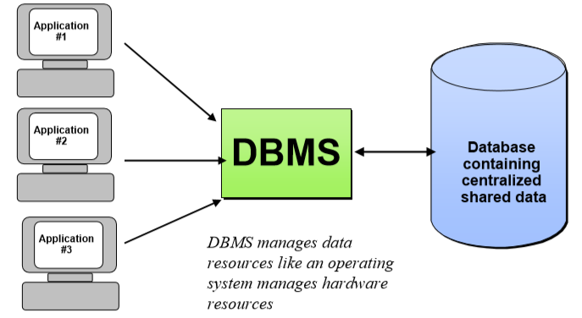
Database Management System

Slide 14
Working with a database
DBMS interface presents the user with data and tools to perform data management operations such as,
  Creating tables
  Viewing records
  Sorting records
  Creating and applying queries
  Generating reports based on those queries

Slide 15
Creating Table
Tables can be created using queries e.g. SQL (structured query language) is used to manage data held in relational database systems.
Before creating a table one should gather a bird-eye view of the data and its characteristics and attributes.
Table consists of set of instances of information of the data you want to store. e.g. I want to save information of customers.

Slide 16
Student Table
STUDENT
Student ID | Student Name | Student Address
001 | Ejaz Khan | Karachi
002 | Ahmed Mujeeb | Sargodha
003 | Mujtaba Saeed | Rawalpindi
004 | Asif Mansoor | Lahore
005 | Fazila Riaz | Islamabad

Slide 17
Student Table
Table Name
Row (Record)
STUDENT
Student ID | Student Name | Student Address
001 | Ejaz Khan | Karachi
002 | Ahmed Mujeeb | Sargodha
003 | Mujtaba Saeed | Rawalpindi
004 | Asif Mansoor | Lahore
005 | Fazila Riaz | Islamabad
Column (Field)

Slide 18
Tables in Relational Database
Any non-key attribute can occur multiple times in multiple records, however duplication of key-attribute or the entire record is not allowed in relational database.
The key attribute is also called as primary key.
Primary key is any of the attributes of the table with unique value for every record. In case of students your registration number.

Slide 19
Student Table
STUDENT
Student ID | Student Name | Student Address
001 | Ejaz Khan | Karachi
002 | Ahmed Mujeeb | Sargodha
003 | Mujtaba Saeed | Rawalpindi
004 | Asif Mansoor | Lahore
005 | Fazila Riaz | Islamabad
Primary Key

Slide 20
Students Register’s a Course
Course is being registered by student. These courses are characterized by their course id and course name.
Likewise the student table it will be having table name, fields and records.
Course table is given as,

Slide 21
Course Table
COURSE
Course ID | Course Name | Course Credits
C1 | Graphic Designing | 3
C2 | Web Development | 3
C3 | Android Development | 3
C4 | Unity 3D | 3
C5 | LateX | 3
Primary Key

Slide 22
Course Table
COURSE
Course ID | Course Name | Course Credits
C1 | Graphic Designing | 3
C2 | Web Development | 3
C3 | Android Development | 3
C4 | Unity 3D | 3
C5 | LateX | 3
Candidate Key

Slide 23
Student Register’s a course
Their belongs a relationship between the student and the course.
A single student can register a single course. A single course can be registered by multiple students.
This relationship is to be reflected by making primary key of one table as a relationship identifying key (foreign key) in the other.

Slide 24
Student Register’s a course
The registration process is shown in the form of entity-relationship diagram.
Register
Student
Course

Slide 25
How this relationship is reflected?
Since the cardinality of the relationship is 1 to many from course side.
Thus PK on one side becomes foreign key in many side.
The PK of course i.e. Course ID becomes a FK in the student table.
This relationship is formed connecting the two tables.

Slide 26
Relationship between the tables
STUDENT
Student ID | Student Name | Student Address | Registered Course
001 | Ejaz Khan | Karachi
002 | Ahmed Mujeeb | Sargodha
003 | Mujtaba Saeed | Rawalpindi
004 | Asif Mansoor | Lahore
005 | Fazila Riaz | Rawalpindi
COURSE
Course ID | Course Name | Course Credits
C1 | Graphic Designing | 3
C2 | Web Development | 3
C3 | Android Development | 3
C4 | Unity 3D | 3
C5 | LateX | 3

Slide 27
Relationship between the tables
STUDENT
Student ID | Student Name | Student Address | Registered Course
001 | Ejaz Khan | Karachi | C1
002 | Ahmed Mujeeb | Sargodha | C1
003 | Mujtaba Saeed | Rawalpindi | C4
004 | Asif Mansoor | Lahore | C4
005 | Fazila Riaz | Rawalpindi | C5
COURSE
Course ID | Course Name | Course Credits
C1 | Graphic Designing | 3
C2 | Web Development | 3
C3 | Android Development | 3
C4 | Unity 3D | 3
C5 | LateX | 3

Slide 28
Viewing Records
This is one of the basic and important functionality of DBMS to allow you to view the tables along with user specified request.
For instance we want to see the name of those students who are from Rawalpindi.
An example SQL query would be like,
  select Student Name from Student where Student Address = ‘Rawalpindi’

Slide 29
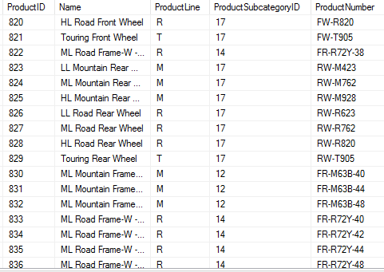
Viewing Records – A Test Sample
Product

Slide 30
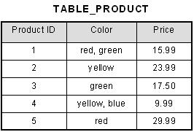
Viewing Records – Another Test Sample

Slide 31
Sorting Records
Records can be sorted based on any criteria provided by the user.
Sorting order and the criteria is provided by the user.
Looking at the product table on slide number 29, the products can be extracted belonging to product line R and are sorted by their sub-cat id.

Slide 32
Sorting Records
Product
select Name from Product where ProductLine = ‘R’ orderby ProductSubcategoryID

Slide 33
Applying Queries
Queries and sub-queries are created and applied to the database to extract the required data.
SQL offers queries required to define and manipulate data into the database.
Create Table, Create View, Orderby, are the examples of queries applied to the database to produce the required information.

Slide 34
Generating Reports
Reports are generated based on the sub-set or whole set of data to extract information and can be presented graphically or statistically.
It can be from looking at the geographic distribution of customers in a company to sales done by the company over a year.
Reports can be generated based on information extracted through applying queries.

Slide 35
Databases Applications
Purchase from the supermarket.
Purchases using your credit card.
Booking a holiday at the travel agent.
Using local library.
Renting video.
Management systems.
Banking management systems.

Slide 36
Examples of DBMS
Oracle.
Microsoft SQL Server
MySQL.
Microsoft Access
Firebase.

