Slide 1
Creating Computer Programs
lec#11

Slide 2
What Is a Computer Program?
Computer programs:
  A computer program is a set of instructions or statements (also called code) to be carried out by the computer's CPU.
lec#11

Slide 3
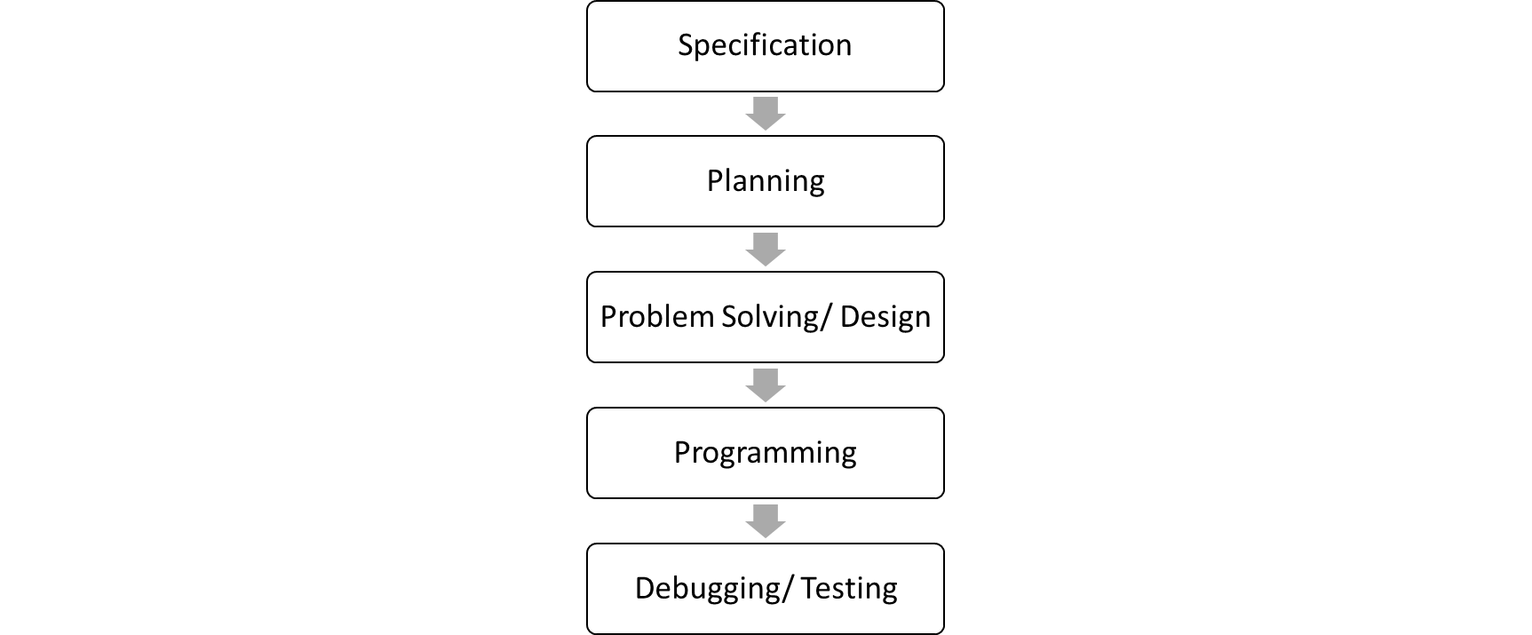
Programming- A Five Step Procedure
lec#11

Slide 4
1. Programming Specification
Program solving the problem
Problem
Programmer
    A program is used to solve a problem
lec#11

Slide 5

1. Programming Specification
    Computer has to be precisely told what it needs to do; otherwise:
lec#11

Slide 6
2. Planning a Computer Program
Plans:
  The steps to solve a problem
  Describe the expected results
  Programming without a plan is difficult
lec#11

Slide 7
Planning Tools
Pseudo code:
  Describe logic and processing flow in human natural language statements that resemble code
  Describes what must be done
  Can be written by non programmers
Flow chart:
  graphically represents logic flow.
lec#11

Slide 8
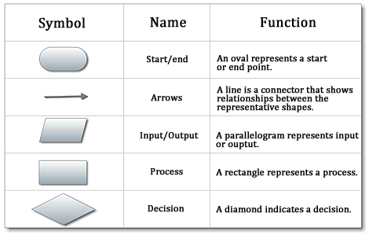
Planning Tools Cont…
lec#11
13A-<number>

Slide 9
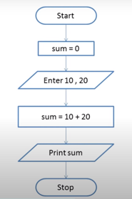
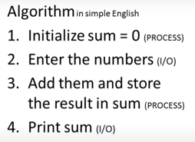
Planning Tools Cont…
lec#11
13A-<number>

Slide 10
3. How Programs Solve Problems?
Algorithm:
  Set of finite steps that solves a problem
  Always leads to a solution
  Steps are always the same
lec#11

Slide 11
3. How Programs Solve Problems?
Heuristic:
  Set of steps that usually solve a problem
  Solution may not be optimal
  Good heuristics provide non-optimal but acceptable solution for difficult problems
  Used when algorithms fail
    Algorithm is nonexistent or too complex
lec#11

Slide 12
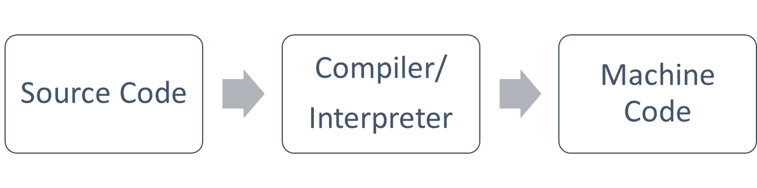
4. Program Coding
Select the appropriate programming language
Follow the Syntax of the chosen programming language
lec#11

Slide 13
4. Program Coding
Compilers and interpreters:
  Converts source code into machine code (binary)
    Allows code to execute
  Checks source code for correctness
lec#11

Slide 14
Compiler Vs Interpreter
Compilers | Interpreters
Slower translation Entire program Faster execution More efficient execution Good for commercial applications Source code is private | Faster translation One instruction or macro at a time Slower execution Less efficient execution Good for program development Source code is public
lec#11

Slide 15
5. Program Debugging and Testing
Quality assurance
Debug the program
Run real world data
lec#11

Slide 16
Control Structures
A control structure is like a block of programming that analyses variables and chooses a direction in which to go based on given parameters.
The term flow control details the direction the program takes (which way program control "flows").
Hence, it is the basic decision-making process in computing.
lec#11

Slide 17
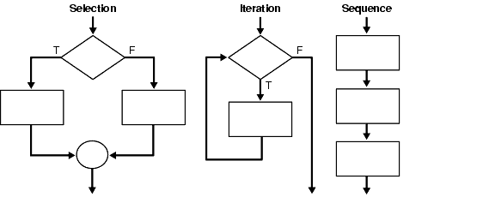
Control Structures Cont…
lec#11
13A-<number>

Slide 18
Control Structures Cont…
Sequence structure:
  Describes the flow of the program
  Typically executed in order
lec#11

Slide 19
Control Structures Cont…
Selection statement:
  Also called conditional statement
  Performs a true or false test
  Determines which code to execute next
lec#11

Slide 20
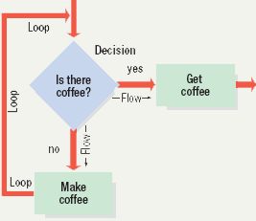
Control Structures Cont…
Repetition statements:
  Also called looping structures
  Repeats a section of code
    Until an exit condition is reached
lec#11

Slide 21
Reference Chapter:
Chapter 12 (Norton)
lec#11

