Slide 1
Introduction to Python

Slide 2
Python-A High Level Language
Computers can only execute programs written in low-level languages. Thus, programs written in a high-level language have to be processed before they can run.
Python is an example of a high-level language.

Slide 3
Interpreters and Compilers
Used for the conversion of high level language to low level language.
Many modern languages use both processes. They are first compiled into a lower level language, called byte code, and then interpreted by a program called a virtual machine.
Python uses both processes, but it is usually considered an interpreted language.
High Level Language
Low Level Language/Machine Code
Compiler/
Interpreter

Slide 4
Programing and Debugging
A program is a sequence of instructions that specifies how to perform a computation.
Programming errors are called bugs and the process of tracking them down and correcting them is called debugging.
Syntax errors
Run-Time errors
Logic errors

Slide 5
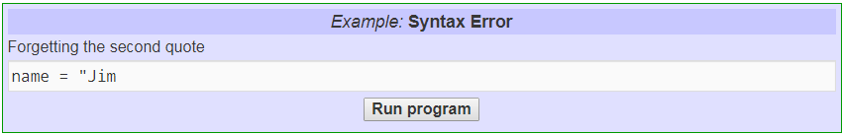
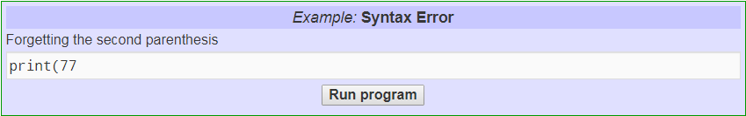
Syntax Error
Syntax refers to the structure of a program and the rules about that structure.
A syntax error happens when Python can't understand what you are saying.

Slide 6
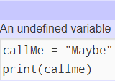

Run Time Error
These errors are also called exceptions because they usually indicate that something exceptional (and bad) has happened.
A run-time error happens when Python understands what you are saying, but runs into trouble when following your instructions.

Slide 7
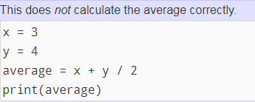
Logic Error
If there is a logic error in your program, it will run successfully, in the sense that the computer will not generate any error messages, but it will not do the right thing. It will do something else. Specifically, it will do what you told it to do.
The problem is that the program you wrote is not the program you wanted to write. The meaning of the program is wrong.

Slide 8
Handling the Print Function
print (“hello”) #printing a string print (‘hello’) #printing a string #multi line printing print(''' hi i am a student ''') print("hi\ni am a student") #\n is used for next line print(3) # printing an integer print(1.2) #printing a float point print(3*2) #printing some calculations

