Slide 1
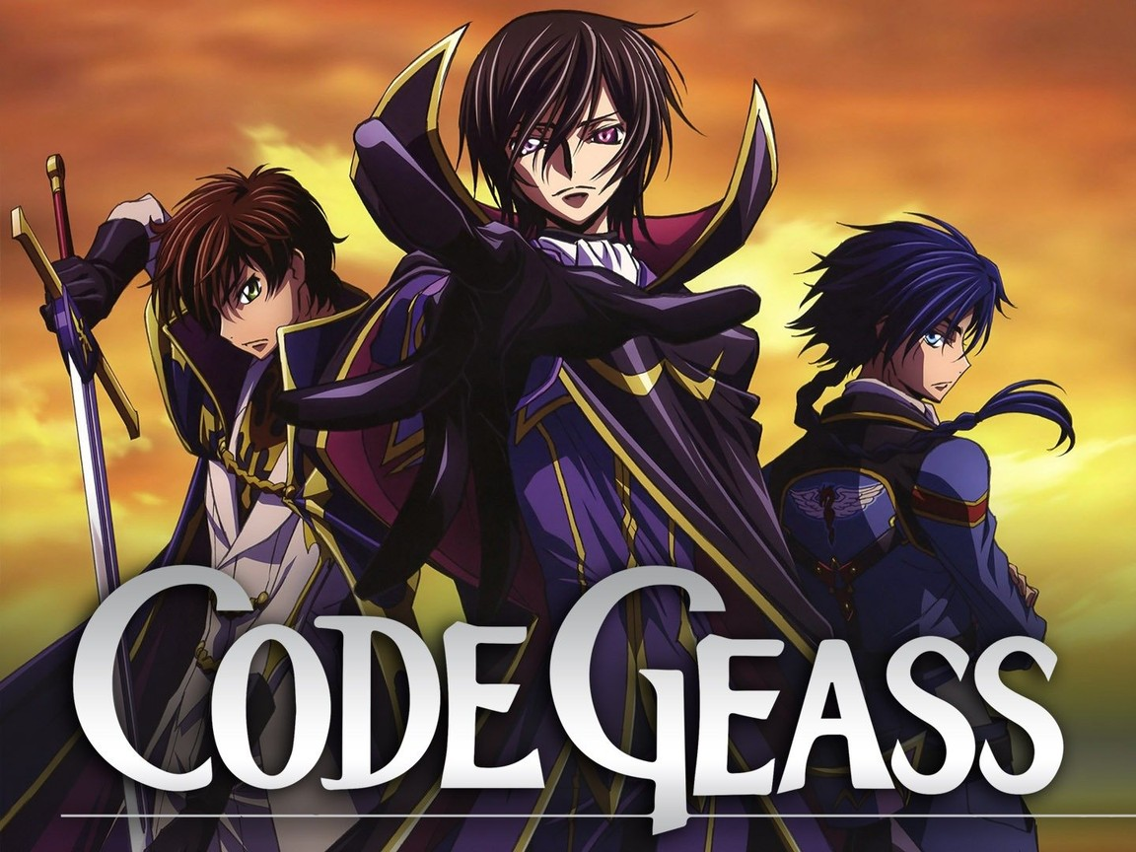

Slide 2
INTRODUCTION
Code Geass is an Anime which was released on October 2006.
It has 2 seasons with each season having 25 episodes.
It is a story of a prince named “Lelouch” who fight against his father.
His father is the King of the Britannia.
The nation which has conquered half of the world and still conquering the other half.

Slide 3
CHARACTERS:
The story revolves around three main characters.
Lelouch lamperouge
Nunnally lamperouge
Charles zi britannia

Slide 4
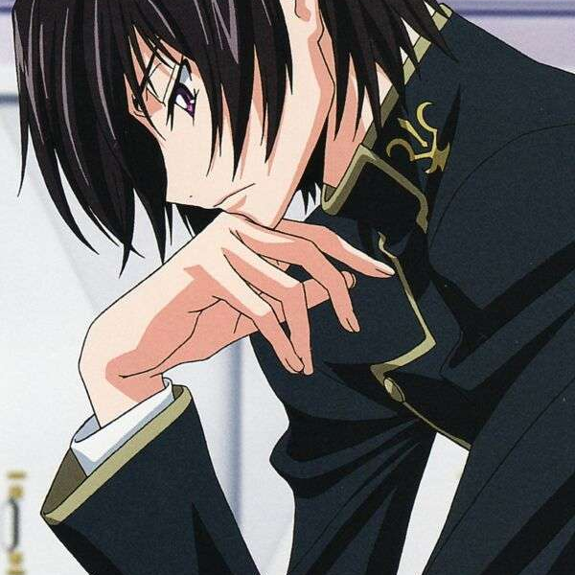
LELOUCH LAMPEROUGE
Lelouch Lamperouge is the title character and leading antihero of the series Code Geass.

Slide 5
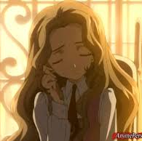
Nunnally lamperouge
She is Lelouch Lamperouge's disabled younger sister. Her real name is Nunnally vi Britannia.

Slide 6
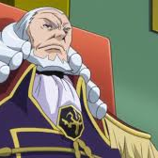
Charles zi britannia
the 98th emperor of the Holy Britannian Empire, the father of Lelouch vi Britannia

Slide 7
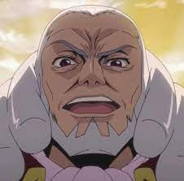
The King is very cruel and ruthless. He kills the people of the nations he has conquered and make them obey him. The protagonist was kicked out of the family with his sister by his father as he was kind and wanted his father to be a good person.

Slide 8
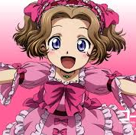
The sister of protagonist cannot stand and see. The protagonist depending on himself is a student and taking care of his disabled sister. His sister wants the world to be a peaceful place where everyone has equal rights so the protagonist promises his sister to make the world peaceful.

Slide 9
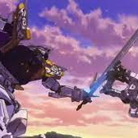
This anime is all about the story of the protagonist fight against his father to stop the wars and make the world peaceful.

Slide 10
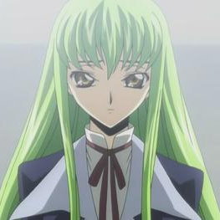
The story starts as the protagonist rescue an immortal which can give him powers. The immortal girl gives protagonist powers and then he decides to fight against his father to stop the wars. The immortal girl has given protagonist the power with which he can give an order to anyone and once he have given the order using the power that person has to obey the order. So, protagonist can make anyone do anything and his father has received the same power as the protagonist had rescued the immortal from the laboratory under his father.

Slide 11
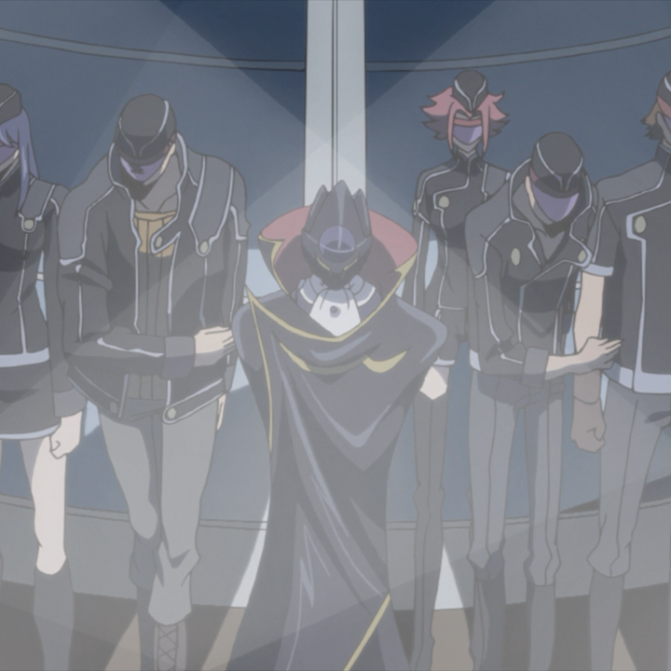
Protagonist use this power to make a force called black knights by creating an identity “Zero” and uses it to fight against his father.

Slide 12
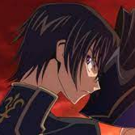
When protagonist acts as Zero then he wears the mask so not to reveal his identity. The protagonist unites the other half world to fight against his father with black knights but his plans failed so he realized that to make the world peaceful he has to unite the whole world. He conquers the whole world by killing his father and ascending the throne. He becomes the king of Britannia and then he conquers the whole world.

Slide 13
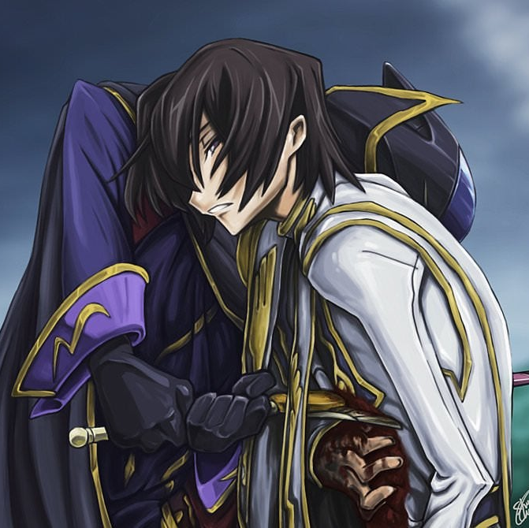
At the end the protagonist gives his friend the identity of “Zero” by giving him the mask of Zero to use black knights to kill the protagonist. At last, the forces he created and the union he made before ascending to the throne were under the command of Zero. So, when the protagonist first plan failed then he gave the identity of Zero to his friend and became the king and after conquering whole world his friend will kill him as Zero.

Slide 14
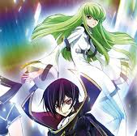
And then the whole world will be under the union which has representative from every nation of world and has the protection of black knights under Zero. In this way every nation and every person will have equal rights in the world and there will be no dictatorship. And anyone who will disturbs the peace of the world will be handled by the black knights under Zero.

Slide 15
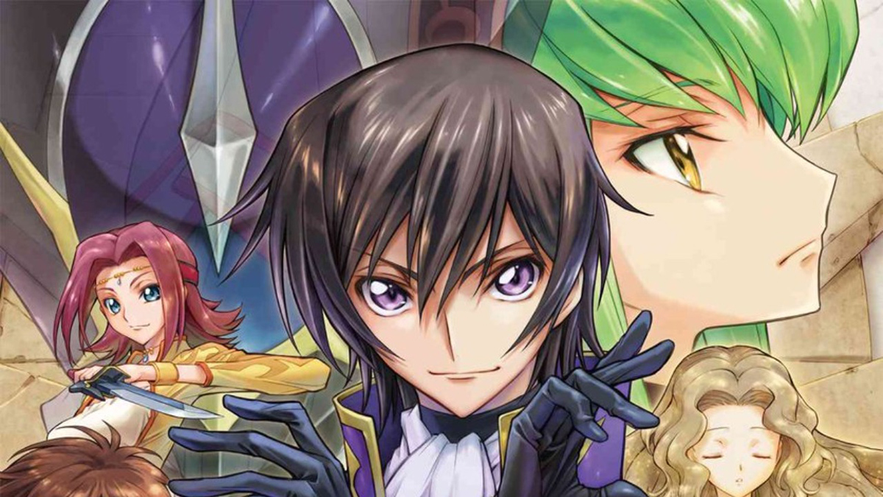
This story is very good and it has an ending with the world everyone desire. The protagonist at last makes a world which is peaceful. The protagonist even used his own life for the cause of the world. I recommend this Anime to anyone who likes this kind of story. It is one of the best Anime I have ever watched.

