Slide 1
Foundations of Planning
Chapter
4
© 2007 Prentice Hall, Inc.
All rights reserved.

Slide 2
What Is Planning?
Planning
  A primary managerial activity that involves:
    Defining the organization’s goals
    Establishing an overall strategy for achieving those goals
    Developing plans for organizational work activities.
  Types of planning
    Informal: not written down, short-term focus; specific to an organizational unit.
    Formal: written, specific, and long-term focus, involves shared goals for the organization.
© 2007 Prentice Hall, Inc. All rights reserved.
7–<number>

Slide 3

Why Do Managers Plan?
Purposes of Planning
  Provides direction
  Reduces uncertainty
  Minimizes waste and redundancy
  Sets the standards for controlling
© 2007 Prentice Hall, Inc. All rights reserved.
7–<number>

Slide 4
Planning and Performance
The Relationship Between Planning And Performance
  Formal planning is associated with:
    Higher profits and returns on assets.
    Positive financial results.
  The quality of planning and implementation affects performance more than the extent of planning.
  The external environment can reduce the impact of planning on performance,
  Formal planning must be used for several years before planning begins to affect performance.
© 2007 Prentice Hall, Inc. All rights reserved.
7–<number>

Slide 5
How Do Managers Plan?
Elements of Planning
  Goals (also Objectives)
    Desired outcomes for individuals, groups, or entire organizations
    Provide direction and evaluation performance criteria
  Plans
    Documents that outline how goals are to be accomplished
    Describe how resources are to be allocated and establish activity schedules
© 2007 Prentice Hall, Inc. All rights reserved.
7–<number>

Slide 6
Types of Goals
Financial Goals
  Are related to the expected internal financial performance of the organization.
Strategic Goals
  Are related to the performance of the firm relative to factors in its external environment (e.g., competitors).
Stated Goals versus Real Goals
  Broadly-worded official statements of the organization (intended for public consumption) that may be irrelevant to its real goals (what actually goes on in the organization).
© 2007 Prentice Hall, Inc. All rights reserved.
7–<number>

Slide 7
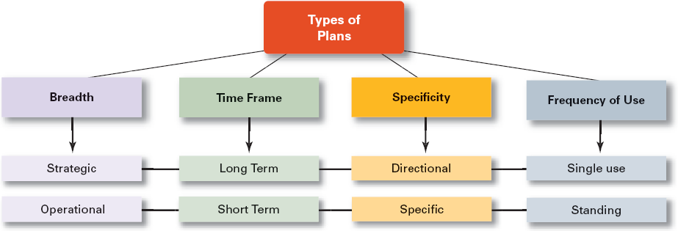
Exhibit 7–2 Types of Plans
© 2007 Prentice Hall, Inc. All rights reserved.
7–<number>

Slide 8
Types of Plans
Strategic Plans
  Apply to the entire organization.
  Establish the organization’s overall goals.
  Seek to position the organization in terms of its environment.
  Cover extended periods of time.
Operational Plans
  Specify the details of how the overall goals are to be achieved.
  Cover short time period.
© 2007 Prentice Hall, Inc. All rights reserved.
7–<number>

Slide 9
Types of Plans (cont’d)
Long-Term Plans
  Plans with time frames extending beyond three years
Short-Term Plans
  Plans with time frames on one year or less
Specific Plans
  Plans that are clearly defined and leave no room for interpretation
Directional Plans
  Flexible plans that set out general guidelines, provide focus, yet allow discretion in implementation.
© 2007 Prentice Hall, Inc. All rights reserved.
7–<number>

Slide 10
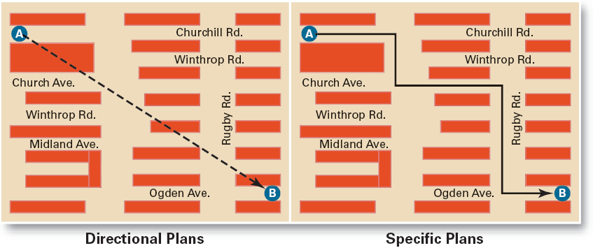
Exhibit 7–3 Specific Versus Directional Plans
© 2007 Prentice Hall, Inc. All rights reserved.
7–<number>

Slide 11
Types of Plans (cont’d)
Single-Use Plan
  A one-time plan specifically designed to meet the need of a unique situation.
Standing Plans
  Ongoing plans that provide guidance for activities performed repeatedly.
© 2007 Prentice Hall, Inc. All rights reserved.
7–<number>

Slide 12
Establishing Goals and Developing Plans
Traditional Goal Setting
  Broad goals are set at the top of the organization.
  Goals are then broken into subgoals for each organizational level.
  Assumes that top management knows best because they can see the “big picture.”
  Goals are intended to direct, guide, and constrain from above.
  Goals lose clarity and focus as lower-level managers attempt to interpret and define the goals for their areas of responsibility.
© 2007 Prentice Hall, Inc. All rights reserved.
7–<number>

Slide 13
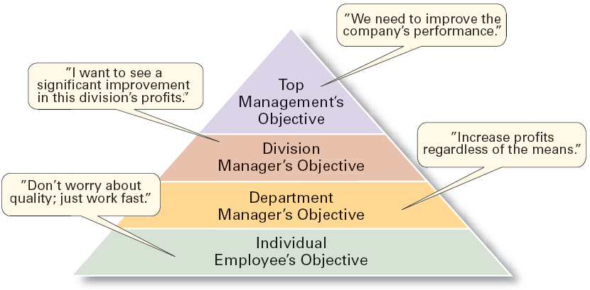
Exhibit 7–4 The Downside of Traditional Goal Setting
© 2007 Prentice Hall, Inc. All rights reserved.
7–<number>

Slide 14
Establishing Goals and Developing Plans (cont’d)
Maintaining the Hierarchy of Goals
  Means–Ends Chain
    The integrated network of goals that results from establishing a clearly-defined hierarchy of organizational goals.
    Achievement of lower-level goals is the means by which to reach higher-level goals (ends).
© 2007 Prentice Hall, Inc. All rights reserved.
7–<number>

Slide 15
Exhibit 7–6 Characteristics of Well-Designed Goals
Written in terms of outcomes, not actions
  Focuses on the ends, not the means.
Measurable and quantifiable
  Specifically defines how the outcome is to be measured and how much is expected.
Clear as to time frame
  How long before measuring accomplishment.
Challenging yet attainable
  Low goals do not motivate.
  High goals motivate if they can be achieved.
Written down
  Focuses, defines, and makes goals visible.
Communicated to all necessary organizational members
  Puts everybody “on the same page.”
© 2007 Prentice Hall, Inc. All rights reserved.
7–<number>

Slide 16
Steps in Goal Setting
Review the organization’s mission statement.
  Do goals reflect the mission?
Evaluate available resources.
  Are resources sufficient to accomplish the mission?
Determine goals individually or with others.
  Are goals specific, measurable, and timely?
Write down the goals and communicate them.
  Is everybody on the same page?
Review results and whether goals are being met.
  What changes are needed in mission, resources, or goals?
© 2007 Prentice Hall, Inc. All rights reserved.
7–<number>

Slide 17
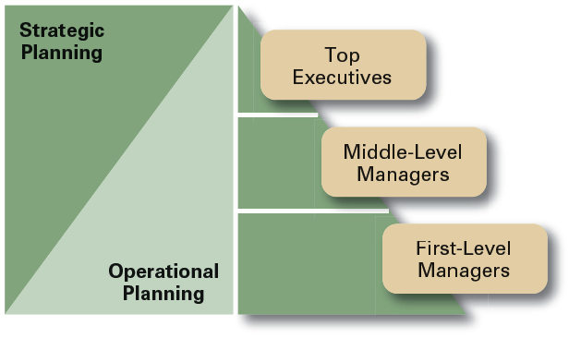
Exhibit 7–7 Planning in the Hierarchy of Organizations
© 2007 Prentice Hall, Inc. All rights reserved.
7–<number>

Slide 18
Approaches to Planning
Establishing a formal planning department
  A group of planning specialists who help managers write organizational plans.
  Planning is a function of management; it should never become the sole responsibility of planners.
Involving organizational members in the process
  Plans are developed by members of organizational units at various levels and then coordinated with other units across the organization.
© 2007 Prentice Hall, Inc. All rights reserved.
7–<number>

Slide 19
Contemporary Issues in Planning
Criticisms of Planning
  Planning may create rigidity.
  Plans cannot be developed for dynamic environments.
  Formal plans cannot replace intuition and creativity.
  Planning focuses managers’ attention on today’s competition not tomorrow’s survival.
  Formal planning reinforces today’s success, which may lead to tomorrow’s failure.
© 2007 Prentice Hall, Inc. All rights reserved.
7–<number>

Slide 20
Contemporary Issues in Planning (cont’d)
Effective Planning in Dynamic Environments
  Develop plans that are specific but flexible.
  Understand that planning is an ongoing process.
  Change plans when conditions warrant.
  Persistence in planning eventually pay off.
  Flatten the organizational hierarchy to foster the development of planning skills at all organizational levels.
© 2007 Prentice Hall, Inc. All rights reserved.
7–<number>

