Slide 1
Introduction to Management and Organizations
By:
Lecturer Sanober Tariq
Chapter
1
© 2007 Prentice Hall, Inc.
All rights reserved.

Slide 2
Management
The art and science of managing resources.
Management is a process of planning, decision making, organizing, leading, motivation and controlling the human resources, financial, physical, and information resources of an organization to reach its goals efficiently and effectively.
© 2007 Prentice Hall, Inc. All rights reserved.
1–<number>

Slide 3

Who Are Managers?
Manager
  Someone who coordinates and oversees the work of other people so that organizational goals can be accomplished.
© 2007 Prentice Hall, Inc. All rights reserved.
1–<number>

Slide 4
Classifying Managers
First-line Managers
  Individuals who manage the work of non-managerial employees.
Middle Managers
  Individuals who manage the work of first-line managers.
Top Managers
  Individuals who are responsible for making organization-wide decisions and establishing plans and goals that affect the entire organization.
© 2007 Prentice Hall, Inc. All rights reserved.
1–<number>

Slide 5
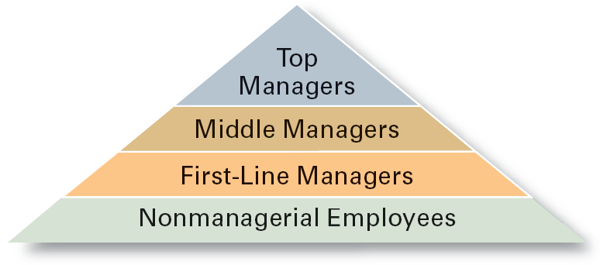
Exhibit 1–1 Managerial Levels
© 2007 Prentice Hall, Inc. All rights reserved.
1–<number>

Slide 6

What Is Management?
Managerial Concerns
  Efficiency
    “Doing things right”
      Getting the most output for the least inputs
  Effectiveness
    “Doing the right things”
      Attaining organizational goals
© 2007 Prentice Hall, Inc. All rights reserved.
1–<number>

Slide 7
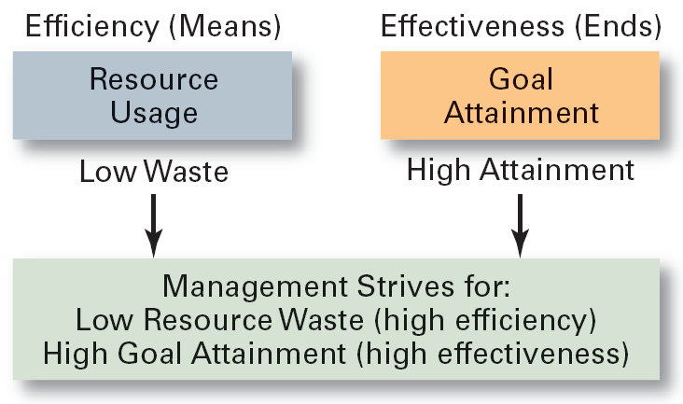
Exhibit 1–2 Effectiveness and Efficiency in Management
© 2007 Prentice Hall, Inc. All rights reserved.
1–<number>

Slide 8
What Do Managers Do?
Functional Approach
  Planning
    Defining goals, establishing strategies to achieve goals, developing plans to integrate and coordinate activities.
  Organizing
    Scheduling, Arranging and structuring work to accomplish organizational goals.
  Leading
    Working with and through people to accomplish goals., influencing the followers.
  Controlling
    Maintaining check and balance, monitoring, comparing, and correcting work.
© 2007 Prentice Hall, Inc. All rights reserved.
1–<number>

Slide 9
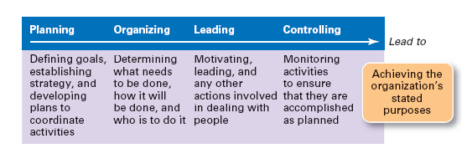
Exhibit 1–3 Management Functions
© 2007 Prentice Hall, Inc. All rights reserved.
1–<number>

Slide 10

What Do Managers Do? (cont’d)
Management Roles Approach (Mintzberg)
  Interpersonal roles
    Figurehead, leader, liaison
  Informational roles
    Monitor, disseminator, spokesperson
  Decisional roles
    Disturbance handler, resource allocator, negotiator
© 2007 Prentice Hall, Inc. All rights reserved.
1–<number>

Slide 11
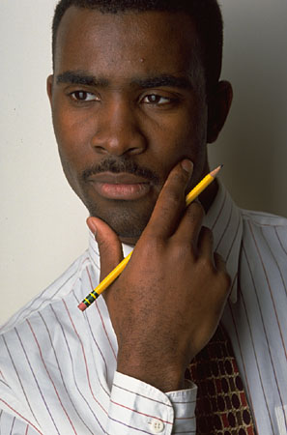
What Managers Actually Do (Mintzberg)
Interaction
  with others
  with the organization
  with the external context of the organization
Reflection
  thoughtful thinking
Action
  practical doing
© 2007 Prentice Hall, Inc. All rights reserved.
1–<number>

Slide 12
What Do Managers Do? (cont’d)
Skills Approach
  Technical skills
    Knowledge and proficiency in a specific field
  Human skills
    The ability to work well with other people
  Conceptual skills
    The ability to think and conceptualize about abstract and complex situations concerning the organization
© 2007 Prentice Hall, Inc. All rights reserved.
1–<number>

Slide 13
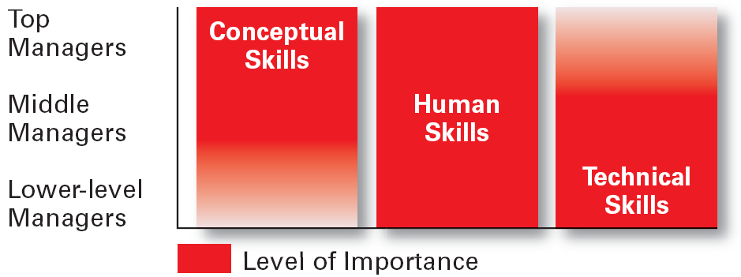
Exhibit 1–5 Skills Needed at Different Management Levels
© 2007 Prentice Hall, Inc. All rights reserved.
1–<number>

Slide 14
How The Manager’s Job Is Changing
The Increasing Importance of Customers
  Customers: the reason that organizations exist
    Managing customer relationships is the responsibility of all managers and employees.
    Consistent high quality customer service is essential for survival.
Innovation
  Doing things differently, exploring new territory, and taking risks
    Managers should encourage employees to be aware of and act on opportunities for innovation.
© 2007 Prentice Hall, Inc. All rights reserved.
1–<number>

Slide 15
What Is An Organization?
An Organization Defined
  A deliberate arrangement of people to accomplish some specific purpose (that individuals independently could not accomplish alone).
Common Characteristics of Organizations
  Have a distinct purpose (goal)
  Composed of people
  Have a deliberate structure
© 2007 Prentice Hall, Inc. All rights reserved.
1–<number>

Slide 16
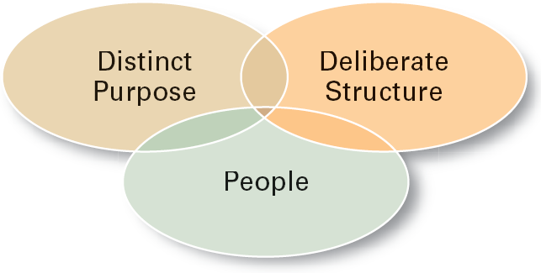
Exhibit 1–9 Characteristics of Organizations
© 2007 Prentice Hall, Inc. All rights reserved.
1–<number>

Slide 17
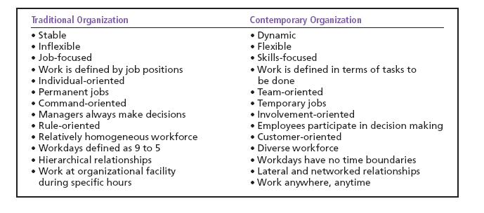
Exhibit 1–10 The Changing Organization
© 2007 Prentice Hall, Inc. All rights reserved.
1–<number>

Slide 18
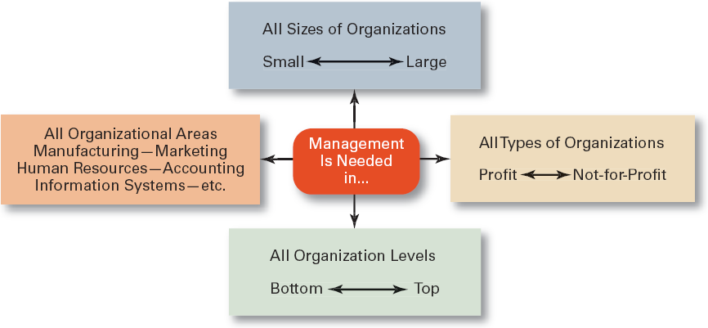
Exhibit 1–11 Universal Need for Management
© 2007 Prentice Hall, Inc. All rights reserved.
1–<number>

