Slide 1
Management Yesterday and Today by:
Lecturer Sanober Tariq
Chapter
2
© 2007 Prentice Hall, Inc.
All rights reserved.

Slide 2
Historical Background of Management
Ancient Management
  Egypt (pyramids) and China (Great Wall)
Adam Smith
  Published “The Wealth of Nations” in 1776
    Advocated the division of labor (job specialization) to increase the productivity of workers
Industrial Revolution
  Substituted machine power for human labor
  Created large organizations in need of management
© 2007 Prentice Hall, Inc. All rights reserved.
2–<number>

Slide 3
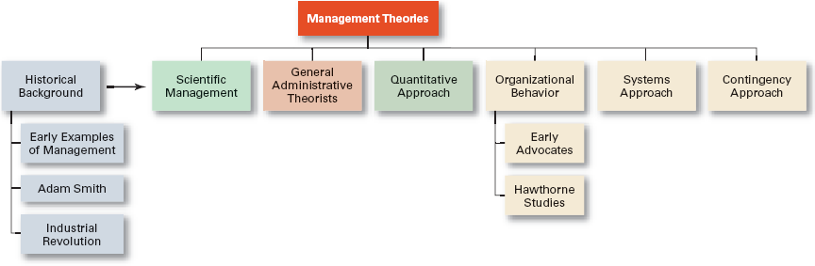
Exhibit 2–1 Development of Major Management Theories
© 2007 Prentice Hall, Inc. All rights reserved.
2–<number>

Slide 4

Major Approaches to Management
Scientific Management
General Administrative Theory
Quantitative Management
Organizational Behavior
Systems Approach
Contingency Approach
© 2007 Prentice Hall, Inc. All rights reserved.
2–<number>

Slide 5
Scientific Management
Fredrick Winslow Taylor
  The “father” of scientific management
  Published Principles of Scientific Management (1911)
    The theory of scientific management
      Using scientific methods to define the “one best way” for a job to be done:
        Putting the right person on the job with the correct tools and equipment.
        Having a standardized method of doing the job.
        Providing an economic incentive to the worker.
© 2007 Prentice Hall, Inc. All rights reserved.
2–<number>

Slide 6
Scientific Management (cont’d)
Frank and Lillian Gilbreth
  Focused on increasing worker productivity through the reduction of wasted motion
© 2007 Prentice Hall, Inc. All rights reserved.
2–<number>

Slide 7
General Administrative Theory
Henri Fayol
  Believed that the practice of management was distinct from other organizational functions
Max Weber
  Developed a theory of authority based on an ideal type of organization .
© 2007 Prentice Hall, Inc. All rights reserved.
2–<number>

Slide 8
Quantitative Approach to Management
Quantitative Approach
  Also called operations research or management science
  Evolved from mathematical and statistical methods developed to solve WWII military logistics and quality control problems
  Focuses on improving managerial decision making by applying:
    Statistics, optimization models, information models, and computer simulations
© 2007 Prentice Hall, Inc. All rights reserved.
2–<number>

Slide 9

Understanding Organizational Behavior
Organizational Behavior (OB)
  The study of the actions of people at work; people are the most important asset of an organization
Early OB Advocates
  Robert Owen
  Hugo Munsterberg
  Mary Parker Follett
  Chester Barnard
© 2007 Prentice Hall, Inc. All rights reserved.
2–<number>

Slide 10
The Hawthorne Studies
A series of productivity experiments conducted at Western Electric from 1927 to 1932.
Experimental findings
  Productivity unexpectedly increased under imposed adverse working conditions.
  The effect of incentive plans was less than expected.
Research conclusion
  Social norms, group standards and attitudes more strongly influence individual output and work behavior than do monetary incentives.
© 2007 Prentice Hall, Inc. All rights reserved.
2–<number>

Slide 11
The Systems Approach
System Defined
  A set of interrelated and interdependent parts arranged in a manner that produces a unified whole.
Basic Types of Systems
  Closed systems
    Are not influenced by and do not interact with their environment (all system input and output is internal).
  Open systems
    Dynamically interact to their environments by taking in inputs and transforming them into outputs that are distributed into their environments.
© 2007 Prentice Hall, Inc. All rights reserved.
2–<number>

Slide 12
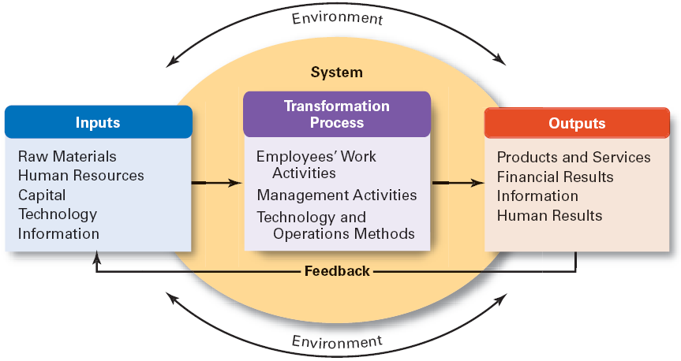
Exhibit 2–6 The Organization as an Open System
© 2007 Prentice Hall, Inc. All rights reserved.
2–<number>

Slide 13
The Contingency Approach
Contingency Approach Defined
  Also sometimes called the situational approach.
  There is no one universally applicable set of management principles (rules) by which to manage organizations.
  Organizations are individually different, face different situations (contingency variables), and require different ways of managing.
© 2007 Prentice Hall, Inc. All rights reserved.
2–<number>

Slide 14

Current Trends and Issues
Globalization
Ethics
Workforce Diversity
Entrepreneurship
E-business
Knowledge Management
Learning Organizations
Quality Management
© 2007 Prentice Hall, Inc. All rights reserved.
2–<number>

