Slide 1
Decision-Making: The Essence of the Manager’s Job
Chapter
5
© 2007 Prentice Hall, Inc.
All rights reserved.

Slide 2
Decision Making
Decision
  Making a choice from two or more alternatives.
The Decision-Making Process
  Identifying a problem and decision criteria and allocating weights to the criteria.
  Developing, analyzing, and selecting an alternative that can resolve the problem.
  Implementing the selected alternative.
  Evaluating the decision’s effectiveness.
© 2007 Prentice Hall, Inc. All rights reserved.
6–<number>

Slide 3
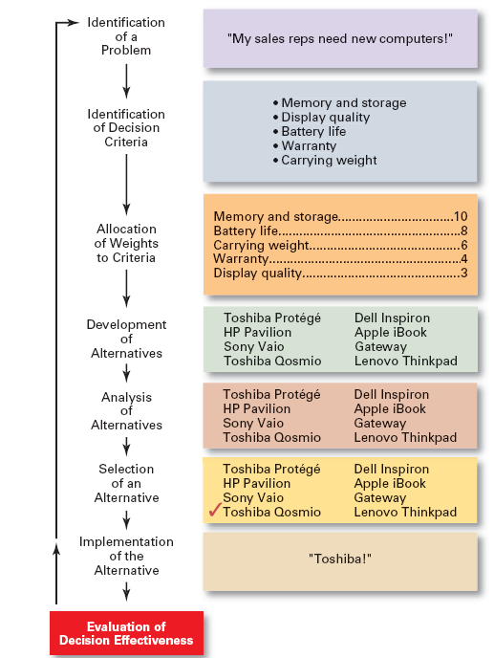
Exhibit 6–1
The Decision-Making Process
© 2007 Prentice Hall, Inc. All rights reserved.
6–<number>

Slide 4
Step 1: Identifying the Problem
Problem
  A discrepancy between an existing and desired state of affairs.
Characteristics of Problems
  A problem becomes a problem when a manager becomes aware of it.
  There is pressure to solve the problem.
  The manager must have the authority, information, or resources needed to solve the problem.
© 2007 Prentice Hall, Inc. All rights reserved.
6–<number>

Slide 5
Step 2: Identifying Decision Criteria
Decision criteria are factors that are important (relevant) to resolving the problem.
  Costs that will be incurred (investments required)
  Risks likely to be encountered (chance of failure)
  Outcomes that are desired (growth of the firm)
Step 3: Allocating Weights to the Criteria
Decision criteria are not of equal importance:
  Assigning a weight to each item places the items in the correct priority order of their importance in the decision making process.
© 2007 Prentice Hall, Inc. All rights reserved.
6–<number>

Slide 6
Exhibit 6–2 Criteria and Weights for Computer Replacement Decision
Criterion Weight
Memory and Storage 10
Battery life 8
Carrying Weight 6
Warranty 4
Display Quality 3
© 2007 Prentice Hall, Inc. All rights reserved.
6–<number>

Slide 7
Step 4: Developing Alternatives
Identifying viable alternatives
  Alternatives are listed (without evaluation) that can resolve the problem.
Step 5: Analyzing Alternatives
Appraising each alternative’s strengths and weaknesses
  An alternative’s appraisal is based on its ability to resolve the issues identified in steps 2 and 3.
© 2007 Prentice Hall, Inc. All rights reserved.
6–<number>

Slide 8
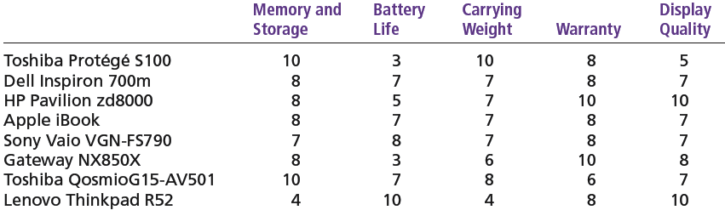
Exhibit 6–3 Assessed Values of Laptop Computers Using Decision Criteria
© 2007 Prentice Hall, Inc. All rights reserved.
6–<number>

Slide 9
Step 6: Selecting an Alternative
Choosing the best alternative
  The alternative with the highest total weight is chosen.
Step 7: Implementing the Alternative
Putting the chosen alternative into action.
  Conveying the decision to and gaining commitment from those who will carry out the decision.
© 2007 Prentice Hall, Inc. All rights reserved.
6–<number>

Slide 10
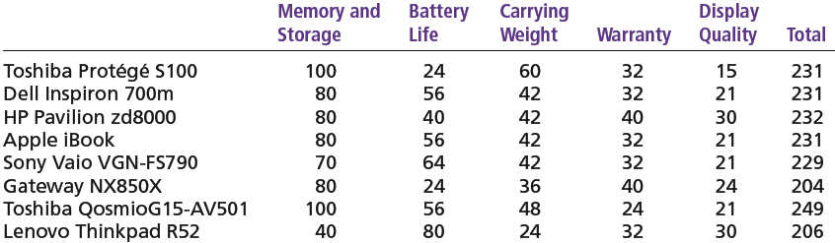
Exhibit 6–4 Evaluation of Laptop Alternatives Against Weighted Criteria
© 2007 Prentice Hall, Inc. All rights reserved.
6–<number>

Slide 11
Step 8: Evaluating the Decision’s Effectiveness
The soundness of the decision is judged by its outcomes.
  How effectively was the problem resolved by outcomes resulting from the chosen alternatives?
  If the problem was not resolved, what went wrong?
© 2007 Prentice Hall, Inc. All rights reserved.
6–<number>

Slide 12
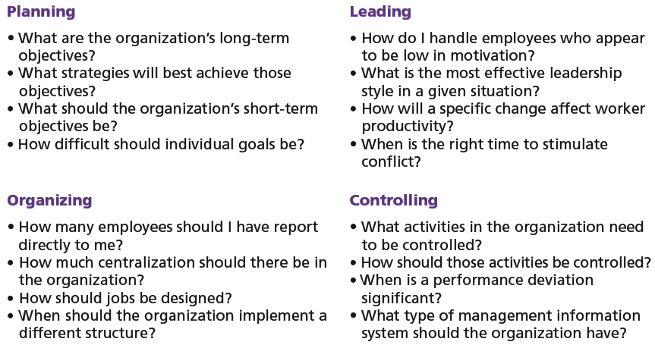
Exhibit 6–5 Decisions in the Management Functions
© 2007 Prentice Hall, Inc. All rights reserved.
6–<number>

Slide 13
Making Decisions
Rationality
  Managers make consistent, value-maximizing choices with specified constraints.
  Assumptions are that decision makers:
    Are perfectly rational, fully objective, and logical.
    Have carefully defined the problem and identified all viable alternatives.
    Have a clear and specific goal
    Will select the alternative that maximizes outcomes in the organization’s interests rather than in their personal interests.
© 2007 Prentice Hall, Inc. All rights reserved.
6–<number>

Slide 14
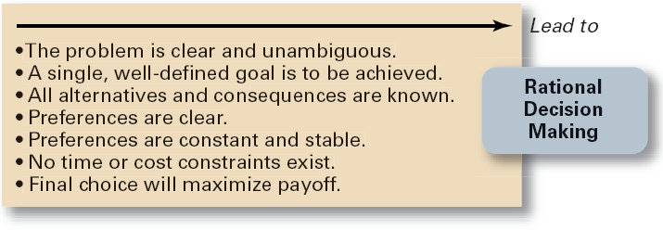
Exhibit 6–6 Assumptions of Rationality
© 2007 Prentice Hall, Inc. All rights reserved.
6–<number>

Slide 15
Making Decisions (cont’d)
Bounded Rationality
  Managers make decisions rationally, but are limited (bounded) by their ability to process information.
  Assumptions are that decision makers:
    Will not seek out or have knowledge of all alternatives
    Will satisfice—choose the first alternative encountered that satisfactorily solves the problem—rather than maximize the outcome of their decision by considering all alternatives and choosing the best.
  Influence on decision making
    Escalation of commitment: an increased commitment to a previous decision despite evidence that it may have been wrong.
© 2007 Prentice Hall, Inc. All rights reserved.
6–<number>

Slide 16
The Role of Intuition
Intuitive decision making
  Making decisions on the basis of experience, feelings, and accumulated judgment.
© 2007 Prentice Hall, Inc. All rights reserved.
6–<number>

Slide 17
Types of Problems and Decisions
Structured Problems
  Involve goals that clear.
  Are familiar (have occurred before).
  Are easily and completely defined—information about the problem is available and complete.
Programmed Decision
  A repetitive decision that can be handled by a routine approach.
© 2007 Prentice Hall, Inc. All rights reserved.
6–<number>

Slide 18
Types of Programmed Decisions
Policy
  A general guideline for making a decision about a structured problem.
Procedure
  A series of interrelated steps that a manager can use to respond (applying a policy) to a structured problem.
Rule
  An explicit statement that limits what a manager or employee can or cannot do.
© 2007 Prentice Hall, Inc. All rights reserved.
6–<number>

Slide 19
Policy, Procedure, and Rule Examples
Policy
  Accept all customer-returned merchandise.
Procedure
  Follow all steps for completing merchandise return documentation.
Rules
  Managers must approve all refunds over $50.00.
  No credit purchases are refunded for cash.
© 2007 Prentice Hall, Inc. All rights reserved.
6–<number>

Slide 20
Problems and Decisions (cont’d)
Unstructured Problems
  Problems that are new or unusual and for which information is ambiguous or incomplete.
  Problems that will require custom-made solutions.
Nonprogrammed Decisions
  Decisions that are unique and nonrecurring.
  Decisions that generate unique responses.
© 2007 Prentice Hall, Inc. All rights reserved.
6–<number>

Slide 21
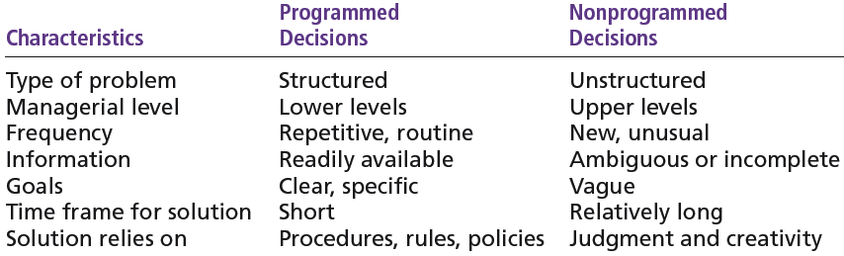
Exhibit 6–8 Programmed versus Nonprogrammed Decisions
© 2007 Prentice Hall, Inc. All rights reserved.
6–<number>

Slide 22
Decision-Making Conditions
Certainty
  A situation in which a manager can make an accurate decision because the outcome of every alternative choice is known.
Risk
  A situation in which the manager is able to estimate the likelihood (probability) of outcomes that result from the choice of particular alternatives.
© 2007 Prentice Hall, Inc. All rights reserved.
6–<number>

Slide 23
Decision-Making Conditions
Uncertainty
  Limited information prevents estimation of outcome probabilities for alternatives associated with the problem and may force managers to rely on intuition, hunches, and “gut feelings”.
    Maximax: the optimistic manager’s choice to maximize the maximum payoff
    Maximin: the pessimistic manager’s choice to maximize the minimum payoff
    Minimax: the manager’s choice to minimize maximum regret.
© 2007 Prentice Hall, Inc. All rights reserved.
6–<number>

Slide 24
Decision-Making Styles
Dimensions of Decision-Making Styles
  Ways of thinking
    Rational, orderly, and consistent
    Intuitive, creative, and unique
  Tolerance for ambiguity
    Low tolerance: require consistency and order
    High tolerance: multiple thoughts simultaneously
© 2007 Prentice Hall, Inc. All rights reserved.
6–<number>

Slide 25
Characteristics of an Effective Decision-Making Process
It focuses on what is important.
It is logical and consistent.
It acknowledges both subjective and objective thinking and blends analytical with intuitive thinking.
It requires only as much information and analysis as is necessary to resolve a particular dilemma.
It encourages and guides the gathering of relevant information and informed opinion.
It is straightforward, reliable, easy to use, and flexible.
© 2007 Prentice Hall, Inc. All rights reserved.
6–<number>

