Slide 1

Oral communication course
Ma’am Midhat Maroof khan

Slide 2
Muhammad Hammad sp24-bsse-0033 section: em

Slide 3
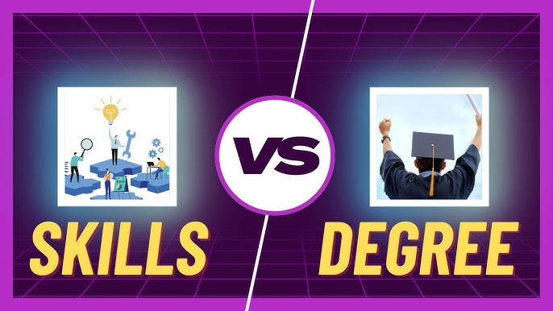
Topic: Why skills, not just a degree matter for your future!

Slide 4
Your Degree is the Start, But Skills Shape Your Future!
While a degree can open doors, it is skills like leadership, communication, and problem-solving that truly drive career success and advancement.

Slide 5
Why Skills Matter More Than Ever in Today’s Job Market
As companies like Google, Apple, and IBM shift focus from degrees to practical skills and experience, it’s clear that hands-on expertise and specialized training are increasingly valuable in today’s job market.

Slide 6
Success Stories Prove Skills Matter More Than Degrees
Many successful people have shown their skill can be more important than a degree.

Slide 7
Essential Skills for Success in the Digital Era
Whether its tech skills like CODING or creative skills like DESIGN, learning something new helps you stay relevant!

Slide 8
Thank you!

