Slide 1
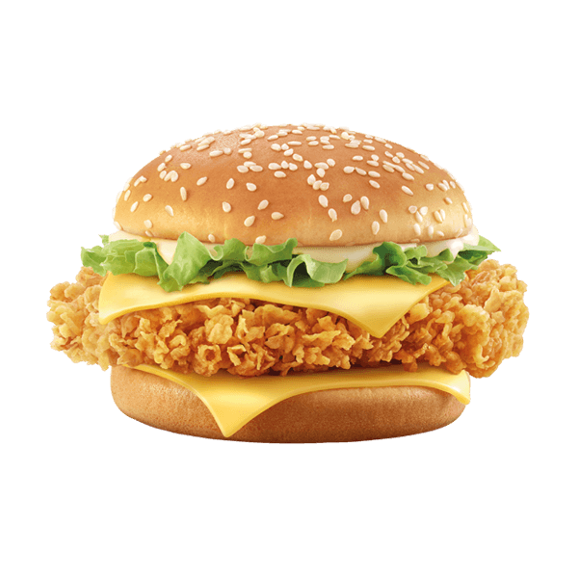
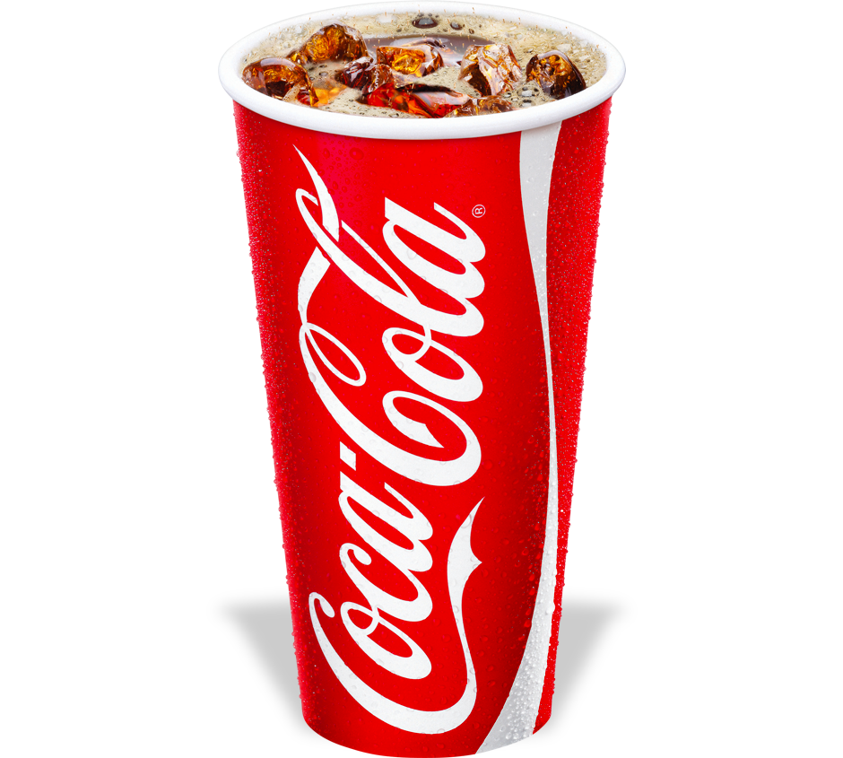

BURGER LAB
Deal 1
1 Zinger + Fries + Drink

Slide 2
BURGER LAB
Deal 2
2 Zinger + 2Fries + 2Drinks

