Slide 1


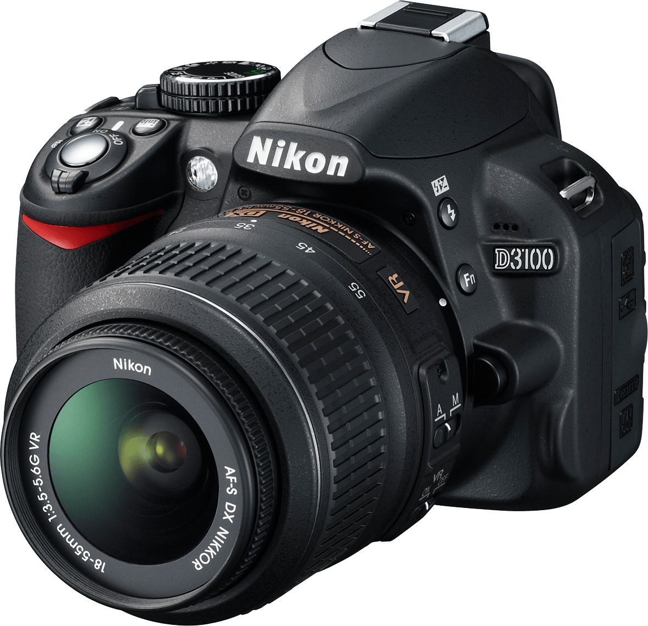
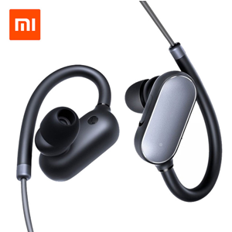
REAL ELECTRONIC
Deal In All Kinds Of
Electronic Items
Contact Us:
03162276402

