Slide 1
PCA Forecast Averaging – Predicting Day Ahead Electricity Price Across Calibration Windows
By
Hammad Ullah
Supervisor: Dr. Tomasz Serafin

Slide 2



Introduction
Longer Window
Mix
Forecasting performance is sensitive to the choice of the calibration window.
Longer Window = Precise estimations.
Shorter Window = Better adapt to changes.
Forecasting accuracy increases with mixing the two.
Inappropriate choice of window may lower the prediction accuracy.
Simple average across all windows is robust and hard to outperform.
Proposed methods may not be directly transferred from one market or model.
Shorter Window
Inappropriate Window
length
Simple Average Window

Slide 3

Aim & Methodology
Forecasting Methods Terminology
Win(T) | Simple Window
AW(T) | Simple Average
WAW(T) | Weighted Average
WAW(T) exp | Expanding Weighted Average
PCA | Principle Component Analysis
To compare the performance of PCA with the other averaging window scheme across calibration window lengths relative to the reference window for the dataset (GEFCOM) used in our study.
Reference Window
Win(728)
Best Performing Window/Scheme
MAE = ? %Change = ?
The ARX Model:

Slide 4
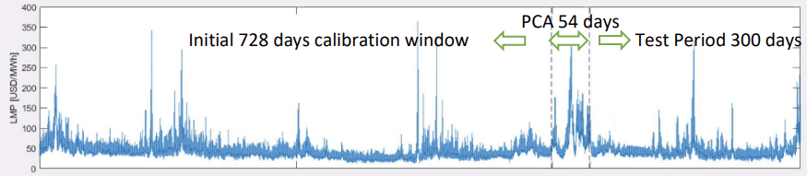
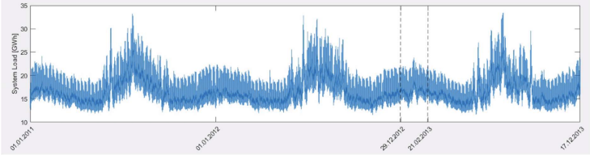
Simple Rolling Calibration Window
GEFCOM dataset (2011 – 2013)
Win(28)
Win(364)
Win(728)
728 days
364 days
28 days

Slide 5

Simple Average Window
AW(364,728)
AW(28:728)
AW(28,728)
AW(56:728)
AW(56,728)
AW(28:7:728)
AW(28:14:728)
AW(28:28:728)
AW(28:28:84,714:7:728)
AW(28,56,728)
AW(28,56,364,728)
AW(28,56,721,728)
728 days
701 windows
364 days
Forecasts
(728 days window)
Forecasts
(364 days window)
Assumes Equal Weights
Forecast
Average

Slide 6



Weighted Average Windows
WAW(364,728)
WAW(28:728)
WAW(28,728)
WAW(56,728)
WAW(28:7:728)
WAW(28:14:728)
WAW(28:28:728)
WAW(28:28:84,714:7:728)
WAW(28,56,728)
WAW(28,56,364,728)
WAW(28,56,721,728)
728 days
364 days
Forecasts
(728 days window)
Forecasts
(364 days window)
Forecast
Average

Slide 7
Expanding Weighted Average Window
WAW(364,728) exp
WAW(28:728) exp
WAW(28,728) exp
WAW(56,728) exp
WAW(28:7:728) exp
WAW(28:14:728) exp
WAW(28:28:728) exp
WAW(28:28:84,714:7:728) exp
WAW(28,56,728) exp
WAW(28,56,364,728) exp
WAW(28,56,721,728) exp
728 days
364 days
Test Period 300 days
Forecast
(728 days window)
Forecasting
Forecast
(364 days window)
Mon Tue Wed Thu Fri
22/02/2013
22/02/2013
24/02/2013
25/02/2013
26/02/2013
Performance Window
Forecasting
Forecast
(Average)
Mon Tue Wed Thu Fri
22/02/2013
22/02/2013
24/02/2013
25/02/2013
26/02/2013
Performance Window

Slide 8
Principle Component Analysis
The majority of forecast combination approaches discussed in the literature, either use a small number of predictions or emphasize the need for prediction selection. Alternatively, one could utilize the information included in a big panel of forecasts by using the principal component analysis (PCA).
For each time period t in the averaging window, estimate the mean and standard deviation of individual forecasts across different calibration window length.
Standardize the predictions and the predicted variable.
Estimate……….day. Based on the number of principle component K used in the model we denote the model by PCA(K).
Run a regression using observations from the averaging window, without the last 24 observation.
Compute the prediction of the normalized dependent variable on day d at hour h.
PCA (1)
PCA (2)
PCA (3)
PCA (4)

Slide 9
Results
Windows | MAE | %change
Win(28) | 5.6412 | -13.40%
Win(364) | 4.9879 | -2.05%
AW(364,728) | 4.9163 | -0.63%
WAW(364,728) exp | 4.8452 | 0.83%
WAW(364,728) | 4.8448 | 0.84%
Win(728) | 4.8854 | 0.00%
AW(28:728) | 4.8517 | 0.69%
WAW(28:728) exp | 4.792 | 1.95%
WAW(28:728) | 4.7827 | 2.15%
AW(28:7:728) | 4.8456 | 0.82%
WAW(28:7:728) exp | 4.7869 | 2.06%
WAW(28:7:728) | 4.7773 | 2.26%
AW(28:14:728) | 4.836 | 1.02%
WAW(28:14:728) exp | 4.7783 | 2.24%
WAW(28:14:728) | 4.7701 | 2.42%
AW(28:28:728) | 4.8228 | 1.30%
WAW(28:28:728) exp | 4.7677 | 2.47%
WAW(28:28:728) | 4.7601 | 2.63%
AW(56,728) | 4.7489 | 2.87%
WAW(56,728) exp | 4.7153 | 3.61%
WAW(56,728) | 4.7071 | 3.79%
AW(28,728) | 4.6892 | 4.18%
WAW(28,728) exp | 4.6586 | 4.87%
WAW(28,728) | 4.6711 | 4.59%
AW(28:28:84,714:7:728) | 4.8288 | 1.17%
WAW(28:28:84,714:7:728) exp | 4.613 | 5.91%
WAW(28:28:84,714:7:728) | 4.5999 | 6.21%
AW(28,56,728) | 4.6739 | 4.53%
WAW(28,56,728) exp | 4.6548 | 4.95%
WAW(28,56,728) | 4.6333 | 5.44%
AW(28,56,364,728) | 4.6142 | 5.88%
WAW(28,56,364,728) exp | 4.5956 | 6.31%
WAW(28,56,364,728) | 4.5957 | 6.30%
AW(28,56,721,728) | 4.6115 | 5.94%
WAW(28,56,721,728) exp | 4.5931 | 6.36%
WAW(28,56,721,728) | 4.592 | 6.39%
PCA(1) | 4.8707 | 0.30%
PCA(2) | 4.8529 | 0.67%
PCA(3) | 4.773 | 2.35%
PCA(4) | 4.7755 | 2.30%
Reference
Scheme/Window
Best performing
Scheme/Window

Slide 10
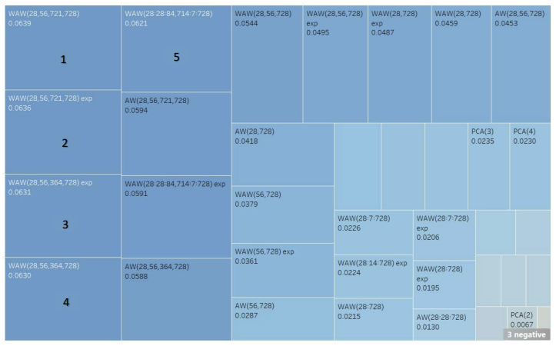
Results: Best performing forecast Window/scheme by rank.

Slide 11


Conclusion
For the given dataset and ARX model considered in the study:
A single weighted average window (WAW) outperformed all the other windows/schemes used in our study by 0.03%.
The PCA forecasts performed poorly compared to most of the other forecast models used in our study.
Low performance of PCA models could be due to the absence of variance stabilizing transformation (VFT).
Increasing PCA window length from 54 to 100 days fetched poorer results.
Maybe the poor performance of PCA had something to do with the data and/or the chosen ARX model.
WAW
PCA

Slide 12
Thank You

