Slide 1
Peking University/Baidu - Autonomous Driving
Kaggle Competition
Presented By: Hammam Hraesha

Slide 2
Competition Overview

Slide 3
Challenge
Develop an model to estimate the absolute pose of vehicles from a single image in a real-world traffic environment.

Slide 4
Evaluation
Submissions are evaluated on mean average precision (mAP) between the predicted pose information and the correct position and rotation.

Slide 5
Timeline
Start Date: 22/10/2019
End Date: 22/01/2020

Slide 6
Explore The Data

Slide 7
Data
train.csv - pose information for all of the images in the training set. (4262 rows)
train_images.zip - images in the training set. (4262 rows)
train_masks.zip - ignore masks for the training set. (Not all images have a mask.)
test_images.zip - images in the test set. (2021 rows)
test_masks.zip - ignore masks for the test set. (Not all images have a mask.)
sample_submission.csv - a sample submission file in the correct format (2021 rows)
  ImageId - a unique identifier for each image (and related mask, if one exists).
  PredictionString - a collection of poses and confidence scores.
car_models.zip - 3D models of the unmasked cars in the training / test images. They can be used for pose estimation, etc.
camera.zip - camera intrinsic parameters.

Slide 8
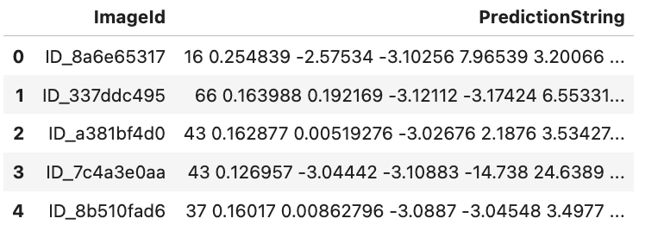
train.csv
High-resolution real world traffic images.
Annotated
  Spatial coordinates (x, y ,z)
  3D orientation labels (yaw, pitch, roll)

Slide 9
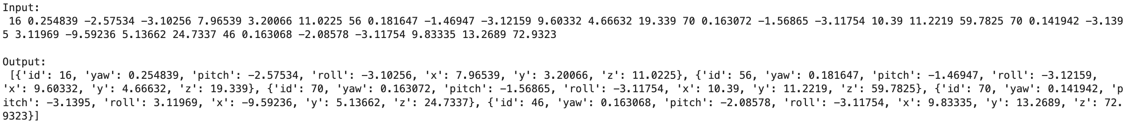
PredictionString - Explained
PredictionString - a collection of poses and confidence scores of all cars in an image.
In the first image we have a total of 5 cars annotated.
‘id’ indicates model type so multiple cars in an image can have the same ‘id’

Slide 10
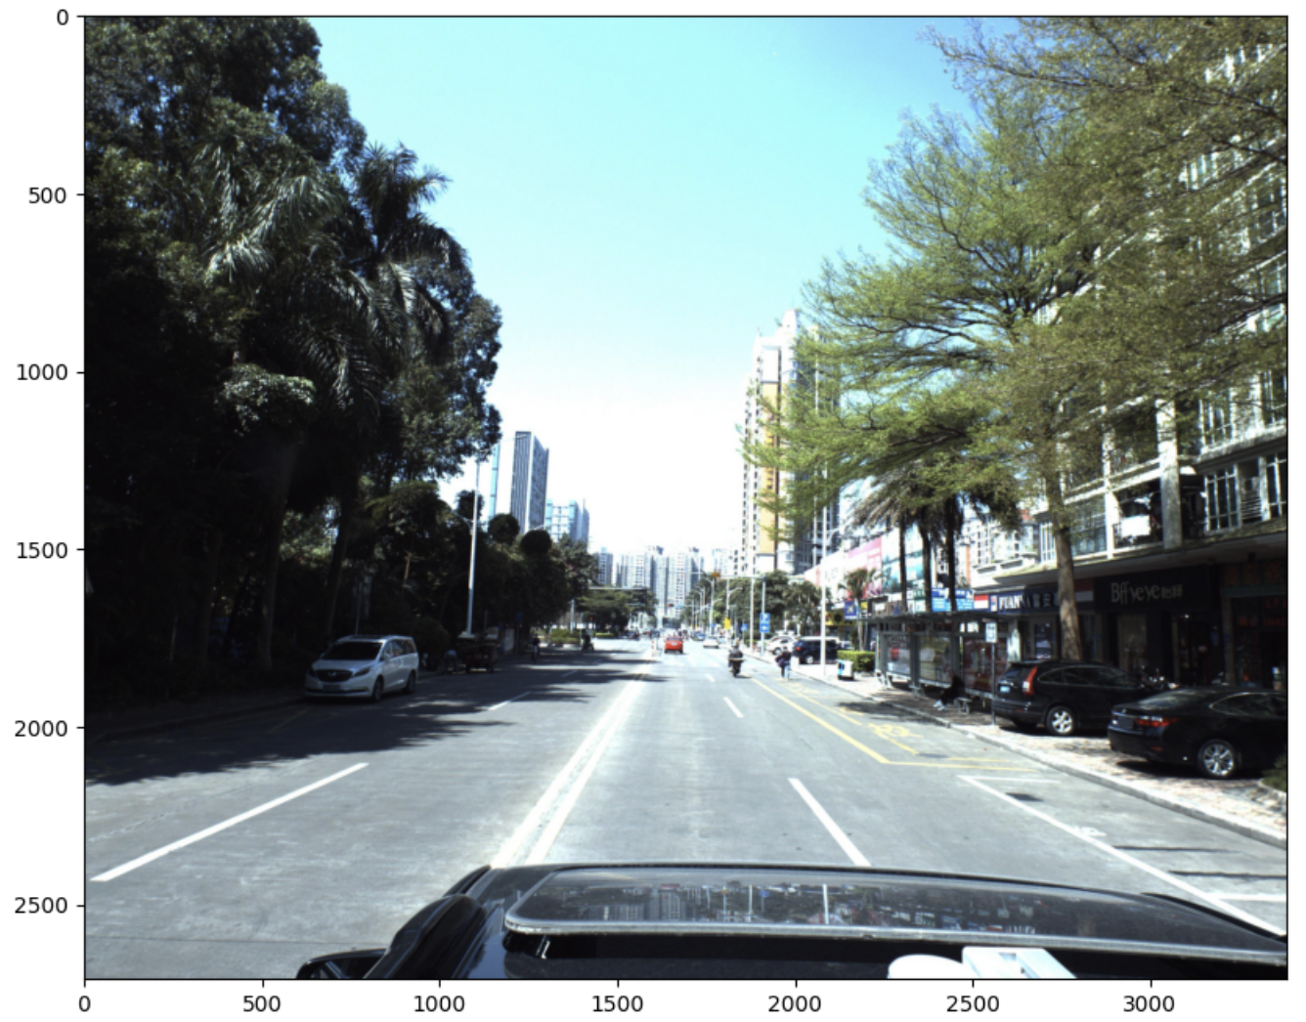
train_images

Slide 11
train_masks.zip and test_masks.zip
Some cars in the images are not of interest (too far away, etc.). Binary masks are provided to allow competitors to remove them from consideration.

Slide 12
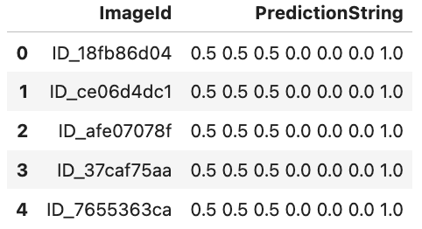
sample_submission.csv
Addition of a confidence score, and the removal of the model type (‘id’).
PredictionString only has 3D orientation, spatial coordinates, and confidence score.

Slide 13
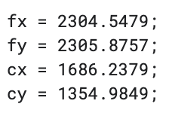
camera.zip

Slide 14
Data Visualization

Slide 15
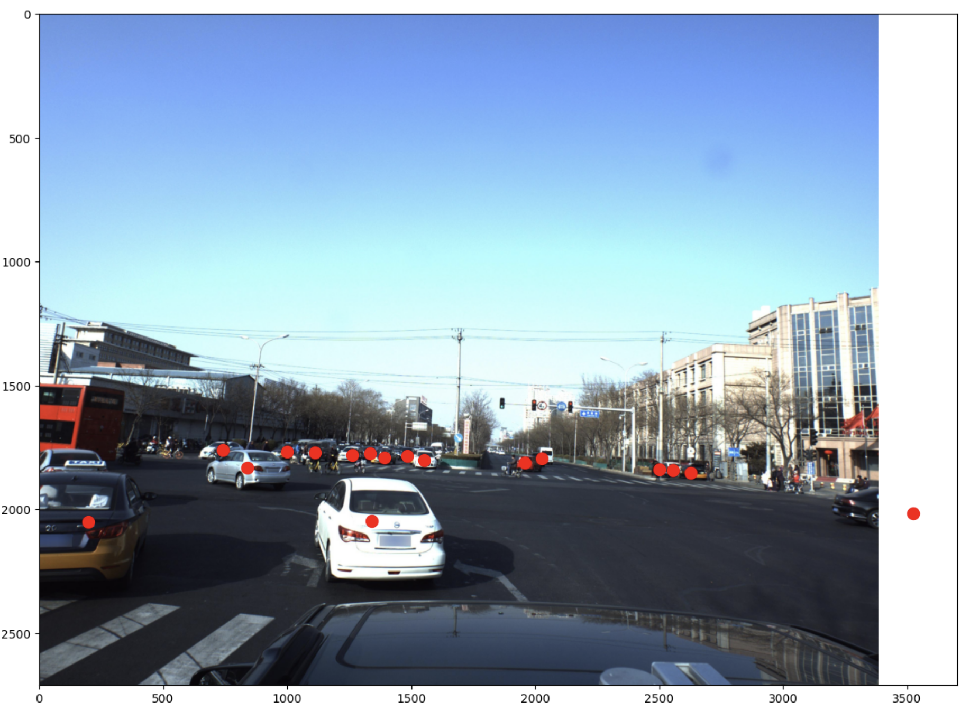
Image with PredictionString coordinates

Slide 16
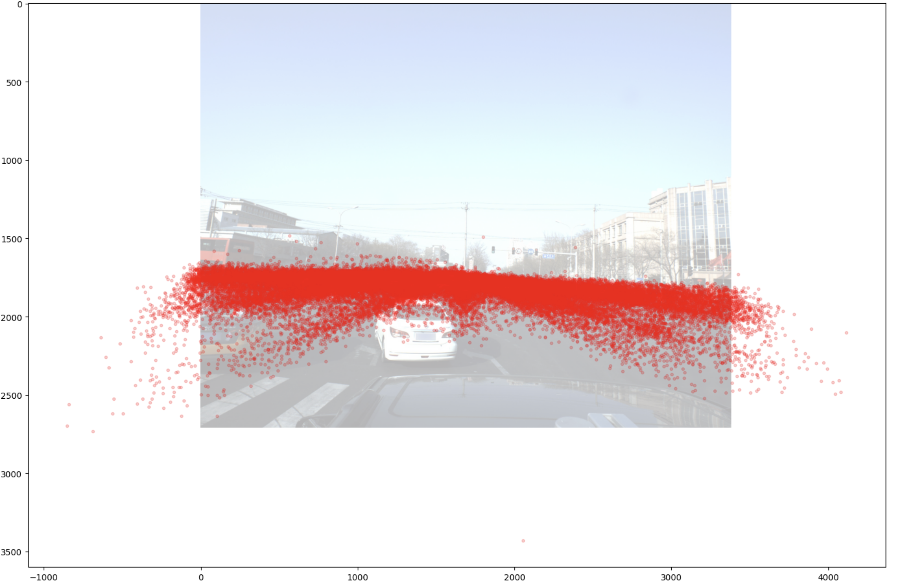
Plot Distribution of Points

Slide 17
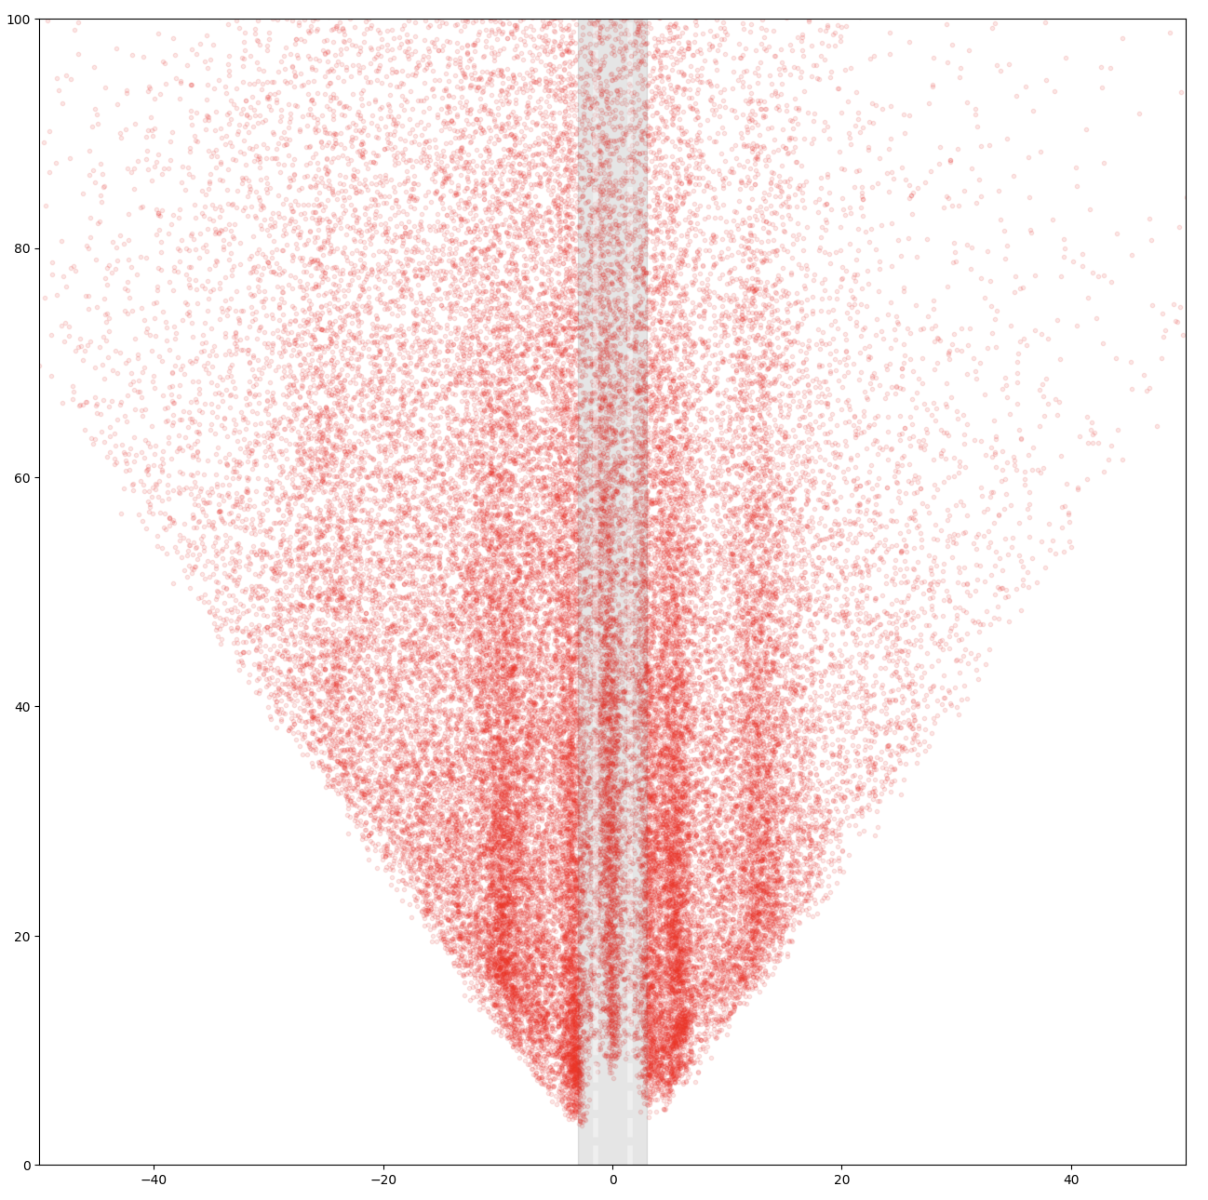
Plot Distribution from Above

Slide 18
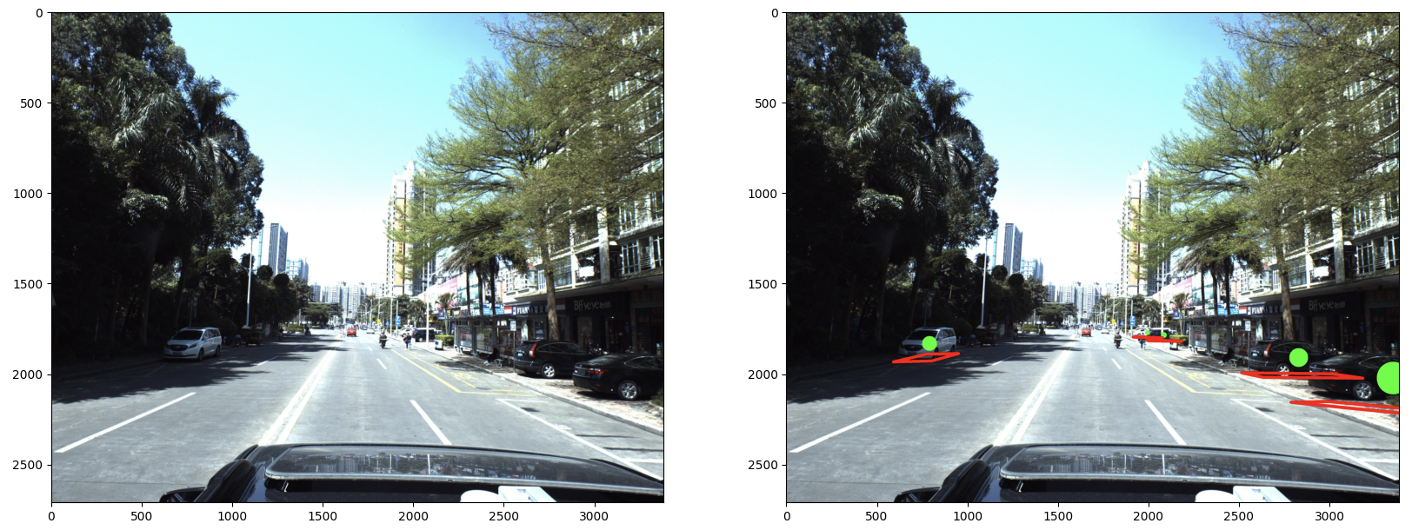

Slide 19
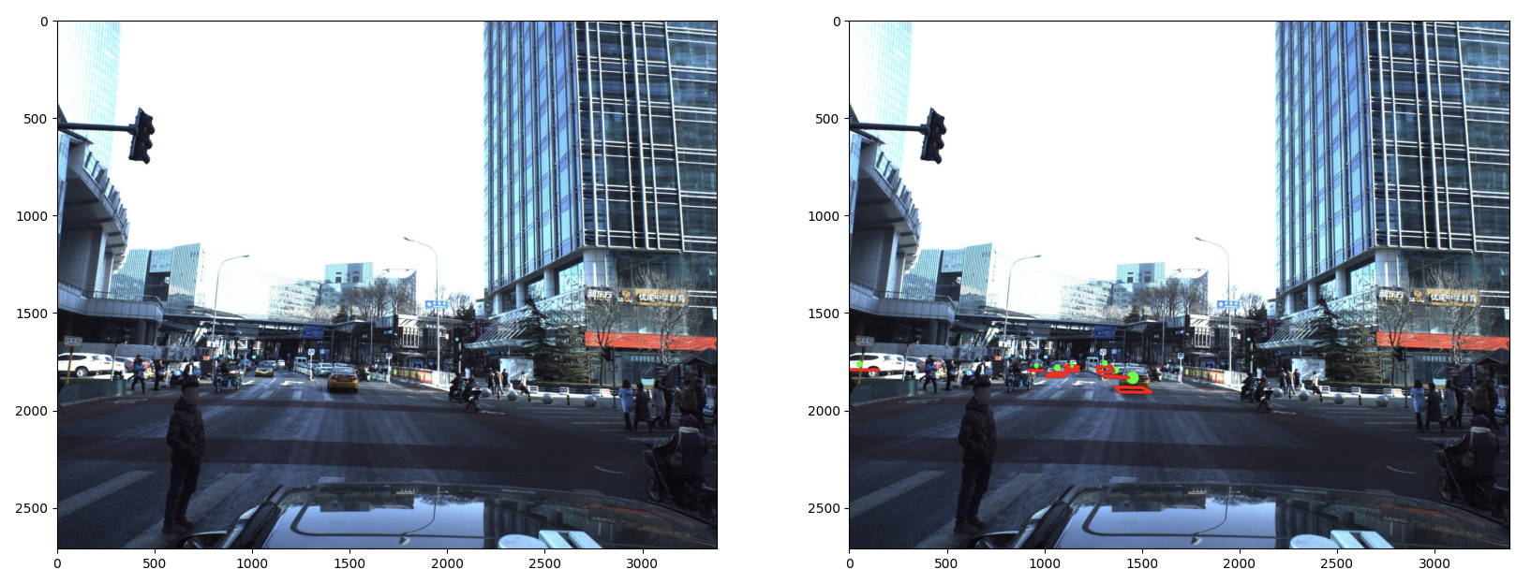

Slide 20
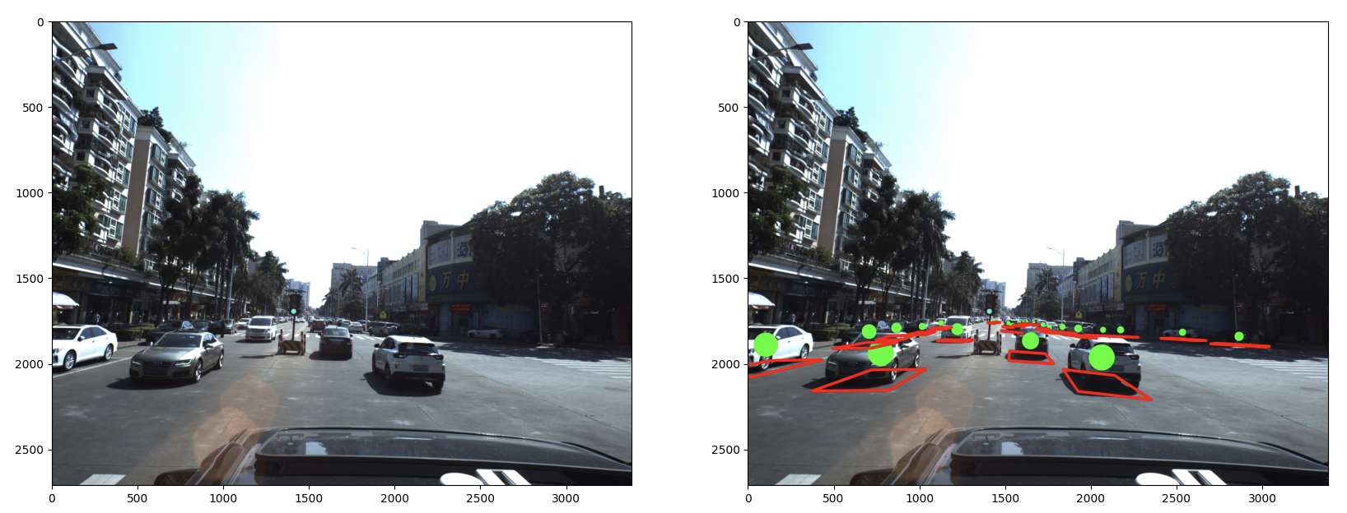

Slide 21
Model Architecture

Slide 22
CenterNet
Uses center point detection for 3D detection and pose estimation.
Low model complexity.
High accuracy and speed.
Commonly used in applications with pose estimation and multi-object tracking.

Slide 23
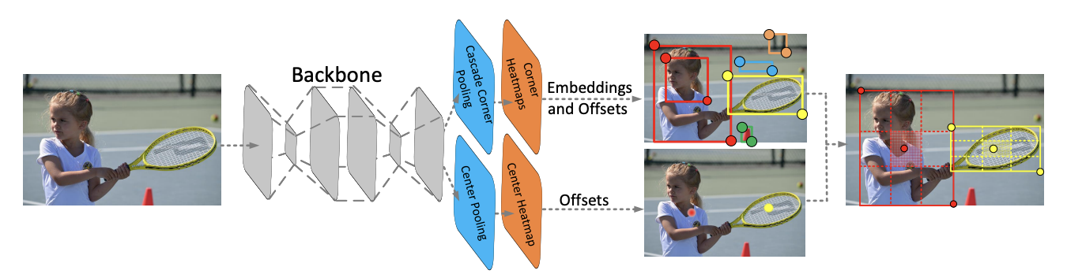

Slide 24
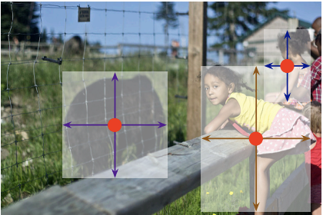
How CenterNet Models Objects
Objects are modeled as the center of their bounding boxes.
The bounding boxes size and properties are inferred from the keypoint features at the center.

Slide 25
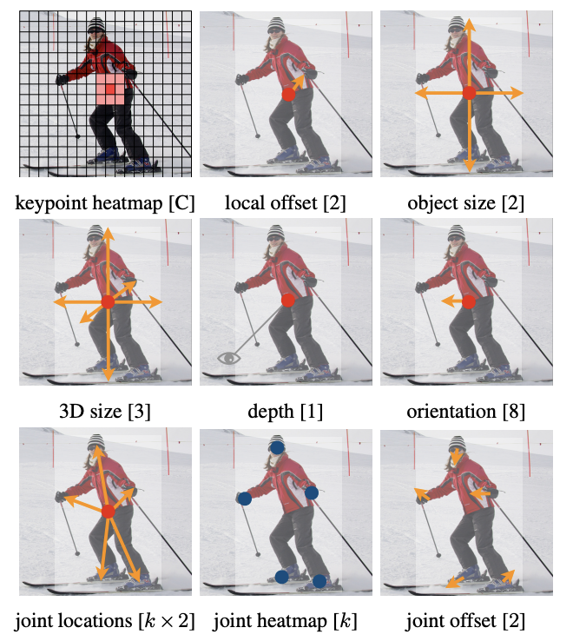
How CenterNet Models Objects for Different Tasks

Slide 26
Data Preprocessing

Slide 27
Image Preprocessing
Standardized image size to 1024x320.
Normalized pixel values from [0, 255] to [0,1].
Horizontal flipping of images for better generalization.
Identified object centers using heatmap.
Normalized 3D coordinates by 100 (from cm to m).
Converted pitch to sin and cos to prevent discontinuity.

Slide 28
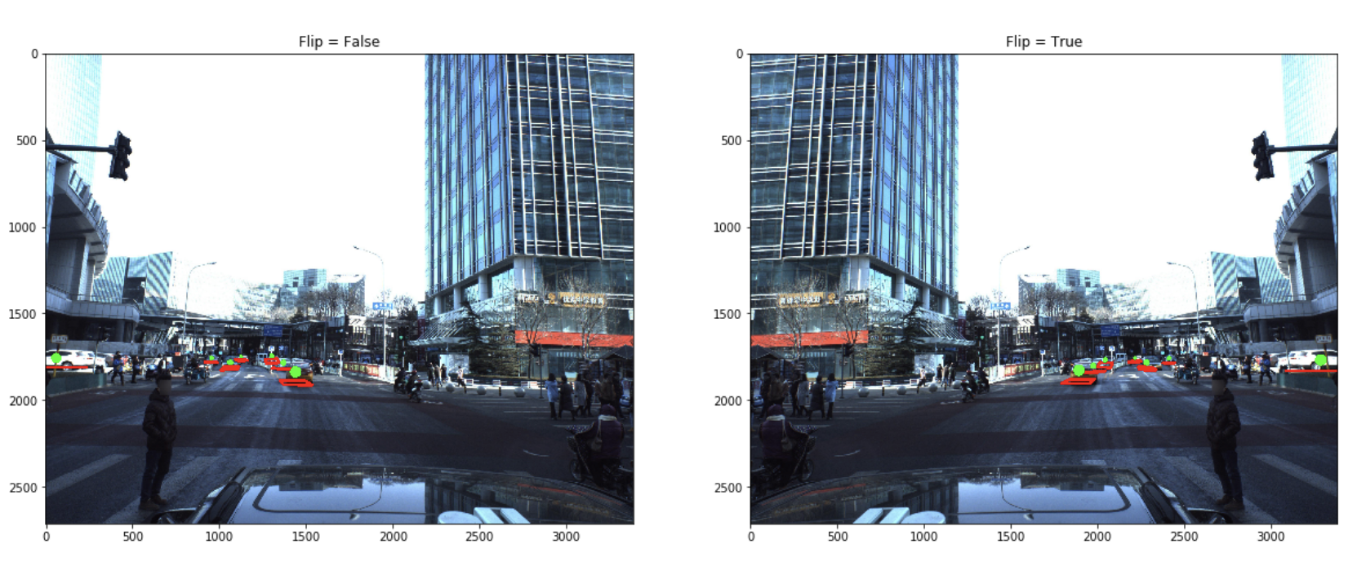
Example of Image Augmentation

Slide 29
Training

Slide 30
Training Setup
Batch size: 4
Number of epochs: 10
Optimizer: Adam
Learning Rate: 0.001
Learning Rate Scheduler: StepLR
Loss: Used the sum of Binary Mask Loss (BCE) and Regression L1 Loss (MAE)

Slide 31
Testing

Slide 32
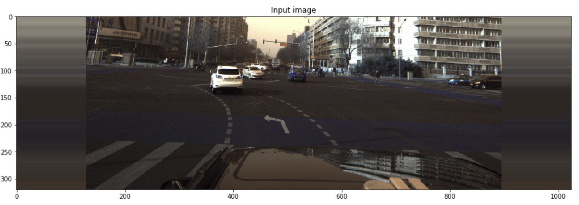
Visualizing an Example

Slide 33
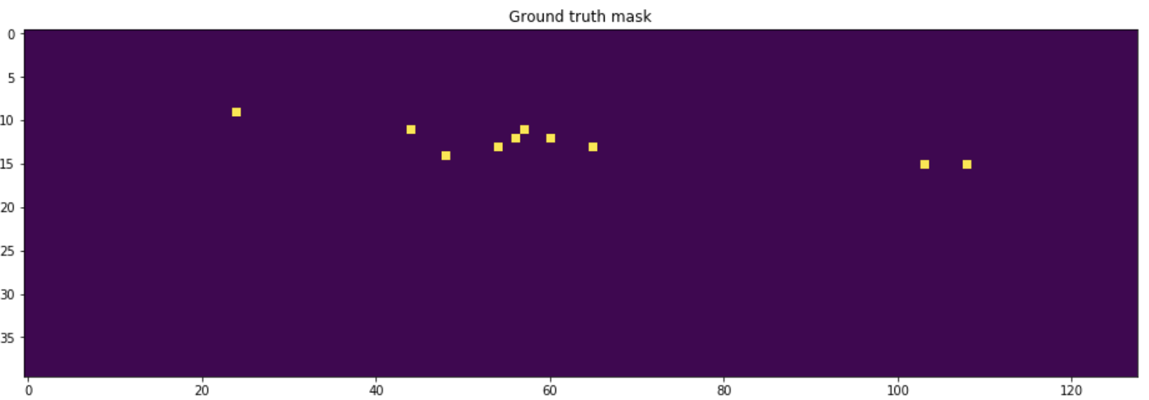

Slide 34
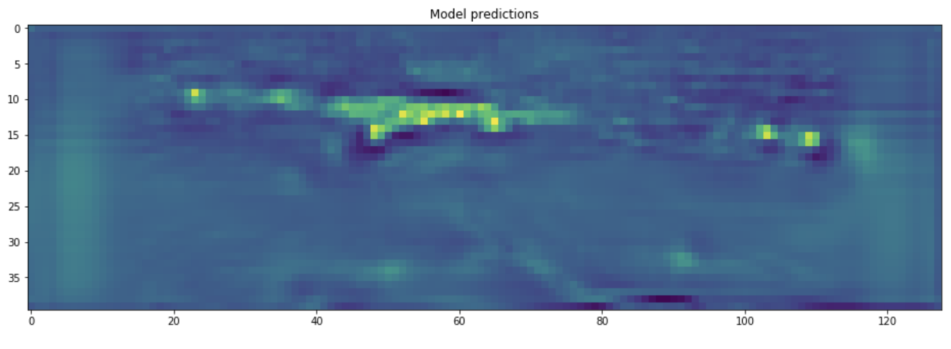

Slide 35
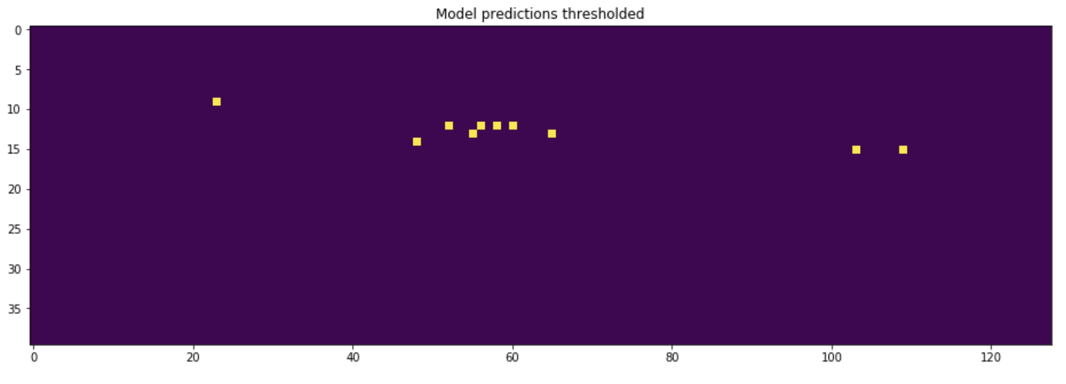

Slide 36
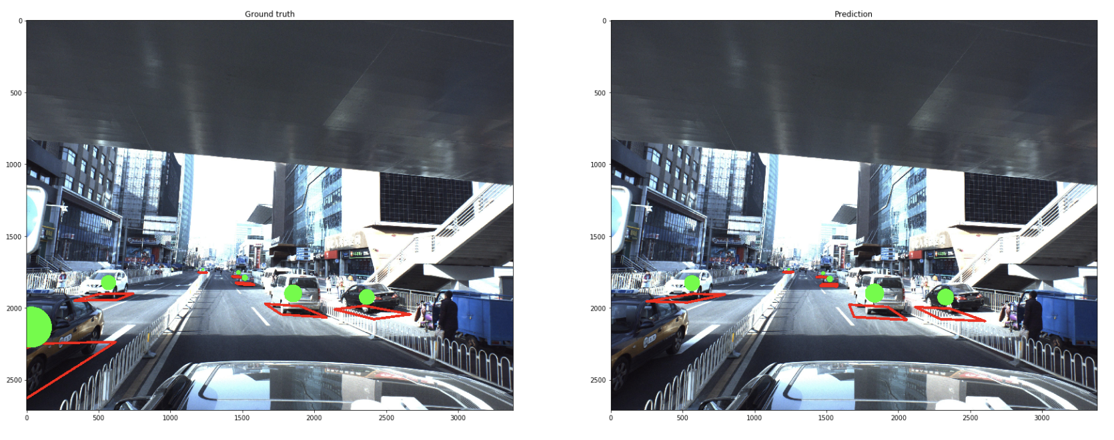
Comparing Ground Truths with Predictions

Slide 37


