Slide 1

Database Fundamentals College Requirements -Compulsive Courses
CSCR2204

Slide 2
Welcome to Database Fundamentals !
Syllabus
Introductions
Course Outline.
Exams.
Lab no (1)

Slide 3
Course Outline.
Introductions and the case Study
Data Definition Language (DDL)
Create user, database and tables and their attributes
alter/delete user, database and tables and their attributes
Data Manipulation Language (DML)
Insert/delete/modify tuples in tables
Query

Slide 4
Lab 1

Slide 5
Lab 1 Outline
SQL
Case Study

Slide 6
What is SQL?
Structured Query Language
Communicate with databases
Used to created and edit databases.
Also used to create queries, forms, and reports.

Slide 7
SQL Overview
Structured Query Language
The standard for relational database management systems (RDBMS)
SQL-92 and SQL-99 Standards – Purpose:
Specify syntax/semantics for data definition and manipulation
Define data structures
Enable portability
Specify minimal (level 1) and complete (level 2) standards
Allow for later growth/enhancement to standard
It also has rules for embedding SQL statements into a general-purpose programming language such as Java, COBOL, or C/C++.

Slide 8
SQL Environment
Catalog
A set of schemas that constitute the description of a database
Schema
The structure that contains descriptions of objects created by a user (base tables, views, constraints)
Data Definition Language (DDL)
Commands that define a database, including creating, altering, and dropping tables and establishing constraints
Data Manipulation Language (DML)
Commands that maintain and query a database
Data Control Language (DCL)
Commands that control a database, including administering privileges and committing data

Slide 9
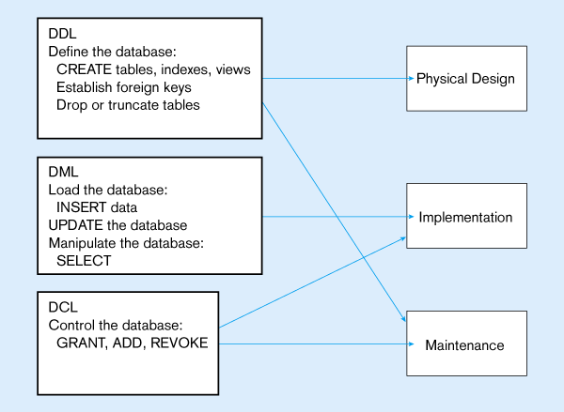

Slide 10
Writing SQL Commands
An SQL statement consists of
reserved words and user-defined words.
An SQL statement are also built according to a set of syntax rules.
Need to end of each SQL statement (the semicolon ‘;’ is used)
Most components of an SQL statement are case insensitive,

Slide 11
Data Types in SQL
Characters:
CHAR(20) -- fixed length
VARCHAR(40) -- variable length
Numbers:
INT
REAL, FLOAT -- differ in precision
MONEY
Times and dates:
DATE
DATETIME -- SQL Server
Others... All are simple

Slide 12
Table Basics
A Table is an object
Database data is stored in Tables
Each table has a unique name
Columns have various attributes, such as column name and data type
Rows contain records or data for the columns

Slide 13
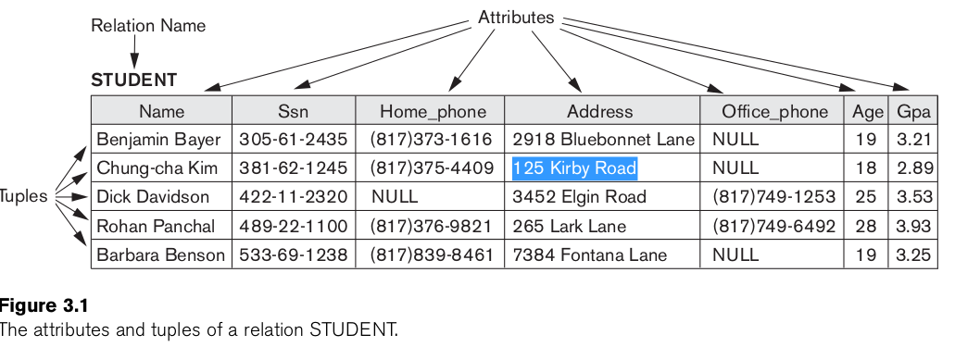
Table

Slide 14
Tables in SQL
Table name
Attribute names
EMPLOYEE
Name | SSN | Address | Salary
Gizmo | 121212 | 2918 Bluebonnet Lane | $19.99
Powergizmo | 123456 | 3452 Elgin Road | $29.99
SingleTouch | 666666 | 265 Lark Lane | $149.99
MultiTouch | 021021 | 125 Kirby Road | $203.99
Tuples or rows

Slide 15
Tables Explained
A tuple = a record
Restriction: all attributes are of atomic type
A table = a set of tuples
Like a list…
…but it is unordered.
The schema of a table is the table name and its attributes:
Product(PName, Price, Category, Manfacturer)
A key is an attribute whose values are unique; we underline a key
Product(PName, Price, Category, Manfacturer)

Slide 16
Terminology
Relation
A relation is a table with columns and rows.
Attribute
An attribute is a named column of a relation.
Relational database schema
A set of relation schemas, each with a distinct name.
Primary key
The candidate key that is selected to identify tuples uniquely within the relation.
Foreign key
An attribute, or set of attributes, within one relation that matches the candidate key of some (possibly the same) relation.
Null
Represents a value for an attribute that is currently unknown or is not applicable for this tuple.

Slide 17
2. Using SQL*Plus

Slide 18


SQL and SQL*Plus Interaction
SQL statements
Server
SQL*Plus
Query results
Buffer
SQL
scripts
Notes:
SQL and SQL*Plus
SQL is a command language for communication with the Oracle9i Server from any tool or application. Oracle SQL contains many extensions. When you enter a SQL statement, it is stored in a part of memory called the SQL buffer and remains there until you enter a new SQL statement. SQL*Plus is an Oracle tool that recognizes and submits SQL statements to the Oracle9i Server for execution. It contains its own command language.
Features of SQL
Can be used by a range of users, including those with little or no programming experience
Is a nonprocedural language
Reduces the amount of time required for creating and maintaining systems
Is an English-like language
Features of SQL*Plus
Accepts ad hoc entry of statements
Accepts SQL input from files
Provides a line editor for modifying SQL statements
Controls environmental settings
Formats query results into basic reports
Accesses local and remote databases

Slide 19
Displaying Table Structure
DESCRIBE command to display the structure of a table:
DESC[RIBE] tablename
Notes:
Displaying Table Structure
In SQL*Plus, you can display the structure of a table using the DESCRIBE command. The result of the command is a display of column names and data types as well as an indication if a column must contain data.
In the syntax:
tablename The name of any existing table, view, or synonym that is accessible to the user
To describe the JOB_GRADES table, use this command:
SQL> DESCRIBE job_grades
Name Null? Type
---------------------------------- -------- -----------
GRADE_LEVEL VARCHAR2(3)
LOWEST_SAL NUMBER
HIGHEST_SAL NUMBER

Slide 20
Displaying Table Structure
SQL> DESCRIBE departments
Name Null? Type
----------------------- -------- ------------
DEPARTMENT_ID NOT NULL NUMBER(4)
DEPARTMENT_NAME NOT NULL VARCHAR2(30)
MANAGER_ID NUMBER(6)
LOCATION_ID NUMBER(4)
Notes:
Displaying Table Structure (continued)
The example in the slide displays the information about the structure of the DEPARTMENTS table.
In the result:
Null? Specifies whether a column must contain data (NOT NULL indicates that a column must contain data.)
Type Displays the data type for a column
The following table describes the data types:

Slide 21
Using LIST, n, and APPEND
SQL> LIST
1 SELECT last_name
2* FROM employees
SQL> 1
1* SELECT last_name
SQL> A , job_id
1* SELECT last_name, job_id
SQL> L
1 SELECT last_name, job_id
2* FROM employees
Notes:
Using LIST, n, and APPEND
Use the L[IST] command to display the contents of the SQL buffer. The asterisk (*) beside line 2 in the buffer indicates that line 2 is the current line. Any edits that you made apply to the current line.
Change the number of the current line by entering the number (n) of the line that you want to edit. The new current line is displayed.
Use the A[PPEND] command to add text to the current line. The newly edited line is displayed. Verify the new contents of the buffer by using the LIST command.
Note: Many SQL*Plus commands, including LIST and APPEND, can be abbreviated to just their first letter. LIST can be abbreviated to L; APPEND can be abbreviated to A.

Slide 22
Using the CHANGE Command
SQL> L
1* SELECT * from employees
SQL> c/employees/departments
1* SELECT * from departments
SQL> L
1* SELECT * from departments
Notes:
Using the CHANGE Command
Use L[IST] to display the contents of the buffer.
Use the C[HANGE] command to alter the contents of the current line in the SQL buffer. In this case, replace the employees table with the departments table. The new current line is displayed.
Use the L[IST] command to verify the new contents of the buffer.

Slide 23
SQL*Plus File Commands
SAVE filename
GET filename
START filename
@ filename
EDIT filename
SPOOL filename
EXIT
Notes:
SQL*Plus File Commands
SQL statements communicate with the Oracle server. SQL*Plus commands control the environment, format query results, and manage files. You can use the commands described in the following table:

Slide 24
Using the SAVE and START Commands
SQL> L
1 SELECT last_name, manager_id, department_id
2* FROM employees
SQL> SAVE my_query
Created file my_query
SQL> START my_query
LAST_NAME MANAGER_ID DEPARTMENT_ID
------------------------- ---------- -------------
King 90
Kochhar 100 90
...
20 rows selected.
Notes:
SAVE
Use the SAVE command to store the current contents of the buffer in a file. In this way, you can store frequently used scripts for use in the future.
START
Use the START command to run a script in SQL*Plus.
EDIT
Use the EDIT command to edit an existing script. This opens an editor with the script file in it. When you have made the changes, quit the editor to return to the SQL*Plus command line.

Slide 25
3. Case Study

Slide 26
Case Study (1)
We illustrate the SQL statements using the instance of the Company case study shown in Figure 1.1, which consists of the following tables:
EMPLOYEE
DEPARTMENT
DEPT_LOCATIONS
PROJECT
WORKS_ON
DEPENDENT

Slide 27
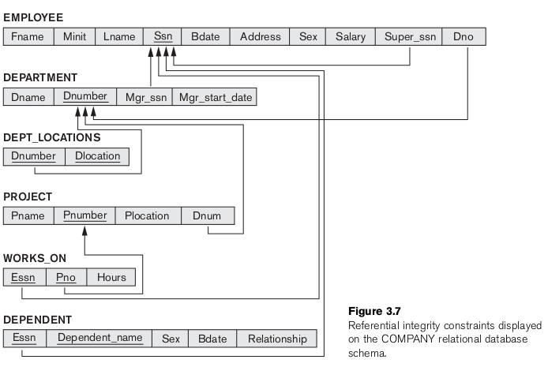

Slide 28
Case Study (2)
You illustrate the SQL statements using the instance of the DreamHome case study, which consists of the following tables:
Branch (branchNo, street, city, postcode)
Staff (staffNo, fName, lName, position, sex, DOB, salary, branchNo)
PropertyForRent (propertyNo, street, city, postcode, type, rooms, rent, ownerNo, staffNo, branchNo)
Client (clientNo, fName, lName, telNo, prefType, maxRent)
PrivateOwner (ownerNo, fName, lName, address, telNo)
Viewing (clientNo, propertyNo, viewDate, comment)

