Slide 1
Chapter 5
More SQL: Complex Queries, Triggers, Views, and Schema Modification

Slide 2
Chapter 5 Outline
More Complex SQL Retrieval Queries
Specifying Constraints as Assertions and Actions as Triggers
Views (Virtual Tables) in SQL
Schema Change Statements in SQL

Slide 3
More Complex SQL Retrieval Queries
Additional features allow users to specify more complex retrievals from database:
  Nested queries, joined tables, outer joins, aggregate functions, and grouping

Slide 4
Comparisons Involving NULL and Three-Valued Logic
Meanings of NULL
  Unknown value
  Unavailable or withheld value
  Not applicable attribute
SQL uses a three-valued logic:
  TRUE, FALSE, and UNKNOWN

Slide 5

Comparisons Involving NULL and Three-Valued Logic (cont’d.)
SQL allows queries that check whether an attribute value is NULL
  IS or IS NOT NULL

Slide 6
Nested Queries, Tuples, and Set/Multiset Comparisons
Nested queries
  Complete select-from-where blocks within WHERE clause of another query
  Outer query
Comparison operator IN
  Compares value v with a set (or multiset) of values V
  Evaluates to TRUE if v is one of the elements in V

Slide 7

Nested Queries (cont’d.)

Slide 8

Nested Queries (cont’d.)
Use tuples of values in comparisons
  Place them within parentheses

Slide 9

Joined Tables in SQL and Outer Joins
Joined table
  Permits users to specify a table resulting from a join operation in the FROM clause of a query
The FROM clause in Q1A
  Contains a single joined table

Slide 10
Joined Tables in SQL and Outer Joins (cont’d.)
Inner join
  Default type of join in a joined table
  Tuple is included in the result only if a matching tuple exists in the other relation
LEFT OUTER JOIN
  Every tuple in left table must appear in result
  If no matching tuple
    Padded with NULL values for attributes of right table

Slide 11
Joined Tables in SQL and Outer Joins (cont’d.)
RIGHT OUTER JOIN
  Every tuple in right table must appear in result
  If no matching tuple
    Padded with NULL values for the attributes of left table
FULL OUTER JOIN
Can nest join specifications

Slide 12
Aggregate Functions in SQL
Used to summarize information from multiple tuples into a single-tuple summary
Grouping
  Create subgroups of tuples before summarizing
Built-in aggregate functions
  COUNT, SUM, MAX, MIN, and AVG
Functions can be used in the SELECT clause or in a HAVING clause

Slide 13

Aggregate Functions in SQL (cont’d.)
NULL values discarded when aggregate functions are applied to a particular column

Slide 14

Grouping: The GROUP BY and HAVING Clauses (cont’d.)
HAVING clause
  Provides a condition on the summary information

Slide 15

Discussion and Summary of SQL Queries

Slide 16
Specifying Constraints as Assertions and Actions as Triggers
CREATE ASSERTION
  Specify additional types of constraints outside scope of built-in relational model constraints
CREATE TRIGGER
  Specify automatic actions that database system will perform when certain events and conditions occur

Slide 17

Specifying General Constraints as Assertions in SQL
CREATE ASSERTION
  Specify a query that selects any tuples that violate the desired condition
  Use only in cases where it is not possible to use CHECK on attributes and domains

Slide 18
Introduction to Triggers in SQL
CREATE TRIGGER statement
  Used to monitor the database
Typical trigger has three components:
  Event(s)
  Condition
  Action

Slide 19
Views (Virtual Tables) in SQL
Concept of a view in SQL
  Single table derived from other tables
  Considered to be a virtual table

Slide 20

Specification of Views in SQL
CREATE VIEW command
  Give table name, list of attribute names, and a query to specify the contents of the view

Slide 21
Specification of Views in SQL (cont’d.)
Specify SQL queries on a view
View always up-to-date
  Responsibility of the DBMS and not the user
DROP VIEW command
  Dispose of a view

Slide 22
Schema Change Statements in SQL
Schema evolution commands
  Can be done while the database is operational
  Does not require recompilation of the database schema

Slide 23
The DROP Command
DROP command
  Used to drop named schema elements, such as tables, domains, or constraint
Drop behavior options:
  CASCADE and RESTRICT
Example:
  DROP SCHEMA COMPANY CASCADE;

Slide 24
The ALTER Command
Alter table actions include:
  Adding or dropping a column (attribute)
  Changing a column definition
  Adding or dropping table constraints
Example:
  ALTER TABLE COMPANY.EMPLOYEE ADD COLUMN Job VARCHAR(12);
To drop a column
  Choose either CASCADE or RESTRICT

Slide 25

The ALTER Command (cont’d.)
Change constraints specified on a table
  Add or drop a named constraint

Slide 26
Summary
Complex SQL:
  Nested queries, joined tables, outer joins, aggregate functions, grouping
CREATE ASSERTION and CREATE TRIGGER
Views
  Virtual or derived tables

Slide 27
Data Modeling Using the
Entity-Relationship (ER) Model
Entity-Relationship (ER) model
  Popular high-level conceptual data model
ER diagrams
  Diagrammatic notation associated with the ER model
Unified Modeling Language (UML)

Slide 28
Using High-Level Conceptual Data Models for Database Design
Requirements collection and analysis
  Database designers interview prospective database users to understand and document data requirements
  Result:
    data requirements
    Functional requirements of the application

Slide 29
Using High-Level Conceptual Data Models (cont’d.)
2. Conceptual schema
  Conceptual design
  Description of data requirements
  Includes detailed descriptions of the entity types, relationships, and constraints
  Transformed from high-level data model into implementation data model

Slide 30
Using High-Level Conceptual Data Models (cont’d.)
3. Logical design or data model mapping
  Result is a database schema in implementation data model of DBMS
4. Physical design phase
  Internal storage structures, file organizations, indexes, access paths, and physical design parameters for the database files specified

Slide 31
A Sample Database Application
COMPANY
  Employees, departments, and projects
  Company is organized into departments
  Department controls a number of projects
  Employee: store each employee’s name, Social Security number, address, salary, sex (gender), and birth date
  Keep track of the dependents of each employee

Slide 32
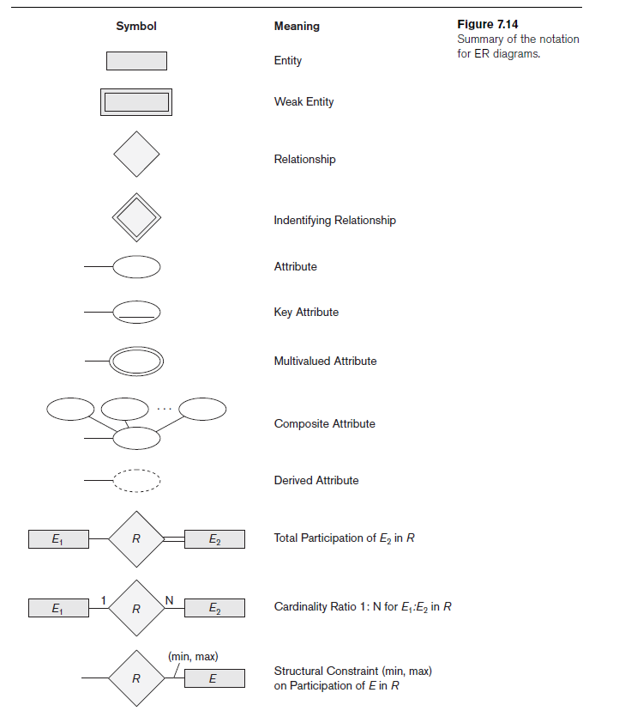
ER Diagrams, Naming Conventions, and Design Issues

Slide 33
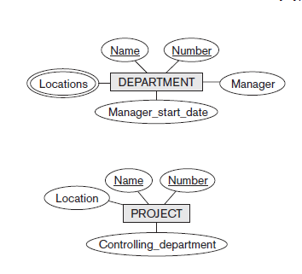
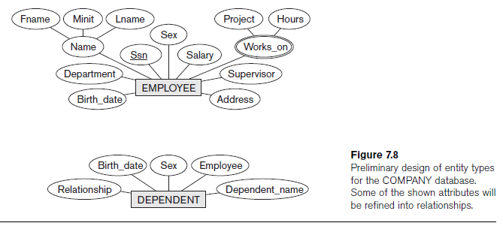
Initial Conceptual Design of the COMPANY Database

Slide 34
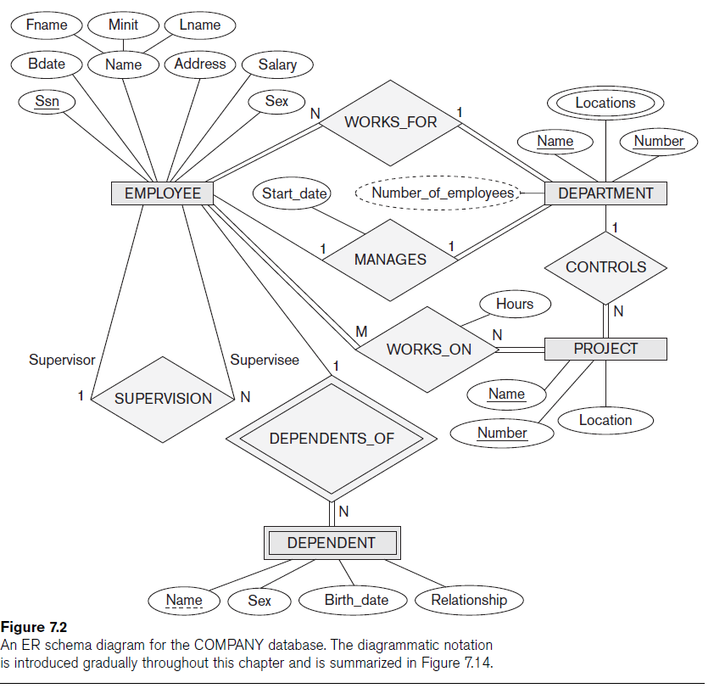

Slide 35
Example of Other Notation:
UML Class Diagrams
UML methodology
  Used extensively in software design
  Many types of diagrams for various software design purposes
UML class diagrams
  Entity in ER corresponds to an object in UML

Slide 36
