Slide 1
Data Structure & Algorithms
Sorting, Searching Algorithm

Slide 2
Searching Algorithms.

Slide 3
Array Searching Algorithms
Two methods for searching an array for a given item:
  The Sequential Search method can be used with any array.
  The Binary Search method can only be used with arrays that are known to be sorted, but is much faster than Sequential Search.

Slide 4
Linear search

Slide 5
Sequential Search
A sequential search of a list/array begins at the beginning of the list/array and continues until the item is found or the entire list/array has been searched

Slide 6
Sequential Search Algorithms
//Search an array A[0..N-1] for X
INPUT : A[0..N-1] an array of integers, floats or chars
item element.
OUTPUT : true if item is found or false other wise.
bool LinSearch(double x[ ], double item){
b ← true
for i ← 0 to N-1
if (x[i]==item)
b ← true
return false

Slide 8
Binary Search
Binary search

Slide 9
Binary Search
  Binary search algorithm assumes that the items in the array being searched are sorted
  The algorithm begins at the middle of the array in a binary search
  If the item for which we are searching is less than the item in the middle, we know that the item won’t be in the second half of the array
  Once again we examine the “middle” element
  The process continues with each comparison cutting in half the portion of the array where the item might be.

Slide 10
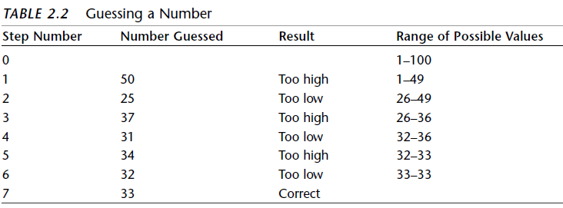
Example

Slide 11
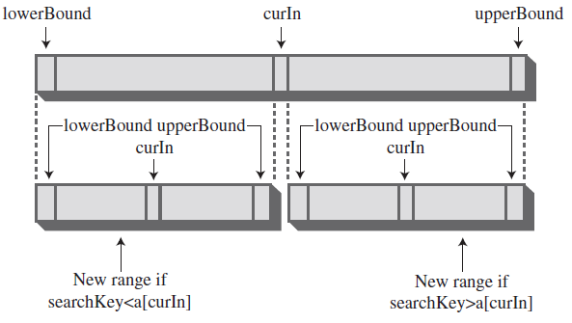
Binary Search (Cont’d)

Slide 12
Binary Search code
public int find(long searchKey)
{
int lowerBound = 0;
int upperBound = nElems-1;
int curIn;
while(true)
{
curIn = (lowerBound + upperBound ) / 2;
if(a[curIn]==searchKey)
return curIn; // found it
else if(lowerBound > upperBound)
return nElems; // can’t find it
else // divide range
{
if(a[curIn] < searchKey)
lowerBound = curIn + 1; // it’s in upper half
else
upperBound = curIn - 1; // it’s in lower half
} // end else divide range
} // end while
} // end find()

Slide 13
Binary Search code
public int find(long searchKey)
{
int lowerBound = 0;
int upperBound = nElems-1;
int curIn;
while(true)
{
curIn = (lowerBound + upperBound ) / 2;
if(a[curIn]==searchKey)
return curIn; // found it
else if(lowerBound > upperBound)
return nElems; // can’t find it
else // divide range
{
if(a[curIn] < searchKey)
lowerBound = curIn + 1; // it’s in upper half
else
upperBound = curIn - 1; // it’s in lower half
} // end else divide range
} // end while
} // end find()

Slide 14
Quiz
Which of the following is true?
  a. The pop operation on a stack is considerably simpler than the remove operation on a queue.
  b. The contents of a queue can wrap around, while those of a stack cannot.
  c. The top of a stack corresponds to the front of a queue.
  d. In both the stack and the queue, items removed in sequence are taken from increasingly high index cells in the array.
  e. In an unordered array, it’s generally faster to find out an item is not in the array than to find out it is.
  f. The bubble sort always ends up comparing every item with every other item.

Slide 15
Exercise:
Write a program to convert from infix to postfix.

