Slide 1
Data Structure & Algorithms
Linked Lists

Slide 2
Arrays disadvantages
In an unordered array, searching is slow, whereas
in an ordered array, insertion is slow.
In both kinds of arrays, deletion is slow. Also,
The size of an array can’t be changed after it’s created.

Slide 3
linked list Types:
simple linked lists,
Double ended lists,
sorted lists,
doubly linked lists.

Slide 4
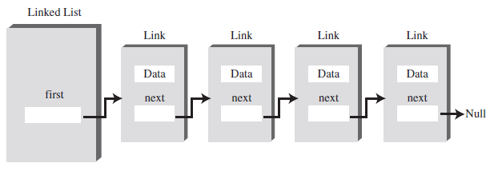
linked list
In a linked list, each data item is embedded in a link.
link is an object of a class called something like Link.
Each link consists of:
The data itself.
A reference to the next link in the list, which is null for the last item.

Slide 5
linked list
class Link
{
public int iData; // data
public double dData; // data
public Link next; // reference to next link
// -------------------------------------------------------------
public Link(int id, double dd) // constructor
{
iData = id; // initialize data
dData = dd; // (‘next’ is automatically set to null)
}
}

Slide 6
linked list
Being able to put a field of type Link inside the class definition of this same type may seem odd !!!!
in Java a Link object doesn’t really contain another Link object, although it may look like it does.
The next field of type Link is only a reference to another link, not an object.
A reference is a number that refers to an object (It’s the object’s address in the computer’s memory).
In a linked list the only way to find a particular element is to follow along the chain of elements.

Slide 7
Simple linked lists

Slide 8
Simple linked list
The operations allowed in this version of a list are:
Inserting an item.
Deleting the item.
Iterating through the list to display its contents

Slide 9
Inserting an item
inserts a new link at the beginning of the list.
To insert the new link, we need only
set the next field in the newly created link to point to the old first link and then
change first so it points to the newly created link.
public void insertFirst(int id, double dd)
{
Link newLink = new Link(id, dd); // make new link
newLink.next = first; // newLink --> old first
first = newLink; // first --> newLink
}

Slide 10
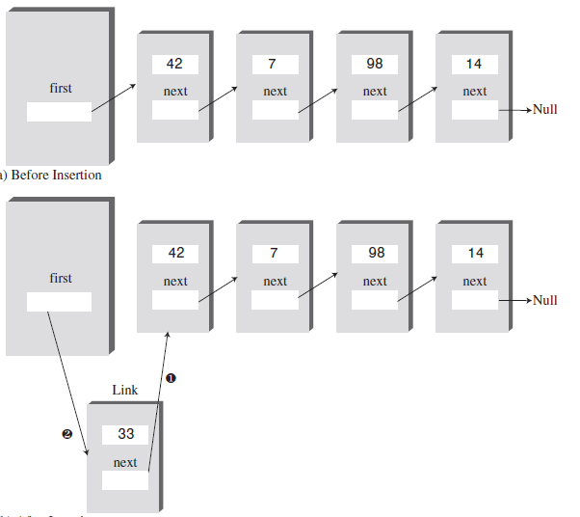
Inserting an item (Cont’d)

Slide 11
Deleting an item
is the reverse of inserting an item.
It disconnects the first link by rerouting first to point to the second link. This second link is found by looking at the next field in the first link:
public Link deleteFirst() // delete first item
{ // (assumes list not empty)
Link temp = first; // save reference to link
first = first.next; // delete it: first-->old next
return temp; // return deleted link
}

Slide 12
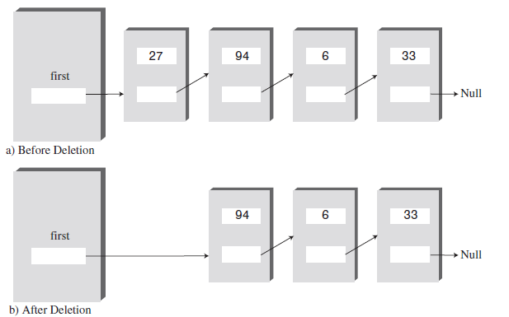
Deleting an item (Cont’d)

Slide 13
Display the list
To display the list, you start at first and follow the chain of references from link to link.
public void displayList()
{
System.out.print(“List (first-->last): “);
Link current = first; // start at beginning of list
while(current != null) // until end of list,
{
current.displayLink(); // print data
current = current.next; // move to next link
}
System.out.println(“ ”);
}

Slide 14
The find() Method
The find() Method:
Essentially the same idea as displayList()
Linearly iterate through the elements with a reference current.
Repeatedly set current to current.next
Except this time, stop when you find the item!

Slide 15
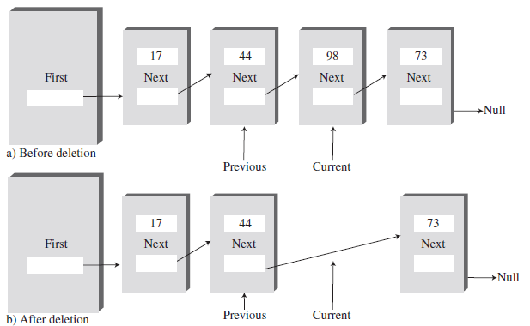
The delete() Method
The delete() method is similar to find() in the way it searches for the link to be deleted.
It needs to maintain a reference not only to the current link (current), but to the link preceding the current link (previous) why?

Slide 16
Double-Ended Lists

Slide 17
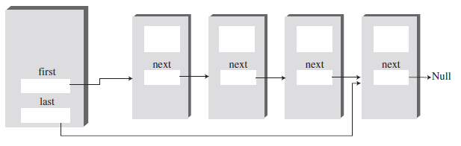
Double-Ended Lists
A double-ended list is similar to an ordinary linked list, but it has one additional feature: a reference to the last link as well as to the first.
Enables easy insertion at both ends
You still cannot delete the last element any easier. Why?
You cannot change find() to start from the end. Why?

Slide 18
Insert at the end
To inserts a new item at the end of the list:
modifying last.next to point to the new link and then
changing last to point to the new link.
public void insertLast(long dd) // insert at end of list
{
Link newLink = new Link(dd); // make new link
if( isEmpty() ) // if empty list,
first = newLink; // first --> newLink
else
last.next = newLink; // old last --> newLink
last = newLink; // newLink <-- last
}

Slide 19
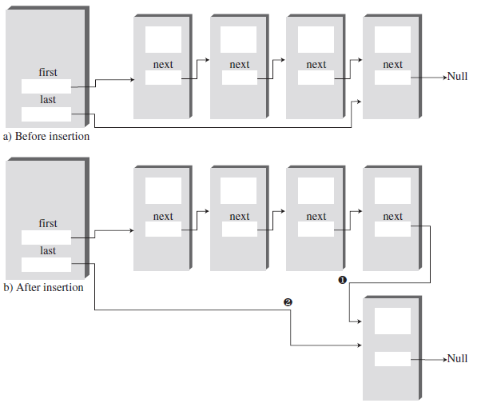
Insert at the end

Slide 20
Sorted Linked Lists

Slide 21
Sorted Linked Lists
In a sorted list, the items are arranged in sorted order by key value.
The advantages of a sorted list over a sorted array are:
speed of insertion (because elements don’t need to be moved) and
the fact that a list can expand to fill available memory, while an array is limited to a fixed size

Slide 22
Insertion in Sorted Linked Lists
public void insert(long key) // insert in order
{
Link newLink = new Link(key); // make new link
Link previous = null; // start at first
Link current = first; // until end of list,
while(current != null && key > current.dData) // or key > current,
{
previous = current;
current = current.next; // go to next item
}
if(previous==null) // at beginning of list
first = newLink; // first --> newLink
else // not at beginning
previous.next = newLink; // old prev --> newLink
newLink.next = current; // newLink --> old current
} // end insert()

Slide 23
Doubly Linked Lists

Slide 24
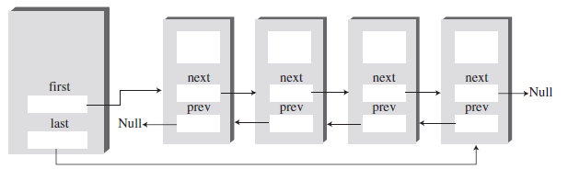
Doubly Linked Lists
A potential problem with ordinary linked lists is that it’s difficult to traverse backward along the list.
Doubly Linked Lists allows you to traverse backward as well as forward through the list.
Each link has two references to other links instead of one:
The first is to the next link, as in ordinary lists.
The second is to the previous link.

Slide 25
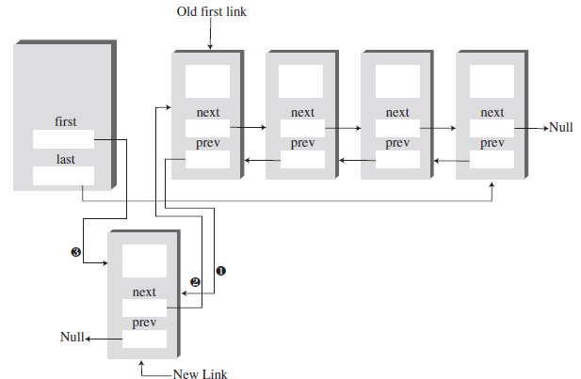
Insertion
Insertion at the beginning:
changes the previous field in the old first link to point to the new link and
changes the next field in the new link to point to the old first link.
Finally, it sets first to point to the new link.

Slide 26
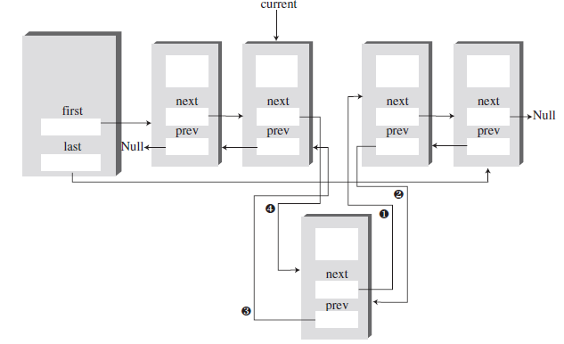
Insertion (Cont’d)
Insertion at an arbitrary location:
First, the link with the specified key value must be found.
Then, two connections must be made between the new link and the next link, and two more between current and the new link.

Slide 27
Insertion (Cont’d)
What If the new link will be inserted at the end of the list?
its next field must point to null,
and last must point to the new link.

Slide 28
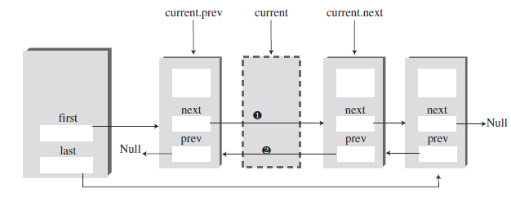
Deletion
There are three deletion routines:
deleteFirst(),
deleteLast(), and
deleteKey().
The first two are fairly straightforward.
In deleteKey(), the key being deleted is current

