Slide 1


Sketch/Image-Based 3D Scene Retrieval: Benchmark, Algorithm, Evaluation
Hameed Abdul-Rashid, Juefei Yuan, Bo Li, Yijuan Lu
Notes:
‹#›

Slide 2
Outline
Introduction
Related Work
Benchmark
Method
Evaluation
Conclusions and Future Work
Notes:
‹#›

Slide 3
Introduction
2D Scene Sketch/Image-Based 3D Scene Retrieval (Scene_SBR_IBR) focuses on retrieving relevant 3D scene models using scene sketches/image(s) as input
Motivation:
Vast applications: 3D scene reconstruction, autonomous driving cars, 3D geometry video retrieval, and 3D AR/VR Entertainment
Notes:
‹#›

Slide 4
Introduction
Challenges
2D sketches/images lack 3D scene information they are supposed to present
Semantic gap between 2D scene iconic sketches or realistic images and accurate 3D scene models
Brand new research topic in the field of sketch/image-based 3D object retrieval (Scene_SBR_IBR)
A query sketch/image contains several objects
Objects may overlap with each other
Relative context configurations among the objects
To promote this challenging research direction, we built the most comprehensive and largest 2D scene sketch/image-based benchmark 3D scene retrieval benchmark, Scene_SBR_IBR.
Notes:
‹#›

Slide 5
Outline
Introduction
Related Work
Benchmark
Method
Evaluation
Conclusions and Future Work
Notes:
‹#›

Slide 6
Outline
Introduction
Related Work
Benchmark
Method
Evaluation
Conclusions and Future Work
Notes:
‹#›

Slide 7
Related Work
3D SCENE RETRIEVAL
Notes:
‹#›

Slide 8
Related Work
2D SCENE DATASETS
Notes:
‹#›

Slide 9
Outline
Introduction
Related Work
Benchmark
Method
Evaluation
Conclusions and Future Work
Notes:
‹#›

Slide 10
Scene_SBR_IBR Benchmark (1/3)
2D Scene Sketch Query Dataset
SBR benchmark [1], augmented further with 500 sketches from Flickr and Google Images
750 2D scene sketches
30 classes (25 sketches per class)
[1] - J. Yuan and et al. SHREC’18 track: 2D scene sketch-based 3D scene retrieval. In 3DOR, pages 1–8, 2018

Slide 11
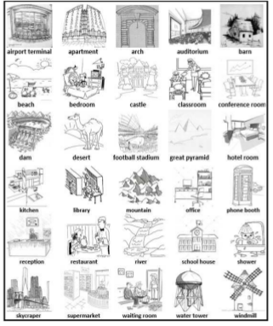
Scene_SBR_IBR Benchmark (1/3)
Fig. 1 Example 2D sketches (1 per class)

Slide 12
Scene_SBR_IBR Benchmark (2/3)
2D scene image dataset
Places88 [2]
30,000 images
30 classes (1,000 images per class)
[2] - B. Zhou and et al. Places: A 10 million image database for scene recognition. IEEE Trans. Pattern Anal. Mach. Intell., 40(6):1452–1464, 2018

Slide 13
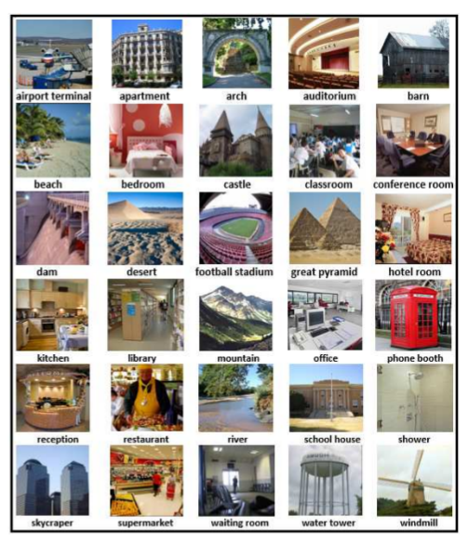
Scene_SBR_IBR Benchmark (2/3)
Fig. 1 Example 2D scenes (1 per class)

Slide 14
Scene_SBR_IBR Benchmark (3/3)
3D scene model dataset
3D Warehouse [3]
3000 scene models
30 classes (100 models per class)
[3] - 3D Warehouse. http://3dwarehouse.sketchup. com/?hl=en, 2018.

Slide 15
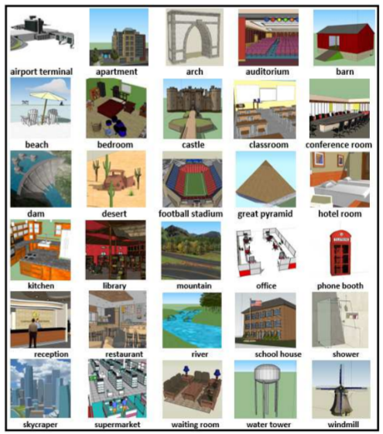
Scene_SBR_IBR Benchmark (3/3)
Fig. 1 Example 3D scenes (1 per class)

Slide 16
Evaluation
Seven commonly adopted performance metrics in 3D model retrieval technique [4, 5]:
Precision-Recall plot (PR)
Nearest Neighbor (NN)
First Tier (FT)
Second Tier (ST)
E-Measures (E)
Discounted Cumulated Gain (DCG)
Average Precision (AP)
We also have developed the code to compute them
http://orca.st.usm.edu/~bli/SceneIBR2018/data.html
[4] H. Abdul-Rashid and et al. SHREC’18 track: 2D scene image-based 3D scene retrieval. In 3DOR, pages 1–8, 2018.
[5] J. Yuan and et al. SHREC’18 track: 2D scene sketch-based 3D scene retrieval. In 3DOR, pages 1–8, 2018.
Notes:
‹#›

Slide 17
Outline
Introduction
Related Work
Benchmark
Method
Evaluation
Conclusions and Future Work
Notes:
‹#›

Slide 18
Our Retrieval Algorithm VMV-VGG

Slide 19
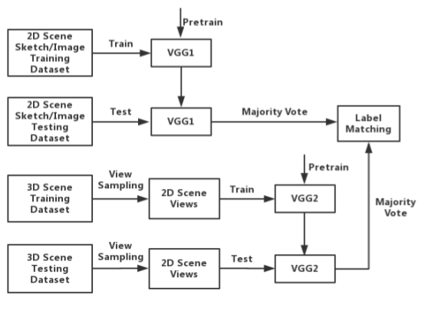
VMV-VGG Architecture

Slide 20
VMV-VGG
Incorporates two different VGG-16 based models [6] (VGG1 and VGG2)
(1) Scene view sampling
Automate sample through QMacro script
Uniformly sample 12 views along the equator of the sphere.
(2) Data Augmentation
Perform random rotations, reflections and translations to augment each dataset’s size by 500 times
[6] - K. Simonyan and A. Zisserman. Very deep convolutional networks for large-scale image recognition. CoRR, abs/1409.1556, 2014.

Slide 21
VMV-VGG contd.
(3) Pre-Training on VGG1 and VGG2
For sketch-based retreival VGG1 is pretrained only on the TU-Berlin dataset [7] for 500 epochs
VGG2 is trained on the Places data set for just 100
#ASK We use Places to pretrain both VGG1 and VGG2 for the first 100 epochs
(4) Fine-tuning
#ASK fine-tune the pre-trained VGG1/VGG2 models each 100/50 epochs
[7] M. Eitz and et al. How do humans sketch objects? ACM Trans. Graph., 31(4):44:1–44:10, 2012.

Slide 22
VMV-VGG contd.
(5) Sketch/Image/View Classification
We feed the well-trained model (VGG1/VGG2) alongside its corresponding testing query sketch/image or target scene view to obtain two classification vectors.
(6) Majority vote-based label matching
We generate a rank list for each query by using a majority vote-based label matching method based on the query's classification vector and the target 3D scene's 13 classification vectors.

Slide 23
Outline
Introduction
Related Work
Benchmark
Method
Evaluation
Conclusions and Future Work
Notes:
‹#›

Slide 24
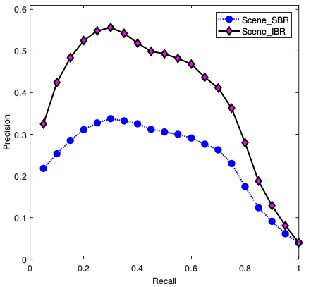
Figure 6. Precision-Recall diagram performance of our VMV-VGG on our
Scene SBR IBR benchmark.
Notes:
‹#›

Slide 25

Results: Performance Metrics
Performance metrics generated by running our VMV-VGG on our Scene SBR IBR benchmark.
Notes:
‹#›

Slide 26
Outline
Introduction
Related Work
Benchmark
Method
Evaluation
Conclusions and Future Work
Notes:
‹#›

Slide 27
Conclusions & Future Work
Objective: To foster this challenging and interesting research direction: Scene Sketch/Image-Based 3D Scene Retrieval
Dataset: Build the current largest 2D Scene sketch/image 3D scene retrieval benchmark
Method: Baseline performance has been provided by VMV-VGG
Evaluation: Performed a comparative evaluation on the accuracy
Impact: Provided the largest and most comprehensive common platform for evaluating 2D scene sketch/image-based 3D scene retrieval
Build a large-scale and/or multimodal 2D scene-based 3D scene retrieval benchmark
Semantics-driven 2D scene image-based 3D scene retrieval
Notes:
‹#›

Slide 28
Build a large-scale and/or multimodal 2D scene-based 3D scene retrieval benchmark
Semantics-driven 2D scene image-based 3D scene retrieval
Notes:
‹#›

Slide 29
References
[1] - J. Yuan and et al. SHREC’18 track: 2D scene sketch-based 3D scene retrieval. In 3DOR, pages 1–8, 2018
[2] - B. Zhou and et al. Places: A 10 million image database for scene recognition. IEEE Trans. Pattern Anal. Mach. Intell., 40(6):1452–1464, 2018
[3] - 3D Warehouse. http://3dwarehouse.sketchup. com/?hl=en, 2018.
[4] H. Abdul-Rashid and et al. SHREC’18 track: 2D scene image-based 3D scene retrieval. In 3DOR, pages 1–8, 2018.
[5] J. Yuan and et al. SHREC’18 track: 2D scene sketch-based 3D scene retrieval. In 3DOR, pages 1–8, 2018.
[6] - K. Simonyan and A. Zisserman. Very deep convolutional networks for large-scale image recognition. CoRR, abs/1409.1556, 2014.
[7] M. Eitz and et al. How do humans sketch objects? ACM Trans. Graph., 31(4):44:1–44:10, 2012.
Notes:
‹#›

Slide 30
Thank you!
Q&A?
E-mail: bo.li@usm.edu

