Slide 1






SHREC’18 Track: 2D Scene Sketch-Based 3D Scene Retrieval
Juefei Yuan, Bo Li, Yijuan Lu, Song Bai, Xiang Bai, Ngoc-Minh Bui,
Minh N. Do, Trong-Le Do, Anh-Duc Duong, Xinwei He, Tu-Khiem Le, Wenhui Li, Anan Liu, Xiaolong Liu, Khac-Tuan Nguyen, Vinh-Tiep Nguyen, Weizhi Nie, Van-Tu Ninh, Yuting Su, Vinh Ton-That, Minh-Triet Tran, Shu Xiang,
Heyu Zhou, Yang Zhou, Zhichao Zhou
Notes:
Good afternoon, everyone. The first one is SHREC’ 18 track: 2D Scene Sketch-Based 3D Scene Retrieval.
It is a joint work of the following authors from these institutes.
The first three persons are organizers while other 22 are participants coming from 3 groups.
1

Slide 2
Outline
Introduction
Benchmark
Evaluation
Methods
Results
Conclusions and Future Work
Notes:
Here is the outline of the presentation.
1

Slide 3
Introduction
2D Scene Sketch-Based 3D Scene Retrieval (SceneSBR) is focusing on retrieving relevant 3D scene models using scene sketch(es) as input
Motivation:
Vast applications: 3D scene reconstruction, autonomous driving cars, 3D geometry video retrieval, and 3D AR/VR Entertainment
Challenges:
2D sketch lacks 3D scene information they are supposed to present
Semantic gap between 2D scene sketches and accurate 3D scene models
Brand new research topic in the field of sketch-based 3D object retrieval (SBR)
A query sketch contains several objects
Objects may overlap with each other
Relative context configurations among the objects
To promote this challenging research area, we organized this track by building the first benchmark SceneSBR
Notes:
2D Scene Sketch-based 3D Scene retrieval (SceneSBR) is focusing on retrieving relevant 3D scene models using scene sketch(es) as input.
The Motivation of the SceneSBR is that:
It has vast applications such as 3D scene reconstruction, autonomous driving cars, 3D geometry video retrieval, and 3D AR/VR Entertainment
But there are some existing challenges, which are:
Firstly, 2D sketch lacks the 3D scene information they are supposed represent
Secondly, semantic gap between 2D scene sketches and accurate 3D scene models
Finally, it is a brand new research topic in the field of sketch-based 3D object retrieval:
The query sketch contains several objects
And the objects that may overlap with each other and also have relative location configurations
We organized this track to further foster this challenging research area by building the first 2D scene sketch-based 3D scene retrieval benchmark
1

Slide 4
Outline
Introduction
Benchmark
Evaluation
Methods
Results
Conclusions and Future Work
Notes:
Let’s continue with the SceneSBR benchmark.
1

Slide 5
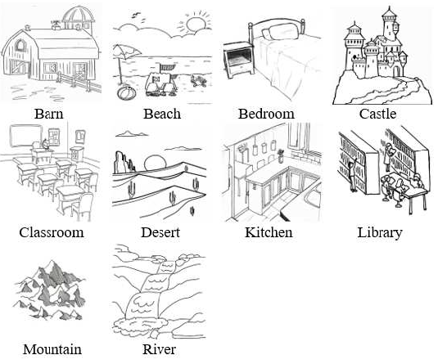
SceneSBR Benchmark (1/3)
2D scene sketch dataset
Use Scene250 benchmark
Our previous work [YLJ16]
Created for sketch recognition
250 2D scene sketches
10 classes, each with 25 sketches
Fig. Example 2D scene sketches (one example per class)
[ YLJ16 ] Ye Y., Lu Y., Jiang H.: Human’s scene sketch understanding. In ICMR ’16 (2016), pp. 355–358.
Notes:
SceneSBR utilizes the 2D scene sketches in Scene250 created in our previous work published in ICMR’16 as its 2D scene sketch dataset and SketchUp 3D scene models (.OBJ and .SKP format) as its 3D scene dataset
The Scene250 scene sketches contain 250 2D scene sketches categorized into 10 classes, each with 25 sketches
The SketchUp 3D scene models contain 1000 3D scene models categorized into 10 classes, each with 100 models
For Training and Testing datasets:
We randomly select 18 sketches and 70 models from each class for training
The remaining 7 sketches and 30 models for testing
1

Slide 6
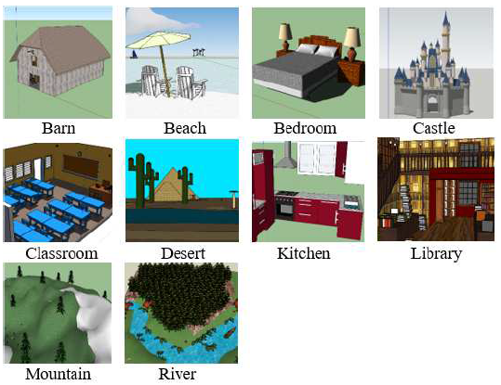
SceneSBR Benchmark (2/3)
3D scene dataset
Collected from 3D Warehouse [Tri18]
1000 SketchUp 3D scene models (.OBJ and .SKP format)
Categorized into 10 classes, each with 100 models
Fig. 2 Example 3D scenes (1 per class)
[ Tri18 ] TRIMBLE: 3D Warehouse. http://3dwarehouse.sketchup.com/?hl=en, 2018.
Notes:
SceneSBR utilizes the 2D Scene sketches in Scene250 as its 2D scene sketch dataset and SketchUp 3D scene models (.OBJ and .SKP format) as its 3D scene dataset
The Scene250 scene sketches contain 250 2D scene sketches categorized into 10 classes, each with 25 sketches
The SketchUp 3D scene models contain 1000 3D scene models categorized into 10 classes, each with 100 models
For Training and Testing datasets:
We randomly select 18 sketches and 70 models from each class for training
The remaining 7 sketches and 30 models for testing
1

Slide 7
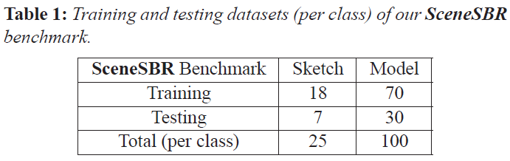
SceneSBR Benchmark (3/3)
Training & Testing datasets
Training: randomly select 18 sketches and 70 models from each class
Testing: remaining 7 sketches and 30 models
Notes:
For Training and Testing datasets:
We randomly select 18 sketches and 70 models from each class for training
The remaining 7 sketches and 30 models for testing
The table here shows the training and testing datasets (per class) of our SceneSBR benchmark
1

Slide 8
Outline
Introduction
Benchmark
Evaluation
Methods
Results
Conclusions and Future Work
Notes:
Here next is about the evaluation
1

Slide 9
Evaluation
Seven common performance metrics in 3D model retrieval technique [LLL*15, LLL*14]:
Precision-Recall plot (PR)
Nearest Neighbor (NN)
First Tier (FT)
Second Tier (ST)
E-Measures (E)
Discounted Cumulated Gain (DCG)
Average Precision (AP)
We also have developed the code to compute them
http://orca.st.usm.edu/~bli/SceneSBR2018/data.html
Notes:
There are seven commonly adopted performance metrics in 3D model retrieval technique, which are PR, NN, FT, ST, E, DCG and AP
We also have developed the code to compute them, the code can be downloaded from the provided link.
1

Slide 10
Outline
Introduction
Benchmark
Evaluation
Methods
Results
Conclusions and Future Work
Notes:
This chapter is about the three methods that are provided by the three participants
1

Slide 11
Methods
VGG and Maximum Mean Discrepancy Domain Adaptation on the VGG-Net (VGG, MMD-VGG)
Triplet Center Loss (TCL)
ResNet50-Based Sketch Recognition and Adapting Place Classification for 3D Models Using Adversarial Training (RNSRAP)
Note: Due to limited time, we are not able to present in detail for each method. But you can find the detailed slides together with scripts in the hided slides followed (slides available on the track website).
Notes:
Here we will list the four participating methods.
VGG and Maximum Mean Discrepancy Domain Adaptation on the VGG-Net (VGG, MMD-VGG).
Triplet Center Loss (TCL).
ResNet50-Based Sketch Recognition and Adapting Place Classification for 3D Models Using Adversarial Training (RNSRAP).
Due to limited time, we will not present in detail for each method. But you can find their slides together with scripts the following hided slides.
1

Slide 12
VGG and Maximum Mean Discrepancy Domain Adaptation on the VGG-Net
Wenhui Li, Anan Liu, Weizhi Nie,
Yuting Su, Shu Xiang, Heyu Zhou
Tianjin University, China
Notes:
First is about the VGG and MMD-VGG methods from Tianjin University, China.

Slide 13
Main Steps
Step 1: Data preprocessing
Step 2: Feature representation
Learning-based setting: MMD-VGG
Maximum Mean Discrepancy [LWD13]
Non-Learning based setting: VGG
Step 3: Euclidian distance computation
Data preprocessing examples
Notes:
Step 1: Data preprocessing: use the 3D design software SketchUp to automatically extract the views of all the 3D models.
Step 2: Feature representation
Learning-based setting (MMD-VGG): Maximum Mean Discrepancy
Non-Learning based setting (VGG): use the VGG model pretrained on the Places dataset [ZLK17] to represent feature directly
Step 3: Euclidian distance computation: calculate the Euclidean distance between the features of a query and a target scene.
1

Slide 14

TCL: Triplet Center Loss
Xiaolong Liu, Xinwei He, Zhichao Zhou,
Yang Zhou, Song Bai, Xiang Bai
Huazhong University of Sci. and Tech. (HUST), China
Notes:
The second is about the TCL method from HUST, China.

Slide 15
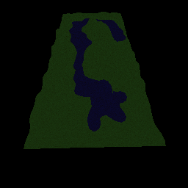
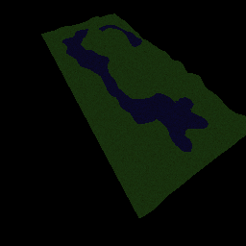
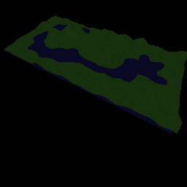

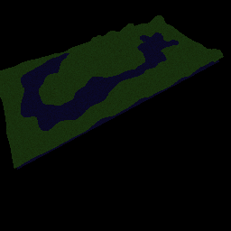
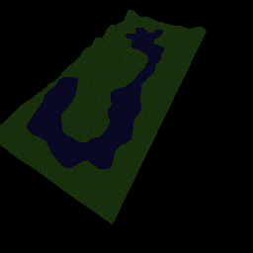
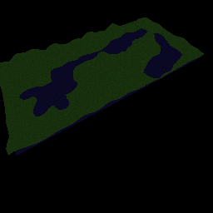
Main Steps
Step 1: View Rendering
Capture 12 view images around the 3D model
y
x
z
…
The view images of a scene model from the “river” category
Step 2: Feature Learning
Step 3: Retrieval
Notes:
Their approach is composed of 3 steps: view rendering, feature learning and retrieval. In the view rendering step, for each 3D scene model (with color texture), they render it into multiple color images from 12 viewpoints. Here shows a sample from the “river” category.
1. Each local region was divided into same smaller sub-regions called cell
2. All cell accumulated a local 1-D vector as the local region feature representation
3. Local normalization methods was used to normalize values
4. Employ 𝝌^𝟐 distance to compare two LSF vector:
χ^2 (𝐹_1,𝐹_2 )=√(∑_(𝑐=1)^(𝐿^3)▒((𝐹_1 (𝑐)−𝐸_χ (𝐹_1 ))/(𝐸_χ (𝐹_1 ) )) +∑_(𝑐=1)^(𝐿^3)▒((𝐹_2 (𝑐)−𝐸_χ (𝐹_2 ))/(𝐸_χ (𝐹_2 ) )) )
1

Slide 16
Main Steps
Step 1: View Rendering
Step 2: Feature Learning
Project the samples from different domains into a common space
Stream 1
2D CNN
Softmax Loss
2D images
…
View
rendering
Stream 2
MVCNN
…
Push
3D Scene models
Pull
Feature Vectors in
a Mixed Batch
Negative Center
CNN Streams
Positive Center
Triplet Center Loss
Notes:
The second step is feature learning. The purpose is to project the samples from different domains into a common space. In that case, the similarity of different samples can be easily measured by the distance of their feature vectors. As there is huge difference between the two domains, they adopt two separate CNN streams for samples from the two domains. Stream I is a normal 2D CNN and Stream 2 use the MVCNN framework. Each CNN stream outputs a set of feature vector for the input samples. These vectors will be mixed in a batch and supervised by Softmax Loss and Triplet Center Loss. Next, let’s look at the triplet center loss.
1

Slide 17
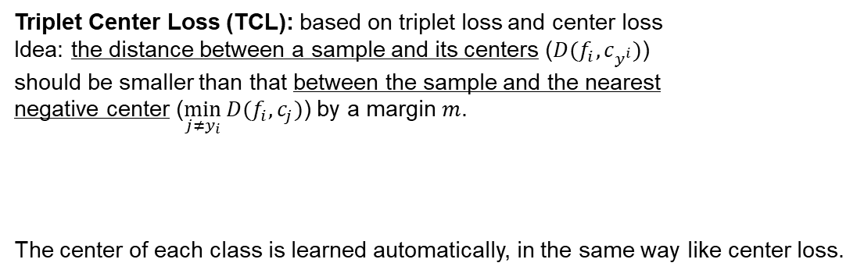

Main Steps
Step 1: View Rendering
Step 2: Feature Learning
Project the samples from different domains into a common space
Push
Triplet Center Loss (TCL): based on triplet loss and center loss
Idea: the distance between a sample and its centers ()
should be smaller than that between the sample and the nearest
negative center () by a margin .
The center of each class is learned automatically, in the same way like center loss.
Pull
Negative Center
Positive Center
Triplet Center Loss
Step 3: Retrieval
Extract features for testing samples and compute similarity matrix
query
feature
similarity
matrix
re-ranking
target
feature
Notes:
Triplet Center Loss is based on triplet loss and center loss. Its idea is that distance between a sample and its centers () should be smaller than that between the sample and the nearest negative center (). . According to this intuition, the mathematical definition can be easily derived. In the equation, are the feature vector and label of the i-th sample. is the center for class j, which is learned automatically, in the same way like center loss.
After training finishes, they adopt the normal retrieval procedure. They calculate the similarity matrix using Euclidean distance metric. To improve the final retrieval performance, they use the ensemble results of different CNN architectures by taking average of corresponding distance matrices.
Based on triplet loss and center loss, its idea is that distance between a sample and its centers (𝐷(𝑓_𝑖, 𝑐_(𝑦^𝑖 ))) should be smaller than that between the sample and the nearest negative center (min┬(𝑗≠𝑦^𝑖 )⁡〖𝐷(𝑓_𝑖,𝑐_𝑗)〗). . According to this intuition, the mathematical definition can be easily derived. In the equation, 𝑓_𝑖, 𝑦_𝑖 are the feature vector and label of the i-th sample. 𝑐_𝑗 is the center for class j, which is learned automatically, in the same way like center loss.
After training finishes, they adopt the normal retrieval procedure. They calculate the similarity matrix using Euclidean distance metric. To improve the final retrieval performance, they use the ensemble results of different CNN architectures by taking average of corresponding distance matrices.
1

Slide 18

RNSRAP: Sketch Recognition with ResNet50 Encoding and Adapting Place Classification for 3D Model Using Adversarial Training
Minh-Triet Tran¹, Van-Tu Ninh¹, Tu-Khiem Le¹, Khac-Tuan Nguyen¹, Vinh Ton-That¹, Ngoc-Minh Bui¹, Trong-Le Do¹, Vinh-Tiep Nguyen², Minh N. Do³, Anh-Duc Duong²
¹University of Science, VNU-HCM
²University of Information Technology, VNU-HCM
³University of Illinois at Urbana-Champaign
Notes:
Next, is the RNSRAP approach which based on ResNet and a classification-based retrieval framework, coming from Vietnam National University at Ho Chi Minh city and UIUC.

Slide 19
Sketch Recognition with ResNet50 Encoding
Use the output of ResNet50 to encode a sketch image into a feature vector of 2048 elements
Extremely small-scale data in sketch data➔ generate different variations of a sketch image
Regular transformations: flipping, rotation, translation, and cropping
Extract different patches with their natural boundaries corresponding to different entities in the image based on the saliency map, then synthesize other sketch images by matting patches
Notes:
Use ResNet18 model in the core of Place365 network to extract the scores of scene attributes which yield a vector of 102 elements.
The classification model is a fully connected neural network having one hidden layer with K nodes (100 ≤ K ≤ 200)
Assign up to two best predicted classes to each 2D scene query image
Train five classification models with the same structure and fuse the results of those models with the voting scheme to determine the label of a 2D scene query image.
1

Slide 20
Sketch Recognition with ResNet50 Encoding
Use types of fully connected neural networks:
Two hidden layers (256 and 128 nodes in each layer)
Only one hidden layer with 200 nodes.
Use multiple classification networks with different initializations for the two types of neural networks.
Fuse the results of those models by using the majority-vote scheme to determine the label of a sketch query image.
Notes:
ASUS-NotebookSKU X541UV, Intel(R) Core(TM) i5-6198DU CPU @ 2.30GHz, 8 GB Memory, and 1 x NVIDIA GeForce 920MX. The training time for a classification model is about 30 minutes. It takes less than 1 second to predict the category of a sketch image.
1

Slide 21
Saliency-Based Selection of 2D Screenshots
Use multiple views of a 3D object for classification
➔Saliency-based selection of 2D screenshots:
Randomly capture multiple screenshots at 3 different levels of details: general views, views focusing on a set of entities, and detailed views on a specific entity
Use DHSNet to generate the saliency map of each screenshot
Select promising screenshots of each 3D model for place classification task.
A 3D model can be classified with high accuracy (more than 92%) with no more than 5 information rich screenshots.
Notes:
1

Slide 22
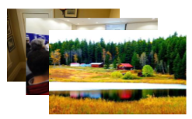
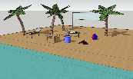
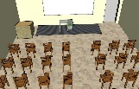

Place Classification Adaptation for 3D Models
Adversarial adaptation for place classification on screenshots of 3D models
Adversarial Adaptation
Classification for Target Domain
M_{s}
Discriminator
Classifier
Source: Natural images
Domain
label
Class
label
Source
representation
M_{t}
M_{t}
Target domain
images
Target
representation
Target: Screenshots
of 3D models
Target
representation
Goal: to learn M_{t} so that the discriminator cannot distinguish the domain of a feature vector encoded by either M_{s} or M_{t} .
Notes:
Adversarial Adaptation step, a natural image is encoded by a source representation Ms and a screenshot of a 3D model is encoded by a target representation Mt .
The goal of this step is to learn Mt so that the discriminator cannot distinguish the domain of a feature vector encoded by either Ms or Mt . They keep the source representation
Ms fixed and train the target representation Mt using a basic adversarial loss until the feature maps of the two domains are indistinguishable by the discriminator. By this way, they obtain a
transformation to match the target distribution (screenshots from 3D models) with the source distribution (natural images).
They use Google cloud machines n1-highmem-2, each with 2 vCPUs, Intel(R) Xeon(R) CPU @ 2.50GHz Intel Xeon E5 v2, 13 GB Memory, and 1 x NVIDIA Tesla K80.
1

Slide 23
Place Classification Adaptation for 3D Models
Heatmaps of informative regions for place prediction on screenshots before adaptation (the first row) and after adaptation (the second row)
Notes:
1

Slide 24
Rank List Generation
Assign one or two best labels for each sketch image, and retrieve all 3D models having such labels.
The similarity between a sketch image and a 3D model: the product of the prediction score of the query image and that of the 3D model on the same label.
Run 1: use the single label of a sketch image from one network in Type 1 and the single label of a 3D model from one place classification model.
Run 2: use the single label of a sketch image from the fusion of 3 networks (one Type 1 and two Type 2 networks) and the single label of a 3D model from the fusion of 5 place classification models.
Run 3: use the two best labels of a sketch image from one network in type 1 and the single label of a 3D model from the fusion of 5 place classification models.
Notes:
For a single classification model, they use the prediction score directly from the network. For a fusion result from multiple classification models, they use the voting ratio as the prediction score.
After retrieval all relevant 3D models into a rank list, all other 3D models which are considered irrelevant are inserted in the tail of that rank list with the distance of infinity.
1

Slide 25
Outline
Introduction
Benchmark
Evaluation
Methods
Results
Conclusions and Future Work
Notes:
Here we will show the results of the three methods by using the seven performance metrics
1

Slide 26
Precision-Recall
Learning-based approaches
Non-learning based approaches
Notes:
We performed evaluation on both learning-based and non-learning based participating approaches.
1

Slide 27
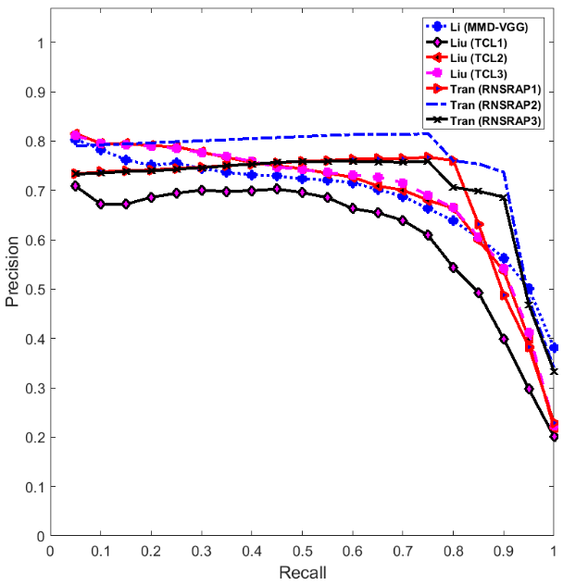
Notes:
There are testing and complete datasets in the benchmark.
This figure is the Precision-Recall plots of 3 learning-based approaches with 7 runs on testing dataset.
From the figure, we can see that Tran’s RNSRAP algorithm performs the best, followed by Liu’s TCL method.
The overall performance of all the learning-based methods are close to each other.
1

Slide 28
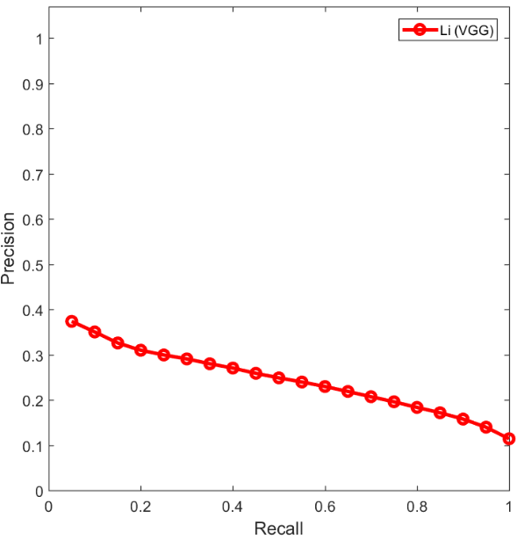
Notes:
The second figure is the Precision-Recall plot of 1 non-learning-based approach with 1 rum on the complete dataset.
From this figure, we can see that the performance is much inferior if compared with learning-based ones.
1

Slide 29
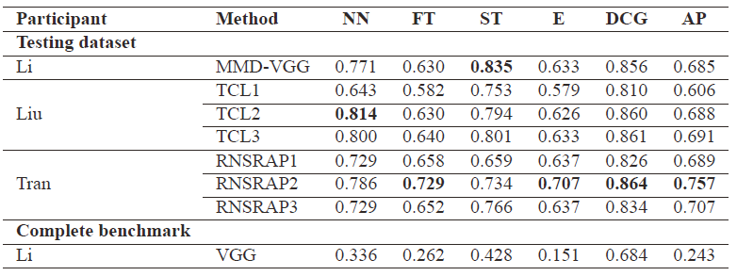
Other Six Performance Metrics
Performance metrics comparison on two different datasets of our SceneSBR benchmark for three learning-based and one non-learning based participating methods.
Notes:
This table compares their performance based on other six performance metrics. The conclusion is consistent as well, if we look at the overall performance like DCG or AP.
1

Slide 30
Outline
Introduction
Benchmark
Evaluation
Methods
Results
Conclusions and Future Work
Notes:
In the last chapter, we will show the conclusions and future work
1

Slide 31
Conclusions
Objective: To foster this challenging and interesting research direction: Scene Sketch-Based 3D Scene Retrieval
Dataset: Build the first 2D Scene SBR benchmark
Participation: Though challenging, 3 groups successfully participated in the track and contributed 8 runs of 4 methods.
Evaluation: Performed a comparative evaluation on the accuracy
Impact: Provided the first common platform for evaluating 2D scene sketch-based 3D scene retrieval
Notes:
Let’s conclude the track.
First, to foster this challenging and interesting research direction Scene Sketch-Based 3D Scene Retrieval, we build the first benchmark for it and organize this track.
About the participation: although challenging, we have 3 groups successfully participated in the track and contributed 8 runs of 4 methods. While, we conducted a comparative evaluation on their performance based on seven commonly used performance metrics. This track also provides the first common platform for this research topic. It can be used to evaluate new 2D scene sketch-based 3D scene retrieval algorithms.
1

Slide 32
Future Work
Build a large-scale and/or multimodal 2D scene-based 3D scene retrieval benchmark
Semantics-driven 2D scene sketch-based 3D scene retrieval
Application-oriented 2D scene-based 3D scene retrieval
Develop new deep learning models specially for this research topic
Interdisciplinary research directions
Notes:
The future work of this research direction includes:
Build a large-scale and/or multimodal 2D scene-based 3D scene retrieval benchmark
Utilize the semantic information existing in both a 2D scene sketch query and all the 3D scene target models to improve either the accuracy or efficiency of a 2D scene sketch-based 3D scene retrieval algorithm
Develop a 2D scene-based 3D scene retrieval dedicated for a related application, such as rainforest scenes for cartoon or movie production, and so on
Develop new deep learning models specially for this research topic
And to further improve retrieval accuracy, especially for NN, and FT since we can push more 3D scene models classified into one class forward to the front part of a retrieval rank list, e.g., a 3D mountain scene model may contains a river, and vice versa.
1

Slide 33
Thank you!
Any Questions?
E-mail: bo.li@usm.edu.
Notes:
If you have any question, please send an email to bo.li@usm.edu. Thank you.
1

