Slide 1


Sketch/Image-Based 3D Scene Retrieval: Benchmark, Algorithm, Evaluation
Juefei Yuan¹, Hameed Abdul-Rashid¹, Bo Li¹, Yijuan Lu²
¹University of Southern Mississippi, ²Texas State University
Presenter: Yijuan Lu
Notes:
‹#›

Slide 2
Outline
Introduction
Related Work
Benchmark
Method
Evaluation
Conclusions and Future Work
Notes:
‹#›

Slide 3
Introduction
2D Scene Sketch/Image-Based 3D Scene Retrieval (Scene_SBR_IBR) focuses on retrieving relevant 3D scene models using scene sketches/image(s) as input
Motivation:
Vast applications: 3D scene reconstruction, autonomous driving cars, 3D geometry video retrieval, and 3D AR/VR Entertainment
Challenges
2D sketches/images lack 3D scene information they are supposed to present
Semantic gap between 2D scene iconic sketches or realistic images and accurate 3D scene models
Notes:
2D Scene Sketch/Image-based 3D Scene retrieval (Scene_SBR_IBR) focuses on retrieving relevant 3D scene models using scene sketch(es)/image(s) as input.
The Motivation of the Scene_SBR_IBR is that:
It has vast applications such as 3D scene reconstruction, autonomous driving cars, 3D geometry video retrieval, and 3D AR/VR Entertainment
‹#›

Slide 4
Introduction
Challenges contd.
Brand new research topic in the field of sketch/image-based 3D object retrieval (Scene_SBR_IBR)
A query sketch/image contains several objects
Objects may overlap with each other
Relative context configurations among the objects
To promote this challenging research direction, we built the most comprehensive and largest 2D scene sketch/image-based benchmark 3D scene retrieval benchmark Scene_SBR_IBR.
Notes:
But there are some existing challenges with 2D sketch/image-based 3D Scene Retrieval, which are:
Firstly, 2D sketches/images lack 3D scene information they are supposed represent
Secondly, there is still a semantic gap between 2D scene sketches/images and accurate 3D scene models
Finally, it is a brand new research topic in the field of sketch/image-based 3D object retrieval:
A query image contains several objects
Objects may overlap with each other
There existing relative context configurations among the objects in a scene image/model
Considering the above, we built the most comprehensive and largest 2D scene sketch/image-based benchmark 3D scene retrieval benchmark, Scene_SBR_IBR.
‹#›

Slide 5
Outline
Introduction
Related Work
Benchmark
Method
Evaluation
Conclusions and Future Work
Notes:
‹#›

Slide 6
Related Work
3D Scene Retrieval
Fisher and Hanrahan proposed context-based 3D model retrieval [1]
3D Bounding box
Dimensionality & context Information
Xu et. al proposed Sketch2Scene, a system for automatic 2D sketch-based 3D scene composition [2]
Functional & spatial relationships
Using structural groups
[1] M. Fisher and P. Hanrahan. Context-based search for 3D models. ACM Trans. Graph., 29:182:1–182:10, 2011.
[2] B. Li and et al. A comparison of 3D shape retrieval methods based on a large-scale benchmark supporting multimodal queries. Computer Vision and Image Understanding, 131:1– 27, 2015.
Notes:
Fisher and Hanrahan proposed context-based 3D model retrieval, which retrieves models according to their spatial context in a 3D scene. They first locate the position of the model by drawing a 3D Bounding box and then searching relevant 3D models based on the dimensionality and context information.
Xu et. al proposed Sketch2Scene for automatic 2D sketch-based 3D scene composition by representing 3D scene objects’ functional and spatial relationships based on structural groups.
‹#›

Slide 7
Related Work
2D/3D Scene Datasets
Xiao et. al built Scene UNderstanding (SUN) datasets
130,519 images across 899 scene categories [3]
Expanded to 908 classes [4]
Xiao et. al created SUN3D [5]
RGB-D video database with camera pose and object labels
[3] J. Xiao and et al. SUN database: Large-scale scene recognition from abbey to zoo. In CVPR, pages 3485–3492. IEEE Computer Society, 2010.
[4] J. Xiao and et al. SUN database: Exploring a large collection of scene categories. International Journal of Computer Vision, 119(1):3–22, 2016.
[5] J. Xiao and et al. SUN3D: A database of big spaces reconstructed using SfM and object labels. In ICCV, pages 1625–1632, 2013.
Notes:
Xiao et. al built SUN and introduced 130,519 images across 899 scene categories. This was later extended to include 908 scenes classes.
Xiao et. al also built SUN3D a RGB-D video database that captures the full extent of 3D scenes with camera pose and object labels.
‹#›

Slide 8
Related Work
2D/3D Scene Datasets contd.
Song et. al constructed SUNCG [6]
46,622 Synthetized 3D scenes with 2,644 objects
84 scene categories
Zhou et. al compiled Places [7]
10,624,928 images
434 scene categories.
[6] S. Song and et al. Semantic scene completion from a single depth image. In CVPR, pages 190–198. IEEE Computer Society, 2017.
[7] B. Zhou and et al. Places: A 10 million image database for scene recognition. IEEE Trans. Pattern Anal. Mach. Intell., 40(6):1452–1464, 2018
Notes:
Song et. al constructed SUNCG, a database of synthetic 3D scenes with manually labelled voxel occupancy and semantic labels. SUNCG is comprised of 45,622 scenes and 2,644 objects across 84 scene categories.
Zhou et. al compiled Places, a database of 10,624,928 scene images across 434 scene categories. While Places does not provide annotations at the object level, it provides the most diverse scene composition.
‹#›

Slide 9
Outline
Introduction
Related Work
Benchmark
Method
Evaluation
Conclusions and Future Work
Notes:
‹#›

Slide 10
Scene_SBR_IBR Benchmark
Scene_SBR:
SceneSBR2018 benchmark [8], augmented further with from Flickr and Google Images totaling 750 2D scene sketches (30 classes, each with 25 sketches).
Scene_IBR:
Composed of 30,000 scene images using categories from Places88 [7] (30 classes, each with 1,000 images).
3D Scene Model Target Dataset
3,000 3D scene models from 3D Warehouse [9] (30 classes, each with 100 models)
[7] B. Zhou and et al. Places: A 10 million image database for scene recognition. IEEE Trans. Pattern Anal. Mach. Intell., 40(6):1452–1464, 2018
[8] J. Yuan and et al. SHREC’18 track: 2D scene sketch-based 3D scene retrieval. In 3DOR, pages 1–8, 2018
[9] 3D Warehouse. http://3dwarehouse.sketchup. com/?hl=en, 2018.
Notes:
The 2D Scene Sketch Query Dataset utilizes the 2D scene images in SBR benchmark further extends with sketches from Flickr and Google images.
The 2D Scene Sketch Query Dataset 750 2D scene images categorized into 30 classes, each with 25 sketches each
The 2D Scene Image Query Dataset utilizes 2D scene categories from Places88 and contain 30,000 2D scene images categorized into 30 classes, each with 1,000 images each
The 3D scene dataset contains 3000 3D scene models. They are categorized into the same 30 classes, each having 100 models.
2D Scene Sketch Query Dataset (Subset 1). The 2D scene sketch query set comprises 750 2D scene sketches (30 classes, each with 25 sketches). One example per class is demonstrated in Fig. 1.
2D Scene Image Query Dataset (Subset 2). The 2D scene image query set is composed of 30,000 scene images (30 classes, each with 1,000 images). One example per class is demonstrated in Fig. 2.
3D Scene Model Target Dataset (Subset 3). The 3D scene dataset is built on the selected 3,000 3D scene models downloaded from 3D Warehouse. Each class has 100 3D scene models. One example per class is shown in Fig. 3.

Slide 11
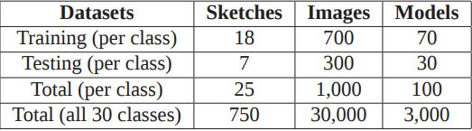
Scene_SBR_IBR Benchmark
Table 1. Training and testing dataset information of our Scene_SBR_IBR benchmark.
Notes:
The 2D Scene Sketch Query Dataset utilizes the 2D scene images in SBR benchmark further extends with sketches from Flickr and Google images.
The 2D Scene Sketch Query Dataset 750 2D scene images categorized into 30 classes, each with 25 sketches each

Slide 12
Scene_SBR_IBR Benchmark (1/3)
2D Scene Sketch Query Dataset
750 2D scene sketches
30 classes
25 sketches per class
Notes:
The 2D Scene Sketch Query Dataset utilizes the 2D scene images in SBR benchmark further extends with sketches from Flickr and Google images.
The 2D Scene Sketch Query Dataset 750 2D scene images categorized into 30 classes, each with 25 sketches each

Slide 13
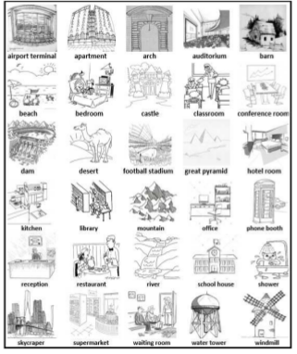
Scene_SBR_IBR Benchmark (1/3)
Fig. 1 Example 2D sketches (1 per class)

Slide 14
Scene_SBR_IBR Benchmark (2/3)
2D Scene Image Query Dataset
30,000 images
30 classes
1,000 images per class
Notes:
The 2D Scene Image Query Dataset utilizes 2D scene categories from Places88 and contain 30,000 2D scene images categorized into 30 classes, each with 1,000 images each

Slide 15
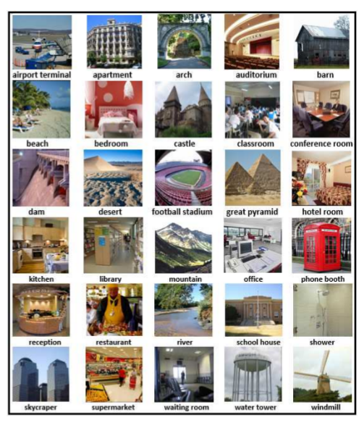
Scene_SBR_IBR Benchmark (2/3)
Fig. 2 Example 2D scenes (1 per class)

Slide 16
Scene_SBR_IBR Benchmark (3/3)
3D Scene Model Target Dataset
3000 scene models
30 classes
100 models per class
Notes:
The 3D scene dataset contains 3000 3D scene models. They are categorized into the same 30 classes, each having 100 models.

Slide 17
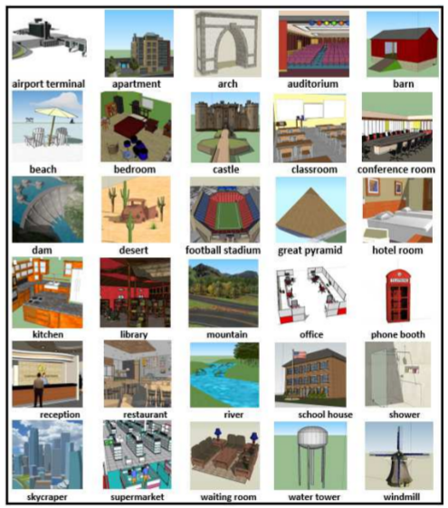
Scene_SBR_IBR Benchmark (3/3)
Fig. 2 Example 3D scenes (1 per class)

Slide 18
Evaluation
Seven commonly adopted performance metrics in 3D model retrieval techniques [10, 11]:
Precision-Recall plot (PR)
Nearest Neighbor (NN)
First Tier (FT)
Second Tier (ST)
E-Measures (E)
Discounted Cumulated Gain (DCG)
Average Precision (AP)
We also have developed the code to compute them
http://orca.st.usm.edu/~bli/Scene_SBR_IBR/data.html
[10] H. Abdul-Rashid and et al. SHREC’18 track: 2D scene image-based 3D scene retrieval. In 3DOR, pages 1–8, 2018.
[11] J. Yuan and et al. SHREC’18 track: 2D scene sketch-based 3D scene retrieval. In 3DOR, pages 1–8, 2018.
Notes:
There are seven commonly adopted performance metrics in 3D model retrieval techniques, which are PR, NN, FT, ST, E, DCG and AP.
We also have developed the code to compute them, and the code can be downloaded from the provided link.
‹#›

Slide 19
Outline
Introduction
Related Work
Benchmark
Method
Evaluation
Conclusions and Future Work
Notes:
‹#›

Slide 20
Our Retrieval Algorithm VMV-VGG

Slide 21
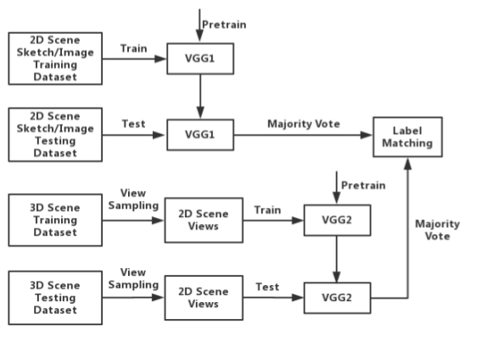
VMV-VGG Architecture

Slide 22
VMV-VGG
Incorporates two different VGG-16 based models [12] (VGG1 and VGG2)
(1) 3D Scene view sampling
(2) Data Augmentation on each training Batch
(3) Pre-Training and Training on VGG1 and VGG2
(4) Fine-tuning
(5) Sketch/Image/View Scene Classification
(6) Majority vote-based label matching
[12] K. Simonyan and A. Zisserman. Very deep convolutional networks for large-scale image recognition. CoRR, abs/1409.1556, 2014.
Notes:
(1) Scene view sampling
Automate sample through QMacro script
Uniformly sample 12 views along the equator of the sphere and 1 top-down view, for 13 views in total.
(2) Data Augmentation
Perform random rotations, reflections or translations to augment each batch size per epoch.
(3) Pre-Training and Training on VGG1 and VGG2
For the sketch-based retrieval
VGG1 is pre-trained only on the TU-Berlin dataset [7] for 500 epochs
VGG2 is pre-trained on only the Places data set for just 100 epochs
For the image-based retrieval
VGG1 and VGG2 is pre-trained on only the Places data set for just 100 epochs
For Training
VGG1 is trained on the 2D Scene Sketch/Image Query Dataset for 100 epochs
VGG2 is trained on 2D views of the 3D scene models for 50 epochs
(4) Fine-tuning
Fine-tune the pre-trained VGG1/VGG2 models each 100/50 epochs
5) Sketch/Image/View Classification
We feed the well-trained model (VGG1/VGG2) alongside its corresponding testing query sketch/image or target scene view to obtain two classification vectors.
(6) Majority vote-based label matching
We generate a rank list for each query by using a majority vote-based label matching method based on the query's classification vector and the target 3D scene's 13 classification vectors.

Slide 23
Outline
Introduction
Related Work
Benchmark
Method
Evaluation
Conclusions and Future Work
Notes:
‹#›

Slide 24
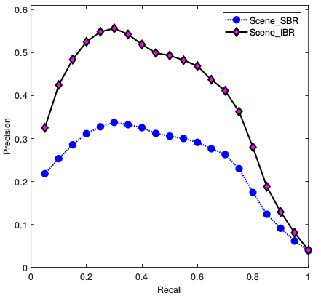
Figure 6. Precision-Recall diagram performance of our VMV-VGG on our
Scene SBR IBR benchmark.
Notes:
We have found that compared with the performance that has been achieved
in our two SHREC’18 tracks [21, 2] which used a much
smaller benchmark containing only 10 classes, in contrast to
the current 30 classes available in our new benchmark, the
overall performance dropped significantly for either type of
retrieval. For example, Li’s MMD-VGG method, which
also utilizes VGG, has achieved an excellent overall per-
formance in terms of DCG (0.856) or AP (0.685) on the
SceneSBR benchmark, while they drop to DCG (0.533)
and AP (0.244) respectively based on our VMV-VGG.
‹#›

Slide 25

Results: Performance Metrics
Performance metrics generated by running our VMV-VGG on our Scene SBR IBR benchmark.
Notes:
This performance decrease should be a direct and natural result after a substantial increase in the comprehensiveness and
challenge level that exist in Scene SBR IBR after we incorporate much more scene categories. The addition of more classes will
cause more ambiguities during the retrieval process and the retrieval algorithm may fail to properly distinguish between classes that
share certain similarities.
‹#›

Slide 26
Outline
Introduction
Related Work
Benchmark
Method
Evaluation
Conclusions and Future Work
Notes:
‹#›

Slide 27
Conclusions & Future Work
Objective: To foster this challenging and interesting research direction: Scene Sketch/Image-Based 3D Scene Retrieval
Dataset: Build the current largest 2D Scene sketch/image 3D scene retrieval benchmark
Method: Baseline performance has been provided by VMV-VGG
Evaluation: Performed a comparative evaluation on the accuracy
Notes:
Sketch/Image-based 3D scene retrieval are research topics with a lot of ap-
plication potentials. There is extremely limited preliminary work in this field, which allows us to explore many promis-
ing ideas and interesting results. In this paper, the currently
largest 3D scene retrieval benchmark Scene SBR IBR is
proposed with the hope to advance this research direc-
tion. To assist other interested researchers, the baseline
performance on the benchmark has been provided by con-
ducting evaluation based on a proposed CNN classifier-
based 3D scene retrieval algorithm VMV-VGG. Our fu-
ture goals include: (1) building a large-scale and/or mul-
timodal 2D scene sketch/image-based 3D scene retrieval
benchmark; (2) semantics-driven 2D scene sketch/image-
based 3D scene retrieval.
‹#›

Slide 28
Conclusions & Future Work
Build a large-scale and/or multimodal 2D scene-based 3D scene retrieval benchmark
Semantics-driven 2D scene image-based 3D scene retrieval
Impact: Provided the largest and most comprehensive common platform for evaluating 2D scene sketch/image-based 3D scene retrieval
Build a large-scale and/or multimodal 2D scene-based 3D scene retrieval benchmark
Semantics-driven 2D scene image-based 3D scene retrieval
Notes:
Sketch/Image-based 3D scene retrieval are research topics with a lot of ap-
plication potentials. There is extremely limited preliminary work in this field, which allows us to explore many promis-
ing ideas and interesting results. In this paper, the currently
largest 3D scene retrieval benchmark Scene SBR IBR is
proposed with the hope to advance this research direc-
tion. To assist other interested researchers, the baseline
performance on the benchmark has been provided by con-
ducting evaluation based on a proposed CNN classifier-
based 3D scene retrieval algorithm VMV-VGG. Our fu-
ture goals include: (1) building a large-scale and/or mul-
timodal 2D scene sketch/image-based 3D scene retrieval
benchmark; (2) semantics-driven 2D scene sketch/image-
based 3D scene retrieval.
‹#›

Slide 29
References
[1] M. Fisher and P. Hanrahan. Context-based search for 3D models. ACM Trans. Graph., 29:182:1–182:10, 2011.
[2] B. Li and et al. A comparison of 3D shape retrieval methods based on a large-scale benchmark supporting multimodal queries. Computer Vision and Image Understanding, 131:1– 27, 2015.
[3] J. Xiao and et al. SUN database: Large-scale scene recognition from abbey to zoo. In CVPR, pages 3485–3492. IEEE Computer Society, 2010.
[4] J. Xiao and et al. SUN database: Exploring a large collection of scene categories. International Journal of Computer Vision, 119(1):3–22, 2016.
[5] J. Xiao and et al. SUN3D: A database of big spaces reconstructed using SfM and object labels. In ICCV, pages 1625–1632, 2013.
[6] S. Song and et al. Semantic scene completion from a single depth image. In CVPR, pages 190–198. IEEE Computer Society, 2017.
[7] B. Zhou and et al. Places: A 10 million image database for scene recognition. IEEE Trans. Pattern Anal. Mach. Intell., 40(6):1452–1464, 2018
[8] J. Yuan and et al. SHREC’18 track: 2D scene sketch-based 3D scene retrieval. In 3DOR, pages 1–8, 2018
[9] 3D Warehouse. http://3dwarehouse.sketchup. com/?hl=en, 2018.
[10] H. Abdul-Rashid and et al. SHREC’18 track: 2D scene image-based 3D scene retrieval. In 3DOR, pages 1–8, 2018.
[11] J. Yuan and et al. SHREC’18 track: 2D scene sketch-based 3D scene retrieval. In 3DOR, pages 1–8, 2018.
[12] K. Simonyan and A. Zisserman. Very deep convolutional networks for large-scale image recognition. CoRR, abs/1409.1556, 2014.
Notes:
‹#›

Slide 30
Thank you!
Q&A?
E-mail: bo.li@usm.edu

