Slide 1
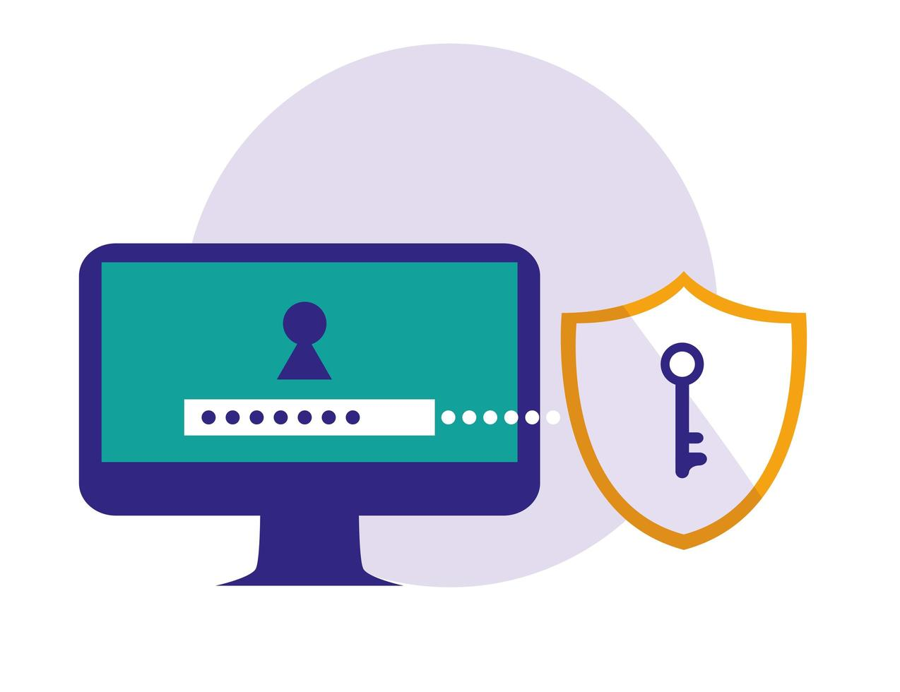
Why Strong Password Practices Are Essential to Cybersecurity
Fun Fact- A 12-character password can take 4 trillion years to crack compared to an 8-character password.
A guide by Hammaz Ahmed

Slide 2

Introduction to Password Security
Passwords are the first line of defense against cyber threats.
Weak passwords are the number one cause of data breaches.
Strong password practices help protect personal, financial, and organizational data.

Slide 3
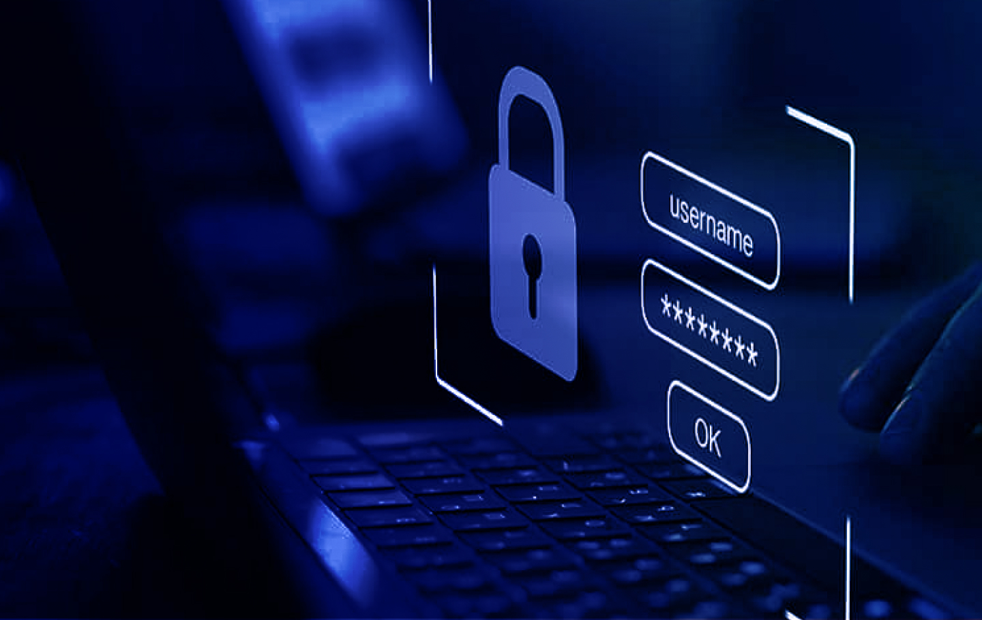
Stats on Password Realted Cyber Attack
Credential Stuffing Attack: 80% of hacking-related breaches involve passwords.
Password Guessing Attack: 81% of hacking-related breaches are due to weak or stolen passwords.
Data Breaches: In 2022, over 15 billion credentials were exposed through data breaches. Many of these breaches occurred due to weak or reused passwords.

Slide 4


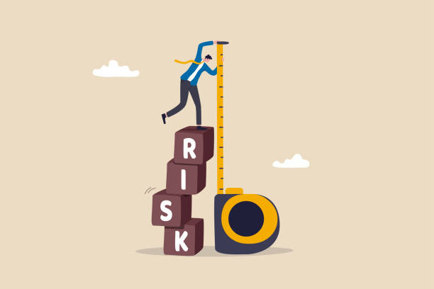
1. The Risks of Weak Passwords
Choose one approach to grab the audience’s attention right from the start: unexpected, emotional, or simple.
Credential Stuffing Attackers use stolen passwords from data breaches.
Brute Forece Attack Simple passwords are cracked quickly..
Reused Passwords One breach can compromise multiple accounts.

Slide 5

How to Create a Strong Password!
Use 12+ characters (mix of uppercase, lowercase, numbers, symbols).
Avoid common words (e.g., “password,” “123456”).
Don’t reuse passwords across multiple accounts.
Use a password manager to store and generate complex passwords.
Tip
Keep your passwords like your toothbrush—never share them, change them regularly, and don’t pick something obvious like 'password123'... unless you’re planning to give hackers a head start!

Slide 6
The Role of Multi-Factor Authentication (MFA)
MFA blocks 99.9% of automated attacks.
Even if a password is compromised, MFA adds another layer of security.
Examples: SMS codes, authenticator apps, biometrics (fingerprint, face recognition).
Tip
Enable MFA—because your password alone is like having a lock on your front door, but leaving the windows wide open. MFA is the second lock, the deadbolt, and a security guard all rolled into one!

Slide 7
Conclusion: Protect your information with Strong Password Passwords
Strong passwords are your first defense against cybercrime.
Use unique, complex passwords and enable MFA to stay secure.
Educate yourself and others on password security to protect personal and organizational data
Quotes for illustration purposes only

