Slide 1
MSDS 6306 Doing Data Science
Case Study Fall Midterm
(Satish, Tyler, Thotho)

Slide 2
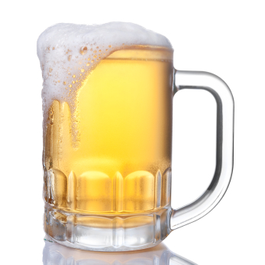
Executive Summary
Purpose
The purpose of this document is to provide a detailed view about the beers crafted in United States of America. After a thorough review of the data, a suggested location for opening a new brewery is to be provided.
Client: Gosset Brew Crew
Request: Perform a analysis to help client decide where to start a new beer crafting factory
Strategic Impact: Start a new Breweries to serve remote unreached locations
Data Snapshot
Beers
Identified 2305 unique Beer names out of 2410 beers records
2.57% missing information about Alcohol by volume of the beer (ABV).
41.7% missing information on International Bitterness Units of the beer (IBU)
Breweries
Identified 551 unique Brewery names out of 558 Brewery records
All there breweries were distributed to 384 cities
https://b-i.forbesimg.com/ups/files/2013/07/beer-mug.jpg

Slide 3
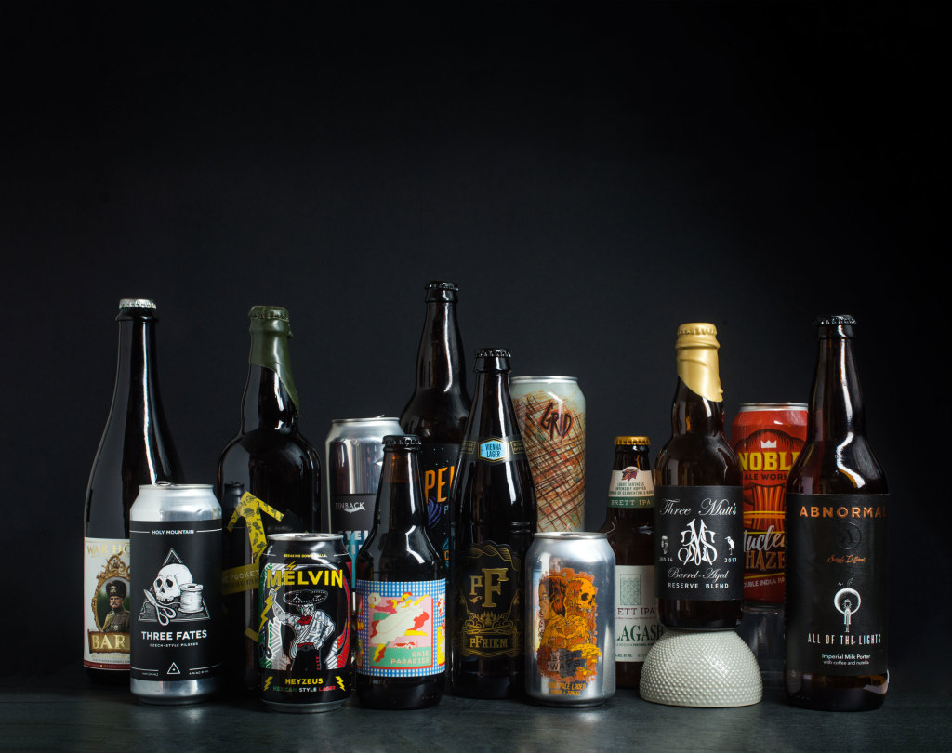
Agenda
Breweries are present in each state
Provide top and bottom 6 records
Missing Information from the records
Median ABV for each state.
Most Bitter and Alcoholic beers
Overview statistics of ABV
Bitterness Vs Alcohol
Conclusion
https://draftmag.com/the-top-25-beers-of-2017/

Slide 4
Breweries by State
Breweries across 50 states and 1 Federal District (DC) are shown below, where the state of Colorado has the highest number of breweries (47)

Slide 5
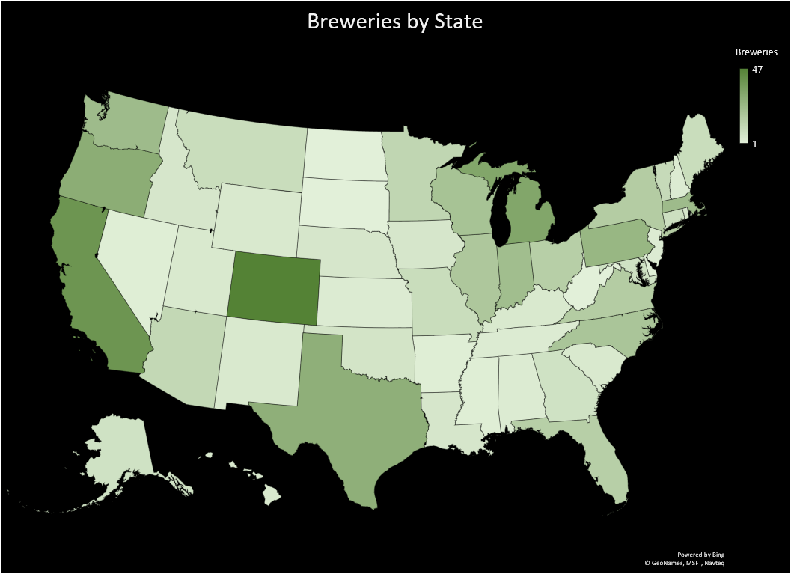
Breweries
Top 5
Colorado 47
California 39
Michigan 32
Oregon 29
Texas 28
Bottom 5
Nevada 2
District of Columbia 1
North Dakota 1
South Dakota 1
West Virginia 1

Slide 6
Top and Bottom 6 records
Beers and Breweries data have been de-normalized into one set for further investigation into the data
Top 6
Head | Beers | Beer_ID | ABV | IBU | Brewery_id | Style | Ounces | Breweries | City | State
1 | Pub Beer | 1436 | 0.05 | NA | 409 | American Pale Lager | 12 | 10 Barrel Brewing Company | Bend | OR
2 | Devil's Cup | 2265 | 0.066 | NA | 178 | American Pale Ale (APA) | 12 | 18th Street Brewery | Gary | IN
3 | Rise of the Phoenix | 2264 | 0.071 | NA | 178 | American IPA | 12 | 18th Street Brewery | Gary | IN
4 | Sinister | 2263 | 0.09 | NA | 178 | American Double / Imperial IPA | 12 | 18th Street Brewery | Gary | IN
5 | Sex and Candy | 2262 | 0.075 | NA | 178 | American IPA | 12 | 18th Street Brewery | Gary | IN
6 | Black Exodus | 2261 | 0.077 | NA | 178 | Oatmeal Stout | 12 | 18th Street Brewery | Gary | IN
Bottom 6
Tail | Beers | Beer_ID | ABV | IBU | Brewery_id | Style | Ounces | Breweries | City | State
2405 | Rocky Mountain Oyster Stout | 1035 | 0.075 | NA | 425 | American Stout | 12 | Wynkoop Brewing Company | Denver | CO
2406 | Belgorado | 928 | 0.067 | 45 | 425 | Belgian IPA | 12 | Wynkoop Brewing Company | Denver | CO
2407 | Rail Yard Ale | 807 | 0.052 | NA | 425 | American Amber / Red Ale | 12 | Wynkoop Brewing Company | Denver | CO
2408 | B3K Black Lager | 620 | 0.055 | NA | 425 | Schwarzbier | 12 | Wynkoop Brewing Company | Denver | CO
2409 | Silverback Pale Ale | 145 | 0.055 | 40 | 425 | American Pale Ale (APA) | 12 | Wynkoop Brewing Company | Denver | CO
2410 | Rail Yard Ale (2009) | 84 | 0.052 | NA | 425 | American Amber / Red Ale | 12 | Wynkoop Brewing Company | Denver | CO

Slide 7
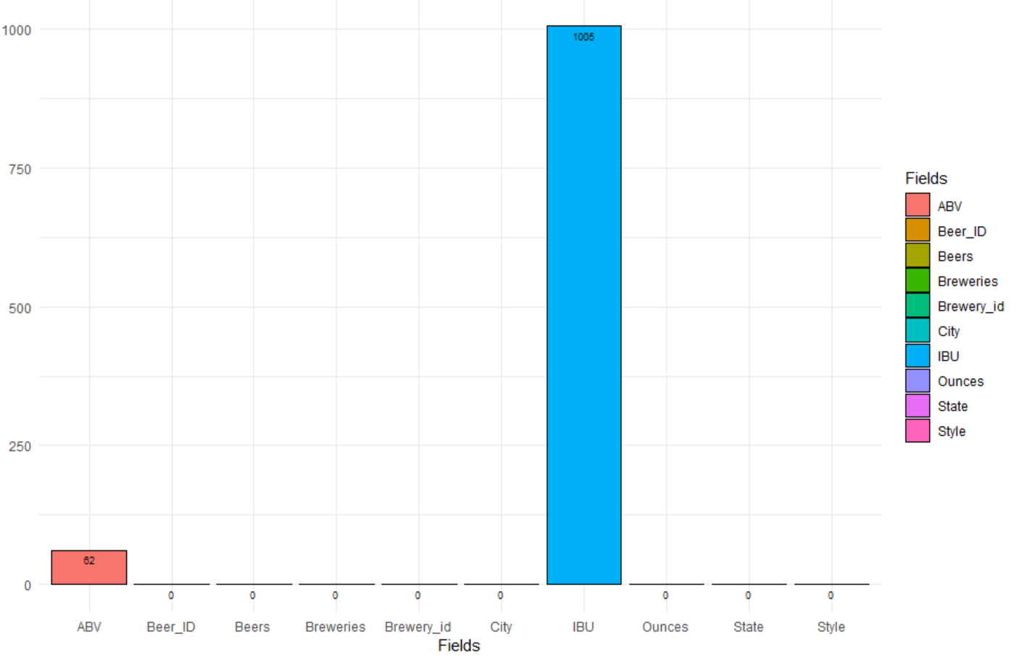
Missing Information from the records
Missing information on the de-normalized data
Data Fields | Missing Information
Beers | 0
Beer_ID | 0
ABV | 62
IBU | 1005
Brewery_id | 0
Style | 0
Ounces | 0
Breweries | 0
City | 0
State | 0
2.57% missing information about Alcohol by volume of the beer (ABV).
41.7% missing information on International Bitterness Units of the beer (IBU)

Slide 8
Median ABV for each state.
Median Alcohol by volume helps Gosset Brew Crew to decide what should the concentration of the alcohol in the beers for their new factory.

Slide 9
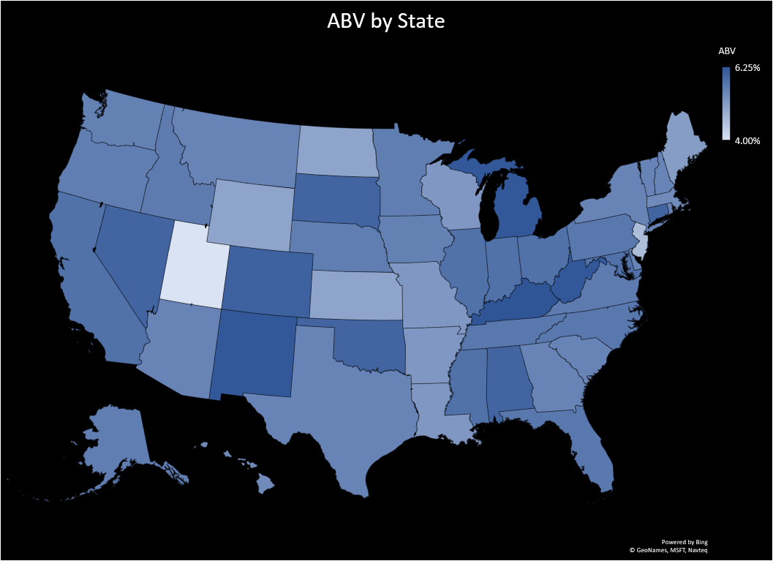
ABV
Median
Top 5
Kentucky 6.25%
District of Columbia 6.25%
West Virginia 6.20%
New Mexico 6.20%
Michigan 6.20%
Bottom 5
Wyoming 5.00%
North Dakota 5.00%
Kansas 5.00%
New Jersey 4.60%
Utah 4.00%

Slide 10
Median IBU for each state.
Median International Bitterness Units helps Gosset Brew Crew to decide the bitterness taste choices by the users in the respective regions.

Slide 11
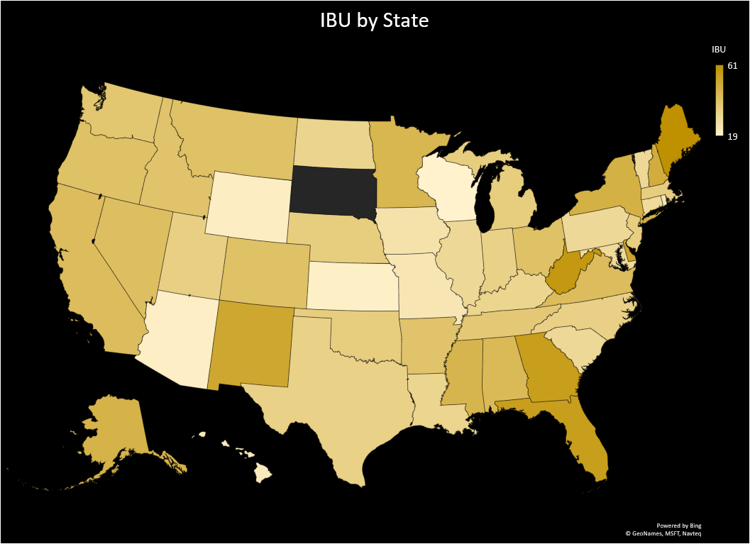
IBU
Median
Top 5
Maine 61
West Virginia 57.5
Florida 55
Georgia 55
Delaware 52
Bottom 5
Hawaii 22.5
Wyoming 21
Arizona 20.5
Kansas 20
Wisconsin 19

Slide 12
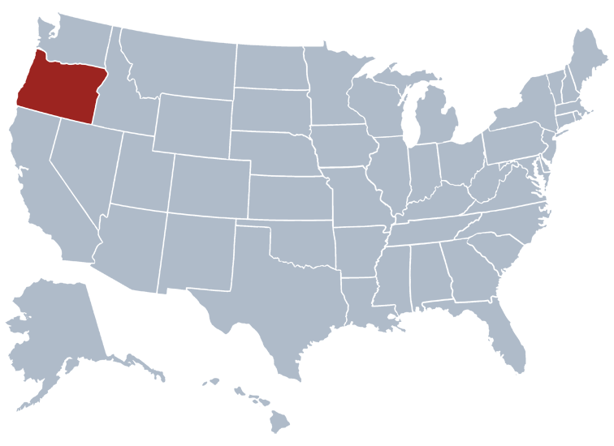
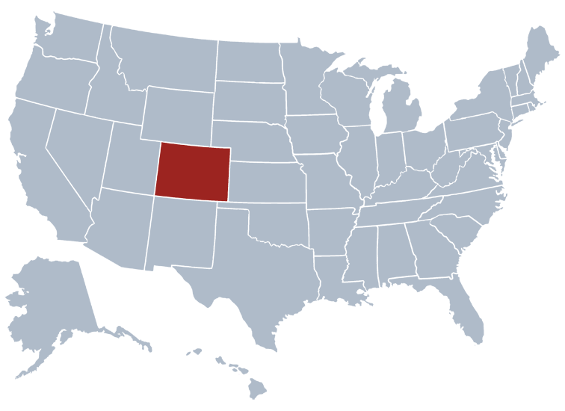
Most Bitter and Alcoholic beers
Oregon has been identified with the most bitter beers with IBU unit of 138 but the most Alcoholic beers have been crafted in CO with ABV units of 0.128
IBU = 138 (OR)
ABV = 12.8% (CO)

Slide 13
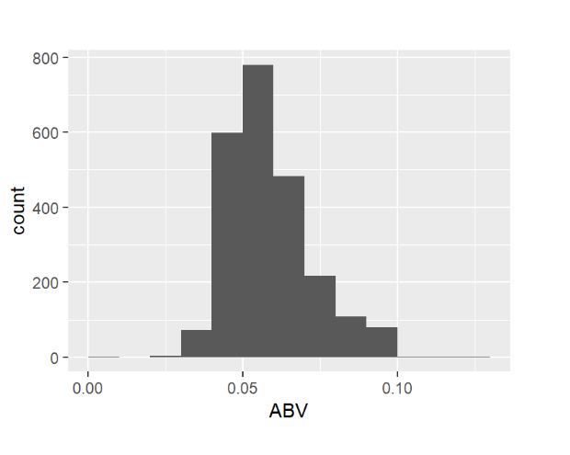
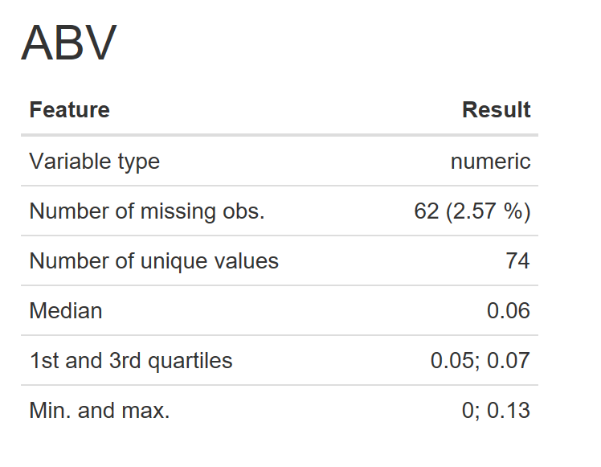
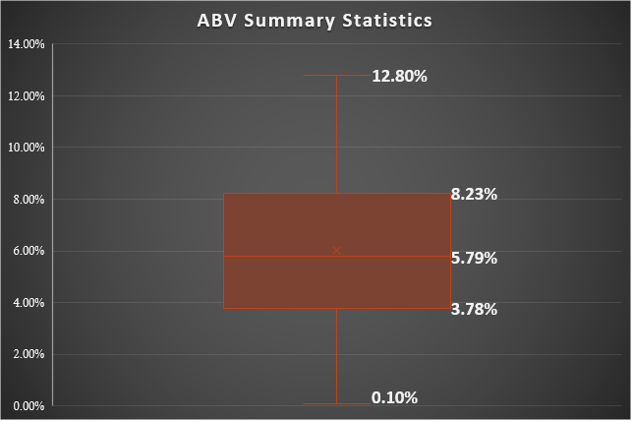
Summary of Alcohol by Volume of the beer (ABV)
ABV range is from .10% to 12.80%
50% of beers fall within the range of 3.78%-8.23%
Average is 5.98%

Slide 14
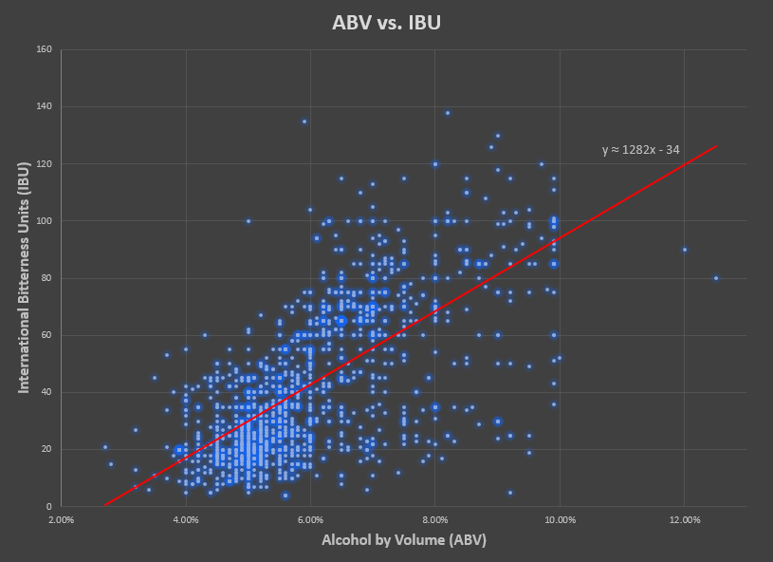

Bitterness vs. Alcohol Content
We could see that there is some linear relationship with between the IBU (bitterness value) and the ABV (Alcohol by volume) based on the scatter plot. An approximation was created with the a trendline:
$$IBU ≈1282\left(ABV\right)−34$$
Exact inference can be drawn only after a causal study on the beers’ values.

Slide 15
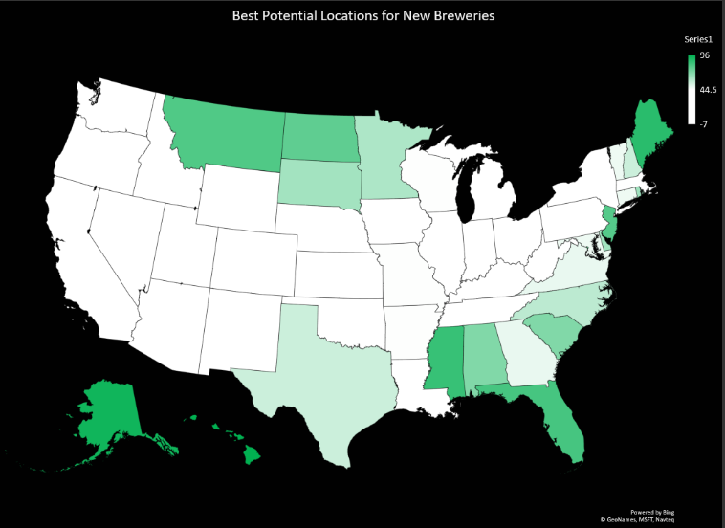
Conclusion
Based on the current data, it may be advantageous to open a new brewery in one of the locations shown on the map. A darker color represents a state with a lower number of current breweries as well as less nearby competition.
The target product should be in the higher ABV range of 7-10% due to current market saturation.
Best Potential Locations for New Breweries
Score = 100 – (current state qty of breweries + adjacent state qty of breweries)

Slide 16
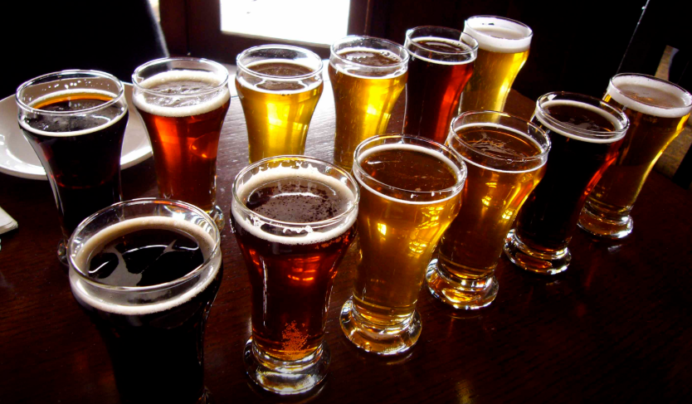
Cheers!

