Slide 1

MSDS 6306 Doing Data Science
Case Study Fall Midterm
(Satish, Tyler, Thotho)

Slide 2
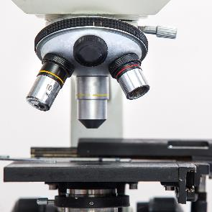

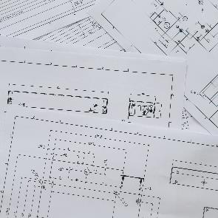



Executive Summary
Beer Study
The purpose of this document is to provide a detailed view about the beers crafted in United States of America.
1
2
Beers
Identified 2305 unique Beer names out of 2410 beers records
2.57% missing information about Alcohol by volume of the beer (ABV).
41.7% missing information on International Bitterness Units of the beer (IBU)
Breweries
Identified 551 unique Brewery names out of 558 Brewery records
All there breweries were distributed to 384 cities
3
4
5
6

Slide 3
Agenda
Breweries are present in each state
Provide top and bottom 6 records
Missing Information from the records
Median ABV for each state.
Most Bitter and Alcoholic beers
Overview statistics of ABV
Bitterness Vs Alcohol
1
2
3
4
5
6

Slide 4
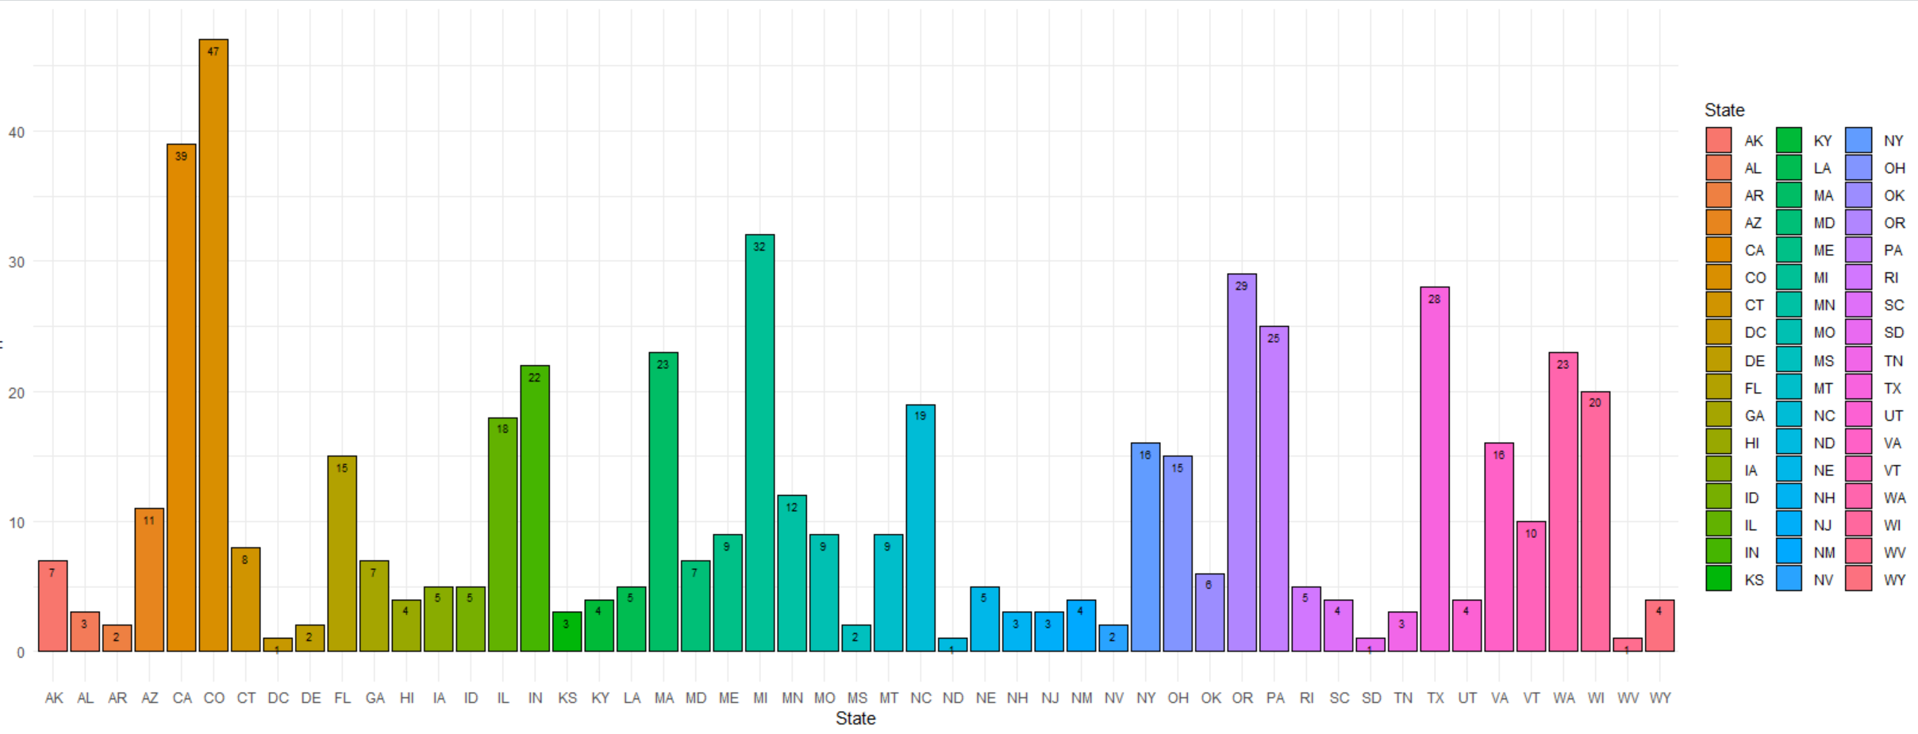
Breweries by State
Breweries across 51 state are provided in the below visuals, where the state of Colorado has the highest number of breweries (47)

Slide 5
Top and Bottom 6 records
Beers and Breweries data have be de-normalized into one set for further investigation into the data
Head | Beers | Beer_ID | ABV | IBU | Brewery_id | Style | Ounces | Breweries | City | State
1 | Pub Beer | 1436 | 0.05 | NA | 409 | American Pale Lager | 12 | 10 Barrel Brewing Company | Bend | OR
2 | Devil's Cup | 2265 | 0.066 | NA | 178 | American Pale Ale (APA) | 12 | 18th Street Brewery | Gary | IN
3 | Rise of the Phoenix | 2264 | 0.071 | NA | 178 | American IPA | 12 | 18th Street Brewery | Gary | IN
4 | Sinister | 2263 | 0.09 | NA | 178 | American Double / Imperial IPA | 12 | 18th Street Brewery | Gary | IN
5 | Sex and Candy | 2262 | 0.075 | NA | 178 | American IPA | 12 | 18th Street Brewery | Gary | IN
6 | Black Exodus | 2261 | 0.077 | NA | 178 | Oatmeal Stout | 12 | 18th Street Brewery | Gary | IN
Tail | Beers | Beer_ID | ABV | IBU | Brewery_id | Style | Ounces | Breweries | City | State
2405 | Rocky Mountain Oyster Stout | 1035 | 0.075 | NA | 425 | American Stout | 12 | Wynkoop Brewing Company | Denver | CO
2406 | Belgorado | 928 | 0.067 | 45 | 425 | Belgian IPA | 12 | Wynkoop Brewing Company | Denver | CO
2407 | Rail Yard Ale | 807 | 0.052 | NA | 425 | American Amber / Red Ale | 12 | Wynkoop Brewing Company | Denver | CO
2408 | B3K Black Lager | 620 | 0.055 | NA | 425 | Schwarzbier | 12 | Wynkoop Brewing Company | Denver | CO
2409 | Silverback Pale Ale | 145 | 0.055 | 40 | 425 | American Pale Ale (APA) | 12 | Wynkoop Brewing Company | Denver | CO
2410 | Rail Yard Ale (2009) | 84 | 0.052 | NA | 425 | American Amber / Red Ale | 12 | Wynkoop Brewing Company | Denver | CO

Slide 6
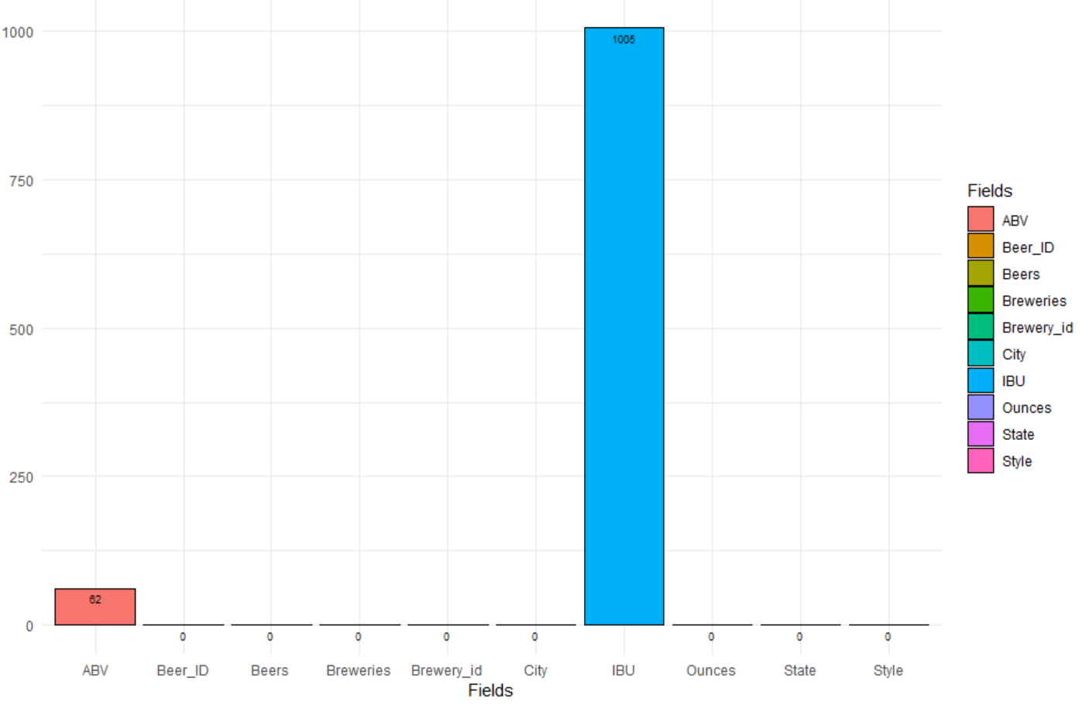
Missing Information from the records
Missing information on the de-normalized data
Data Fields | Missing Information
Beers | 0
Beer_ID | 0
ABV | 62
IBU | 1005
Brewery_id | 0
Style | 0
Ounces | 0
Breweries | 0
City | 0
State | 0
2.57% missing information about Alcohol by volume of the beer (ABV).
41.7% missing information on International Bitterness Units of the beer (IBU)

Slide 7
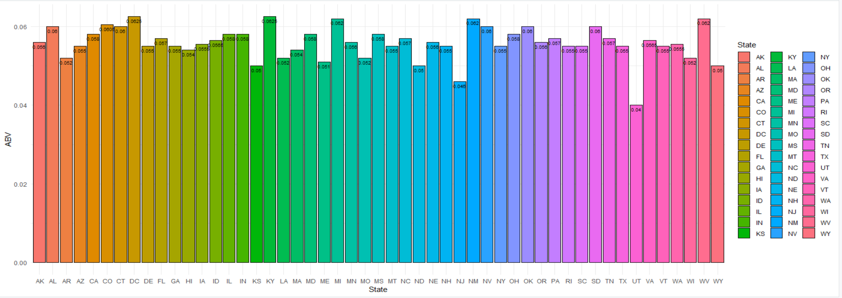
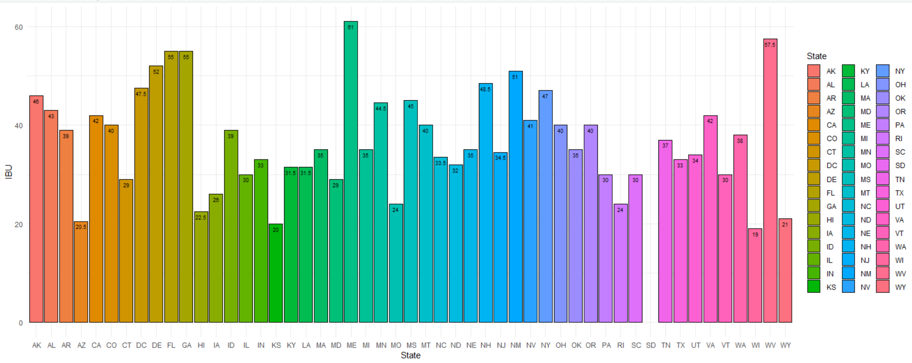
Median ABV for each state.

Slide 8
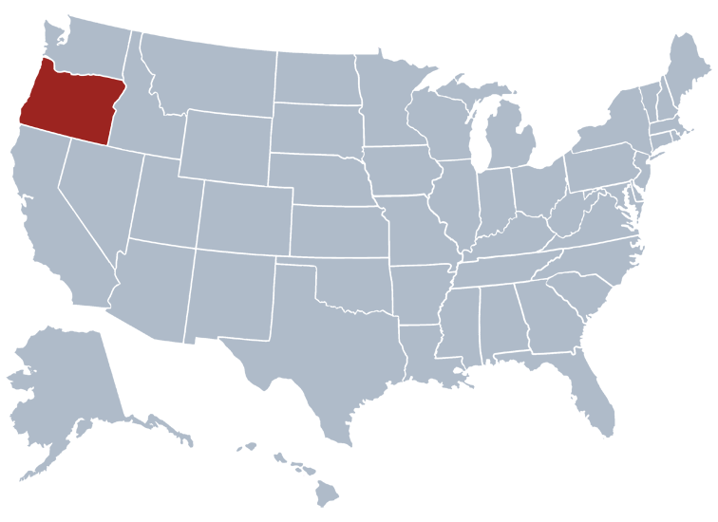
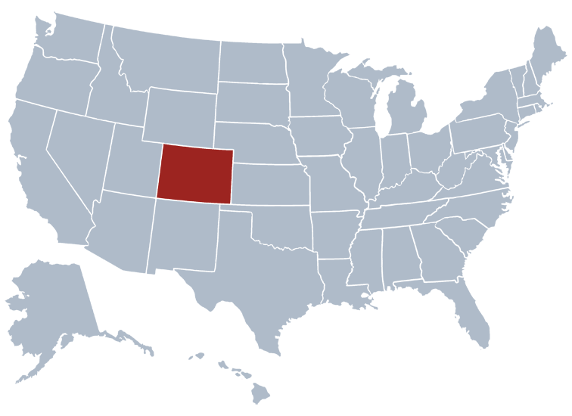
Most Bitter and Alcoholic beers
Oregon has been identified with the most bitter beers with IBU unit of 138 but the most Alcoholic beers have been crafted in CO with ABV units of 0.128
IBU = 138 (OR)
ABV = 0.128 (CO)

Slide 9
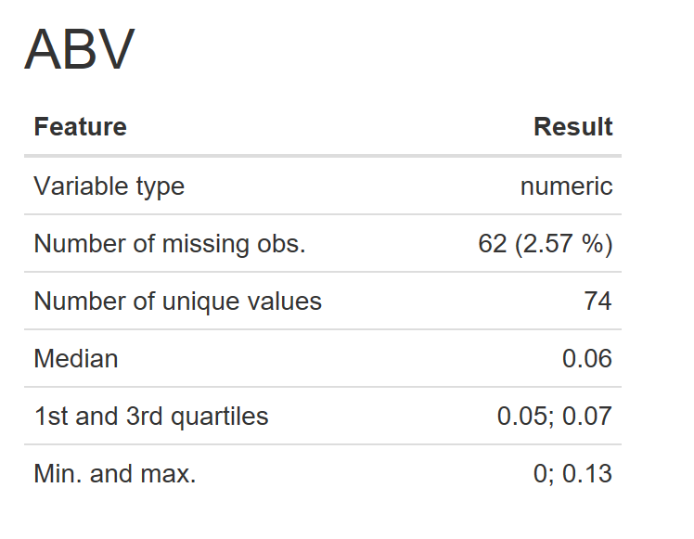
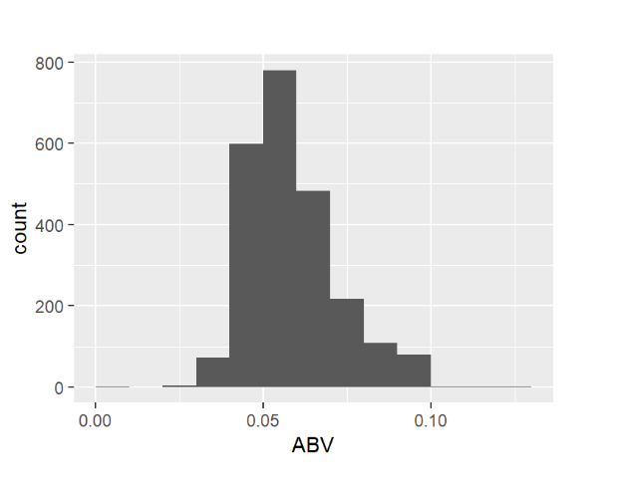
Summary of Alcohol by volume of the beer (ABV)

Slide 10
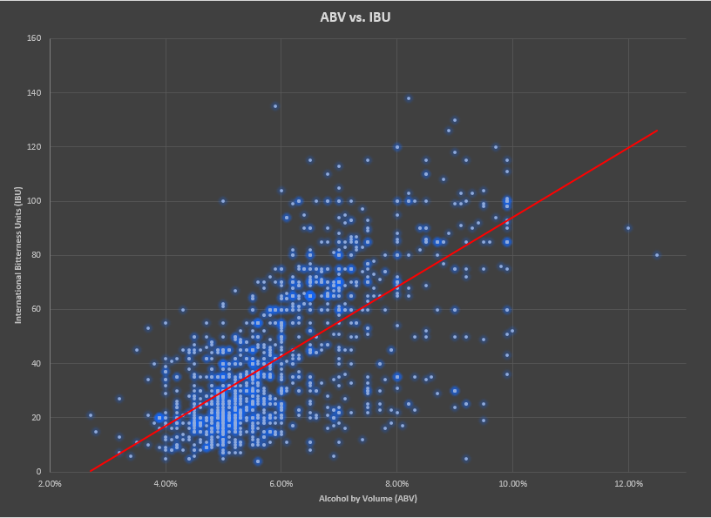
Bitterness Vs Alcohol
WE could see that there is some linear relationship with between the IBU (bitterness value) and the ABV (Alcohol volume) based on the scatter plot.
Exact inference can be drawn only after a causal study on the beers.

Slide 11
Conclusion
Data A
Data B
Data C

Slide 12

Thank You

