Slide 2
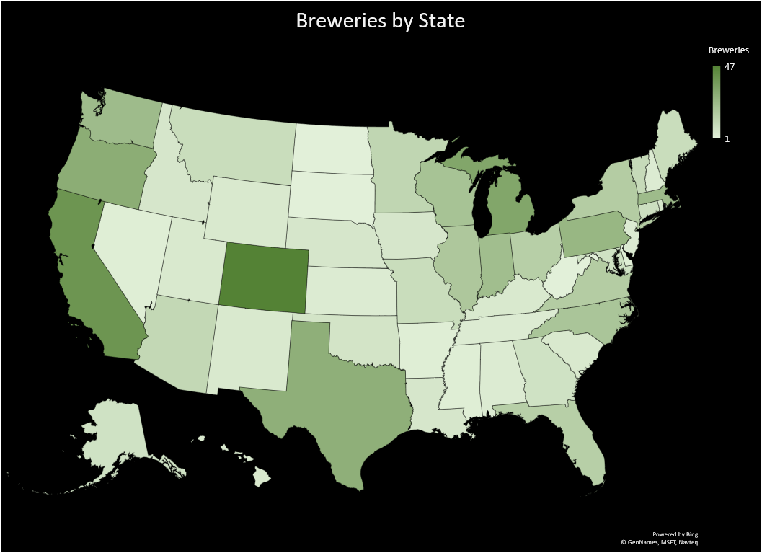
Breweries
Top 5
Colorado 47
California 39
Michigan 32
Oregon 29
Texas 28
Bottom 5
Nevada 2
District of Columbia 1
North Dakota 1
South Dakota 1
West Virginia 1

Slide 3
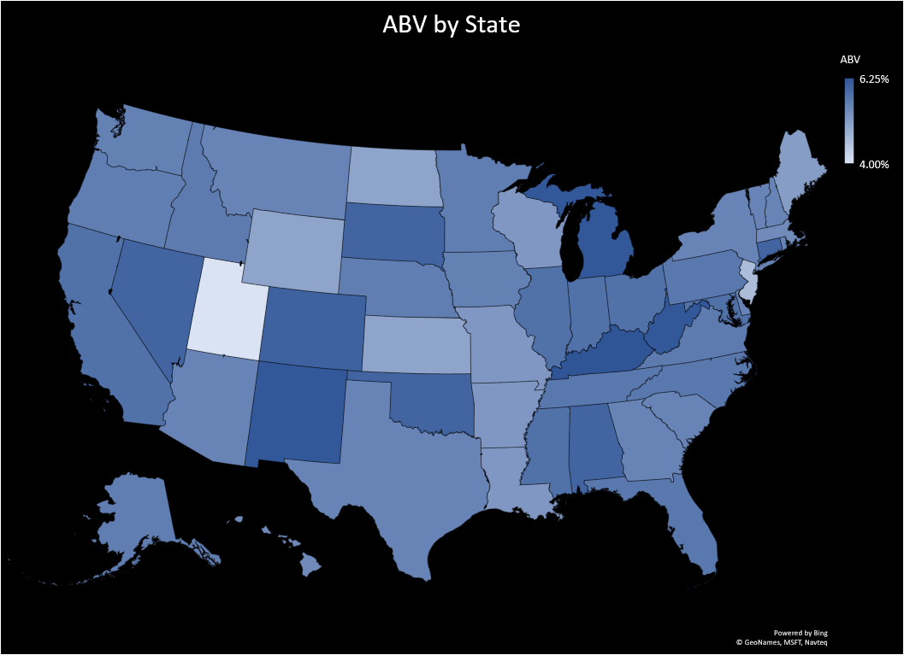
ABV
Top 5
Kentucky 6.25%
District of Columbia 6.25%
West Virginia 6.20%
New Mexico 6.20%
Michigan 6.20%
Bottom 5
Wyoming 5.00%
North Dakota 5.00%
Kansas 5.00%
New Jersey 4.60%
Utah 4.00%

Slide 4
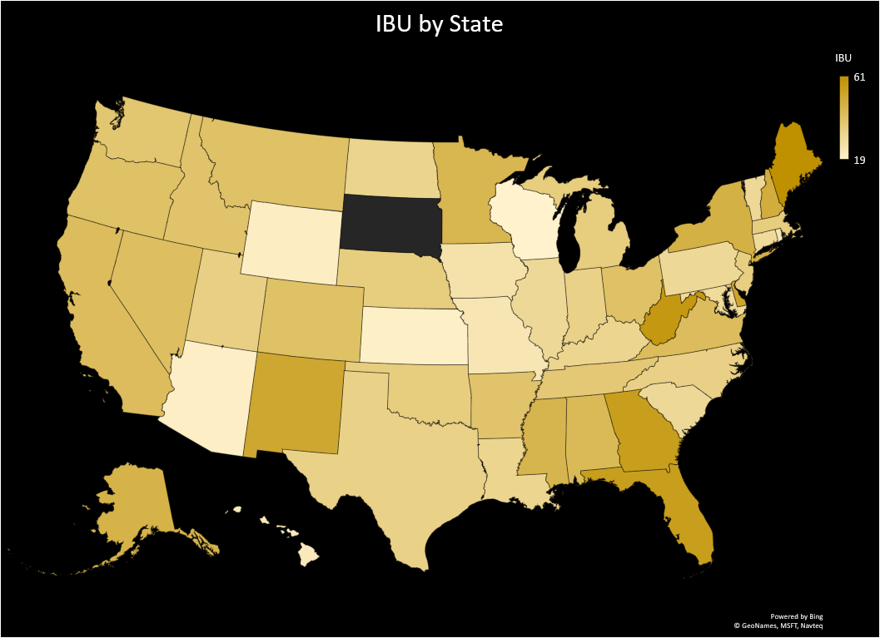
IBU
Top 5
Maine 61
West Virginia 57.5
Florida 55
Georgia 55
Delaware 52
Bottom 5
Hawaii 22.5
Wyoming 21
Arizona 20.5
Kansas 20
Wisconsin 19

Slide 5
