Slide 1
Talent management Analytics
Client: DDS Analytics
Authors: Satish Mylapore, Tyler Lynch, Liang Huang, james clay

Slide 2
Agenda
Executive Summary
Workflow & Methodology
DDS Analytics - Data Insight
Summary & Recommendations

Slide 3
Executive Summary
Objective
DDS Analytics is an analytics company that specializes in talent management solutions for Fortune 1000 companies. The purpose of this document is to recommend next best actions by providing insight into employee turnover and trends.
Monthly Salary Summary
Attrition Summary
High Impact Features on Attrition
JobRole | Average Income | Percent Employees
Highest Paid Employees
Manager | 17182 | 7%
Research Director | 16034 | 5%
High percent of Employees
Sales Executive | 6924 | 22%
Research Scientist | 3240 | 20%
JobRole | Attrition | Percent Employees
Yes
Sales Representative | 33 | 39.8%
Laboratory Technician | 62 | 23.9%
Human Resources | 12 | 23.1%
Sales Executive | 57 | 17.5%
Research Scientist | 47 | 16.1%
Over Time
Marital Status(Single)
Distance From Home
Business Travel (Travel Frequently)
Life Satisfaction
Summary
It is evident from the information that main factor for the attrition are Life Satisfaction, Salary and Working Overtime, This highly impacts the employee roles Sales Executive, Research Scientist who has the highest ration of employees in DDS Analytics.
Recommendations
Improve work-life balance of the employees who travels very frequently
Improve Salary packages for the Sales representative and Research Scientist
Introduce programs/plans to address the needs of employees with challenging situations (eg., Single Mom, Distance from Home)

Slide 4





Methodology
Data Inception
Data Cleaning & Preparation
Feature Engineering
Value Extraction
Recommendation
Staging Area
Model Development Environment
Enterprise Integration / Secured Connection / Facade
Model Output:
Attrition Turnover
Features Impacting Attrition
Role Specific Trends
Age Income Relationship
Life Satisfaction
Summary
Data Cleaning
Outlier Detection
Missing Value
Checks and Balances
Format Conversion
Model output staged for application consumption.
Data Enrichment
Data passed as flat file.
Random Forest
Logistic Regression
Kmeans
Exploratory Analysis
Application
Enable DDS Analytics to make matured decision on Talen Management Solutions
Data Parsing
Data quality
Exception Handling
Data sets prepared for consumption in R.
Enterprise Data (SAP, Teradata, etc.)
Feature Creation
Variable Selection
Variable Creation
Access Point
DDS Analytics
Ground Truth Data
Training Data
Test Data
Out of sample data
Technology Stack (R, Plyr, Dplyr, ggplot, gridExtra)
Environment:
2x Processors ;
RAM – 16 GB; HDD – 1TB
Output
End Users

Slide 5
DDS Analytics – Data Insight
Top 7 Features highly influencing attrition
Impacting Features | Impact Percentage on Attrition
Overtime (Yes) | 1.56%
Marital Status (Single) | 1.29%
Job Satisfaction | 0.34%
Job Involvement | 0.57%
Environment Satisfaction | 0.35%
Distance From Home | 0.30%
Business Travel (Travel Frequently) | 1.59%
DDS Analytics has 16.12% of Attrition. Addressing the above top 7 features will help the client to immediately address 6% of total attrition rate.

Slide 6
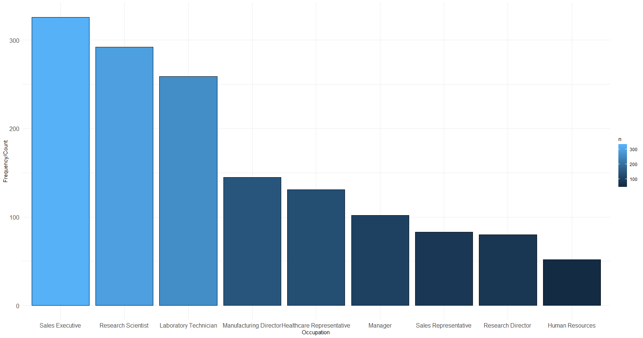
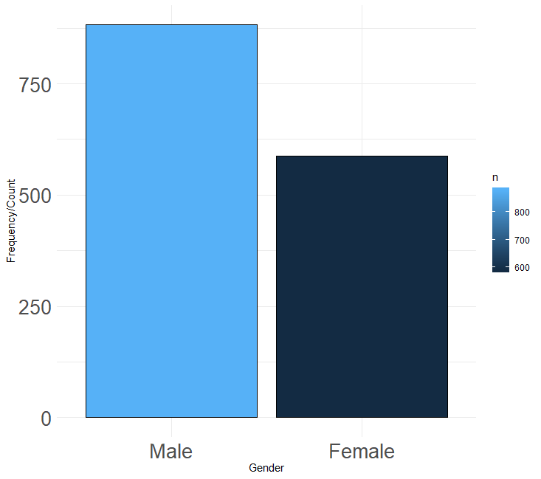
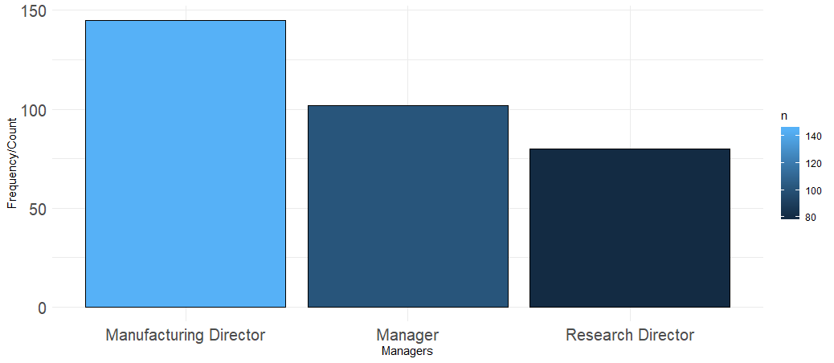
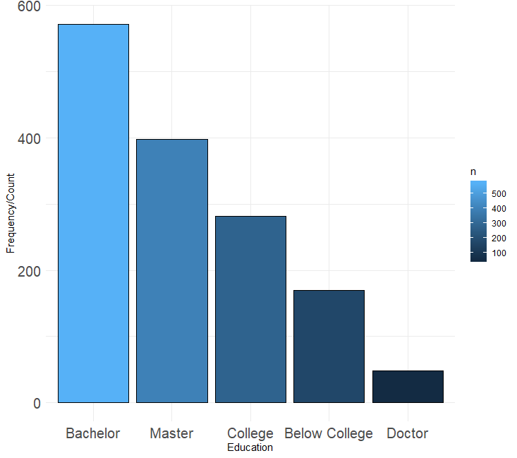
DDS Analytics – Data Insight
Team size w.r.t. Gender, Occupation, Education and Management Positions
Occupation
Gender
Management Position
Education

Slide 7
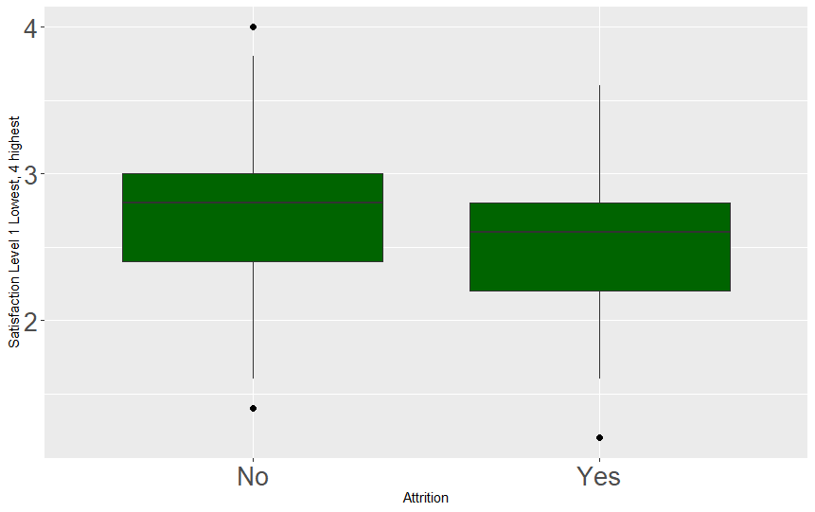
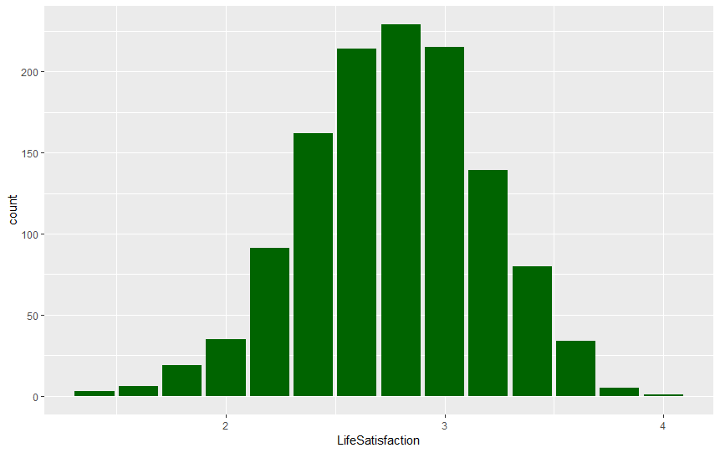
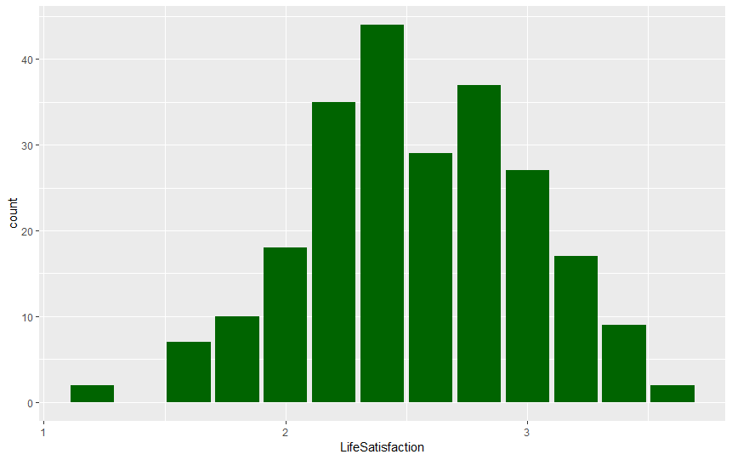
DDS Analytics – Data Insight
𝐿𝑖𝑓𝑒 𝑆𝑎𝑡𝑖𝑠𝑓𝑎𝑐𝑡𝑖𝑜𝑛 𝑖𝑠 𝑎𝑣𝑒𝑟𝑎𝑔𝑒 𝑜𝑓 𝐸𝑛𝑣𝑖𝑟𝑜𝑛𝑒𝑚𝑛𝑡 𝑆𝑎𝑡𝑖𝑠𝑓𝑎𝑐𝑡𝑖𝑜𝑛,𝐽𝑜𝑏 𝑆𝑎𝑡𝑖𝑠𝑓𝑎𝑐𝑡𝑖𝑜𝑛, Relationship 𝑆𝑎𝑡𝑖𝑠faction, Work life 𝐵𝑎𝑙𝑎𝑛𝑐𝑒,𝐽𝑜𝑏 𝐼𝑛𝑣𝑜𝑙𝑣𝑒𝑚𝑡)

Slide 8
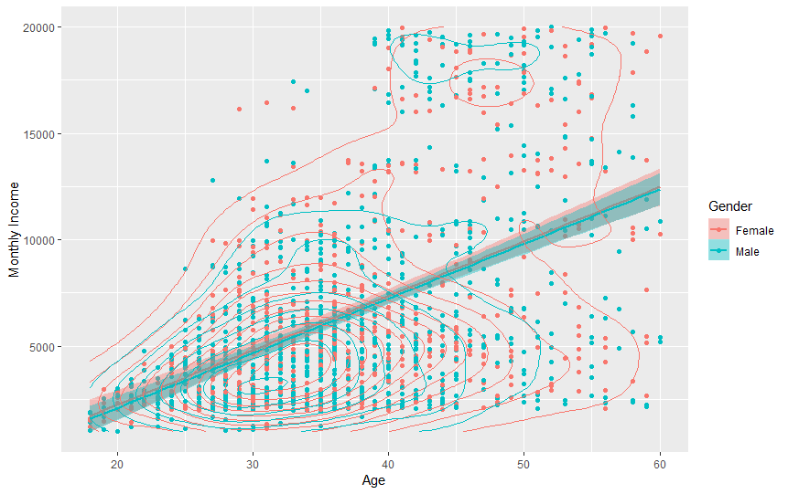
DDS Analytics – Data Insight
Relationship between Age and Monthly Income
DDS Analytics has 40% of Female Employees and 60% Male employees
Mean salary of both Male ($ 6381)and Female($ 6687) similar
There are visually 2 salary groups between age 25-40 with average of $5K and between 45-50 with average of $14K

Slide 9
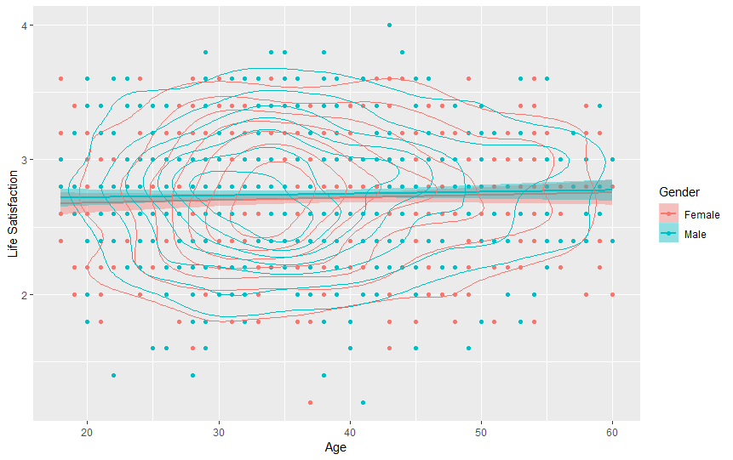
DDS Analytics – Data Insight
Relationship between Age and Life Satisfaction
Overall life satisfaction of the employees are between good to better satisfaction

Slide 10
Summary
Key impact factors on attrition:
Overtime
Life Satisfaction
Business Travel Frequently
Distance From Home
Key Job Roles on Attrition:
Sales Representative
Laboratory Technician
Human Resources
Sales Executive
Research Scientist

Slide 11
Recommendations
Reduce overtime by increasing workforces in key job roles
Increase life satisfaction in 5 ways:
𝐸𝑛𝑣𝑖𝑟𝑜𝑛𝑒𝑚𝑛𝑡 𝑆𝑎𝑡𝑖𝑠𝑓𝑎𝑐𝑡𝑖𝑜𝑛
𝐽𝑜𝑏 𝑆𝑎𝑡𝑖𝑠𝑓𝑎𝑐𝑡𝑖𝑜𝑛
Relationship 𝑆𝑎𝑡𝑖𝑠faction
Work life 𝐵𝑎𝑙𝑎𝑛𝑐𝑒
𝐽𝑜𝑏 Involvement
Reduce Business travel frequency by increasing workforce or utilizing telecommunication equipment and tools
Providing company transportation service such as shuttle bus and WFH allowances

Slide 12
Thank you!

