Slide 1

Math Reasoning
A collaborative project on improving LLM reasoning with MCTS and process-level scoring
Ruochen Wu (rw3152) · Hammer Niu (hn2477) · Shengbo Yi (sy3302)
Project focus
Move beyond direct generation to deliberate multi-step reasoning.
Search over reasoning paths and score them before returning an answer.
1

Slide 2

1. Motivation & Project Objective
Why a search-based reasoning framework?
Why standard LLM reasoning is limited
Direct next-token generation often commits too early to one line of thought.
For multi-step math problems, small intermediate errors can quickly compound.
A fluent final answer may still come from a weak or inconsistent reasoning path.
Project objective
Build a concrete math reasoning system that explores multiple candidate trajectories, evaluates them, and returns the strongest final solution.
Use math as the primary testbed, with longer-term potential to generalize to code generation and strategic planning.
Key idea: combine Monte Carlo Tree Search (MCTS) with a Process-level Preference Model (PPM).
2

Slide 3
2. Solution Overview
From problem input to final answer
1
2
3
4
5
Problem
MCTS Search
PPM Scoring
Best Trajectory
Final Answer
Input a math problem
Explore multiple next-step candidates
Score each step / trajectory
Choose the strongest reasoning chain
Return a more reliable solution
MCTS in this project
Select: choose the most promising node.
Expand: generate candidate next reasoning steps.
Simulate: evaluate the resulting path.
Backpropagate: update the tree with the path score.
PPM in this project
The PPM is trained on self-generated trajectories.
Trajectory pairs train PPM; verifier works without a checkpoint.
It scores process quality rather than only the final answer.
Implementation note
Models: OpenAI, DeepSeek, Anthropic, Ollama.
The method is exposed through a lightweight interactive demo.
Search and scoring are integrated into one reasoning pipeline.
3

Slide 4
3. System Architecture
1. Problem Input
2. Candidate Step Generator
3. MCTS Controller
4. Process-level Scorer (PPM)
5. Trajectory Selector
6. Final Answer
Math question enters the system.
LLM proposes next-step reasoning candidates.
Organizes tree search over candidate steps.
Scores each partial path or full trajectory.
Keeps the highest- quality reasoning chain.
Outputs the selected solution.
Inside the MCTS Controller
Scoring signal
Preference data
Select
Expand
PPM sends quality scores back to guide which branches should continue expanding.
Correct vs. incorrect trajectories are used as preference pairs to train the PPM.
Pick the most
promising node.
Generate candidate
next steps.
Simulate
Backpropagate
Why this architecture is more concrete
Generation, search, scoring, and final answer selection are separated into distinct modules.
The feedback loop from the PPM to MCTS makes the reasoning process explicit and inspectable.
Evaluate the
resulting path.
Update node values
in the tree.
4

Slide 5
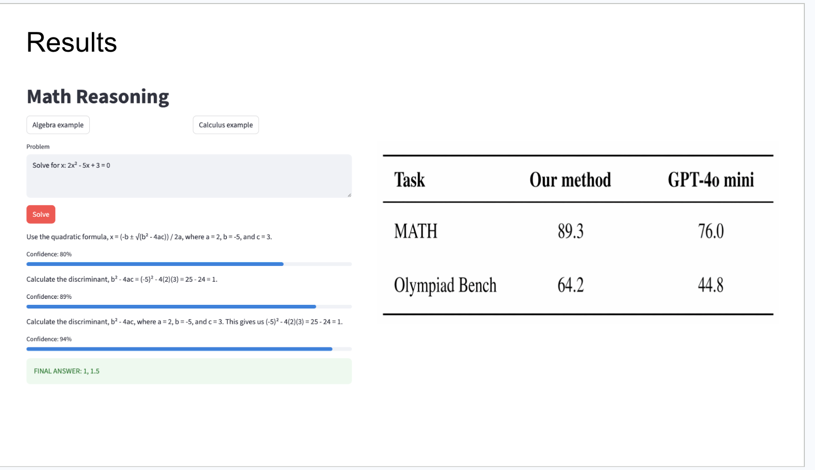
4. Experimental Setup & Main Results
Demo output
Evaluation setup
Benchmarks: deterministic ablations; MATH/Olympiad scripts ready.
Baseline: simple MCTS / direct strategy depending on script.
Our method: adaptive MCTS + verifier or hybrid process scorer.
Goal: test whether search and process scoring improve path choice and efficiency.
Task
Our method
Baseline
Search
3/3
0/3
Key findings
Adaptive search and hybrid scoring outperform their controlled baselines in no-key ablations.
The full MATH/OlympiadBench scripts are included for API-backed benchmark validation.
Scoring ablation
3/3
0/3
5

Slide 6
5. Project Contributions
1
Baseline reproduction
We reproduce a working MCTS + PPM framework for math reasoning and verify that the pipeline solves multi-step problems more deliberately than direct prompting.
2
System integration
We package the method as one end-to-end project: problem input, search, preference-based path evaluation, final answer generation, and a demo interface.
3
Empirical validation path
We provide deterministic ablations, a side-by-side demo, and scripts for API-backed MATH/OlympiadBench evaluation.
Takeaway: this deck presents one unified collaborative project with a single goal — build and validate a more deliberate math reasoning system.
6

Slide 7
6. Limitations & Next Steps
Full benchmark run
Checkpoint publication
1
2
Run the included MATH/OlympiadBench scripts with final API keys and save result JSON files.
Train a PPM checkpoint from collected trajectories and include or document its regeneration path.
Demo recording
Broader evaluation
3
4
Record a narrated video from the Streamlit comparison UI for final CourseWorks submission.
Add more benchmarks and deeper failure analysis to understand when search helps most.
7

Slide 8
7. Conclusion
Main takeaways
We build a complete math reasoning prototype around MCTS and a Process-level Preference Model.
The system explores multiple candidate reasoning paths instead of relying on one direct generation.
Controlled ablations show the implemented search and scoring changes improve path choice.
The project establishes a foundation for more efficient search, stronger supervision, and broader reasoning applications.
8

