Slide 1
Identifying tumor pseudo-longitudinal resistance signatures
Ben Rothschild, Shoshana Stadlan, and Vivian Zweig

Slide 2
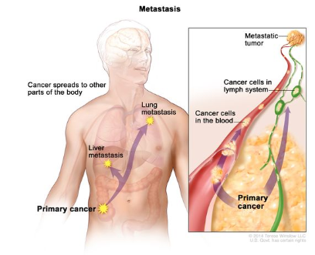
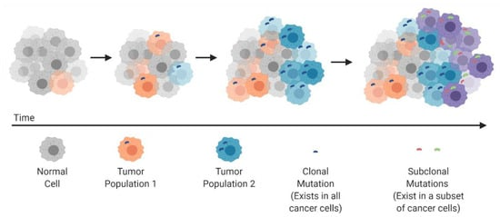
Tumor recurrence and metastasis is a leading cause of cancer-related death
Cancer subclonal populations drive progression, metastasis, and recurrence
Tumor Heterogeneity: A Great Barrier in the Age of Cancer Immunotherapy
National Cancer Institute
Notes:
Vivian

Slide 3
What tumor subpopulations survive treatment, and where the cancer will spread?
Memorial Sloan Kettering Cancer (MSK) IMPACT, MET, and CHORD
1
Data exploration reshaped our question
2
Can we predict if a sample was collected pre- or post- treatment? Using SHAP, what features will our model use to make a prediction?
3
Notes:
Speaker note: Today, we will present an exploration of our dataset and explain how it reshaped our question. Frame the discussion of IMPACT, MET, and CHORD as what features we have available. In each slide, explain what types of missing or incomplete data exist.
Vivian

Slide 4
MSK-IMPACT 50K is a pan-cancer clinical sequencing cohort
54,331 tumors and their matched normal samples; profiled using MSK-IMPACT
A sample is a biopsy sequenced once with the MSK-IMPACT panel, paired with a matched normal from the same patient
Sample |  |  | Somatic mutation + CCF |  |  | Copy number (gene / allele-specific) |  | SV | Genome-wide |  |  | HLA class I
SAMPLE_ID | PATIENT_ID | panel | TP53_HGVSp | TP53_ccf | TP53_clonal | ERBB2_cna | ERBB2_tcn;lcn | Fusion | WGD | FGA | SBS13_APOBEC | HLA_A_germline | HLA_LOH_somatic
P-0001234-T01-IM6 | P-0001234 | IMPACT468 | p.R175H | 0.96 | CLONAL | 2 | 18;2 | NaN | True | 0.41 | 0.22 | A*02:01/A*24:02 | False
P-0001234-T02-IM7 | P-0001234 | IMPACT505 | p.R175H | 0.88 | CLONAL | 0 | 2;1 | NaN | True | 0.37 | 0.31 | A*02:01/A*24:02 | True
P-0005678-T01-IM3 | P-0005678 | IMPACT341 | NaN | NaN | NaN | 0 | 2;1 | EML4-ALK | False | 0.08 | 0.02 | A*01:01/A*03:01 | False

Slide 5
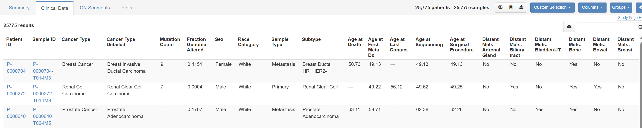
MSK-MET is a pan-cancer cohort of tumor genomic and clinical outcome data
25,000 patients
IMPACT genomic sequencing data
Clinical data:
Timeline info
Metastasis info

Slide 6
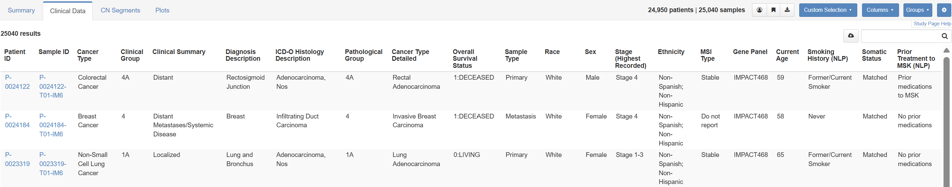
MSK-CHORD is a pan-cancer clinical sequencing and therapeutic cohort
25,040 sequenced tumors from 24,950 patients and their matched normals (MSK-IMPACT)
Clinical annotations:
Some possible covariates
Treatments types: chemo, hormone, targeted, immune, biologic, bone, investigative, and radiation
Notes:
Vivian

Slide 7
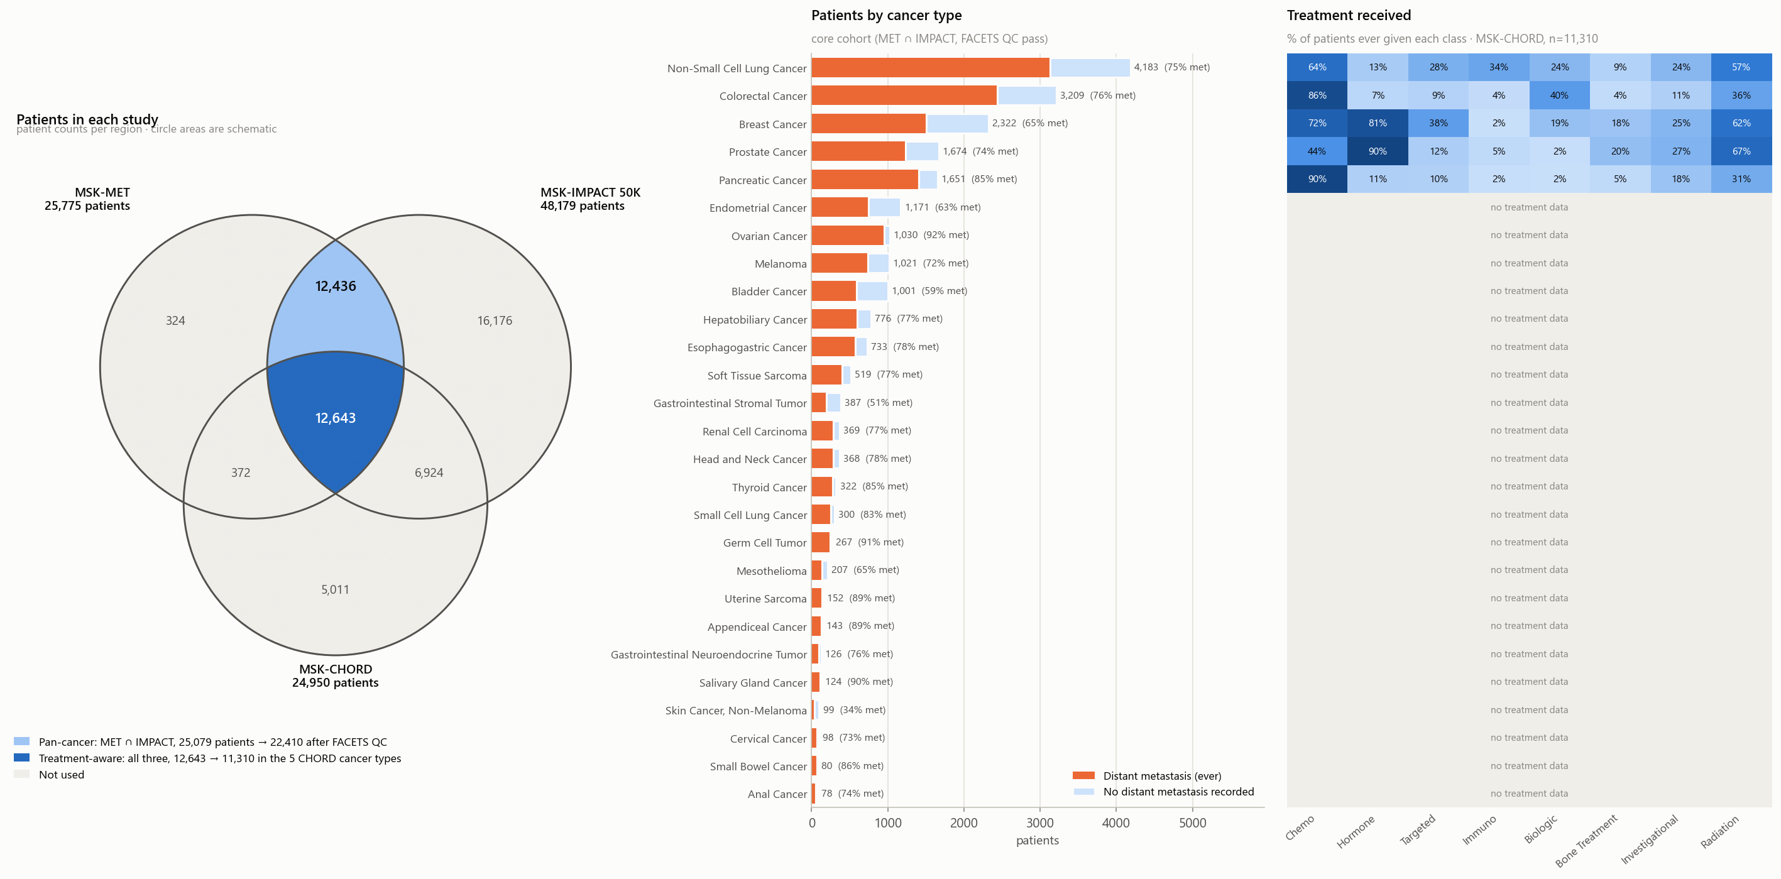
12,643 patients with 27 cancer types and eight treatment types
Notes:
Together, these datasets are comprehensive

Slide 8
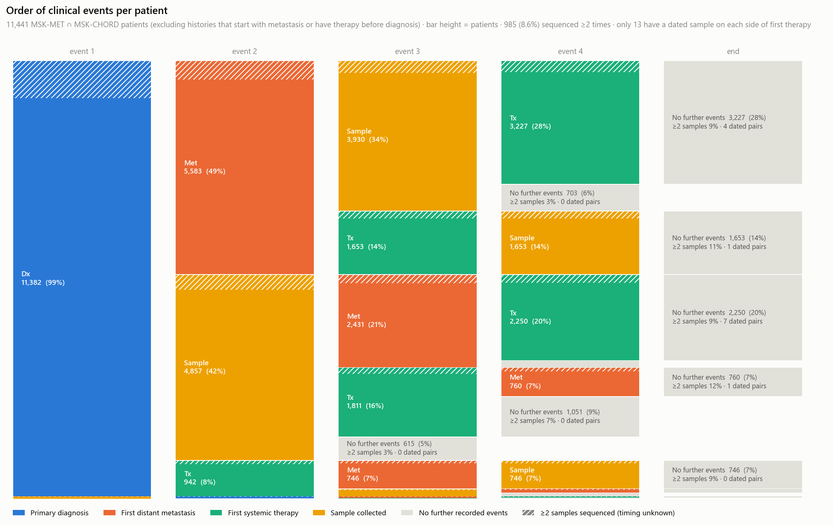
The order of clinical events varies per patient
Q1: What tumor subpopulations survive treatment, and where the cancer will spread?
76% of patients had a sample taken pre-treatment
Therefore, we cannot predict what subpopulations survive treatment and where they spread.
Q2: Can we predict if a sample was collected pre- or post- treatment? Using SHAP, what features will our model use to make a prediction?

Slide 9
Next steps…
Can we predict if a sample was collected pre- or post- treatment? Using SHAP, what features will our model use to make a prediction?

Slide 10
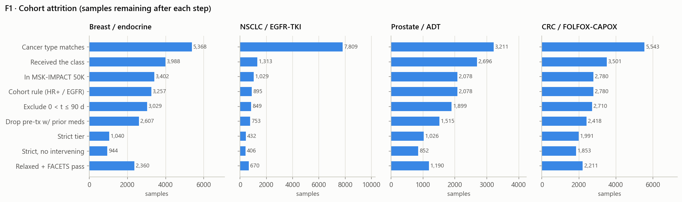
Data cleaning turns 25,040 samples into four labelled cohorts
Pre (label 0): collected on or before the first dose
Post (label 1): collected > 90 days after it; days 0–90 excluded
Strict tier: first-line drug class, no prior therapy outside MSK, FACETS QC pass, one sample per patient
4,308 samples
in the main analysis
3,306 pre · 1,002 post
Notes:
Our new question is whether we can tell if a sample was collected before or after treatment. To answer it, we first needed a clean, labelled dataset. We started from all 25,040 MSK-CHORD samples with a collection date and built four cohorts, each pairing a cancer with its standard drug class: breast cancer with endocrine therapy, EGFR-mutant lung cancer with EGFR inhibitors, prostate cancer with androgen deprivation, and colorectal cancer with FOLFOX or CAPOX chemotherapy.
A sample is pre-treatment if it was collected on or before the first dose, and post-treatment if it was collected more than 90 days after. We drop the first 90 days, because the drug has barely had time to act.
Each bar shows how many samples remain after a step. For lung cancer the biggest drop comes first, because only EGFR-mutant patients get EGFR inhibitors. Our strict tier then requires the drug to be the first line of therapy, no treatment outside MSK beforehand, and a sample that passes copy-number quality control. With one sample per patient and hypermutated tumours set aside, that leaves 4,308 samples: 3,306 before treatment and 1,002 after.

Slide 11
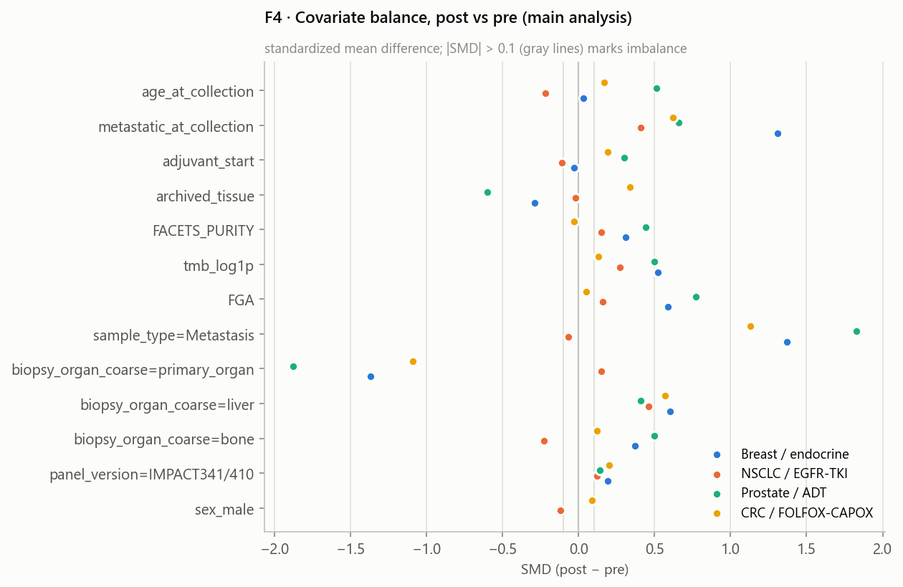
Preprocessing makes samples comparable and keeps the test set unseen
1
Keep oncogenic alterations
Hotspot and truncating mutations, amplifications, deep deletions, driver fusions and LOH: 2,095 candidate features
2
Mask by gene panel
A gene missing from a sample's panel is unknown, not unaltered; the main model uses only genes every panel covers
3
Add confounders as covariates
Biopsy site, metastatic status, purity, TMB, FGA, panel version, age and sex, so they aren't mistaken for treatment
4
Split by patient, fit inside folds
5 folds × 20 repeats grouped by patient; imputation and scaling learned on training folds only
Post-treatment samples are mostly metastases biopsied outside the primary organ (prostate: 82% → 13% from the prostate itself)
Notes:
Next, we turned each sample into a row of features. First, we kept only alterations likely to drive cancer: hotspot and truncating mutations, amplifications, deep deletions, driver fusions and loss of heterozygosity.
Second, MSK used four gene-panel versions over the years, and the older, smaller panels are more common in post-treatment samples. So a gene that isn't on a sample's panel counts as unknown, not unaltered, and the main model uses only genes every panel covers.
Third, this plot shows why we need covariates. Each dot compares post- with pre-treatment samples; anything past the grey lines is imbalanced. In three of the four cohorts, post-treatment samples are far more often metastases, biopsied from places like the liver or bone. In prostate cancer, 82 percent of pre-treatment samples come from the prostate itself, versus 13 percent after treatment. A model could learn biopsy site instead of biology, so site, metastatic status, purity and mutation burden all go in as covariates.
Finally, we split folds by patient and fit every step on the training folds only, so nothing leaks from the test set.

Slide 12
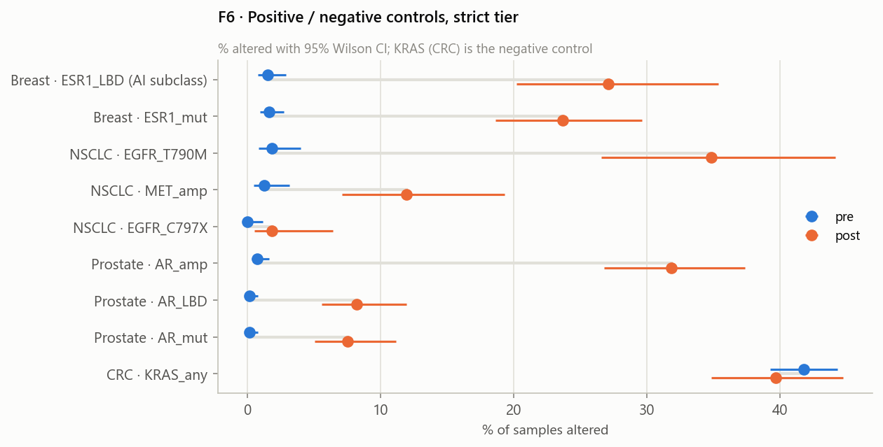
Known resistance alterations rise after treatment, so the labels hold up
1.6% → 23.7%
ESR1 mutation · breast / endocrine
1.9% → 34.9%
EGFR T790M · lung / EGFR-TKI
0.7% → 31.8%
AR amplification · prostate / ADT
41.8% → 39.7%
KRAS · colorectal (negative control: no change)
Same pattern in all four cohort tiers · counts reproduce the plan within 2.3% · FGA matches MSK-MET (r = 0.995)
Notes:
Before modelling, we checked that the labels capture real treatment effects. We already know what resistance to each drug looks like, so we can test for it. Blue is the share of samples with an alteration before treatment; orange is the share after.
ESR1 mutations, a known route of resistance to endocrine therapy, rise from under 2 percent to 24 percent in breast cancer. The EGFR T790M resistance mutation rises from 2 to 35 percent in lung cancer, and AR amplification from under 1 to 32 percent in prostate cancer. As a negative control, KRAS in colorectal cancer, which chemotherapy shouldn't select for, stays flat at about 40 percent.
The same pattern holds in all four of our cohort tiers, and the pipeline reproduces our planned cohort counts to within 2.3 percent. So the labels work, and the dataset is ready for the classifier, where SHAP will show which features it relies on.

