Slide 1
Welcome to the University of Sheffield Department of Electronic & Electrical Engineering Health & Safety Induction September 2016

Slide 2
Dianne Webster
Departmental Safety Officer
Room: F27 George Porter Building
Tel: 25859/07920781765
Email: d.webster@sheffield.ac.uk

Slide 3
Fire and Emergency Evacuation
Familiarise yourself with the evacuation procedure!!
Continuously sounding alarm
Nearest available exit(s)
Assembly points – Portobello, Diamond & PLB - St Georges Church green
North Campus – Carpark beyond the Gatehouse
Velocity – Bakers Lane
Pedestrian safety – do not stand in the road!
Evacuation drill - October
Fire Alarm Testing – carried out weekly

Slide 4
In an Emergency: The University Control Centre can be contacted 24/7 by dialling
4444 from an internal telephone
or from your mobile on
0114 222 4444

Slide 5
Accident or serious illness
Key points:
4444 - University Control Centre
(0114 222 4444)
1st Aid boxes - EEE 1st Aiders
Report any incident to DSO

Slide 6
EEE Safety Web Pages
www.shef.ac.uk/eee/safety
The EEE Safety web pages set out the Departmental Safety Policy and highlight:
your responsibilities regarding health & safety
the safety procedures to be followed to comply with legal requirements
where further information can be found

Slide 7


Slide 8
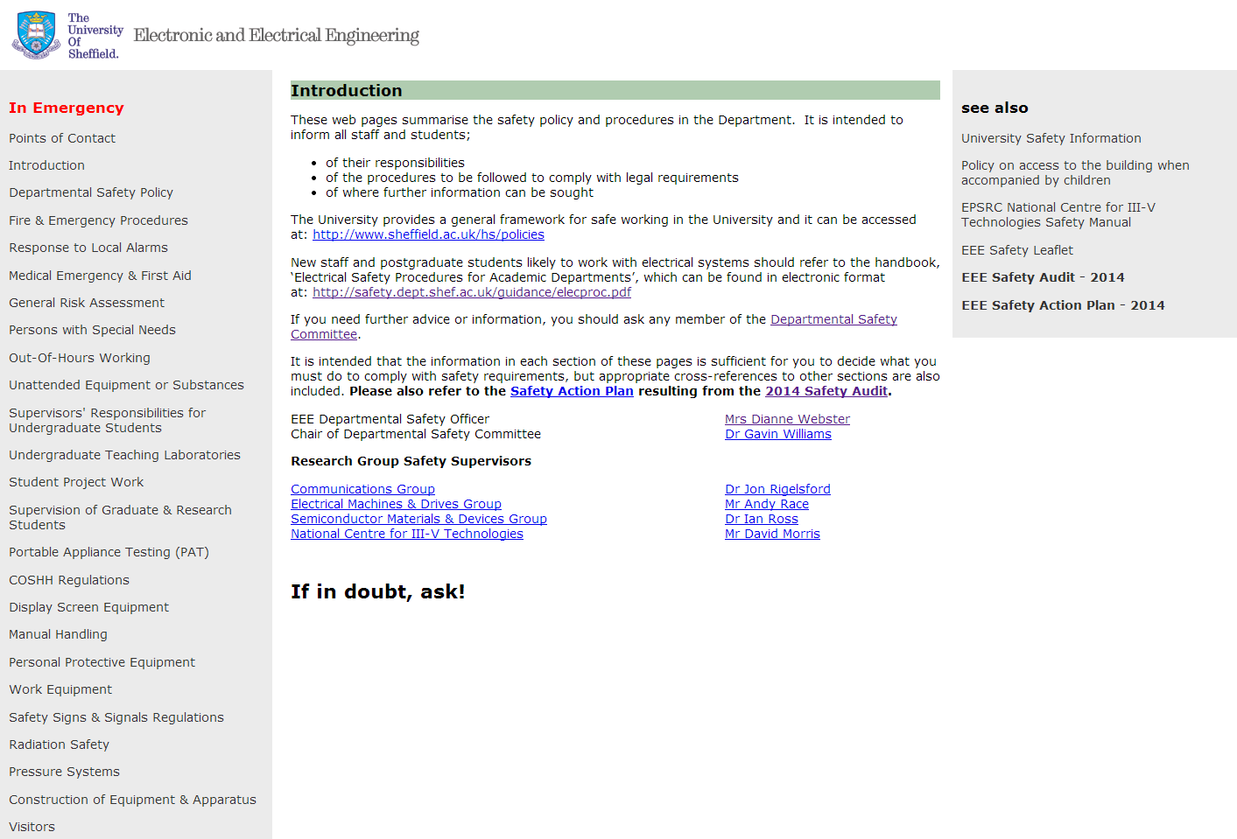

Slide 9
Project Risk Assessment
The supervisor and student should conduct a risk assessment at the start of the project to ensure that any hazards are identified.
Project risk assessment is completed using the on-line tool, RACIE. The link can be found at
www.shef.ac.uk/eee/safety
Project students are required to submit a completed risk assessment form as part of their Interim Project Report even if this shows no risk has been identified.

Slide 10
GENERIC ASSESSMENT
RACIE ID 2495
This assessment has been written to cover the most common hazards you may encounter in your project.
It is not an exhaustive list!
Most projects will contain the following categories as a minimum – Fire, Slips and Trips, DSE and Electrical hazards.

Slide 11
Risk Assessment - A Guide
What is a risk assessment? A risk assessment is a careful examination of what could cause harm to people, so that you can assess what precautions you should take to prevent harm. A good risk assessment prevents anyone doing an experiment or activity that puts themselves or others in danger.
You don’t need to be a health and safety expert to conduct a Risk Assessment!!
When doing a risk assessment you need to follow five steps:
Step 1 Identify the hazards (chemicals, electricity, soldering iron, computer work etc)
Step 2 Decide who might be harmed and how they might be harmed (what could go wrong?)
Step 3 Evaluate the risks (the chance, high or low, that somebody could be harmed) then decide on the precautions (control measures) you need to take
Step 4 Record your findings
Step 5 Review your risk assessment and update if necessary
**Once your Risk Assessment has been approved by your supervisor, please print it out and display it in your work area**

Slide 12
Risk Assessment Exercise - Crossing the road
We all carry out risk assessments every day, for example, we all cross the road! What is the Hazard?
The hazard is being hit by a vehicle What is the Risk?
The likelihood/chance of that happening
What precautions (control measures) do you apply?

Slide 13
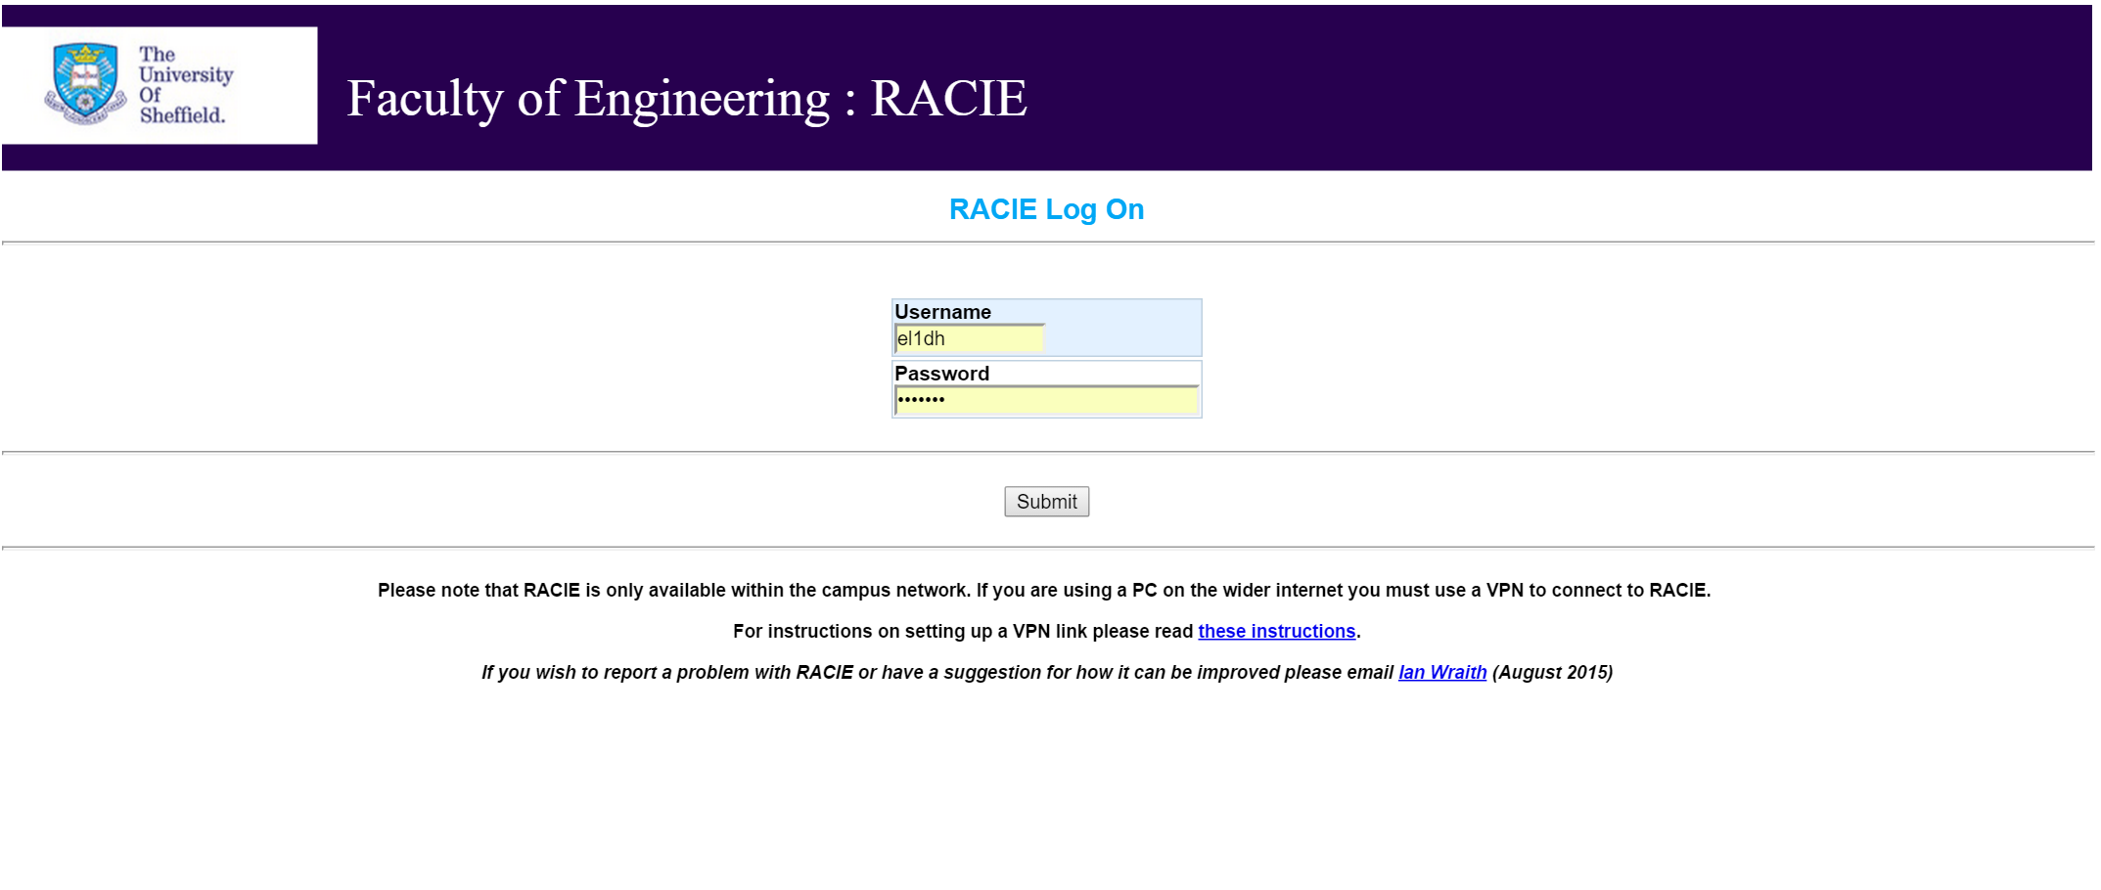

Slide 14


Slide 15
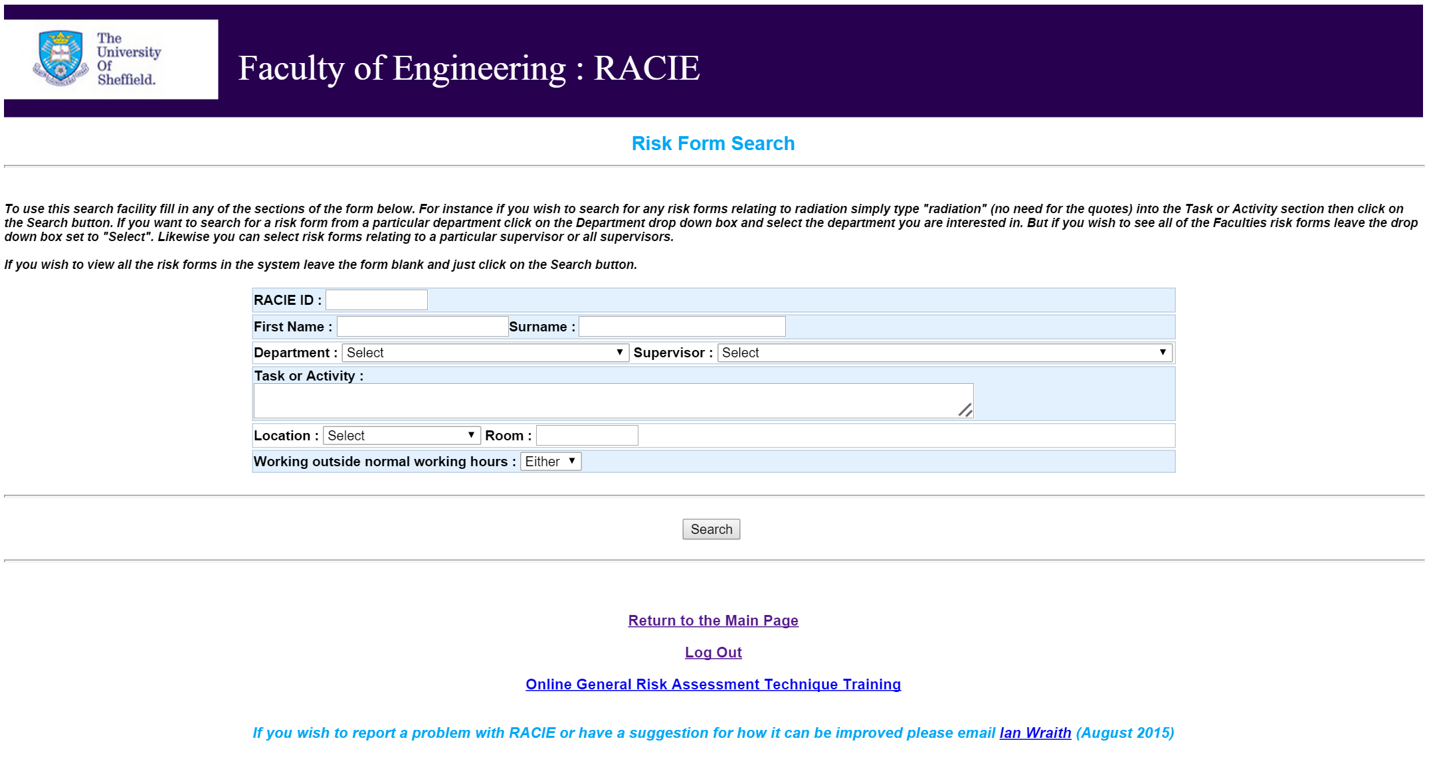
RACIE ID 2495

Slide 16
This may sound like ‘common sense’, but most accidents happen because people fail to use tools/materials in a safe way!

Slide 17
Undergraduate Students shall ensure that they conduct their work in a safe manner. In addition all undergraduate students shall:
Comply with all safety instructions, oral and written, given to them;
Never enter a laboratory, workshop or storeroom unless authorised to do so;
Never use any material, equipment or facility without having first been given specific instructions on the operations to be performed and the precautions to be adopted by the tutor or supervisor, and
Never attempt to repair or modify any apparatus belonging to the department. Faulty or damaged equipment must not be used and should be brought to the attention of a member of the academic staff or senior technical staff.

Slide 18
Laboratory Environment
Key points:
Obey the (local) laboratory rules
Do not work alone in a laboratory at any time
Report faulty equipment to staff
No eating or drinking is allowed

Slide 19
EEE Safety Committee
EEE - Type 1 Department (research laboratories)
Departmental Safety Committee with Student representatives
Staff/Student committee
http://www.shef.ac.uk/eee/safety

Slide 20


